Slide 1

Center of map
App Server
1883
start(-34.023, -122.233)
JS Server
tracks()
tracks.json
node_info(node_id)
When click on the map object
node_info.json

Slide 2
Json files (Support file)
af.json → contains the name of the air force entities.
cb.json → contains the name of the cyber force entities.
lf.json → contains the name of the land force entities.
sb.json → contains the name of the sea subsurface force entities.
ss.json → contains the name of the sea surface force entities.
sp.json → contains the name of the space force entities.

Slide 3
Json files (Design Time)
entity_model.json → the file defines the behavior of each type of entity supported by the simulation.

Slide 4
Json files (Simulation Time)
node_info.json → it is used to send the current information (in simulation time) with the information about one specific node.
tracks.json → it is used to send the current information (in simulation time) about all node's existent in the simulation.

Slide 5

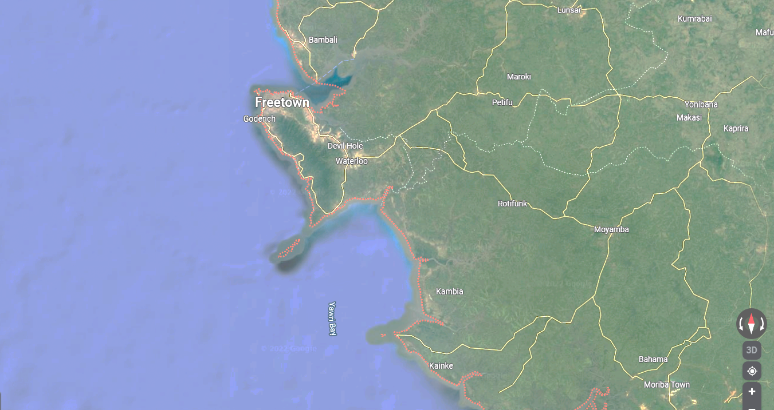




























10.922195,
-16.604382
10.972890,
-9.347859
7.213207,
-15.810291
7.146273,
-9.565907

