Slide 1

Center of map
App Server
1883
start(-34.023, -122.233)
JS Server
tracks()
tracks.json
node_info(node_id)
When click on the map object
node_info.json

Slide 2
Json files (Support file)
af.json → contains the name of the air force entities.
cb.json → contains the name of the cyber force entities.
lf.json → contains the name of the land force entities.
sb.json → contains the name of the sea subsurface force entities.
ss.json → contains the name of the sea surface force entities.
sp.json → contains the name of the space force entities.

Slide 3
Json files (Design Time)
entity_model.json → the file defines the behavior of each type of entity supported by the simulation.

Slide 4
Json files (Simulation Time)
node_info.json → it is used to send the current information (in simulation time) with the information about one specific node.
tracks.json → it is used to send the current information (in simulation time) about all node's existent in the simulation.

Slide 5

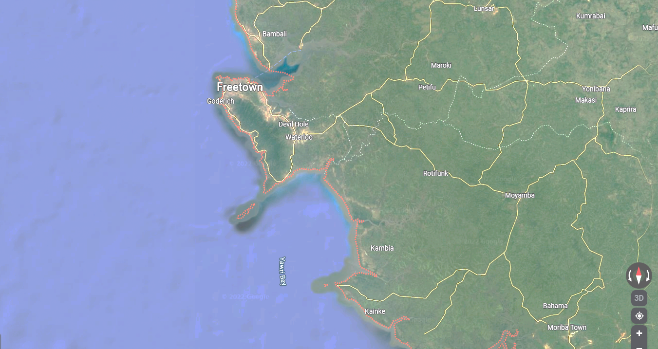

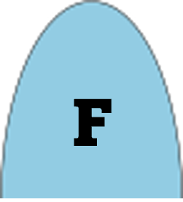


























10.922195,
-16.604382
10.972890,
-9.347859
7.213207,
-15.810291
7.146273,
-9.565907

Slide 6

yes
Has an activity task?
Set the TASK STATUS to SUCESSFULL
Set the TASK STATUS to FAIL
Update position
Can you accomplish your task (weapon)?
Can you sense your target?
no
no
yes
yes
no
Set the TASK STATUS to FAIL
Is the target destroyed?
yes
no
Are there more tasks?
yes
Do your behavior mode is equal 2
Can you engage your target (range)?
Engage (calculate the impact on the target)
Engage (calculate the impact on your node)
Load a new task to activity space
yes
no
Are you in the initial position?
no
yes
yes
Is your node destroyed?
no
no
yes
Can you sense any enemy?
Update the NODE HEALTH.
Set the NODE STATUS to END
no
no
yes
Set destination equal INITIAL POSITION
Set the NODE STATUS to DESTROYED
${node}_{health}={node}_{health}$- $f\left(engage\right)$

Slide 7
Sense Utility Function
$$S\left(attacker\right)=true, if \left\{\begin{aligned}{precision}_{sensor}∗ {intensity}_{sensor}∗RAND>0.65 \\ {distance}_{target}< {range}_{attacker}\end{aligned}\right.$$

Slide 8
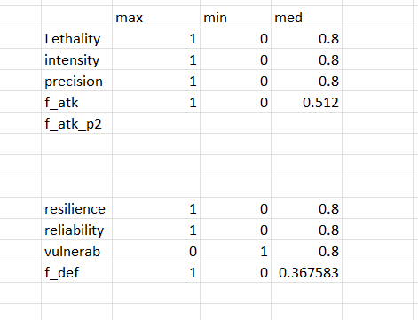
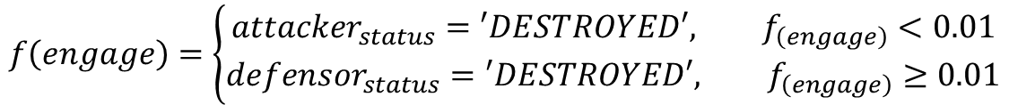

Engage Utility Function
$$f_{(attacker)}={lethality}_{entity}∗{intensity}_{weapon} ∗{precision}_{weapon}∗RAND$$
$$f_{(defensor)}=\frac{{resilience}_{entity}∗{reliability}_{weapon}}{2^{{vulnerability}_{entity}}}∗RAND$$
$$f_{(engage)}=f_{\left(attacker\right)}− f_{(defensor)}$$
$$f\left(engage\right)=\left\{\begin{aligned}{attacker}_{status}=′DESTROYED′, f_{\left(engage\right)}<0.01 \\ &{defensor}_{status}=′DESTROYED′, f_{\left(engage\right)}≥0.01\end{aligned}\right.$$

Slide 9

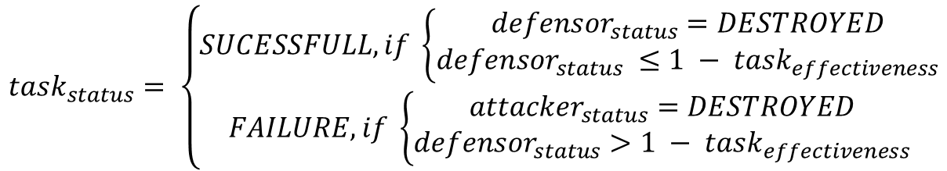
Mission Result
$${task}_{status}= \left\{\begin{aligned}SUCESSFULL, if \left\{\begin{aligned}{defensor}_{status}=DESTROYED \\ {defensor}_{status} ≤1 − {task}_{effectiveness}\end{aligned}\right. \\ FAILURE, if \left\{\begin{aligned}{attacker}_{status}=DESTROYED \\ {defensor}_{status}>1 − {task}_{effectiveness}\end{aligned}\right.\end{aligned}\right.$$
$${mission}_{status}= \left\{\begin{aligned}SUCESSFULL, if \left\{\frac{\sum_{0}^{N_{tasks}}{{task}_{status}}}{N_{task}}\right.≥ {mission}_{effectiveness} \\ FAILURE\end{aligned}\right.$$

Slide 10
Task
F2T2EA
Find: Identify a target. Find a target within surveillance or reconnaissance data or via intelligence means.
Fix: Fix the target's location. Obtain specific coordinates for the target either from existing data or by collecting additional data.
Track: Monitor the target's movement. Keep track of the target until either a decision is made not to engage the target, or the target is successfully engaged.
Target: Select an appropriate weapon or asset to use on the target to create desired effects. Apply command and control capabilities to assess the value of the target and the availability of appropriate weapons to engage it.
Engage: Apply the weapon to the target.
Assess: Evaluate the effects of the attack, including any intelligence gathered at the location.

