Slide 1
Success and Health – the Role of the Subconcious Mind
Dr. Gabriele Alpers, Life Coach Dipl.Wi.-Ing.
mind E motion
KA-BCG Meetup on Saturday 3 rd March 2018

Slide 2
Agenda
Introduction
Success
Health
Goals
Subconscious Mind
Summary
Take Home Messages

Slide 3
2. Success
Are you successful? Do you achieve your goals?
What is success for your parents? What is success for the persons you grew up with?
What is success for you?
→ Subjective versus Objective (e.g. Abitur, Bachelor, Master)

Slide 4
3. Health
Are you healthy? Do you feel healthy?
What is health for your parents? What is health for the persons you grew up with?
What is health for you?
→ Subjective versus Objective (e.g. health check-up)

Slide 5
3.1. Health – World Health Organization
„Health promotion is the process of enabling people to increase control over, and to improve, their health. To reach a state of complete physical, mental and social well-being, an individual or group must be able to identify and to realize aspirations, to satisfy needs, and to change or cope with the environment. Health is, therefore, seen as a resource for everyday life, not the objective of living. Health is a positive concept emphasizing social and personal resources, as well as physical capacities. Therefore, health promotion is not just the responsibility of the health sector, but goes beyond healthy life-styles to well-being. ...
Good health is a major resource for social, economic and personal development and an important dimension of quality of life. „
http://www.who.int/healthpromotion/conferences/previous/ottawa/en/
→ Health is the basis of success

Slide 6
Aktivpause

Slide 7
3.2. Health and Resources
What keeps you healthy? nutrition, physical activity/sports, relaxation and sleep, social and physical environment you live in ...
What are your resources? - organizational, social, personal - material, immaterial (e.g. optimism, intuition) - ... - the subconscious mind

Slide 8
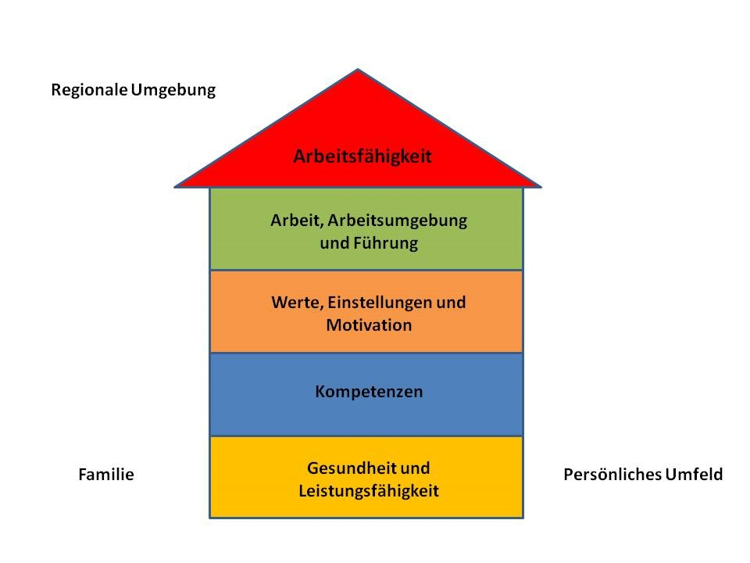
3.3. The House of Workability
Abb. 1: Haus der Arbeitsfähigkeit (mod. nach Ilmarinen & Tempel, 2010, S. 40)

Slide 9
3.4. Definition Workability
Definition Arbeitsfähigkeit: „Die Arbeitsfähigkeit beschreibt ... die Summe von Faktoren, die eine Frau oder einen Mann in einer bestimmten Situation in die Lage versetzen, eine gestellte Arbeitsaufgabe erfolgreich zu bewältigen.“ (Ilmarinen, 2002)

Slide 10
Aktivpause

Slide 11
4. Goals
In 5 years from today → March 2023
I am ...
I have ...
I own ...
I live in ...
I achieved ...

Slide 12
4.1. What do you want to achieve in your life?
What are your values?
What are your goals? What is your desire? What is your vision?
What drives you?
Where is your focus? What are you focusing on today?
→ What influences you?

Slide 13
4.2. Your Goals are SMART
Specific
Measurable
Attractive
Realistic, Reasonable
Time bound

Slide 14
Aktivpause

Slide 15
5. The Subconscious Mind (scm)
The automatic mind
Controls the body / inner organs like heart, lungs, intestines
Works automatically
Is a perfect multitasker (How do you catch a ball?)
Is your memory bank
Carries out the automatic programs = the habitual ways of thinking, feeling, acting that have been programmed into the scm
Your gut feeling/intuition works through your scm

Slide 16
5.1. The Scm is programmed by
Identification
Authority figures
Repetition
Emotions
Exaggeration
Hypnosis

Slide 17
5.2. The Scm is your Servant
Now it is your turn, program yourself
→ give directions to your scm
Scm is your servant unless programmed otherwise earlier

Slide 18
5.3 Rules for Structuring Directives to Program the Scm
Use the present tense
Be positive
Be specific, detailed, simple
Use exciting emotional words
Be realistic
Personalize
Symbolize

Slide 19
5.4. The Language of the Scm
The language of the scm is pictures/images → visualize, imagine
Where do you SEE yourself in 5 years from today? March 2023 Draw a picture NOW
→ focus

Slide 20
5.5. Focus
What the scm focuses on the body and emotions will follow
This is your life. What do you expect of your life? You are responsible for your life, your health, achieving your goals
You have free will
→ Take responsibility NOW

Slide 21
5.6. Example FOCUS
2016 Olympic summer games, Chinese lady swimmer won 6 medals, reporter asked her enthusiastically „How do you feel about this? You achieved something most extraordinary. Are you happy?“

Slide 22
5.7 Experiential Learning
Life long learning especially through experience → understand what you learnt
Your actions ...... thus your life have to be meaningful
What makes you happy? What influences you?
→ Act NOW

Slide 23
6. Summary
What did you learn this afternoon?
....
....
....

Slide 24
7. Take Home Messages
You have free will
→ You set your goals, you focus OR not
→ You have a strong influence on your success and your health
The Scm is your valuable resource

Slide 25
Thought is the basis of all reality
Mind
over
Matter

Slide 26
Literature
Alpers, Gabriele N. (2009): Beanspruchungen, Ressourcen und Gesundheit von Mittleren Führungskräften; Arbeitswissenschaft in der betrieblichen Praxis, Band 33, Peter Lang, Frankfurt am Main.
Bristol, Claude M. (1969): The Magic of Believing, Pocket Books, New York. Bristol, Claude M. (2010): Erfolgreich – The Magic of Believing, Deltus media, Leipzig. Bristol, Claude M., Sherman, Harold (1992): TNT The Power within you – how to release the forces inside you & get what you want!, Fireside, New York.
Chilton, Pamela, Harmon, Hugh(1997): Odyssey of the Soul. A Trilogy. Book One Apocatastasis, Quick Book Publishing, www.odysseyofthesoul.org, www.odysseyofthesoul.de
Hill, Napoleon (2015): Denke Nach Und Werde Reich. Die 13 Gesetze des Erfolgs, Ariston.
Hill, Napoleon (1987): Wunder, die Sie selbst vollbringen – Überwinden Sie Ihre Grenzen!, Ariston Verlag, Genf.
Ilmarinen, Juhani, Tempel, Jürgen (2002): Arbeitsfähigkeit 2010 – Was können wir tun, damit Sie gesund bleiben? VSA-Verlag, Hamburg. http://www.who.int/healthpromotion/conferences/previous/ottawa/en/abgerufen am 2.3.2018

