Slide 1

EVENT MANAGEMENT IN GILGIT BALTISTAN
PREPARED BY:KHUSH KABEER AND SHAFA ALI
KARAKORAM INTERNATIONAL UNIVERSITY

Slide 2
CONTENTS
Introduction
Problem statement
Solution
Literature Review
Functional Requirements
Non Functional requirements
Tool and Technologies
conclusion

Slide 3
Introduction
Seamless Event Planning: Streamline the entire event planning process from start to finish.
Tailored Services: Offering customizable packages for birthday parties, wedding ceremonies, and more to suit diverse preferences
Professional Photography & Videography: Capture every moment with top-notch photography and videography services.
Unique Product Offerings: Exclusive selection of products ranging from décor to entertainment essentials for unforgettable events.
Creative Themes & Concepts: Bring visions to life with imaginative themes and innovative event concepts.

Slide 4
Introduction
Expert Team of Professionals: Experienced team dedicated to delivering excellence in every aspect of event management.
Customer-Centric Approach: Putting clients' needs first with personalized attention and exceptional customer service.
Memorable Experiences, Every Time: Crafting unforgettable experiences that leave a lasting impression on hosts and guests alike.

Slide 5
Problem statement
Fragmented Planning Process: Event planners juggle numerous tasks from venue booking to logistics, navigating multiple vendors and platforms, resulting in a chaotic and disjointed planning experience.
Lack of Transparency and Communication: Inefficient communication channels breed misunderstandings and delays, leaving event organizers, vendors, and clients in the dark. Without centralized platforms, confusion reigns over event details and updates, frustrating all parties involved.

Slide 6
Problem statement
Budgetary Strain and Oversight: Managing event budgets is a labyrinthine challenge, fraught with complexities. Without effective tools, planners risk overspending and compromising event quality, leading to financial strain and disappointment.
Vendor Coordination Challenges: Coordinating various vendors poses logistical hurdles, increasing the risk of miscommunication, delays, and inconsistencies, hindering the seamless execution of events.

Slide 7
Problem statement
Budgetary Strain and Oversight: Managing event budgets is a labyrinthine challenge, fraught with complexities. Without effective tools, planners risk overspending and compromising event quality, leading to financial strain and disappointment.
Vendor Coordination Challenges: Coordinating various vendors poses logistical hurdles, increasing the risk of miscommunication, delays, and inconsistencies, hindering the seamless execution of events.

Slide 8
solution
Simplified Budget Management: Implement a user-friendly budget management system that allows planners to estimate, track, and manage budgets effectively, ensuring events stay within financial constraints without sacrificing quality.
Efficient Communication Tools: Provide robust communication features to facilitate clear and timely communication between event organizers, vendors, and clients, minimizing misunderstandings and delays.

Slide 9
solution
Simplified Budget Management: Implement a user-friendly budget management system that allows planners to estimate, track, and manage budgets effectively, ensuring events stay within financial constraints without sacrificing quality.
Personalized Planning Assistance: Offer personalized planning assistance and recommendations based on the specific requirements and preferences of each event, helping organizers make informed decisions and create memorable experiences tailored to their needs.

Slide 10
Review Of Literature
Emerging Event Technologies: Explore cutting-edge technologies like virtual reality and artificial intelligence, analyzing their impact on modern event management practices.
Enhancing Customer Experience: Investigate strategies for creating memorable and engaging event experiences, including experiential marketing and social media integration.
Trends in Attendee Engagement: Examine current trends and best practices in attendee engagement, highlighting successful approaches such as gamification and interactive event features.

Slide 11

CHALLENGES IN EVENT MANAGEMENT
Complex logistics, communication gaps, and resource allocation issues create hurdles in event management.

Slide 12

BENEFITS OF WEB APP SOLUTION
E cient scheduling, seamless communication, and streamlined resource management are key beneﬁts of the web app solution.

Slide 13
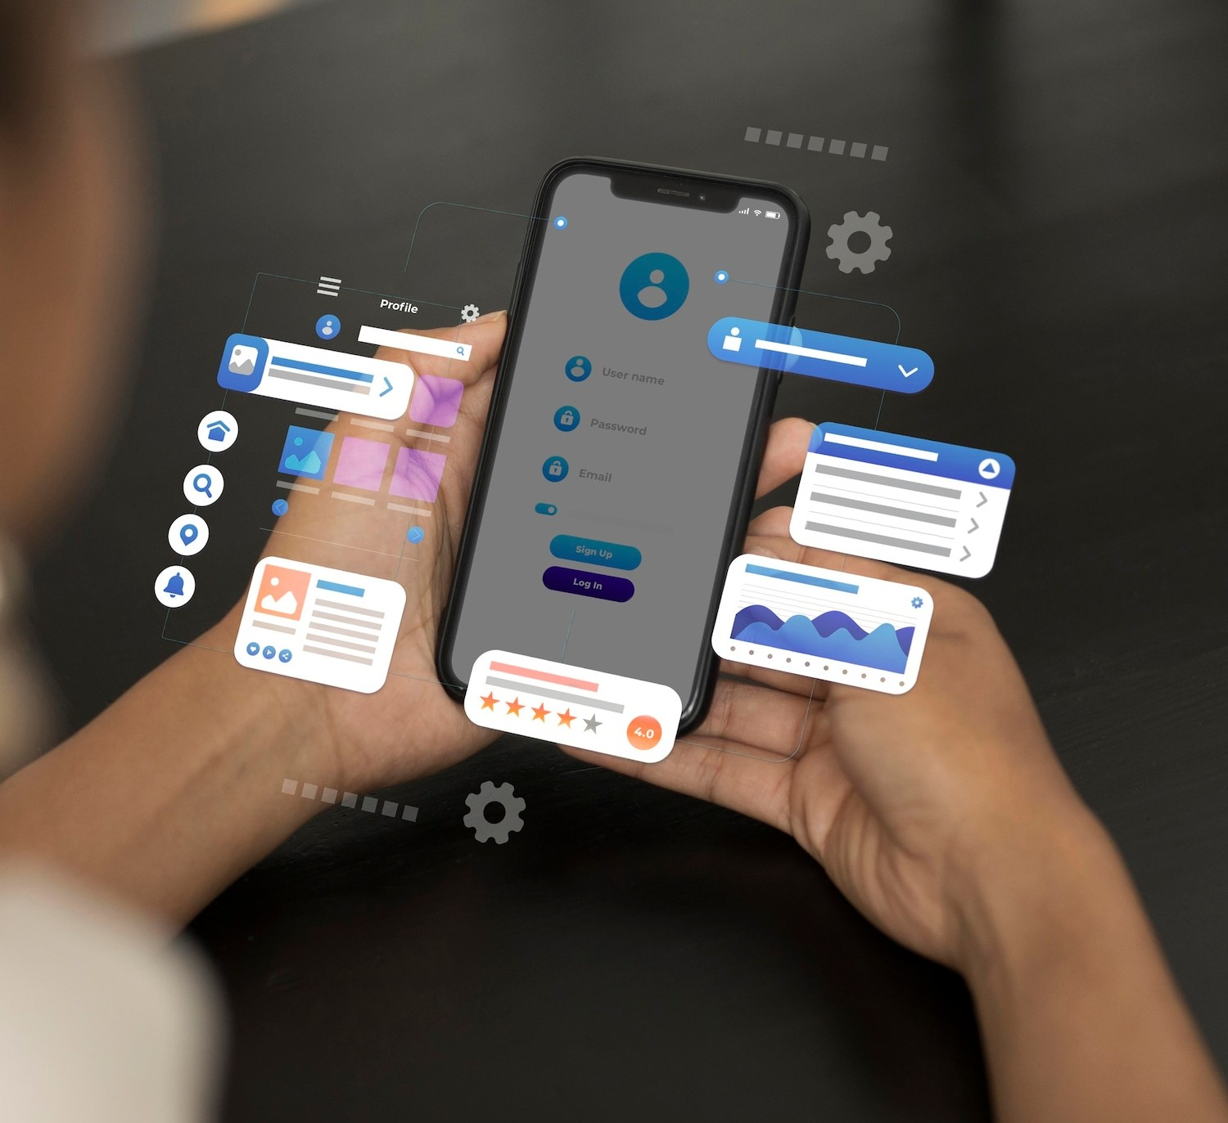
FEATURES OF THE WEB APP
User-friendly interface, real-time updates, and customizable templates make the web app a powerful tool for event management.

Slide 14

CASE STUDY: SUCCESSFUL IMPLEMENTATION
Highlighting a case study of a major event in Gilgit Baltistan where the web app solution led to smoother operations and enhanced participant experience.

Slide 15

CUSTOMIZATION AND INTEGRATION
The web app allows customization based on speciﬁc event needs and seamless integration with existing management systems.

Slide 16


DATA ANALYTICS AND INSIGHTS
Utilizing data from the web app for analytics, trend analysis, and decision- making to improve future event management strategies.

Slide 17

USER FEEDBACK AND TESTIMONIALS
Positive testimonials and user feedback highlighting the e ectiveness and impact of the web app solution on event management.

Slide 18


TRAINING AND SUPPORT
Comprehensive training programs and 24/7 support to ensure smooth adoption and utilization of the web app solution.

Slide 19

FUTURE ENHANCEMENTS AND UPDATES
Continual improvements, new features, and updates to ensure the web app remains at the forefront of event management technology.

Slide 20

CONCLUSION
Embracing the web app solution for event management in Gilgit Baltistan will lead to e ciency, e ectiveness, and enhanced experiences for all stakeholders.

Slide 21




Thanks!
Do you have any questions? youremail@email.com
+91 620 421 838
www.yourwebsite.com @yourusername

