Slide 1
Lecture # 10 State diagram/sequence detector of mealy and Moore machine
By: Muhammad Zain Uddin
email: zuddin@iba.edu.pk

Slide 2
The State Diagram
A state is an abstraction of memory
A state remembers a history of inputs applied to the circuit
Examples:
State S0 represents the fact that the last input is a 0
State S1 represents the fact that the last input is a 1
State S2 represents the fact that the last two-input sequence is "11"
Obtaining the state diagram is the most important step
Requires experience and good understanding of the problem

Slide 3

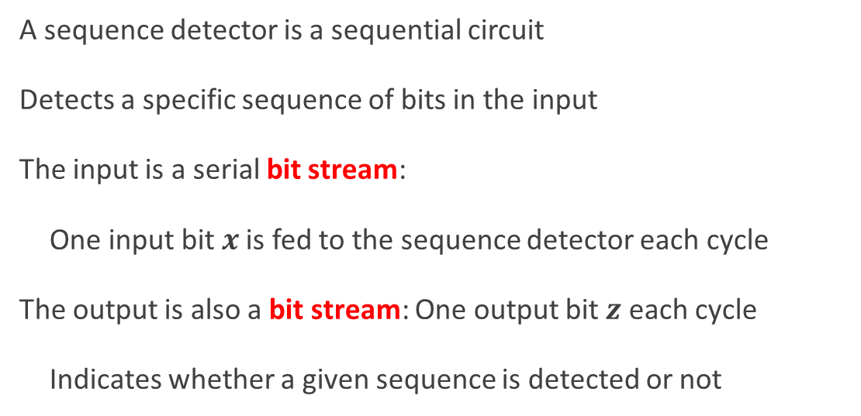


Example: Sequence Detector
A sequence detector is a sequential circuit
Detects a specific sequence of bits in the input
The input is a serial bit stream:
One input bit $x$ is fed to the sequence detector each cycle
The output is also a bit stream: One output bit $z$ each cycle
Indicates whether a given sequence is detected or not
$$x$$
Sequence Detector
$$z$$
$$clk$$

Slide 4
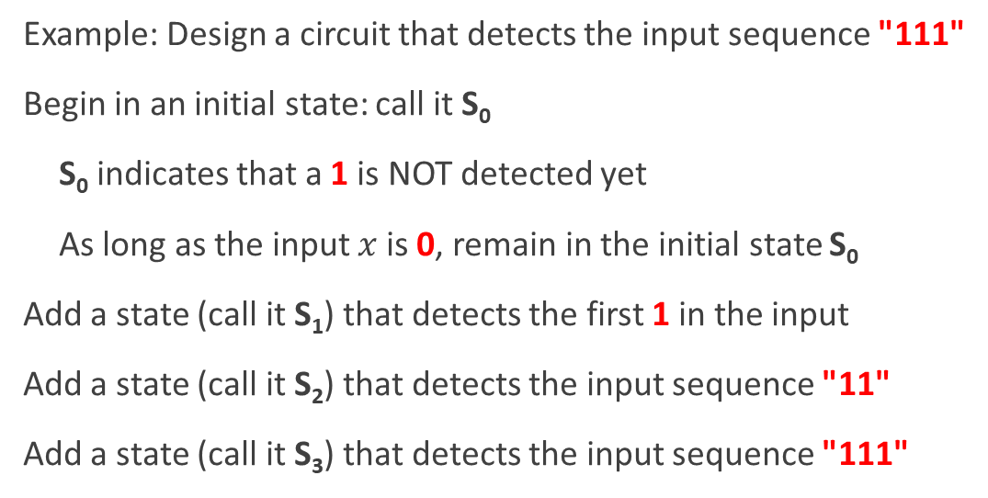
State Diagram for a Sequence Detector
Example: Design a circuit that detects the input sequence "111"
Begin in an initial state: call it S₀
S₀ indicates that a 1 is NOT detected yet
As long as the input $x$ is 0, remain in the initial state S₀
Add a state (call it S₁) that detects the first 1 in the input
Add a state (call it S₂) that detects the input sequence "11"
Add a state (call it S₃) that detects the input sequence "111"
0
S₀
1
S₁
1
S₂
1
S₃

Slide 5
Complete the State Diagram
Moore Design: Assign Output to States
The output in S₀, S₁, and S₂ should be 0
The output in S₃ should be 1
0
0
S₀
0
S₁
0
1
Now complete the state diagram:
Add transitions from S₁, S₂, S₃ back to S₀ if the input is 0
Add transition from S₃ to itself if the input is 1 to detect sequences longer than three 1's
0
0
1
S₃
1
S₂
0
1
1

Slide 6
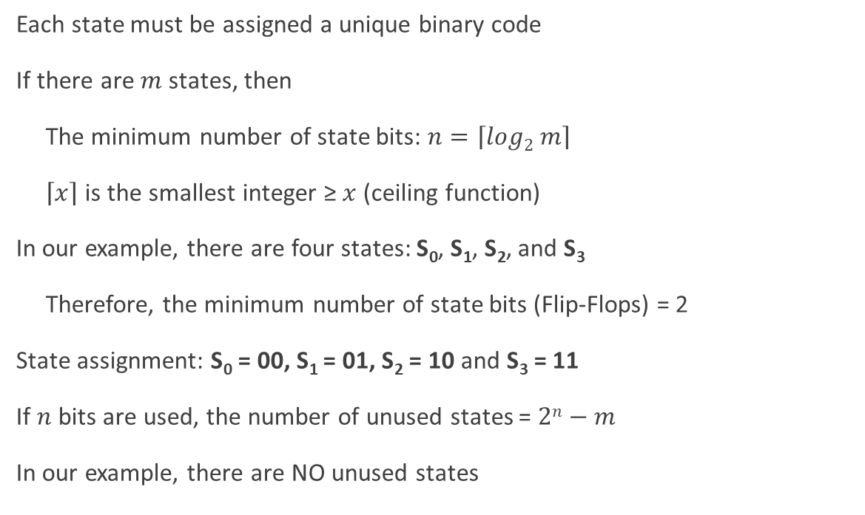
State Assignment
Each state must be assigned a unique binary code
If there are $m$ states, then
The minimum number of state bits: $n=\left\lceil log2 m\right\rceil$
$\left\lceil x\right\rceil$ is the smallest integer ≥ $x$ (ceiling function)
In our example, there are four states: S₀, S₁, S₂, and S₃
Therefore, the minimum number of state bits (Flip-Flops) = 2
State assignment: S₀ = 00, S₁ = 01, S₂ = 10 and S₃ = 11
If $n$ bits are used, the number of unused states = $2n−m$
In our example, there are NO unused states

Slide 7
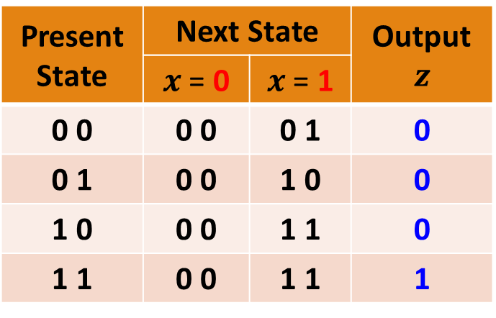
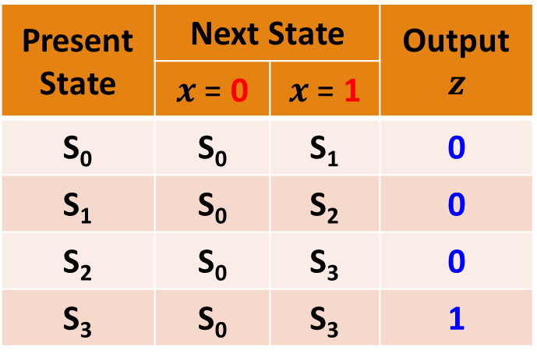
From State Diagram to State Table
Present State | Next State |  | Output $$z$$
 | $x$ = 0 | $x$ = 1
S₀ | S₀ | S₁ | 0
S₁ | S₀ | S₂ | 0
S₂ | S₀ | S₃ | 0
S₃ | S₀ | S₃ | 1
0
0
S₀
0
S₁
0
1
0
0
1
Present State | Next State |  | Output $$z$$
 | $x$ = 0 | $x$ = 1
0 0 | 0 0 | 0 1 | 0
0 1 | 0 0 | 1 0 | 0
1 0 | 0 0 | 1 1 | 0
1 1 | 0 0 | 1 1 | 1
S₃
1
S₂
0
1
State Assignment
S₀ = 00, S₁ = 01
S₂ = 10, S₃ = 11
1

Slide 8


Structure of a Moore Sequence Detector
Next
State
Current
State
$$x$$
Next State
Logic
D Flip
Flops
Output
Logic
$$z$$
clock
In our design examples, only D-type Flip-Flops will be used
They are the simplest to analyze and implement
Next, we need minimal expressions for
Next State Logic
Output Logic

Slide 9

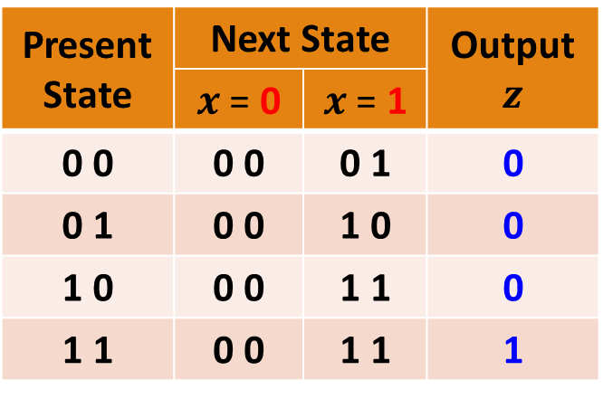

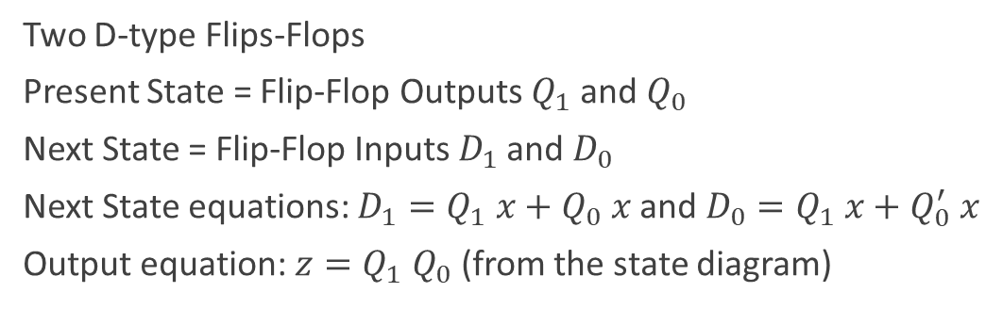






Derive Next State an Output Equations
Present State | Next State |  | Output $$z$$
 | $x$ = 0 | $x$ = 1
0 0 | 0 0 | 0 1 | 0
0 1 | 0 0 | 1 0 | 0
1 0 | 0 0 | 1 1 | 0
1 1 | 0 0 | 1 1 | 1
$$x$$
$$D_{1}$$
$$x$$
$$D_{0}$$
$$Q_{1}Q_{0}$$
0
1
$$Q_{1}Q_{0}$$
0
1
00
0
0
00
0
1
01
0
1
01
0
0
11
0
1
11
0
1
10
0
1
10
0
1
Two D-type Flips-Flops
Present State = Flip-Flop Outputs $Q_{1}$ and $Q_{0}$
Next State = Flip-Flop Inputs $D_{1}$ and $D_{0}$
Next State equations: $D_{1}=Q_{1} x+Q_{0} x$ and $D_{0}=Q_{1} x+Q_{0}^{′} x$
Output equation: $z=Q_{1} Q_{0}$ (from the state diagram)
$$Q_{1} x+Q_{0} x$$
$$Q_{1} x+Q_{0}^{′} x$$

Slide 10
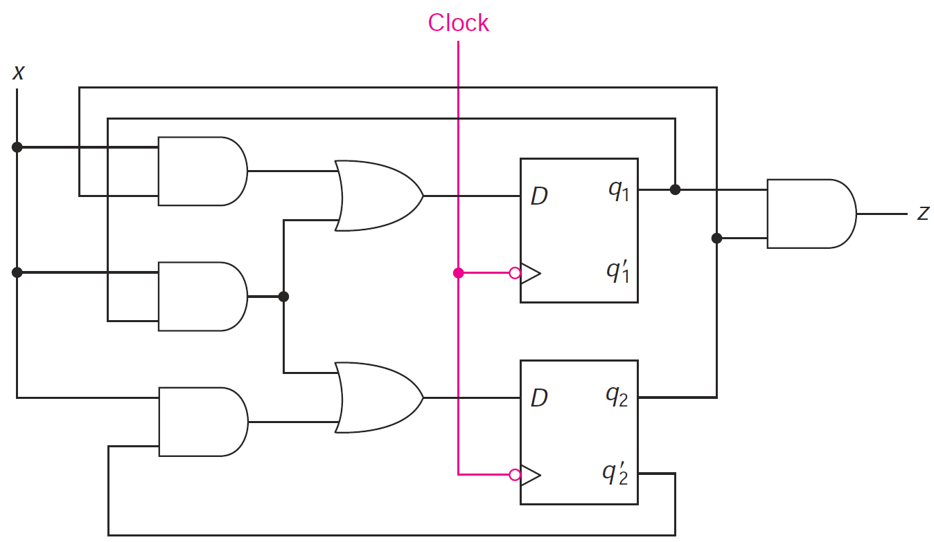








Draw the Moore Sequence Detector Circuit
$D_{1}=Q_{1} x+Q_{0} x$ , $D_{0}=Q_{1} x+Q_{0}^{′} x$
$z=Q_{1} Q_{0}$
Next State Logic
Output
Logic
$$D_{1}$$
$$Q_{1}$$
$$Q_{1}^{′}$$
$$D_{0}$$
$$Q_{0}$$
$$Q_{0}^{′}$$

Slide 11
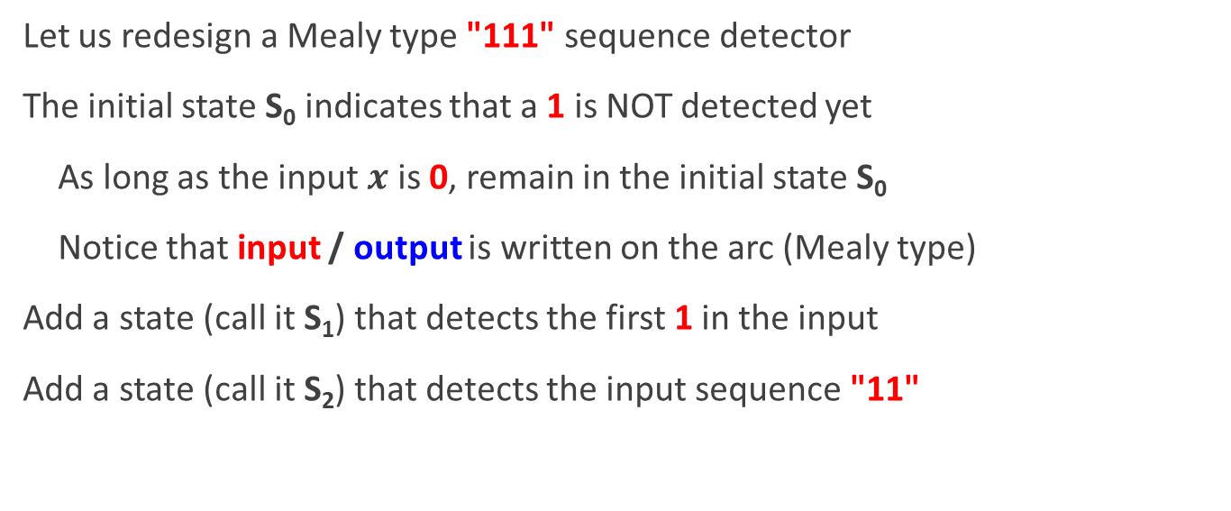
Mealy Type Sequence Detector
Let us redesign a Mealy type "111" sequence detector
The initial state S₀ indicates that a 1 is NOT detected yet
As long as the input $x$ is 0, remain in the initial state S₀
Notice that input / output is written on the arc (Mealy type)
Add a state (call it S₁) that detects the first 1 in the input
Add a state (call it S₂) that detects the input sequence "11"
0 / 0
S₀
S₁
S₂
1 / 0
1 / 0

Slide 12
Complete the Mealy State Diagram
State S₂ is reached after detecting the input sequence "11"
At S₂, if the next input is 1 then the output should be 1
Make a transition from S₂ back to itself labeled 1 / 1
No need for state S₃, because output is on the arc
Now complete the state diagram
Add transitions from S₁ and S₂ back to S₀ when input is 0
0 / 0
0 / 0
1 / 1
Mealy Machines typically use
less states than Moore Machines
0 / 0
S₀
S₁
S₂
1 / 0
1 / 0

Slide 13
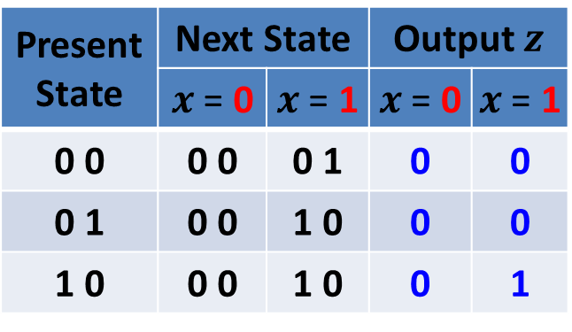
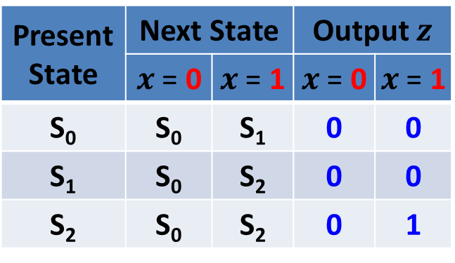
State Assignment and State Table
Three States ➔ Minimum number of state bits (Flip-Flops) = 2
Assign: S₀ = 00, S₁ = 01, and S₂ = 10 (State 11 is Unused)
0 / 0
0 / 0
1 / 1
0 / 0
S₀
S₁
S₂
1 / 0
1 / 0
Present State | Next State |  | Output $z$
 | $x$ = 0 | $x$ = 1 | $x$ = 0 | $x$ = 1
S₀ | S₀ | S₁ | 0 | 0
S₁ | S₀ | S₂ | 0 | 0
S₂ | S₀ | S₂ | 0 | 1
Present State | Next State |  | Output $z$
 | $x$ = 0 | $x$ = 1 | $x$ = 0 | $x$ = 1
0 0 | 0 0 | 0 1 | 0 | 0
0 1 | 0 0 | 1 0 | 0 | 0
1 0 | 0 0 | 1 0 | 0 | 1

Slide 14

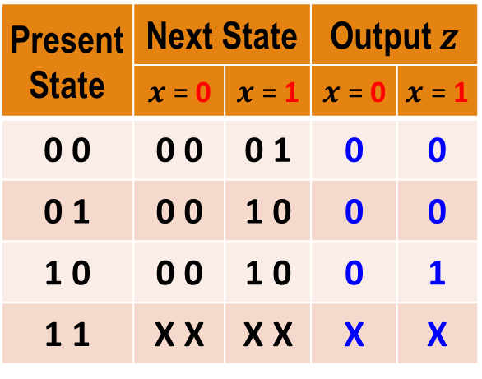


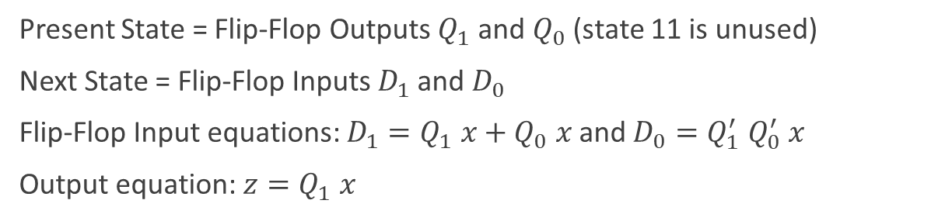






Derive Next State and Output Equations
$$D_{1}$$
$$D_{0}$$
$$z$$
$$x$$
$$x$$
$$x$$
Present State | Next State |  | Output $z$
 | $x$ = 0 | $x$ = 1 | $x$ = 0 | $x$ = 1
0 0 | 0 0 | 0 1 | 0 | 0
0 1 | 0 0 | 1 0 | 0 | 0
1 0 | 0 0 | 1 0 | 0 | 1
1 1 | X X | X X | X | X
$$Q_{1}Q_{0}$$
0
1
$$Q_{1}Q_{0}$$
0
1
$$Q_{1}Q_{0}$$
0
1
00
0
0
00
0
1
00
0
0
01
0
1
01
0
0
01
0
0
11
X
X
11
X
X
11
X
X
10
0
1
10
0
0
10
0
1
$$Q_{1} x+Q_{0} x$$
$$Q_{1}^{′} Q_{0}^{′} x$$
$$Q_{1} x$$
Present State = Flip-Flop Outputs $Q_{1}$ and $Q_{0}$ (state 11 is unused)
Next State = Flip-Flop Inputs $D_{1}$ and $D_{0}$
Flip-Flop Input equations: $D_{1}=Q_{1} x+Q_{0} x$ and $D_{0}=Q_{1}^{′} Q_{0}^{′} x$
Output equation: $z=Q_{1} x$

Slide 15
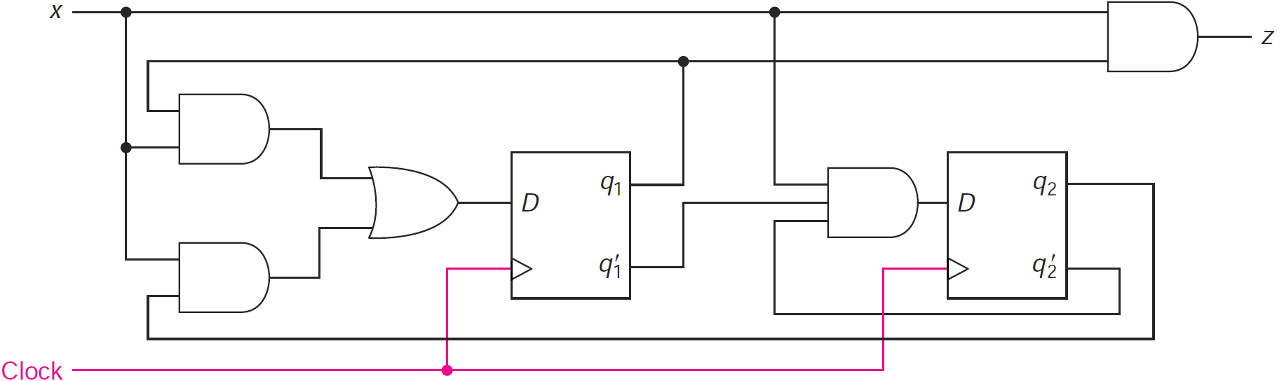









Draw the Mealy Sequence Detector Circuit
$$z=Q_{1} x$$
$$D_{1}=Q_{1} x+Q_{0} x$$
$$D_{0}=Q_{1}^{′} Q_{0}^{′} x$$
Output Logic
Next State
Logic
Next State
Logic
$$Q_{1}$$
$$Q_{0}$$
$$D_{1}$$
$$D_{0}$$
$$Q_{1}^{′}$$
$$Q_{0}^{′}$$
Reset

Slide 16
Mealy versus Moore Sequence Detector
Moore
Sequence
Detector
Mealy Sequence Detector
0
0 / 0
0 / 0
1 / 1
0
S₀
0
S₁
0
0 / 0
1
S₀
S₁
S₂
1 / 0
1 / 0
In general, Moore state diagrams have more states than corresponding Mealy.
The drawback of Mealy is that glitches can appear in the output if the input is not synchronized with the clock.
0
0
1
S₃
1
S₂
0
1
1

Slide 17
Verification
Sequential circuits should be verified by showing that the circuit produces the original state diagram
Verification can be done manually, or with the help of a simulation program
All possible input combinations are applied at each state and the state variables and outputs are observed
A reset input is used to reset the circuit to its initial state
Apply a sequence of inputs to test all the state-input combinations, i.e., all transitions in the state diagram
Observe the output and the next state that appears after each clock edge in the timing diagram

Slide 18
Input Test Sequence
Required to verify the correct operation of a sequential circuit
It should test each state transition of the state diagram
Test sequences can be produced from the state diagram
Consider the Mealy sequence detector, starting at S₀ (reset), we can use an input test sequence to verify all state transitions:
Input test sequence: reset then x = 0, 1, 0, 1, 1, 0, 1, 1, 1, 1
0 / 0
0 / 0
1 / 1
Reset input forces initial state to be S₀
0 / 0
S₀
S₁
S₂
reset
1 / 0
1 / 0

Slide 19
Verifying the Mealy Sequence Detector
0 / 0
0 / 0
1 / 1
0 / 0
S₀
1 / 0
S₁
1 / 0
S₂
reset
Input test sequence: reset then x = 0, 1, 0, 1, 1, 0, 1, 1, 1, 1
cc0
cc1
cc2
cc3
cc4
cc5
cc6
cc7
cc8
cc9
cc10
clock
reset
x
0
1
0
1
1
0
1
1
1
1
Q1
S0
S0
S1
S0
S1
S2
S0
S1
S2
S2
Q0
glitch
z
0
0
0
0
0
0
0
0
1
1

