Slide 1
Lecture # 11 Counter designing/ Up-Down counter designing
By: Muhammad Zain Uddin
email: zuddin@iba.edu.pk

Slide 2
Designing with Unused States
A circuit with n flip-flops has 2^{n} binary states
However, the state diagram may have m states
Therefore, the number of unused states = 2^{n} – m
Unused states do not appear in the state diagram
Sometimes treated as don't cares when simplifying expressions in K-maps
However, it is possible to enter an unused state!
Caused by outside interference or a circuit malfunction
Must specify the output and next state values for unused states
A special (invalid) output can be used to indicate an unused state
A return to a valid state must be possible without reset
Next state for unused states should be specified (NOT don't cares!)

Slide 3
Design of a Binary Counter
Problem Specification:
Design a circuit that counts up from 0 to 7 then back to 0
000 → 001 → 010 → 011 → 100 → 101 → 110 → 111 → 000
When reaching 7, the counter goes back to 0 then goes up again
There is no input to the circuit
The counter is incremented each cycle
The output of the circuit is the present state (count value)
The circuit should be designed using D-type Flip-Flops

Slide 4
Designing the State Diagram
Eight states are needed to store the count values 0 to 7
No input, state transition happens at the edge of each cycle
Three Flip-Flops
are required for
the eight states
S0
S7
S1
S6
S2
Each state is
assigned a unique
binary count value
S5
S3
S4

Slide 5
State Table
Only two columns: Present State and Next State
State changes each cycle
Present State Q₂ Q₁ Q₀ | Next State D₂ D₁ D₀
0 0 0 | 0 0 1
0 0 1 | 0 1 0
0 1 0 | 0 1 1
0 1 1 | 1 0 0
1 0 0 | 1 0 1
1 0 1 | 1 1 0
1 1 0 | 1 1 1
1 1 1 | 0 0 0
000
111
001
110
010
101
011
100

Slide 6



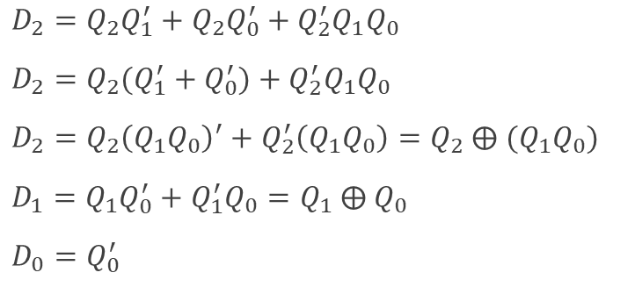






Deriving the Next State Equations
$$Q_{0}$$
$$D_{2}$$
$$Q_{0}$$
$$D_{1}$$
$$Q_{0}$$
$$D_{0}$$
$$Q_{2}Q_{1}$$
0
1
$$Q_{2}Q_{1}$$
0
1
$$Q_{2}Q_{1}$$
0
1
Present State Q₂ Q₁ Q₀ | Next State D₂ D₁ D₀
0 0 0 | 0 0 1
0 0 1 | 0 1 0
0 1 0 | 0 1 1
0 1 1 | 1 0 0
1 0 0 | 1 0 1
1 0 1 | 1 1 0
1 1 0 | 1 1 1
1 1 1 | 0 0 0
00
0
0
00
0
1
00
1
0
01
0
1
01
1
0
01
1
0
11
1
0
11
1
0
11
1
0
10
1
1
10
0
1
10
1
0
$D_{2}=Q_{2}Q_{1}^{′}+Q_{2}Q_{0}^{′}+Q_{2}^{′}Q_{1}Q_{0}$
$D_{2}=Q_{2}(Q_{1}^{′}+Q_{0}^{′})+Q_{2}^{′}Q_{1}Q_{0}$
$D_{2}=Q_{2}{\left(Q_{1}Q_{0}\right)}^{′}+Q_{2}^{′}\left(Q_{1}Q_{0}\right)=Q_{2}$ ⨁ $(Q_{1}Q_{0})$
$D_{1}=Q_{1}Q_{0}^{′}+Q_{1}^{′}Q_{0}=Q_{1} \text{⨁} Q_{0}$
$D_{0}=Q_{0}^{′}$

Slide 7





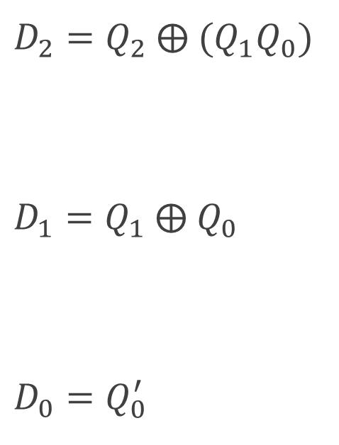








3-Bit Counter Circuit Diagram
$D_{2}=Q_{2}$ ⨁ $(Q_{1}Q_{0})$
$D_{1}=Q_{1} \text{⨁} Q_{0}$
$D_{0}=Q_{0}^{′}$
$$D_{2}$$
$$Q_{2}$$
$$Q_{2}$$
$$Q_{2}^{′}$$
$$D_{1}$$
$$Q_{1}$$
Output = 3-bit Count Value
$$Q_{1}$$
$$Q_{1}^{′}$$
$$D_{0}$$
$$Q_{0}$$
$$Q_{0}$$
$$Clock$$
$$Q_{0}^{′}$$

Slide 8
Up/Down Counter with Enable
Problem Specification:
Design a 2-bit Up / Down counter
Two inputs: E (Enable) and U (Up)
If E = 0 then counter remains in the same state (regardless of U)
If EU = 11 then count up from 0 to 3, then back to 0
If EU = 10 then count down from 3 down to 0, then back to 3
The output of the counter is the present state (count value)
The circuit should be designed using T Flip-Flops
A reset signal resets the counter to its initial state

Slide 9
Designing the State Diagram
E = 0
E = 0
Four states are required
to store the count 0 to 3
Count up if EU = 11
Count down if EU = 10
Disable counter if E = 0
Transition to same state if
EU = 00 or 01
Asynchronous reset to
start initially at state S0
EU = 10
S0
S1
Reset
EU = 11
EU = 10
EU = 11
EU = 11
EU = 10
S3
EU = 11
S2
EU = 10
E = 0
E = 0

Slide 10
State Assignment and State Table
Four States ➔ Two State variables (2 Flip-Flops)
State Assignment: S0 = 00, S1 = 01, S2 = 10, and S3 = 11
E = 0
E = 0
EU = 10
00
01
Present State Q₁ Q₀ | Next State
 | E U 0 0 | E U 0 1 | E U 1 0 | E U 1 1
0 0 | 0 0 | 0 0 | 1 1 | 0 1
0 1 | 0 1 | 0 1 | 0 0 | 1 0
1 0 | 1 0 | 1 0 | 0 1 | 1 1
1 1 | 1 1 | 1 1 | 1 0 | 0 0
Reset
EU = 11
EU = 10
EU = 11
EU = 11
EU = 10
11
EU = 11
10
EU = 10
E = 0
E = 0

Slide 11
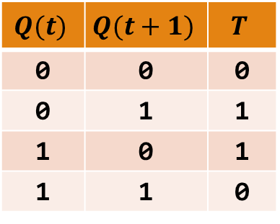
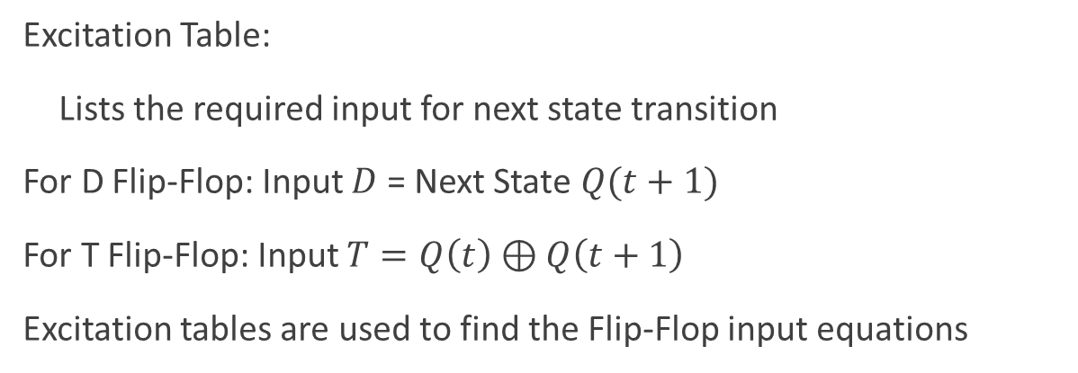
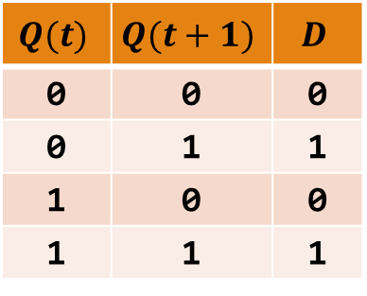
Excitation Table for Flip-Flops
Excitation Table:
Lists the required input for next state transition
For D Flip-Flop: Input $D$ = Next State $Q(t+1)$
For T Flip-Flop: Input $T=Q\left(t\right)⊕Q\left(t+1\right)$
Excitation tables are used to find the Flip-Flop input equations
Excitation Tables for the D and T Flip-Flops
$$Q(t)$$ | $$Q(t+1)$$ | $$D$$
0 | 0 | 0
0 | 1 | 1
1 | 0 | 0
1 | 1 | 1
$$Q(t)$$ | $$Q(t+1)$$ | $$T$$
0 | 0 | 0
0 | 1 | 1
1 | 0 | 1
1 | 1 | 0

Slide 12



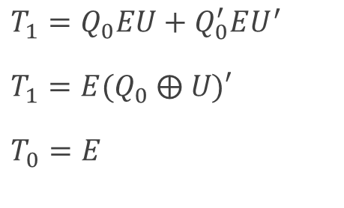



Deriving the T-Flip-Flop Input Equations
Present State Q₁ Q₀ | Next State at (t+1)
 | E U 0 0 | E U 0 1 | E U 1 0 | E U 1 1
0 0 | 0 0 | 0 0 | 1 1 | 0 1
0 1 | 0 1 | 0 1 | 0 0 | 1 0
1 0 | 0 | 1 0 | 0 1 | 1 1
1 1 | 1 | 1 1 | 1 0 | 0 0
Present State Q₁ Q₀ | Flip-Flop Inputs T₁ T₀
 | E U 0 0 | E U 0 1 | E U 1 0 | E U 1 1
0 0 | 0 0 | 0 0 | 1 1 | 0 1
0 1 | 0 0 | 0 0 | 0 1 | 1 1
1 0 | 0 0 | 0 0 | 1 1 | 0 1
1 1 | 0 0 | 0 0 | 0 1 | 1 1
$$T_{1}$$
$$T_{0}$$
$$EU$$
$$EU$$
$$Q_{1}Q_{0}$$
00
01
11
10
$$Q_{1}Q_{0}$$
00
01
11
10
$T_{1}=Q_{0}EU+Q_{0}^{′}EU^{′}$
$T_{1}=E(Q_{0} \text{⨁} U)′$
$T_{0}=E$
00
0
0
0
1
00
0
0
1
1
01
0
0
1
0
01
0
0
1
1
11
0
0
1
0
11
0
0
1
1
10
0
0
0
1
10
0
0
1
1

Slide 13


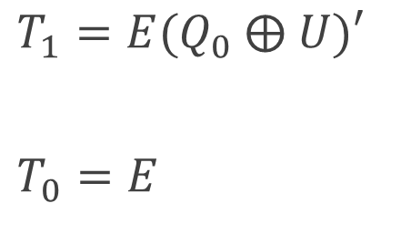










2-bit Up/Down Counter Circuit Diagram
$$U$$
$$T_{1}$$
$$Q_{1}$$
$$Q_{1}$$
$T_{1}=E(Q_{0} \text{⨁} U)′$
$T_{0}=E$
$$Q_{1}^{′}$$
2-bit Count Value
$$E$$
$$T_{0}$$
$$Q_{0}$$
$$Q_{0}$$
$$Clock$$
$$Q_{0}^{′}$$
$$Reset$$

