Slide 1
Lecture # 12 Counter logic /Ripple or Asynchronous counter/Synchronous counter/Integration of counter
By: Muhammad Zain Uddin
email: zuddin@iba.edu.pk

Slide 2



Counter
Sequential circuit that goes through a specific sequence of states
Output of the counter is the count value
Modulo-N counter: goes through 0, 1, 2, …, (N – 1)
Modulo-8 binary counter goes through 0, 1, 2, …, 7
Modulo-10 (BCD) counter goes through 0, 1, 2, …, 9
Counting can be up or down
Some Applications:
Timers
Event Counting
Frequency Division
Counter
$$clock$$
n
$$Count$$
$$reset$$

Slide 3
Implementing Counters
Two Basic Approaches:
Ripple Counters
The system clock is connected to the clock input of the first flip-flop (LSB)
Each flip-flop output connects to the clock input of the next flip-flop
Advantage: simple circuit and low power consumption
Disadvantage: The counter is not truly synchronous
No common clock to all flip-flops
Ripple propagation delay as the clock signal propagates to the MSB
Synchronous Counters
The system clock is connected to the clock input of ALL flip-flops
Combinational logic is used to implement the desired state sequence

Slide 4






















Ripple Counter
Q₀ toggles at the positive edge of every cycle
Q₁ toggles when Q₀ goes from 1 down to 0
Q₂ toggles when Q₁ goes from 1 down to 0
Q₃ toggles when Q₂ goes from 1 down to 0
$$D_{3}$$
$$Q_{3}$$
$$Q_{3}$$
$$R$$
$$Q_{3}^{′}$$
$$D_{2}$$
$$Q_{2}$$
$$Q_{2}$$
Q3 | Q2 | Q1 | Q0
0 | 0 | 0 | 0
0 | 0 | 0 | 1
0 | 0 | 1 | 0
0 | 0 | 1 | 1
0 | 1 | 0 | 0
0 | 1 | 0 | 1
0 | 1 | 1 | 0
0 | 1 | 1 | 1
1 | 0 | 0 | 0
Counts Up from 0 to 15 then back to 0
$$R$$
$$Q_{2}^{′}$$
$$D_{1}$$
$$Q_{1}$$
$$Q_{1}$$
$$R$$
$$Q_{1}^{′}$$
$$D_{0}$$
$$Q_{0}$$
$$Q_{0}$$
$$Clock$$
$$Reset$$
$$R$$
$$Q_{0}^{′}$$

Slide 5



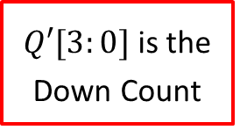





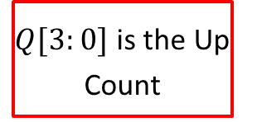
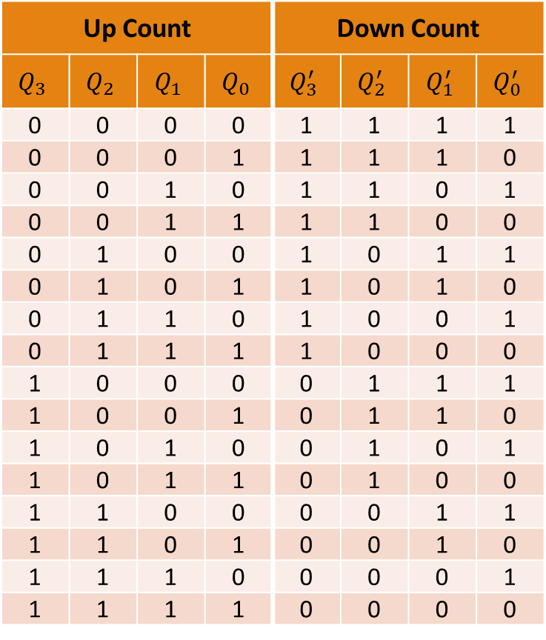














Ripple Counter (cont'd)
Up Count |  |  |  | Down Count
$$Q_{3}$$ | $$Q_{2}$$ | $$Q_{1}$$ | $$Q_{0}$$ | $$Q_{3}^{′}$$ | $$Q_{2}^{′}$$ | $$Q_{1}^{′}$$ | $$Q_{0}^{′}$$
0 | 0 | 0 | 0 | 1 | 1 | 1 | 1
0 | 0 | 0 | 1 | 1 | 1 | 1 | 0
0 | 0 | 1 | 0 | 1 | 1 | 0 | 1
0 | 0 | 1 | 1 | 1 | 1 | 0 | 0
0 | 1 | 0 | 0 | 1 | 0 | 1 | 1
0 | 1 | 0 | 1 | 1 | 0 | 1 | 0
0 | 1 | 1 | 0 | 1 | 0 | 0 | 1
0 | 1 | 1 | 1 | 1 | 0 | 0 | 0
1 | 0 | 0 | 0 | 0 | 1 | 1 | 1
1 | 0 | 0 | 1 | 0 | 1 | 1 | 0
1 | 0 | 1 | 0 | 0 | 1 | 0 | 1
1 | 0 | 1 | 1 | 0 | 1 | 0 | 0
1 | 1 | 0 | 0 | 0 | 0 | 1 | 1
1 | 1 | 0 | 1 | 0 | 0 | 1 | 0
1 | 1 | 1 | 0 | 0 | 0 | 0 | 1
1 | 1 | 1 | 1 | 0 | 0 | 0 | 0
$Q[3:0]$ is the Up Count
$$D_{3}$$
$$Q_{3}$$
$$Q_{3}$$
$$R$$
$$Q_{3}^{′}$$
$Q′[3:0]$ is the Down Count
$$D_{2}$$
$$Q_{2}$$
$$Q_{2}$$
How to Count
Down?
$$R$$
$$Q_{2}^{′}$$
Connect
Q0 to Clk Q1 Q1 to Clk Q2
Q2 to Clk Q3
$$D_{1}$$
$$Q_{1}$$
$$Q_{1}$$
$$R$$
$$Q_{1}^{′}$$
$$D_{0}$$
$$Q_{0}$$
$$Q_{0}$$
$$Clock$$
$$Reset$$
$$R$$
$$Q_{0}^{′}$$

Slide 6
Timing of a Ripple Counter
Clock
Q₀
Q₁
Q₂
Q₃
Drawback of ripple counter:
Flip-flops are NOT driven by the same clock (Not Synchronous)
Q delay increases as we go from Q₀ to Q₃
Given Δ = flip-flop delay ➔ Delay of Q₀, Q₁, Q₂, Q₃ = Δ, 2Δ, 3Δ, 4Δ

Slide 7


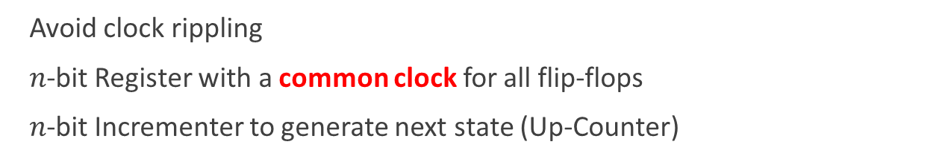



Synchronous Counter
Avoid clock rippling
$n$-bit Register with a common clock for all flip-flops
$n$-bit Incrementer to generate next state (Up-Counter)
$$n$$
n-bit Incrementer (+1)
$$n$$
$$Reset$$
n-bit Register
$Clock$
$$Q[n−1:0]$$

Slide 8























4-Bit Synchronous Counter with Enable
An incrementer is a reduced (contracted) form of an adder
4-Bit Incrementer
EN = 0 ➔
No Change
EN = 1 ➔
Increment
$$c3$$
$$c2$$
$$c1$$
$$Cout$$
$$EN$$
How to
Count
Down?
$$D_{3}$$
$$Q_{3}$$
$$D_{2}$$
$$Q_{2}$$
$$D_{1}$$
$$Q_{1}$$
$$D_{0}$$
$$Q_{0}$$
$$R$$
$$R$$
$$R$$
$$R$$
$$Clock$$
Increment
Q' (Not Q)
$$Reset$$
$$Q_{3}$$
$$Q_{2}$$
$$Q_{1}$$
$$Q_{0}$$
4-bit Counter Output

Slide 9
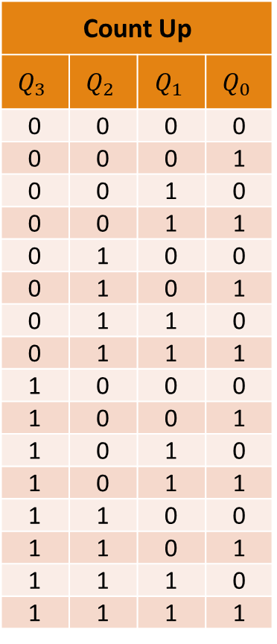
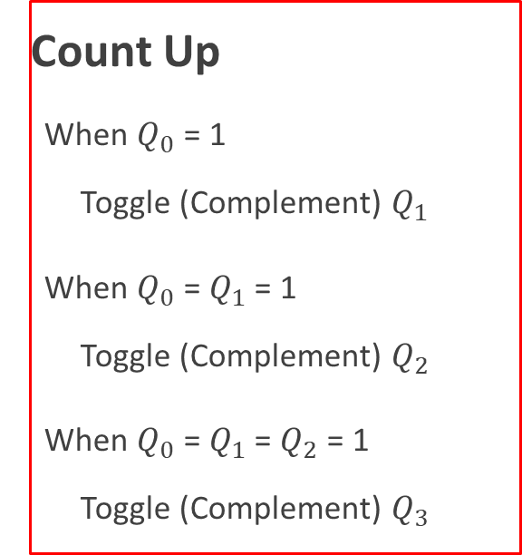
Synchronous Counter (Counting Up)
Count Up
$$Q_{3}$$ | $$Q_{2}$$ | $$Q_{1}$$ | $$Q_{0}$$
0 | 0 | 0 | 0
0 | 0 | 0 | 1
0 | 0 | 1 | 0
0 | 0 | 1 | 1
0 | 1 | 0 | 0
0 | 1 | 0 | 1
0 | 1 | 1 | 0
0 | 1 | 1 | 1
1 | 0 | 0 | 0
1 | 0 | 0 | 1
1 | 0 | 1 | 0
1 | 0 | 1 | 1
1 | 1 | 0 | 0
1 | 1 | 0 | 1
1 | 1 | 1 | 0
1 | 1 | 1 | 1
Count Up
When $Q_{0}$ = 1
Toggle (Complement) $Q_{1}$
When $Q_{0}$ = $Q_{1}$ = 1
Toggle (Complement) $Q_{2}$
When $Q_{0}$ = $Q_{1}$ = $Q_{2}$ = 1
Toggle (Complement) $Q_{3}$

Slide 10






4-Bit Synchronous Counter with T Flip-Flops
Toggle Q1 when c1 = 1, Toggle Q2 when c2 = 1, etc.
$$c3$$
$$c2$$
$$c1$$
EN = 0 ➔
No Change
EN = 1 ➔
Increment
$$Cout$$
$$EN$$
$$T_{3}$$
$$Q_{3}$$
$$T_{2}$$
$$Q_{2}$$
$$T_{1}$$
$$Q_{1}$$
$$T_{0}$$
$$Q_{0}$$
$$R$$
$$R$$
$$R$$
$$R$$
$$Clock$$
$$Reset$$
$$Q_{3}$$
$$Q_{2}$$
$$Q_{1}$$
$$Q_{0}$$
4-bit Counter Output

Slide 11
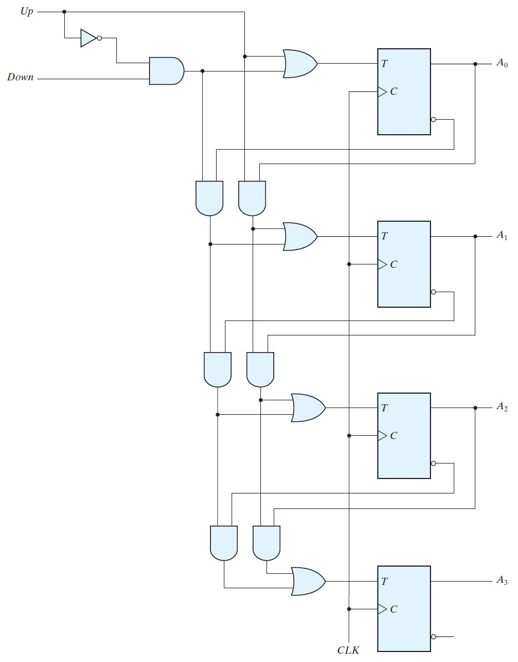







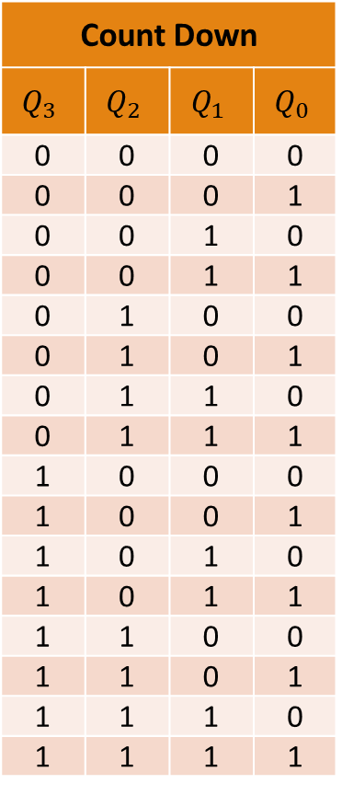



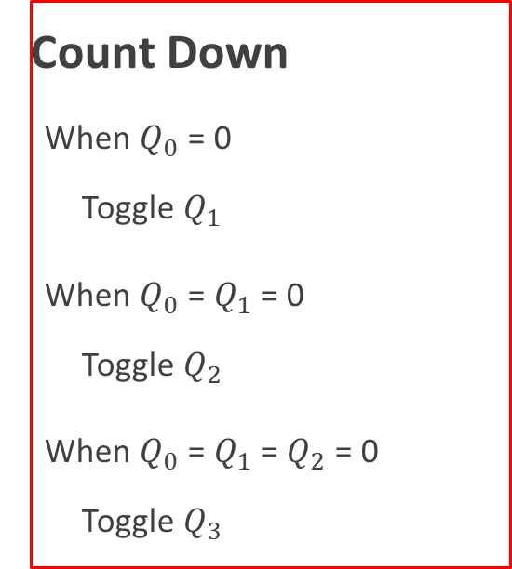
Synchronous Up-Down Counter (T Flip-Flops)
Count Down
$$Q_{3}$$ | $$Q_{2}$$ | $$Q_{1}$$ | $$Q_{0}$$
0 | 0 | 0 | 0
0 | 0 | 0 | 1
0 | 0 | 1 | 0
0 | 0 | 1 | 1
0 | 1 | 0 | 0
0 | 1 | 0 | 1
0 | 1 | 1 | 0
0 | 1 | 1 | 1
1 | 0 | 0 | 0
1 | 0 | 0 | 1
1 | 0 | 1 | 0
1 | 0 | 1 | 1
1 | 1 | 0 | 0
1 | 1 | 0 | 1
1 | 1 | 1 | 0
1 | 1 | 1 | 1
$$Up$$
$$Q_{0}$$
$$Down$$
Count Down
When $Q_{0}$ = 0
Toggle $Q_{1}$
When $Q_{0}$ = $Q_{1}$ = 0
Toggle $Q_{2}$
When $Q_{0}$ = $Q_{1}$ = $Q_{2}$ = 0
Toggle $Q_{3}$
$$Q_{0}^{′}$$
$$Q_{1}$$
$$Q_{1}^{′}$$
$$Q_{2}$$
$$Q_{2}^{′}$$
$$Q_{3}$$
$$Q_{3}^{′}$$

Slide 12
Timing of a Synchronous Counter
Clock
Q₀
Q₁
Q₂
Q₃
Advantage of Synchronous counter:
ALL Flip-flops are driven by the same clock
Delay of all outputs is identical ➔ Delay of Q₀ = Q₁ = Q₂ = Q₃ = Δ

Slide 13
Frequency Division
A counter can be used as a frequency divider
Counter is driven by a Clock with frequency F
Output Q₀ Frequency = F/2, Output Q₁ Frequency = F/4
Output Q₂ Frequency = F/8, Output Q₃ Frequency = F/16
Clock
Q₀
Q₁
Q₂
Q₃

Slide 14


















BCD Counter
Problem: Convert a 4-bit binary counter into a BCD counter
Solution: When output reaches 9 then reset back to 0
Asynchronous Reset: Count to 10 and reset immediately
4-bit Counter with
Synchronous Reset
4-bit Counter with
Asynchronous Reset
4-bit
Counter
4-bit
Counter
$$Cout$$
$$EN$$
1
$$Cout$$
$$EN$$
1
$$clock$$
$$clock$$
$$Reset$$
$$Reset$$
$$Reset$$
(Synchronous)
$$Reset$$
(Asynchronous)
$$Q_{3}$$
$$Q_{2}$$
$$Q_{1}$$
$$Q_{0}$$
$$Q_{3}$$
$$Q_{2}$$
$$Q_{1}$$
$$Q_{0}$$

Slide 15







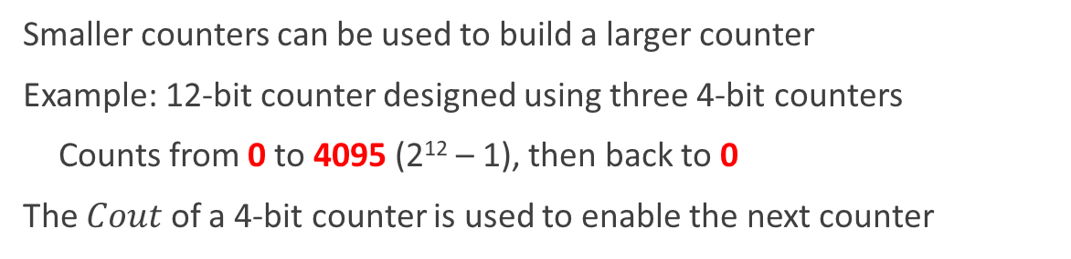









Building Larger Synchronous Counters
Smaller counters can be used to build a larger counter
Example: 12-bit counter designed using three 4-bit counters
Counts from 0 to 4095 (2¹² – 1), then back to 0
The $Cout$ of a 4-bit counter is used to enable the next counter
$$clock$$
$$reset$$
$$Cout$$
4-bit
Counter
4-bit
Counter
4-bit
Counter
$$Cout$$
$$EN$$
$$Cout$$
$$EN$$
$$Cout$$
$$EN$$
$$EN$$
$$R$$
$$R$$
$$R$$
4
4
4
$$Q[11:8]$$
$$Q[7:4]$$
$$Q[3:0]$$

Slide 16








Synchronous Counter with Parallel Load
Ability to load an initial binary number into the counter
Prior to the count operation
Two control inputs:
Load: Initialize counter with input Data
EN: enables the counting
$$Load$$
$$Data[3:0]$$
4
Very useful in implementing different counting sequences
4-bit
Counter
$$Cout$$
$$Cout$$
$$EN$$
$$EN$$
$$clock$$
4
$$Q[3:0]$$

Slide 17



















Implementing a Counter with Parallel Load
$$Load$$
$$D_{3}$$
$$D_{2}$$
$$D_{1}$$
$$D_{0}$$
$$c3$$
$$c2$$
$$c1$$
$$Cout$$
$$EN$$
0
1
0
1
0
1
0
1
Load | EN | Action
0 | 0 | No change
0 | 1 | Increment Count
1 | X | Load data
$$D$$
$$Q$$
$$D$$
$$Q$$
$$D$$
$$Q$$
$$D$$
$$Q$$
$$Clock$$
$$Q_{3}$$
$$Q_{2}$$
$$Q_{1}$$
$$Q_{0}$$
4-bit Counter Output

Slide 18















3-to-12 Counter
Convert a 4-bit binary counter with load into 3-to-12 counter
Solution: Detect binary count 12 and then load 3
Detect 12: Binary count with Q₃ = Q₂ = 1
$$Preset$$
$$D_{3}$$
$$D_{2}$$
$$D_{1}$$
$$D_{0}$$
0
0
1
1
Synchronous Preset
Load: 0011
$$Load$$
$$Cout$$
4-bit Counter
$$EN$$
$$Cout$$
$$EN$$
$$clock$$
$$Q_{3}$$
$$Q_{2}$$
$$Q_{1}$$
$$Q_{0}$$

Slide 19


























9-to-99 Counter
Problem: Use two 4-bit binary counters with parallel load and logic gates to build a counter that counts from 9 to 99 = 'b01100011
Add a synchronous Preset input to initialize the counter to value 9
$$D_{7}$$
$$D_{6}$$
$$D_{5}$$
$$D_{4}$$
$$D_{3}$$
$$D_{2}$$
$$D_{1}$$
$$D_{0}$$
$$Preset$$
0
1
0
0
1
$$Load$$
$$Load$$
$$Cout$$
4-bit Counter
4-bit Counter
$$EN$$
$$Cout$$
$$EN$$
$$Cout$$
$$EN$$
$$clock$$
$$Q_{7}$$
$$Q_{6}$$
$$Q_{5}$$
$$Q_{4}$$
$$Q_{3}$$
$$Q_{2}$$
$$Q_{1}$$
$$Q_{0}$$

