Slide 1
Lecture # 13 Register/Shift register/Parallel load.
By: Muhammad Zain Uddin
email: zuddin@iba.edu.pk

Slide 2
Registers
Registers
Shift Registers and their Applications

Slide 3










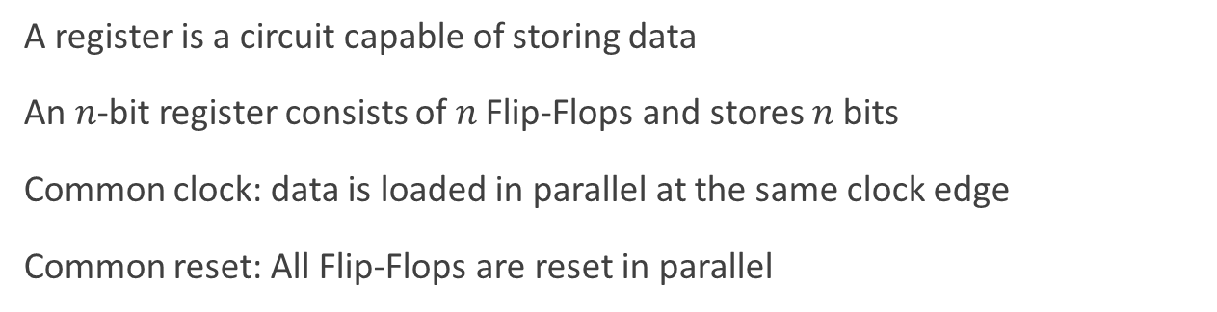





















Register
A register is a circuit capable of storing data
An $n$-bit register consists of $n$ Flip-Flops and stores $n$ bits
Common clock: data is loaded in parallel at the same clock edge
Common reset: All Flip-Flops are reset in parallel
$$D_{3}$$
$$D_{2}$$
$$D_{1}$$
$$D_{0}$$
4-bit
Register
$$D_{3}$$
$$Q_{3}$$
$$D_{2}$$
$$Q_{2}$$
$$D_{1}$$
$$Q_{1}$$
$$D_{0}$$
$$Q_{0}$$
$$D_{3}$$
$$Q_{3}$$
$$D_{2}$$
$$Q_{2}$$
$$R$$
$$R$$
$$R$$
$$R$$
$$D_{1}$$
$$Q_{1}$$
$$Clock$$
$$D_{0}$$
$$Q_{0}$$
$$Reset$$
$$Q_{3}$$
$$Q_{2}$$
$$Q_{1}$$
$$Q_{0}$$
$$Reset$$

Slide 4







Register Load (or Enable)
Question: How to control the loading of data into a register?
Solution: Introduce a register Load (or Enable) signal
If the register is enabled, load the data into the register
Otherwise, do not change the value of the register
Question: How to implement register Load?
$$I[n−1:0]$$
$$n$$
$Load (Enable)$
n-bit Register
$$Reset$$
$Clock$
$$n$$
$$Q[n−1:0]$$

Slide 5









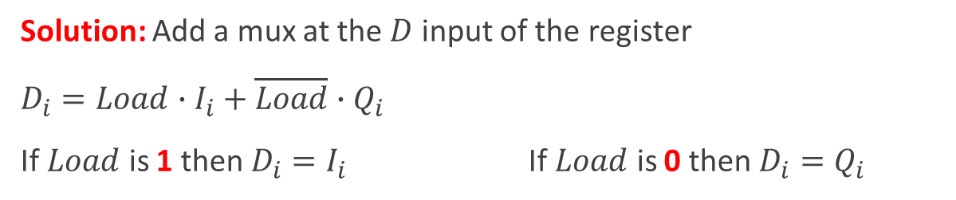














Register with Parallel Load
Solution: Add a mux at the $D$ input of the register
$D_{i}=Load∙I_{i}+\overline{Load}∙Q_{i}$
If $Load$ is 1 then $D_{i}=I_{i}$ If $Load$ is 0 then $D_{i}=Q_{i}$
$$I_{3}$$
$$I_{2}$$
$$I_{1}$$
$$I_{0}$$
$$Load$$
1
0
1
0
1
0
1
0
$$D_{3}$$
$$Q_{3}$$
$$D_{2}$$
$$Q_{2}$$
$$D_{1}$$
$$Q_{1}$$
$$D_{0}$$
$$Q_{0}$$
$$R$$
$$R$$
$$R$$
$$R$$
$$Clock$$
$$Reset$$
$$Q_{3}$$
$$Q_{2}$$
$$Q_{1}$$
$$Q_{0}$$

Slide 6














Shift Registers
A shift register is a cascade of flip flops sharing the same clock
Allows the data to be shifted from each flip-flop to its neighbor
The output of a flip-flop is connected to the input of its neighbor
Shifting can be done in either direction
All bits are shifted simultaneously at the active edge of the clock
Serial Input SI
$$D_{3}$$
$$Q_{3}$$
$$D_{2}$$
$$Q_{2}$$
$$D_{1}$$
$$Q_{1}$$
$$D_{0}$$
$$Q_{0}$$
Serial Output SO
$$R$$
$$R$$
$$R$$
$$R$$
$$Clock$$
$$Reset$$
Right Shift Register

Slide 7

Timing of a Shift Register
Serial Input SI
$$D_{3}$$
$$Q_{3}$$
$$D_{2}$$
$$Q_{2}$$
$$D_{1}$$
$$Q_{1}$$
$$D_{0}$$
$$Q_{0}$$
Serial Output SO
$$R$$
$$R$$
$$R$$
$$R$$
$$Clock$$
$$Reset$$
Cycle | SI | Q3 | Q2 | Q1 | Q0 = SO
T0 | 1 | 1 | 0 | 1 | 0
T1 | 0 | 1 | 1 | 0 | 1
T2 | 1 | 0 | 1 | 1 | 0
T3 | 1 | 1 | 0 | 1 | 1
T4 | 0 | 1 | 1 | 0 | 1
T5 | 1 | 0 | 1 | 1 | 0
T6 | 0 | 1 | 0 | 1 | 1

Slide 8






Shift Register with Parallel Output
The output of a shift register can be serial or parallel
A Serial-In Parallel-Out (SIPO) shift register is shown below
All flip-flop outputs can be read in parallel
Serial Input SI
$$D_{3}$$
$$Q_{3}$$
$$D_{2}$$
$$Q_{2}$$
$$D_{1}$$
$$Q_{1}$$
$$D_{0}$$
$$Q_{0}$$
$$R$$
$$R$$
$$R$$
$$R$$
$$Clock$$
$$Reset$$
$$Q_{3}$$
$$Q_{2}$$
$$Q_{1}$$
$$Q_{0}$$
Parallel Output PO

Slide 9


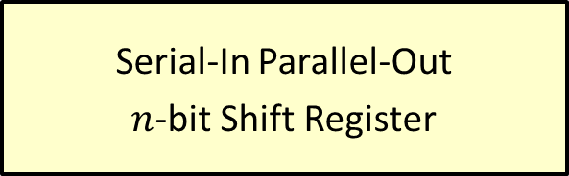


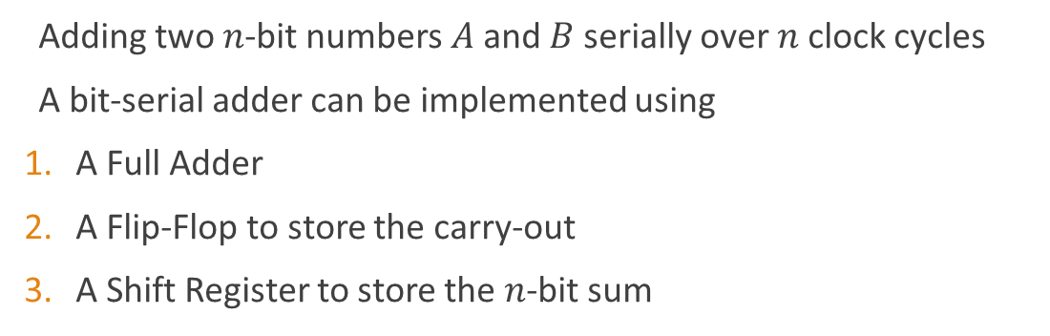








Bit Serial Adder
Adding two $n$-bit numbers $A$ and $B$ serially over $n$ clock cycles
A bit-serial adder can be implemented using
A Full Adder
A Flip-Flop to store the carry-out
A Shift Register to store the $n$-bit sum
Serial Addition
Starts at the
Least-significant bit
Full
Adder
$$S$$
Serial-In Parallel-Out
$n$-bit Shift Register
Serial Inputs
$$A$$
$$B$$
$$Reset$$
$$n$$
$$Cin$$
$$Cout$$
Flip
Flop
$$Q$$
$$D$$
$$Sum[n−1:0]$$
$$Reset$$
$$Clock$$

Slide 10


















Sequence Detector with a Shift Register
A sequence detector can be implemented using:
Left Shift Register (SIPO) + AND Gates
Example: Detecting the sequences 1010 and 1100
Bits are shifted left starting at the most-significant bit
1
0
1
0
$$Q_{3}$$
$$D_{3}$$
$$Q_{2}$$
$$D_{2}$$
$$Q_{1}$$
$$D_{1}$$
$$Q_{0}$$
$$D_{0}$$
Serial Input SI
$$Q_{3}^{′}$$
$$R$$
$$Q_{2}^{′}$$
$$R$$
$$Q_{1}^{′}$$
$$R$$
$$Q_{0}^{′}$$
$$R$$
$$Clock$$
$$Reset$$
Detect
1010
Detect
1100

Slide 11




Parallel-In Serial-Out Shift Register
A Parallel-In Serial-Out (PISO) Shift Register has:
$n$ parallel data input lines
Serial Input
Serial Output
Control input s
Clock input
Reset input
Two control functions:
s = 0 ➔ Shift Data
s = 1 ➔ Parallel Load $n$ input bits
Parallel Data Input
Serial In
$$n$$
Control
Parallel-In Serial-Out
Shift Register
$$s$$
Clock
Reset
$$R$$
Serial Output

Slide 12



















Parallel In Serial Out Shift Register
Two control functions:
s = 0 ➔ Shift s = 1 ➔ Load data
Parallel Data Input
Serial
Input SI
$$I_{3}$$
$$I_{2}$$
$$I_{1}$$
$$I_{0}$$
$$s$$
0
1
0
1
0
1
0
1
Serial
Output SO
$$D_{3}$$
$$Q_{3}$$
$$D_{2}$$
$$Q_{2}$$
$$D_{1}$$
$$Q_{1}$$
$$D_{0}$$
$$Q_{0}$$
$$R$$
$$R$$
$$R$$
$$R$$
$$Clock$$
$$Reset$$

Slide 13

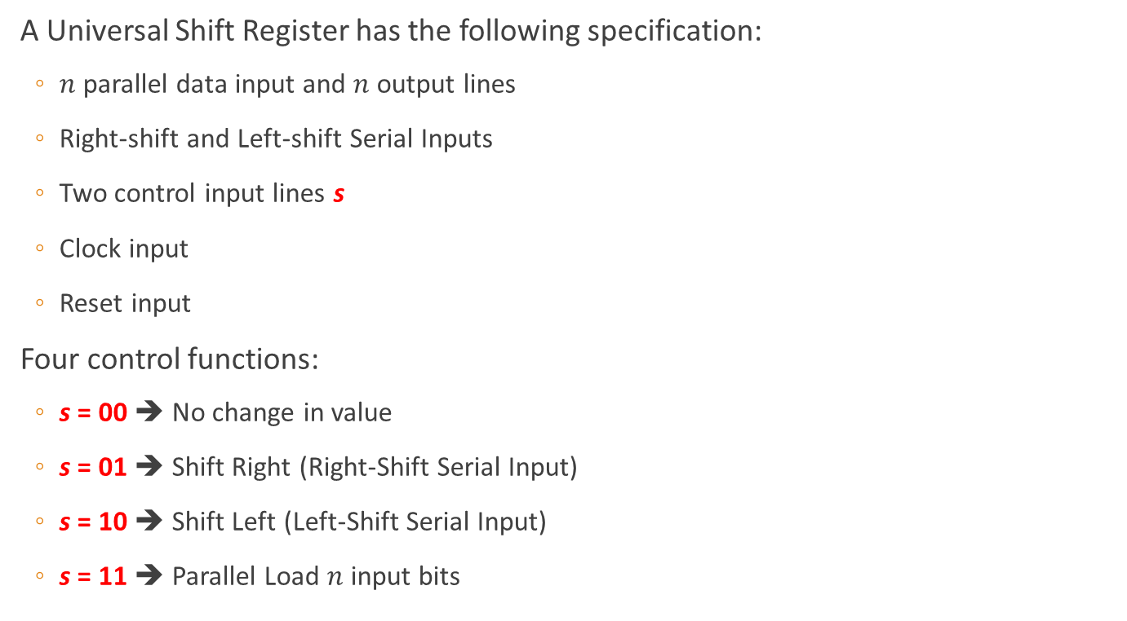



Universal Shift Register
R-shift
Serial
Input
Parallel
Data
Input
L-shift
Serial
Input
A Universal Shift Register has the following specification:
$n$ parallel data input and $n$ output lines
Right-shift and Left-shift Serial Inputs
Two control input lines s
Clock input
Reset input
Four control functions:
s = 00 ➔ No change in value
s = 01 ➔ Shift Right (Right-Shift Serial Input)
s = 10 ➔ Shift Left (Left-Shift Serial Input)
s = 11 ➔ Parallel Load $n$ input bits
$$n$$
Control
2
Universal
Shift Register
$$s$$
Clock
Reset
$$R$$
$$n$$
Parallel Data Output

Slide 14























Universal Shift Register Design
Parallel Inputs
$$I_{3}$$
$$I_{2}$$
$$I_{1}$$
$$I_{0}$$
Right-Shift
Serial Input
Left-Shift
Serial Input
$$s$$
3
2
1
0
3
2
1
0
3
2
1
0
3
2
1
0
s = 0 ➔
No change
s = 1 ➔
Shift Right
s = 2 ➔
Shift Left
s = 3 ➔
Parallel Load
2
$$D_{3}$$
$$D_{2}$$
$$D_{1}$$
$$D_{0}$$
$$R$$
$$Q_{3}$$
$$R$$
$$Q_{2}$$
$$R$$
$$Q_{1}$$
$$R$$
$$Q_{0}$$
$$Clock$$
$$Reset$$
$$Q_{3}$$
$$Q_{2}$$
$$Q_{1}$$
$$Q_{0}$$
Parallel Outputs

