Slide 1
Lecture # 1
Introduction/Overview/Number System/Truth table
By: Muhammad Zain Uddin email: zuddin@iba.edu.pk
M. ZAIN UDDIN
1

Slide 2

Digital Logic Design
Muhammad Zain Uddin
Lecturer, IBA

Slide 3
My Introduction
Course Instructor
Name : Muhammad Zain Uddin
Qualification : PhD(IBA, in progress), MSCS (IBA), MCS (PAF-KIET, Equivalency course),BE(PAF-
KIET)
Teaching Experience : Lecturer in IBA (2023-till date), PhD Scholar/Research Assistant in IBA (2020-2023), Lecturer in PAF-KIET (2017-2019), Lab Instructor at PAF-KIET(2016-2017).
Industry Experience/Business : CEO/Cofounder of CYBORG Innovation (2023) and ZAHIR.
, IoT/Hardware Department Manager at Axon Solution (2021-2023),RnD Engineer at ALM
Associate (2020)
Email :zuddin@iba.edu.pk
M. ZAIN UDDIN
3

Slide 4
About ZAHIR
Custom Tailoring Services for Pakistani Brands – Worldwide Delivery
If you're a fan of Pakistani fashion and want your favorite brands custom-stitched to your exact specifications, look no further! We provide bespoke stitching services tailored to your unique style and needs, with convenient worldwide delivery.
Contact us today to get started on your personalized wardrobe!
Insta: Zahir_tailoring WhatsApp: +923312840106 fb:thezahirTailoring website: za-hir.com

Slide 5
Text and Reference Books
Thomas Floyd, Digital logic fundamentals
Morris Mano, “Computer SystemArchitecture”, Pearson, 3rd Ed.
Digital Design and Computer Architecture,
D.M. Harris and S.L. Harris, Morgan Kaufmann, 2013 (2nd Edition).

Slide 6
Criteria
Final
Midterm
Projects
Quiz
Assignment
Labs
30 Marks
20 Marks
15 Marks
15 Marks (Min 6)
10 Marks (Min 5)
15 Marks

Slide 7
Administrative Rules/Policies
Well discipline is expected from class.
Toavoid disturbance to others, Mobile phones must be set to the silentmode.
Kindly follow the dress code policy define in student’s Handbook
We will have some Pop-Quizzes (means without prior announcement).
Late submissions or email based or any other way except lms submission of assignments/Labs are subject to no submission at all.
No concept of deadline extensions
Copying is strictly prohibited.
Active involvement in lectures will be highlyappreciated.

Slide 8
ANY QUESTION?

Slide 9




Principle of Abstraction
Application Software
programs
OS
Operating Systems
device drivers
Architecture
instructions registers
CAAL
focus of this course
Micro- architecture
datapaths controllers
Logic
adders memories
DLD
Digital Circuits
AND gates NOT gates
Analog Circuits
amplifiers filters
Devices
transistors diodes
Physics
electrons
8

Slide 10
Scope
The purpose of this course is that we:
Learn the principles of digital design
Learn to systematically debug increasingly complex designs
Design and build digital systems
Learn what’s under the hood of an electronic component
9

Slide 11


Digital Logic Design
?
?

Slide 12
Course Overview
Subjects | Building Blocks | Theory
Combinational Logic | AND, OR, NOT, XOR | Boolean Algebra
Standard Modules | Function of combination logics | Arithmetics, Encoder, Decoder, Mux, De- Mux, Comparator
Sequential Network | Flip flops, Latches | Finite State Machine
System Design (Optional) | Data Paths, Control Paths | Methodologies
10

Slide 13
Combinational Logic vs Sequential Network
x₁
.
.
.
x_{n}
x₁
.
.
.
x_{n}
s_{i}
f_{i}(x)
f_{i}(x,s)
CLK
Sequential Networks
Memory
Time Steps (Clock)
t
y_{i}^{t} = f_{i} (x₁^{t},…,x_{n}^{t}, s₁^{t}, …,s_{m} )
t t t
s_{i}^{t+1} = g_{i}(x₁^{t},…,x_{n} , s₁ ,…,s_{m} )
Combinational logic:
y_{i} = f_{i}(x₁,..,x_{n})

Slide 14
Agenda of next lecture
Number system
Number system conversion
Truth Table
Digital Input
Logic Gates
M. ZAIN UDDIN
13

Slide 15
Types of number system
Binary
Octal
Hexa Decimal
Decimal
M. ZAIN UDDIN
14

Slide 16
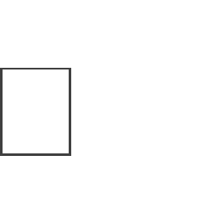
Decimal numbers
In the decimal number systems each of the ten digits, 0 through 9, represents a certain quantity. The position of each digit in a decimal number indicates the magnitude of the quantity represented and can be assigned a weight. The weights for whole numbers are positive powers of ten that increases from right to left, beginning with 10º = 1
……………10 10 10³ 10² 10¹ 10º
For fractional numbers, the weights are negative powers of ten that decrease from left to right
beginning with 10¯¹.
10² 10¹ 10º . 10¯¹ 10¯² 10¯³ ……..
The value of a decimal number is the sum of digits after each digit has been multiplied by its
weights as in following examples.

Slide 17

Express the decimal number 87 as a sum of the values of each digit.
Solution: the digit 8 has a weight of 10, which is 10 , as indicated by its position. The digit 7 has
a weight of 1, which is 10º, as indicated by its position.
87 = (8 x 10 ) + (7 x 10º) = (8 x 10) +
(7 x 1) = 87
Determine the value of each digit in 939
Express the decimal number 725.45 as a sum of the values of each digit.
725.45 = (7 x 10²) + (2 x 10¹) + (5 x 10º) + (4 x 10¯¹) +
(5 x 10¯²) = 700 + 20 + 5 + 0.4 + 0.05

Slide 18
BINARY NUMBERS
The binary system is less complicated than the decimal system because it has only two digits, it is a base-two system. The two binary digits (bits) are 1 and 0. The position of a 1 or 0 in a binary number indicates its weight, or value within the number, just as the position of a decimal digit determines the value of that digit. The weights in a binary number are based on power of two as:
….. 2 2³ 2 2 2º . 2¯ 2¯ ……….
With 4 digits position we can count from zero to 15.In general, with n bits we can count up to a number equal to 2ⁿ - 1.
Largest decimal number = 2ⁿ - 1

Slide 19
BINARY NUMBERS
A binary number is a weighted number. The right-most bit is the least significant bit (LSB) in a binary whole number and has a weight of 2º =1. The weights increases from right to left by a power of two for each bit. The left-most bit is the most significant bit (MSB); its weight depends on the size of the binary number.

Slide 20
Decimal number
Binary number
0 | 0 | 0 | 0 | 0
1 | 0 | 0 | 0 | 1
2 | 0 | 0 | 1 | 0
3 | 0 | 0 | 1 | 1
4 | 0 | 1 | 0 | 0
5 | 0 | 1 | 0 | 1
6 | 0 | 1 | 1 | 0
7 | 0 | 1 | 1 | 1
8 | 1 | 0 | 0 | 0
9 | 1 | 0 | 0 | 1
10 | 1 | 0 | 1 | 0
11 | 1 | 0 | 1 | 1
12 | 1 | 1 | 0 | 0
13 | 1 | 1 | 0 | 1
14 | 1 | 1 | 1 | 0
15 | 1 | 1 | 1 | 1

Slide 21

Binary-to-Decimal Conversion
The decimal value of any binary number can be found by adding the weights of all bits that are 1 and discarding the weights of all bits that are 0.
Example
Let’s convert the binary whole number 101101 to decimal.
Weight: 2 2
Binary no: 1 0
2 2 2 2º
1 1 0 1
101101= 2 + 2 + 2 + 2º = 32+8+4+1=45

Slide 22
Decimal-to-Binary Conversion
One way to find the binary number that is equivalent to a given decimal number is to determine the set of binary weights whose sum is equal to the decimal number. For example decimal number 9, can be expressed as the sum of binary weights as follows:
9 = 8 + 1 or 9 = 2³ + 2º
Placing 1s in the appropriate weight positions, 2³ and
2º, and 0s in the 2² and 2¹ positions determines the binary number for decimal 9.
2³ 2² 2¹ 2º
1 0 0 1 Binary number for nine

Slide 23
Hexadecimal numbers
The hexadecimal number system has sixteen digits and is used primarily as a compact way of displaying or writing binary numbers because it is very easy to convert between binary and hexadecimal. Long binary numbers are difficult to read and write because it is easy to drop or transpose a bit. Hexadecimal is widely used in computer and microprocessor applications. The hexadecimal system has a base of sixteen; it is composed of 16 digits and alphabetic characters.
The maximum 3-digits hexadecimal number is FFF or decimal 4095 and maximum 4-digit hexadecimal number is FFFF or decimal 65.535

Slide 24
Decimal | Binary | Hexadecimal
0 | 0000 | 0
1 | 0001 | 1
2 | 0010 | 2
3 | 0011 | 3
4 | 0100 | 4
5 | 0101 | 5
6 | 0110 | 6
7 | 0111 | 7
8 | 1000 | 8
9 | 1001 | 9
10 | 1010 | A
11 | 1011 | B
12 | 1100 | C
13 | 1101 | D
14 | 1110 | E
15 | 1111 | F

Slide 25
Binary-to-Hexadecimal Conversion
Simply break the binary number into 4-bit groups, starting at the right-most bit and replace each
4-bit group with the equivalent hexadecimal symbol as in the following example.
Convert the binary number to hexadecimal:
1100101001010111
Solution:
1100 1010 0101 0111
C
A 5 7 = CA57

Slide 26
Hexadecimal-to-Decimal Conversion
One way to find the decimal equivalent of a hexadecimal number is to first convert the hexadecimal number to binary and then convert from binary to decimal.
Convert the hexadecimal number 1C to decimal:
1 C
0001 1100 = 2 + 2³ + 2² = 16 +8+4 = 28

Slide 27
Decimal-to-Hexadecimal Conversion
Repeated division of a decimal number by 16 will produce the equivalent hexadecimal number, formed by the remainders of the divisions. The first remainder produced is the least significant digit (LSD). Each successive division by 16 yields a remainder that becomes a digit in the equivalent hexadecimal number. When a quotient has a fractional part, the fractional part is multiplied by the divisor to get the remainder.

Slide 28
Convert the decimal number 650 to hexadecimal by repeated division by 16.
650 = 40.625 0.625 x 16 = 10 = A (LSD)
16
40 = 2.5
16
0.5 x 16 = 8 = 8
2 = 0.125 0.125 x 16 = 2 =
16
The hexadecimal number is 28A
2 (MSD)

Slide 29
Octal Numbers
Like the hexadecimal system, the octal system provides a convenient way to express binary numbers and codes.
However, it is used less frequently than hexadecimal in conjunction with computers and microprocessors to express binary quantities for input and output purposes.
The octal system is composed of eight digits, which are: 0, 1, 2, 3, 4, 5, 6, 7
To count above 7, begin another column and start over: 10, 11, 12, 13, 14, 15, 16, 17, 20, 21 and so on.
Counting in octal is similar to counting in decimal, except that the digits 8 and 9 are not used.

Slide 30
Octal-to-Decimal Conversion
Since the octal number system has a base of eight, each successive digit position is an increasing power of eight, beginning in the right-most column with 8º. The evaluation
Of an octal number in terms of its decimal equivalent is accomplished by multiplying each digit by its weight and summing the products.
Let’s convert octal number 2374 in decimal number.
Weight 8³ 8² 8 8º Octal number 2 3 7 4
2374 = (2 x 8³) + (3 x 8²) + (7 x 8 ) + (4 x 8º)=1276

Slide 31
Decimal-to-Octal Conversion
A method of converting a decimal number to an octal number is the repeated division-by-8 method,
which is similar to the method used in the conversion of decimal numbers to binary or to hexadecimal.
Let’s convert the decimal number 359 to octal. Each successive division by 8 yields a remainder that becomes a digit in the equivalent octal number. The first remainder generated is the least significant digit (LSD).
359 = 44.875 0.875 x 8 = 7 (LSB)
8
44
= 5.5
0.5 x 8 = 4
8
5 = 0.625
0.625 x 8 =
5 (MSB)
8
The number is 547.

Slide 32
Octal-to-Binary Conversion
Because each octal digit can be represented by a 3-bit binary number, it is very easy to convert from octal to binary..
Octal/Binary Conversion
Octal Digit 0 1 2
Binary 000 001 010
3 4 5 6 7
011 100 101 110 111
Let’s convert the octal numbers 25 and 140.
2 | 5 | 1 | 4 | 0
010 | 101 | 001 | 100 | 000

Slide 33
Binary-to-Octal Conversion
Conversion of a binary number to an octal number is the reverse of the octal-to-binary
conversion.
Let’s convert the following binary numbers to octal:
1 1 0 1 0 1 1 0 1 1 1 1 0 0 1
6 5 = 65 5 7 1 = 571

Slide 34
Truth Table
On Board
A(4) | B(2) | C(1)
0 | 0 | 0
0 | 0 | 1
0 | 1 | 0
0 | 1 | 1
1 | 0 | 0
1 | 0 | 1
1 | 1 | 0
1 | 1 | 1
M. ZAIN UDDIN
33

Slide 35
Review of previous lecture
Number system
Number system conversion
Truth Table
Digital Input
Logic Gates

Slide 36
Types of Inputs
Example 1: Designing a circuit which takes 4 individual sensor from tank that gives digital values and tell how many sensors are high on 7 segment display
Example 2: Designing a circuits that takes two input of 2 bits each and determine the product of these two inputs in binary

Slide 37
Basic Designing Rules
Step 1: identify number of inputs and individual input bits
Step 2: draw truth table if total number of inputs bits
Step 3: identify number of outputs and output bits
Step 4: Identify output value on each combination of inputs
Remaining steps will be discussed later

Slide 38
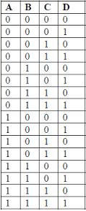
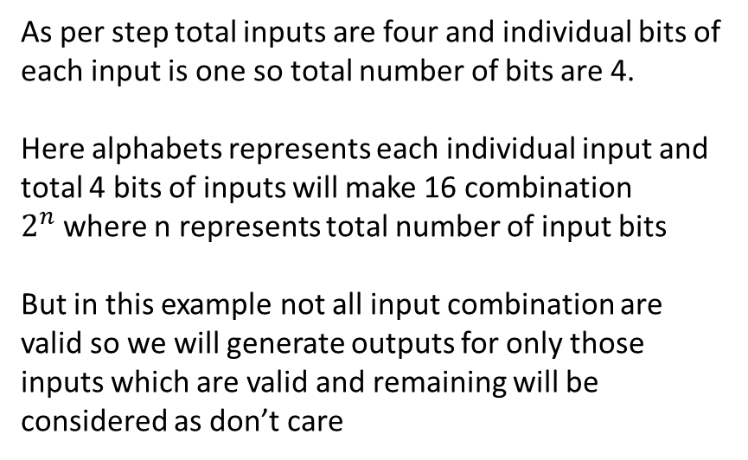
Example 1
As per step total inputs are four and individual bits of each input is one so total number of bits are 4.
Here alphabets represents each individual input and total 4 bits of inputs will make 16 combination $2^{n}$where n represents total number of input bits
But in this example not all input combination are valid so we will generate outputs for only those inputs which are valid and remaining will be considered as don’t care

Slide 39
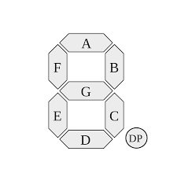
Example 1 (Cont.):
Inputs outputs
Inputs | Outputs
A | B | C | D | a | b | c | d | e | f | g
0 | 0 | 0 | 1 | 0 | 1 | 1 | 0 | 0 | 0 | 0
0 | 0 | 1 | 1 | 1 | 1 | 0 | 1 | 1 | 0 | 1
0 | 1 | 1 | 1 | 1 | 1 | 1 | 1 | 0 | 0 | 1
1 | 1 | 1 | 1 | 0 | 1 | 1 | 0 | 0 | 1 | 1

Slide 40
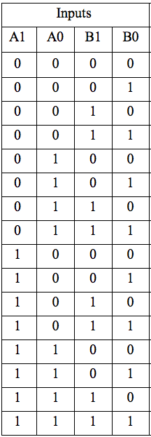
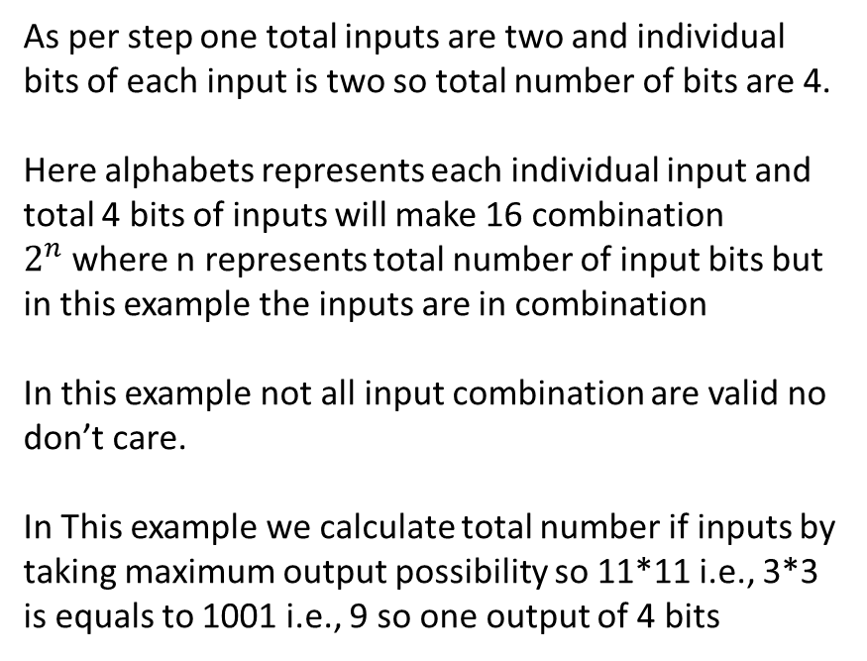
Example 2
As per step one total inputs are two and individual bits of each input is two so total number of bits are 4.
Here alphabets represents each individual input and total 4 bits of inputs will make 16 combination $2^{n}$where n represents total number of input bits but in this example the inputs are in combination
In this example not all input combination are valid no don’t care.
In This example we calculate total number if inputs by taking maximum output possibility so 11*11 i.e., 3*3 is equals to 1001 i.e., 9 so one output of 4 bits

Slide 41
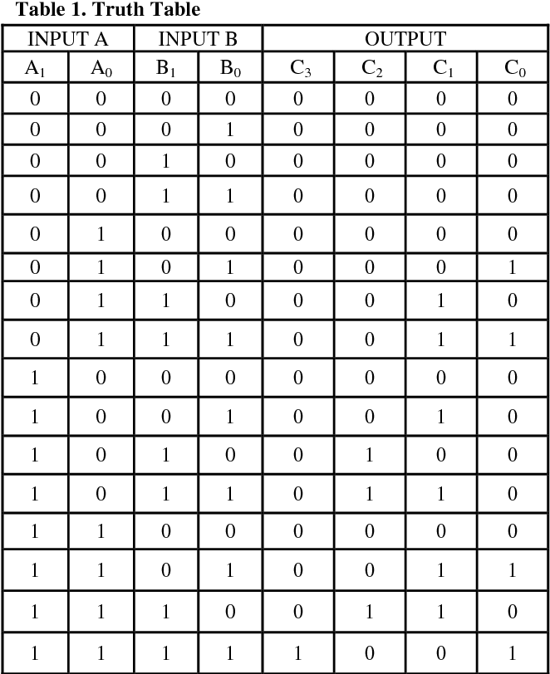
Example 2

Slide 42
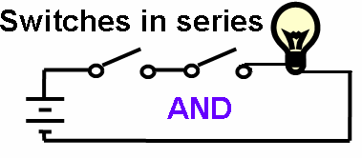
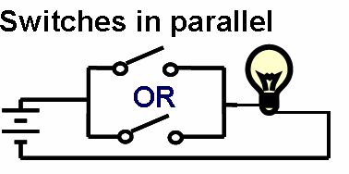
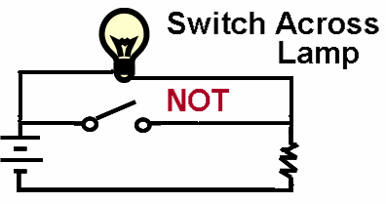
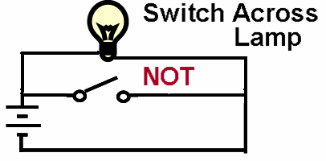
Practical Implementation of the Basic Logic Functions
Using Switches
Input/Output Definitions
Input:
logic 1 is switch closed
logic 0 is switch open
Output:
logic 1 is lamp on
logic 0 is lamp off.
Functions depend on the definitions! (see Positive and Negative in Unit 3)
Avoid ambiguities – What does it mean when the result of a medical test is positive?
42

Slide 43
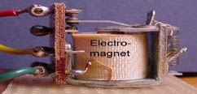
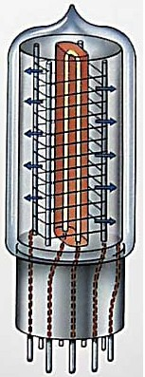
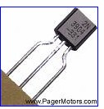
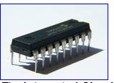
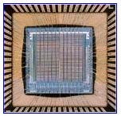
Practical Implementation of Logic Functions: Evolution of Switches in Computers
Earliest electromechanical computers had switches that opened and closed by magnetic fields produced through energizing coils in relays
Later, electronic vacuum tubes replaced relays.
Later, discrete transistors replaced tubes
Later, computers were constructed of many integrated circuits (IC), each containing many transistors
Nowadays whole processors are made of a
single chip. The Itanium 2 Intel processor
chip contains 1.72 billion transistors
12

Slide 44
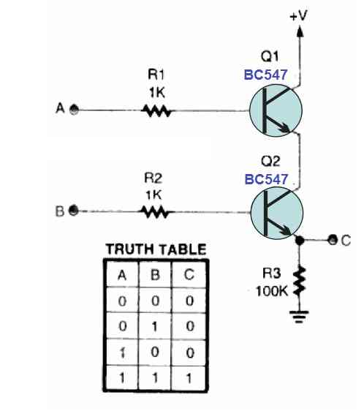
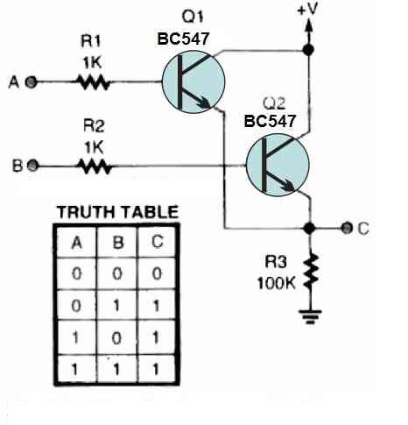
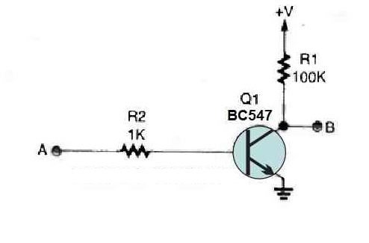
Practical Implementation of the Basic Logic Functions
Using Transistor

Slide 45
Logic Gates
There are total seven logic gates
AND
OR Basic logic gates any circuitry can be built using these three
NOT
XOR
NAND
NOR
XNOT
Universal gates means all logical gates can be built using these two gates

Slide 46
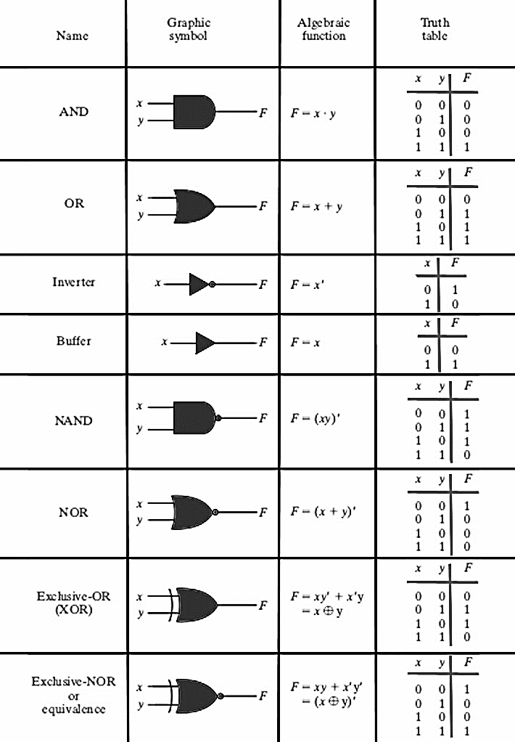

Slide 47
Definition of each gate
AND: If all inputs are high output will be high
OR: if minimum one input is high output will be high
NOT: opposite or inverted of inputs (in this logic input bits are equal to output bits)
NAND: If minimum one input is low output will be high
NOR: If all inputs are low output will be high
XOR: If high inputs are odd output will be high
XNOR: If high inputs are even output will be high

Slide 48
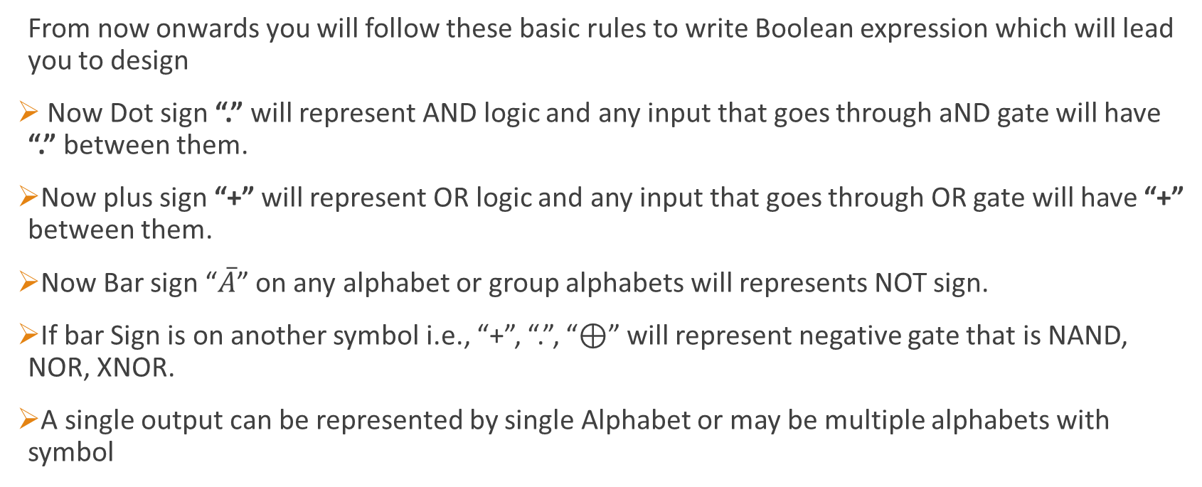
Introduction to Boolean Algebra
From now onwards you will follow these basic rules to write Boolean expression which will lead you to design
Now Dot sign “.” will represent AND logic and any input that goes through aND gate will have “.” between them.
Now plus sign “+” will represent OR logic and any input that goes through OR gate will have “+” between them.
Now Bar sign “$\overline{A}$” on any alphabet or group alphabets will represents NOT sign.
If bar Sign is on another symbol i.e., “+”, “.”, “⊕” will represent negative gate that is NAND, NOR, XNOR.
A single output can be represented by single Alphabet or may be multiple alphabets with symbol

Slide 49
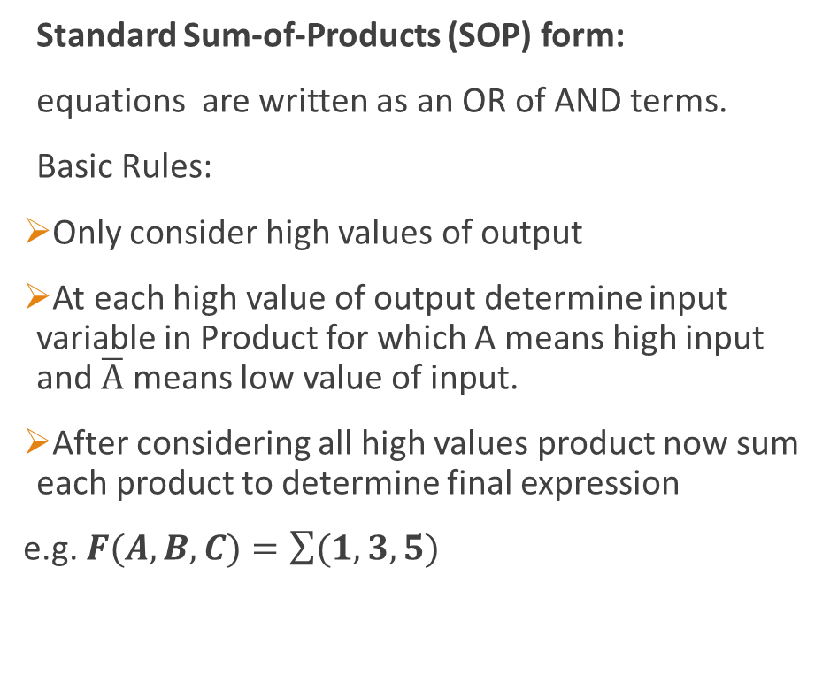
Boolean Standard of Expression
Standard Sum-of-Products (SOP) form:
equations are written as an OR of AND terms.
Basic Rules:
Only consider high values of output
At each high value of output determine input variable in Product for which A means high input and $\overline{A}$ means low value of input.
After considering all high values product now sum each product to determine final expression
e.g. $F(A,B,C)=\sum{(1,3,5)}$

Slide 50
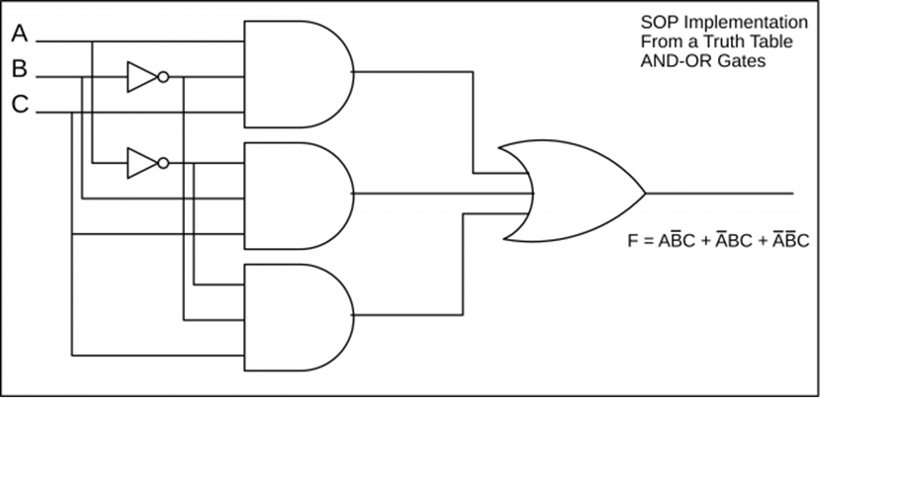
Example Circuit

Slide 51
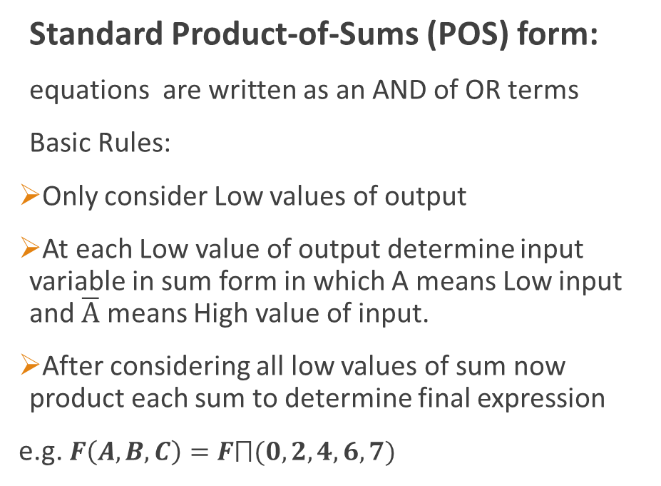
Boolean Standard of Expression
Standard Product-of-Sums (POS) form:
equations are written as an AND of OR terms
Basic Rules:
Only consider Low values of output
At each Low value of output determine input variable in sum form in which A means Low input and $\overline{A}$ means High value of input.
After considering all low values of sum now product each sum to determine final expression
e.g. $F\left(A,B,C\right)=F⨅(0,2,4,6,7)$

Slide 52
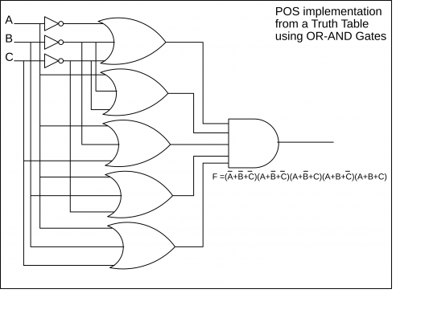
Example Circuit

Slide 53
Basic Designing Rules
Step 1: identify number of inputs and individual input bits
Step 2: draw truth table if total number of inputs bits
Step 3: identify number of outputs and output bits
Step 4: Identify output value on each combination of inputs
Step 5: Now determine Boolean expression of each output bit.
Remaining steps will be discussed later

Slide 54
Next Lecture
Different examples of circuit using SOP and POS
Circuitry costing and decision making.
Boolean Rules and Laws
Minimizing circuitry using those rules and laws

