Slide 1
Lecture # 2
Truth table/Digital Inputs/Boolean Algebra
By: Muhammad Zain Uddin email: zuddin@iba.edu.pk
M. ZAIN UDDIN
1

Slide 2

Digital Logic Design
Muhammad Zain Uddin
Lecturer, IBA

Slide 3
Review of previous lecture
Number system
Number system conversion
Truth Table
Digital Input
Logic Gates

Slide 4
Logic Gates
There are total seven logic gates
AND
OR Basic logic gates any circuitry can be built using these three
NOT
XOR
NAND
NOR
XNOR
Universal gates means all logical gates can be built using these two gates

Slide 5
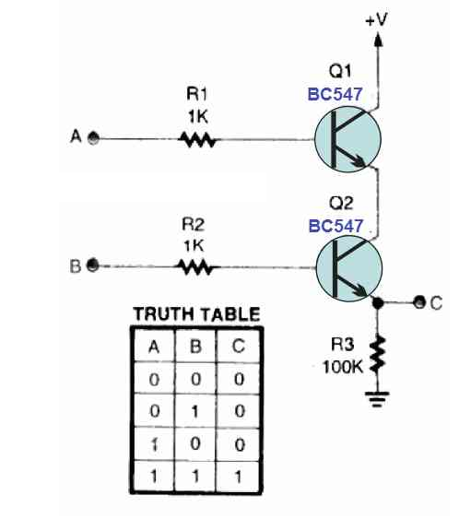
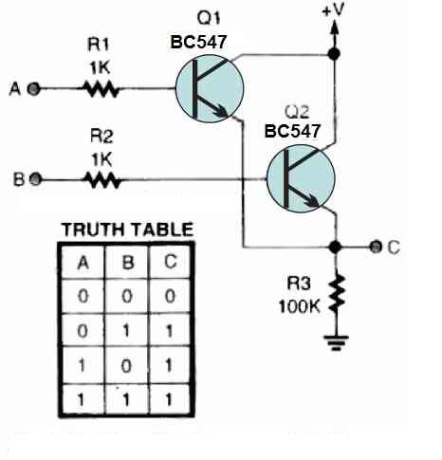
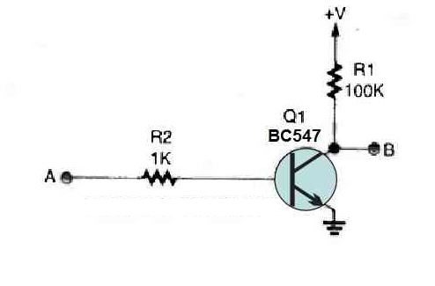
Practical Implementation of the Basic Logic Functions
Using Transistor

Slide 6
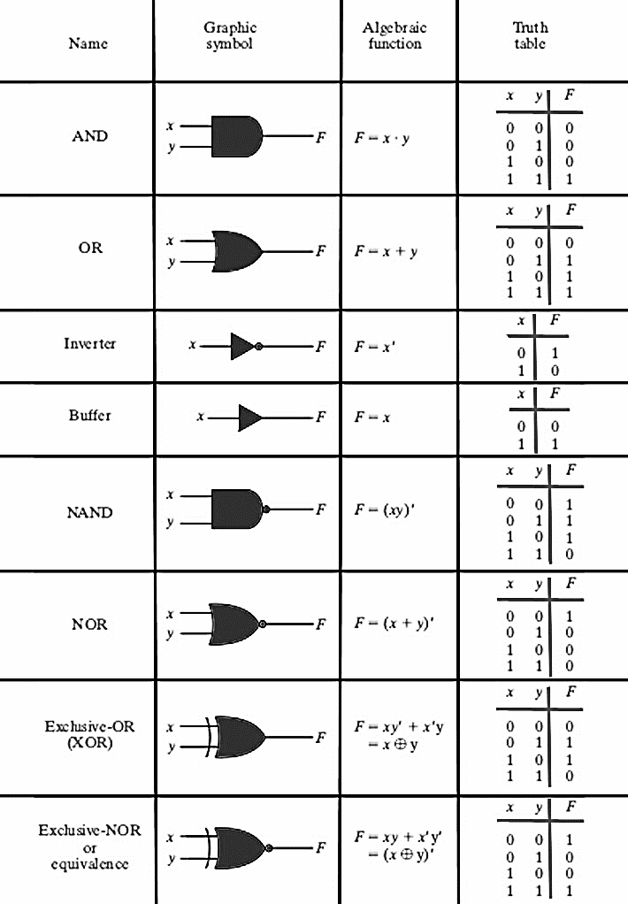

Slide 7
Definition of each gate
AND: If all inputs are high output will be high
OR: if minimum one input is high output will be high
NOT: opposite or inverted of inputs (in this logic input bits are equal to output bits)
NAND: If minimum one input is low output will be high
NOR: If all inputs are low output will be high
XOR: If high inputs are odd output will be high
XNOR: If high inputs are even output will be high

Slide 8
Types of Inputs
Example 1: Designing a circuit which takes 4 individual sensor from tank that gives digital values and tell how many sensors are high on 7 segment display
Example 2: Designing a circuits that takes two input of 2 bits each and determine the product of these two inputs in binary

Slide 9
Basic Designing Rules
Step 1: identify number of inputs and individual input bits
Step 2: draw truth table if total number of inputs bits
Step 3: identify number of outputs and output bits
Step 4: Identify output value on each combination of inputs
Remaining steps will be discussed later

Slide 10
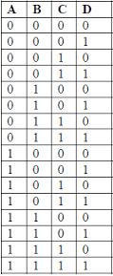
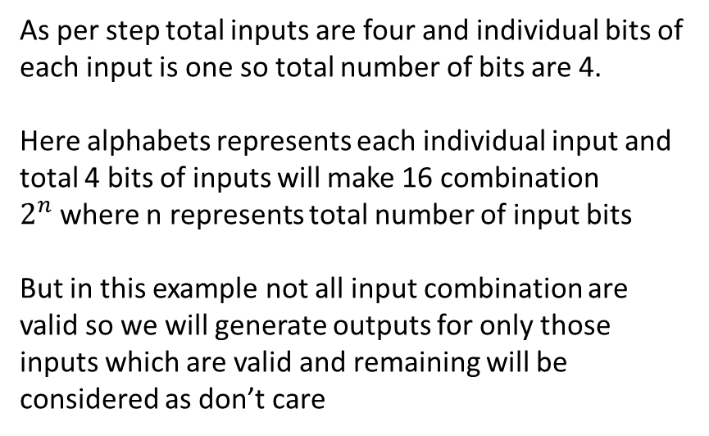
Example 1
As per step total inputs are four and individual bits of each input is one so total number of bits are 4.
Here alphabets represents each individual input and total 4 bits of inputs will make 16 combination $2^{n}$where n represents total number of input bits
But in this example not all input combination are valid so we will generate outputs for only those inputs which are valid and remaining will be considered as don’t care

Slide 11
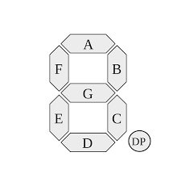
Example 1 (Cont.):
Inputs outputs
Inputs | Outputs
A | B | C | D | a | b | c | d | e | f | g
0 | 0 | 0 | 1 | 0 | 1 | 1 | 0 | 0 | 0 | 0
0 | 0 | 1 | 1 | 1 | 1 | 0 | 1 | 1 | 0 | 1
0 | 1 | 1 | 1 | 1 | 1 | 1 | 1 | 0 | 0 | 1
1 | 1 | 1 | 1 | 0 | 1 | 1 | 0 | 0 | 1 | 1

Slide 12
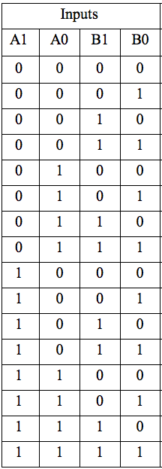
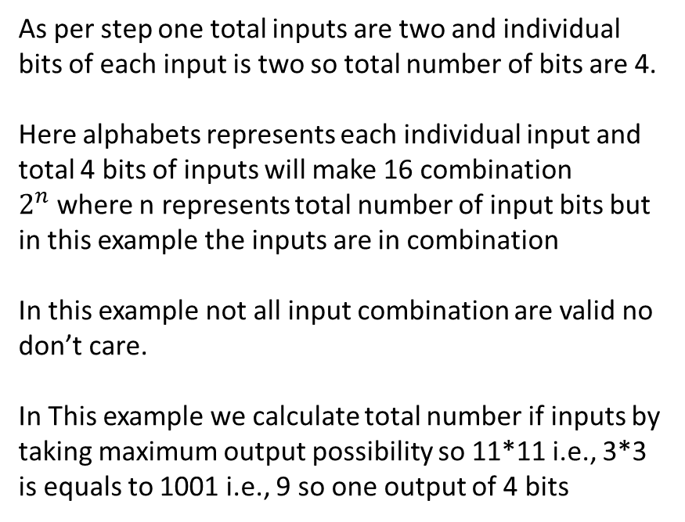
Example 2
As per step one total inputs are two and individual bits of each input is two so total number of bits are 4.
Here alphabets represents each individual input and total 4 bits of inputs will make 16 combination $2^{n}$where n represents total number of input bits but in this example the inputs are in combination
In this example not all input combination are valid no don’t care.
In This example we calculate total number if inputs by taking maximum output possibility so 11*11 i.e., 3*3 is equals to 1001 i.e., 9 so one output of 4 bits

Slide 13
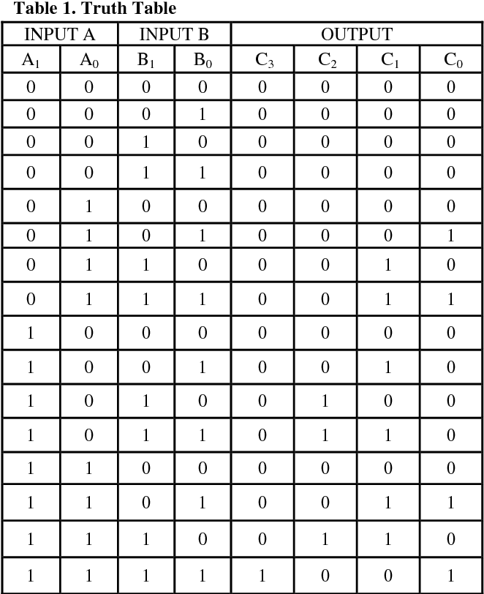
Example 2

Slide 14
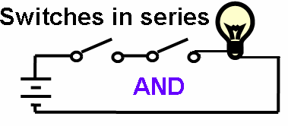
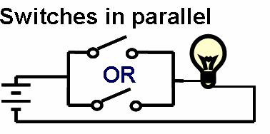
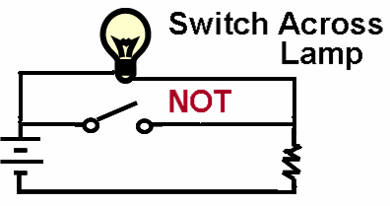
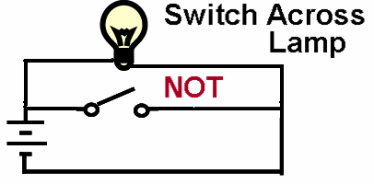
Practical Implementation of the Basic Logic Functions
Using Switches
Input/Output Definitions
Input:
logic 1 is switch closed
logic 0 is switch open
Output:
logic 1 is lamp on
logic 0 is lamp off.
Functions depend on the definitions! (see Positive and Negative in Unit 3)
Avoid ambiguities – What does it mean when the result of a medical test is positive?
14

Slide 15
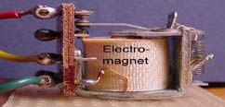
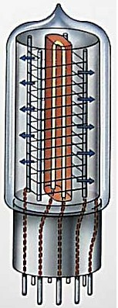
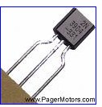
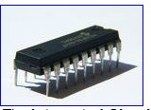
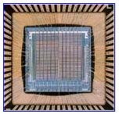
Practical Implementation of Logic Functions: Evolution of Switches in Computers
Earliest electromechanical computers had switches that opened and closed by magnetic fields produced through energizing coils in relays
Later, electronic vacuum tubes replaced relays.
Later, discrete transistors replaced tubes
Later, computers were constructed of many integrated circuits (IC), each containing many transistors
Nowadays whole processors are made of a
single chip. The Itanium 2 Intel processor
chip contains 1.72 billion transistors
12

Slide 16
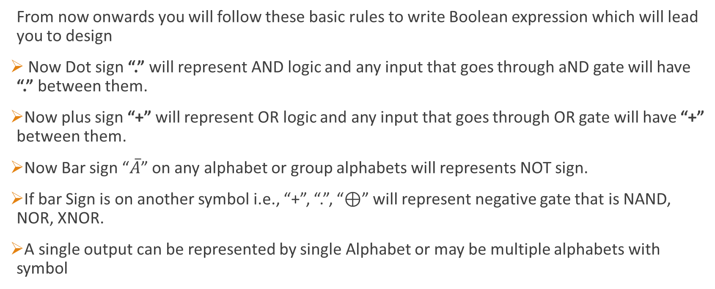
Introduction to Boolean Algebra
From now onwards you will follow these basic rules to write Boolean expression which will lead you to design
Now Dot sign “.” will represent AND logic and any input that goes through aND gate will have “.” between them.
Now plus sign “+” will represent OR logic and any input that goes through OR gate will have “+” between them.
Now Bar sign “$\overline{A}$” on any alphabet or group alphabets will represents NOT sign.
If bar Sign is on another symbol i.e., “+”, “.”, “⊕” will represent negative gate that is NAND, NOR, XNOR.
A single output can be represented by single Alphabet or may be multiple alphabets with symbol

Slide 17
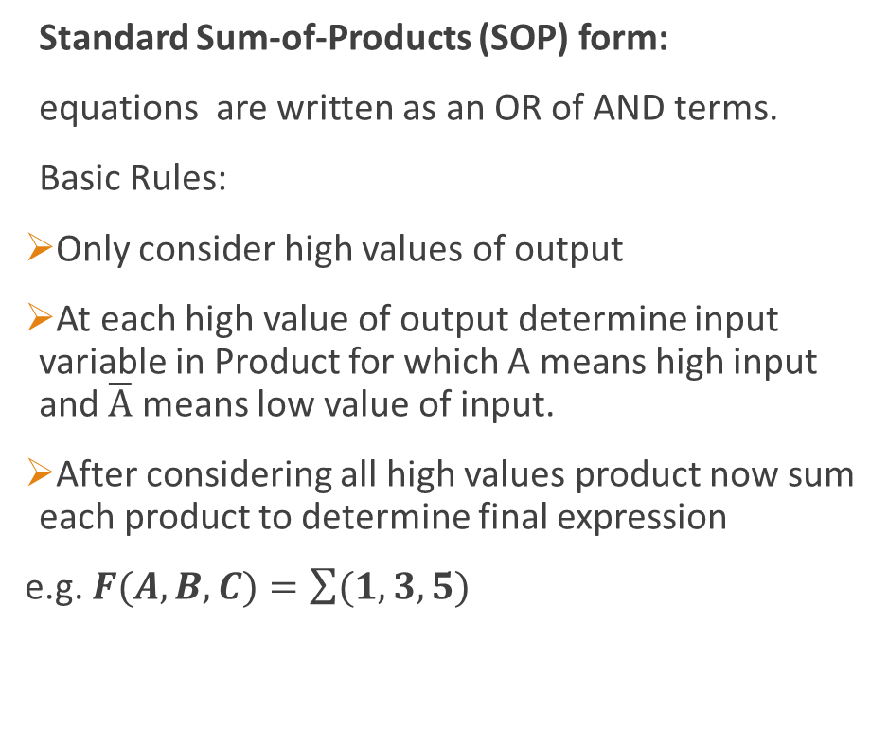
Boolean Standard of Expression
Standard Sum-of-Products (SOP) form:
equations are written as an OR of AND terms.
Basic Rules:
Only consider high values of output
At each high value of output determine input variable in Product for which A means high input and $\overline{A}$ means low value of input.
After considering all high values product now sum each product to determine final expression
e.g. $F(A,B,C)=\sum{(1,3,5)}$

Slide 18
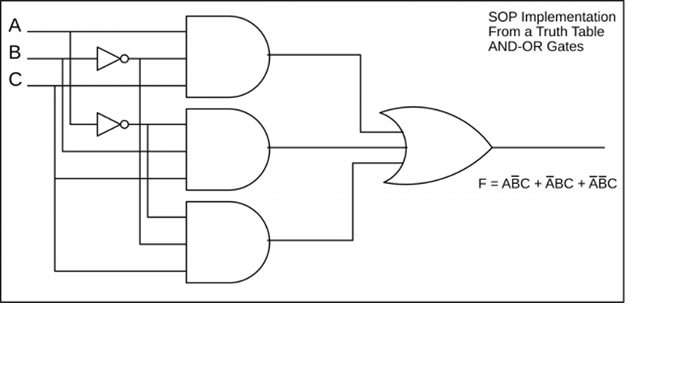
Example Circuit

Slide 19
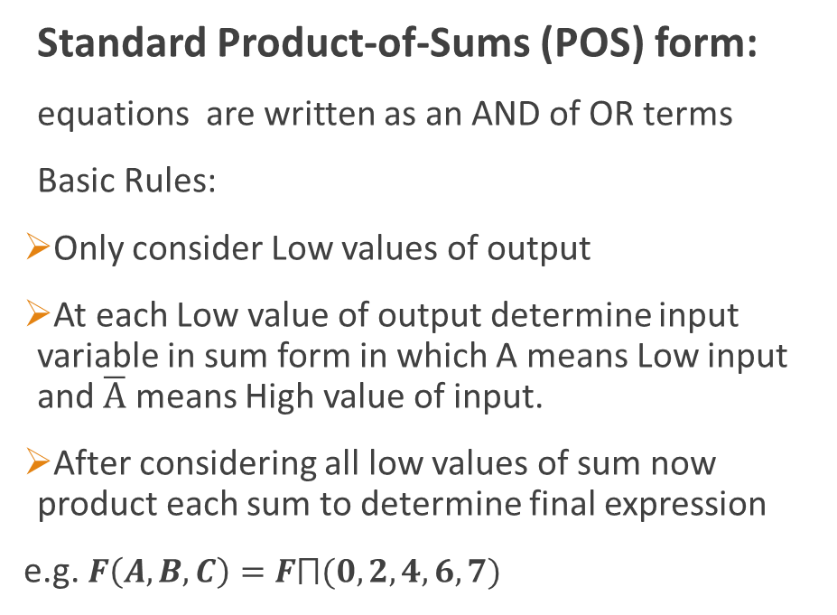
Boolean Standard of Expression
Standard Product-of-Sums (POS) form:
equations are written as an AND of OR terms
Basic Rules:
Only consider Low values of output
At each Low value of output determine input variable in sum form in which A means Low input and $\overline{A}$ means High value of input.
After considering all low values of sum now product each sum to determine final expression
e.g. $F\left(A,B,C\right)=F⨅(0,2,4,6,7)$

Slide 20
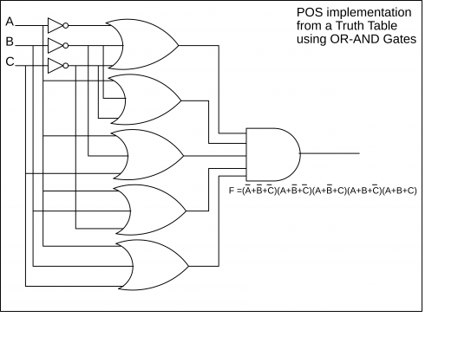
Example Circuit

Slide 21
Basic Designing Rules
Step 1: identify number of inputs and individual input bits
Step 2: draw truth table if total number of inputs bits
Step 3: identify number of outputs and output bits
Step 4: Identify output value on each combination of inputs
Step 5: Now determine Boolean expression of each output bit.
Remaining steps will be discussed later

Slide 22
Next Lecture
Different examples of circuit using SOP and POS
Circuitry costing and decision making.
Boolean Rules and Laws
Minimizing circuitry using those rules and laws

