Slide 1
Lecture # 4 Introduction to Boolean algebra/Types of input/ Logic gates/
By: Muhammad Zain Uddin
email: zuddin@iba.edu.pk

Slide 2

Digital Logic Design
Muhammad Zain Uddin
Lecturer,
IBA

Slide 3
Review of previous lecture
SOP POS equation understanding
Boolean Rules and Laws
Simplification of Boolean equation
Gate Equivalecy
Designing Rules finalizartion

Slide 4
Basic Designing Rules
Step 1: identify number of inputs and individual input bits
Step 2: draw truth table if total number of inputs bits
Step 3: identify number of outputs and output bits
Step 4: Identify output value on each combination of inputs
Step 5: identify whether any output can be solve using single gate or related to single or multiple inputs.
Step 6: Now determine Boolean expression of each output bit.
Step 7 : Simplify this equation using Boolean rules laws or Kmap
Step 8: Draw the circuit diagram of that simplified equation.

Slide 5
Combinational Logic Circuits
An example of an SOP implementation is shown. The SOP expression is an AND-OR combination of the input variables and the appropriate complements.
A
B
ABC
C
X = ABC
+ DE
SOP
D
E
DE

Slide 6
Combinational Logic Circuits
When the output of a SOP form is inverted, the circuit is called an AND-OR-Invert circuit. The AOI configuration lends itself to product-of-sums (POS) implementation.
An example of an AOI implementation is shown. The output expression can be changed to a POS expression by applying DeMorgan’s theorem twice.
A
B
ABC
C
X = ABC
+ DE
X = ABC
+ DE
AOI
D
X = (ABC)(DE)
DeMorgan
E
DE
X = (A + B + C)(D + E)
POS

Slide 7
Implementing Combinational Logic
Implementing a SOP expression is done by first forming the AND terms; then the terms are ORed together.
Show the circuit that will implement the Boolean expression X = ABC + ABD + BDE. (Assume that the variables and their complements are available.)
Start by forming the terms using three 3-input AND gates.
Then combine the three terms using a 3-input OR gate.
A
B
C
A
X = ABC + ABD + BDE
B
D
B
D
E

Slide 8
Solution
continued…
Circuit:
A
C
X =
A
C
+
A
B
A
B
The result is shown as a sum of products.
It is a simple matter to implement this form using only NAND gates as shown in the text and following example.

Slide 9
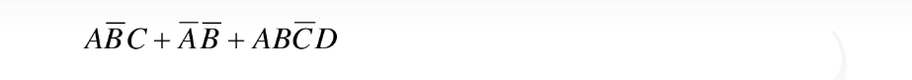
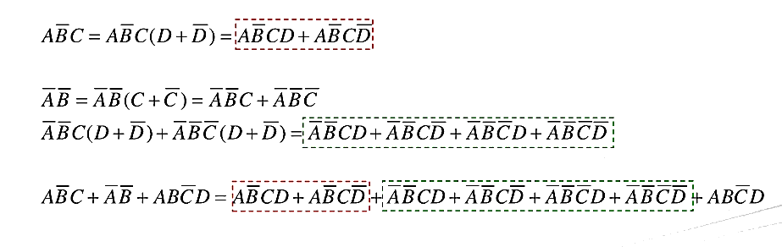
Converting Eq. into Standard SOP

Slide 10
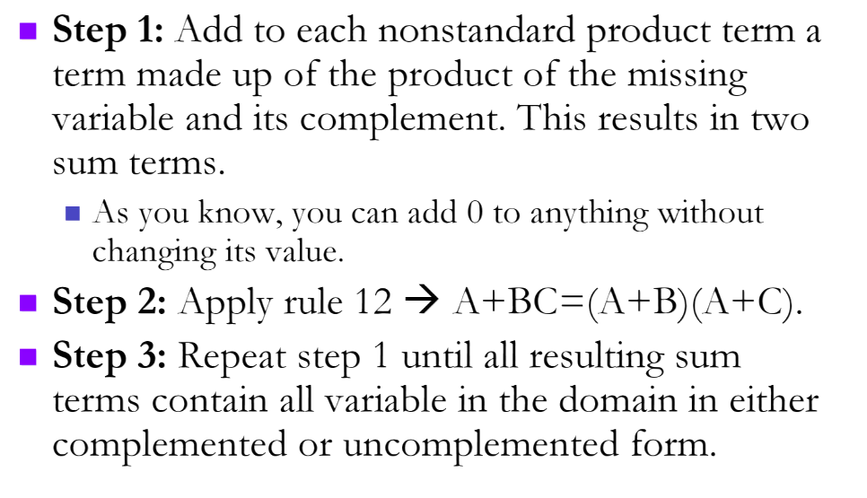
Converting Eq. into Standard POS

Slide 11
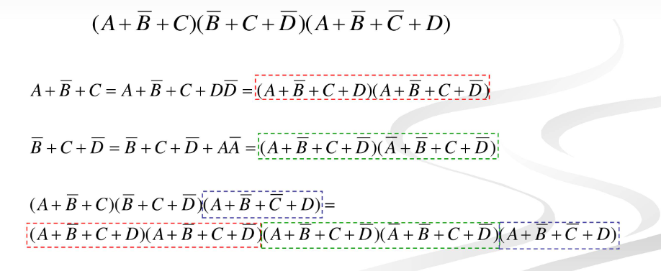
Example

Slide 12
NAND Logic
Convert the circuit in the previous example to one that uses only NAND gates.
Recall from Boolean algebra that double inversion cancels. By adding inverting bubbles to above circuit, it is easily converted to NAND gates:
A
C
X =
A
C
+
A
B
A
B

Slide 13
Universal Gates
NAND gates are sometimes called universal gates because they can be used to produce the other basic Boolean functions.
A
A
A
AB
B
Inverter
AND gate
A
A
A + B
A + B
B
B
OR gate
NOR gate

Slide 14
Universal Gates
NOR gates are also universal gates and can form all of the basic gates.
A
A
A
A + B
B
Inverter
OR gate
A
A
AB
AB
B
B
AND gate
NAND gate

Slide 15
NAND Logic
Recall from DeMorgan’s theorem that AB = A + B. By using equivalent symbols, it is simpler to read the logic of SOP forms. The earlier example shows the idea:
A
C
X =
A
C
+
A
B
A
B
The logic is easy to read if you (mentally) cancel the two connected bubbles on a line.

Slide 16
NOR Logic
Alternatively, DeMorgan’s theorem can be written as A + B = A B. By using equivalent symbols, it is simpler to read the logic of POS forms. For example,
A
B
X =
(A + B)(A + C)
A
C
Again, the logic is easy to read if you cancel the two connected bubbles on a line.

Slide 17
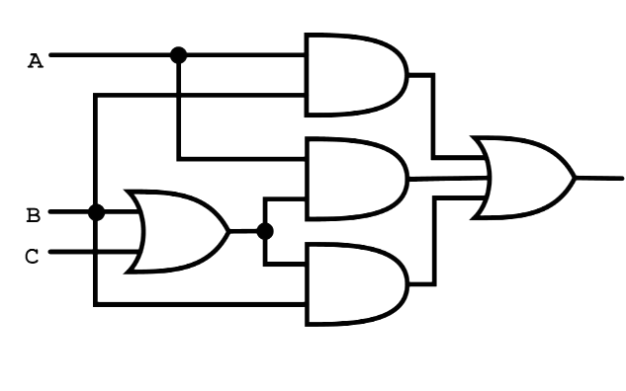
Simplification Examples
AB+A (B+C) +B (B+C)

Slide 18
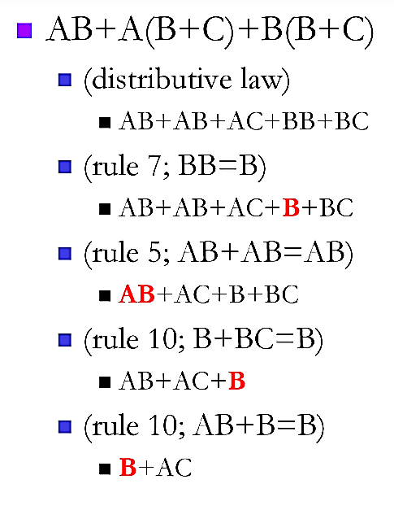
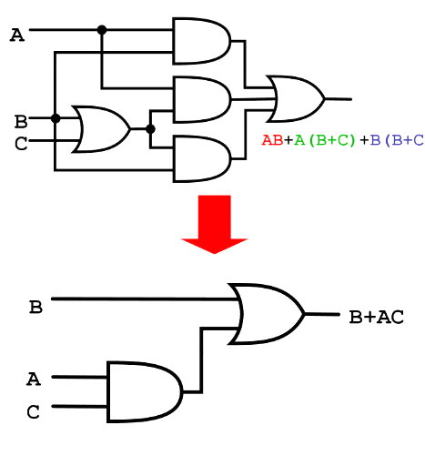
Solution Cont.

Slide 19
Pulsed Waveforms
For combinational circuits with pulsed inputs, the output can be predicted by developing intermediate outputs and combining the result. For example, the circuit shown can be analyzed at the outputs of the OR gates:
A
A
G₁
B
B
G₃
C
C
D
G₂
D
G₁
G₂
G₃

Slide 20
Pulsed Waveforms
Inputs
Output
Alternatively, you can develop the truth table for the circuit and enter 0’s and 1’s on the waveforms. Then read the output from the table.
A B C D
X
0 0 0 0
0
0 0 0 1
1
A
0 0 1 0
1
G₁
0 0 1 1
1
B
0 1 0 0
0
G₃
C
0 1 0 1
1
G₂
0 1 1 0
1
D
0 1 1 1
1
1 0 0 0
0
A
0 1 0 1 0 1 0 1 0 1
1 0 0 1
0
0 1 1 0 0 1 1 0 0 0
1 0 1 0
0
B
1 0 1 1
0
C
0 0 0 1 1 1 1 0 0 0
1 1 0 0
0
1 1 0 1
1
D
0 0 0 0 0 0 0 1 1 0
1 1 1 0
1
G₃
0 0 0 0 1 1 1 0 1 0
1 1 1 1
1

Slide 21
Karnaugh maps
The Karnaugh map (K-map) is a tool for simplifying combinational logic with 3 or 4 variables. For 3 variables, 8 cells are required (2³).
The map shown is for three variables labeled A, B, and C. Each cell represents one possible product term.
Each cell differs from an adjacent cell by only one variable.

Slide 22
Karnaugh maps
Cells are usually labeled using 0’s and 1’s to represent the variable and its complement.
The numbers are entered in gray code, to force adjacent cells to be different by only one variable.
Gray code
Ones are read as the true variable and zeros are read as the complemented variable.

Slide 23
Karnaugh maps
Alternatively, cells can be labeled with the variable letters. This makes it simple to read, but it takes more time preparing the map.
C C
Read the terms for the yellow cells.
AB
AB
AB
AB
The cells are ABC and ABC.

Slide 24
Karnaugh Map Implementation
For basic combinational logic circuits, the Karnaugh map can be read and the circuit drawn as a minimum SOP.
A Karnaugh map is drawn from a truth table. Read the minimum SOP expression and draw the circuit.
1. Group the 1’s into two overlapping groups as indicated.
Read each group by eliminating any variable that changes across a boundary.
B changes across this boundary
The vertical group is read A C.
C changes across this boundary
The horizontal group is read AB.
X = A C +AB

Slide 25
Karnaugh maps
A 4-variable map has an adjacent cell on each of its four boundaries as shown.
Each cell is different only by one variable from an adjacent cell.
Grouping follows the rules given in the text.
The following slide shows an example of reading a four variable map using binary numbers for the variables…

Slide 26
Karnaugh maps
Group the 1’s on the map and read the minimum logic.
C changes across outer boundary
1. Group the 1’s into two separate groups as indicated.
Read each group by eliminating any variable that changes across a boundary.
B changes
B changes
The upper (yellow) group is read as AD.
The lower (green) group is read as AD.
C changes
X
X = A D +AD

