Slide 1
Lecture # 5 K-Map 5 inputs/Function of Boolean algebra/Encoder-Decoder/ Arithmetic of Boolean algebra
By: Muhammad Zain Uddin
email: zuddin@iba.edu.pk

Slide 2

Digital Logic Design
Muhammad Zain Uddin
Lecturer,
IBA

Slide 3
Review of previous lecture
Boolean rules Simplification
Designing Rules finalization
K-Maps Rules
K-Map Simplification
3,4 inputs K-map example

Slide 4
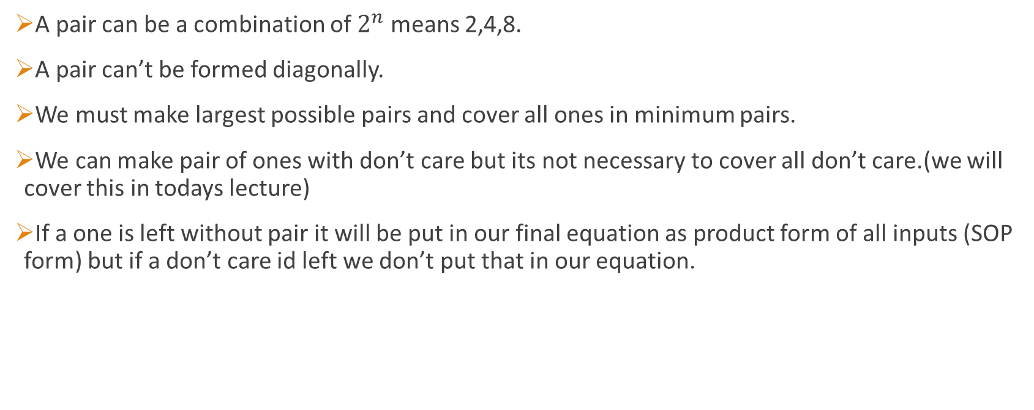
Basic Rules of K-Map
A pair can be a combination of $2^{n}$ means 2,4,8.
A pair can’t be formed diagonally.
We must make largest possible pairs and cover all ones in minimum pairs.
We can make pair of ones with don’t care but its not necessary to cover all don’t care.(we will cover this in todays lecture)
If a one is left without pair it will be put in our final equation as product form of all inputs (SOP form) but if a don’t care id left we don’t put that in our equation.

Slide 5
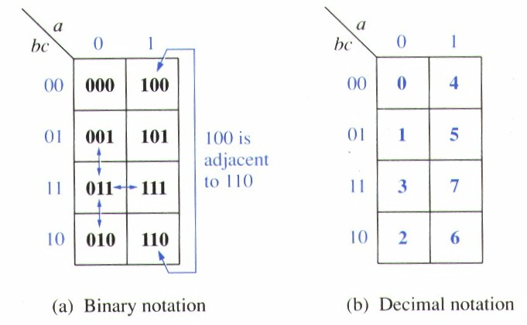
3-variable k Map
Adjacent terms in 3-variable K map.

Slide 6
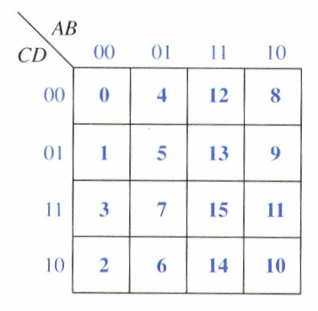
4-Variable K Map
0, 8 are adjacent squares
0, 2 are adjacent squares, etc.
1, 4, 13, 7 are adjacent to 5.
0,8,2,10 are adjacent

Slide 7
Three-Variable K-Maps

Slide 8
Four-Variable K-Maps

Slide 9
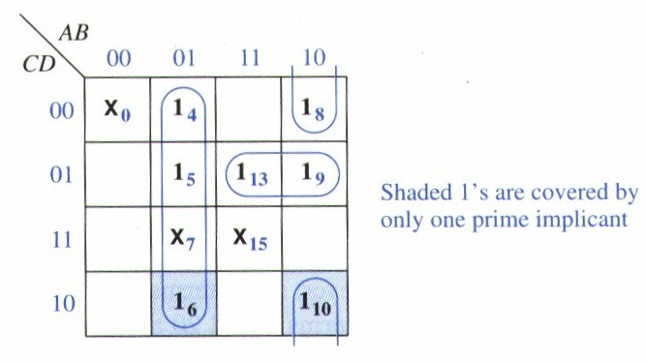
Example of Don’t care
Find the 1 that is covered by only one term first (Do not share with other circle).

Slide 10
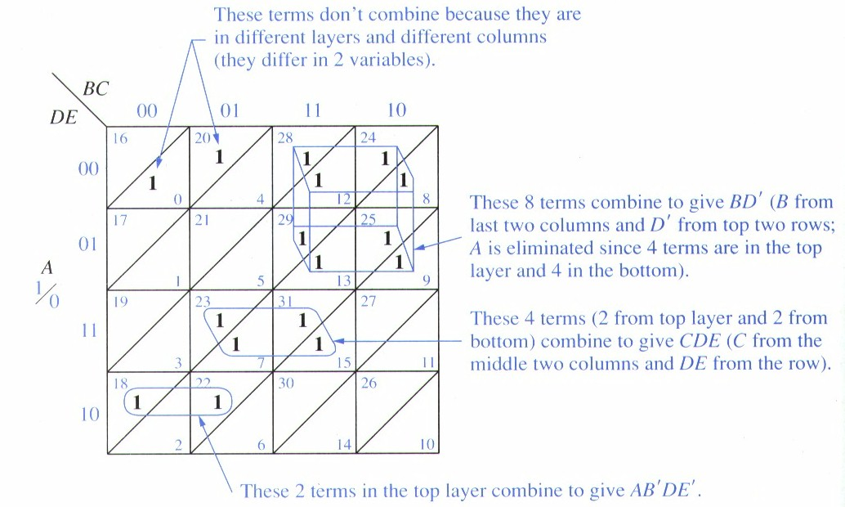
5-Variable K Map
Use two 4-variable map to form a 5-variable K map (16 + 16 = 32) (A,B,C,D,E)
A’ in the bottom layer
A in the top layer.

Slide 11
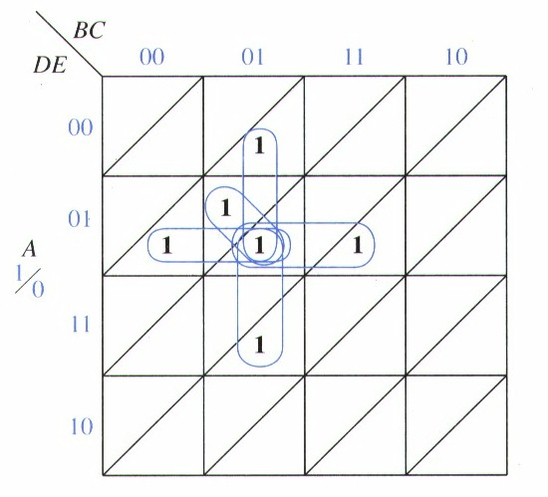
5 Neighbors
Same plane and above or under

Slide 12
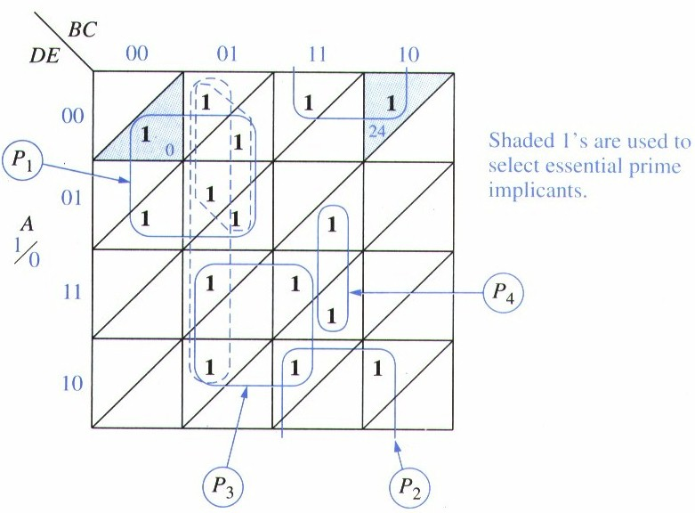
Example: 5-variables
Ans: F = A’B’D’ + ABE’ + ACD + A’BCE + {AB’C or B’CD’}
P1 + P2 + P3 + P4 + AB’C or B’CD’

Slide 13
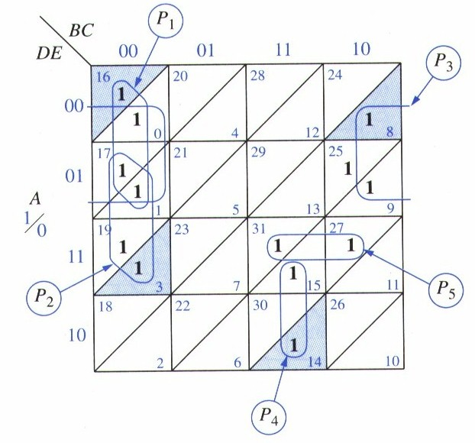
One More Excample
F = B’C’D’ + B’C’E + A’C’D’ + A’BCD + ABDE + {C’D’E or AC’E}
(17,19,25,27 =AC’E), (1,9,17,25 = C’D’E)

Slide 14
Decoders
A decoder is a logic circuit that detects the presence of a specific combination of bits at its input. Two simple decoders that detect the presence of the binary code 0011 are shown. The first has an active HIGH output; the second has an active LOW output.
A₀
A₀
A₁
X
A₁
X
A₂
A₂
A₃
A₃
Active HIGH decoder for 0011
Active LOW decoder for 0011

Slide 15
Decoders
IC decoders have multiple outputs to decode any combination of inputs. For example the binary-to-decimal decoder shown here has 16 outputs – one for each combination of binary inputs.
Question
For the input shown, what is the output?

Slide 16
Decoders
X/Y
A specific integrated circuit decoder is the 74HC154 (shown as a 4-to-16 decoder). It includes two active LOW chip select lines which must be at the active level to enable the outputs. These lines can be used to expand the decoder to larger inputs.
A₀
A₁
A₂
A₃
CS₁
CS₂
EN
74HC154

Slide 17
Decoders
BCD-to-decimal decoders accept a binary coded decimal input and activate one of ten possible decimal digit indications.
A₀
A₁
A₂
A₃
Example
Assume the inputs to the 74HC42 decoder are the sequence 0101, 0110, 0011, and 0010. Describe the output.
Solution
All lines are HIGH except for one active output, which is LOW. The active outputs are 5, 6, 3, and 2 in that order.

Slide 18
BCD Decoder/Driver
Another useful decoder is the 74LS47. This is a BCD-to-seven segment display with active LOW outputs.
V_{CC}
The a-g outputs are designed for much higher current than most devices (hence the word driver in the name).
BCD/7-seg
BI/RBO
BI/RBO
BCD inputs
Outputs to seven segment device
LT
LT
RBI
RBI
74LS47
GND

Slide 19
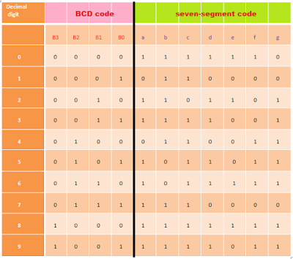
Truth table
This decoder is built for common cathode Seven-segment as you can see we take one as high led and zero as low.

Slide 20
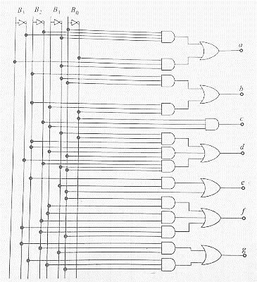
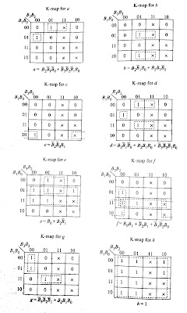

Slide 21
BCD Decoder/Driver
Here the 7447A is an connected to an LED seven segment display. Notice the current limiting resistors, required to prevent overdriving the LED display.

Slide 22
Encoders
An encoder accepts an active logic level on one of its inputs and converts it to a coded output, such as BCD or binary.
The decimal to BCD is an encoder with an input for each of the ten decimal digits and four outputs that represent the BCD code for the active digit. The basic logic diagram is shown. There is no zero input because the outputs are all LOW when the input is zero.
1
A₀
2
3
A₁
4
5
A₂
6
7
8
A₃
9

Slide 23
Encoders
Example
Show how the decimal-to-BCD encoder converts the decimal number 3 into a BCD 0011.
Solution
The top two OR gates have ones as indicated with the red lines. Thus the output is 0111.
1
0
1
A₀
2
0
1
3
1
A₁
4
0
5
0
0
A₂
6
0
0
7
8
0
0
0
A₃
9

Slide 24
Encoders
The 74HC147 is an example of an IC encoder. It is has ten active-LOW inputs and converts the active input to an active-LOW BCD output.
V_{CC}
This device is offers additional flexibility in that it is a priority encoder. This means that if more than one input is active, the one with the highest order decimal digit will be active.
HPRI/BCD
Decimal input
BCD output
74HC147
The next slide shows an application …
GND

Slide 25
Half-Adder
Basic rules of binary addition are performed by a half adder, which has two binary inputs (A and B) and two binary outputs (Carry out and Sum).
The inputs and outputs can be summarized on a truth table.
The logic symbol and equivalent circuit are:
Σ
Σ
A
Σ
A
C_{out}
B
C_{out}
B

