Slide 1
Lecture # 6 Arithmetic of Boolean algebra/Half adder/Full Adder/Parallel Adder/Comparator
By: Muhammad Zain Uddin
email: zuddin@iba.edu.pk

Slide 2

Digital Logic Design
Muhammad Zain Uddin
Lecturer,
IBA

Slide 3
Review of previous lecture
5 inputs K-map
3,4 and 5 inputs K map examples
Function of Boolean Algebra
Decoder Designing (Binary to Deimal, BCD to Decimal etc)
Encoder Designing (Decimal to binary, Decimal to BCD etc)

Slide 4
Full-Adder
By contrast, a full adder has three binary inputs (A, B, and Carry in) and two binary outputs (Carry out and Sum). The truth table summarizes the operation.
A full-adder can be constructed from two half adders as shown:
Σ
Σ
Σ
Σ
A
A
A
Sum
Σ
B
B
C_{out}
B
C_{out}
A
Σ
B
C_{in}
C_{out}
C_{in}
C_{out}
Symbol

Slide 5
Full-Adder
Σ
Σ
1
Σ
Σ
0
Sum
1
A
A
Example
B
0
1
0
C_{out}
B
C_{out}
For the given inputs, determine the intermediate and final outputs of the full adder.
1
C_{out}
1
Solution
The first half-adder has inputs of 1 and 0; therefore, the Sum =1 and the Carry out = 0.
The second half-adder has inputs of 1 and 1; therefore, the Sum = 0 and the Carry out = 1.
The OR gate has inputs of 1 and 0, therefore the final carry out = 1.

Slide 6
Full-Adder
Notice that the result from the previous example can be read directly on the truth table for a full adder.
Σ
Σ
1
Σ
Σ
0
Sum
1
A
A
B
0
1
0
C_{out}
B
C_{out}
1
C_{out}
1

Slide 7
Parallel Adders
Full adders are combined into parallel adders that can add binary numbers with multiple bits. A 4-bit adder is shown.
A₄ B₄
A₃ B₃
A₂ B₂
A₁ B₁
C₀
A
B
C_{in}
A
B
C_{in}
A
B
C_{in}
A
B
C_{in}
C_{out}
Σ
C_{out}
Σ
C_{out}
Σ
C_{out}
Σ
C₄
C₃
C₂
C₁
Σ₄
Σ₃
Σ₂
Σ₁
The output carry (C₄) is not ready until it propagates through all of the full adders. This is called ripple carry, delaying the addition process.

Slide 8
Parallel Adders
The logic symbol for a 4-bit parallel adder is shown. This 4-bit adder includes a carry in (labeled (C₀) and a Carry out (labeled C₄).
Σ
1
2
3
4
1
2
3
4
Binary number A
4-bit sum
1
2
3
4
Binary number B
Input carry
C₀
C₄
Output carry
The 74LS283 is an example. It features look-ahead carry, which adds logic to minimize the output carry delay. For the 74LS283, the maximum delay to the output carry is 17 ns.

Slide 9
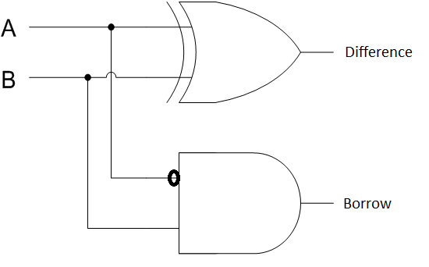
Half- Subtractor Function Table
Input |  | Output
A | B | Diff | Bor
0 | 0 | 0 | 0
0 | 1 | 1 | 1
1 | 0 | 1 | 0
1 | 1 | 0 | 0

Slide 10
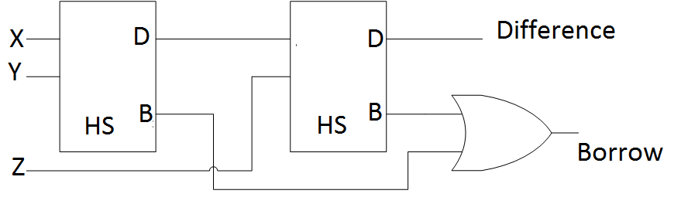

Full-Subtractor Function Table
Input |  |  | Output
A | B | C | Diff | Bor
0 | 0 | 0 | 0 | 0
0 | 0 | 1 | 1 | 1
0 | 1 | 0 | 1 | 1
0 | 1 | 1 | 0 | 1
1 | 0 | 0 | 1 | 0
1 | 0 | 1 | 0 | 0
1 | 1 | 0 | 0 | 0
1 | 1 | 1 | 1 | 1
A’B’
A’B
AB
A’B
C’
1
C
1
1
1

Slide 11
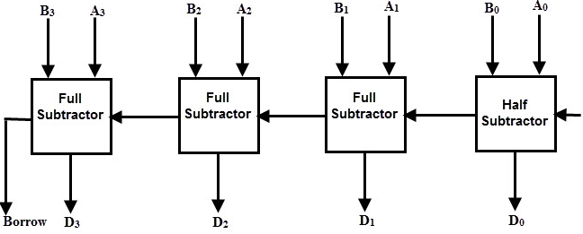
4-bit Parallel Subtractor

Slide 12
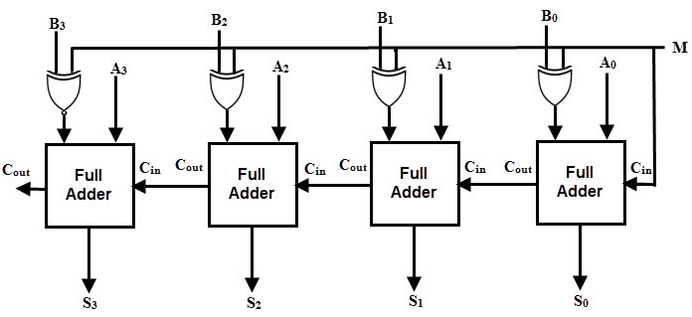
Binary Adder and Subtractor
A complete logical circuit capable of adding or subtracting two numbers by using 2’s complement is shown in Figure below

Slide 13
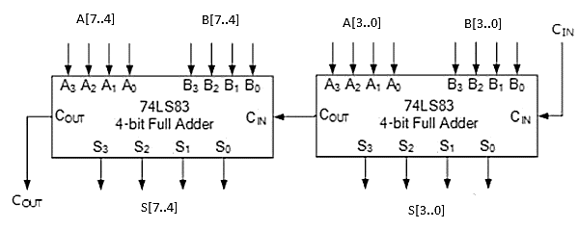
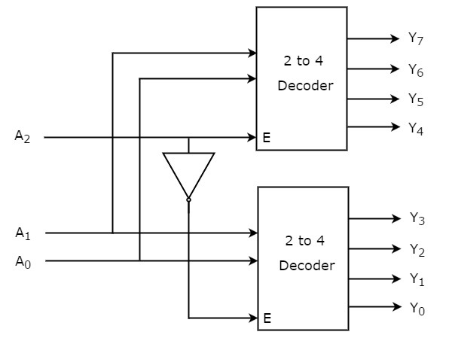
Integration of multiple fuction

Slide 14
Adding Multiple inputs of multiple bits
In Situation like this when you know you can’t design using single function so analyze how many and which type of adder function you need ? You have following function
Half adder(can add two inputs of one bit each and produce an output of two bits)
Full Adder(can add three inputs of one bit each and produce an output of two bits)
Parallel adder (can add two inputs of four bits each and produce an output of five bits)
Now if you are adding more than two inputs having multiple bits it is suggested to use parallel adder as parallel adder can add multiple bits two inputs easily
But if you are adding single bit input you can use half and full adder with parallel adder easily

Slide 15
Comparators
The function of a comparator is to compare the magnitudes of two binary numbers to determine the relationship between them. In the simplest form, a comparator can test for equality using XNOR gates.
Example
How could you test two 4-bit numbers for equality?
Solution
AND the outputs of four XNOR gates.
A₁
B₁
A₂
B₂
Output
A₃
B₃
A₄
B₄

Slide 16
Comparators
IC comparators provide outputs to indicate which of the numbers is larger or if they are equal. The bits are numbered starting at 0, rather than 1 as in the case of adders. Cascading inputs are provided to expand the comparator to larger numbers.
COMP
A₀
0
A₁
A
A₂
A₃
3
Cascading inputs
A > B
A > B
A = B
A = B
Outputs
A < B
A < B
B₀
0
B₁
A
The IC shown is the 4-bit 74LS85.
B₂
B₃
3

Slide 17
Comparators
IC comparators can be expanded using the cascading inputs as shown. The lowest order comparator has a HIGH on the A = B input.
LSBs
MSBs
A₀
COMP
A₄
COMP
A₁
0
A₅
0
A₂
A
A₆
A
A₃
A₇
3
3
A > B
A > B
A > B
A > B
+5.0 V
A = B
A = B
A = B
A = B
Outputs
B₀
A < B
A < B
B₄
A < B
A < B
0
0
B₁
A
B₅
A
B₂
B₆
B₃
3
B₇
3

