Slide 1
Lecture # 7 Comparator/Mux-Demux/Designing through mux/Integration of Functions
By: Muhammad Zain Uddin
email: zuddin@iba.edu.pk

Slide 2

Digital Logic Design
Muhammad Zain Uddin
Lecturer,
IBA

Slide 3
Review of previous lecture
Cascading of functions
Adder (Half, Full, Parallel)
Athematic using adder function
Subtractor (Half Full)
Adder Subtractor
Comparator (Con.t)

Slide 4
Comparators
The function of a comparator is to compare the magnitudes of two binary numbers to determine the relationship between them. In the simplest form, a comparator can test for equality using XNOR gates.
Example
How could you test two 4-bit numbers for equality?
Solution
AND the outputs of four XNOR gates.
A₁
B₁
A₂
B₂
Output
A₃
B₃
A₄
B₄

Slide 5
Comparators
IC comparators provide outputs to indicate which of the numbers is larger or if they are equal. The bits are numbered starting at 0, rather than 1 as in the case of adders. Cascading inputs are provided to expand the comparator to larger numbers.
COMP
A₀
0
A₁
A
A₂
A₃
3
Cascading inputs
A > B
A > B
A = B
A = B
Outputs
A < B
A < B
B₀
0
B₁
A
The IC shown is the 4-bit 74LS85.
B₂
B₃
3

Slide 6
Comparators
IC comparators can be expanded using the cascading inputs as shown. The lowest order comparator has a HIGH on the A = B input.
LSBs
MSBs
A₀
COMP
A₄
COMP
A₁
0
A₅
0
A₂
A
A₆
A
A₃
A₇
3
3
A > B
A > B
A > B
A > B
+5.0 V
A = B
A = B
A = B
A = B
Outputs
B₀
A < B
A < B
B₄
A < B
A < B
0
0
B₁
A
B₅
A
B₂
B₆
B₃
3
B₇
3

Slide 7
Multiplexer (Data Selectors)
The term Multiplexer means many into one.
Multiplexing is the process of transmitting a large number of information over a single line.
A Digital Multiplexer (MUX) is a combinational Circuit that select one digital information from several sources and transmits the selected information on a single output line.
A Multiplexer is also called a Data Selector.
The Multiplexer has several data input line and a single output line.

Slide 8
Mux (Con.t)
MUX directs one of the inputs to its output line by using a control bit word (selection line) to its select lines.
Multiplexer contains the followings:
data inputs
selection inputs
a single output
Selection input determines the input that should be connected to the output.
The multiplexer acts like an electronic switch that selects one from different.

Slide 9
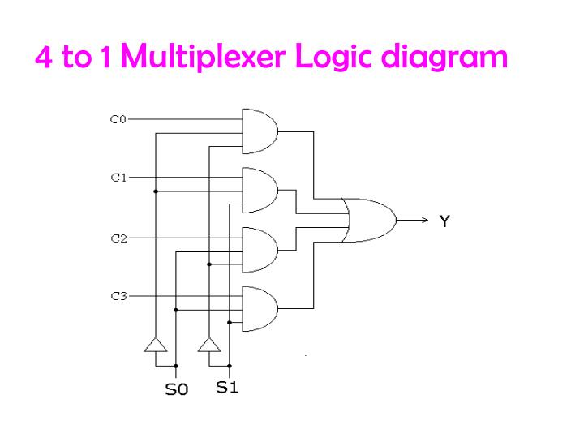

Slide 10
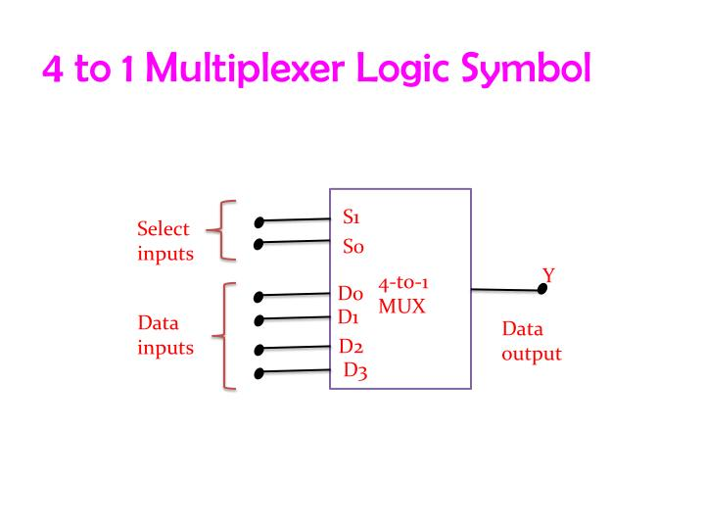

Slide 11
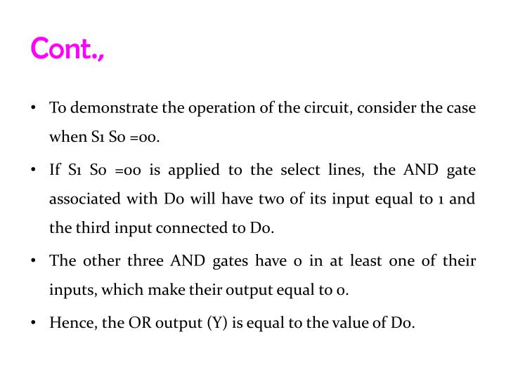

Slide 12
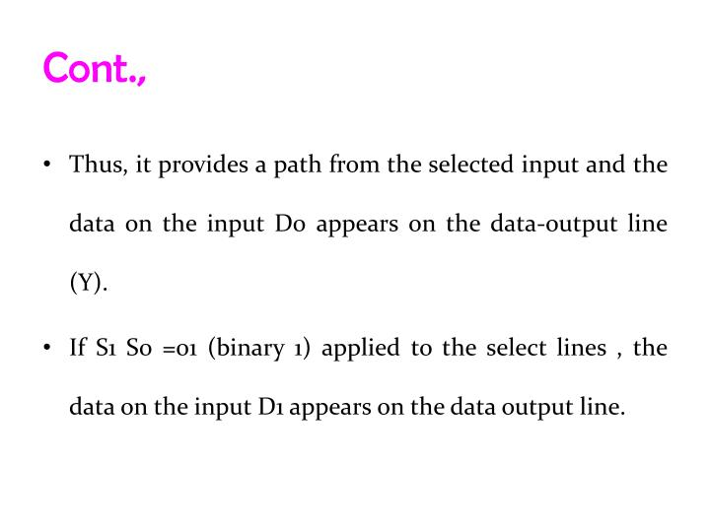

Slide 13
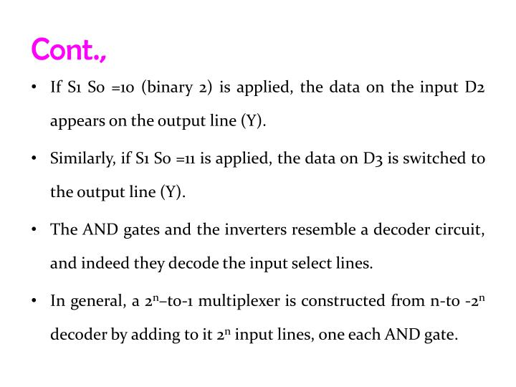

Slide 14
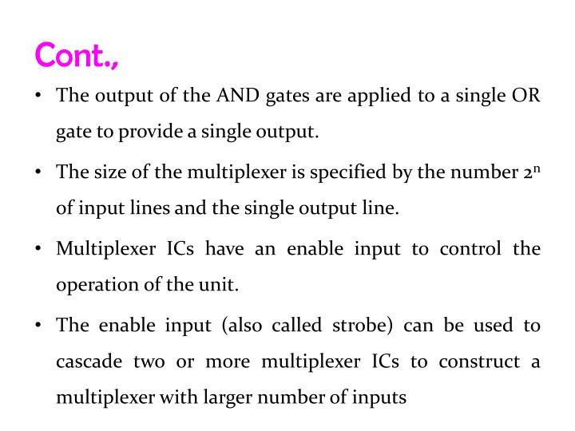

Slide 15
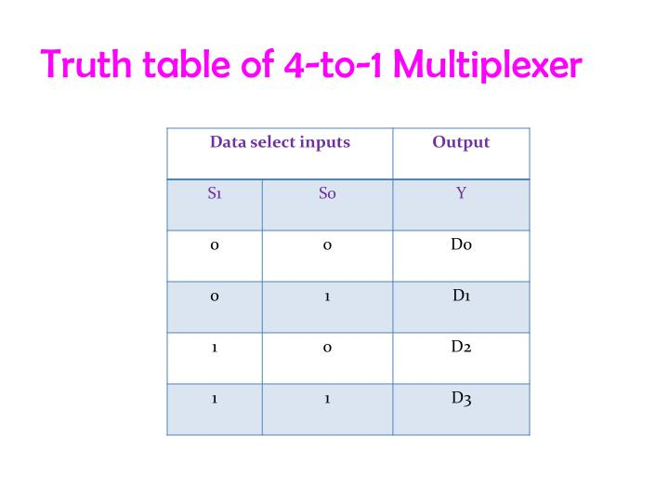

Slide 16
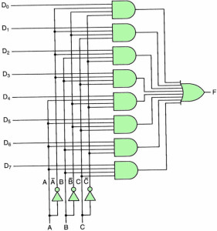
8-1 Multiplexer Circuit

Slide 17
De-Multiplexer
The De-Multiplexer is a combinational logic circuit that performs the reverse operation of multiplexer (Several output lines, one input line).
De -Multiplexer means one to many. A De-Multiplexer is a circuit with one input and many output. By applying control signal, we can steer any input to the output. Few types of De -Multiplexer are 1-to 2, 1-to-4, 1-to-8 and 1-to 16 De -Multiplexer .
De-Multiplexer is the process of taking information from one input and transmitting the same over one of several outputs.

Slide 18
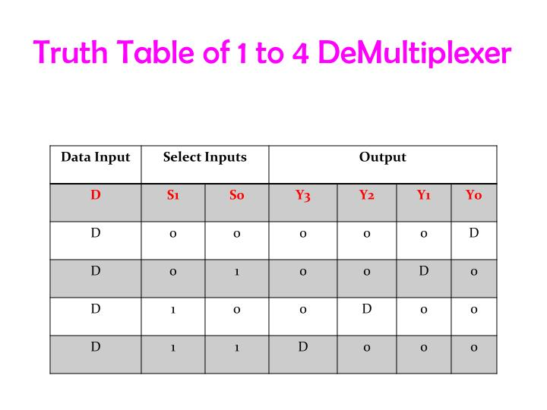

Slide 19
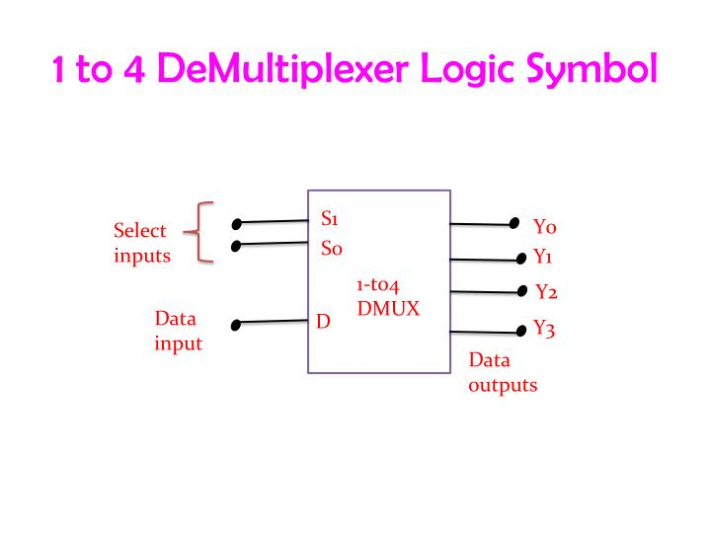

Slide 20
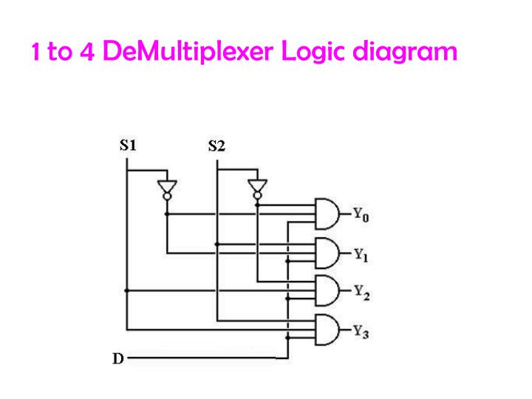

Slide 21
Switching-network logic blocks
Multiplexer (MUX)
Routes one of many inputs to a single output
Also called a selector
Demultiplexer (DEMUX)
Routes a single input to one of many outputs
Also called a decoder
multiplexer
demultiplexer
We construct these
devices from:
logic gates
networks of tran-
sistor switches
control
control

Slide 22
The “WHY” slide
Multiplexers/Demultiplexers
If you had the ability to select which input to operate, the same part of a circuit can be used multiple times. So if you have a lot of inputs and all of them are supposed to go through same complex logic functions, you can save a lot of space on your circuit board by using a multiplexer.
Then you will also need a demultiplexer to decode the output coming out in serial into separate output ports.

Slide 23
“WHY”: Sharing complex logic functions
Share an adder: Select inputs; route sum
A₀ A₁
B₀ B₁
S_{a}
MUX
MUX
S_{b}
multiple inputs
A
B
single adder
Sum
S_{s}
DEMUX
multiple output destinations
Z₀ Z₁

Slide 24
Multiplexers (con't)
2:1 mux: Z = S'In₀ + SIn₁
4:1 mux: Z = S₀'S₁'In₀ + S₀'S₁In₁ + S₀S₁'In₂ + S₀S₁In₃
8:1 mux: Z = S₀'S₁'S₂'In₀ + S₀'S₁S₂In₁ + ...
I₀ I₁
2:1 mux
I₀ I₁ I₂ I₃
I₀ I₁ I₂ I₃ I₄ I₅ I₆ I₇
Z
4:1 mux
Z
S₀
8:1 mux
Z
S₀ S₁
S₀ S₁ S₂

Slide 25
Cascading multiplexers
Can form large multiplexers from smaller ones
Many implementation options
8:1 mux
8:1 mux
I₀ I₁ I₂ I₃
I₀ I₁
2:1 mux
4:1 mux
2:1 mux
I₂ I₃
2:1 mux
Z
4:1 mux
I₄ I₅ I₆ I₇
Z
4:1 mux
I₄ I₅
2:1 mux
I₆ I₇
2:1 mux
S₀ S₁
S₂
S₀
S₁ S₂

Slide 26
Multiplexers as general-purpose logic
A 2^{n}:1 mux can implement any function of n variables
A lookup table
A 2^{n – 1}:1 mux also can implement any function of n variables
Example: F(A,B,C) = m0 + m2 + m6 + m7 = A'B'C' + A'BC' + ABC' + ABC = A'B'(C') + A'B(C') + AB()
A B C F 0 0 0 1 0 0 1 0 0 1 0 1 0 1 1 0 1 0 0 0 1 0 1 0 1 1 0 1 1 1 1 1
1 0 1 0 0 0 1 1
0 1 2 3 4 5 6 7
C' C' 0 1
F
C' C' 0 1
0 1 2 3
F
8:1 MUX
4:1 MUX
S1
S0
S2
S1
S0
A B
A B C

Slide 27
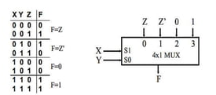
Multiplexers as general-purpose logic

Slide 28
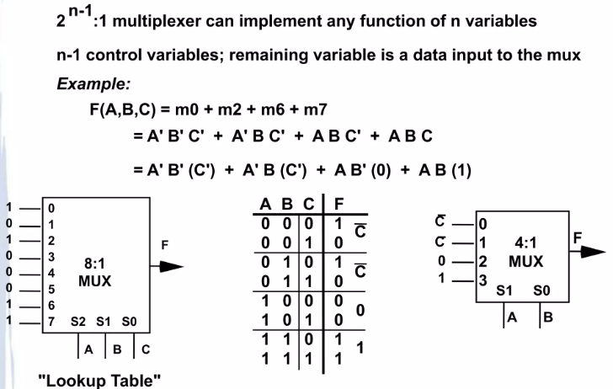
Multiplexers as general-purpose logic

Slide 29
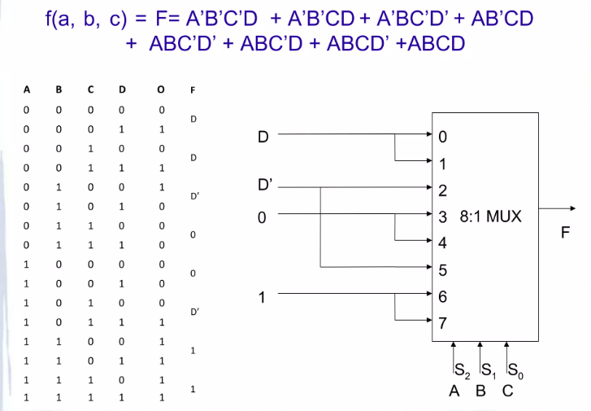
Multiplexers as general-purpose logic

