Slide 1
Lecture # 8 Introduction to Sequential Circuits/Synchronous versus Asynchronous/Latches/Flip-Flops/Characteristic Tables and Equations
By: Muhammad Zain Uddin
email: zuddin@iba.edu.pk

Slide 2

Digital Logic Design
Muhammad Zain Uddin
Lecturer,
IBA

Slide 3
Combinational versus Sequential
Two classes of digital circuits
Combinational Circuits
Sequential Circuits
Combinational Circuit
Outputs = F(Inputs)
Function of Inputs only
NO internal memory
Sequential Circuit
Outputs is a function of Inputs and internal Memory
There is an internal memory that stores the state of the circuit
Time is very important: memory changes with time
Combinational
Circuit
Inputs
Outputs

Slide 4
Introduction to Sequential Circuits
A Sequential circuit consists of:
Memory elements:
Latches or Flip-Flops
Store the Present State
Combinational Logic
Computes the Outputs of the circuit
Outputs depend on Inputs and Current State
Computes the Next State of the circuit
Next State also depends on the Inputs and the Present State
Inputs
Combinational
Logic
Outputs
Present
State
Next
State
Memory
Elements

Slide 5
Two Types of Sequential Circuits
Synchronous Sequential Circuit
Uses a clock signal as an additional input
Changes in the memory elements are controlled by the clock
Changes happen at discrete instances of time
Asynchronous Sequential Circuit
No clock signal
Changes in the memory elements can happen at any instance of time
Our focus will be on Synchronous Sequential Circuits
Easier to design and analyze than asynchronous sequential circuits

Slide 6
Synchronous Sequential Circuits
Inputs
Combinational
Logic
Outputs
Present
State
Next
State
Memory
Elements
Clock
Synchronous sequential circuits use a clock signal
The clock signal is an input to the memory elements
The clock determines when the memory should be updated
The present state = output value of memory (stored)
The next state = input value to memory (not stored yet)

Slide 7
The Clock
Positive
Pulse/ Level
Negative
Pulse/ Level
Clock cycle
Clock cycle
Time
Clock is a periodic signal = Train of pulses (1's and 0's)
The same clock cycle repeats indefinitely over time
Positive Pulse: when the level of the clock is 1
Negative Pulse: when the level of the clock is 0
Rising Edge: when the clock goes from 0 to 1
Falling Edge: when the clock goes from 1 down to 0

Slide 8
Memory Elements
Memory can store and maintain binary state (0's or 1's)
Until directed by an input signal to change state
Main difference between memory elements
Number of inputs they have
How the inputs affect the binary state
Two main types:
Latches are level-sensitive (the level of the clock)
Flip-Flops are edge-sensitive (sensitive to the edge of the clock)
Flip-Flips are used in synchronous sequential circuits
Flip-Flops are built with latches

Slide 9
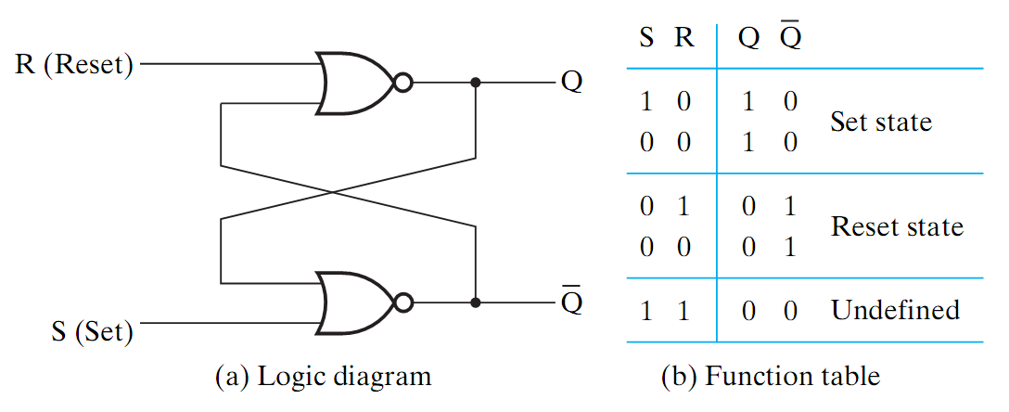
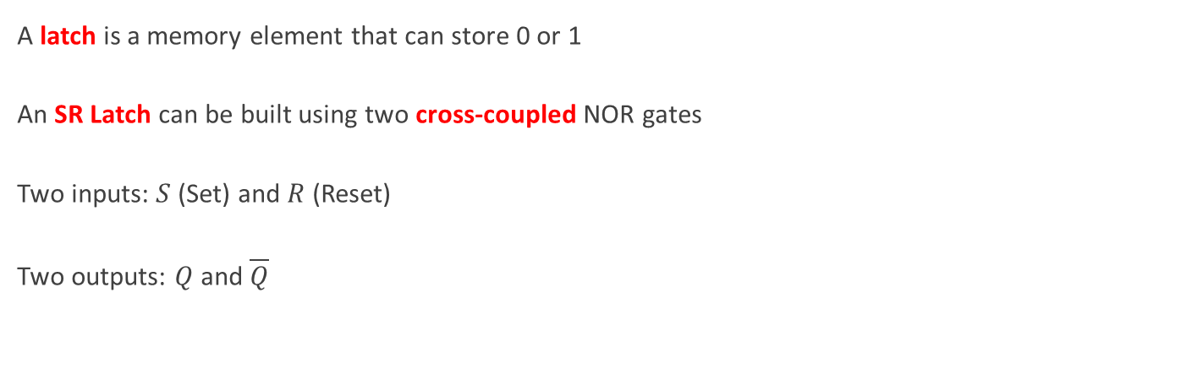
SR Latch
A latch is a memory element that can store 0 or 1
An SR Latch can be built using two cross-coupled NOR gates
Two inputs: $S$ (Set) and $R$ (Reset)
Two outputs: $Q$ and $\overline{Q}$

Slide 10
SR Latch Operation
Set Operation
Store Operation
0
R (Reset)
0
1
R (Reset)
1
Q
Q
0
0
Q
1
Q
S (Set)
0
S (Set)
Reset Operation
Store Operation
1
R (Reset)
0
0
R (Reset)
0
Q
Q
1
1
Q
0
Q
S (Set)
0
S (Set)

Slide 11
SR Latch Invalid Operation
Invalid Operation
Race Condition
R (Reset)
1
0
R (Reset)
1→0
0→1
Q
Q
0
Q
1→0
Q
S (Set)
1
S (Set)
0→1
S = R = 1 should never be used
If S and R change from 1 → 0 simultaneously then race condition (oscillation) occurs
Final Q and Q are unknown
Unknown State
R (Reset)
0
0 or 1
Q
S (Set)
0
Q
1 or 0

Slide 12
Timing Diagram of an SR Latch
Set
No change
Reset
No change
Set
Undefined
Reset
No change
Set
S
1
0
0
0
1
1
0
0
0
1
R
0
0
1
0
0
1
0
1
0
0
Q
1
1
0
0
1
0
0
0
1
Q
0
0
1
1
0
0
1
1
0
Time

Slide 13
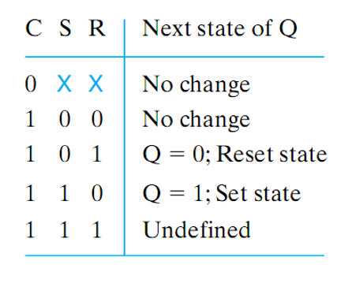
Gated SR Latch with Clock Enable
R (Reset)
CR
Q
C (Clock)
CS
Q
S (Set)
An additional Clock (enable) input signal C is used
Clock controls when the state of the latch can be changed
When C=0, the S and R inputs have no effect on the latch
The latch will remain in the same state, regardless of S and R
When C=1, then normal SR latch operation

Slide 14
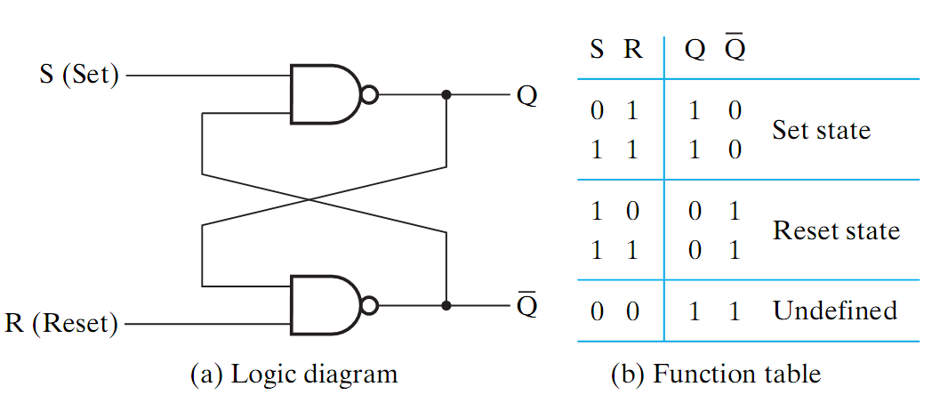
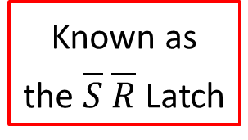
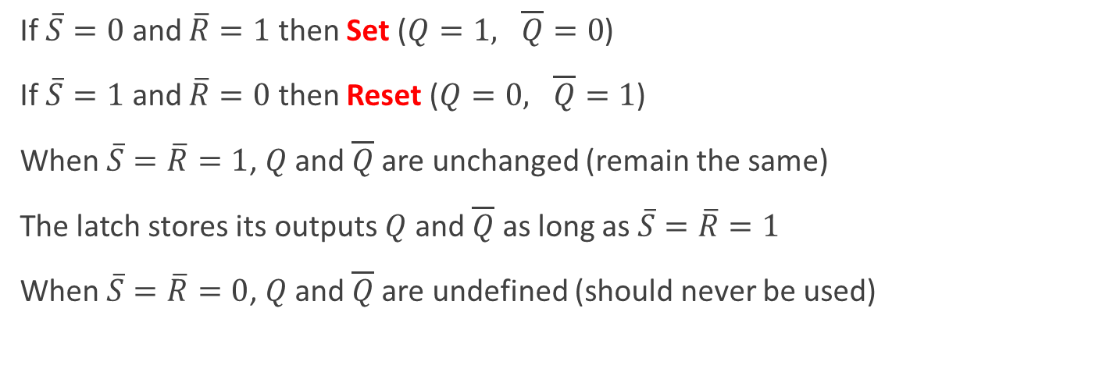
S R Latch with NAND Gates
Known as
the $\overline{S} \overline{R}$ Latch
If $\overline{S}=0$ and $\overline{R}=1$ then Set ($Q=1, \overline{Q}=0$)
If $\overline{S}=1$ and $\overline{R}=0$ then Reset ($Q=0, \overline{Q}=1$)
When $\overline{S}=\overline{R}=1$, $Q$ and $\overline{Q}$are unchanged (remain the same)
The latch stores its outputs $Q$ and $\overline{Q}$ as long as $\overline{S}=\overline{R}=1$
When $\overline{S}=\overline{R}=0$, $Q$ and $\overline{Q}$are undefined (should never be used)

Slide 15
S R Latch Operation
Set Operation
Store Operation
S (Set)
0
1
S (Set)
1
1
Q
Q
0
Q
0
Q
R (Reset)
1
R (Reset)
1
Reset Operation
Store Operation
S (Set)
1
0
S (Set)
1
0
Q
Q
1
Q
1
Q
R (Reset)
0
R (Reset)
1

Slide 16
S R Latch Invalid Operation
Invalid Operation
Race Condition
S (Set)
0
1
S (Set)
0→1
1→0
Q
Q
1
Q
Q
R (Reset)
0
R (Reset)
0→1
1→0
S = R = 0 should never be used
If S and R change from 0 → 1 simultaneously then race condition (oscillation) occurs
Final Q and Q are unknown
Unknown State
S (Set)
1
0 or 1
Q
R (Reset)
1
Q
1 or 0

Slide 17
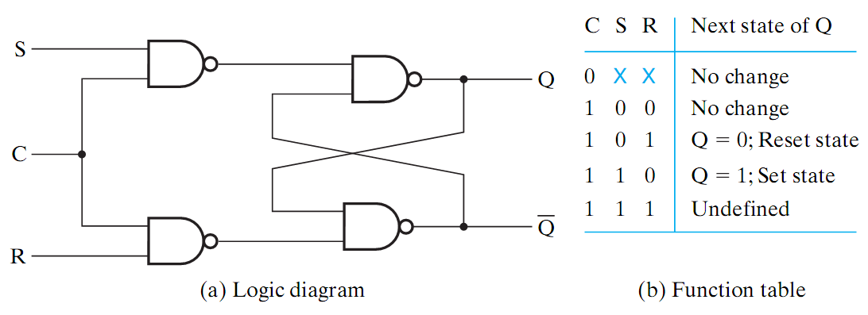
Gated SR Latch with Clock Enable
S
R
An additional Clock (enable) input signal C is used
Clock controls when the state of the latch can be changed
When C=0, the latch remains in the same state
When C=1, then normal latch operation
The NAND gates invert the S and R inputs when C=1

Slide 18
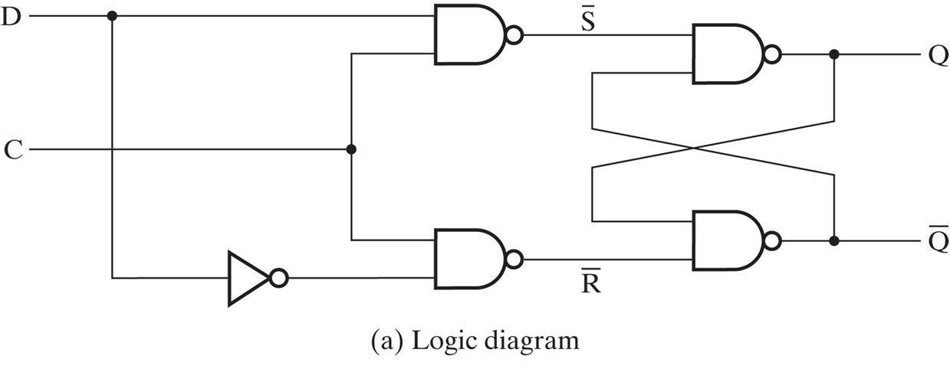
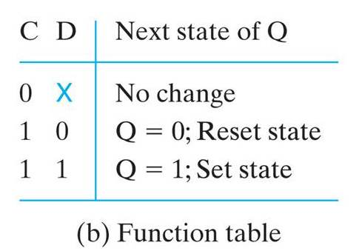
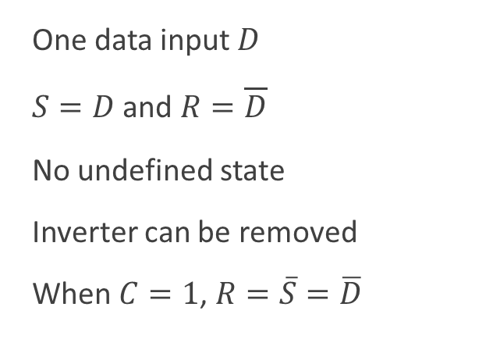
D-Latch with Clock Enable
S
R
One data input $D$
$S=D$ and $R=\overline{D}$
No undefined state
Inverter can be removed
When $C=1$, $R=\overline{S}=\overline{D}$
D
S
Q
Q
C
R

Slide 19
Timing of a D-Latch with Clock Enable
D
S
Q
D-Latch with
Clock Input
Q
C
R
C
D
S
R
Q
Time

Slide 20




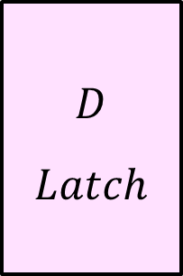

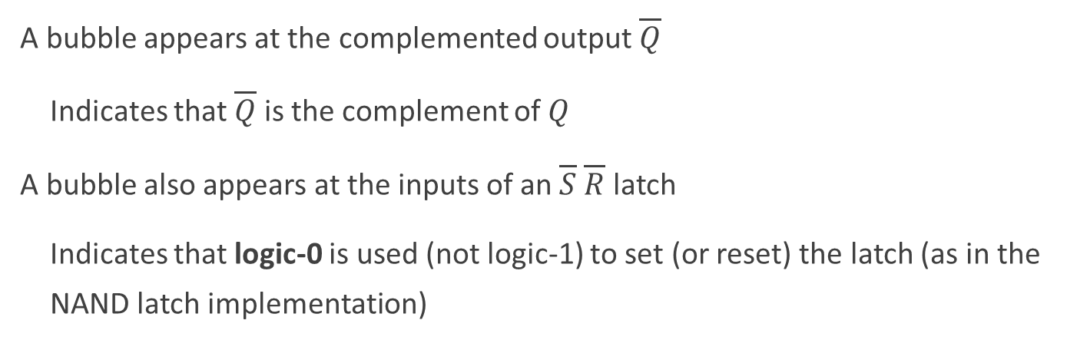






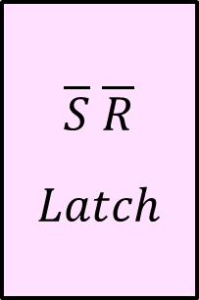




Graphic Symbols for Latches
$$S$$
$S R$
$Latch$
$$Q$$
$$\overline{S}$$
$\overline{S} \overline{R}$
$Latch$
$$Q$$
$$D$$
$D$
$Latch$
$$Q$$
$$C$$
$$C$$
$$R$$
$$\overline{Q}$$
$$\overline{R}$$
$$\overline{Q}$$
$$C$$
$$\overline{Q}$$
A bubble appears at the complemented output $\overline{Q}$
Indicates that $\overline{Q}$ is the complement of $Q$
A bubble also appears at the inputs of an $\overline{S} \overline{R}$ latch
Indicates that logic-0 is used (not logic-1) to set (or reset) the latch (as in the NAND latch implementation)

Slide 21



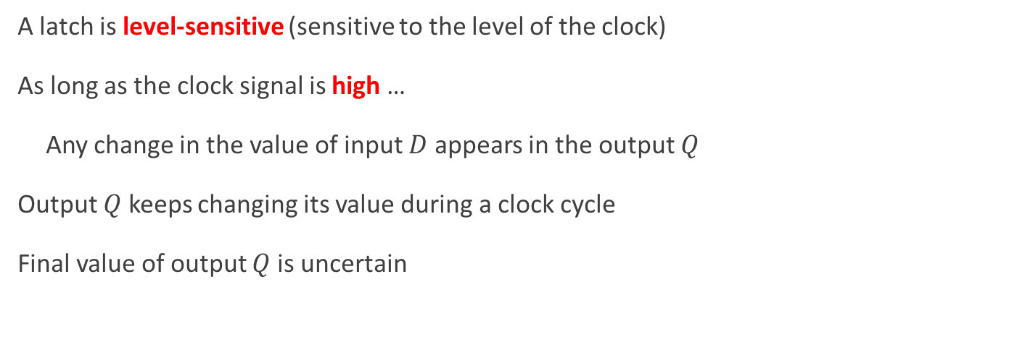





Problem with Latches
A latch is level-sensitive (sensitive to the level of the clock)
As long as the clock signal is high …
Any change in the value of input $D$ appears in the output $Q$
Output $Q$ keeps changing its value during a clock cycle
Final value of output $Q$ is uncertain
Due to this uncertainty, latches are NOT used as memory elements in synchronous circuits
$Latch$
$$Q$$
$$D$$
$$Q$$
$$Clk$$
$$C$$
$$\overline{Q}$$
$$\overline{Q}$$

Slide 22
Flip-Flops
A Flip-Flop is a better memory element for synchronous circuits
Solves the problem of latches in synchronous sequential circuits
A latch is sensitive to the level of the clock
However, a flip-flop is sensitive to the edge of the clock
A flip-flop is called an edge-triggered memory element
It changes it output value at the edge of the clock
High
Level
Low
Level
Rising edge
Falling edge
Rising edge
Falling edge
Time

Slide 23
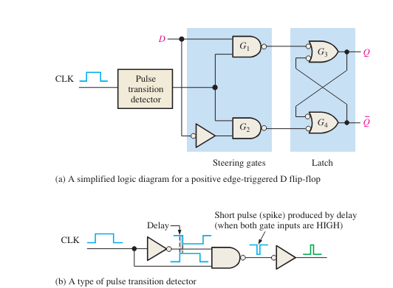
Pulse Transition detection

Slide 24
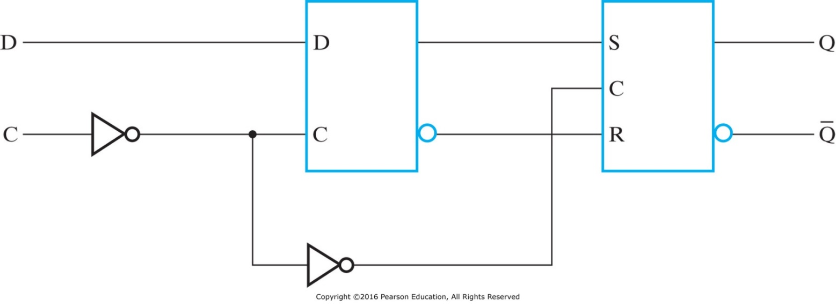


Edge-Triggered D Flip-Flop
Built using two latches in a master-slave configuration
A master latch (D-type) receives external inputs
A slave latch (SR-type) receives inputs from the master latch
Only one latch is enabled at any given time
When Clk=0, the master is enabled and the D input is latched (slave disabled)
When Clk=1, the slave is enabled to generate the outputs (master is disabled)
Outputs change when Clk changes from 0 to 1
$$Q_{m}$$
Master
Slave
Clk
$$\overline{Q_{m}}$$

Slide 25
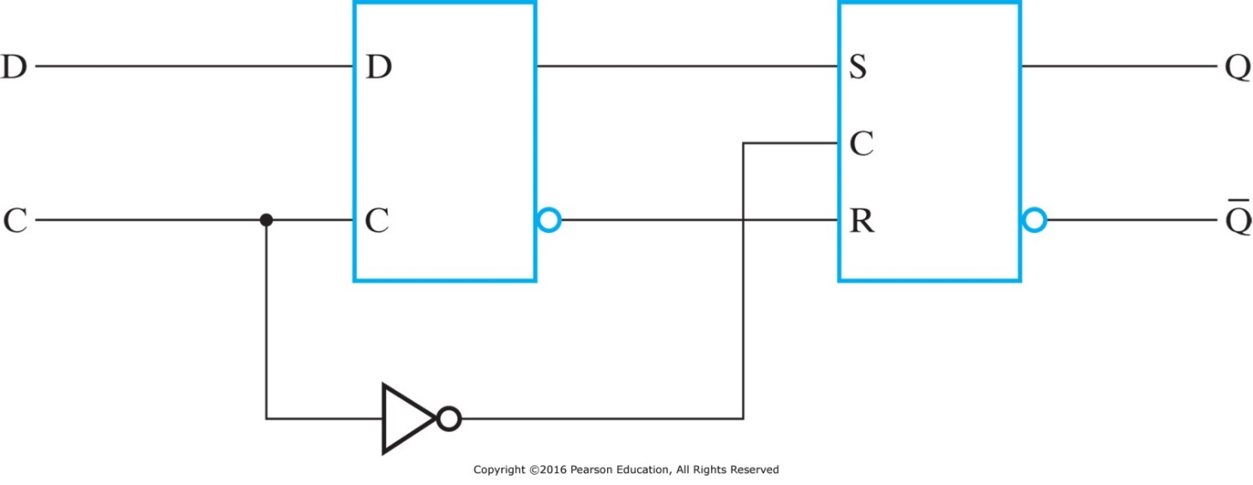


Negative Edge-Triggered D Flip-Flop
Similar to positive edge-triggered flip-flop
The first inverter at the Master C input is removed
Only one latch is enabled at any given time
When Clk=1, the master is enabled and the D input is latched (slave disabled)
When Clk=0, the slave is enabled to generate the outputs (master is disabled)
Outputs change when Clk changes from 1 to 0
$$Q_{m}$$
Clk
Master
Slave
$$\overline{Q_{m}}$$

Slide 26
D Flip-Flop Timing Diagram
The diagram shows the timing of a positive-edge D Flip-Flop
The master latch changes its output Qm when the clock C is 0
The rising edge of the clock triggers the D Flip-Flop
Notice the slight delay in the output Q after the rising edge
Clk
D
Qm
Q
Time

Slide 27










Graphic Symbols for Flip-Flops
$$Data$$
Flip
Flop
$$Data$$
Flip
Flop
$$D$$
$$Q$$
$$D$$
$$Q$$
$$Clk$$
$$\overline{Q}$$
$$Clk$$
$$\overline{Q}$$
A Flip-Flop has a similar symbol to a Latch
The difference is the arrowhead at the clock input
The arrowhead indicates sensitivity to the edge of the clock
A circle at the Clk input indicates negative edge-triggered FF

Slide 28
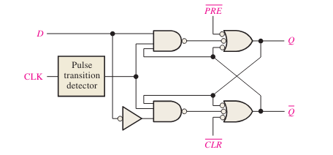





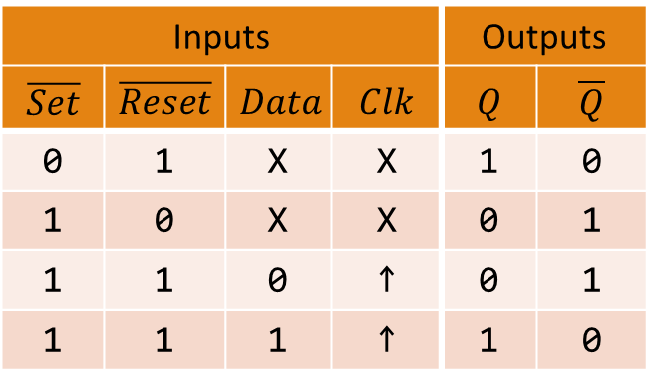


Asynchronous Set and Reset
When Flip-Flops are powered, their initial state is unknown
Some flip-flops have an asynchronous Set and Reset inputs
Set forces Q to become 1, independently of the clock
Reset forces Q to become 0, independently of the clock
$$\overline{Set}$$
Inputs |  |  |  | Outputs
$$\overline{Set}$$ | $$\overline{Reset}$$ | $$Data$$ | $$Clk$$ | $$Q$$ | $$\overline{Q}$$
0 | 1 | X | X | 1 | 0
1 | 0 | X | X | 0 | 1
1 | 1 | 0 | ↑ | 0 | 1
1 | 1 | 1 | ↑ | 1 | 0
Flip
Flop
$Data$
$$D$$
$$Q$$
$Clk$
$$\overline{Q}$$
$$\overline{Reset}$$
Function Table

Slide 29
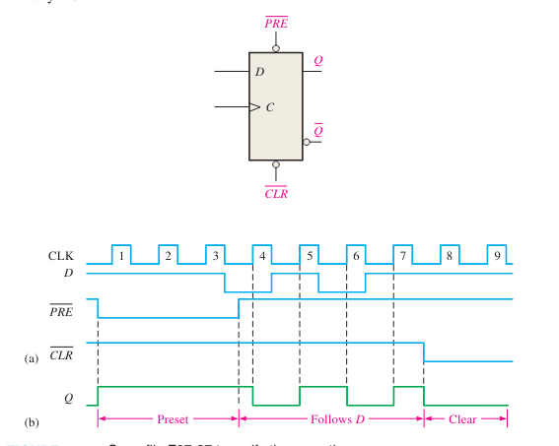
Asynchronous Set and Reset

Slide 30













JK Flip-Flop
The D Flip-Flop is the most commonly used type
The JK is another type of Flip-Flop with inputs: J, K, and Clk
When JK = 10 ➔ Set, When JK = 01 ➔ Reset
When JK = 00 ➔ No change, When JK = 11 ➔ Invert outputs
JK can be implemented using two Clocked SR latches and gates
Master
Slave
$$Q_{1}$$
SR Latch
SR Latch
$$S$$
$$S$$
$$Q$$
$$J$$
$$Clk$$
$$C$$
$$C$$
$$K$$
$$\overline{Q_{1}}$$
$$R$$
$$R$$
$$\overline{Q}$$

Slide 31
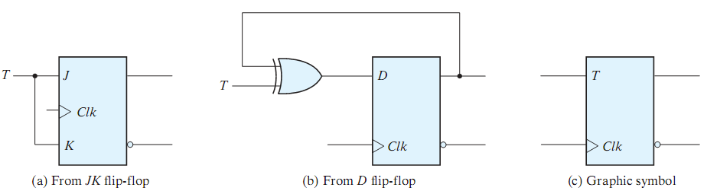
T Flip-Flop
The T (Toggle) flip-flop has inputs: T and Clk
When T = 0 ➔ No change, When T = 1 ➔ Invert outputs
The T flip-flop can be implemented using a JK flip-flop
It can also be implemented using a D flip-flop and a XOR gate

Slide 32
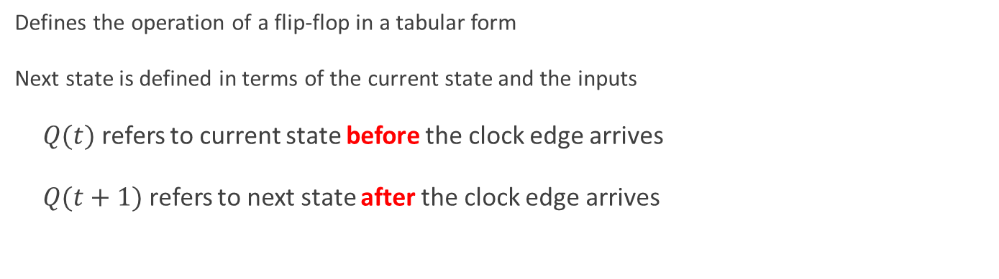
Flip-Flop Characteristic Table
Defines the operation of a flip-flop in a tabular form
Next state is defined in terms of the current state and the inputs
$Q(t)$ refers to current state before the clock edge arrives
$Q(t+1)$ refers to next state after the clock edge arrives
D Flip-Flop
D | Q(t+1)
0 | 0 Reset
1 | 1 Set
JK Flip-Flop
J K | Q(t+1)
0 0 | Q(t) No change
0 1 | 0 Reset
1 0 | 1 Set
1 1 | Q'(t) Complement
T Flip-Flop
T | Q(t+1)
0 | Q(t) No change
1 | Q'(t) Complement

Slide 33
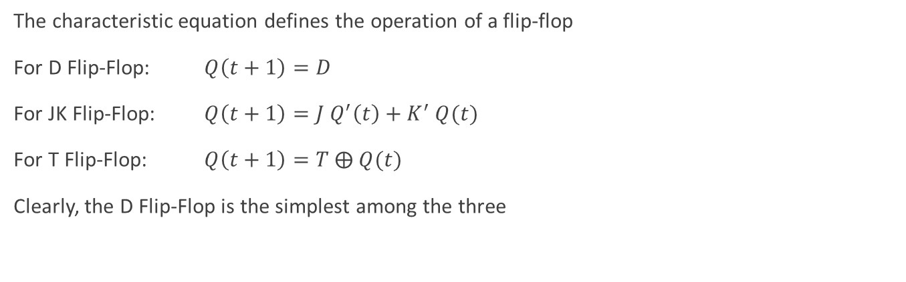
Flip-Flop Characteristic Equation
The characteristic equation defines the operation of a flip-flop
For D Flip-Flop: $Q\left(t+1\right)=D$
For JK Flip-Flop: $Q\left(t+1\right)=J Q^{′}\left(t\right)+K^{′} Q(t)$
For T Flip-Flop: $Q\left(t+1\right)=T ⨁ Q(t)$
Clearly, the D Flip-Flop is the simplest among the three
D Flip-Flop
D | Q(t+1)
0 | 0 Reset
1 | 1 Set
JK Flip-Flop
J K | Q(t+1)
0 0 | Q(t) No change
0 1 | 0 Reset
1 0 | 1 Set
1 1 | Q'(t) Complement
T Flip-Flop
T | Q(t+1)
0 | Q(t) No change
1 | Q'(t) Complement

Slide 34
Summary
In a sequential circuit there is internal memory
Output is a function of current inputs and present state
The stored memory value defines the present state
Similarly, the next state depends on current inputs and present state
Two types of sequential circuits:
Synchronous sequential circuits are clocked (easier to implement)
Asynchronous sequential circuits are not clocked
Two types of Memory elements: Latches and Flip-Flops
Latches are level-sensitive, flip-flops are edge-triggered
Flip-flops are better memory elements for synchronous circuits
A flip-flop is described using a characteristic table and equation

