Slide 1
Lecture # 9 sequential circuit designing and analysis/state table and diagram
By: Muhammad Zain Uddin
email: zuddin@iba.edu.pk

Slide 2
Sequential Circuit Analysis
Digital Logic Design

Slide 3
Presentation Outline
Analysis of Clocked Sequential circuits
State and Output Equations
State Table
State Diagram
Mealy versus Moore Sequential Circuits
State and Timing Diagrams

Slide 4
Analysis of Clocked Sequential Circuits
Analysis is describing what a given circuit will do
The output of a clocked sequential circuit is determined by
Inputs
State of the Flip-Flops
Analysis Procedure:
Obtain the equations at the inputs of the Flip-Flops
Obtain the output equations
Fill the state table for all possible input and state values
Draw the state diagram

Slide 5
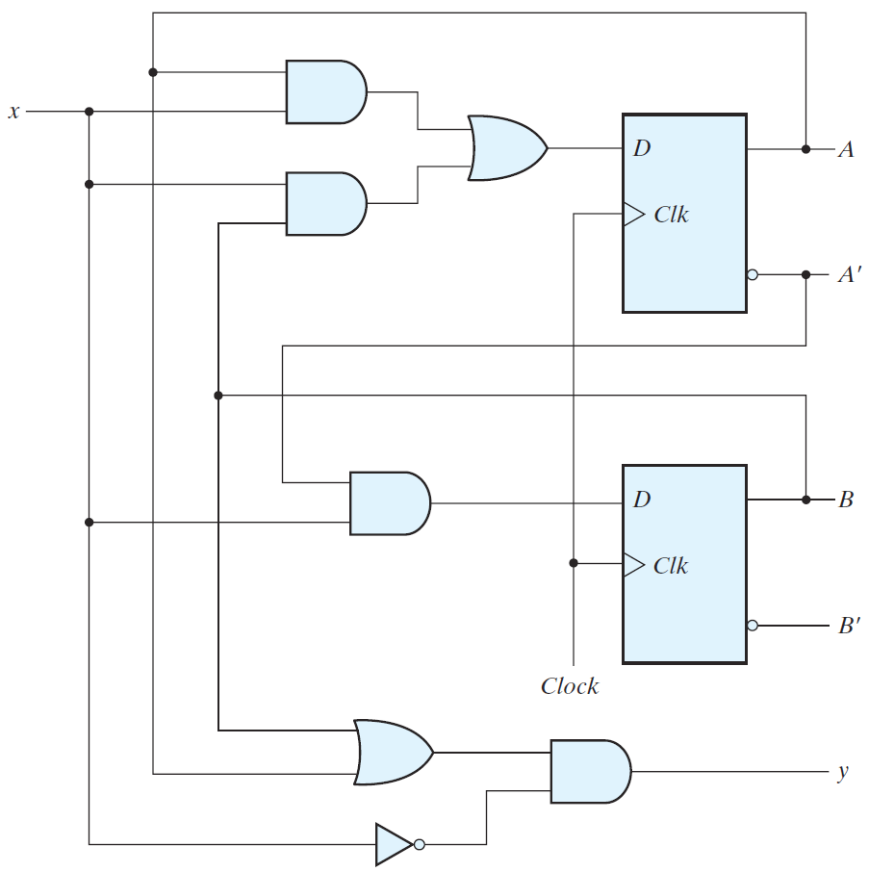
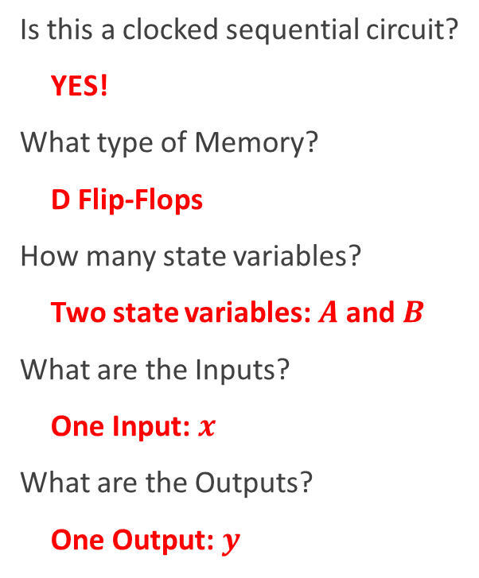
Analysis Example
Is this a clocked sequential circuit?
YES!
What type of Memory?
D Flip-Flops
How many state variables?
Two state variables: $A$ and $B$
What are the Inputs?
One Input: $x$
What are the Outputs?
One Output: $y$

Slide 6
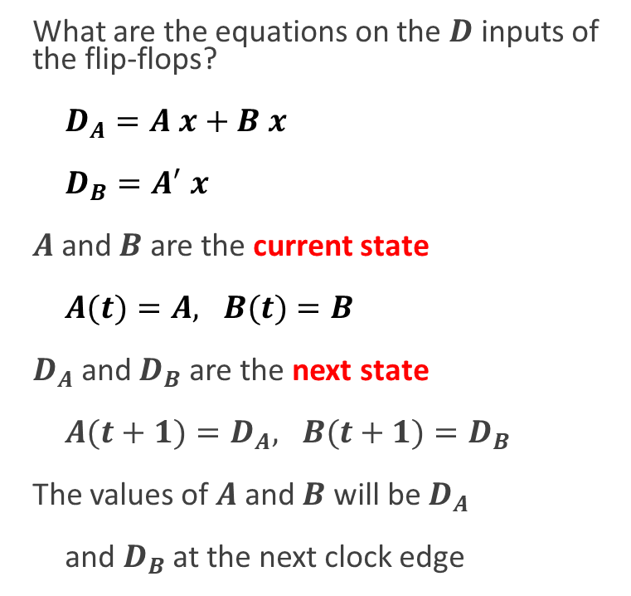
Flip-Flop Input Equations
What are the equations on the $D$ inputs of the flip-flops?
$D_{A}=A x+B x$
$D_{B}=A^{′} x$
$A$ and $B$ are the current state
$A(t)=A, B(t)=B$
$D_{A}$ and $D_{B}$ are the next state
$A(t+1)=D_{A}, B(t+1)=D_{B}$
The values of $A$ and $B$ will be $D_{A}$
and $D_{B}$ at the next clock edge

Slide 7
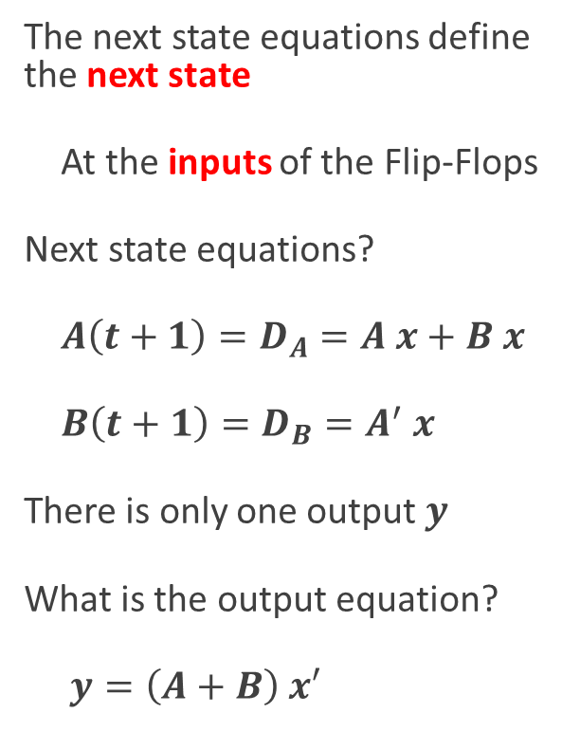
Next State and Output Equations
The next state equations define the next state
At the inputs of the Flip-Flops
Next state equations?
$A\left(t+1\right)=D_{A}=A x+B x$
$B\left(t+1\right)=D_{B}=A^{′} x$
There is only one output $y$
What is the output equation?
$y=\left(A+B\right) x′$

Slide 8
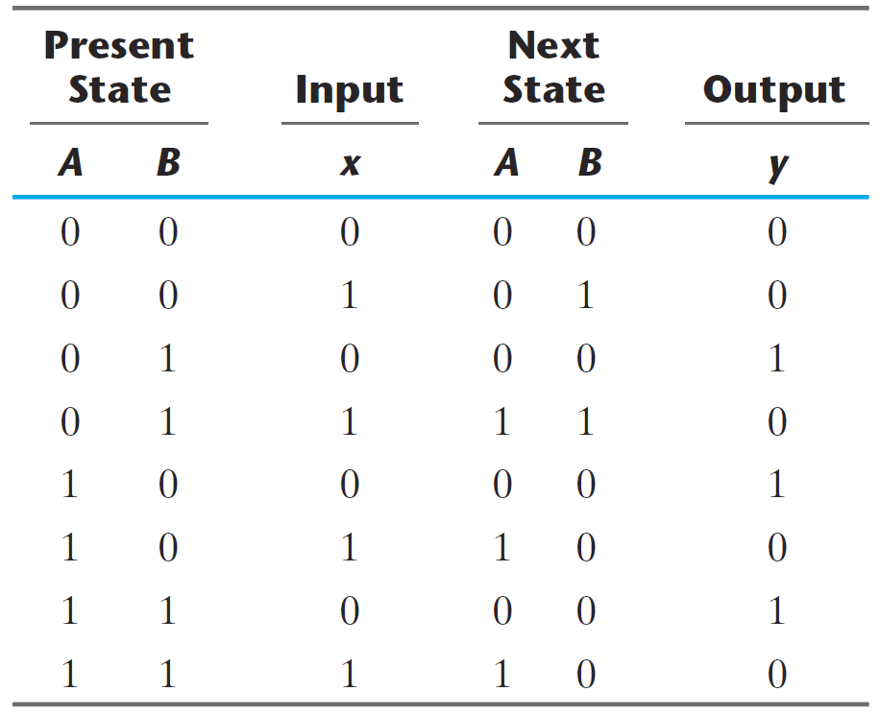
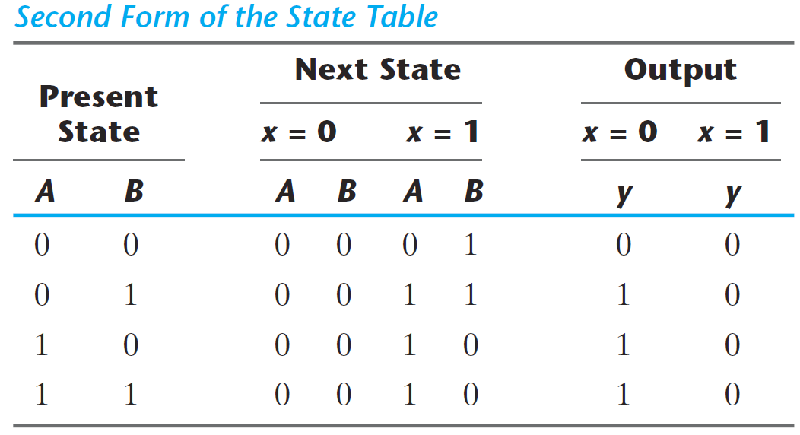
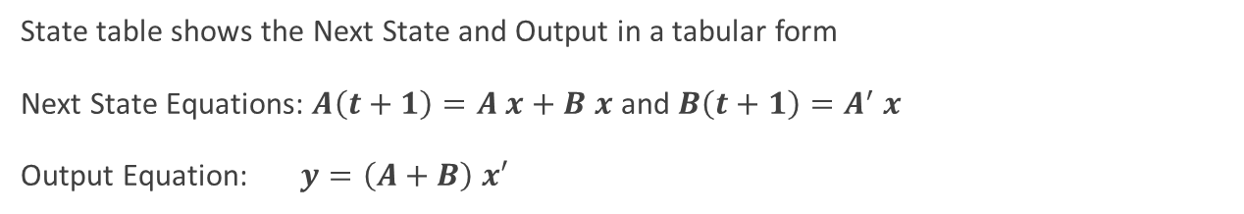
State Table
State table shows the Next State and Output in a tabular form
Next State Equations: $A\left(t+1\right)=A x+B x$ and $B\left(t+1\right)=A^{′} x$
Output Equation: $y=\left(A+B\right) x′$
Another form of the state table

Slide 9
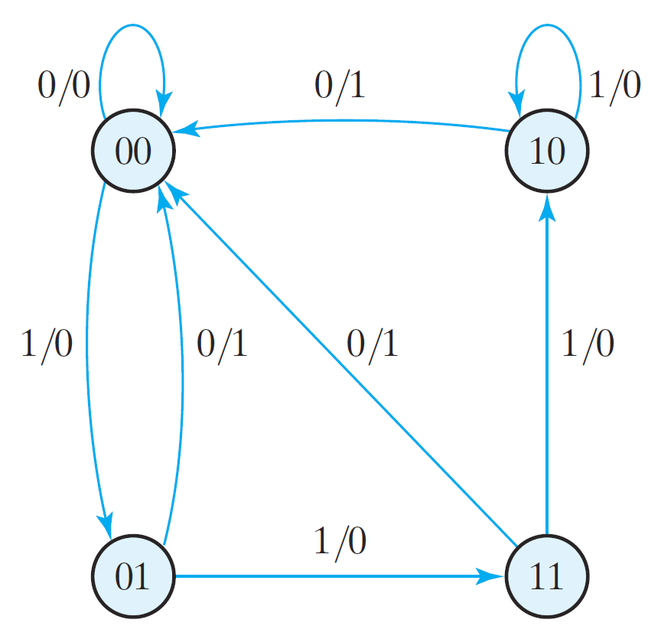
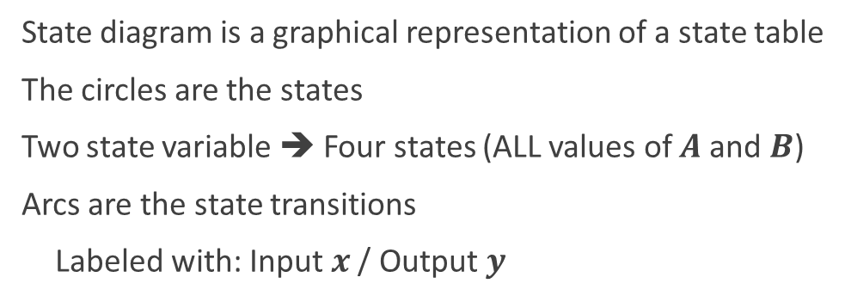
State Diagram
State diagram is a graphical representation of a state table
The circles are the states
Two state variable ➔ Four states (ALL values of $A$ and $B$)
Arcs are the state transitions
Labeled with: Input $x$ / Output $y$

Slide 10
Combinational versus Sequential Analysis
Analysis of Combinational Circuits
Obtain the Boolean Equations
Fill the Truth Table
Analysis of Sequential Circuits
Obtain the Next State Equations
Obtain the Output Equations
Fill the State Table
Draw the State Diagram
Output is a function of input only
Next state is a function of input and current state
Output is a function of input and current state

Slide 11
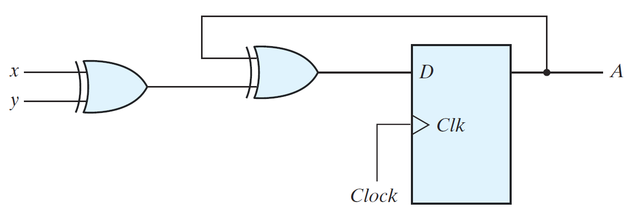
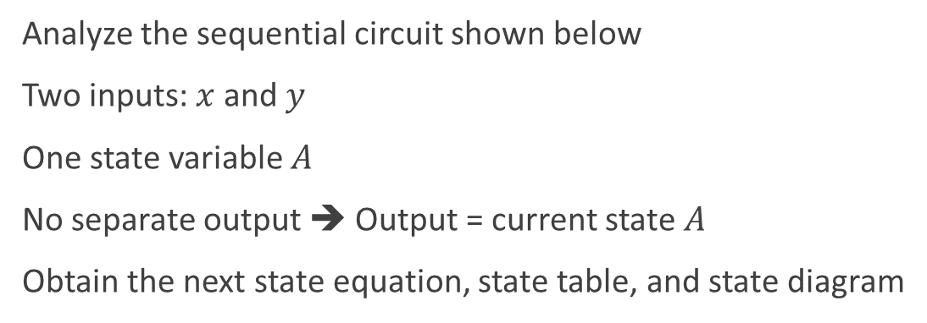
Example with Output = Current State
Analyze the sequential circuit shown below
Two inputs: $x$ and $y$
One state variable $A$
No separate output ➔ Output = current state $A$
Obtain the next state equation, state table, and state diagram

Slide 12
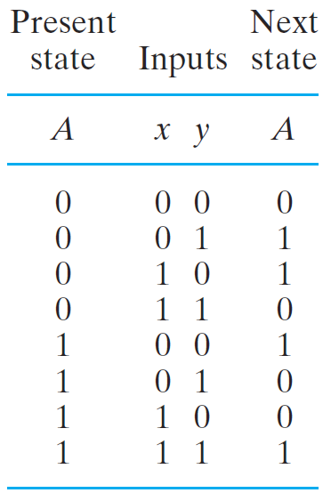
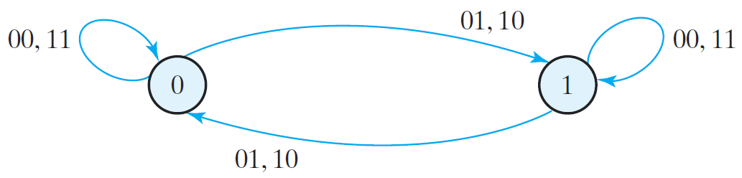
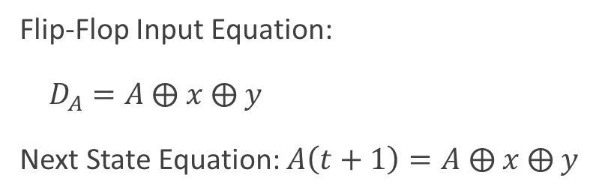
Example with Output = Current State
Flip-Flop Input Equation:
$D_{A}=A$ ⨁ $x$ ⨁ $y$
Next State Equation: $A\left(t+1\right)=A$ ⨁ $x$ ⨁ $y$

Slide 13
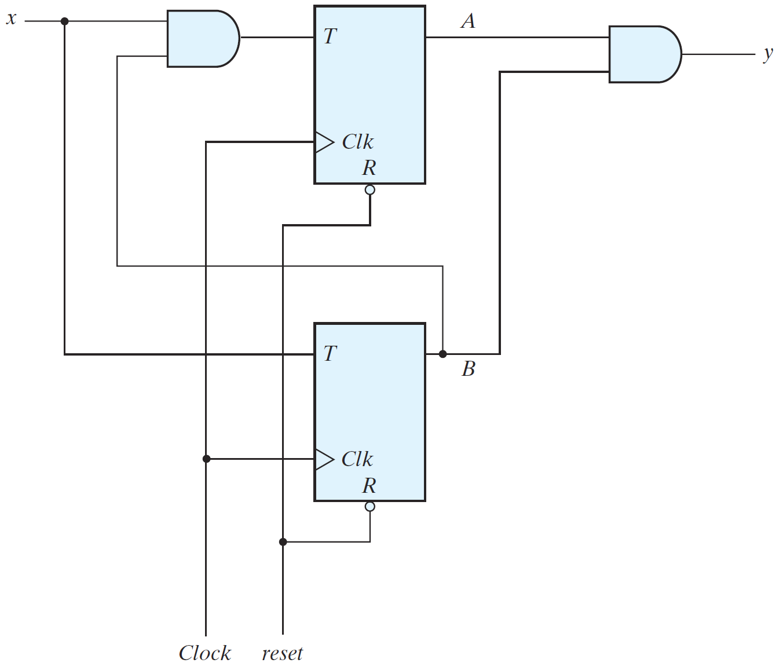
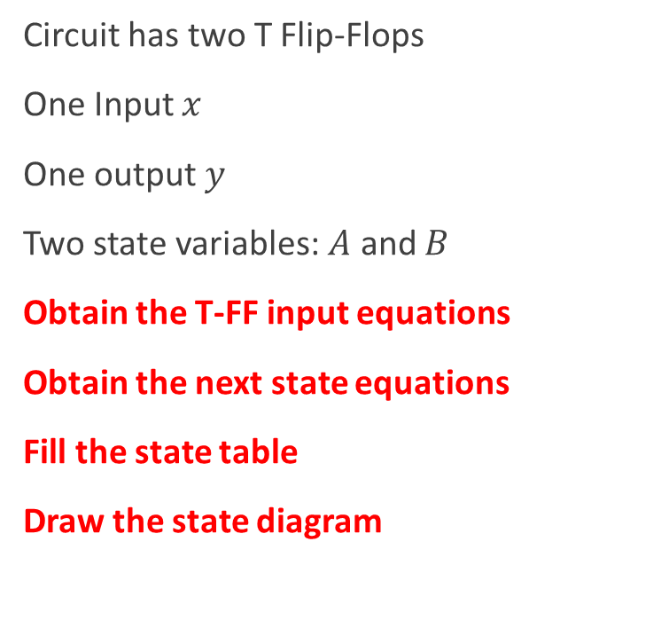
Sequential Circuit with T Flip-Flops
Circuit has two T Flip-Flops
One Input $x$
One output $y$
Two state variables: $A$ and $B$
Obtain the T-FF input equations
Obtain the next state equations
Fill the state table
Draw the state diagram

Slide 14
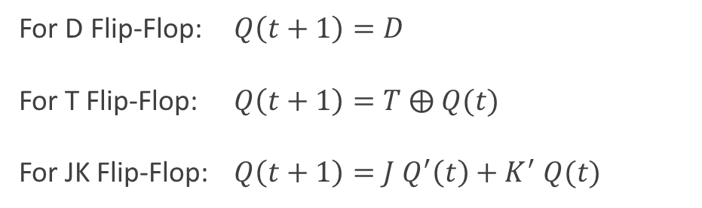
Recall: Flip-Flop Characteristic Equation
For D Flip-Flop: $Q\left(t+1\right)=D$
For T Flip-Flop: $Q\left(t+1\right)=T$ ⨁ $Q(t)$
For JK Flip-Flop: $Q\left(t+1\right)=J Q^{′}\left(t\right)+K^{′} Q(t)$
These equations define the Next State
D Flip-Flop
D | Q(t+1)
0 | 0 Reset
1 | 1 Set
T Flip-Flop
T | Q(t+1)
0 | Q(t) No change
1 | Q'(t) Complement
JK Flip-Flop
J K | Q(t+1)
0 0 | Q(t) No change
0 1 | 0 Reset
1 0 | 1 Set
1 1 | Q'(t) Complement

Slide 15
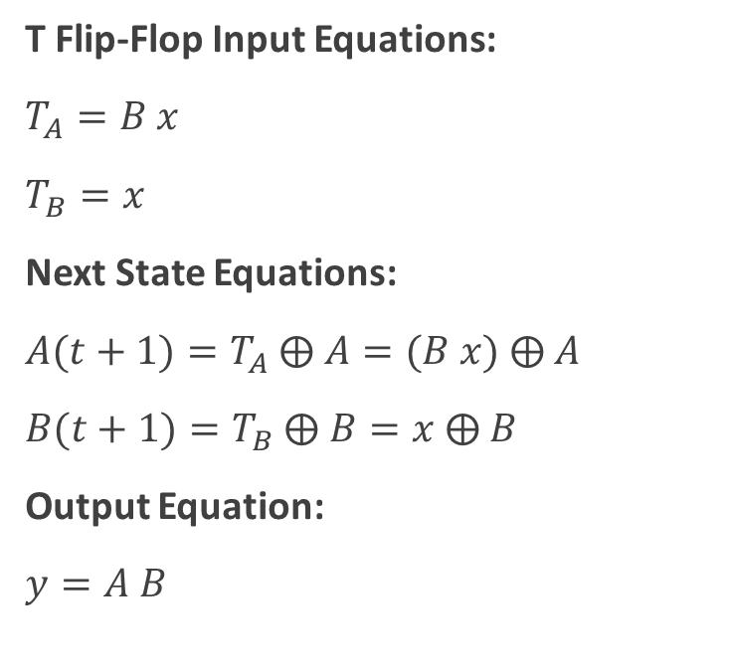
Sequential Circuit with T Flip-Flops
T Flip-Flop Input Equations:
$T_{A}=B x$
$T_{B}=x$
Next State Equations:
$A(t+1)=T_{A}$ ⨁ $A=(B x)$ ⨁ $A$
$B(t+1)=T_{B}$ ⨁ $B=x$ ⨁ $B$
Output Equation:
$y=A B$

Slide 16
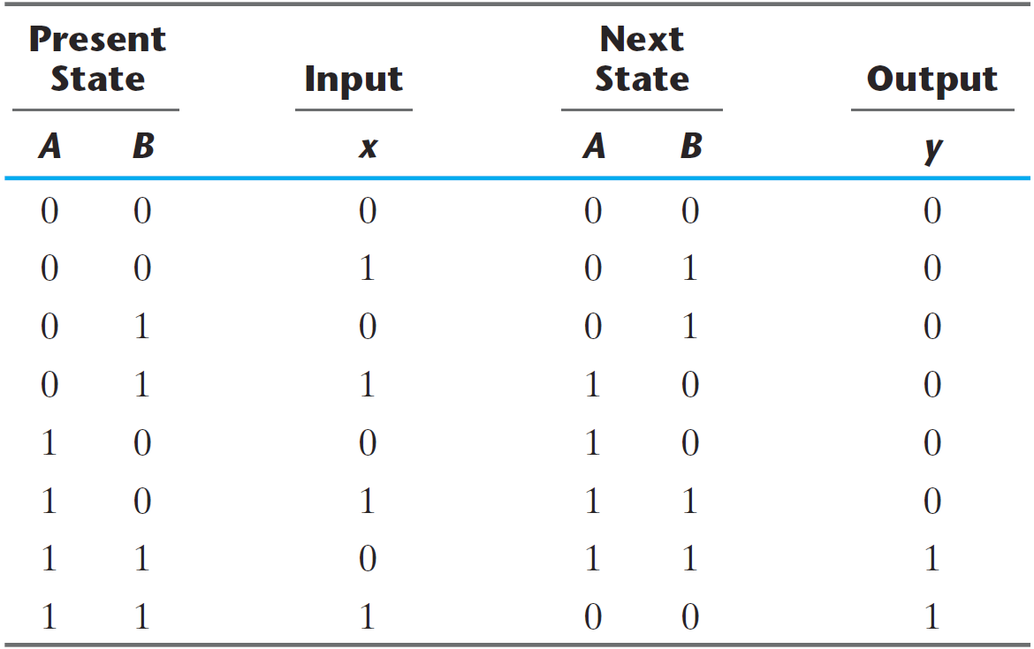
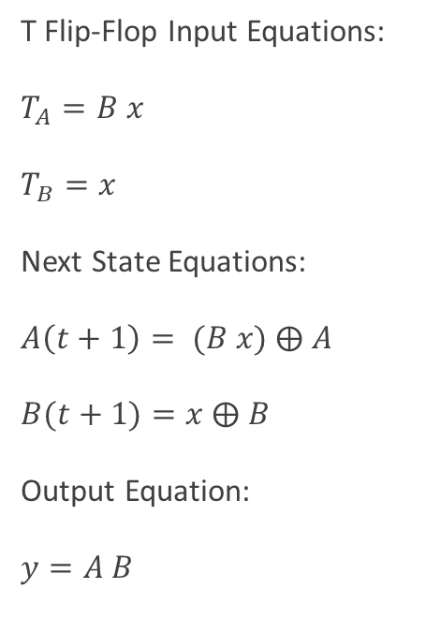
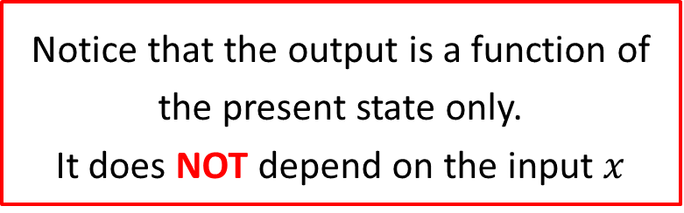
From Next State Equations to State Table
T Flip-Flop Input Equations:
$T_{A}=B x$
$T_{B}=x$
Next State Equations:
$A\left(t+1\right)= (B x)$ ⨁ $A$
$B(t+1)=x$ ⨁ $B$
Output Equation:
$y=A B$
Notice that the output is a function of the present state only.
It does NOT depend on the input $x$

Slide 17
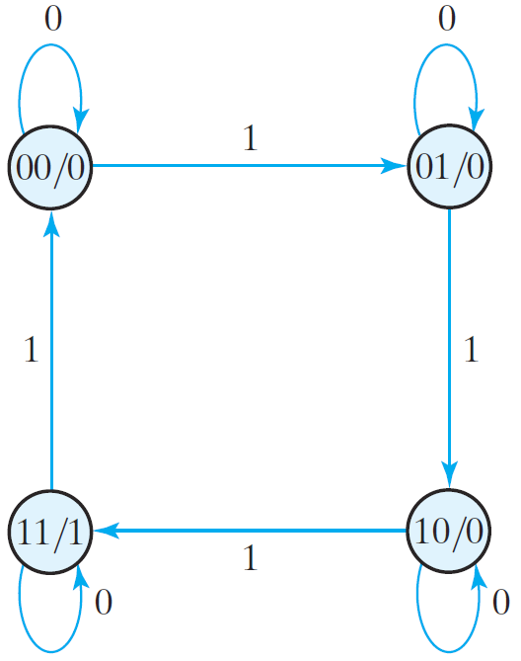
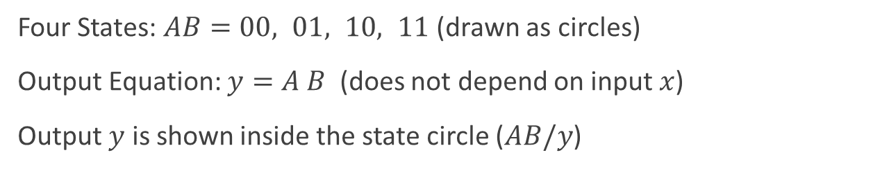
From State Table to State Diagram
Four States: $AB=00, 01, 10, 11$ (drawn as circles)
Output Equation: $y=A B$ (does not depend on input $x$)
Output $y$ is shown inside the state circle ($AB/y$)

Slide 18
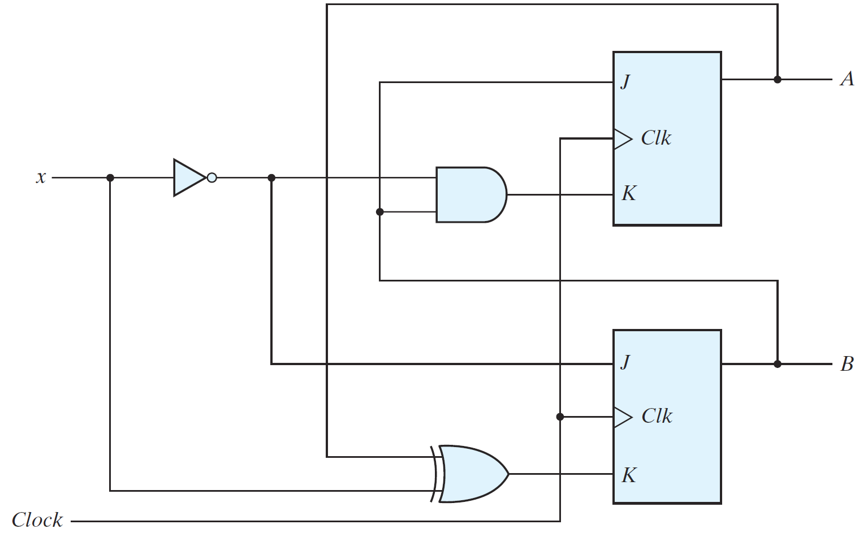
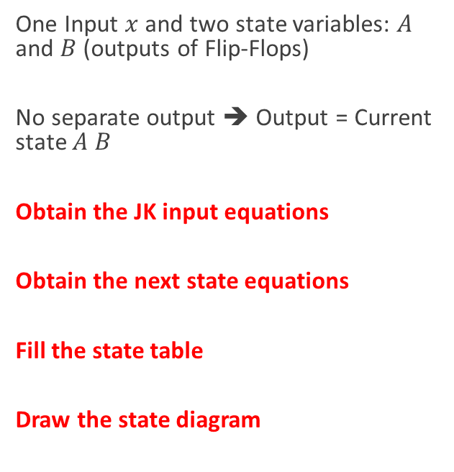
Sequential Circuit with a JK Flip-Flops
One Input $x$ and two state variables: $A$ and $B$ (outputs of Flip-Flops)
No separate output ➔ Output = Current state $A B$
Obtain the JK input equations
Obtain the next state equations
Fill the state table
Draw the state diagram

Slide 19
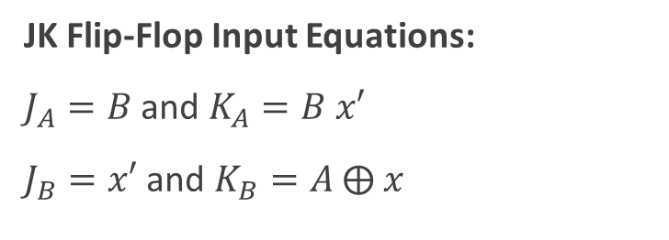
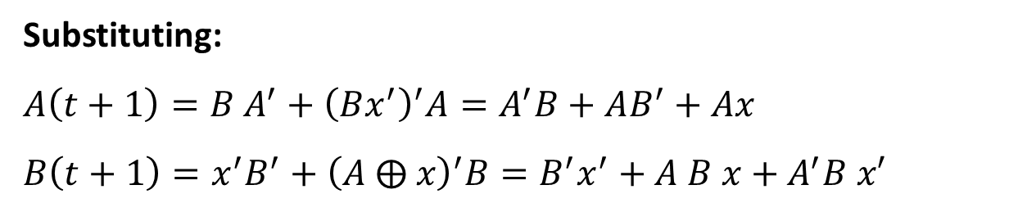
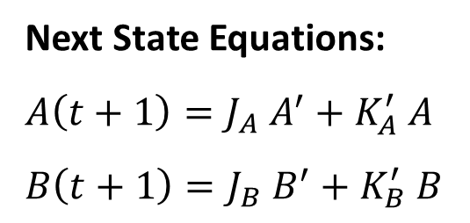
JK Input and Next State Equations
JK Flip-Flop Input Equations:
$J_{A}=B$ and $K_{A}=B x′$
$J_{B}=x′$ and $K_{B}=A$ ⨁ $x$
Next State Equations:
$A\left(t+1\right)=J_{A} A^{′}+K_{A}^{′} A$
$B\left(t+1\right)=J_{B} B^{′}+K_{B}^{′} B$
Substituting:
$A\left(t+1\right)=B A^{′}+{\left(Bx^{′}\right)}^{′}A=A^{′}B+AB^{′}+Ax$
$B\left(t+1\right)=x^{′}B^{′}+{\left(A ⨁ x\right)}^{′}B=B^{′}x^{′}+A B x+A^{′}B x′$

Slide 20
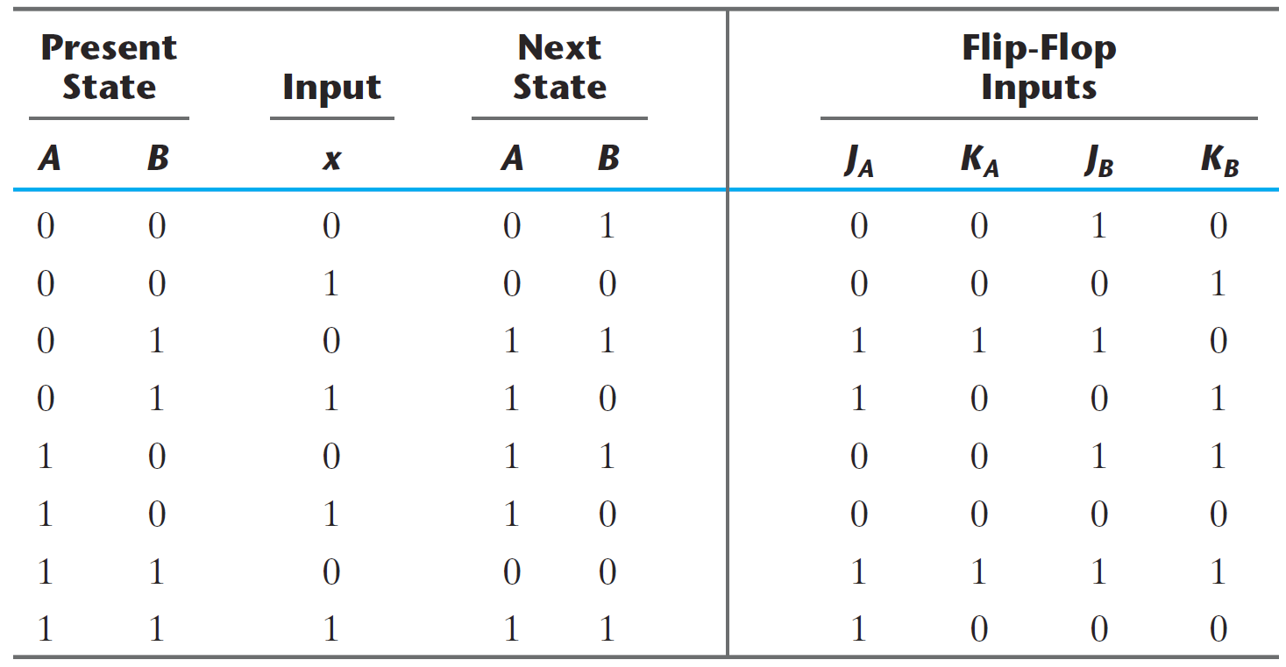
From JK Input Equations to State Table
JK Input Equations: $J_{A}=B$ , $K_{A}=B x′$ , $J_{B}=x′$ and $K_{B}=A$ ⨁ $x$

Slide 21
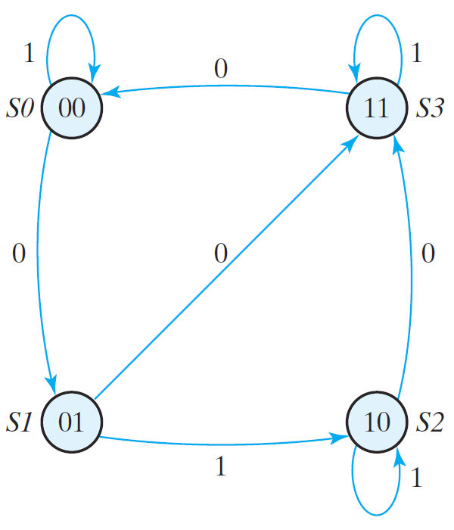
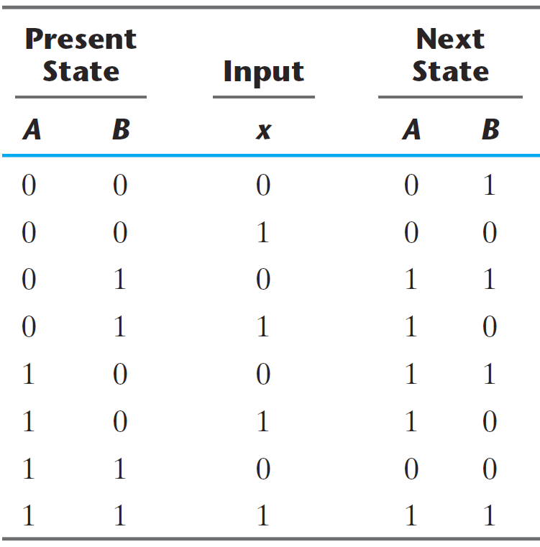
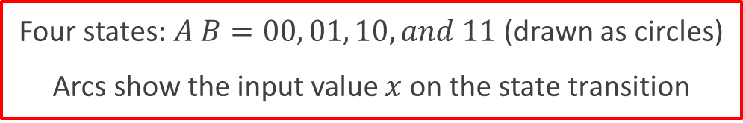
From State Table to State Diagram
Four states: $A B=00, 01, 10, and 11$ (drawn as circles)
Arcs show the input value $x$ on the state transition

Slide 22
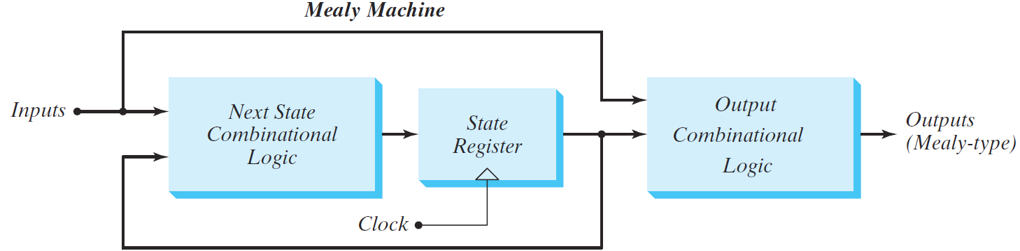
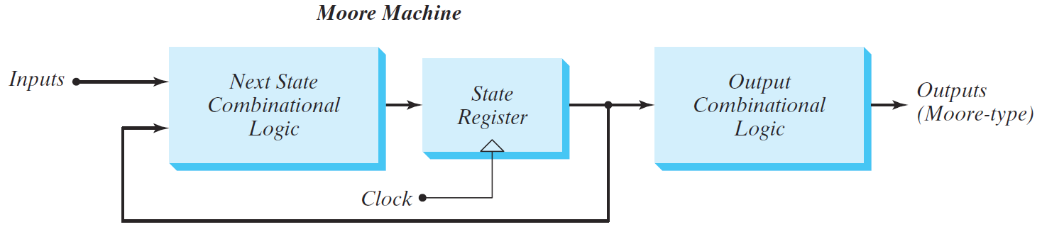
Mealy versus Moore Sequential Circuits
There are two ways to design a clocked sequential circuit:
Mealy Machine: Outputs depend on present state and inputs
Moore Machine: Outputs depend on present state only

Slide 23
Mealy Machine
The outputs are a function of the present state and Inputs
The outputs are NOT synchronized with the clock
The outputs may change if inputs change during the clock cycle
The outputs may have momentary false values (called glitches)
The correct outputs are present just before the edge of the clock

Slide 24
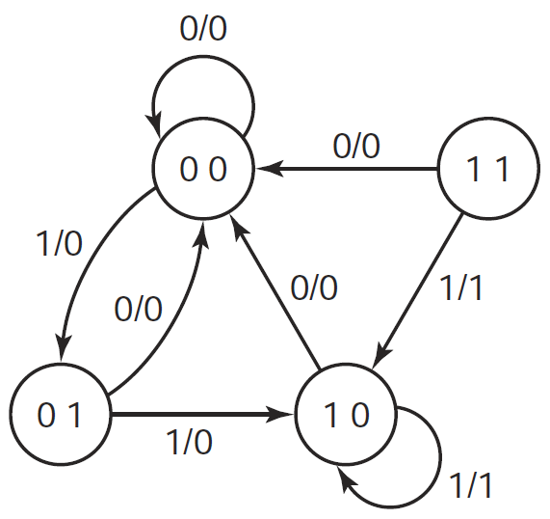
Mealy State Diagram
An example of a Mealy state diagram is shown on the right
Each arc is labeled with:
Input / Output
The output is shown on the arcs of the state diagram
The output depends on the current state and input
Notice that State 11 cannot be reached from the other states

Slide 25
Tracing a Mealy State Diagram
Cycle | 0 | 1 | 2 | 3 | 4 | 5 | 6 | 7 | 8
Input x | 0 | 1 | 1 | 0 | 1 | 1 | 1 | 1 | 0
Present State A B | ? | 0 | 0 | 1 | 0 | 0 | 1 | 1 | 1
 | ? | 0 | 1 | 0 | 0 | 1 | 0 | 0 | 0
Output z | 0 | 0 | 0 | 0 | 0 | 0 | 1 | 1 | 0
When the circuit is powered, the initial state (AB) is unknown
Even though the initial state is unknown, the input x = 0 forces a transition to state AB = 00, regardless of the present state
Sometimes, a reset input is used to initialize the state to 00

Slide 26
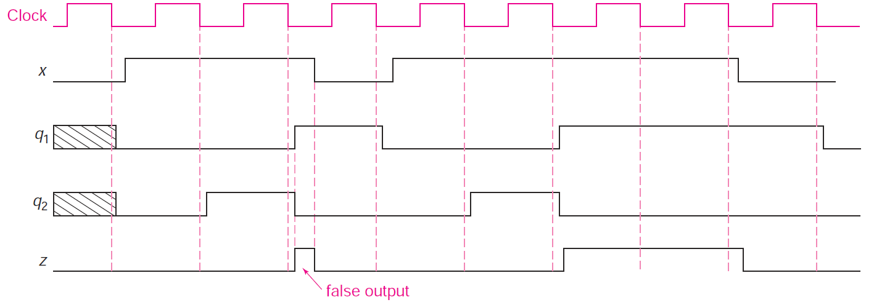
False Output in the Timing Diagram
Cycle | 0 | 1 | 2 | 3 | 4 | 5 | 6 | 7 | 8
Input x | 0 | 1 | 1 | 0 | 1 | 1 | 1 | 1 | 0
Present State A B | ? | 0 | 0 | 1 | 0 | 0 | 1 | 1 | 1
 | ? | 0 | 1 | 0 | 0 | 1 | 0 | 0 | 0
Output z | 0 | 0 | 0 | 0 | 0 | 0 | 1 | 1 | 0
Negative edge-triggered
A
B

Slide 27
Moore Machine
The outputs are a function of the Flip-Flop outputs only
The outputs depend on the current state only
The outputs are synchronized with the clock
Glitches cannot appear in the outputs (even if inputs change)
A given design might mix between Mealy and Moore

Slide 28
Moore State Diagram
0
An example of a Moore state diagram is shown on the right
Arcs are labeled with input only
The output is shown inside the state: (State / Output)
The output depends on the current state only
0
00
0
01
0
1
0
0
1
11
1
10
0
1
1

Slide 29
Tracing a Moore State Diagram
0
When the circuit is powered, the initial state (AB) and output are unknown
Input x = 0 resets the state AB to 00. Can also be done with a reset signal.
0
00
0
01
0
1
Cycle | 0 | 1 | 2 | 3 | 4 | 5 | 6 | 7 | 8
Input x | 0 | 1 | 1 | 0 | 1 | 1 | 1 | 1 | 0
Present State A B | ? | 0 | 0 | 1 | 0 | 0 | 1 | 1 | 1
 | ? | 0 | 1 | 0 | 0 | 1 | 0 | 1 | 1
Output z | ? | 0 | 0 | 0 | 0 | 0 | 0 | 1 | 1
0
0
1
11
1
10
0
1
1

Slide 30
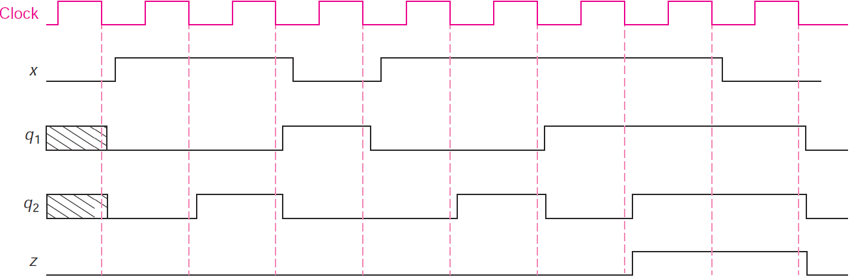
Timing Diagram of a Moore Machine
Cycle | 0 | 1 | 2 | 3 | 4 | 5 | 6 | 7 | 8
Input x | 0 | 1 | 1 | 0 | 1 | 1 | 1 | 1 | 0
Present State A B | ? | 0 | 0 | 1 | 0 | 0 | 1 | 1 | 1
 | ? | 0 | 1 | 0 | 0 | 1 | 0 | 1 | 1
Output z | ? | 0 | 0 | 0 | 0 | 0 | 0 | 1 | 1
The output is synchronized with the clock. No false output (or glitch) can appear.
Negative edge-triggered
A
B

Slide 31
Summary
To analyze a clocked sequential circuit:
Obtain the equations at the Inputs of the flip-flops
Obtain the Next State equations
For a D Flip-Flop, the Next State = D input equation
For T and JK, use the characteristic equation of the Flip-Flop
Obtain the Output equations
Fill the State Table
Put all the combinations of current state and input
Fill the next state and output columns
Draw the State Diagram
Two types of clocked sequential circuits: Mealy versus Moore

