Slide 1

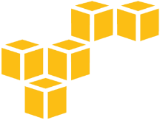
VPC
dEVOPS DESK

Slide 2
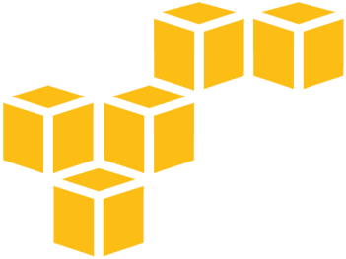
contents
What is Amazon VPC?
VPC Components
VPC Advantages
VPC and Subnet
Public and Private subnets
Internet Gateway, NAT, Route Table

Slide 3
Private IPs
RFC1918 name | IP address range | Classful description
24-bit block | 10.0.0.0 – 10.255.255.255 | single class A network
20-bit block | 172.16.0.0 – 172.31.255.255 | 16 contiguous class B networks
16-bit block | 192.168.0.0 – 192.168.255.255 | 256 contiguous class C networks

Slide 4
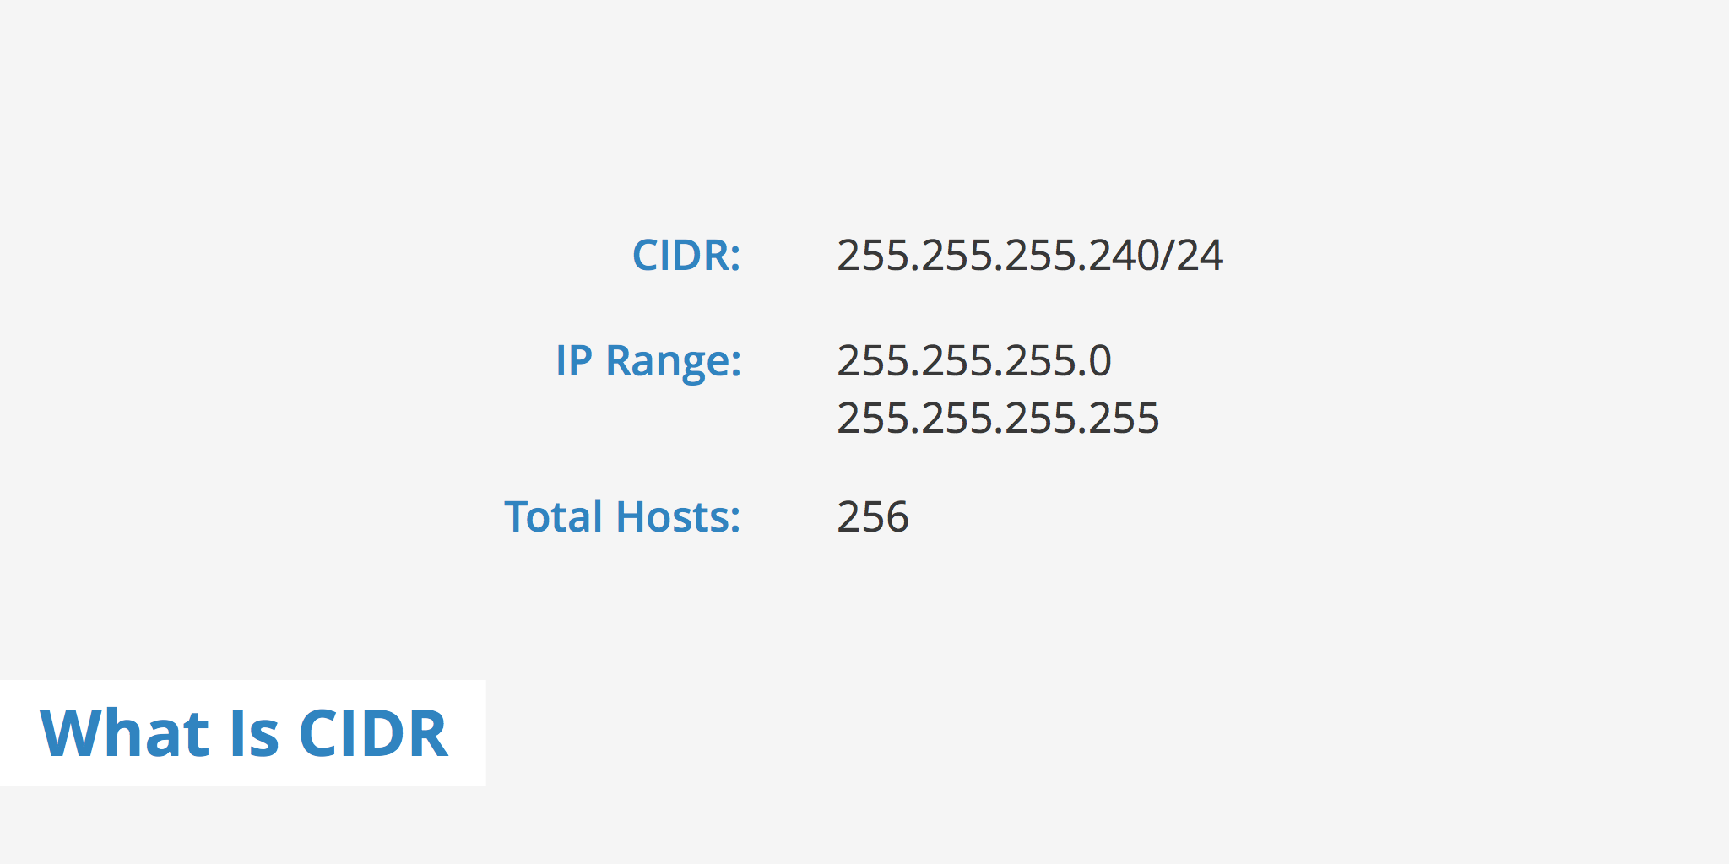
CIDR - Classless Inter-Domain Routing

Slide 5
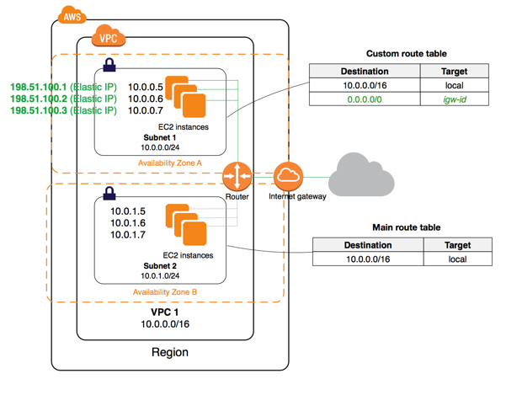
What is AWS VPC ?
Amazon Virtual Private Cloud (Amazon VPC) enables you to launch Amazon Web Services (AWS) resources into a virtual network that you've defined. This virtual network closely resembles a traditional network that you'd operate in your own data center, with the benefits of using the scalable infrastructure of AWS.

Slide 6
VPC AWS Components
VPC’s
Subnet (Public and Private)
Route table
Internet Gateway
NAT

Slide 7
VPC Advantages
Multiple Connectivity Options
A variety of connectivity options exist for your Amazon Virtual Private Cloud. You can connect your VPC to the Internet, to your datacenter, or other VPC's, based on the AWS resources.
Secure
Amazon VPC provides advanced security features such as security groups and network access control lists to enable inbound and outbound filtering at the instance level and subnet level.
Simple
You can create a VPC quickly and easily using the AWS Management Console. You can select one of the common network setups that best match your needs and press "Start VPC Wizard."

Slide 8
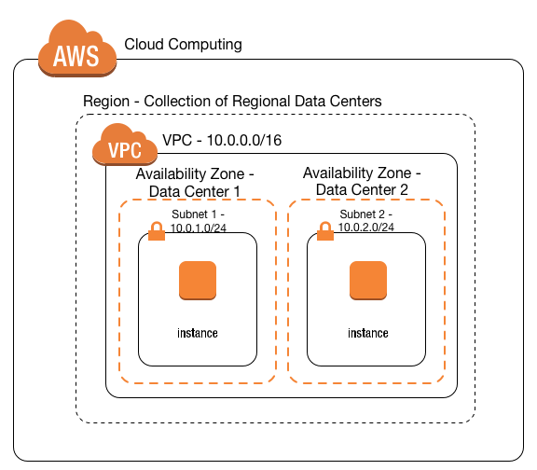
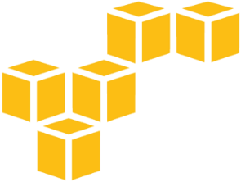
VPC & Subnet
A virtual private cloud (VPC) is a virtual network dedicated to your AWS account. It is logically isolated from other virtual networks in the AWS cloud. You can launch your AWS resources, such as Amazon EC2 instances, into your VPC.
A subnet is a range of IP addresses in your VPC. You can launch AWS resources into a subnet that you select. Use a public subnet for resources that must be connected to the Internet, and a private subnet for resources that won't be connected to the Internet.

Slide 9
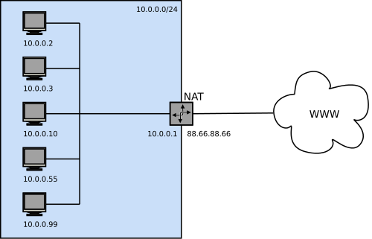
NAT
NAT maps multiple private IPv4 addresses to a single public IPv4 address. A NAT device has an Elastic IP address and is connected to the Internet through an Internet gateway. You can connect an instance in a private subnet to the Internet through the NAT device, which routes traffic from the instance to the Internet gateway, and routes any responses to the instance.

Slide 10
Ig & Route table
INTERNET GATEWAY
An Internet gateway is a VPC component that allows communication between instances in your VPC and the Internet.
ROUTE TABLE
A route table contains a set of rules, called routes, that are used to determine where network traffic is directed.
Each subnet in your VPC must be associated with a route table; the table controls the routing for the subnet. A subnet can only be associated with one route table at a time, but you can associate multiple subnets with the same route table.

Slide 11
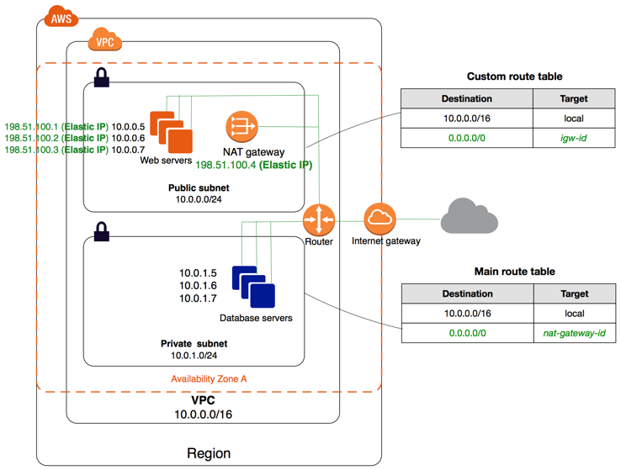
Private & Public Subnets

Slide 12
it’s time for Hands-on

Slide 13
Thank you

