Slide 1
> Face Detection

Slide 2
Data Preprocessing
Collect all Images
Labeling
Face Detection
Cropping
Blob from Image (RGB Mean Subtraction)
Save Data

Slide 3
Data Preprocessing
Collect all Images
Labeling
Face Detection
Cropping
Blob from Image (RGB Mean Subtraction)
Save Data

Slide 4
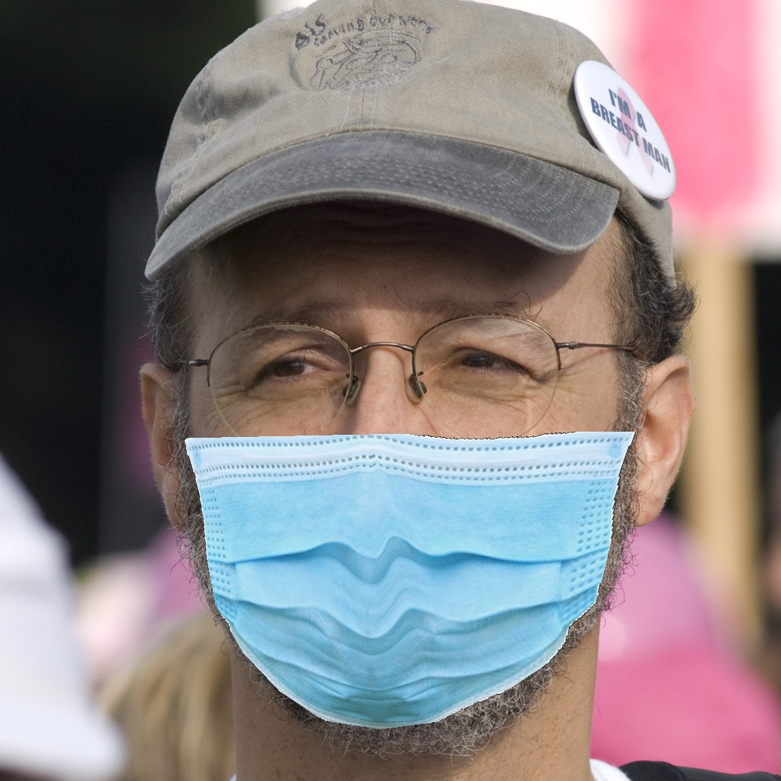
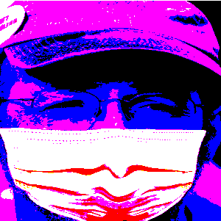
Blob from Image
Blob from Image

Slide 5
OpenCV deep neural network (DNN)
Face Detection (FP16):
Floating-point 16 version of the original Caffe implementation
res10_300x300_ssd_iter_140000_fp16.caffemodel:
This file contains the weights for the actual layers. It can be downloaded from https://github.com/opencv/opencv_3rdparty/raw/19512576c112aa2c7b6328cb0e8d589a4a90a26d/res10_300x300_ssd_iter_140000_fp16.caffemodel
deploy.prototxt:
This file defines the model architecture. It can be downloaded from https://github.com/opencv/opencv/blob/master/samples/dnn/face_detector/deploy.Prototxt

Slide 6
Data Preprocessing
Collect all Images
Labeling
Face Detection
Cropping
Blob from Image (RGB Mean Subtraction)

Slide 7
> Python Script

Slide 8
3: Face Detection
4: Crop Detection
Resize Image
RGB Mean Subtraction
Append in
Numpy Array
5: Blob from Image

Slide 9
Data Preprocessing

Slide 10
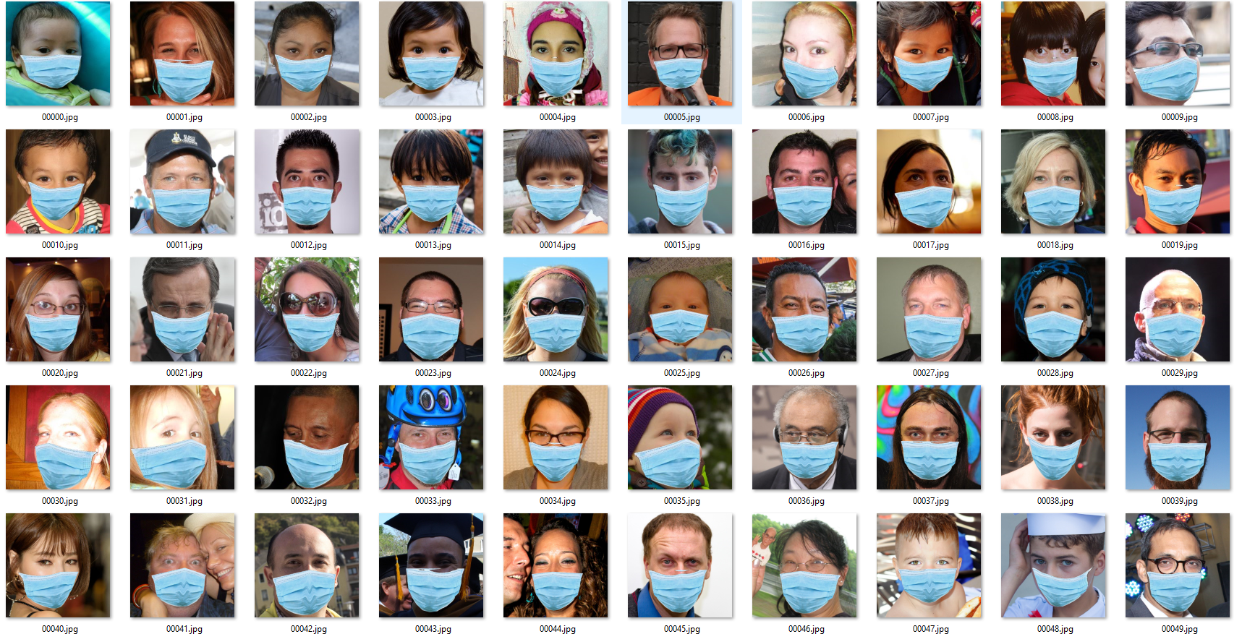
Repeat for all Images

Slide 11
OpenCV deep neural network (DNN)
Single Shot MultiBox Detector (SSD) framework using a ResNet-10 network
Caffe
TensorFlow
Torch
Darknet

