Slide 1
> Convolutional Neural Network
Architecture

Slide 2
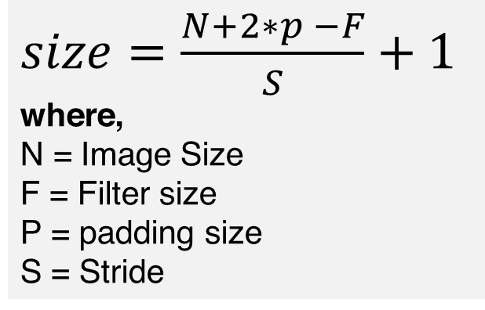
CNN Architecture
$size=\frac{N+2∗p −F}{S}+1$
where,
N = Image Size
F = Filter size
P = padding size
S = Stride
Stride = 1
Padding =“same”
100 x 100 x3
fc 192, relu
3x3 conv, 16
3x3 conv, 32
3x3 conv, 64
pool/2
pool/2
flatten
fc 4, sigmoid
pool/2
relu
relu
relu
fc 28, relu
size: 100
size: 50
size: 25
size: 12

Slide 3
> Python Script

