Slide 1
PyQt Basics

Slide 2
Qt
Qt is a cross-platform application framework that was created for use with C++.
Available in both commercial and open-source license
Qt is officially pronounced cute, though many people say Q T

Slide 3
PyQt
PyQt is a Python library that allows the Qt framework.
Developed by Riverbank Computing under the GPL license.
It is currently supported on Windows, Linux, macOS, UNIX, Android and iOS.

Slide 4
Hello PyQt
PyQt
QtWidgets
QtGui
QtCore

Slide 5
QtWidget

Slide 6
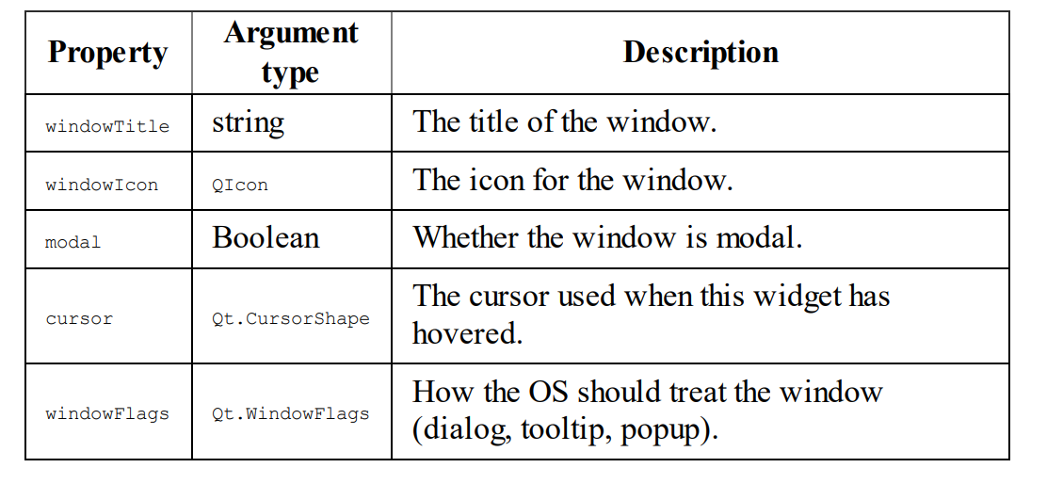
QWidget
Parent class of all other widgets

Slide 7
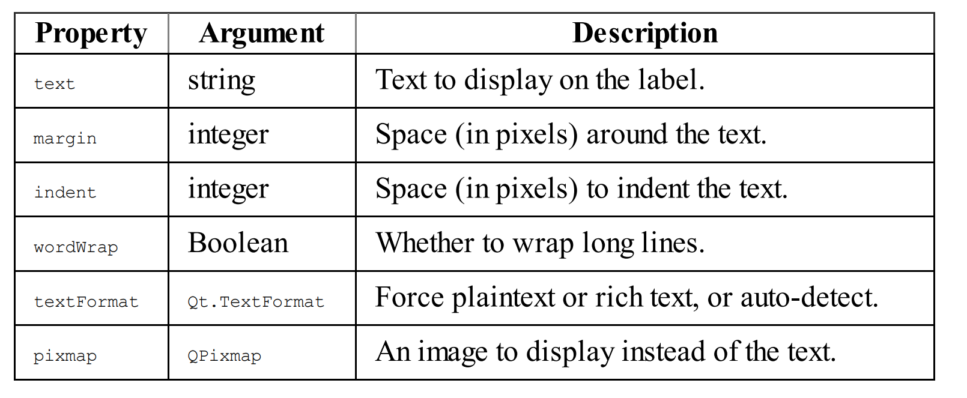
QLabel
Configured to display simple text and images.

Slide 8
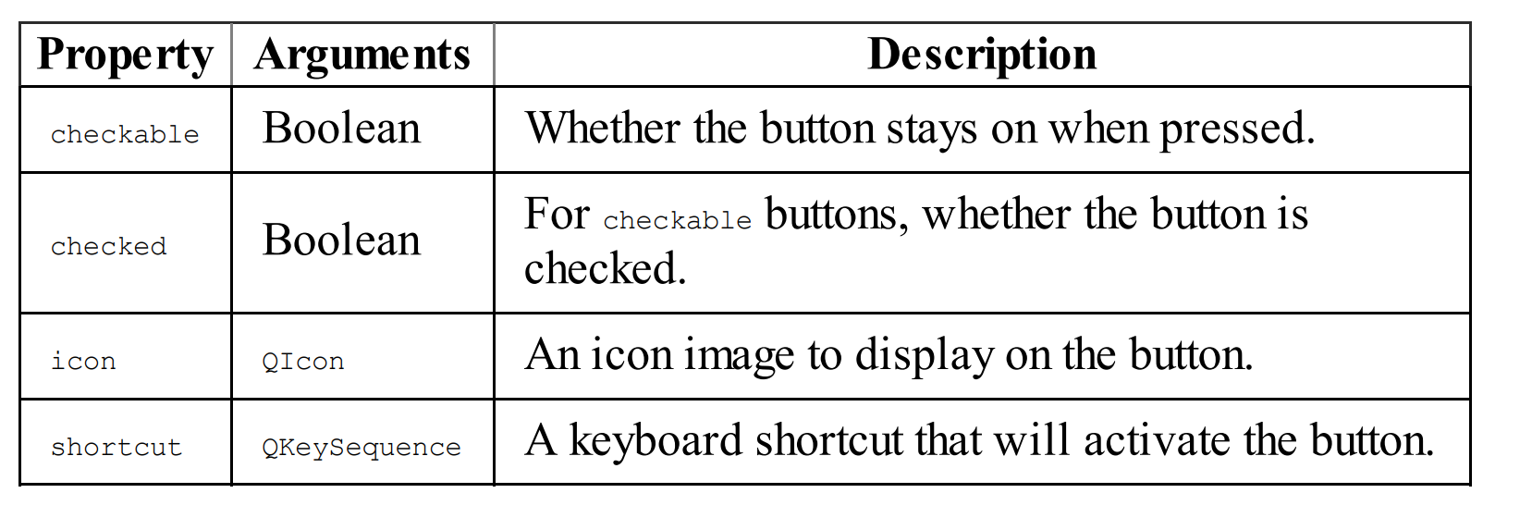
QPushButton
Clickable button widget.

Slide 9
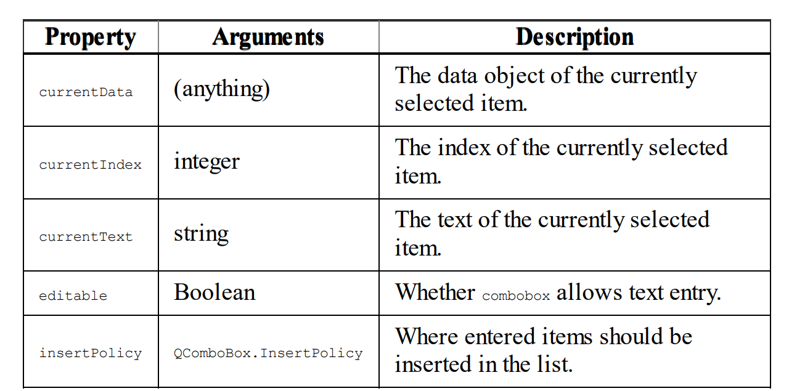
QComboBox
dropdown.

Slide 10
Placing and arranging widgets
Layouts

Slide 11
Layout
QHBoxLayout
QVBoxLayout
QGridLayout
QFormLayout

Slide 12
Signal & Slot
Backend

Slide 13
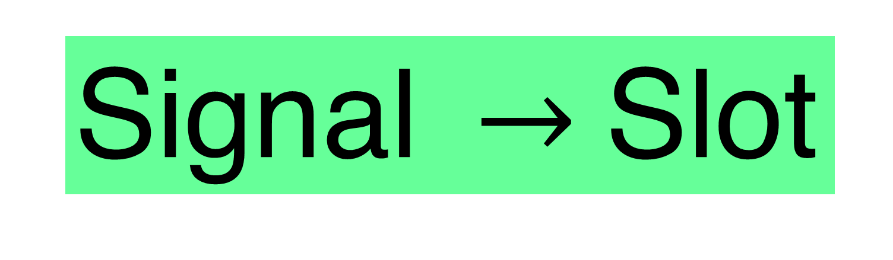
Signal & Slot
Signal is a special property of an object that can be emitted in response to type of event.
Slots are objects methods that can receive a signal and act in response to it.
Signal $→$Slot

Slide 14
Desktop App with PyQt

Slide 15
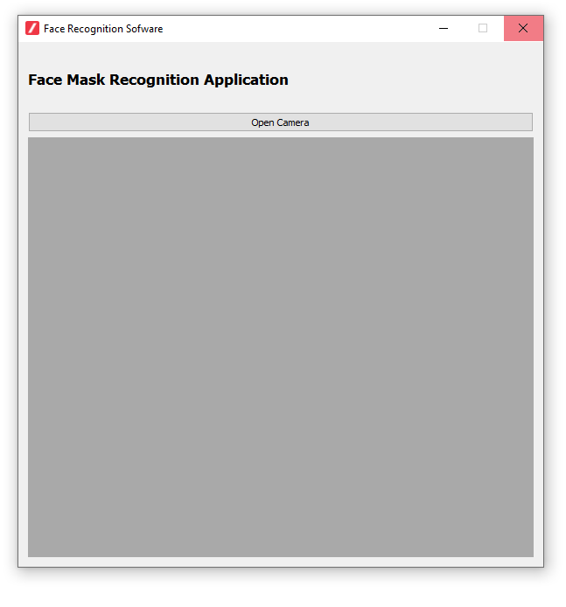
PyQt app
Icon
Label
PushButton
Screen or Pixmap

Slide 16
Get into the Class

