Slide 1
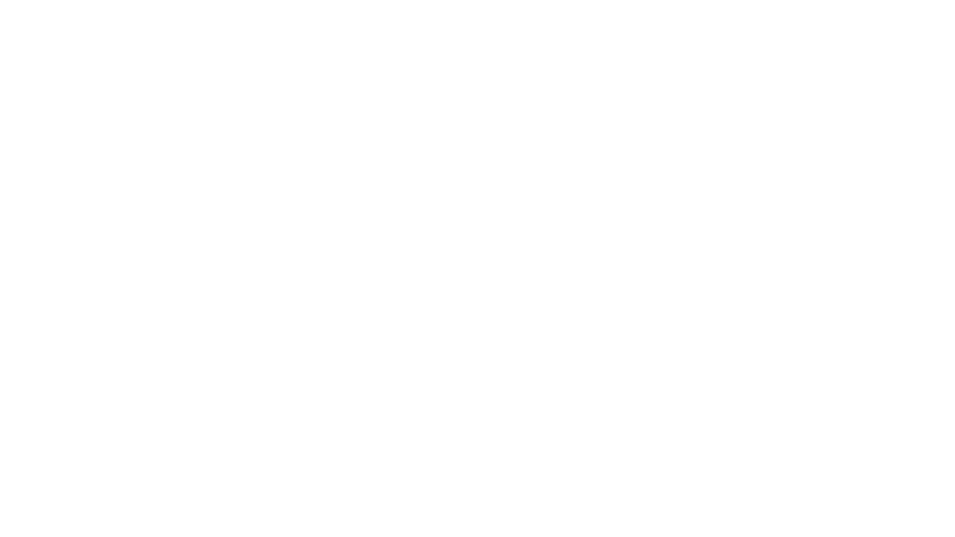

A Tale of rational inattention theory:
Mpo624-2018-final project
By: Kayla Besong

Slide 2

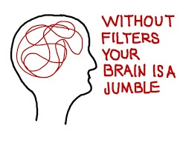
Rational inattention theory
The effects of the cost of information acquisition on decision making

Slide 3
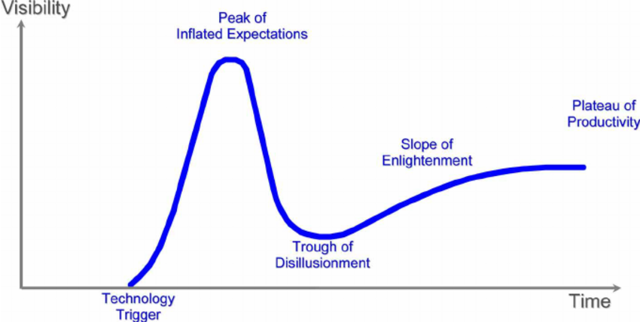
Expectations are the blueprints for disappointment

Slide 4
Goals and hopes for the project: part 1
Expectations
Use the Drillsdown IDV Access Notebook to extract data for the ’Ridiculously Resilient Ridge’ of 2018
Streamfunction
Vorticity
Satellite
Perform regression using streamfunction + vorticity
Consider FFT of variables through lifetime of event
Including before and after
Perform EOF-Image analysis on the Satellite image
Question I had from class previously

Slide 5
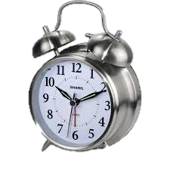
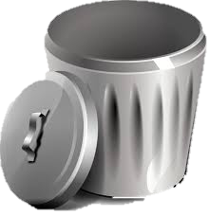
Goals and hopes for the project: part 1
Reality
I could not find the data I was looking for
IDV notebook would not load
Did not have the correct packages installed
Debugging process not straightforward

Slide 6
Goals and hopes for the project: part 2
Expectations
Use the tools we learned in class to help analyze my GFD2 project
Explore relationship of energy transfer
How non-linear is the relationship?
Perhaps a wavelet analysis if not too complex
Look at the evolution of streamfunction output
Create animation to more easily view snapshots overtime
Choose interesting run that corresponds with interesting points in energy over time to perform an EOF

Slide 7
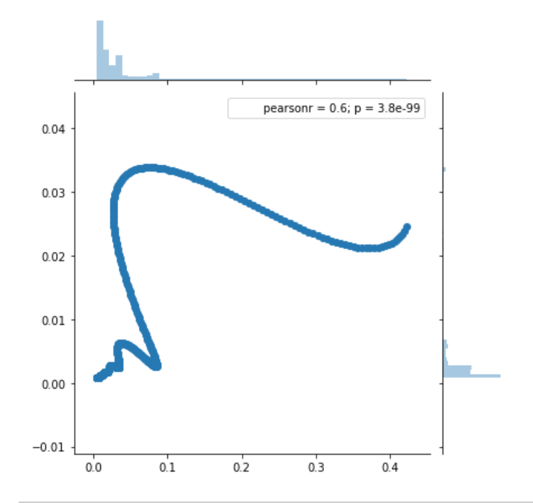
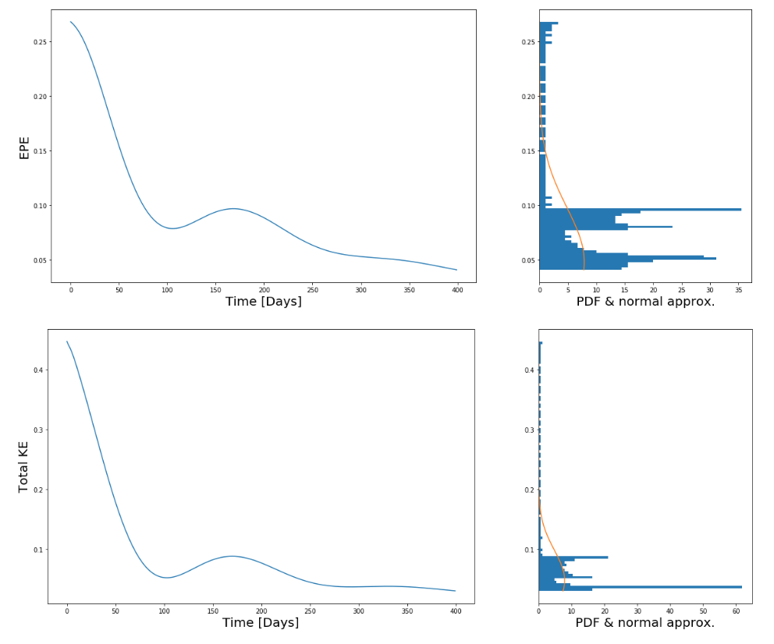
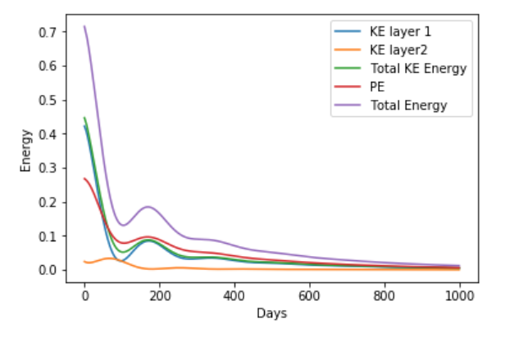
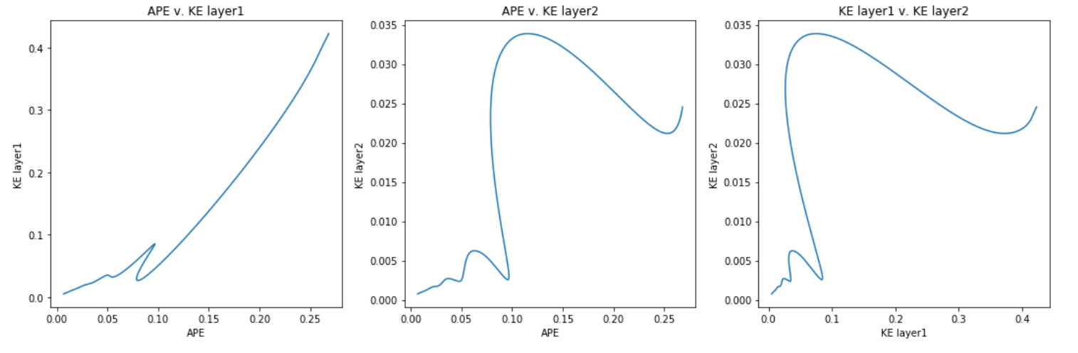
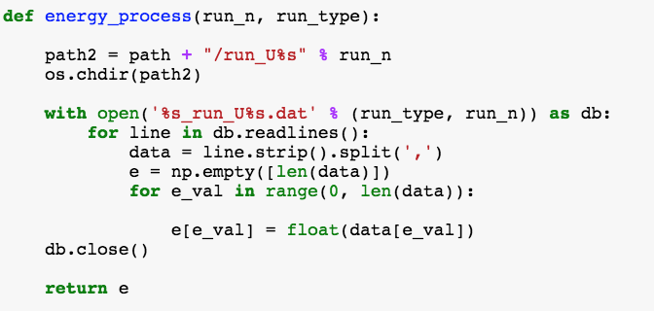
Reality in Energy Analysis
Developed function to read in data based on run number + energy type
Plotted to see evolution of time and relationship between energetics
Just read a paper on wavelet decomposition of energetics
We have a notebook on wavelet decomposition!
Why don’t I try that!

Slide 8
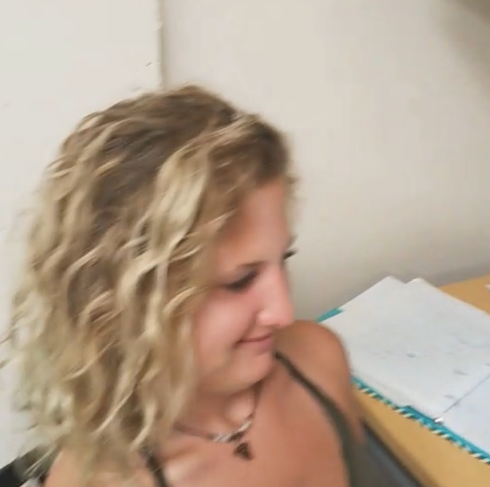
Reality in Energy Analysis
‘I have no clue’
‘Probably not’
‘Does my answer make sense?’
The wavelet transform was highly complex
Was not sure if my data was even applicable to the code provided
Considered FFT as well

Slide 9
Reality

Slide 10
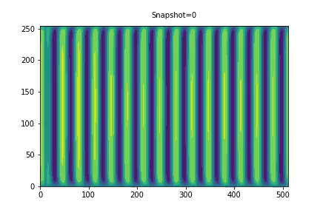
Reality in Streamfunction analysis
Was able to create function to process data to:
Read per snapshot
Create an animation for and save
Animation tools from notebooks very helpful
Enhacned my analysis

Slide 11

Reality

Slide 12
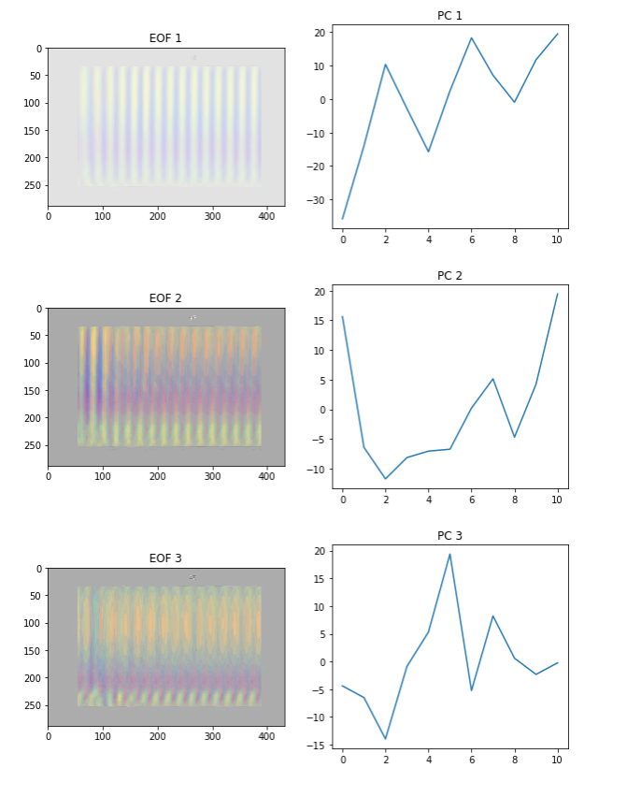
Reality in Streamfunction analysis
Was not able to produce an EOF of mean meridional streamfunction for a given snapshot
Could not get the matrices to align
Settled for an EOF of produced animation
Was curious of how EOF of data snapshot would look
Didn’t have any expectation for results due to it being on the colors versus actual data

Slide 13
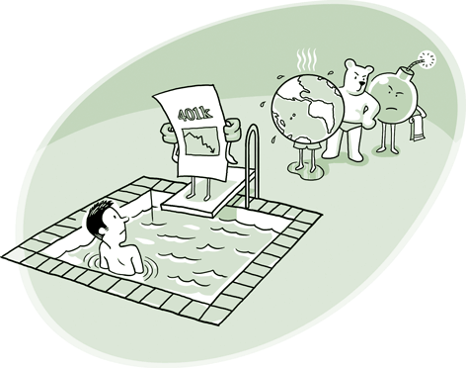
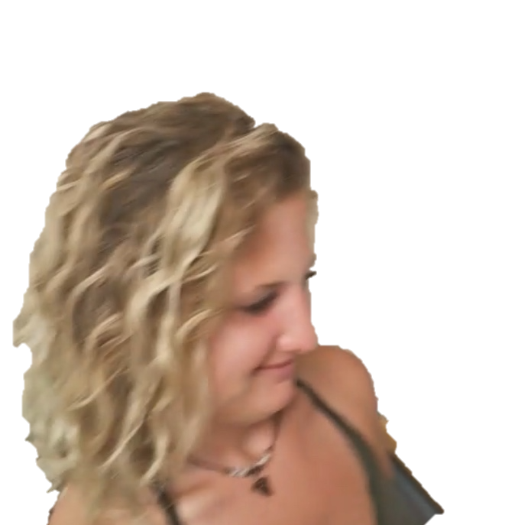
Conclusion
So many tools
Great resources
Too little time
Not even sure if I am applying tools correctly
COMPS

