Slide 1
Introduction to UM CCS and Pegasus supercomputer
Natalie Perlin
(nperlin@rsmas.miami.edu; hpc@ccs.miami.edu)
Center of Computational Science,
Rosenstiel School of Marine and Atmospheric Sciences, University of Miami
September 14, 2018

Slide 2
Outline
Center of Computational Science (CCS), University of Miami
Advanced Computing (High Performance Computing) group: computing, storage and database services: ccs.miami.edu/ac
Pegasus cluster basic information
Requesting the CCS and Pegasus account: https://portal.ccs.miami.edu/
Joining or creating a Project
Accessing the Pegasus cluster
Linux and Home environment. Software modules
Data and file transfer
Compilers, MPI, and Interpreters
Job scheduling with LSF. Running Interactive jobs
HPC Documentation. Help via RT tickets: hpc@ccs.miami.edu

Slide 3

Center of Computational Science (CCS), University of Miami
http://ccs.miami.edu/
Several groups and focus areas :
Advanced Computing
Big Data Analysis and Data Mining
Climate and Environmental Hazards
Computational Biology and Bioinformatics
Drug Discovery
Engagement and Outreach
Social Systems Informatics
Software Engineering
Smart Cities
Visualization

Slide 4
Advanced Computing group http://ccs.miami.edu/ac http://ccs.miami.edu/ac/docs
Maintains one of the largest centralized academic High Performance Computing (HPC) cyber infrastructures in the country
Compute resources, data storage, and database services for UM students, faculty, and staff: over 1500 CCS users
Pegasus supercomputer: Linux/CentOS 6.5 batch/interactive compute cluster, ~ 5,500 cores based on IBM iDataPlex systems
Visualization clusters, and dedicated graphical nodes on Pegasus
Integrated storage environment: high-capacity dedicated storage and high-speed storage optimized for performance, all supported by the IBM SpectrumScale (former GPFS - general parallel file system)
Systems and Cloud Storage maintenance

Slide 5
Pegasus cluster info
Location: independent network provider, Verizon Terremark NAP of the Americas Datacenter in Miami
Based on IBM iDataPlex dx360 M4 systems
Computational nodes: 16 cores (two 8-core SandyBridge Intel 2.6 GHz processors)
Total of 5500+ computational cores
Node memory: 32GiB (2 GiB per core) and several larger node for memory- intense computations
Node interconnect: Mellanox FDR InfiniBand fiber optic cables
Login and management nodes
CentOS 6.5 Operating System
LSF (Load Sharing Facility) job scheduler
Dedicated high-volume DDN storage (diskless)
IBM SpectrumScale (GPFS) filesystem, designed for massively parallel work
Large suite of compilers, MPI, standard scientific and optimized libraries
Software modules with most demanding applications

Slide 6

Requesting and obtaining the CCS and Pegasus account
NB: All the HPC resources including the portal web site are accessed ONLY ONLY ONLY via secure campus network (wired or wireless “SecureCanes”) or VPN connection!
Register at the CCS/Pegasus User Portal: https://portal.ccs.miami.edu/
Register as CCS User:
Enter your University CaneID to proceed
Must have a valid UM e-mail address to register
Follow the instructions sent to your UM e-mail to confirm your identity, affiliation with the UM
Use User Portal:
Login, view or change your account info
Join or create a Project, for scratch (work) space allocation, software requests
Reset Password
Notes:
Web sites including account management, project management, request forms, HPC documentation

Slide 7
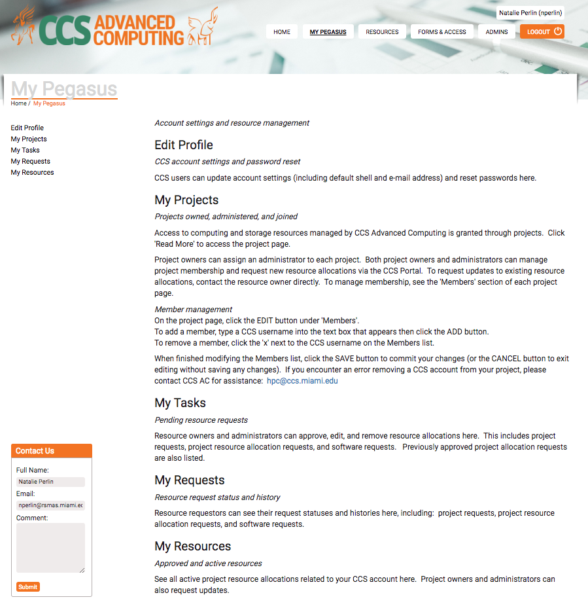

Slide 8
Joining or creating a Project
Login to https://portal.ccs.miami.edu/ with your CCS User and password credentials
Top menu: choose “Forms and Access”, left menu: “Project”
To Create a new project: fill the form Project Request Detail . Note: approval of the projects is done by the allocation committee, and the projects requesting Scratch Size > 2TB or/and CPU hours > 50,000 hours could take longer time to be reviewed and approved (> 1 month).
To join an existing Project: contact your RSMAS advisor or faculty member!
Project Users have higher priority in job queues
Project Users get access to the project scratch space shared by the project users, in addition to their $HOME directory 250G allocation
$HOME | /scratch/projects
250 G | 2 T *
permanent, not purged | high-speed, purged
/nethome/uid | /scratch/projects/projectid
- Project members have read and write access to this space. Subfolder as needed!
- Data older than 3 weeks are subject to purge

Slide 9
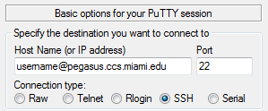
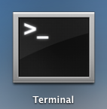
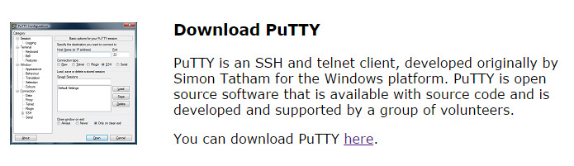

Accessing Pegasus cluster
with Secure Shell (SSH)
SSH – Linux and Mac OS X
Use the included SSH in Terminal
SSH – MS Windows
Use an SSH client like PuTTY
Download from: http://www.putty.org
Choose the SSH client
Notes:
NB!! Remember that Pegasus is available from within the UM’s secure network connections only!!

Slide 10


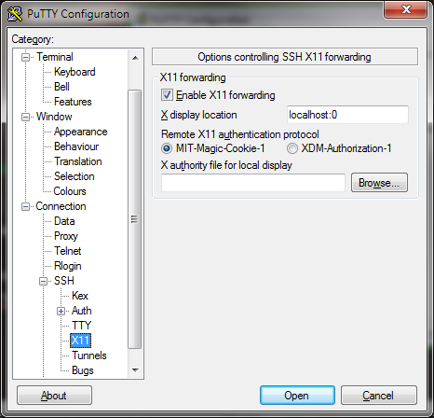
Accessing Pegasus cluster
Enable graphics, graphical display forwarding with X11
SSH – Linux:
Set “X11Forwarding yes” in SSH config: in /etc/ssh/ssh_config
Use –X flag:
SSH – Mac OS X:
Install XQuartz X11 created by Apple as a community project to continue support X11 on OS X:
http://xquartz.macosforge.org/
Use –X flag:
SSH – MS Windows
Install the Xming X server for Windows:
http://sourceforge.net/projects/xming/
Launch Xming before launching PuTTY
Configure PuTTY to use X11:
From the left Configuration menu, find Connection-> SSH -> X11
Check the box “Enable X11 forwarding”
Add “localhost:0” to X display connection
Save Session settings in PuTTY to remain

Slide 11
Linux and Home environment. Software modules
Home environment is Linux bash shell (or other Linux/Unix shell of your choice), and customized by environmental variables
view them by typing “env” or “env | sort”
Your home directory is env. variable $HOME=/nethome/uid , $USER=uid
check a particular env. variable setting with “echo $VARID”, for instance, “echo $SHELL”
Software is accessible by loading the appropriate Modules
module avail (gives you a list of available modules)
module list (gives you a list of modules loaded into your current environment)
module load modulename (loads the requested module environment)
module display modulename (displays module environment and software installation information
module unload modulename (removes the environment associated with the module from your profile)
Request a new software at https://portal.ccs.miami.edu/
Forms and Access (top menu) -> Software (left menu)
We only globally install software when we have multiple requests for the software
Install a new software in your own home directory if needed

Slide 12

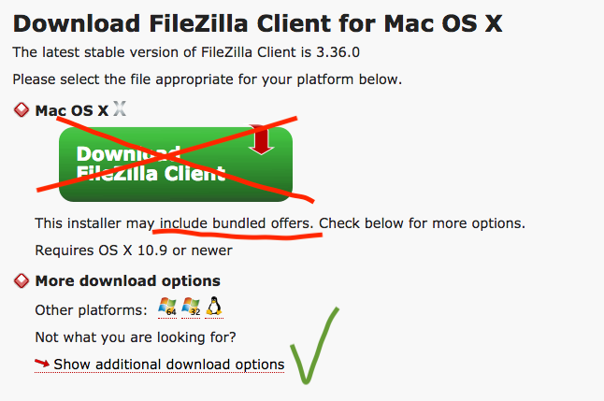
Data and file transfer to/from Pegasus
http://ccs.miami.edu/ac/docs/#fts
Command line programs in a terminal:
scp
rsync
sftp
GUI interface: FileZilla (multi-platform)
Download a specific client:
https://filezilla-project.org/download.php?type=client
choose a specific client from “Show additional download options”
MS Windows: other programs of your choice
PSFTP (PuTTY FTP)
Cygwin FTP
SCP file to Pegasus: | bash$ scp /local/file.txt uid@pegasus.ccs.miami.edu:/nethome/uid/file.txt
SCP directory to Pegasus (recursive): | bash$ scp –r /local/localdirectory uid@pegasus.ccs.miami.edu:/nethome/uid/

Slide 13
Compilers, MPI, and language interpreters
GNU compilers : gcc/4.4.7 (default for gcc) module, version 4.4.7 20120313
f77, f95/gfortran, - Fortran compilers
gcc - C and C++ compiler
Intel compiler suite : intel module, version composer_xe_2013.2.146
icc, icpc - Intel C , C++ compilers
ifort - Fortran compiler
Portland Group’s PGI Accelerator : pgi/13.10 module, version 13.10
pgf77, pgf90 - PGI Fortran compilers
pgcc, pgCC/pgc++ - PGI C, C++ compilers
MPI builds:
impi - Intel-built MPI module
openmpi/1.7.5 module built with Intel ifort, icc compilers
openmpi-gcc/1.6.2 module (default for openmpi-gcc), build with GNU compilers
Language interpreters:
python - modules python/2.7.3 (default for python), python/3.3.1
perl - module perl/5.18.1
R - modules R/2.15.2, R/3.0.0, R/3.0.1, R/3.1.2

Slide 14
Job scheduling with LSF (batch jobs)
The computational jobs are scheduled to run on processing nodes in using the LSF (Load Sharing Facility) resource manager, LSF docs: http://www.ccs.miami.edu/hpc/lsf/9.1.1/
Create a script with all the commands to launch your application as a bash or csh script.
Supply the header with the information for the LSF (see examples) .
Submit your job: [login3]$ bsub < myjob.sh
Common LSF commands:
bjobs - displays your running and pending jobs
bkill jobID - terminates/cancels a job identified by jobID number
Example of a serial (1-cpu) job script header:
#!/bin/bash
#BSUB –J serialjob
#BSUB –n 1
#BSUB –q general
#BSUB –W 3:00
#BSUB –R “rusage[mem=512] span[hosts=1]”
#BSUB –o %J.out
#BSUB –e %J.err
#
myjob.exe
Example of an MPI job script header (with Intel mpi):
#!/bin/bash
#BSUB –J mpijob
#BSUB –n 32
#BSUB –q general
#BSUB –W 5:00
#BSUB –R “rusage[mem=28000]”
#BSUB –R “span[ptile=16]”
#BSUB –o %J.out
#BSUB –e %J.err
# Run an MPI job with the “hydra” MPI job starter
mpiexec.hydra myjob.exe

Slide 15
Running interactive jobs
Running interactive (non-graphical) job, starting on regular compute nodes:
[login3]$ bsub -Is $(your_job_and_options)
[login3]$ bsub –Is matlab -nodisplay
There is an interactive queue for starting interactive graphical jobs:
[login3]$ bsub –q interactive –Is –XF matlab
Job <4427514> is submitted to queue <interactive>.
<<ssh X11 forwarding job>>
<<Waiting for dispatch ...>>
<<Starting on n002>>
Upon exiting the interactive job, you are returned to your login node.
Make sure you have the graphical display forwarding (X11) set-up and enabled on your local machine/terminal if running a graphic applications.

Slide 16


HPC Resources and Documentation
Policies: http://ccs.miami.edu/ac/policies/
Documentation: http://ccs.miami.edu/ac/docs
Pegasus Linux User Guides: http://ccs.miami.edu/ac/docs-linux/
CCS User Portal: https://portal.ccs.miami.edu/
Support and FAQ: http://ccs.miami.edu/ac/support/
Help and questions : hpc@ccs.miami.edu
Sending a mail to hpc@ccs.miami.edu creates an RT (Request Tracking) ticket and assigns a ticket number. Further communication including this number will ensure the problem is tracked till it solved, and then the ticket could be closed.
Dear HPC, …

