Slide 1

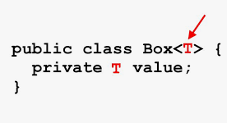
Generics
Contents
Introduction
Basic Syntax
Why Using Generics?
Generic Classes and Interfaces
Generic Methods
Bounded Types
Wildcards Generic Types

Slide 2
Generics
Introduction
Generics introduced by Java JDK 1.5.
Generics means parameterized types.
Generics add the type safety.
Generics does not work with primitive types (int, float, char, …).

Slide 3
Generics
Basic Syntax
T is a type parameter that will be replaced with a concrete type when the class is instantiated.
public class Box<T> {
private T t;
public void set(T t) {
this.t = t;
}
public T get() {
return t;
}
}

Slide 4
Generics
Why Generics?
Generics can be achieved by specifying Object Type and using proper casting when it required
So why we use generics ??
By using Object , java Compiler doesn’t have info about the type of the data so ,
Explicit Casts must be employed to retrieve the stored data.
Several type mismatch errors can’t be found till runtime

Slide 5
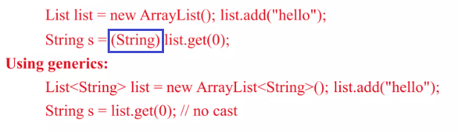
Generics
Why Generics?

Slide 6
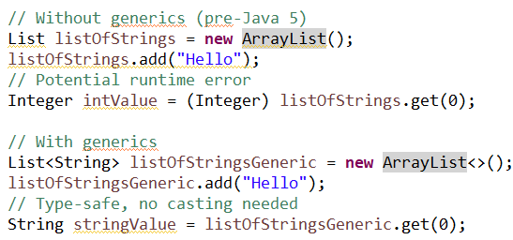
Generics
Why Use Generics?
Type safety:

Slide 7
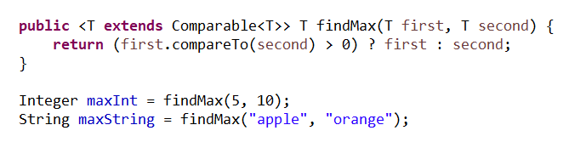
Generics
Why Use Generics?
code reusability

Slide 8
Generics
Generic is Working with references Data Types
Reference Types:
List<String> stringList = new ArrayList<>();
Map<Integer, String> map = new HashMap<>();
Primitive Types:
List<int> intList = new ArrayList<>(); // This is not allowed

Slide 9
Generics
Generic is Working with references Data Types
Wrapper Classes:
To use generics with primitive types, you must use their corresponding wrapper classes:
byte | Byte
short | Short
int | Integer
long | Long
float | Float
double | Double
boolean | Boolean
char | Character

Slide 10
Generics
Generic is Working with references Data Types
public class GenericExample {
public static void main(String[] args) {
List<Integer> numbers = new ArrayList<>();
numbers.add(10);
numbers.add(20);
numbers.add(30);
for (Integer number : numbers) {
System.out.println(number);
}
}
}

Slide 11
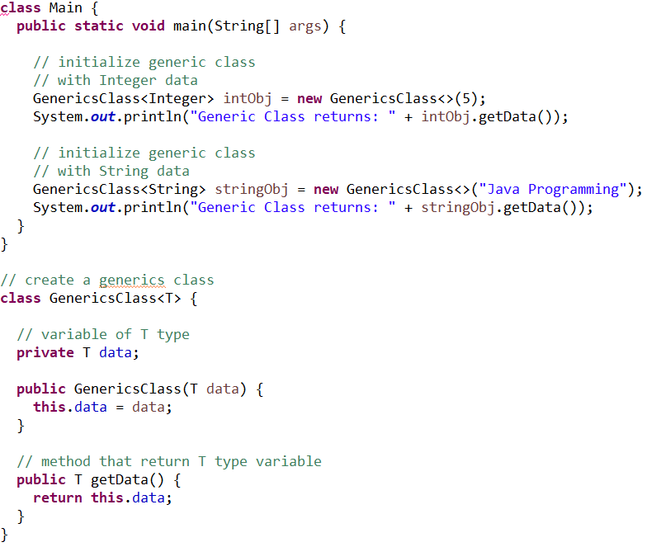
Generics
Java Generic Class

Slide 12
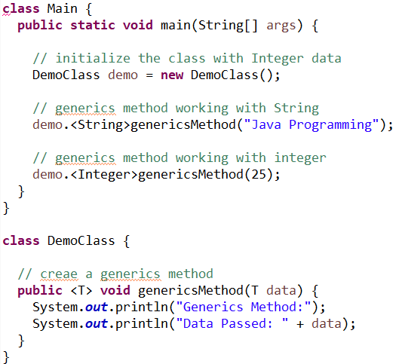
Generics
Java Generic Method

Slide 13
Generics
Bounded Types
Allows you to restrict the types that can be used as type arguments for a generic class, interface, or method.
Ensures that the type parameters meet certain criteria which is useful for:
maintaining type safety
leveraging polymorphism
Types of Bounded Types : Upper Bounded Types (extends)
Lower Bounded Types (super)

Slide 14
Generics
Upper Bounded Types
An upper bounded type restricts the type parameter to be a specific type or a subtype of that type. This is specified using the extends keyword.
<T extends SomeClass>
public class Box<T extends Number> {
private T t;
public void set(T t) {this.t = t;}
public T get() {return t;}
public void print() {System.out.println(t.doubleValue());}
}

Slide 15
Generics
Upper Bounded Types
The Box class can only be instantiated with types that are subclasses of Number (e.g., Integer, Double), ensuring that the type has a doubleValue() method.
public static void main(String[] args) {
Box<Integer> intBox = new Box<>();
intBox.set(10);
intBox.print(); // Output: 10.0
Box<Double> doubleBox = new Box<>();
doubleBox.set(10.5);
doubleBox.print(); // Output: 10.5
// Box<String> stringBox = new Box<>();
}

Slide 16
Generics
Lower Bounded Types
A lower bounded type restricts the type parameter to be a specific type or a supertype of that type. This is specified using the super keyword.
<T super SomeClass>
public class BoxPriter {
public static void addNumbers(List<? super Integer> list) {
for (int i = 1; i <= 10; i++) {
list.add(i);
}
}

Slide 17
Generics
Lower Bounded Types
A lower bounded type restricts the type parameter to be a specific type or a supertype of that type. This is specified using the super keyword.
public static void main(String[] args) {
List<Number> numberList = new ArrayList<>();
addNumbers(numberList);
System.out.println(numberList); // Output: [1, 2, 3, 4, 5, 6, 7, 8, 9, 10]
List<Object> objectList = new ArrayList<>();
addNumbers(objectList);
System.out.println(objectList); // Output: [1, 2, 3, 4, 5, 6, 7, 8, 9, 10]
}

Slide 18
Generics
Wildcards
Wildcards are special symbols used in generics to represent an unknown type.
Wildcards allow for more flexible and reusable code by letting you specify a range of acceptable types for a generic class, interface, or method.
There are three types of wildcards:
unbounded wildcards
upper bounded wildcards
bounded wildcards.

Slide 19
Generics
Wildcards
Types of Wildcards
Unbounded Wildcard (?)
Upper Bounded Wildcard (? extends Type)
Lower Bounded Wildcard (? super Type)

Slide 20
Generics
Wildcards
Unbounded Wildcard (?)
An unbounded wildcard represents an unknown type. It can be any type, similar to using Object, but it retains generic type information.
List<?> list = new ArrayList<>();

Slide 21
Generics
Wildcards
Unbounded Wildcard (?)
public static void printList(List<?> list) {
for (Object elem : list) {System.out.println(elem);}}
public static void main(String[] args) {
List<String> stringList=List.of("apple","banana","cherry");
List<Integer> intList = List.of(1, 2, 3);
printList(stringList); // Output: apple, banana, cherry
printList(intList); // Output: 1, 2, 3
}

Slide 22
Generics
Wildcards
Upper Bounded Wildcard (? extends Type)
An upper bounded wildcard restricts the unknown type to be a specific type or a subtype of that type. This is specified using the extends keyword.
List<? extends Number> list = new ArrayList<>();

Slide 23
Generics
Wildcards
Upper Bounded Wildcard (? extends Type)
static double sumOfList(List<? extends Number> list) {
double sum = 0.0;
for (Number num : list) {sum += num.doubleValue();}
return sum;}
public static void main(String[] args) {
List<Integer> intList = List.of(1, 2, 3);
List<Double> doubleList = List.of(1.1, 2.2, 3.3);
System.out.println(sumOfList(intList)); // Output: 6.0
System.out.println(sumOfList(doubleList)); // Output: 6.6
}

Slide 24
Generics
Wildcards
Lower Bounded Wildcard (? super Type)
A lower bounded wildcard restricts the unknown type to be a specific type or a supertype of that type. This is specified using the super keyword.
List<? super Integer> list = new ArrayList<>();

Slide 25
Generics
Wildcards
Lower Bounded Wildcard (? super Type)
public static void addNumbers(List<? super Integer> list) {for (int i = 1; i <= 10; i++) {list.add(i);}}
public static void main(String[] args) {
List<Number> numberList = new ArrayList<>();
List<Object> objectList = new ArrayList<>();
addNumbers(numberList);
addNumbers(objectList);
System.out.println(numberList); // Output: [1, 2, 3, 4, 5, 6, 7, 8, 9, 10]
System.out.println(objectList); // Output: [1, 2, 3, 4, 5, 6, 7, 8, 9, 10]
}

Slide 26
Generics
Generics
Thank You !!

