Slide 1

Exceptions
Content
Exceptions Types
Exceptions Keywords
Exceptions Handling
Customization Exceptions
Types

Slide 2
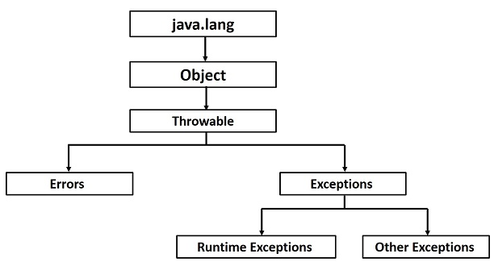
Exceptions
Hierarchy
Types

Slide 3
Exceptions
Types
RuntimeException (unchecked)
- any exception that extends RuntimeException
- counted as bugs and must be fixed to complete app
- unchecked by the compiler – developer responsibility
Compilation Exceptions (checked)
- any exception that doesn’t extend RuntimeException
- user defined exceptions
- are NOT bugs !! And therefore checked by the compiler
Errors : Serious problems that user /programmer is not responsible about it and they shouldn’t handle it.
Types

Slide 4
Exceptions
Runtime Exceptions
ArithmeticException
NullPointerException
NegativeArraySizeException
ArrayIndexOutOfBoundsException
SecurityException
NumberFormatException
ClassCastException
Types

Slide 5
Exceptions
Compile Exceptions
IOException [EOFException, FileNotFoundException…]
SQLException
DOMException, SAXException
ClassNotFoundException
RemoteException
AWTException
Types

Slide 6
Exceptions
Errors
An Error is a subclass of Throwable that indicates serious problems that a reasonable application should not try to catch
Assertation Error
IncompatibleClassChangeError
ExceptionInitializerError
OutOfMemoryError
StackOverFlowError
Internal Error
Types
VirtualMachineError

Slide 7
Exceptions
Keywords
Keyword | Description
try | Used to specify a block where we should place exception code. must be followed by either catch or finally.
catch | Used to handle the exception. It must be preceded by try block which means we can't use catch block alone.
finally | Used to execute the important code of the program. It is executed whether an exception is handled or not.
throw | used to throw an exception.
throws | used to declare exceptions. It doesn't throw an exception. It specifies that there may occur an exception in the method. It is always used with method signature.
Keywords

Slide 8
Exception
Handling Exceptions
Compilation Exception must be handled (caught or thrown)
Runtime Exception may be handled (caught or thrown)
Handling
Handling
Catching exceptions - providing a solution to the situation
Throwing Exceptions – hand on the situation so clients can decide upon their wanted solution

Slide 9
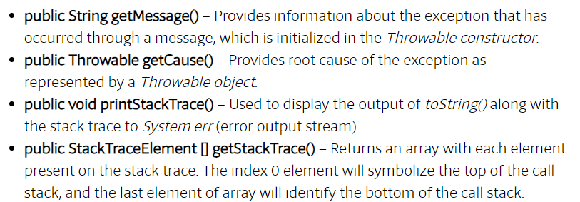
Exceptions
Methods Exceptions
Methods

Slide 10
Exceptions
Catching Exceptions
Should be written as close to the origin throwing point as possible.
Catching java.lang.Exception will catch all types of exceptions.
Use java.lang.Exception methods to get information:
Catching Exception
Try{
………….
}catch(Exception e){
System.out.println(e.getMessage());
e.printStackTrace(System.out);
}

Slide 11
Exceptions
Catching Exceptions
public class Test {
public static void main(String args[]) {
try {
int a[] = new int[2];
System.out.println("Access element three:" +a[3]); }catch (ArrayIndexOutOfBoundsException e) {
System.out.println("Exception thrown :"+ e);
} System.out.println("Out of the block");
}
}
Catching Exception

Slide 12
Exceptions
Catching Exceptions
public void check(String fileName, String value) {
try {
FileInputStream in = new FileInputStream(fileName);
if (Integer.parseInt(value) >= 100) {return;}
} catch (I Exception e) {// handle I/O problem…
return;
} catch (NumberFormatException e) {
// handle runtime exception…
} finally {
System.out.println("This is printed in any case...");}
System.out.println("Done!");}
Catching Exception

Slide 13
Exceptions
Throwing Exceptions
Any method can delegate exceptions to the caller.
A method must declare any thrown checked Exception as part of its signature.
Throwing Runtime Exceptions (unchecked) is allowed but not always necessary.
throws – used in a method or constructor signatures to declare all their thrown exceptions.
throw – is used inside a method body when throwing a created exception object.
Throwing Exception

Slide 14
Exceptions
Throwing Exceptions
public class Checking {
public static int check(String s) throws NumberFormatException
{
return Integer.parseInt(s);
}
public static void main(String[] args) {
int num = check(args[0]);
System.out.println(num + 1);
}
}
Throwing Exception

Slide 15
Exceptions
Throwing Exceptions
public class Checking {
public static int check(String s) throws NumberFormatException {
int x = Integer.parseInt(s);
if (x > 100)
throw new NumberFormatException("Number is too big");
return x;
}
public static void main(String[] args) {
int num = check(args[0]);
System.out.println(num + 1);
}
}
Throwing Exception

Slide 16
Exceptions
Customized Exceptions
public class NumberOutOfLimitsException extends Exception {
// added field
private int num = 0;
public NumberOutOfLimitsException(String msg, int num) {
super(msg);
this.num = num;
}
// added method
public int getNum() {
return num;
}
}
Customization

Slide 17
Exceptions
Customized Exceptions
public class NumChecker {
public void check(int num) throws NumberOutOfLimitsException {
if (num < 0 || num > 100)
throw new NumberOutOfLimitsException("Wrong value", num);
}
}
public class TestChecker {
public static void main(String[] args) {
NumChecker nc = new NumChecker();
try {
nc.check(Integer.parseInt(args[0]));
System.out.println(args[0] + " is OK");
} catch (NumberOutOfLimitsException e) {
System.out.println(e.getMessage() + " " + e.getNum());
}
}
}
Customization

Slide 18
Exceptions
Thank You !!

