Slide 1
Spring
Introduction
Spring Core Container
Spring Beans
Spring AOP
Spring Properties
Spring JPA
Spring Boot
Spring Data JPA
Spring Data NOSQL
Spring MVC & REST ( Feigns)
Spring Security
Spring Apache Kafka
Spring Testing
Agenda

Slide 2
Spring
Introduction

Slide 3
Spring
What is Spring?
Spring is an open-source development framework for Enterprise Java applications.
The core features of the Spring Framework can be used in developing any Java application
Spring provides several tools and framework features to develop microservices e.g. Spring Boot and Spring Cloud
Introduction

Slide 4

Spring
The Spring Framework is a Java platform that provides comprehensive infrastructure support for developing Java applications.
Spring handles the infrastructure so developers can focus on application business logic.
Introduction

Slide 5
Spring
Advantages
Benefit | Spring ( MS ,MONO) | J2EE (MONO)
Lightweight | basic version of spring framework is around 2MB | Basic WebLogic version is around 800MB.
Open source | Yes-Spring became the most popular technology to develop Java Enterprise Application | No- is disappearing from the market
cost | Free | 200$ - 500$
Introduction

Slide 6
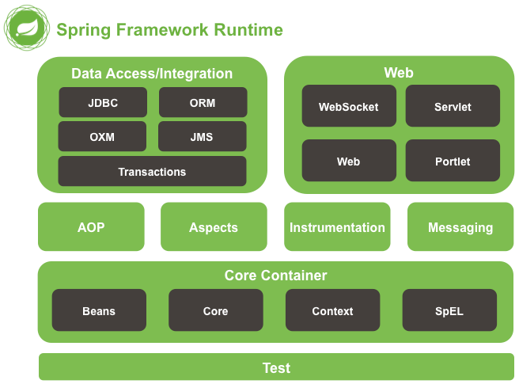
Spring
Modules
Introduction

Slide 7
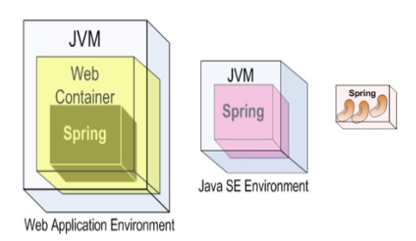
Spring
Core Container
The Spring container is responsible for instantiating, configuring, and assembling the beans.
The Container manages the Beans creation, configuration and management.
Bean that is instantiated by the Container has a lifecycle.
Beans are the java objects which form a Spring application and are managed by Spring container.
Introduction

Slide 8
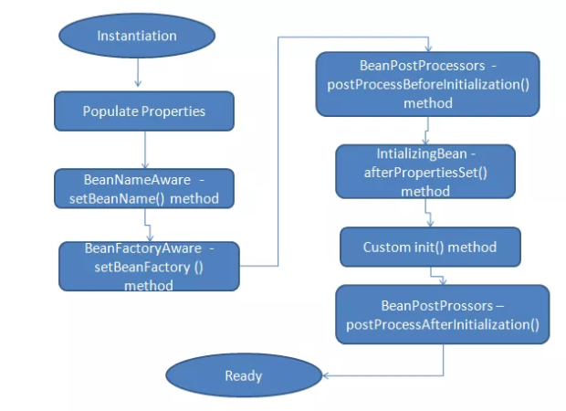
Spring
Beans
When a Bean is instantiated, it might have to perform some actions to get into its initial state.
The container assists the Bean to achieve all required resources to get into initial state
Introduction

Slide 9
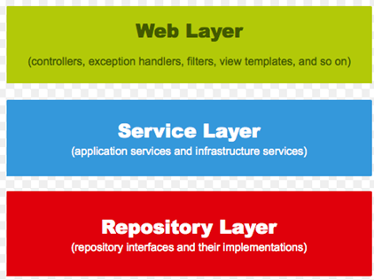
Spring
Spring Application Design
when building a Spring application, is to split application into layers:
Introduction
Notes:
9

Slide 10
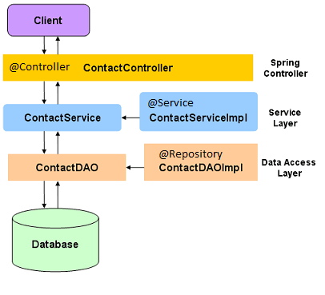
Spring
Spring Application Design
Every layer is composed of Spring Beans.
Components of a ‘lower’ level are injected to higher layer components.
Injection on the interfaces gains Loose coupling and separation of implementation.
Introduction

Slide 11
Spring
Spring Core Container

Slide 12
Spring
Spring Core Container
The Spring container is the Run Time Environment of the Spring Beans.
In the Spring container Beans are created ,wired, configured and managed based on information that developers provide to the Spring container.
Spring Framework provides two Interfaces to implement the Spring Core Container
org.springframework.beansFactory
org.springframework.context
Spring Core Container

Slide 13
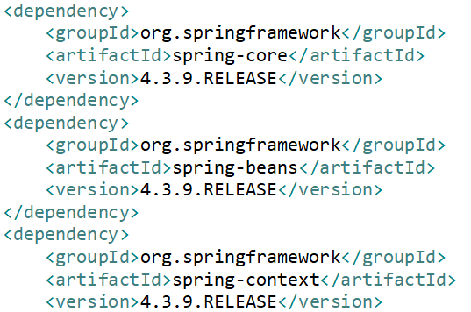
Spring
Spring Core Container
How to Create Spring Core Container ?
Spring Core Container

Slide 14
Spring
Spring Core Container
How to Create Spring Core Container ?
Spring Core Container
public static void main(String[] args) {
ApplicationContext ctx = new AnnotationConfigApplicationContext(SpringMain.class);
}

Slide 15
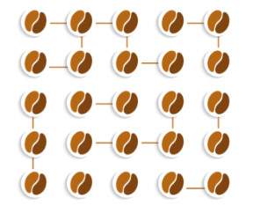
Spring
Spring Core Container
DI relation
Spring Core Container
Spring Core Container
Spring Beans

Slide 16
Spring
IOC - Inversion Of Control
The Spring IoC is a pattern that give the Spring Container to handle the objects creation, manage them and wiring them together and configure them.
The abstract meaning of “inversion of control” is to invert the bean creation from the Class control to the Container control.
The container gets its instructions on objects to instantiate,configure, and assemble by reading the configuration metadata provided.
Spring Core Container

Slide 17
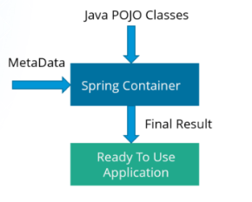
Spring
IOC - Inversion Of Control
The main tasks performed by IoC container are:
to instantiate the application classes
to configure the objects by metadata
to assemble the dependencies between the objects
Spring Core Container

Slide 18

Spring
Dependency Injection
DI is a way to achieve Inversion of Control (IoC)
DI is to provide the actual instructions (the meta data) to Spring Container to Control the Beans maintaining
DI is implemented via annotations , Java Code , XML
DI is done On Constructor , setter method, class data member.
There are two types of DI ( By Type , By Name)
Spring Core Container

Slide 19
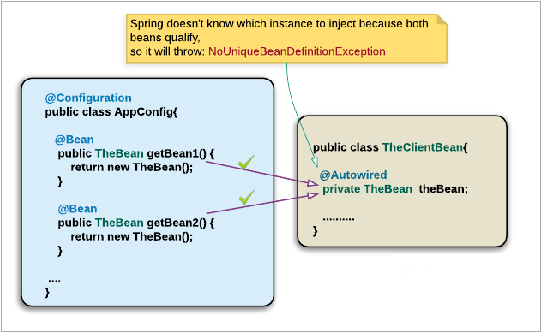
Spring
Injection By Name
Spring Core Container

Slide 20
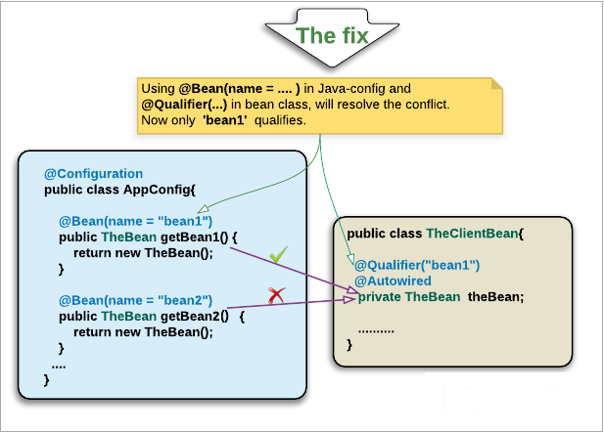
Spring
Injection By Name
Spring Core Container

Slide 21
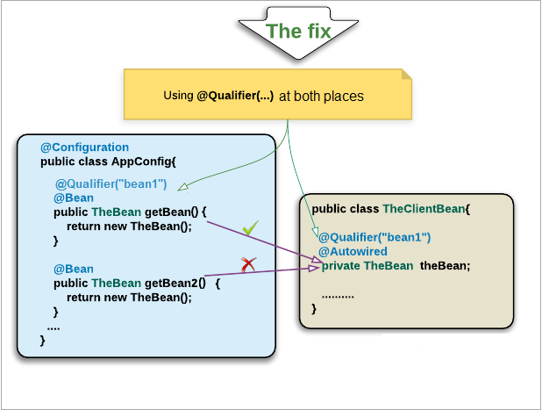
Spring
Injection By Name
Spring Core Container

Slide 22
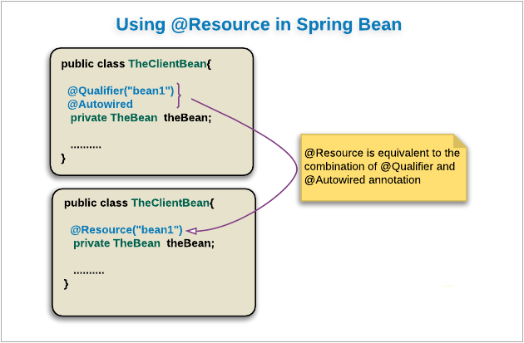
Spring
Injection By Name
Spring Core Container

Slide 23
Spring
DI By Name
@Autowired wires per type and @Resource wires per bean name.
@Resource = @Autowired + @Qualifier
@Autowired is a spring annotation whereas @Resource is specified by the JSR-250.
Spring Core Container

Slide 24
Spring
Injection By Name
Injection By Name – Whenever there are few candidates for DI:
@Component
public class LWapiServiceImplBasic implements LWapiService {
@Component
public class LWapiServiceImplExtended implements LWapiService {
Spring Core Container
@Service
public class CustWalletServiceImpl implements CustWalletService {
@Resource
private LWapiService service;
?
Conflict

Slide 25
Spring
Injection By Name
Injection By Name – Whenever there are few candidates for DI:
@Component("LWapiClientBean_A")
public class LWapiServiceImplBasic implements LWapiService {
@Component("LWapiClientBean_B")
public class LWapiServiceImplExtended implements LWapiService {
Spring Core Container
@Service
public class CustWalletServiceImpl implements CustWalletService {
@Resource(name="LWapiClientBean_A")
private LWapiService service;
Conflict Resolved

Slide 26
Spring
Injection By Name
Injection By Name – @Autowired + @Qualifier
@Component("LWapiClientBean_A")
public class LWapiServiceImplBasic implements LWapiService{
@Component("LWapiClientBean_B")
public class LWapiServiceImplExtended implements LWapiService{
Spring Core Container
@Service
public class CustWalletServiceImpl implements CustWalletService {
@Autowired
@Qualifier(" LWapiClientBean_A")
private LWapiService service;

Slide 27
Spring
Spring Beans

Slide 28
Spring
Bean Creation
XML – the oldest approach
SpringMain.java
public class SpringMain {
public static void main(String[] args) {
ApplicationCon text ctx =
new FileSystemXmlApplicationContext("SpringContext.xml");
}
}
SpringContext.xml - beans definition
<bean id="thePerson“ class="com.jbt.spring.example.model.Person" >
</bean>
Spring Beans

Slide 29
Spring
Bean Creation
Stereotype Annotations approach
@Component
Spring Beans
@Controller
@Service
@Repository

Slide 30
Spring
Bean Creation
Spring Configuration class approach
public class SpringMain {
@Bean
public Person thePerson(){
return new Person(1234,"Joe", 24, null, null);}
}
Spring Beans
public static void main(String[] args) {
ApplicationContext ctx = new AnnotationConfigApplicationContext(SpringMain.class);
Person p1 = (Person)ctx.getBean(“thePerson”);
}

Slide 31
Spring
Spring Beans Scope:
Bean Scopes refers to the lifecycle of Bean
how long does that object live
how many objects will be created for that bean.
Bean Scopes controls the instance creation of the bean, and it is managed by the spring container.
The spring provide five scopes for a bean
Three of them only in the context of web-aware Spring ApplicationContext.
Two of the two is available for both IoC container and Spring-MVC container
Spring Beans

Slide 32
Spring
Spring Beans Types:
Singleton
Only one instance of the bean will be created for a container.
Same instance will be shared for all requests in Container.
This is the default scope for the spring beans.
Spring container first checks whether an instance of that bean is already created or not:
If it is already created, then the Spring container returns the same instance
Otherwise, it creates a new instance of that bean only at the first request
Spring Beans

Slide 33
Spring
Spring Beans Types:
Prototype
More than one instance of the bean will be created for a container.
Spring Container will create a new instance of bean per each request.
prototype scope for all beans that are stateful.
Spring Beans

Slide 34
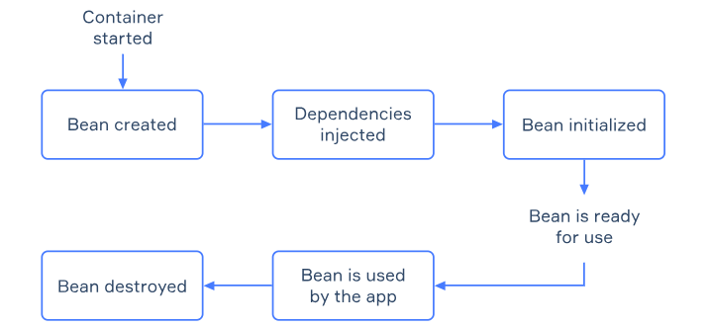
Spring
Spring Beans Lifecycle :
Spring Beans

Slide 35
Spring
Spring Beans Lifecycle :
BeanPostProcessor is part of Spring's dependency injection and bean lifecycle management features
BeanPostProcessor is an interface provided by the Spring framework that allows you to define custom logic to be executed before and after the initialization of Spring beans.
PostProcessBeforeInitialization: this method is called before a bean's initialization callback (such as @PostConstruct or a custom initialization method).
PostProcessAfterInitialization: this method is called after a bean's initialization callback.
Spring AOP

Slide 36
Spring
Spring Beans Lifecycle :
Spring Core Container allows us to customize the initialization according to the needs of our application
load resources
read a file
connect to a database
Spring Core Container allows us to destroy the beans which are no longer required in the application
Spring Beans

Slide 37
Spring
Spring Beans Lifecycle :
There are several ways to add these customizations to your code:
Use special annotations (@PostConstruct, @PreDestroy, @Bean).
Implement some interfaces (InitializingBean, DisposableBean).
Use an XML bean definition file. (Since this is an outdated way mostly used for legacy applications, we will skip it in this topic.)
Spring Beans

Slide 38
Spring
Spring AOP

Slide 39
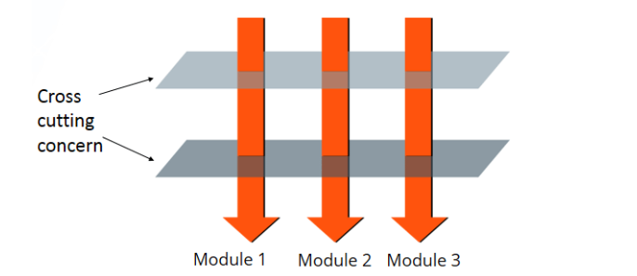
Spring
AOP
AOP is a programming paradigm that allows for the separation of cross-cutting concerns (e.g., logging, security, transaction management) from the business logic in an application.
AOP Improves code modularity by separating cross-cutting concerns.
AOP Enables reusing aspects across different modules of the application.
AOP Simplifies maintenance by keeping the core logic clean and isolated from auxiliary services.
Spring AOP

Slide 40
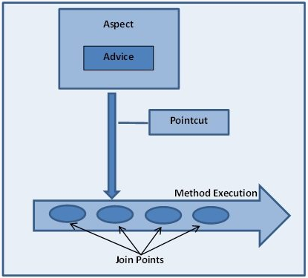
Spring
AOP
Spring AOP

Slide 41
Spring
AOP
Aspect A modularization of a concern that cuts across multiple objects (e.g., logging, security, transaction management).
Join Point A point during the execution of a program, such as the execution of a method or the handling of an exception.
Advice Action taken by an aspect at a particular join point (e.g., before, after, around).
Pointcut A predicate that matches join points. Advice is associated with a pointcut expression and runs at any join point matched by the pointcut.
Spring AOP

Slide 42
Spring
AOP
Aspect:
An aspect is a modularization of a concern that cuts across multiple classes.
In Spring AOP, an aspect encapsulates cross-cutting concerns and defines the advice and pointcuts.
Spring AOP

Slide 43
Spring
AOP
Advice:
Advice is the actual action or code that needs to be executed.
In Spring AOP, advice can be executed at various points in the execution of a program.
The common types of advice are:
Before : Executed before a method.
After returning : Executed after a method returns a value.
After throwing : Executed if a method throws an exception.
After : Executed regardless of the method outcome.
Around : Wraps around a method invocation.
Spring AOP

Slide 44
Spring
AOP
Pointcut:
A pointcut is a set of one or more join points where advice should be executed.
It defines when an advice should be applied.
Pointcuts use expressions to match method invocations.
Join Point:
A join point is a specific point in the execution of a program such as a method call, or an exception being thrown.
Spring AOP

Slide 45
Spring
Spring Propertires

Slide 46
Spring
Properties
Spring supports Properties Values Injection.
Property files are key=value format files externalized application parameters.
There are various ways to achieve Properties Values Injection in Spring
@PropertySource or @PropertySources Annotations
ResourceBundleMessageSource
PropertiesFactoryBean
Spring Properties

Slide 47
Spring
Properties
Injecting the values to Application Beans can be done in two ways:
Directly using the @Value at the field level
Injecting Environment resource and load properties as required
Spring Properties

Slide 48
Spring
Properties
Using the @Value at the field level
Where properties are defined:
prop.val1=prop1-VALUE
prop.val2=prop2-VALUE
Spring Properties
@Service("myBean")
public class MyBean {
@Value("${prop.val1}")
private String propVal1;

Slide 49
Spring
Properties
Injecting Environment resource
@Service("myBean2")
public class MyBean2 {
@Autowired
private Environment env;
private String val;
@PostConstruct
public void init(){
val = env.getProperty("prop.val1");
System.out.println("MyBean2.init() – val:[" + val + "]");
}
Where properties are defined:
prop.val1=prop1-VALUE
prop.val2=prop2-VALUE
Spring Properties

Slide 50
Spring
Properties
@Configuration
@PropertySources( {
@PropertySource("classpath:proj1.properties"),
@PropertySource("classpath:proj2.properties")})
public class SpringConfig {
@Bean
public PropertySourcesPlaceholderConfigurer ppc() throws IOException {
return new PropertySourcesPlaceholderConfigurer();}
}

Slide 51
Spring
Spring Boot

Slide 52
Spring
Spring Boot
Spring Boot provides a good platform for Java developers to develop a stand-alone and production-grade spring application that you can just run.
Spring Boot provides features and properties which are make the developers life more easy.
Spring Boot

Slide 53
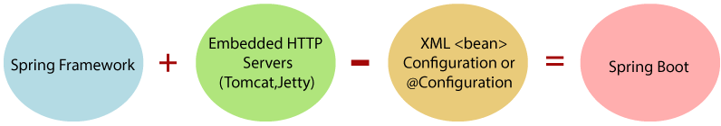
Spring
Spring Boot
Spring Boot can be explained simply by the illustration below:
Spring Boot
Notes:
53

Slide 54
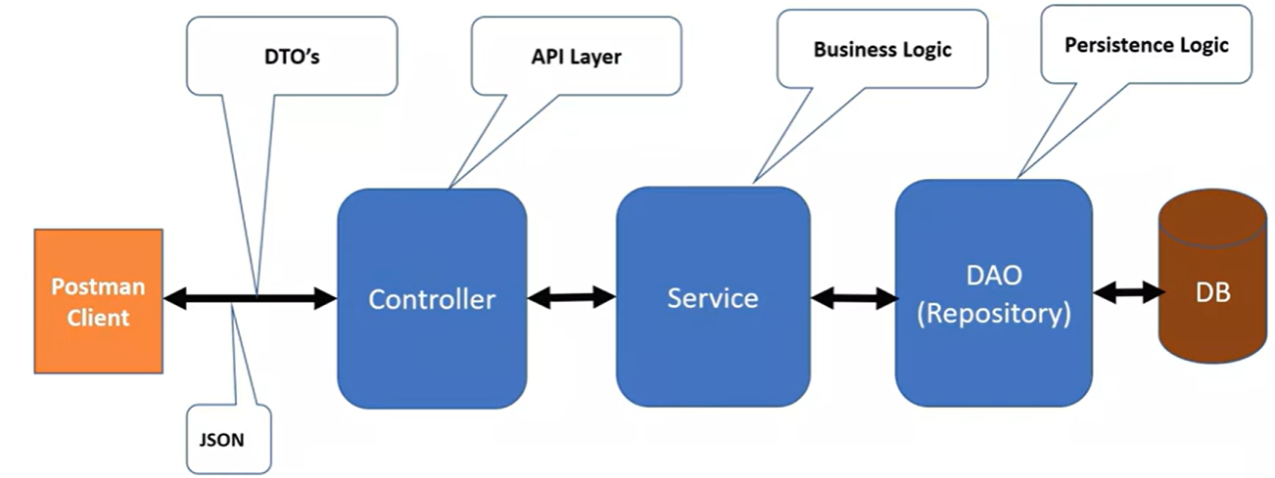
Spring
Spring Boot Application Design
Spring Boot
Notes:
54

Slide 55
Spring
Advantages
Easy to understand and develop spring applications.
Increases productivity of the developers.
Reduces the development resources use.
Spring Boot

Slide 56
Spring
Goals
To avoid complex XML /Annotations configuration in Spring.
To develop a production ready Spring applications in an easier way.
To reduce the development time and run the application independently.
Offer an easier way of getting started with the application.
Spring Boot
Notes:
56

Slide 57
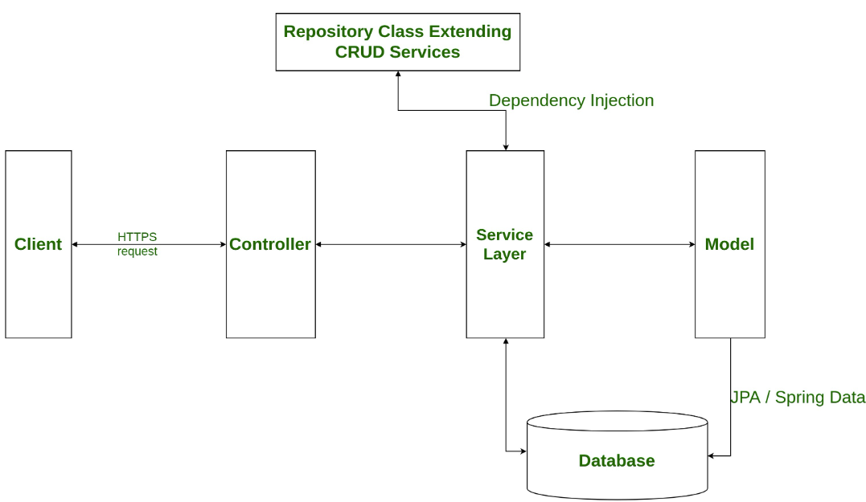
Spring
Spring Boot Application
Notes:
57

Slide 58
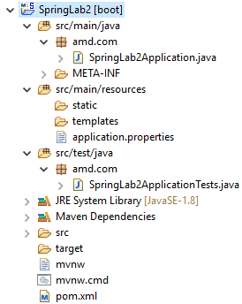
Spring
Spring Boot Application
Notes:
58

Slide 59
Spring
Spring Boot Application
@SpringBootApplication = @Configuration + @EnableAutoConfiguration + @ComponentScan
Notes:
59

Slide 60
Spring
Spring Boot App VS Spring Basic App
@SpringBootApplication = @Configuration + @EnableAutoConfiguration + @ComponentScan
Notes:
60

Slide 61
Spring
Spring JPA Data

Slide 62
Spring
Spring Data
Spring Data is a part of the larger Spring Framework.
aims to simplify data access in Java-based applications.
provides a consistent and high-level approach to interact with different types of data stores:
Relational databases
NoSQL databases
Spring Data
Notes:
62

Slide 63
Spring
Spring Data modules IO
Spring Data JPA (Java Persistence API)
Spring Data MongoDB
Spring Data Redis
Spring Data Couchbase
Spring Data JDBC
Spring Data REST
Spring Data
Notes:
63

Slide 64
Spring
Spring Data JPA
Spring Data JPA simplifies the development of data access layers using JPA.
Spring Data JPA provides a set of abstractions and repositories to make it easier to interact with databases using JPA.
Spring Data JPA provides a JPA and Crud Repository interfaces for CRUD operations.
Spring Data JPA
Notes:
64

Slide 65
Spring
Java Persistence API - JPA
JPA is a specification for managing relational data in Java applications.
JPA provides a standardized way for Java developers to interact with relational databases.
JPA is abstracting the details of database-specific implementations and allowing developers to work with Java objects rather than SQL queries.
Spring Data JPA
Notes:
65

Slide 66
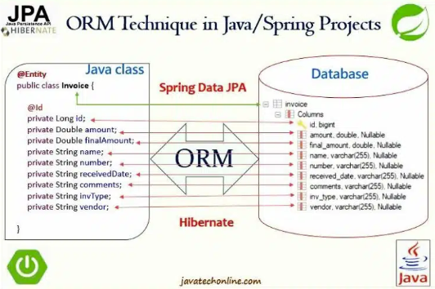
Spring
ORM
Spring Data JPA
Notes:
66

Slide 67
Spring
Java Persistence API - JPA
JPA allows developers to map Java objects to database tables and vice versa.
Entities is a lightweight, persistent domain object.
Entities represent data stored in a database table.
JPA provides annotations to define entities in Java code.
EntityManager is a key interface in JPA responsible for managing the lifecycle of entities.
EntityManager provides methods to persist, merge, remove, and find entities.
Spring Data JPA
Notes:
67

Slide 68
Spring
JPA Repositories
The central interface in the Spring Data repository abstraction is Repository.
It takes the domain class to manage as well as the ID type of the domain class as type arguments.
This interface acts primarily as a marker interface to capture the types to work with and to help you to discover interfaces that extend this one.
The JPARepository provides sophisticated CRUD functionality for the entity class that is being managed.
Spring Data JPA
Notes:
68

Slide 69
Spring
JPA Repository - Example
public interface EmployeeRepository extends JpaRepository<Employee, Integer>{
public Employee findById (int empid);
public List<Employee> findByName (String name);
public List<Employee> findByNameLike (String name);
public List<Employee> findByAge (int age);
public List<Employee> findByAgeLessThan (int age);
public List<Employee> findByAgeGreaterThan (int age);
}
Spring Data JPA
Notes:
69

Slide 70
Spring
JPA Repository - Example
@Service
public class EmployeeServiceImpl implements EmployeeService {
@Autowired
private EmployeeRepository employeeRepository;
@Override
@Transactional
public Employee saveEmployee(Employee employee) {
Employee e = employeeRepository.save(employee);
return e;
}
Spring Data JPA
Notes:
70

Slide 71
Spring
Declarative Transaction Management
Transaction is a unit of work that is performed as a single, indivisible operation.
Transactions ensure data integrity and consistency in the face of failures or errors.
Transaction typically involves a series of one or more operations (such as database reads or writes) that should be executed as a single, atomic, and consistent unit.
Spring Data JPA
Notes:
71

Slide 72
Spring
Declarative Transaction Management
Atomicity: A transaction is atomic, meaning that it is treated as a single, indivisible unit. Either all its operations are performed, or none are.
Consistency: A transaction brings the database from one consistent state to another.
Isolation: Transactions are isolated from each other, meaning that the operations of one transaction are not visible to other transactions until the first transaction is committed.
Durability: Once a transaction is committed, its changes are permanent and survive subsequent failures, such as power outages or crashes.
Spring Data JPA
Notes:
72

Slide 73
Spring
Declarative Transaction Management
managing transactions involves starting, committing, or rolling back transactions based on the success or failure of a series of operations.
Notes:
73

Slide 74
Spring
Declarative Transaction Management
@Transactional
Transactional is an annotation allows you to specify the scope and behavior of transactions on methods or classes.
Transactional is simplifying the transaction management process.
Spring Data JPA
Notes:
74

Slide 75
Spring
Declarative Transaction Management
When using JPA outside of a dependency injection container, transactions need to be handled programmatically by the developer:
UserTransaction utx = entityManager.getTransaction();
try { utx.begin(); businessLogic(); utx.commit(); }
catch(Exception ex) { utx.rollback(); throw ex; }
With Spring @Transactional, the above code gets reduced to simply this:
@Transactional public void businessLogic() { ... use entity manager inside a transaction ... }
Spring Data JPA
Notes:
75

Slide 76
Spring
Custom JPA methods
Keyword Sample
And findByLastnameAndFirstname
Or findByLastnameOrFirstname
Between findByStartDateBetween
LessThan findByAgeLessThan
GreaterThan findByAgeGreaterThan
After findByStartDateAfter
Before findByStartDateBefore
IsNull findByAgeIsNull
IsNotNull findByAge(Is)NotNull
Like findByFirstnameLike
NotLike findByFirstnameNotLike
StartingWith findByFirstnameStartingWith
EndingWith findByFirstnameEndingWith
Spring Data JPA
Notes:
76

Slide 77
Spring
Custom JPA methods
Keyword Sample
Containing findByFirstnameContaining()
OrderBy findByAgeOrderByLastnameDesc()
Not findByLastnameNot()
In findByAgeIn(Collection<Age> ages)
NotIn findByAgeNotIn(Collection<Age> age)
TRUE findByActiveTrue()
FALSE findByActiveFalse()
Spring Data JPA
Notes:
77

Slide 78
Spring
Custom JPA methods
public interface UserRepository extends JpaRepository<User, Long>
{
User findByEmailAddress(String emailAddress);
List<User> findByFirstnameEndsWith(String firstname);
}
Spring Data JPA
Notes:
78

Slide 79
Spring
Custom JPA Queries
@Query annotation is used to define custom queries for data access operations
The custom queries are typically written in :
HQL - Hibernate Query Language
JPQL - Java Persistence Query Language
Spring Data JPA
Notes:
79

Slide 80
Spring
Custom JPA Queries
public interface UserRepository extends JpaRepository<User, Long> {
@Query("select u from User u where u.emailAddress = ?1")
User findByEmailAddress(String emailAddress);
@Query("select u from User u where u.firstname like %?1")
List<User> findByFirstnameEndsWith(String firstname);
}
Spring Data JPA
Notes:
80

Slide 81
Spring
Custom JPA Queries
public interface FileUploadRepository extends JpaRepository<FileUpload, Long>
{
@Query("Select a from VInboxMessage a where a.accountNumber = :accountNumber “
+ ” And a.accountBranchNumber = :accountBranchNumber And a.idType Is Null “
+ “ And a.idNumber Is Null And a.archiveInboxDate Between :fromDate And :toDate “ )
public List<VInboxMessage> findByFewParams (@Param("accountNumber")
String accountNumber, @Param("accountBranchNumber") String accountBranchNumber,
@Param("fromDate") Date fromDate, @Param("toDate") Date toDate );
}
Notes:
81

Slide 82
Spring
Spring NOSQL Data

Slide 83
Spring
Challenges with Relational Databases
Scalability issues
Traditional relational databases often struggle to scale horizontally to accommodate increasing volumes of data and traffic.
Scaling a relational database typically involves vertical scaling, which means upgrading hardware resources such as CPU, memory, and storage. However, this approach has its limitations in terms of cost and feasibility.
Horizontal scaling, which involves distributing data across multiple servers, is challenging to implement in relational databases due to their tightly coupled nature and ACID compliance requirements.
Spring Data NOSQL
Notes:
83

Slide 84
Spring
Challenges with Relational Databases
Schema flexibility requirements:
Relational databases enforce a rigid schema, where data must conform to predefined tables, columns, and relationships.
Any changes to the schema, such as adding new columns or altering existing ones, often require downtime and schema migrations, which can be complex and disruptive.
This lack of flexibility can be problematic in scenarios where the data model evolves frequently, or when dealing with semi-structured or unstructured data that doesn't fit neatly into a tabular format.
Spring Data NOSQL
Notes:
84

Slide 85
Spring
Challenges with Relational Databases
Handling semi-structured and unstructured data
Traditional relational databases are designed primarily for structured data with well-defined schemas.
They struggle to efficiently handle semi-structured and unstructured data types such as JSON, XML, text documents, images, videos, etc.
Storing and querying semi-structured or unstructured data in relational databases often involves cumbersome workarounds, such as storing serialized objects or using large object (LOB) fields.
Spring Data NOSQL
Notes:
85

Slide 86
Spring
Challenges with Relational Databases
Performance and Complexity:
As the volume of data grows and the complexity of queries increases, traditional relational databases may suffer from performance degradation.
Join operations, especially across large tables, can be resource-intensive and may lead to slower query execution times.
Optimizing the performance of relational databases often requires expertise in database tuning, indexing, and query optimization, adding complexity to database management.
Spring Data NOSQL
Notes:
86

Slide 87
Spring
Challenges with Relational Databases
High Availability and Disaster Recovery:
Achieving high availability and disaster recovery in traditional relational databases can be challenging and expensive.
Implementing features such as replication, failover, and backup/restore procedures may require additional infrastructure and expertise.
Downtime during maintenance activities or hardware failures can impact business operations and lead to data loss.
Spring Data NOSQL
Notes:
87

Slide 88
Spring
What is NOSQL?
NoSQL "Not Only SQL," is a category of database management systems (DBMS).
NoSQL databases are designed to address specific challenges which may not be efficiently handled by traditional relational databases like Large-scale , Distributed data processing and Storage.
NoSQL databases support flexible data models that can accommodate various types of data structures, including key-value pairs, documents, wide-column stores, and graph
Spring Data NOSQL
Notes:
88

Slide 89
Spring
Types of NOSQL
Document-oriented: MongoDB, Couchbase, Amazon DynamoDB
Key-Value: Redis, Amazon DynamoDB, Riak
Columnar: Apache Cassandra, HBase, Google Bigtable
Graph: Neo4j, Amazon Neptune, ArangoDB
Time-Series: Influx DB, Prometheus, OpenTSDB
Spring Data NOSQL
Notes:
89

Slide 90
Spring
Use Cases and Applications
Real-time analytics and reporting
Content management systems
E-commerce platforms
Social media and networking applications
Internet of Things (IoT) data processing
Mobile app development
Gaming and recommendation engines
Logging and event data processing
Spring Data NOSQL
Notes:
90

Slide 91
Spring
Advantages of NoSQL Databases
Scalability: Easily scale to handle growing data volumes and user traffic.
Flexibility: Accommodate changing data models and requirements.
Performance: High throughput and low latency for read and write operations.
Fault Tolerance: Built-in redundancy and failover mechanisms for high availability
Cost-Effectiveness: Lower total cost of ownership compared to traditional relational databases for certain use cases
Spring Data NOSQL
Notes:
91

Slide 92
Spring
Challenges and Considerations
Lack of ACID transactions in some NoSQL databases.
Data consistency trade-offs in distributed systems.
Complex querying and data modeling in some NoSQL databases.
Operational complexity of managing distributed systems.
Integration with existing systems and tools.
Security and compliance concerns
Spring Data NOSQL
Notes:
92

Slide 93
Spring
Challenges and Considerations
Lack of ACID transactions in some NoSQL databases.
Data consistency trade-offs in distributed systems.
Complex querying and data modeling in some NoSQL databases.
Operational complexity of managing distributed systems.
Integration with existing systems and tools.
Security and compliance concerns
Spring Data NOSQL
Notes:
93

Slide 94
Spring
MongoDB VS RDBMS
MongoDB | RDBMS
Database | Database
Collection | Table
Document | Tuple/Row
Field | column
Embedded Documents | Table Join
Primary Key (Default key _id provided by MongoDB itself) | Primary Key
Spring Data NOSQL
Notes:
94

Slide 95
Spring
MongoDB
Collection is a group of MongoDB documents.
Collection is the equivalent of an RDBMS table.
Collection exists within a single database.
Collections do not enforce a schema.
Spring Data NOSQL
Notes:
95

Slide 96
Spring
MongoDB
Document is a set of key-value pairs.
Documents have dynamic schema :
Documents in the same collection do not need to have the same set of fields or structure.
common fields in a collection's documents may hold different types of data.
Spring Data NOSQL
Notes:
96

Slide 97
Spring
MongoDB
{
_id: ObjectId(7df78ad8902c)
title: 'MongoDB Overview’,
description: 'MongoDB is no sql database’,
by: ‘Tsofen’,
url: 'http://www.tutorialspoint.com’,
tags: ['mongodb', 'database', 'NoSQL’],
likes: 100,
comments: [
{ user:'user1', message: 'My first comment', dateCreated: new Date(2011,1,20,2,15), like: 0 }, { user:'user2', message: 'My second comments', dateCreated: new Date(2011,1,25,7,45), like: 5 }
]
}
Spring Data NOSQL
Notes:
97

Slide 98
Spring
MongoDB Relationships
Relationships in MongoDB represent how various documents are logically related to each other.
Relationships can be modeled via Embedded and Referenced approaches.
Relationships can be either 1:1, 1:N, N:1 or N:N.
Spring Data NOSQL
Notes:
98

Slide 99
Spring
MongoDB Relationships
{ "_id":ObjectId("52ffc33cd85242f436000001"), "name": "Tom Hanks", "contact": "987654321", "dob": "01-01-1991" }
Spring Data NOSQL
Notes:
99

Slide 100
Spring
Spring Rest Data
Notes:
100

Slide 101
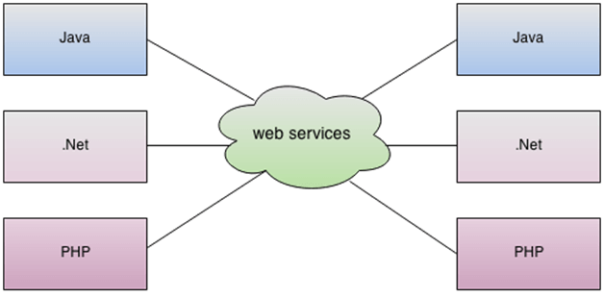
Spring
Restful Web Services
Spring Data Rest
Notes:
101

Slide 102
Spring
Restful Web Services
A web service is a software system designed to support interoperable machine-to-machine interaction over a network.
A web service provide a standardized way for different software applications to communicate with each other regardless of the programming languages, operating systems, or platforms they are built on.
Web services has two types :
SOAP (Simple Object Access Protocol).
REST (Representational State Transfer).
Web services use standard protocols such as HTTP, XML, JSON .
Spring Data Rest
Notes:
102

Slide 103
Spring
Restful Web Services
REST stands for REpresentational State Transfer.
REST is developed by Roy Thomas Fielding, who also developed HTTP.
The RESTful web services main goal is to make web services more effective.
RESTful web services try to define services using the different concepts that are already present in HTTP.
REST is an architectural approach, not a protocol.
Spring Data Rest
Notes:
103

Slide 104
Spring
Restful Web Services
RESTful web services use standard HTTP methods (GET, POST, PUT, DELETE) to perform CRUD (Create, Read, Update, Delete) operations on resources.
RESTful web services use lightweight data formats such as JSON or XML for message payloads.
Restful web services based on the Servlets technology to handle the Requests and Response (Http).
Restful web services response is using the HTTP status Codes
Spring Data Rest
Notes:
104

Slide 105
Spring
http://ilin9090:8080/Items
Http Request
POST /Items : It creates a user.
GET /Items/{id} : It retrieves the detail of a user.
GET /Items : It retrieves the detail of all users.
DELETE /Items: It deletes all users.
DELETE /items/{id} : It deletes a user.
GET /Items/{id}/posts/post_id : It retrieve the detail of a specific post.
Spring Data Rest
Notes:
105

Slide 106
Spring
The Anatomy Of A Request
The endpoint (or route) : https://www.smashingmagazine.com/tag/javascript/. https://www.smashingmagazine.com/tag/GO/. The method : GET, PUT, POST,DELET
The headers : HTTP/1.1
Content-Type: application/json
The data (or body): byBody : { "id": 10, "name": "shirt", "color": "red", "price": "$123" }
byURL : /saveitem?id=10&name=“shirt”&color=“red”&price=“123”
Spring Data Rest
Notes:
106

Slide 107
Spring
The Anatomy Of A Request
Endpoint
Endpoint is the starting point of the API you’re requesting from.
Endpoint = root-endpoint + path
The root-endpoint of Github’s API is https://www.smashingmagazine.com
The path determines the resource you’re requesting for, example /tag/javascript/
The Path starts with one of the special chars / ?
Any colons (:) on a Path denotes a variable :username .
Spring Data Rest
Notes:
107

Slide 108
Spring
The Anatomy Of A Request
QueryParameters
The final part of an endpoint is query parameters.
The query parameters are not part of the REST architecture, but you’ll see lots of APIs use them.
Query parameters give you the option to modify your request with key-value pairs.
They always begin with a question mark (?). Each parameter pair is then separated with an ampersand (&) ?query1=value1&query2=value2
Spring Data Rest
Notes:
108

Slide 109
Spring
The Anatomy Of A Request
PathVariable
Path variables are placeholders in the URL path that represent dynamic values.
They are defined within the path itself and are used to specify specific resources or identifiers.
Path variables are used to map URL patterns to handler methods in a web application framework.
They provide a way to pass data that is integral to the resource being accessed. http://example.com/api/products/{productId}
Spring Data Rest
Notes:
109

Slide 110
Spring
The Anatomy Of A Request
Format
JSON (JavaScript Object Notation) a common format for sending and requesting data through a REST API.
A JSON object looks like a JavaScript Object. In JSON, each property and value
must be wrapped with double quotation marks, like this:
{
"property1": "value1",
"property2": "value2",
"property3": "value3"
}
Spring Data Rest
Notes:
110

Slide 111
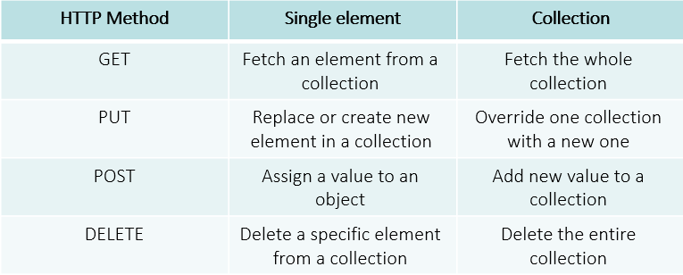
Spring
The Anatomy Of A Request
Method
Spring Data Rest
Notes:
111

Slide 112
Spring
The Anatomy Of A Request
Header
Headers are used to provide information to both the client and server.
It can be used for many purposes, such as authentication and providing information about the body content.
HTTP Headers are property-value pairs that are separated by a colon.
The example below shows a header that tells the server to expect JSON content.
"Content-Type: application/json". Missing the opening ".
Spring Data Rest
Notes:
112

Slide 113
Spring
The Anatomy Of A Request
Body
The data (sometimes called “body” or “message”) contains information you want to be sent to the server.
This option is only used with POST, PUT or DELETE requests
Spring Data Rest
Notes:
113

Slide 114
Spring
Http Response
HTTP/1.1 200
Content-Type: application/json
{ "id": 10, "name": "shirt", "color": "red", "price": "$23" }
Spring Data Rest
HTTP/1.1 200
Pagination-Count: 100
Pagination-Page: 5
Pagination-Limit: 20
Content-Type: application/json
[
{ "id": 10, "name": "shirt", "color": "red", "price": "$123" },
{ "id": 11, "name": "coat", "color": "black", "price": "$230" }
]
Notes:
114

Slide 115
Spring
Http Response
HTTP/1.1 400
Content-Type: application/json
{
"message": "Validation errors in your request",
"errors": [
{
"message": "Oops! The value is invalid",
"code": 34,
"field": "email"
}
]
}
Spring Data Rest
Notes:
115

Slide 116
Spring
Http Response
HTTP/1.1 400
Content-Type: application/json
{
"message": "Validation errors in your request",
"errors": [{"message": "Oops! The value is invalid",
"code": 34,
"field": "email"} ] }
Spring Data Rest
HTTP/1.1 503
Content-Type: application/json
{ "message": "The server is up, but overloaded with requests. Try again later!" }
Notes:
116

Slide 117
Spring
RESTful Service Constraints
There must be a service producer and service consumer.
The service is stateless.
The service result must be cacheable.
The interface is uniform and exposing resources.
The service should assume a layered architecture.
Spring Data Rest
Notes:
117

Slide 118
Spring
Stateless In Rest
No Client Session State:
The server side does not maintain any information about the client's state between requests.
Each request is treated independently, and the server does not rely on any previous interactions with the client to process the current request.
Independence of Requests:
Each request sent by the client to the server must contain all the information needed by the server to fulfill the request. This includes authentication credentials, request parameters, and any other relevant data.
Scalability: Statelessness simplifies the design of web services and makes them easier to scale horizontally.
Cache-ability: Stateless interactions make it easier to cache responses at various levels
Spring Data Rest
Notes:
118

Slide 119
Spring
Spring Rest Components
Controller: Controllers are responsible for handling incoming HTTP requests and producing appropriate responses.
In Spring REST, controllers are typically annotated with @RestController and @Controller annotation.
@RestController = @Controller + @ResponseBody
Spring Data Rest
Notes:
119

Slide 120
Spring
Spring Rest Components
Request Mapping:
Request mapping convenient way to define the routes and HTTP methods that each handler method should handle.
Request mapping annotation can be replaced with @GetMapping, @PostMapping, @PutMapping, @DeleteMapping.
Spring Data Rest
Notes:
120

Slide 121
Spring
Spring Rest Properties
value or path: Specifies the URI path(s) for which the handler method should be mapped. This property is mandatory.
produces: Specifies the media types that the handler method can produce. It can be used to control the Content-Type header of the response.
consumes: Specifies the media types that the handler method can consume. It can be used to control the Content-Type header of the request.
params: Specifies the query parameters that must be present in the request for the handler method to be invoked. It takes a list of parameter expressions.
Spring Data Rest
Notes:
121

Slide 122
Spring
Spring Rest Properties
headers: Specifies the headers that must be present in the request for the handler method to be invoked. It takes a list of header expressions.
method: Specifies the HTTP method(s) that the handler method can handle. By default, all HTTP methods are supported.
name: An alternative to value for specifying the URI path(s). It can be used when only one attribute is provided.
producesCondition: An alternative to produces for specifying the media types conditionally based on the request.
Spring Data Rest
Notes:
122

Slide 123
Spring
Spring Rest Properties
consumesCondition: An alternative to consumes for specifying the media types conditionally based on the request.
paramsCondition: An alternative to params for specifying the query parameters conditionally based on the request.
headersCondition: An alternative to headers for specifying the headers conditionally based on the request.
pathMatcher: Specifies the strategy for matching the URI path. By default, Ant-style path patterns are used.
Spring Data Rest
Notes:
123

Slide 124
Spring
Spring Security

Slide 125
Spring
Authentication and Authorization
Authentication is the process of verifying the identity of a user or entity attempting to access a system or resource.
Authentication ensure that the user is who they claim to be by validating their credentials, such as usernames, passwords, biometric data, security tokens, or other factors.
Authentication mechanisms establish trust between the user and the system, allowing the user to proceed with their intended actions only after their identity is confirmed.
Spring Security
Notes:
125

Slide 126
Spring
Authentication and Authorization
Authentication is the process of verifying the identity of a user or entity attempting to access a system or resource.
Authentication ensure that the user is who they claim to be by validating their credentials, such as usernames, passwords, biometric data, security tokens, or other factors.
Authentication mechanisms establish trust between the user and the system, allowing the user to proceed with their intended actions only after their identity is confirmed.
Spring Security

Slide 127
Spring
Authentication and Authorization
Authorization is the process of determining whether a user or entity has the necessary permissions and privileges to access a specific resource or perform a certain action within a system.
Once a user is authenticated, authorization mechanisms enforce policies and rules to control what actions they are allowed to perform and what resources they can access.
Authorization typically involves assigning roles, permissions, or access levels to users or groups, based on their identity, attributes, or other contextual information.
Spring Security
Notes:
127

Slide 128
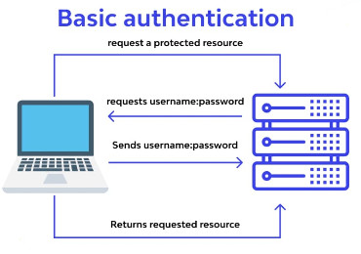
Spring
Basic Auth
Spring Security
Notes:
128

Slide 129
Spring
JWT
JSON Web Token (JWT) is an open standard that defines a compact and self-contained way for securely transmitting information between parties as a JSON object.
JWTs can be signed using a secret with:
The HMAC algorithm
A public/private key pair using RSA or ECDSA.
Spring Security
Notes:
129

Slide 130
Spring
JWT Use
Authorization:
Authorization is the most common scenario for using JWT. Once the user is logged in, each subsequent request will include the JWT, allowing the user to access the services, and resources that are permitted with that token.
Information Exchange:
JSON Web Tokens are a good way of securely transmitting information between parties
Spring Security
Notes:
130

Slide 131
Spring
JWT Structure
JWT token is compact form, JSON Web Tokens consist of three parts separated by dots (.), which are:
Header
Payload
Signature
Therefore, a JWT typically looks like the following.
xxxxx.yyyyy.zzzzz
Spring Security
Notes:
131

Slide 132
Spring
JWT Structure
Header :
The header typically consists of two parts:
The type of the token, which is JWT,
The signing algorithm being used, such as HMAC SHA256 or RSA.
Spring Security
{ "alg": "HS512", "typ": "JWT" }
Notes:
132

Slide 133
Spring
JWT Structure
Payload:
The payload is the second part of JWT and it is containing the Claims.
Claims are statements about an entity (the user) and additional data.
There are three types of claims: registered, public, and private claims
Spring Security
{ “email” : jsjjdjasd@jdjd.com
“password” : “2esde2” , }
Notes:
133

Slide 134
Spring
JWT Structure
Signature:
To create the signature part you have to take
The encoded header
The encoded payload
A secret, the algorithm specified in the header
Spring Security
HMACSHA256(base64UrlEncode(header) + "." + base64UrlEncode(payload), secret)
Notes:
134

Slide 135
Spring
Spring Security
Notes:
135

Slide 136
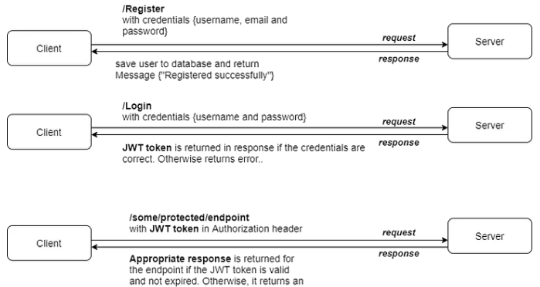
Spring
Secured Flow
Spring Security

Slide 137
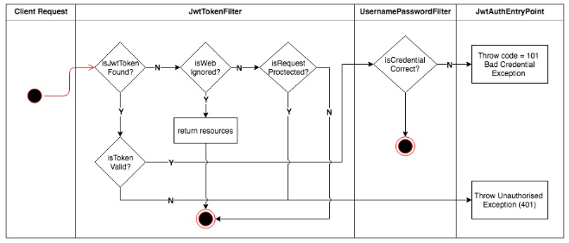
Spring
JWT Auth
Spring Security
Notes:
137

Slide 138
Spring
JWT Auth
Spring Security
Notes:
138

Slide 139
Spring
Dependencies
<dependency>
<groupId>org.springframework.boot</groupId>
<artifactId>spring-boot-starter-security</artifactId>
</dependency>
Spring Security
<dependency>
<groupId>io.jsonwebtoken</groupId>
<artifactId>jjwt</artifactId>
<version>0.12.5</version>
</dependency>
Notes:
139

Slide 140
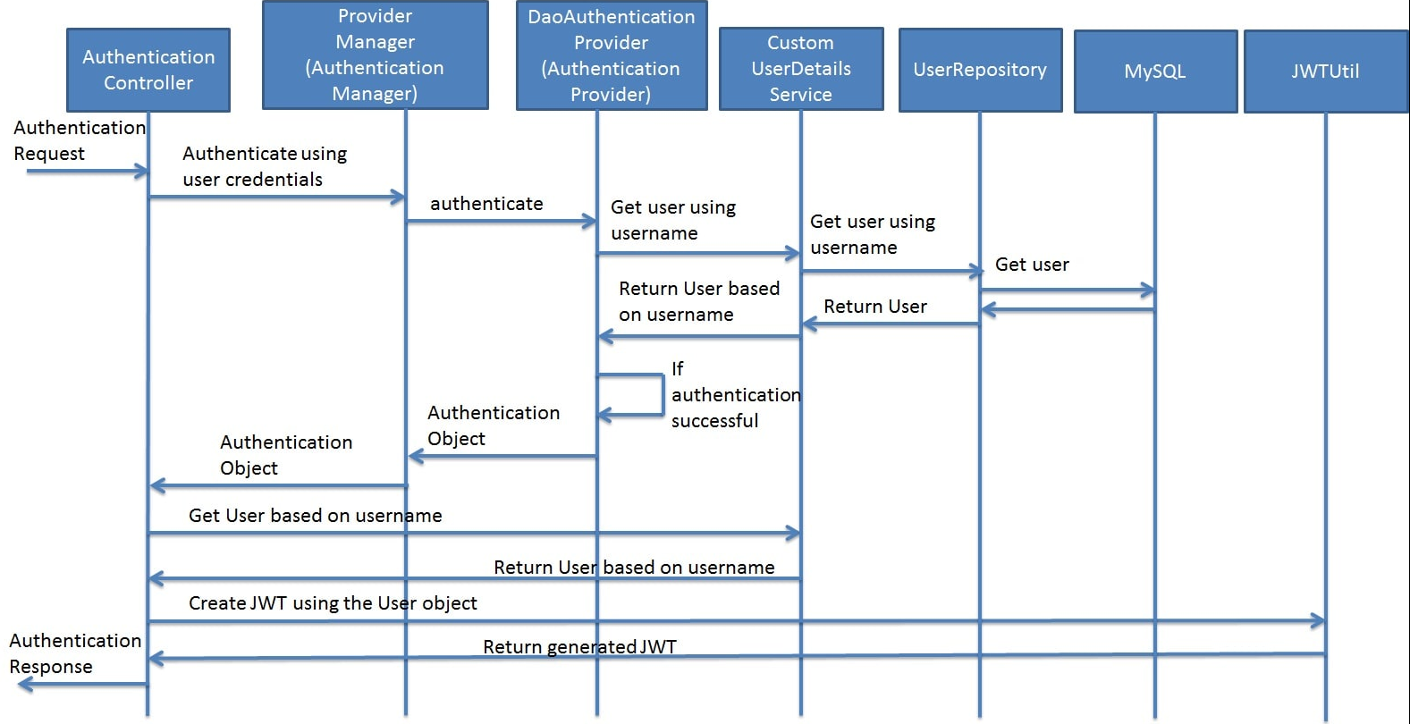
Spring
Spring Security
Notes:
140

Slide 141
Spring
Spring Security
🧑‍💼 User Authentication:
A user provides their credentials (e.g., username and password) to the server during login.
Spring Security
2. 🎫 Token Generation:
Upon successful authentication, the server creates a JWT containing information about the user (claims), such as their user ID, roles, and other relevant data. This information is stored in the token's payload.

Slide 142
Spring
Spring Security
3. 🖋️ Token Signing:
The server signs the JWT using a secret key. This signature ensures that the token hasn't been tampered with.
Spring Security
4. 📨 Token Response:
The server sends the JWT to the client, typically in an HTTP response, as part of the login response.

Slide 143
Spring
Spring Security
5. 💼 Client-Side Storage:
The client (usually a web browser or mobile app) stores the JWT securely. Common storage locations include browser local storage, session storage, or cookies.
Spring Security
6. 🔐 Authentication Requests:
For subsequent requests to protected resources, the client includes the JWT in the request headers, usually using the Authorization header with the Bearer prefix (e.g., Authorization: Bearer <token>).

Slide 144
Spring
Spring Security
7. 🧾 Token Verification:
The server receiving the request verifies the JWT's authenticity by checking the signature using the secret key. It also checks the token's expiration time and other claims.
Spring Security
8. 🚪 Access Control:
If the JWT is valid and contains the required claims (e.g., proper user role), the server allows access to the requested resource

Slide 145
Spring
Swagger

Slide 146
Spring
Swagger
Swagger is an open-source software framework backed by a large ecosystem of tools that helps developers design, build, document, test and consume RESTful web services.
Swagger framework is constructed from Open API Specification , Open-Source Tools and a Swagger Hub .
https://swagger.io/ is the URL of Online Swagger Framework
Swagger

Slide 147
Spring
Swagger UI
<dependency>
<groupId>org.springdoc</groupId>
<artifactId>springdoc-openapi-starter-webmvc-ui</artifactId>
<version>2.0.3</version>
</dependency>
Swagger

Slide 148
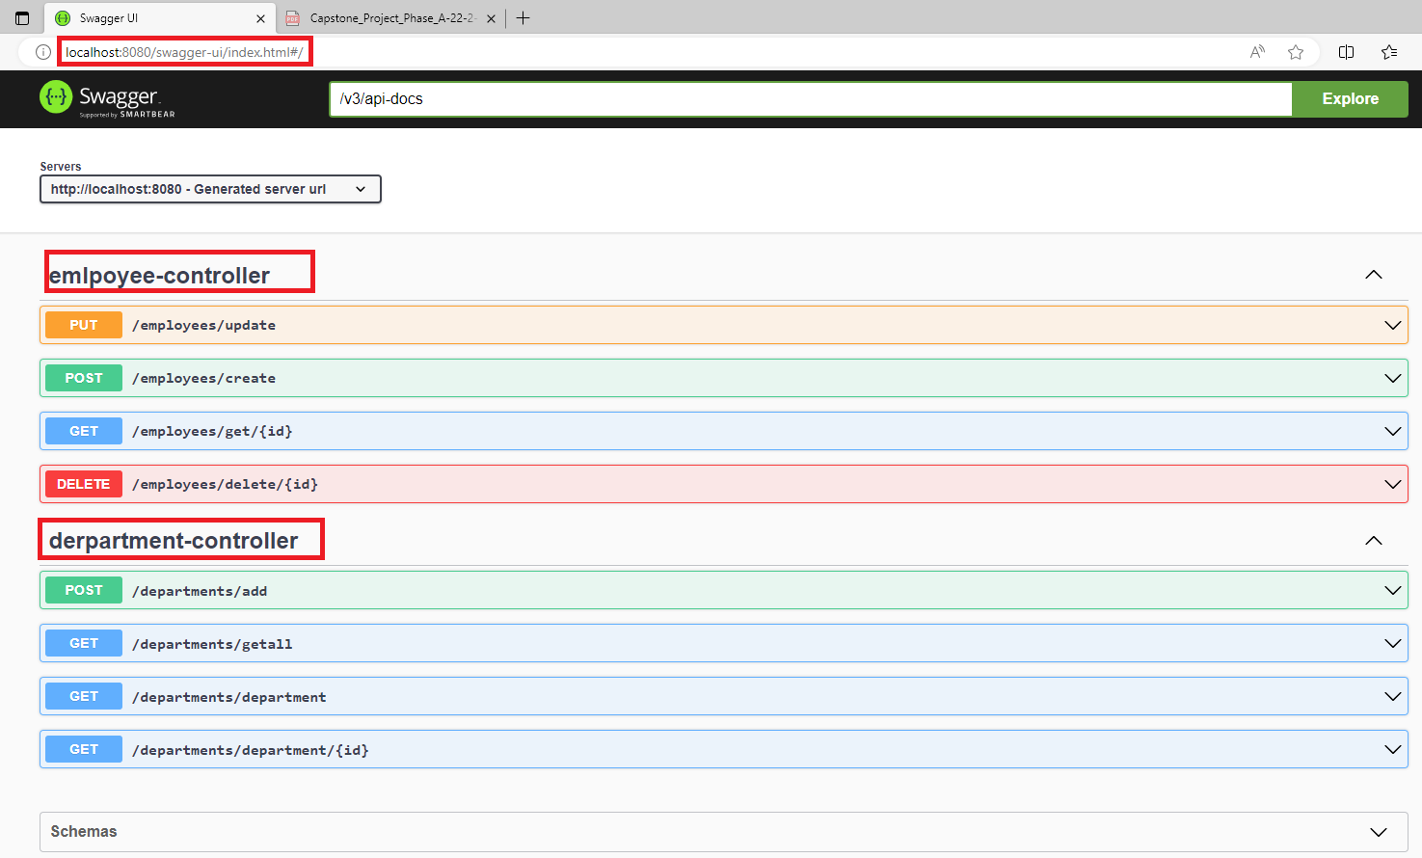
Spring
Swagger UI
Swagger
Swagger UI

Slide 149
Spring
Swagger Editor
Swagger
Swagger Editor : https://editor.swagger.io/

Slide 150
Spring
YAML
“YAML Ain't Markup Language” is a human-readable data serialization language commonly used for configuration files and structured data exchange in various applications.
YAML files use a simple and intuitive syntax designed to be easy for both humans and machines to read and write.
YAML files are designed to be easy for humans to read and write. It uses indentation to represent hierarchy and structure, making it visually intuitive.
YAML uses indentation (typically spaces) to denote structure and nesting, rather than relying on explicit symbols or tags.
Swagger

Slide 151
Spring
YAML
YAML supports various data types including scalar (strings, numbers, booleans), sequences (arrays/lists), and mappings (key-value pairs).
YAML allows comments using the # symbol, making it easy to add explanatory notes within the file.
YAML is not tied to any specific programming language, making it suitable for configuration files and data interchange between different systems and applications.
YAML supports the inclusion of other YAML files (known as anchors and references), allowing for reuse and modularity in larger configurations.
Swagger

Slide 152
Spring
YAML Example
server:
port: 8080
spring:
datasource:
url: jdbc:mysql://localhost:3306/mydatabase
username: root
password: password
driver-class-name: com.mysql.cj.jdbc.Driver
jpa:
hibernate:
ddl-auto: update
properties:
hibernate:
dialect: org.hibernate.dialect.MySQLDialect
logging:
level:
root: info
org.springframework.web: debug
Swagger

Slide 153
Spring
YAML Example
/store/inventory:
get:
tags:
- store
summary: Returns pet inventories by status
description: Returns a map of status codes to quantities
operationId: getInventory
responses:
'200':
description: successful operation
content:
application/json:
schema:
type: object
additionalProperties:
type: integer
format: int32
security:
- api_key: []
Swagger

Slide 154
Spring
Customize Swagger GUI
public interface BookControllerIFC {
@Operation(summary= "Create New Book" ,tags = {"Books", "POST"})
@ApiResponses({
@ApiResponse(responseCode = "201", content = {
@Content(schema = @Schema(implementation = Book.class), mediaType = "application/json") }),
@ApiResponse(responseCode = "500", content = { @Content(schema = @Schema()) }) })
@PostMapping("/create")
public ResponseEntity<Book> createBook(@RequestBody Book book) ;
}

Slide 155
Generate YAML from Code
@Configuration
public class OpenAPIConfig {
@Value("${Kabhad82.openapi.dev-url}")
private String devUrl;
@Bean
public OpenAPI myOpenAPI() {
Server devServer = new Server();
devServer.setUrl(devUrl);
devServer.setDescription("Server URL in Development environment");
Info info = new Info()
.title("Tutorial Management API")
.version("1.0")
.contact(contact)
.description("This API exposes endpoints to manage tutorials.").termsOfService(“”);
.license(null);
return new OpenAPI().info(info).servers(List.of(devServer));
}}

Slide 156
Spring
YAML Example
springdoc.api-docs.path=/Kabhad82-api-docs
springdoc.swagger-ui.tryItOutEnabled=true
springdoc.swagger-ui.filter=true
Kabhad82.openapi.dev-url=http://localhost:8080
Swagger

Slide 157
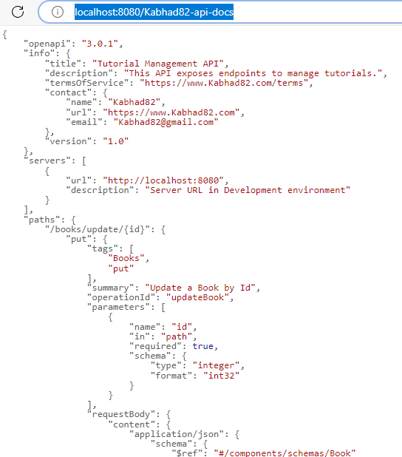
Spring
YAML Example
Swagger

Slide 158
Spring
Spring Streaming
Spring Streaming

Slide 159
Spring
Event-Driven Architecture
Event-Driven Architecture (EDA) is a design pattern that emphasizes the use of events to trigger and communicate changes between different components of a system.
In an EDA, services interact through the exchange of events, which are messages representing an occurrence or a state change.
Spring Streaming

Slide 160
Spring
Advantages of Event-Driven Architecture
Loose coupling: Services are decoupled from each other, promoting independence and modularity.
Scalability: Services can scale independently based on event demand, improving overall system performance.
Asynchronous processing: Events enable asynchronous communication, reducing latency and improving responsiveness.
Flexibility: New services can be added, or existing ones modified without affecting the entire system.
Spring Streaming

Slide 161
Spring
Kafka
Apache Kafka is a distributed streaming platform that serves as a backbone for building real-time data pipelines and streaming applications.
Kafka is designed to handle high-throughput, fault-tolerant, and scalable event streaming.
Kafka is built around the publish-subscribe messaging model, where producers publish messages (events) to topics, and consumers subscribe to those topics to receive and process the messages.
The events are stored in Kafka in an immutable and append-only manner, allowing both real-time and historical data processing.
Spring Streaming

Slide 162
Spring
Kafka Concepts
Topics: Channels for publishing and subscribing to events.
Producers: Services that produce and send events to Kafka topics.
Consumers: Services that subscribe to topics and process incoming events.
Partitions: Each topic is divided into partitions, allowing for parallel processing and load distribution.
Spring Streaming

Slide 163
Spring
Role of Kafka in EDA
In EDA, microservices are designed to produce and consume events, allowing them to communicate asynchronously without direct dependencies on each other.
Apache Kafka plays a pivotal role in Event-Driven Architecture (EDA) by acting as a scalable and durable event bus for communication between microservices
Spring Streaming

Slide 164
Spring
Kafka key Roles
Event Broker: Kafka acts as a central event broker, serving as a highly scalable and reliable middleware to handle event streams.
Event Log: Kafka’s append-only log-like storage allows events to be durably stored and retained for a configurable period.
Decoupling Services: Kafka decouples services by enabling producers to publish events without needing to know which specific services will consume them. Similarly, consumers do not need to be aware of the producers generating the events.
Reliability and Fault Tolerance: Kafka provides strong guarantees of data durability and fault tolerance. Events are replicated across multiple brokers, ensuring high availability even in the face of node failures.
Spring Streaming

Slide 165
Spring
Kafka key Roles
4. Scalability: Kafka’s distributed architecture allows it to scale horizontally by adding more brokers to the cluster. This enables it to handle high-throughput event streams from numerous producers and consumers.
5. Real-Time Data Processing: Kafka enables real-time data processing by delivering events with low latency.
6. Event Time Ordering: Kafka preserves the order of events within each partition, ensuring event time ordering.
7. Schema Evolution and Compatibility: Kafka supports schema serialization using frameworks like Avro or Protobuf, allowing for schema evolution and ensuring backward and forward compatibility when services evolve over time.
Spring Streaming

Slide 166
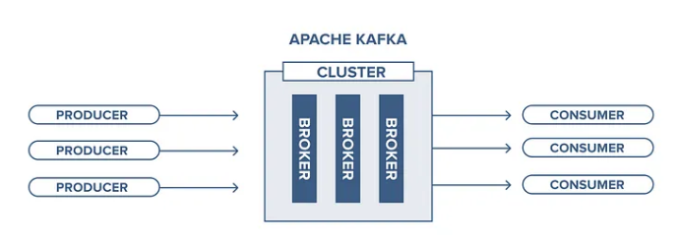
Spring
Kafka
Spring Streaming

Slide 167
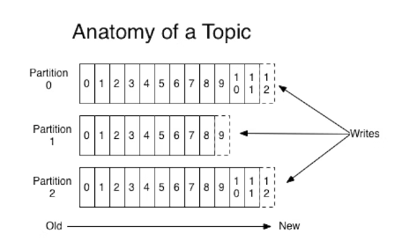
Spring
Kafka
Spring Streaming

Slide 168
Spring
Kafka
Spring Streaming

Slide 169
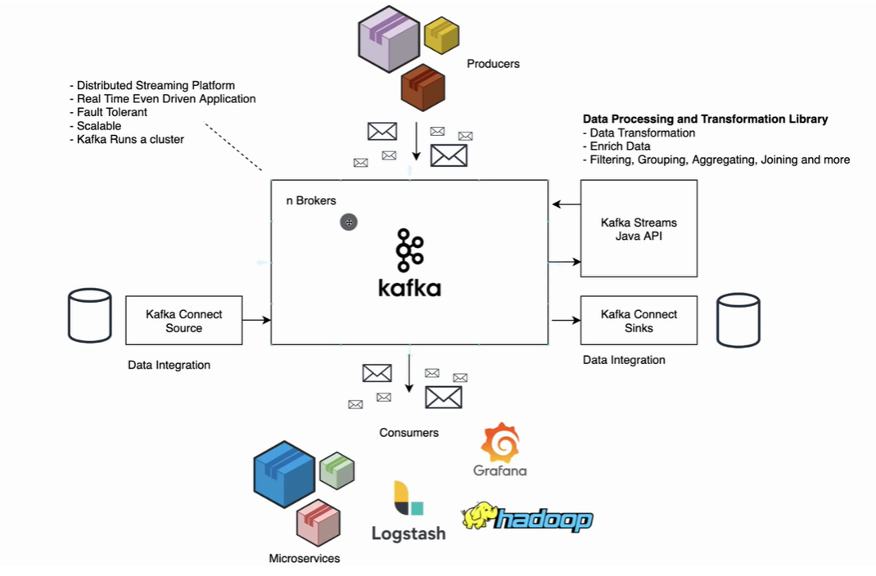
Spring
Kafka
Spring Streaming

Slide 170
Spring
Kafka
URL for Download
https://kafka.apache.org/quickstart
$ tar -xzf kafka_2.13-3.7.0.tgz
$ cd kafka_2.13-3.7.0
Spring Streaming

Slide 171
Spring
Start Kafka Environment
Apache Kafka can be started using ZooKeeper or KRaft.
To get started with either configuration follow one the sections below but not both.
Kafka with ZooKeeper
Run the following commands to start all services in the correct order:
Spring Streaming
# Start the ZooKeeper service
bin/zookeeper-server-start.sh config/zookeeper.properties
Open another terminal session and run:
# Start the Kafka broker service
bin/kafka-server-start.sh config/server.properties

Slide 172
Spring
CREATE A TOPIC TO STORE YOUR EVENTS
Kafka is a distributed event streaming platform that lets you read, write, store, and process events (also called records or messages in the documentation) across many machines.
Spring Streaming
Open another terminal session and run:
$ bin/kafka-topics.sh --create --topic quickstart-events --bootstrap-server localhost:9092

Slide 173
Spring
WRITE SOME EVENTS INTO THE TOPIC
A Kafka client communicates with the Kafka brokers via the network for writing (or reading) events. Once received, the brokers will store the events in a durable and fault-tolerant manner for as long as you need—even forever.
Run the console producer client to write a few events into your topic. By default, each line you enter will result in a separate event being written to the topic.
Spring Streaming
$ bin/kafka-console-producer.sh --topic quickstart-events --bootstrap-server localhost:9092 This is my first event This is my second event

Slide 174
Spring
READ THE EVENTS
Open another terminal session and run the console consumer client to read the events you just created:
$ bin/kafka-console-consumer.sh --topic quickstart-events --from-beginning --bootstrap-server localhost:9092
This is my first event
This is my second event
Spring Streaming

Slide 175
Spring
TERMINATE THE KAFKA ENVIRONMENT
Stop the producer and consumer clients with Ctrl-C, if you haven't done so already.
Stop the Kafka broker with Ctrl-C.
Lastly, if the Kafka with ZooKeeper section was followed, stop the ZooKeeper server with Ctrl-C.
Spring Streaming
$ rm -rf /tmp/kafka-logs /tmp/zookeeper /tmp/kraft-combined-logs

Slide 176
Spring
Zookeeper
Stop the producer and consumer clients with Ctrl-C, if you haven't done so already.
Stop the Kafka broker with Ctrl-C.
Lastly, if the Kafka with ZooKeeper section was followed, stop the ZooKeeper server with Ctrl-C.
Spring Streaming

Slide 177
Spring
Zookeeper
Spring Streaming

