Slide 1
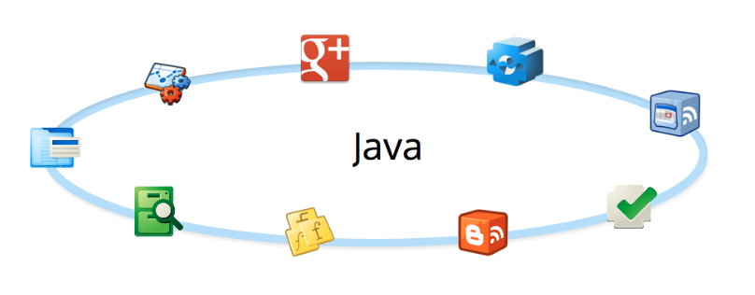
Iostream
Notes:
Java IOStream (Input/Output Stream) is a fundamental concept in Java programming used for handling input and output operations.
It allows Java programs to read from and write to data streams,
which can be files, network connections, or other data sources.
IOStreams provide a standardized way to handle various types of input and output in a consistent manner.

Slide 2
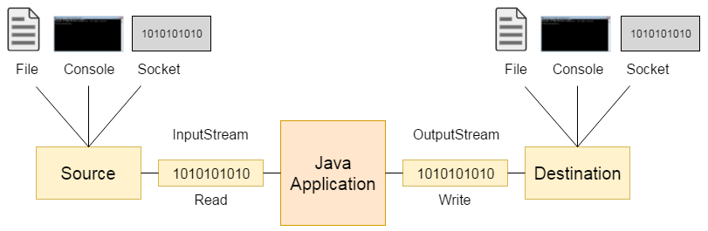
Streaming Data
Streaming Data

Slide 3
Streaming Data VS. Random Access
Streaming data – a stream is a sequence of data read or written, one item at a time
Blocking: java.io package
Non-blocking: java.nio package
Random access – reading and writing data can be done in a non sequential order
java.io.RandomAccessFile
Streaming Data

Slide 4
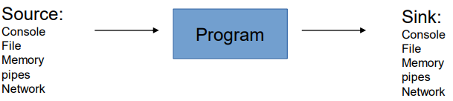
Source & Sink
Streaming Data
A stream can come to the program from a source or can be generated by the program to a sink. Sources and sinks are both node streams:
Notes:
streaming data - הזרמת נתונים - تدفق البيانات
Input streams (זרמי קלט) read data from a source into a Java program.
The source can be a file, a network connection, a byte array, or any other data source.
The data flows into the program from the external source.
Output Streams (זרמי פלט) (To a Sink) (حوض – כיור)
Output streams write data from a Java program to a sink.
The sink can be a file, a network connection, a byte array, or any other data destination.
The data flows out from the program to the external sink.
Examples of Input Streams:
FileInputStream: Reads bytes from a file.
ByteArrayInputStream: Reads bytes from a byte array.
BufferedInputStream: Adds buffering capabilities to an input stream to improve reading efficiency.
InputStreamReader: Converts byte streams to character streams (often used to read text data).
Examples of Output Streams:
FileOutputStream: Writes bytes to a file.
ByteArrayOutputStream: Writes bytes to a byte array.
BufferedOutputStream: Adds buffering capabilities to an output stream to improve writing efficiency.
OutputStreamWriter: Converts character streams to byte streams (often used to write text data).

Slide 5
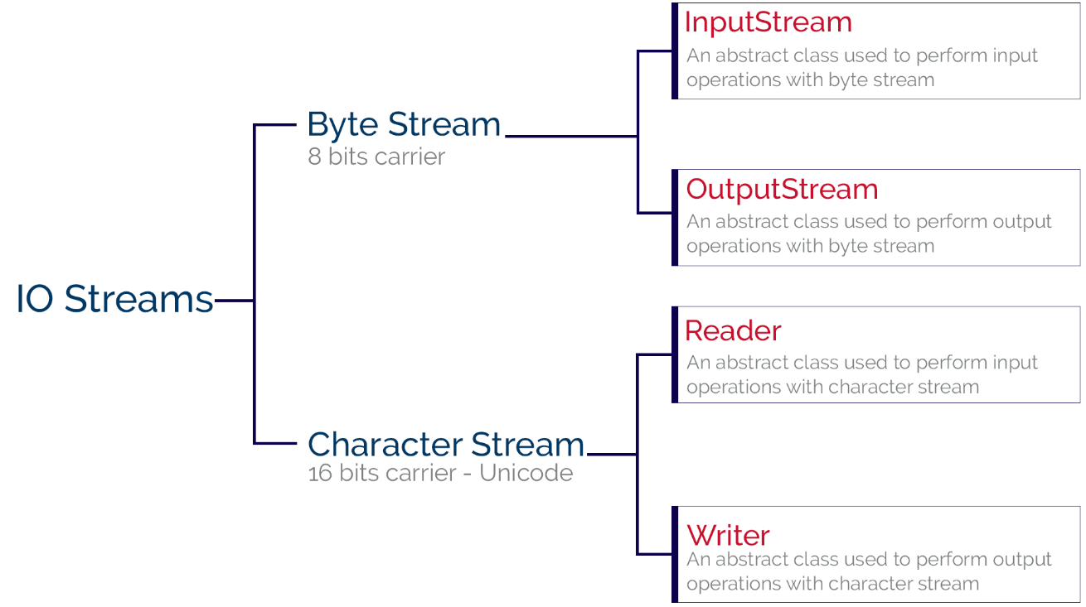
IO Stream
Streaming Data
Notes:
InputStream
Type of Data: InputStream handles raw byte data.
Read Method: The primary read() method in InputStream reads one byte at a time.
Number of Bits Read: Since a byte consists of 8 bits, each call to read() reads 8 bits.
Reader
Type of Data: Reader handles character data.
Read Method: The primary read() method in Reader reads one character at a time.
Number of Bits Read: Java uses UTF-16 encoding for characters, where each character typically requires 16 bits (2 bytes). Therefore, each call to read() reads 16 bits.

Slide 6
Byte Stream VS. Character Stream
The basic abstract classes for the different types of streams are:
Streaming Data
Character streams:
Reader
Writer
Byte streams:
InputStream
OutputStream
Notes:
InputStream:
Type of Data: InputStream is designed for handling raw byte data.
It reads data byte by byte, making it suitable for binary data such as images, audio files, and other non-text data.
Class Hierarchy: InputStream is the superclass for all classes representing an input stream of bytes.
OutputStream
Type of Data: OutputStream is designed for handling raw byte data. It writes data byte by byte, making it suitable for binary data such as images, audio files, and other non-text data.
Class Hierarchy: OutputStream is the superclass for all classes representing an output stream of bytes
Reader:
Type of Data: Reader is designed for handling character data.
It reads data character by character, making it suitable for text data such as plain text files and text-based network protocols.
Class Hierarchy: Reader is the superclass for all classes representing an input stream of characters.
Writer
Type of Data: Writer is designed for handling character data. It writes data character by character, making it suitable for text data such as plain text files and text-based network protocols.
Class Hierarchy: Writer is the superclass for all classes representing an output stream of characters.

Slide 7
InputStream VS. Reader
Feature | InputStream | Reader
Data Type | Byte-oriented (binary data) | Character-oriented (text data)
Superclass | InputStream | Reader
Read Method | read() (reads byte) | read() (reads character)
Buffering | BufferedInputStream | BufferedReader
File Handling | FileInputStream | FileReader
Common Use Cases | Binary files (e.g., images, audio) | Text files (e.g., plain text, JSON)
Conversion Bridging | N/A | InputStreamReader (converts byte streams to character streams)
Streaming Data

Slide 8
Character Stream
Use :
When dealing with text-based data, such as plain text files, configuration files, or any file that contains human-readable characters.
Advantages:
Character streams automatically handle character encoding and decoding, making them suitable for dealing with text in different character sets.
They provide higher-level abstractions like Reader and Writer, which work with characters rather than bytes.
Example:
FileReader reader = new FileReader("textFile.txt");
FileWriter writer = new FileWriter("output.txt");
Streaming Data

Slide 9
Byte Stream
Use :
When working with binary data, such as image files, audio files, or any non-text data.
Advantages:
Byte streams are low-level and handle data in its raw form, making them suitable for binary data or when you need to work with the actual bytes of a file.
They are more suitable for network operations where data is transmitted in binary form.
Example:
FileInputStream inputStream = new FileInputStream("binaryFile.bin");
FileOutputStream outputStream = new FileOutputStream("output.bin");
Streaming Data

Slide 10
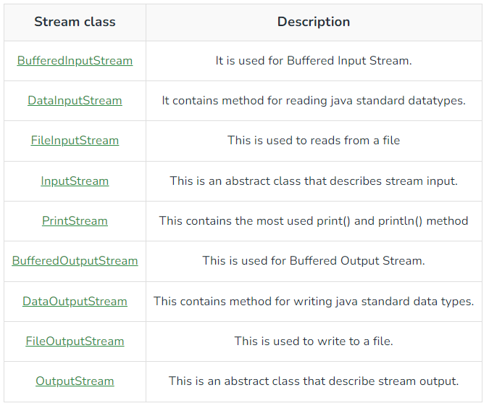
Byte Streaming Methods
Streaming Data
Notes:
BufferedInputStream is a Java class that provides a buffered mechanism for reading input streams. It extends FilterInputStream and adds functionality to buffer the input, which can significantly improve the efficiency of input operations, especially when reading data from slow sources like files or network connections.
default buffer size (usually 8192 bytes).
DataInputStream is a Java class that allows an application to read primitive Java data types from an underlying input stream in a machine-independent way. This class is part of the java.io package and is often used in scenarios where you need to read binary data that was written by a DataOutputStream.
FileInputStream is a Java class that provides a means to read bytes from a file. It is part of the java.io package and is a subclass of InputStream. FileInputStream is typically used to read binary data such as image files, audio files, and other non-text files.
InputStream is an abstract class in Java that is the superclass for all classes representing an input stream of bytes. It is part of the java.io package and provides a standard interface for reading byte streams.
PrintStream is a Java class in the java.io package that provides methods for outputting formatted representations of objects to a text output stream. Unlike other output streams, PrintStream does not throw IOException, which makes it easier to use but requires careful handling to ensure proper error checking.
BufferedOutputStream is a Java class in the java.io package that provides a buffered mechanism for writing bytes to an output stream. It extends FilterOutputStream and is designed to improve the efficiency of output operations by reducing the number of write operations to the underlying output stream.
DataOutputStream is a Java class that allows an application to write primitive Java data types to an output stream in a machine-independent manner. It is part of the java.io package and is commonly used in conjunction with DataInputStream for reading and writing binary data that needs to be portable across different platforms.
FileOutputStream is a Java class in the java.io package that provides a means to write bytes to a file. It is a subclass of OutputStream and is typically used to handle binary data, such as image files, audio files, and other non-textual data.
OutputStream is an abstract class in Java located in the java.io package. It is the superclass of all classes that represent an output stream of bytes. As an abstract class, OutputStream cannot be instantiated directly but provides a common interface for writing byte-oriented data to various output destinations, such as files, memory, or network connections.

Slide 11
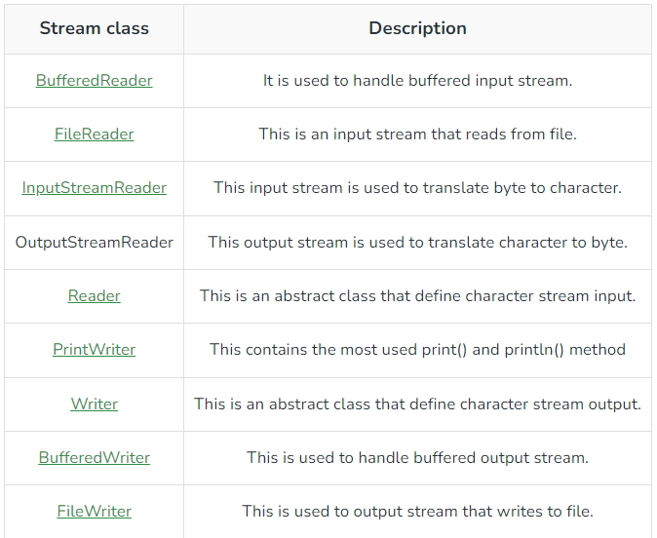
Character Stream methods
Streaming Data
Notes:
BufferedReader is a class in the java.io package that provides efficient reading of characters from a text-based input stream. It extends Reader and adds buffering to improve performance, particularly when reading data from a character-based stream such as files or network connections.
FileReader is a class in the java.io package that provides a way to read the contents of a file as a stream of characters. It is a direct subclass of Reader, and it is specifically designed for reading files in a character-based manner.
InputStreamReader is a class in the java.io package that acts as a bridge between byte streams (InputStream) and character streams (Reader). It reads bytes from an underlying InputStream and decodes them into characters using a specified character encoding.
OutputStreamWriter is a class in the java.io package that serves as a bridge between byte streams (OutputStream) and character streams (Writer). It encodes characters into bytes using a specified character encoding and writes them to an underlying OutputStream.
Reader is an abstract class in the java.io package that provides a framework for reading character-based input streams. As the superclass of all classes that represent an input stream of characters, Reader is designed to handle text data and provides methods for reading characters, arrays of characters, and lines of text.
PrintWriter is a class in the java.io package that provides a convenient way to write formatted text to a file or other output streams. It extends Writer and provides methods for writing characters, strings, and formatted output, including support for automatic line flushing.
Writer is an abstract class in the java.io package that serves as a superclass for all classes that write character data to a stream. It provides a basic framework for writing characters, arrays of characters, and strings to various output destinations, such as files, network connections, or memory.
BufferedWriter is a class in the java.io package that provides buffering for Writer instances. It improves performance by reducing the number of I/O operations when writing characters to an output stream. By using a buffer, BufferedWriter minimizes the number of write operations by accumulating data in memory and writing it out in larger chunks.
FileWriter is a class in the java.io package that provides a convenient way to write character data to files. It extends OutputStreamWriter and directly writes characters to files in the default character encoding of the platform.

Slide 12
IO endpoints
Main IO endpoints (sources and sinks):
File System:
• FileReader / FileWriter / FileInputStream / FileOutputStream
Networking:
• Socket / ServerSocket
Threads communication (pipes):
• PipedInputStream / PipedOutputStream
Streaming Data
Notes:
The Socket class in Java, part of the java.net package, represents a client-side socket for communication over a network.
It provides methods for establishing a connection to a server, sending and receiving data, and closing the connection.
It is commonly used in network programming to facilitate communication between different computers over a network or the Internet.
The ServerSocket class in Java, part of the java.net package, is used to create server-side sockets that listen for incoming client connections.
It provides the means for a server application to accept connections from clients over a network.
PipedInputStream is a class in the java.io package that implements an input stream where data can be read from another thread's PipedOutputStream.
It is part of Java's support for inter-thread communication and allows data to be passed between threads in a producer-consumer fashion.
The PipedOutputStream class in Java, part of the java.io package, is used to create an output stream that is connected to a PipedInputStream.
This class allows data to be written to the pipe and subsequently read from it by a connected PipedInputStream. It is commonly used for inter-thread communication, enabling one thread to write data to a pipe while another thread reads from it.

Slide 13
Streams
Three default accessed streams
System.in – InputStream
System.out - PrintStream (OutputStream)
System.err - PrintStream
Streaming Data
Notes:
System.in is a static field in the System class in Java, representing the standard input stream. It is of type InputStream and is typically used to read data from the console or standard input device (like a keyboard) in a Java application.
System.out is a static field in the System class in Java that represents the standard output stream. It is an instance of PrintStream and is commonly used to output data to the console or standard output device (like a terminal or console window).
System.err is a static field in the System class in Java, representing the standard error stream. It is an instance of PrintStream and is used for outputting error messages or other diagnostic information to the console or standard error device. Unlike System.out, which is used for regular output, System.err is specifically intended for error reporting.

Slide 14
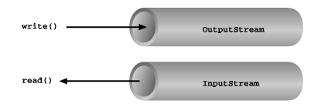
IO Stream Func
Basic input and output stream functionality
Streaming Data
Notes:
The Java I/O (Input/Output) streams framework is designed to handle input and output operations in a consistent manner. It provides a unified way to read from and write to various data sources such as files, network connections, and memory buffers. Here's an overview of how I/O streams work in Java:
Basic Concepts
Streams:
Streams are sequences of data that can be read from or written to. Java I/O streams come in two main types:
Input Streams: Used for reading data from a source (e.g., files, network).
Output Streams: Used for writing data to a destination (e.g., files, network).
Byte Streams vs. Character Streams:
Byte Streams: Handle I/O of raw bytes and are suitable for binary data. They are represented by classes in the java.io package that end with Stream (e.g., FileInputStream, FileOutputStream).
Character Streams: Handle I/O of characters and are suitable for text data. They automatically handle character encoding. They are represented by classes in the java.io package that end with Reader or Writer (e.g., FileReader, FileWriter).
How Streams Work
Reading from a Stream (InputStream):
InputStream: This is the abstract base class for all byte-based input streams.
Methods:
int read(): Reads a single byte of data from the stream and returns it as an integer. Returns -1 if the end of the stream is reached.
int read(byte[] b): Reads up to b.length bytes of data into the byte array b. Returns the number of bytes read or -1 if the end of the stream is reached.
int read(byte[] b, int off, int len): Reads up to len bytes of data into the byte array b starting at offset off.
Example:javaCopy code
InputStream in = new FileInputStream("example.txt"); int data = in.read(); // Read one byte byte[] buffer = new byte[1024]; int bytesRead = in.read(buffer); // Read multiple bytes in.close();
Writing to a Stream (OutputStream):
OutputStream: This is the abstract base class for all byte-based output streams.
Methods:
void write(int b): Writes a single byte of data to the stream.
void write(byte[] b): Writes the entire byte array b to the stream.
void write(byte[] b, int off, int len): Writes a portion of the byte array b to the stream.
void flush(): Flushes the stream, ensuring that any buffered data is written out.
void close(): Closes the stream and releases any system resources associated with it.
Example:javaCopy code
OutputStream out = new FileOutputStream("example.txt"); out.write(65); // Write one byte (representing 'A') byte[] data = {66, 67, 68}; // Represents 'BCD' out.write(data); // Write the byte array out.close();
Buffered Streams
Buffered Streams: These streams use an internal buffer to improve performance by reducing the number of I/O operations. For example, BufferedInputStream and BufferedOutputStream wrap around other input/output streams to provide buffering.
Benefits:
Reduces the number of read/write operations to the underlying source/destination.
Improves performance, especially when dealing with small chunks of data.
Example:javaCopy code
BufferedOutputStream bos = new BufferedOutputStream(new FileOutputStream("example.txt")); bos.write(65); // Write one byte bos.flush(); // Flush buffered data to the file bos.close();
Character Streams
Character Streams: Handle text data and automatically handle character encoding/decoding.
Reader and Writer classes are used for character-based I/O.
FileReader: Reads characters from a file.
FileWriter: Writes characters to a file.
Example:javaCopy code
FileWriter writer = new FileWriter("example.txt"); writer.write("Hello, World!"); writer.close(); FileReader reader = new FileReader("example.txt"); int ch; while ((ch = reader.read()) != -1) { System.out.print((char) ch); } reader.close();
Error Handling
IOException: Most I/O operations can throw IOException, which must be handled using try-catch blocks or by declaring the exception in the method signature.
Summary
Java's I/O streams framework provides a flexible and powerful way to handle I/O operations for both byte and character data. Byte streams are used for raw binary data, while character streams handle text data with automatic encoding. Buffered streams enhance performance by reducing the number of I/O operations, and exception handling ensures that errors during I/O operations are properly managed.

Slide 15
InputStream methods
int available()
int read()
int read(byte[] b)
int read(byte[] b, int off, int len)
long skip(long n)
void close()
void mark(int readlimit)
boolean markSupported()
void reset()
Streaming Data
Notes:
int available():Returns the estimated number of bytes that can be read from the input stream without blocking. This method provides a hint about the number of bytes that are currently available.
int read():Reads the next byte of data from the input stream. Returns the byte as an integer in the range 0 to 255 (0x00 to 0xff). Returns -1 if the end of the stream has been reached.
int read(byte[] b):
Reads up to b.length bytes of data from the input stream into the byte array b. Returns the number of bytes read, or -1 if the end of the stream has been reached.
int read(byte[] b, int off, int len):
Reads up to len bytes of data from the input stream into the byte array b, starting at offset off. Returns the number of bytes read, or -1 if the end of the stream has been reached.
long skip(long n):Skips over and discards n bytes of data from the input stream. Returns the number of bytes actually skipped.
void close():Closes the input stream and releases any system resources associated with it. It is important to close the stream when done to avoid resource leaks.
void mark(int readlimit):
Marks the current position in the input stream. You can later call reset() to return to this position. Not all InputStream implementations support marking.
void reset():
Resets the input stream to the last marked position. Throws IOException if the stream does not support marking or if no mark has been set.
markSupported():Indicates whether the stream supports the mark() and reset() methods. It helps to avoid IOException by checking support before using these methods.
Use markSupported() to ensure that marking and resetting operations are feasible for the given InputStream.

Slide 16
OutputStream methods
void write(byte[] b)
void write(byte[] b, int off, int len)
void write(int b)
void flush()
void close()
Streaming Data
Notes:
void write(int b):
Writes the specified byte to the output stream. The byte is given as an integer, but only the lower 8 bits of the integer are written.
void write(byte[] b):
Writes the entire byte array to the output stream. The array is written from the beginning to the end.
void write(byte[] b, int off, int len):
Writes a portion of the byte array to the output stream. off is the starting offset in the array, and len is the number of bytes to write.
void flush():
Flushes the output stream. This method forces any buffered output bytes to be written out. It is important to call flush() to ensure that all data is sent to the underlying stream before closing it.
void close():
Closes the output stream and releases any system resources associated with it. It is important to close the stream after operations are complete to avoid resource leaks. Note that closing a stream also flushes it.

Slide 17
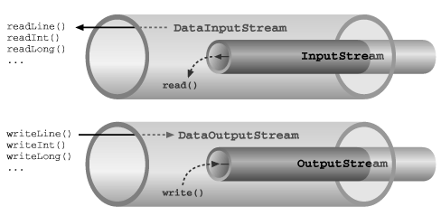
IOStream Func
Basic input and output stream functionality
Streaming Data
Notes:
Key Methods of DataInputStream (THERE IS no readLine())
Reading Primitive Data Types
boolean readBoolean():
Reads a boolean value from the input stream. It reads a single byte and interprets it as a boolean. A byte value of 0 is considered false, and any non-zero value is considered true.
byte readByte():
Reads a byte value from the input stream. It reads one byte and returns it as a byte.
char readChar():
Reads a char value from the input stream. It reads two bytes and converts them into a char using the UTF-16 encoding.
short readShort():
Reads a short value from the input stream. It reads two bytes and converts them into a short.
int readInt():
Reads an int value from the input stream. It reads four bytes and converts them into an int.
long readLong():
Reads a long value from the input stream. It reads eight bytes and converts them into a long.
float readFloat():
Reads a float value from the input stream. It reads four bytes and converts them into a float.
double readDouble():
Reads a double value from the input stream. It reads eight bytes and converts them into a double.
String readUTF():
Reads a string encoded in UTF-8 from the input stream. The string is prefixed with a variable-length UTF-8 encoding length.
The DataOutputStream class in Java is used to write primitive data types to an output stream in a portable way. It is part of the java.io package and extends FilterOutputStream. It allows you to write data in a format that can be read by DataInputStream, ensuring data integrity across different platforms.
Key Methods of DataOutputStream
Writing Primitive Data Types
void writeBoolean(boolean v):
Writes a boolean value to the output stream. It writes 0 for false and 1 for true.
Example:javaCopy code
DataOutputStream dos = new DataOutputStream(new FileOutputStream("data.bin")); dos.writeBoolean(true); dos.close();
void writeByte(int v):
Writes a byte value to the output stream. The value is treated as an int, but only the lower 8 bits are written.
Example:javaCopy code
DataOutputStream dos = new DataOutputStream(new FileOutputStream("data.bin")); dos.writeByte(65); // Writes the byte value corresponding to 'A' dos.close();
void writeChar(int v):
Writes a char value to the output stream. The value is treated as an int, but only the lower 16 bits are written.
Example:javaCopy code
DataOutputStream dos = new DataOutputStream(new FileOutputStream("data.bin")); dos.writeChar('A'); dos.close();
void writeShort(int v):
Writes a short value to the output stream. The value is treated as an int, but only the lower 16 bits are written.
Example:javaCopy code
DataOutputStream dos = new DataOutputStream(new FileOutputStream("data.bin")); dos.writeShort(12345); dos.close();
void writeInt(int v):
Writes an int value to the output stream. It writes four bytes.
Example:javaCopy code
DataOutputStream dos = new DataOutputStream(new FileOutputStream("data.bin")); dos.writeInt(123456789); dos.close();
void writeLong(long v):
Writes a long value to the output stream. It writes eight bytes.
Example:javaCopy code
DataOutputStream dos = new DataOutputStream(new FileOutputStream("data.bin")); dos.writeLong(1234567890123456789L); dos.close();
void writeFloat(float v):
Writes a float value to the output stream. It writes four bytes.
Example:javaCopy code
DataOutputStream dos = new DataOutputStream(new FileOutputStream("data.bin")); dos.writeFloat(3.14f); dos.close();
void writeDouble(double v):
Writes a double value to the output stream. It writes eight bytes.
Example:javaCopy code
DataOutputStream dos = new DataOutputStream(new FileOutputStream("data.bin")); dos.writeDouble(3.141592653589793); dos.close();
void writeUTF(String str):
Writes a String in UTF-8 format to the output stream. The string is preceded by a variable-length encoding of its length.
Example:javaCopy code
DataOutputStream dos = new DataOutputStream(new FileOutputStream("data.bin")); dos.writeUTF("Hello, World!"); dos.close();
Additional Methods
void write(byte[] b):
Writes an array of bytes to the output stream.
Example:javaCopy code
DataOutputStream dos = new DataOutputStream(new FileOutputStream("data.bin")); byte[] data = {65, 66, 67}; // Represents 'ABC' dos.write(data); dos.close();
void write(byte[] b, int off, int len):
Writes a portion of an array of bytes to the output stream, starting at offset off and writing len bytes.
Example:javaCopy code
DataOutputStream dos = new DataOutputStream(new FileOutputStream("data.bin")); byte[] data = {65, 66, 67, 68, 69}; dos.write(data, 1, 3); // Writes bytes 66, 67, and 68 dos.close();
void flush():
Flushes the output stream. This method forces any buffered output bytes to be written out.
Example:javaCopy code
DataOutputStream dos = new DataOutputStream(new FileOutputStream("data.bin")); dos.writeInt(123456789); dos.flush(); // Ensure the data is written to the file dos.close();
void close():
Closes the output stream and releases any system resources associated with it. It is important to close the stream to avoid resource leaks.
Example:javaCopy code
DataOutputStream dos = new DataOutputStream(new FileOutputStream("data.bin")); dos.writeInt(123456789); dos.close(); // Close the stream
Summary
DataOutputStream provides methods for writing primitive data types (such as int, float, long, etc.) and strings in a portable way. It ensures that data is written in a format that can be read back using DataInputStream. The class also supports writing byte arrays and offers flush() and close() methods to manage output and resources.

Slide 18
Filter Streams Decorators
Stream created over another stream
Subclasses of:
FilterInputStream
FilterOutputStream
FilterReader
FilterWriter
used frequently to decorate IO into:
Text
Primitives
Objects
Stream Decoration
Notes:
ECLIPSE – AFTER explanation:
C:\Users\Administrator\Desktop\MST\Material\05IOStream\NewExamples\FilterStreamExample.java
Filter streams in Java are a way to modify or enhance the functionality of existing streams. They are part of the java.io package and act as decorators for other streams. The concept of filter streams allows you to add specific functionalities, such as buffering, data transformation, or compression, without modifying the underlying stream's core operations.
What Are Filter Streams?
Filter streams are classes that extend InputStream, OutputStream, Reader, or Writer and provide additional functionality to the stream they wrap. The underlying stream is referred to as the "base stream," and the filter stream acts as a "decorator" that adds extra behavior.
How Filter Streams Work
Composition:
Filter streams are typically composed of two layers: the base stream and the filter stream. The filter stream wraps around the base stream, enhancing or modifying its behavior.
Delegation:
The filter stream delegates calls to the underlying base stream. For example, BufferedInputStream delegates read operations to the FileInputStream but provides buffering to improve performance.
Enhanced Functionality:
Filter streams can add additional features, such as buffering, formatting, or data transformation, to the base stream's functionality. This allows you to create a chain of stream decorations to achieve the desired behavior.
Common Filter Streams in Java
1. Buffered Streams
BufferedInputStream and BufferedOutputStream:
Provide buffering for input and output operations, which improves performance by reducing the number of read and write operations on the underlying stream.
Example:javaCopy code
BufferedInputStream bis = new BufferedInputStream(new FileInputStream("file.txt")); BufferedOutputStream bos = new BufferedOutputStream(new FileOutputStream("file.txt"));
BufferedReader and BufferedWriter:
Provide buffering for character input and output operations, as well as methods for efficient text reading and writing.
Example:javaCopy code
BufferedReader br = new BufferedReader(new FileReader("file.txt")); BufferedWriter bw = new BufferedWriter(new FileWriter("file.txt"));
2. Data Streams
DataInputStream and DataOutputStream:
Allow reading and writing of primitive data types (like int, float, long) in a machine-independent way.
Example:javaCopy code
DataInputStream dis = new DataInputStream(new FileInputStream("data.bin")); DataOutputStream dos = new DataOutputStream(new FileOutputStream("data.bin"));
3. Object Streams
ObjectInputStream and ObjectOutputStream:
Allow reading and writing of serialized objects.
Example:javaCopy code
ObjectInputStream ois = new ObjectInputStream(new FileInputStream("object.dat")); ObjectOutputStream oos = new ObjectOutputStream(new FileOutputStream("object.dat"));
4. Print Streams
PrintStream and PrintWriter:
Provide convenient methods for writing formatted representations of objects to text streams.
Example:javaCopy code
PrintStream ps = new PrintStream(new FileOutputStream("output.txt")); PrintWriter pw = new PrintWriter(new FileWriter("output.txt"));
5. Compressed Streams
GZIPInputStream and GZIPOutputStream:
Provide compression and decompression functionality for streams using the GZIP format.
Example:javaCopy code
GZIPInputStream gzipIn = new GZIPInputStream(new FileInputStream("compressed.gz")); GZIPOutputStream gzipOut = new GZIPOutputStream(new FileOutputStream("compressed.gz"));

Slide 19
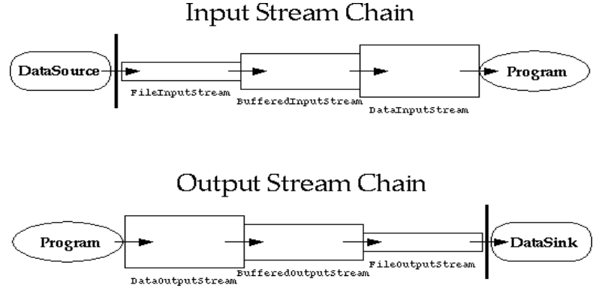
Chaining Decorators
Stream Decoration
Notes:
ECLIPSE example: C:\Users\Administrator\Desktop\MST\Material\05IOStream\NewExamples\ChainedDecorationsExample.java
Chaining decorations in the context of filter streams refers to the practice of combining multiple filter streams together to build a pipeline of decorations that enhance or modify the behavior of the base stream. This allows you to apply multiple layers of functionality in a flexible and composable way.
How Chaining Decorations Works
Base Stream: Start with a base stream, which is an instance of a fundamental stream class such as FileInputStream or FileOutputStream.
Filter Streams: Wrap the base stream with one or more filter streams. Each filter stream adds a specific enhancement or functionality. For example, you might wrap a FileInputStream with a BufferedInputStream to add buffering, and then wrap that with a DataInputStream to enable reading primitive data types.
Pipeline: The filter streams are arranged in a chain, where each filter stream wraps around the previous one. The input stream flows through this chain, and each filter stream in the chain processes the data or enhances the behavior of the base stream.
Benefits of Chaining Decorations
Modularity: Each filter stream focuses on a single aspect of functionality, making the code modular and easier to maintain.
Flexibility: You can easily change or rearrange the order of filter streams to achieve different behaviors.
Reuse: Filter streams can be reused in different chains to provide consistent functionality across various parts of your application.
Example of Chaining Decorations
Consider an example where you want to read primitive data types from a file, but with added buffering to improve performance and support for data types:
Decorator Design Pattern Overview
Base Component: This is the core component or interface that defines the basic operations. In the case of I/O streams, Reader and Writer are the base components.
Concrete Component: This is a specific implementation of the base component. For example, FileReader and FileWriter are concrete implementations of Reader and Writer, respectively.
Decorator: This wraps around the concrete component to add or enhance functionality. BufferedReader and BufferedWriter are decorators that enhance the capabilities of Reader and Writer by adding buffering.

Slide 20
Switch Stream Type
Switch between binary <-> text IO
InputStreamReader:
Converts bytes read from an InputStream into characters using a specified charset.
OutputStreamReader:
Converts characters to bytes according to the character coding before writing
Stream Decoration
Notes:
The InputStreamReader class in Java is a bridge between byte streams and character streams. It reads bytes from an InputStream and decodes them into characters using a specified charset. This is particularly useful when you need to read text data from a byte-based stream, such as a file or network connection, and you want to interpret the bytes as characters.
The OutputStreamWriter class in Java is a bridge between character streams and byte streams. It encodes characters into bytes using a specified charset and writes them to an OutputStream. This is particularly useful when you need to write text data to a byte-based stream, such as a file or network connection, and you want to ensure the characters are properly encoded.

Slide 21
Text Decorators
BufferedReader / BufferedWriter
Provides Line based reading and writing:
Reading:
BufferedReader.readLine() returns String (or null on end of file).
Writing:
BufferedWriter.write(String line) & BufferedWriter.newline()
Stream Decoration
Notes:
Text decorators in Java are classes that add functionality to text processing streams, enhancing or modifying their behavior. These decorators typically wrap around other text streams or readers/writers to provide additional capabilities such as buffering, formatting, or text conversion.
Here are some common types of text decorators:
1. Buffered Decorators
BufferedReader:
Adds buffering to a Reader to improve efficiency by reducing the number of read operations.
Example:javaCopy code
BufferedReader br = new BufferedReader(new FileReader("file.txt"));
BufferedWriter:
Adds buffering to a Writer to improve efficiency by reducing the number of write operations.
Example:javaCopy code
BufferedWriter bw = new BufferedWriter(new FileWriter("file.txt"));
2. Print Decorators
PrintWriter:
Provides convenient methods for writing formatted text and handles text encoding. It can be used to write data to various output streams, including files and network connections.
Example:javaCopy code
PrintWriter pw = new PrintWriter(new FileWriter("file.txt"));
PrintStream:
Similar to PrintWriter but extends OutputStream. It provides methods for printing formatted representations of objects.
Example:javaCopy code
PrintStream ps = new PrintStream(new FileOutputStream("file.txt"));
3. Character Encoding Decorators
InputStreamReader:
Converts bytes from an InputStream into characters using a specified charset.
Example:javaCopy code
InputStreamReader isr = new InputStreamReader(new FileInputStream("file.txt"), "UTF-8");
OutputStreamWriter:
Encodes characters into bytes using a specified charset before writing them to an OutputStream.
Example:javaCopy code
OutputStreamWriter osw = new OutputStreamWriter(new FileOutputStream("file.txt"), "UTF-8");
4. Data Handling Decorators
DataInputStream:
Provides methods for reading primitive data types (e.g., int, float) in a portable way from an underlying byte stream.
Example:javaCopy code
DataInputStream dis = new DataInputStream(new FileInputStream("data.bin"));
DataOutputStream:
Provides methods for writing primitive data types in a portable way to an underlying byte stream.
Example:javaCopy code
DataOutputStream dos = new DataOutputStream(new FileOutputStream("data.bin"));
5. Object Serialization Decorators
ObjectInputStream:
Allows for reading and deserializing objects from an input stream.
Example:javaCopy code
ObjectInputStream ois = new ObjectInputStream(new FileInputStream("object.dat"));
ObjectOutputStream:
Allows for writing and serializing objects to an output stream.
Example:javaCopy code
ObjectOutputStream oos = new ObjectOutputStream(new FileOutputStream("object.dat"));
6. Compression Decorators
GZIPInputStream:
Provides decompression for reading GZIP-compressed data from an input stream.
Example:javaCopy code
GZIPInputStream gzipIn = new GZIPInputStream(new FileInputStream("compressed.gz"));
GZIPOutputStream:
Provides compression for writing GZIP-compressed data to an output stream.
Example:javaCopy code
GZIPOutputStream gzipOut = new GZIPOutputStream(new FileOutputStream("compressed.gz"));
Summary
Text decorators in Java enhance or modify the behavior of text processing streams by adding functionality such as buffering, formatting, character encoding, data handling, object serialization, or compression. These decorators can be combined to create complex text processing pipelines that are efficient and flexible.

Slide 22
Primitives Decorators
DataInputStream / DataOutputStream
Provides primitive based reading and writing:
Reading:
• readUTF() : String
• readInt() : int
• readBoolean() : boolean ….
Writing:
• writeUTF(String)
• writeInt(int)
• writeBoolean(boolean)
Stream Decoration

Slide 23
Object Decorators
ObjectInputStream / ObjectOutputStream
All objects must implement Serializable
Provides Objects based reading and writing:
Reading:
• readObject() : Object
Writing:
• writeObject(Object)
Stream Decoration
Notes:
ECLIPSE : C:\Users\Administrator\Desktop\MST\Material\05IOStream\code\ObjectStreamExample.java
In Java, a serializable object refers to an object whose state can be converted into a byte stream for purposes such as saving to a file, sending over a network, or persisting to a database.
This process is known as serialization.
Conversely, the byte stream can be converted back into a copy of the original object through deserialization.

Slide 24
Serialization
Only the object's data are serialized
Data marked with the transient keyword are not serialized.
Serialization stores the state of an object to a file
Serializable objects can be stored and loaded from object streams:
ObjectInputStream
ObjectOutputStream
Serialization
Notes:
Serialization:
Serialization is the process of converting an object's state into a byte stream. This allows the object to be saved to a file or transmitted over a network.
The ObjectOutputStream class is used for serialization in Java.
Deserialization:
Deserialization is the process of converting a byte stream back into an object. This reconstructs the original object from the byte stream.
The ObjectInputStream class is used for deserialization in Java.
Serializable Interface:
To make an object serializable, the class must implement the java.io.Serializable interface. This is a marker interface, meaning it does not contain any methods. Its purpose is to indicate that a class can be serialized.
Example:javaCopy code
import java.io.Serializable; public class Person implements Serializable { private static final long serialVersionUID = 1L; private String name; private int age; // Constructor, getters, setters, etc. }
serialVersionUID:
serialVersionUID is a unique identifier for each serializable class. It is used to ensure that during deserialization, the class definition matches the serialized version.
It is a good practice to explicitly declare a serialVersionUID to avoid potential InvalidClassException issues when changes are made to the class.
Example of Serialization and Deserialization
Here's a simple example demonstrating serialization and deserialization of a Person object:
Serialization Example:
javaCopy code
import java.io.*; public class SerializationExample { public static void main(String[] args) { Person person = new Person("John Doe", 30); try (ObjectOutputStream oos = new ObjectOutputStream(new FileOutputStream("person.ser"))) { oos.writeObject(person); } catch (IOException e) { e.printStackTrace(); } } }
Deserialization Example:
javaCopy code
import java.io.*; public class DeserializationExample { public static void main(String[] args) { try (ObjectInputStream ois = new ObjectInputStream(new FileInputStream("person.ser"))) { Person person = (Person) ois.readObject(); System.out.println("Name: " + person.getName()); System.out.println("Age: " + person.getAge()); } catch (IOException | ClassNotFoundException e) { e.printStackTrace(); } } }
Important Points
Serializable Fields:
Only fields marked as serializable are included in the serialized form. Fields that are not serializable should be marked as transient if they should not be serialized.
Example:javaCopy code
private transient int nonSerializableField;
Inheritance:
If a class inherits from another class that implements Serializable, it does not need to explicitly implement Serializable itself. However, all non-transient fields in the subclass must be serializable.
Custom Serialization:
You can customize the serialization process by defining writeObject() and readObject() methods in your class. These methods allow you to control what is serialized and how deserialization is handled.
javaCopy code
private void writeObject(ObjectOutputStream oos) throws IOException { // Custom serialization code } private void readObject(ObjectInputStream ois) throws IOException, ClassNotFoundException { // Custom deserialization code }
Summary
A serializable object in Java is an object that implements the Serializable interface, allowing its state to be converted into a byte stream. This enables the object to be saved, transmitted, and reconstructed later. The process involves converting the object's state into bytes (serialization) and then back into an object (deserialization). Key aspects of serialization include managing serialVersionUID, handling transient fields, and potentially customizing the serialization process.

Slide 25
Random Access
Constructors:
RandomAccessFile(File file, String mode)
RandomAccessFile(String name, String mode)
Mode is usually ”r” or ”rw” .
file pointer can be read and positioned:
int skipBytes(int)
void seek(long)
long getFilePointer()
Random AccessFile
Notes:
ECLIPSE : C:\Users\Administrator\Desktop\MST\Material\05IOStream\NewExamples\RandomAccessFileExample.java
RandomAccessFile in Java is a class that allows you to read from and write to a file in a non-sequential, random-access manner. Unlike traditional file streams that read or write data sequentially, RandomAccessFile provides the ability to move to any part of the file and perform read or write operations from that position. This makes it useful for applications that need to access different parts of a file quickly, such as database systems, file-based data structures, or for implementing file editing operations.
Key Features of RandomAccessFile
Random Access:
You can read from or write to any part of the file using the file pointer. This is achieved by setting the file pointer to the desired location using the seek(long pos) method.
Dual Functionality:
RandomAccessFile can be used both as an input and output stream. You can perform read operations using methods similar to DataInputStream, and write operations similar to DataOutputStream.
File Pointer:
It maintains a file pointer (or cursor) that indicates the current position in the file. You can move this pointer to any position using the seek() method.
File Modes:
When creating a RandomAccessFile object, you specify a mode that determines whether the file is opened for reading, writing, or both. The modes are:
"r": Open for reading only.
"rw": Open for reading and writing.
Key Methods
long getFilePointer():
Returns the current offset (position) in the file.
Example:javaCopy code
long pos = raf.getFilePointer();
void seek(long pos):
Moves the file pointer to the specified position. This allows random access to any part of the file.
Example:javaCopy code
raf.seek(100); // Move the file pointer to the 100th byte
int read():
Reads the next byte of data from the file. Returns the byte as an int (0–255) or -1 if the end of the file is reached.
Example:javaCopy code
int data = raf.read();
void write(int b):
Writes the specified byte of data to the file at the current file pointer position.
Example:javaCopy code
raf.write(65); // Write the byte value for 'A'
void write(byte[] b):
Writes an array of bytes to the file at the current file pointer position.
Example:javaCopy code
byte[] data = "Hello".getBytes(); raf.write(data);
void close():
Closes the file and releases any associated resources.
Example:javaCopy code
raf.close();
public int skipBytes(int n)
* skip over a specified number of bytes in the file, effectively advancing the file pointer by that number of bytes. This method is particularly useful when you want to skip over certain sections of a file to reach a specific position or to ignore data that is not relevant for your current operation.
Example Usage
Here's an example demonstrating how to use RandomAccessFile to read and write data at specific positions in a file:
javaCopy code
import java.io.RandomAccessFile; import java.io.IOException; public class RandomAccessFileExample { public static void main(String[] args) { String filePath = "example.dat"; try (RandomAccessFile raf = new RandomAccessFile(filePath, "rw")) { // Write data to the file raf.writeInt(123); // Write an integer at position 0 raf.writeDouble(3.14); // Write a double at position 4 (after the integer) // Move the file pointer to the beginning raf.seek(0); // Read data from the file int intValue = raf.readInt(); double doubleValue = raf.readDouble(); // Print read values System.out.println("Read Integer: " + intValue); System.out.println("Read Double: " + doubleValue); } catch (IOException e) { e.printStackTrace(); } } }
Summary
RandomAccessFile provides a flexible way to access different parts of a file efficiently. It allows both reading and writing operations with the ability to move the file pointer to any location in the file. This makes it particularly useful for scenarios where you need non-sequential access to file data, such as modifying specific records or implementing file-based data structures.

Slide 26
Stream Tokenizer
A class reads the stream character by character.
Each of them can have zero or more of the following attributes:
white space, alphabetic, numeric, string quote or comment character.
types of characters:
Word characters: ranges like ‘a’ to ‘z’ and ‘A’ to ‘Z
Numeric characters: 0,1,…,9
Whitespace characters: ASCII values from 0 to 32
Comment character: /
String quote characters: ‘ and “
StreamTokenizer
Notes:
ECLIPSE - C:\Users\Administrator\Desktop\MST\Material\05IOStream\code\Tokenizer.java
The StreamTokenizer class in Java is a utility class used for tokenizing input streams of text. It provides a way to break down input into tokens (e.g., words, numbers, symbols) based on certain delimiters and patterns. This is particularly useful for parsing and analyzing text files, where you need to process or interpret the content in a structured manner.
Key Features of StreamTokenizer
Tokenization:
StreamTokenizer reads characters from an input stream and breaks the text into tokens based on specific criteria, such as whitespace, delimiters, and custom patterns.
Token Types:
Tokens can be of different types, including:
WORD: A sequence of letters.
NUMBER: A numerical value.
STRING: A quoted string.
COMMENT: A comment (if comment handling is enabled).
EOF: End of file marker.
Customization:
You can customize tokenization by specifying which characters are considered delimiters, how comments are handled, and whether to recognize specific characters as part of tokens.
Stream-Based:
StreamTokenizer works with InputStream and Reader objects, allowing it to tokenize data from various input sources, such as files or network streams.
Key Methods
nextToken():
Reads the next token from the input stream. It sets the ttype field to the type of the token read (e.g., TT_WORD, TT_NUMBER, etc.) and updates the corresponding value field (sval, nval).
Example:javaCopy code
int tokenType = tokenizer.nextToken();
parseNumbers(boolean parseNumbers):
Controls whether numbers should be parsed as tokens. By default, numbers are parsed as tokens.
Example:javaCopy code
tokenizer.parseNumbers(true);
resetSyntax():
Resets the syntax rules to default. This can be useful for reconfiguring the tokenizer after customizations.
Example:javaCopy code
tokenizer.resetSyntax();
setCommentChar(int ch):
Sets the character that indicates the start of a comment. The rest of the line is treated as a comment if this character is encountered.
Example:javaCopy code
tokenizer.setCommentChar('#');
setWhitespaceChars(int lowVal, int hiVal):
Specifies which characters are considered whitespace. Characters in this range are treated as delimiters.
Example:javaCopy code
tokenizer.setWhitespaceChars(' ', ' ');
Example Usage
Here's a simple example of using StreamTokenizer to tokenize the contents of a file:
javaCopy code
import java.io.FileReader; import java.io.IOException; import java.io.StreamTokenizer; public class StreamTokenizerExample { public static void main(String[] args) { String filePath = "example.txt"; try (FileReader fileReader = new FileReader(filePath); StreamTokenizer tokenizer = new StreamTokenizer(fileReader)) { // Configure the tokenizer (e.g., enable number parsing) tokenizer.parseNumbers(true); tokenizer.eolIsSignificant(true); int tokenType; while ((tokenType = tokenizer.nextToken()) != StreamTokenizer.TT_EOF) { switch (tokenType) { case StreamTokenizer.TT_WORD: System.out.println("Word: " + tokenizer.sval); break; case StreamTokenizer.TT_NUMBER: System.out.println("Number: " + tokenizer.nval); break; case StreamTokenizer.TT_EOL: System.out.println("End of Line"); break; default: System.out.println("Other: " + (char) tokenType); break; } } } catch (IOException e) { e.printStackTrace(); } } }
Explanation
Initialization:
StreamTokenizer is initialized with a FileReader that reads from the file.
Configuration:
parseNumbers(true) enables number parsing.
eolIsSignificant(true) treats end-of-line characters as significant.
Token Processing:
nextToken() reads tokens from the file.
Depending on the token type, different actions are taken (e.g., printing words, numbers, or handling end-of-line).
Summary
StreamTokenizer is a versatile class for parsing text input in Java. It breaks down input into tokens based on various criteria and supports customization for different tokenization needs. This makes it a useful tool for tasks like file parsing, data extraction, and text analysis.

Slide 27
Thank You !!

