Slide 1

Threads
Content
Introduction
Threads
Threads States
Methods
Locks
Executers

Slide 2
Threads
What is Multitasking ?
Running at the same time (concurrently) and performing different tasks
For example, a Web browser can do several things at the same time:
scroll a page
download a file
play animation, sound
print page
load a new page
Introduction

Slide 3
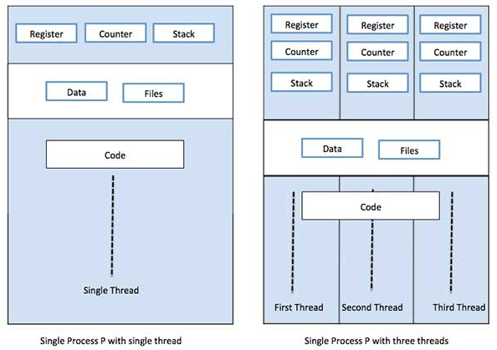
Threads
What is Multitasking ?
Introduction

Slide 4
Threads
What is a Thread?
A Thread is an independent path of execution within a program
Many threads can run concurrently within a program.
Every thread in Java is created and controlled by the java.lang.Thread class.
A Java program can have many threads, and these threads can run concurrently, either asynchronously or synchronously.
Every thread has a priority. Threads with higher priority are executed in preference to threads with lower priority.
Introduction

Slide 5
Threads
What is a Process?
A process has a self-contained execution environment.
A process generally has a complete, private set of basic run-time resources
Threads are sometimes called lightweight processes
Both processes and threads provide an execution environment, but creating a new thread requires fewer resources than creating a new process.
Introduction

Slide 6
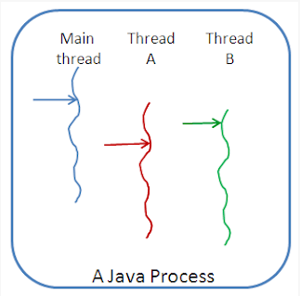
Threads
Thread VS. Process
Introduction

Slide 7
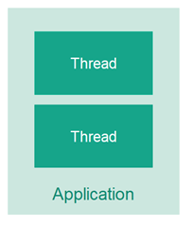
Threads
What is a Multithreading ?
Multithreading means that you have multiple threads of execution inside the same application.
A thread is like a separate CPU executing your application.
a multithreaded application is like an application that has multiple CPUs executing different parts of the code at the same time.
Introduction

Slide 8
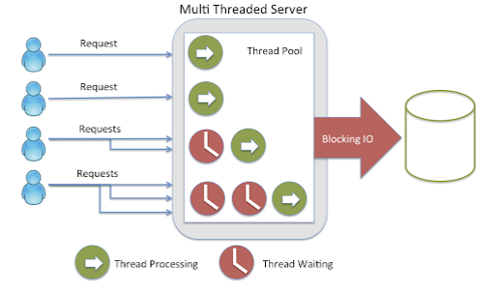
Threads
Why to use Multithreading ?
Introduction

Slide 9
Threads
Why to use Multithreading ?
Improve application performance.
Better resource utilization.
Simplify modeling real-world problems.
Perform asynchronous or background processing.
Introduction

Slide 10
Threads
Create New Thread
There are 2 ways for defining and creating threads
Subclassing Thread and Overriding run
Implementing the Runnable interface
Thread

Slide 11
Threads
Create New Thread
Implementing Runnable
Allows your class to extend some other class
Is good if you want light-weight runnable objects
That’s what interfaces are for
Problems – might be less convenient for coding
Sub classing Thread
Allows direct access to Thread attributes and methods
Less coding
Problems – single inheritance in Java – your class cannot extend another class
Thread

Slide 12
Threads
Create New Thread
public class SimpleThread extends Thread {
//override run and extends thread
public SimpleThread(String str) {
super(str);
}
@Override
public void run() {
for (int i = 0; i < 10; i++) {
System.out.println(i + " " + getName());
System.out.println(Thread.currentThread().getPriority());
try {
sleep((long)(Math.random() * 1000));
} catch (InterruptedException e) {
e.getStackTrace();}
}
System.out.println("DONE! " + getName()); }
public static void main (String[] args) {
new SimpleThread("thread1").start();
new SimpleThread("thread2").start();
System.out.println("Hi Assaf" +Thread.currentThread().getPriority());}
}
Thread

Slide 13
Threads
Create New Thread
public class SimpleRunnable implements Runnable {
public void run() {
for (int i = 0; i < 10; i++) {
System.out.println(i + " " + Thread.currentThread().getName());
System.out.println(Thread.currentThread().getPriority());
try {
Thread.sleep((long)(Math.random() * 3000));
}
catch (InterruptedException e) {}
}
System.out.println("DONE! " + Thread.currentThread(). getName());
}
public static void main (String[] args)
{
SimpleRunnable runner=new SimpleRunnable ();
Thread t1=new Thread(runner, “Apple thread");
Thread t2=new Thread(runner, “Banana thread");
t1.start();
t2.start(); }
}
Thread

Slide 14
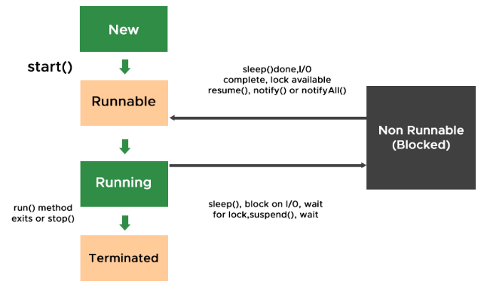
Threads
Thread Lifecycle
Thread

Slide 15
Threads
Thread States
New Thread
Thread is created but not yet started.
No system resource have been allocated for it yet
Can only be started
Calling any method besides causes an IllegalThreadStateException
States

Slide 16
Threads
Thread States
Runnable:
Thread is ready to run and waiting for CPU time.
When a start() method is called over thread processed by the thread scheduler
Case A: Can be a running thread (Running State)
Case B: Can not be a running thread (Blocked State)
States

Slide 17
Threads
Thread States
Running
Creates the system resources necessary to run the thread
Schedules the thread to run
Calls the thread's run method
States

Slide 18
Threads
Thread States
Not Runnable (Blocked)
A thread becomes Not Runnable when one of these events occurs:
It’s sleep(), yield() method is invoked.
One thread uses join() on another and becomes blocked.
The thread calls the wait() method to wait for a specific condition to be satisfied.
The thread is blocked on I/O.
States

Slide 19
Threads
Thread States
Terminated (Dead)
The run method must terminate naturally
Stop() method – deprecated!!!
This method is inherently unsafe. Stopping a thread with Thread.stop causes it to unlock all of the monitors that it has locked (as a natural consequence of the unchecked ThreadDeath exception propagating up the stack)
States

Slide 20
Threads
Thread Methods
start(): Starts the execution of the thread.
run(): Entry point for the thread.
sleep(long millis): Puts the thread to sleep for the specified milliseconds.
join(): Waits for the thread to die.
yield(): Causes the currently executing thread to temporarily pause and allow other threads to execute.
interrupt(): Interrupts the thread.
Methods

Slide 21
Threads
Start Method
Starting a thread by calling the start() function.
Q: why don’t we directly call the overridden run() function?
A: The purpose of start() is to create a separate call stack for the thread. A separate call stack is created by it, and then run() is called by JVM.
Methods
Notes:
What happens when a function is called? When a function is called the following operations take place:
The arguments are evaluated.
A new stack frame is pushed into the call stack.
Parameters are initialized.
Method body is executed.
Value is returned and current stack frame is popped from the call stack.

Slide 22
Threads
Sleep Method
Move the thread to a non-Runnable state for a period (ms)
Usually, the simplest way to delay threads or main
Note: blocks the thread at least to the specified time – not exactly
throws InterruptedException
When thread are out of the blocking state before time
Might happen due to OS activity
Methods
Notes:
What happens when a function is called? When a function is called the following operations take place:
The arguments are evaluated.
A new stack frame is pushed into the call stack.
Parameters are initialized.
Method body is executed.
Value is returned and current stack frame is popped from the call stack.

Slide 23
Threads
Join Method
Move the running thread to a non-Runnable state until a specific thread ends
Delays the caller until the referenced thread ends
Is absolute – not like priority
throws InterruptedException
When thread are out of the blocking state before time
Might happen due to OS activity
Methods
Notes:
What happens when a function is called? When a function is called the following operations take place:
The arguments are evaluated.
A new stack frame is pushed into the call stack.
Parameters are initialized.
Method body is executed.
Value is returned and current stack frame is popped from the call stack.

Slide 24
Threads
Yield Method
Move the Running thread to the Rannable pool (Equals to sleep(0))
Usually for giving other low priority thread a chance to run
throws InterruptedException
When thread are out of the blocking state before time
Might happen due to OS activity
Methods
Notes:
What happens when a function is called? When a function is called the following operations take place:
The arguments are evaluated.
A new stack frame is pushed into the call stack.
Parameters are initialized.
Method body is executed.
Value is returned and current stack frame is popped from the call stack.

Slide 25
Threads
Suspend Method
The suspend() method of thread class puts the thread from running to waiting state.
The suspended thread is often resumed using the resume() method.
suspend() and resume() method is deprecated in the latest Java version.
Methods
Notes:
What happens when a function is called? When a function is called the following operations take place:
The arguments are evaluated.
A new stack frame is pushed into the call stack.
Parameters are initialized.
Method body is executed.
Value is returned and current stack frame is popped from the call stack.

Slide 26
Threads
Inter-thread Communication Methods
Mechanism by which threads can communicate with each other.
wait(): Causes the current thread to wait until another thread invokes notify().
notify(): Wakes up a single thread that is waiting on this object's monitor.
notifyAll(): Wakes up all threads that are waiting on this object's monitor.
Methods

Slide 27
Threads
What is Synchronization?
It is the mechanism that bounds the access of multiple threads to share a common resource hence is suggested to be useful where only one thread at a time is granted the access to run over.
Synchronization

Slide 28
Threads
Why Synchronization?
To prevent thread interference.
To ensure consistency of shared data.
To manage access to shared resources.
Synchronization

Slide 29
Threads
Synchronized method
public synchronized void method() {
// synchronized code
}
Synchronization
public synchronized static void staticMethod() {
// synchronized code
}

Slide 30
Threads
Synchronized Block
public void method() {
synchronized(this) {
// synchronized code
}
}
Synchronization

Slide 31
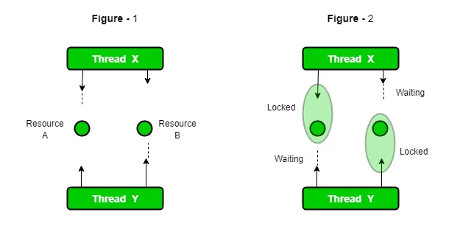
Threads
Lock
More flexible locking mechanism than synchronized.
Reentrant Lock

Slide 32
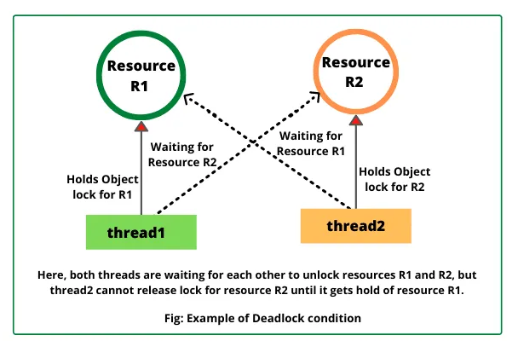
Threads
Lock
Dead Lock

Slide 33
Threads
Lock
Is two threads, each waiting for a lock from the other
Is not detected or avoided
Can be avoided by:
Deciding on the order to obtain locks
Adhering to this order throughout
Releasing locks in reverse order
Dead Lock

Slide 34
Threads
Daemon
Threads keep on running even after main thread ends
Means that the VM still ‘on the air’ until the last thread dies
To kill a thread when system exits it must be a daemon
Thread can be set to behave as daemon via setDaemon(boolean)
Thread can be checked via isDaemon()
Garbage collection is a daemon thread
therefore, doesn’t last after system exit
That’s why sometimes object may never get the finalize() call
Daemon Thread

Slide 35
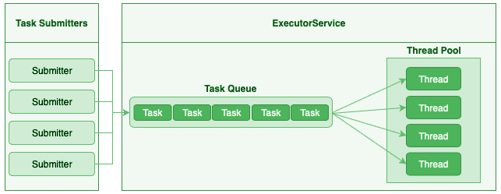
Threads
Executor
Executor

Slide 36
Threads
Thank You !!

