Slide 1

Collections
Contents
Introduction
Core IFCs
Collection IFC
List
Set
Queue
Map
Vector
Advanced Collections

Slide 2
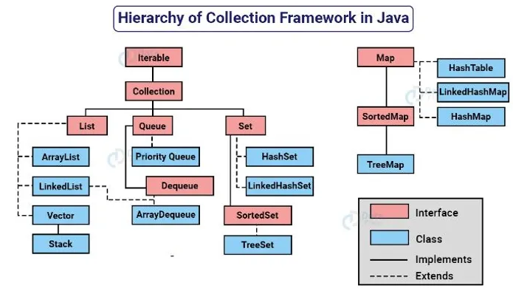
Collections
Introduction
Hierarchy

Slide 3
Collections
Introduction
Contains prepackaged data structures, interfaces, algorithms for manipulating those data structures.
Examples of collections – hand of cards, software engineers working on same project, etc.
Collections – Use existing data structures without concern for how they are implemented
Collections

Slide 4
Collections
Introduction
Collection: Root interface of the collection hierarchy.
List: Ordered collection (sequence).
Set: Collection that contains no duplicate elements.
Queue: Collection used to hold multiple elements prior to processing.
Map: Object that maps keys to values, not a true collection.
Hierarchy

Slide 5
Collections
Implementations
Collection
List Interface
ArrayList, LinkedList
Set Interface
HashSet, LinkedHashSet, TreeSet
Queue Interface
PriorityQueue, LinkedList
Map Interface
HashMap, LinkedHashMap, TreeMap
Interfaces

Slide 6
Collections
Core IFC
Collection Classes:
Legacy Classes
Vector
Classes & special IFCs
Specialized Interfaces:
Deque Interface
Map.Entry Interface

Slide 7
Collections
Collection
Common Methods:
add(E e): Adds an element to the collection.
remove(Object o): Removes an element from the collection.
size(): Returns the number of elements in the collection.
clear(): Removes all elements from the collection.
isEmpty(): Checks if the collection is empty.
contains(Object o): Checks if the collection contains a specific element.
Collection

Slide 8
Collections
List
Common Implementations: ArrayList , LinkedList
Common Methods:
get(int index): Returns the element at the specified position.
set(int index, E element): Replaces the element at the specified position.
add(int index, E element): Inserts an element at the specified position.
remove(int index): Removes the element at the specified position.
indexOf(Object o): Returns the index of the first occurrence of the specified element.
List

Slide 9
Collections
List
Characteristics:
Resizable array.
Fast random access.
Performance:
O(1) time complexity for the get and set operations.
O(n) for add and remove operations (amortized O(1) for adding at the end).
Use Case:
Best for frequent access and modification of elements by index.
Example:
List<String> arrayList = new ArrayList<>();
arrayList.add("Apple");
ArrayList

Slide 10
Collections
Set
Common Implementations:
HashSet , LinkedHashSet , TreeSet
Common Methods:
All methods from Collection.
Set

Slide 11
Collections
Set
Characteristics:
Backed by a hash table.
No guaranteed order of elements.
Performance:
O(1) time complexity for basic operations (add, remove, contains).
Use Case:
Best for high-performance operations with no need for order.
Example:
HashSet
Set<String> hashSet = new HashSet<>();
hashSet.add("Orange");

Slide 12
Collections
Set
Characteristics:
Hash table with linked list running through it.
Maintains insertion order.
Performance:
O(1) time complexity for basic operations.
Use Case:
Best for when iteration order matters.
Example:
LinkedHashSet
Set<String> linkedHashSet = new LinkedHashSet<>();
linkedHashSet.add("Grapes");

Slide 13
Collections
Set
Characteristics:
Navigable set backed by a TreeMap.
Elements sorted in natural order or by a comparator.
Performance:
O(log n) time complexity for basic operations.
Use Case:
Best for sorted data and range view.
Example:
TreeSet
Set<String> treeSet = new TreeSet<>();
treeSet.add("Pineapple");

Slide 14
Collections
Queue
Common Implementations:
LinkedList , PriorityQueue
Common Methods:
offer(E e): Inserts the specified element into this queue.
poll(): Retrieves and removes the head of this queue.
peek(): Retrieves, but does not remove, the head of this queue.
Queue

Slide 15
Collections
Map
Common Implementations:
HashMap , LinkedHashMap , TreeMap , Hashtable
Common Methods:
put(K key, V value): Associates the specified value with the specified key.
get(Object key): Returns the value to which the specified key is mapped.
remove(Object key): Removes the mapping for a key.
containsKey(Object key): Checks if the map contains a mapping for the specified key.
keySet(): Returns a set view of the keys.
Map

Slide 16
Collections
Map
Characteristics:
Hash table-based implementation.
No guaranteed order.
Performance:
O(1) time complexity for basic operations.
Use Case:
Best for high-performance key-value mapping.
Example:
HashMap
Map<String, Integer> hashMap = new HashMap<>();
hashMap.put("Apple", 1);

Slide 17
Collections
Map
Characteristics:
Hash table with a linked list running through it.
Maintains insertion order.
Performance:
O(1) time complexity for basic operations.
Use Case:
Best for iteration order needs.
Example:
LinkedHashMap
Map<String, Integer> linkedHashMap = new LinkedHashMap<>();
linkedHashMap.put("Banana", 2);

Slide 18
Collections
Map
Characteristics:
Red-black tree-based implementation.
Sorted according to natural order or by comparator.
Performance:
O(log n) time complexity for basic operations.
Use Case:
Best for sorted key-value pairs.
Example:
TreeMap
Map<String, Integer> treeMap = new TreeMap<>();
treeMap.put("Orange", 3);

Slide 19
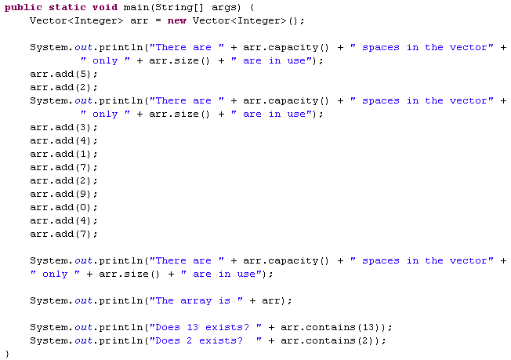
Collections
Vector
הגודל הפיזי ההתחלתי של המערך הוא 10
Vector
ניתן לראות כי ברגע שהמקום במערך נגמר המחלקה מגדילה אותו פי 2

Slide 20
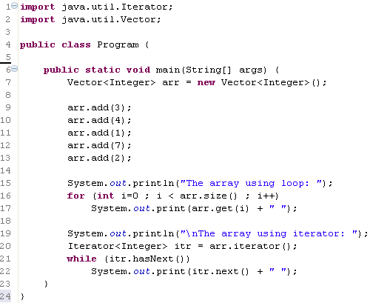
Collections
Vector
Vector
הגדרת איטרטור מטיפוס איברי האוסף
קבלת איטרטור לאיבר הראשון באוסף
כל עוד יש איברים באוסף
קבלת האיבר הבא

Slide 21
Collections
Vector
public static void main(String args[]) {
Enumeration<String> days;
Vector<String> dayNames = new Vector<String>();
dayNames.add("Sunday");
dayNames.add("Monday");
dayNames.add("Tuesday");
dayNames.add("Wednesday");
dayNames.add("Thursday");
dayNames.add("Friday");
dayNames.add("Saturday");
days = dayNames.elements();
while (days.hasMoreElements()) {
System.out.println(days.nextElement());
}
}
Vector

Slide 22
Collections
Advanced Collections
Characteristics:
A specialized Map implementation for use with enum keys.
All keys must be of the same enum type.
Performance:
Highly efficient, faster than HashMap when working with enum keys.
Use Case:
Best for maps with enum keys.
Example:
EnumMap
enum Day { MONDAY, TUESDAY, WEDNESDAY, THURSDAY, FRIDAY, SATURDAY, SUNDAY }
EnumMap<Day, String> map = new EnumMap<>(Day.class);
map.put(Day.MONDAY, "Start of work week");

Slide 23
Collections
Advanced Collections
Characteristics:
A thread-safe implementation of HashMap optimized for concurrent access.
Divides the map into segments to reduce contention.
Performance:
High throughput for concurrent read and write operations.
Use Case:
Best for high-concurrency scenarios.
Example:
ConcurrentMap
Map<String, Integer> concurrentMap = new ConcurrentHashMap<>();
concurrentMap.put("key1", 1);

Slide 24
Collections
Advanced Collections
Characteristics:
A thread-safe variant of ArrayList where all mutative operations (add, set, remove) are implemented by making a fresh copy of the underlying array.
Performance:
Suitable for situations where reads vastly outnumber writes.
Use Case:
Best for lists where traversal operations are more frequent than updates.
Example:
CopyOnWriteArrayList
List<String> list = new CopyOnWriteArrayList<>();
list.add("Item1");

Slide 25
Collections
Thank You !!

