Slide 1
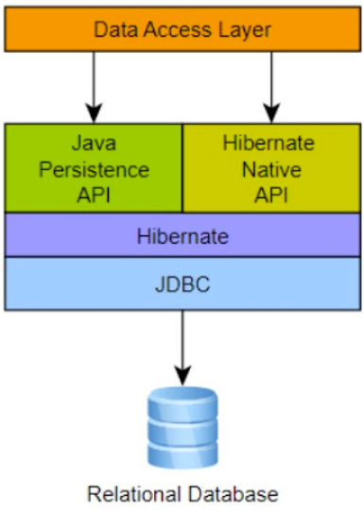
JPA
Java Persistence API
JPA

Slide 2
JPA
Java Persistence API
JPA (Java Persistence API) is a Java specification for managing relational data in applications using Java objects.
Provides a standard way to map Java objects (POJO) to relational database tables.
Entity-Bean will hold DB values in instance variables
Container is responsible for synchronizing objects with the stored data – using naked objects pool
Access to the bean values will be done using get & set methods
JPA

Slide 3
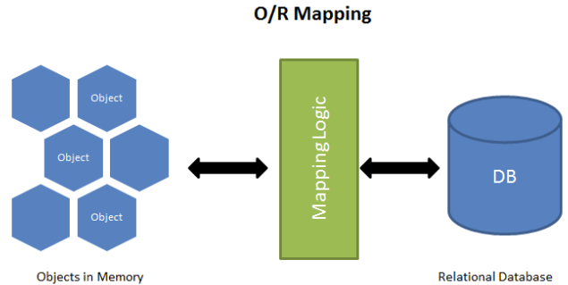
JPA
ORM
JPA

Slide 4
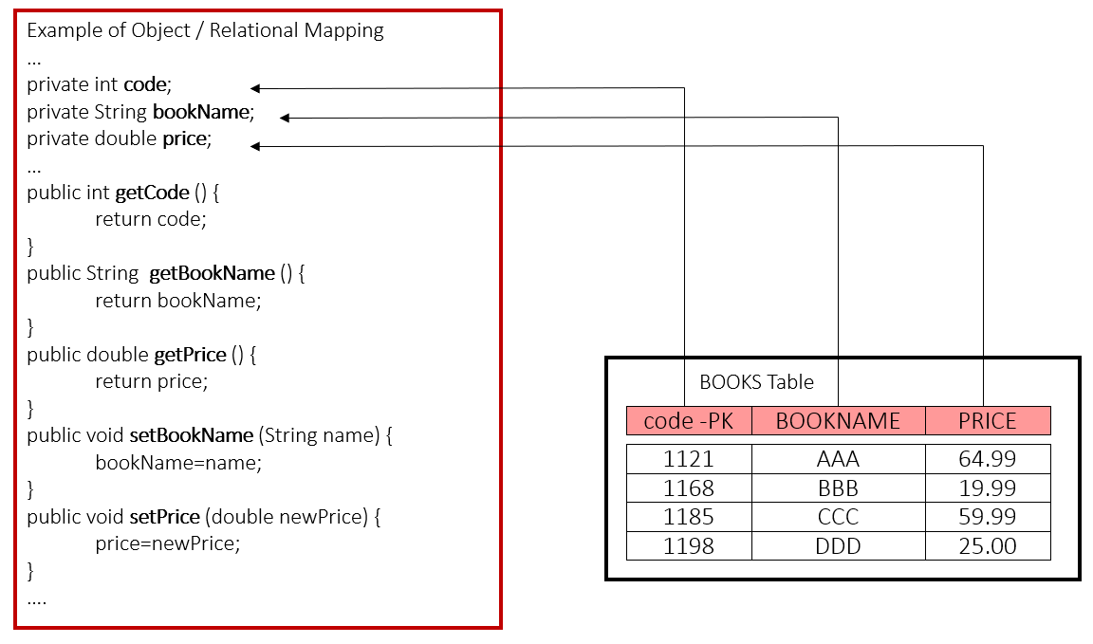
JPA
ORM
JPA

Slide 5
JPA
JPA Architecture
Entity: A lightweight Java class representing a table in the database.
EntityManager: Interface used to interact with the persistence context.
EntityManagerFactory: Factory class for creating EntityManager instances.
Persistence Context: Environment where entities are managed.
Persistence Unit: Configuration of an entity manager
JPA

Slide 6
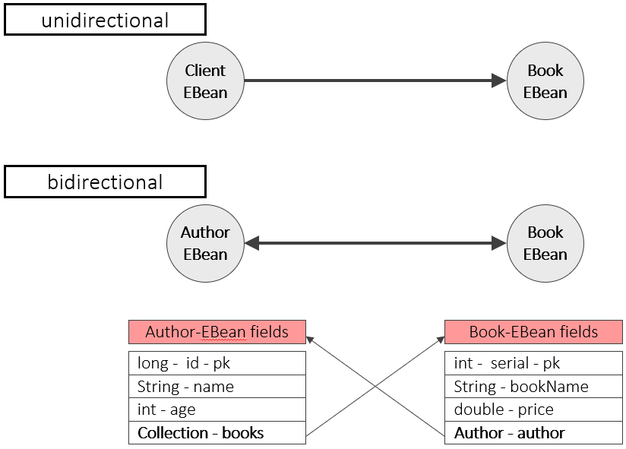
JPA
Relation of Reference Objects
JPA

Slide 7
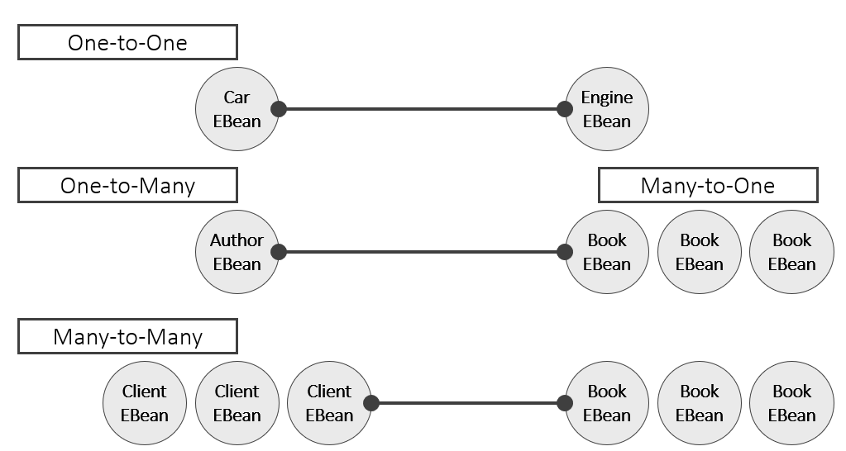
JPA
Relation of Reference Objects
JPA

Slide 8
JPA
JPA Annotations
@Entity : indicate that this object is an Entity Bean.
@Table : let us to customize the table name either.
@Id : indicate that the class Data Member has PK constraint.
@Column : let us to customize and add attributes to columns.
@OneToOne : 1:1
@OneToMany : 1:n
@ManyToOne: n:1
@ManyToMany : m : n
JPA

Slide 9
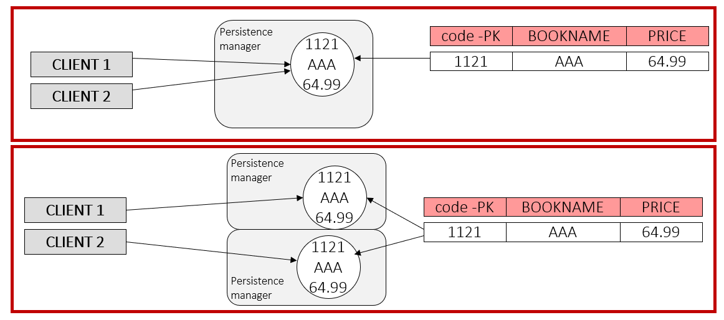
JPA
Relation of Reference Objects
Same data may be reflected by more then one instance.
Each persistence manager holds only one instance of entity mapped to a row.
JPA

Slide 10
JPA
EntityBean
Entity bean class must:
be annotated with @Entity annotation (‘name’ attribute is optional)
have no-argument constructor
not be Enum or interface
have non final Class and data members
May be abstract
May extend non-Entities classes
Accessor methods (getters/ setters) mustn’t be private & are optional
Both set() & get () must be present
Get() is the one that should be annotated
Bean field type can be different than types defined in the DB
JPA

Slide 11
JPA
EntityBean
Accessor methods
Must follow Java Bean naming convention
May work with the following collections:
Collection<OtherE>
Set<OtherE>
List<OtherE>
Map<PK><OtherE>
If application exception is thrown by accessor methods during container load & store operations will
throw PersistenceException
rollback the existing transaction
If any Runtime exception is thrown – the transaction is rolled back
JPA

Slide 12
JPA
EntityBean Example
@Entity
@Table(name=“COUNTRIES”)
public class Country implements Serializable{
private int id;
private String name;
private String language;
private double area;
private Collection<City> cities = new HashSet();
@Id //denotes PK
@GeneratedValue
@Column(name=“CNT_ID", nullable=false, columnDefinition="integer")
public int getId() { return id; }
public void setId() { this.id=id; }
@Column(name=“NAME", nullable=false)
public String getName() { return name; }
public void setName(String name) { this.name=name; }
@Column(name=“LANG", nullable=false)
public String getLanguage() { return language; }
public void setLanguage(String language) { this. language = language; }
@Column(name=“AREA", nullable=false, columnDefinition=“double")
public double getArea() { return area; }
public void setArea(double area) { this. area = area; }
JPA

Slide 13
JPA
EntityBean Example
@OneToMany
public Collection<City> getCities(){ return cities; }
public void setCities(Collection<City> cities){ this. cities = cities; }
//business method to add a single city
public void addCity(City city) {
getCities().add(city) ;
city.setCountry(this); //since it is a bidirectional relations
}
}
JPA

Slide 14
JPA
EntityBean PK
private int personID;
@Id
@GeneratedValue(GenerationType.AUTO)
public int getPersonID() { …. }
public void setPersonID( int personID ) { … }
Entity beans must have a PK
Simple PK:
Is one of the persistent fields
Annotated with @Id
Can be automatically generated when annotated @GeneratedValue
strategy attribute may specify any of the supported generation types
GenerationType enum supports: TABLE, SEQUENCE, IDENTITY, AUTO
JPA

Slide 15
JPA
EntityBean PK
GenerationType is an enumeration in Java Persistence API (JPA) that defines different strategies for generating primary key values.
The four types of GenerationType are:
AUTO:
The default strategy.
JPA decides the generation strategy based on the database dialect.
It may use IDENTITY, SEQUENCE, or TABLE strategies.
IDENTITY:
Uses an auto-incremented database column to generate unique identifiers.
Each new record gets the next value from the database identity column.
SEQUENCE:
Utilizes a database sequence object to generate unique identifiers.
JPA uses @SequenceGenerator to define the sequence name and allocation size.
TABLE:
Uses a special table to generate primary key values.
Can be used when the database does not support IDENTITY or SEQUENCE.
JPA

Slide 16
JPA
Compose EntityBean PK
When PK is more than one column a PK class should be composed
Must be public Serializable object
Must have no-argument constructor
May be properties-based (use public accessor methods)
Must override equals() & hashcode() to become logically comparable
Fields and properties must have the same name & type as in the Entity bean class
Cannot be automatically generated
Use @EmbeddedId & @Embeddable - for PK classes that are part of the beans state
JPA

Slide 17
JPA
Compose EntityBean PK
@Embeddable
public class CityPK implements Serializable{
private String name;
private int code;
public CityPK() {}
public CityPK (String name, int code){
this.name=name;
this.code=code;
}
public int hashCode () {
return name.hashCode()+code;
}
public boolean equals (Object o) {
if (o instanceof CityPK)
if (((CityPK)o).name.equals(this.name) && ((CityPK)o).code==this.code)
return true;
return false;
}
@Column(name=“CITY_NAME”)
public String getName(){ return name; }
public void setName(String name){ this.name=name;}
@Column(name=“CITY_CODE”)
public int getCode(){ return code; }
public void setCode(int code){ this.code=code;}
}
In this case – the PK is not part of the
state of the Entity bean – it is used
internally.
requirements:
class is annotated as embeddable
implements Serializable
overrides hashCode() & equals()
data members are actual CMP fields
denoted getters & setters
JPA

Slide 18
JPA
Compose EntityBean PK
The entity bean uses CityPK class as
PK externally.
This means that it will use CityPK
objects for maintaining both code &
name CMP fields.
requirements:
declare the composite PK class
denote each CMP field that is part of
the PK
@Entity
@Table(name=“CITIES”)
public class City implements Serializable
private CityPK pk;
private Country country;
…
@EmbeddedId()
public CityPK getPK() { return pk; }
public void setPK(CityPK pk) { this.pk=pk; }
…
}
JPA

Slide 19
JPA
Entity Field
@Column
name – name of the mapped table column (String).
nullable – specifies whether the column may take null values or not (true/false).
unique – specifies whether the column holds unique values or not (true/false).
columnDefinition - specifies the DDL type of the column, When not specified – mapping is done according to system defaults table)
length – specified the permitted VARCHAR length
JPA

Slide 20
JPA
Entity Field
@Transient
means that the CMP field is not persisted
relevant for ‘read only’ attribute that only have ‘get’ methods
is used at the get() method level
@Basic
specifies the default mapping between Java types & DDL type
therefore – usually never used but:
help in determining fetch policy via fetch attribute
FetchType enum supports: LAZY, EAGER
LAZY – data is loaded only when the denoted column is read
EAGER – data is loaded on first fetch from the DB
@Transient
JPA
@Basic(fetch=FetchType.LAZY)

Slide 21
JPA
Entity Field
@Temporal(TemporalType.TIME)
More annotation for fields:
@Temporal
Helps in determining which DB type is mapped to java.util.Date or java.util.Calendar
Default mapping is to ‘timestamp’
Attribute value is TemporalType enum
TemporalType enum supports: DATE,TIME,TIMESTAMP
Can be used in addition to @Basic annotation & fetch policy
@Lob
Useful when the persisted types are:
Blob (byte[], Byte[], Serializable objects)
Clob (char[], Character[], long Strings)
Can be used in addition to @Basic annotation & fetch policy
JPA
@Lob

Slide 22
JPA
Entity Field
@Enumerated(EnumType.STRING)
@Enumerated
Useful for mapping enums to a table (get/set takes and returns enum)
Enums are stored by default as number (ordinal value) or as string
The value of @Enumerated is specified via EnumType enum
EnumType enum supports: ORDINAL,STRING
JPA

Slide 23
JPA
Entity Manager
A unit that manages Entity beans of the same persistent context
Persistent context
Is set of entity instances
Each persistence entity has a unique instance
Works with a single DataSource specified in the persistence.xml
EntityManager interface defines the way of interacting with the persistent context
Encapsulates all JDBC activity
Makes interaction simple
Allows entity beans to remain POJOs
Supports attached and detached entities
JPA

Slide 24
JPA
Entity Manager
A unit that manages Entity beans of the same persistent context
Persistent context
Is set of entity instances
Each persistence entity has a unique instance
Works with a single DataSource specified in the persistence.xml
EntityManager interface defines the way of interacting with the persistent context
Encapsulates all JDBC activity
Makes interaction simple
Allows entity beans to remain POJOs
Supports attached and detached entities
JPA

Slide 25
JPA
Entity Manager
persist (Object entity)
Inserts a new table row where the entity is mapped to
JPA
find(Class<T> entity class, Object pk)
Returns entity <T> or null if not found
getReference(Class<T> entity class, Object pk)
Returns entity <T> or EntityNotFoundException
createQuery(String ejbQL)
returns a query object that allows to find entity beans
createNamedQuery(String queryName)
same, but uses a pre-defined query specified in the DD
createNativeQuery(String SQL)
same, but uses a vendor specific query or SQL query
remove (Object entity)
Deletes a table row where the entity is mapped to
merge (Object entity)
Attaches the entity to the persistent context - update
refresh (Object entity)
Overrides the managed entity state with DB data
contains (Object entity)
Returns ‘true’ if the entity is currently managed
flush ()
Forces DB updates done via persist, merge, remove
clear ()
Detaches all managed entities, unsaved changes are lost

Slide 26
JPA
Entity Manager
Persist
EntityExistsException – If entry already exists
IllegalArgumentException – If sent parameter is not an Entity
Merge, Remove, Find
IllegalArgumentException – If sent parameter is not an Entity
GetReference, Refresh
IllegalArgumentException – If sent parameter is not an Entity (class)
EntityNotFoundException – if the Entity cannot be accessed
Query execution
IllegalArgumentException – If JPQL raises problems of invalid
Native Query execution
PersistenceException - wraps any underlying exception
JPA

Slide 27
JPA
Entity Bean
Annotations for relationship:
@OneToOne - Unidirectional, Bidirectional
@OneToMany – Unidirectional, Bidirectional
@ManyToOne - Unidirectional
@ManyToMany - Unidirectional, Bidirectional
Each annotation supports:
fetch policy settings - fetch=FetchType.EAGER/LAZY
cascade
mapped by
Join table
When using @ManyToMany a 3rd table must be created
If JPA is generating DB schema – a join table and columns can be specified
Use @JoinTable or @JoinColumn for that
Is generated automatically
JPA

Slide 28
JPA
Entity Bean
Cascade value
Specifies how the persistent manager treats dependent entities in each action
Supported actions: ‘PERSIST’, ‘MERGE’, ‘REMOVE’, ‘REFRESH’, ‘ALL’
Permitted only for OneToOne, OneToMany , ManyToOne
JPA
@Entity
public class Country implements Serializable
private Capital capital;
@OneToOne(cascade={CascadeType.PERSIST, CascadeType.REMOVE})
public Capital getCapital(){
return capital;
}
public void setCapital(Capital capital){
this. capital = capital; } }
@Entity
public class Country implements Serializable
private Capital capital;
@OneToOne(cascade={CascadeType.ALL})
public Capital getCapital(){
return capital;
}
public void setCapital(Capital capital){
this. capital = capital;
}
}
Means that every time
a Country entity is persisted
or removed,
the same happens to its
dependent entity called Capital

Slide 29
JPA
Entity Bean
Cascade value
Country c=new Country();
Capital cap=new Capital ();
cap.setCountry(c);
c.setCapital(cap);
entityManager.persist(c);
Since cascade was set to ALL,
Any operation, including ‘persist’
includes all dependent entities.
In this case, adding a new Country entry
will also create a new Capital entry
JPA

Slide 30
JPA
Entity Bean
NOT to use cascading
JPA
When entities have different lifespan
a deletion of one should not be followed by a deletion of other
For example – when City is removed – Country should stay
When merging entity with little changes / updates
If most of the CMP & CMR fields haven’t change – there is no reason to cascade the ‘merge’ operation
Might affect performance - save round trips to the DB
You should know how your entities are going to be used before you set cascading

Slide 31
JPA
Entity Bean
mappedBy value
Used only in bidirectional relationship
Specifies the field or property in the dependent entity – not the owner
Forbidden for ManyToOne (the ‘ManyToOne’ is in the owner)
In OneToOne – the owner is the one that hold the foreign key
The ‘ejbPostCreate()’ issue is solved easily
JPA

Slide 32
JPA
Entity Bean
OneToOne unidirectional
@Entity
public class Country implements Serializable
private Capital capital;
@OneToOne
public Capital getCapital(){
return capital;
}
public void setCapital(Capital capital){
this. capital = capital;
}
}
@Entity
public class Capital implements Serializable
…
}
JPA
Country c=new Country();
Capital cap=new Capital();
c.setCapital(cap);

Slide 33
JPA
Entity Bean
OneToOne bidirectional
@Entity
public class Country implements Serializable
private Capital capital;
@OneToOne
public Capital getCapital(){
return capital;
}
public void setCapital(Capital capital){
this. capital = capital;
}
}
@Entity
public class Capital implements Serializable
private Country country;
@OneToOne(mappedBy=“capital”)
public Country getCountry(){
return country;
}
public void setCountry(Country country){
this.country =country;
}
}
Country c=new Country();
Capital cap=new Capital ();
cap.setCountry(c);
c.setCapital(cap);
JPA
Country is created with a ‘null’ Capital value
Capital is created & set with a country
Capital is assigned to the country

Slide 34
JPA
Entity Bean
OneToMany unidirectional
@Entity
public class Country implements Serializable
private Collection<City> cities =new ArrayList<City>();
@OneToMany
public Collection<City> getCities(){
return cities;
}
public void setCities(Collection<City> cities){
this. cities = cities;
}
}
@Entity
public class City implements Serializable
…
}
JPA
Some issues when working with ‘Many’ relationship
The Collection CMR must be instantiated in the declaration line – Otherwise, when clients create POJOs offline, the collection will be null.
Most server uses ‘LAZY’ loading for Collection CMR fields. If users detaches entity beans – policy should change to ‘EAGER’ – otherwise, without calling the appropriate get() method and force collection loading - the instances are not fully loaded when handed to remote clients!

Slide 35
JPA
Entity Bean
OneToMany unidirectional
many Cities can point to the same Country
JPA
@Entity
public class City implements Serializable
private Country c;
@ManyToOne
public Country getCountry(){
return c;
}
public void setCountry( Country c){
this. c= c;
}
}
@Entity
public class Country implements Serializable
…
}

Slide 36
JPA
Entity Bean
OneToMany / ManyToOne bidirectional
@Entity
public class Country implements Serializable
private Collection<City> cities = new HashSet<City>();
@OneToMany(mappedBy=“country”)
public Collection<City> getCities(){
return cities;
}
public void setCities(Collection<City> cities){
this. cities = cities;
}
}
@Entity
public class City implements Serializable
private Country country;
@ManyToOne
public Country getCountry(){
return country;
}
public void setCountry(Country country){
this.country =country;
}
}
JPA

Slide 37
JPA
Entity Bean
ManyToMany unidirectional
@Entity
public class Country implements Serializable
private Collection<City> cities = new HashSet<City>();
@ManyToMany
public Collection<City> getCities(){
return cities;
}
public void setCities(Collection<City> cities){
this. cities = cities;
}
}
@Entity
public class City implements Serializable
…
}
JPA

Slide 38
JPA
Entity Bean
ManyToMany unidirectional
@Entity
public class Country implements Serializable
private Collection<City> cities = new HashSet<City>();
@ManyToMany
public Collection<City> getCities(){
return cities;
}
public void setCities(Collection<City> cities){
this. cities = cities;
}
}
@Entity
public class City implements Serializable
…
}
JPA

Slide 39
JPA
Entity Bean
ManyToMany bidirectional
@Entity
public class Country implements Serializable
private Collection<City> cities = new HashSet<City>();
@ManyToMany
public Collection<City> getCities(){
return cities;
}
public void setCities(Collection<City> cities){
this. cities = cities;
}
}
@Entity
public class City implements Serializable
private Collection<Country> countries = new HashSet<Country>()
@ManyToMany(mappedBy=“cities”)
public Collection<Country> getCountries(){
return countries;
}
public void setCountries(Collection<Country> countries){
this. countries = countries;
}
}
JPA
The owner may be anyone
In this example Country entities
can be referenced by different
City entities & vise versa

Slide 40
JPA
Entity Bean
Working with Maps
Usually for holding a key to an entity bean.
Key is one of the unique fields of the entity class (pk)
Use @MapKey to specify field name
JPA
@Entity
public class Country implements Serializable
private Map<String,City> cities = new HashTree<String,City>();
@ManyToMany
@MapKey(name=”cityName”)
public Map<String,City> getCities(){
return cities;
}
public void setCities(Map<String,City> cities){
this. cities = cities;
}
}

Slide 41
JPA
Querying
JPQL
query language for objects
is used upon abstract schema names representing actual entities
queries may result in Objects and CMP field (including primitives)
In previous versions
JPQL statements were part of the DD
Therefore, kind of hard coded
Now
Are assigned to the Entity Manager via
JPA
createQuery(String ejbQL)
returns a query object that allows to find entity beans

Slide 42
JPA
Querying
JPQL statements
JPA
SELECT OBJECT(b) FROM MyEntityBean AS b WHERE b.name LIKE ‘A%’
SELECT
FROM
WHERE [optional]
Return type
OBJECT – stub \ Collection
CMP Field – b.price
Use ‘DISTINCT’ for non-
repeatable Collections
Variables Declaration
Abstract Schema Name is the type
AS declares the variable name
IN may be used to select or reference a
collection
Can define more than one variable:
FROM mybeanA AS a, mybeanB as b
Conditions
SQL like syntax
Can use CMP fields
b.price>50.99
Allows to assign
parameters to the query
- ?index – by index
-:name – by name

Slide 43
JPA
Querying
JOIN operator
Useful when querying a collection CMR field
JPA
SELECT city from Country AS c join c.cities as city
SELECT city.name from Country AS c join c.cities as city
SELECT city from Country AS c join c.cities as city ORDER BY city.name DESC
Returns a List of all cities from all countries
Returns a List of all city names from all countries
Returns a sorted List of all cities
from all countries. The list is
ordered by city names in a
descending order

Slide 44
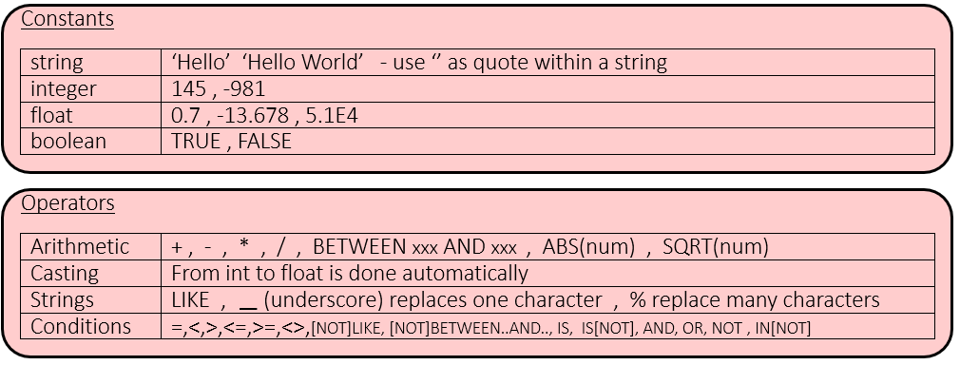
JPA
Querying
Querying
WHERE clause
Syntax is like SQL
JPA

Slide 45
JPA
JPA
Thank You !!

