Slide 1

Linux

Slide 2
Content
Introduction
Windows VS. Linux
Linux Commands

Slide 3
What is Linux?
Linux is an open source operating system
Different distributions (or known as distros)
Most common one is Ubuntu
Introduction

Slide 4
Usage
Servers
Development
Embedded Systems
Desktop
Introduction

Slide 5
What is an OS?
software that manages computer hardware and software resources
Ensures running programs don’t interfere with each other
Process Management
Memory Management
File System Management
Device Management
Security and Access Control
User Interface
Introduction

Slide 6
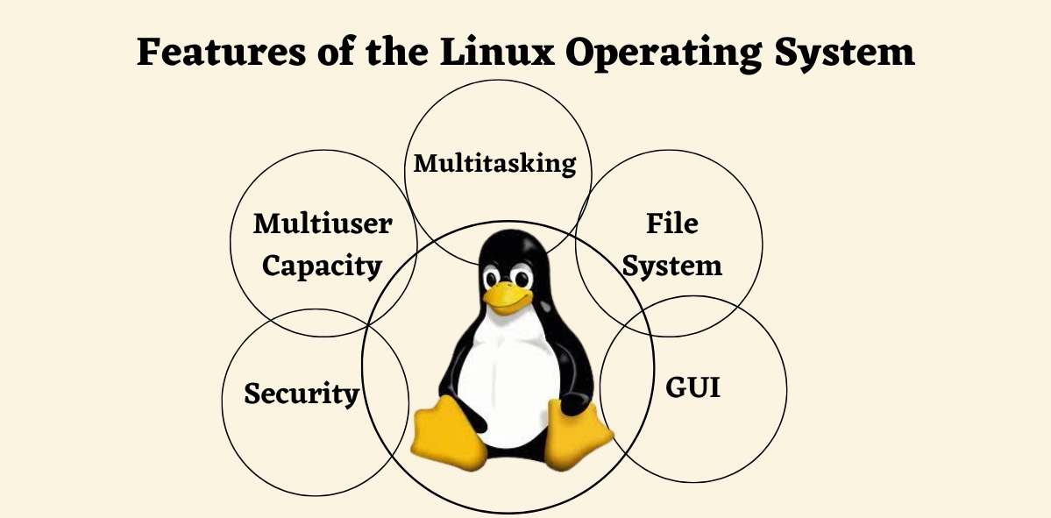
Features
Introduction

Slide 7
Naming
Named after Linus Torvalds
Combo of Linus + Unix
Developed it in 1991
Initially was named: Freax
Combo of: Free, Freak, Unix
Introduction

Slide 8

Windows VS. Linux

Slide 9
Which is better?
Linux and Windows.
Each has its own set of unique features
advantages and disadvantages.
While it is difficult to say which one is the better choice
it is not as difficult to answer which is the better choice given your needs.
Windows VS. Linux

Slide 10
Licensing
Windows
Closed Source
Need to Purchase a License to use it
Linux
Open-Source
Free or Low Cost
Windows VS. Linux

Slide 11
User Interface
Windows
Known for its user-friendly GUI
Customization: allows some customization, but is limited
Linux
variety of desktop envs: GNOME, KDE, XFCE
users normally use CLI extensively
UI is highly customizable
Windows VS. Linux

Slide 12
Software Support
Windows
Wide Compatibility
Limited Open Source software
Linux
Limited Proprietary software
Rich in open source software
Windows VS. Linux

Slide 13
Security
Windows
Target for malware
Improved security over the years, with features like UAC
Linux
Strong Security
Open Source Advantage
Windows VS. Linux

Slide 14
Performance
Windows
Resource Intensive
Optimized for GUI
Linux
Efficient and Lightweight
Scalable Performance
Windows VS. Linux

Slide 15
Other differences
File System and Management
Updates and Software Management
Community and Support
Use Cases
Windows VS. Linux

Slide 16
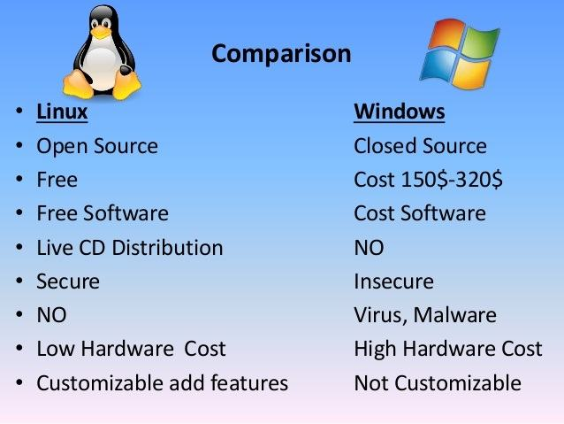
Quick Comparison
Windows VS. Linux

Slide 17

Linux Commands

Slide 18
Terminal
The Terminal is a text-based interface
where all commands in Linux are run
Usage:
File Management
Process Management
Text Manipulation
Package Management
Networking
Run:
Let’s Open a terminal
Right click -> new terminal window
Linux Commands

Slide 19
pwd command
Get current working directory
Always returns the “Absolute Path”
Linux Commands

Slide 20
ls command
Used for listing files and directories
Usage:
‘ls’ – list the files in current directory
‘ls file/folder name’ – list the files / folders per the given input
Linux Commands

Slide 21
ls command options
-r : reverse the order of listing
-l : use long listing format
-t : sort by modification time, newest first
-a : do not ignore entries starting with .
-d : list directories themselves, not their contents
Combining options
Linux Commands

Slide 22
mkdir command
Creates a new directory
Usage:
mkdir [options] directory_name
Create multiple directories at once
Linux Commands

Slide 23
rmdir command
Removes a directory
What happens in case the directory exists?
What if it exists and has some files and folders?
What if it doesn’t exist?
Removing multiple directories
Using relative / absolute path
Linux Commands

Slide 24
cd command
cd = Change Directory
Changes the current directory to the given one
Relative path / Absolute path
The ‘..’ directory
The ‘/’ directory
The ‘~’ directory
Linux Commands

Slide 25
echo command
Display a line of text to the terminal
Usage:
echo [options] [string]
Example:
echo Hello, World!
echo -e "Line 1\nLine 2"
Linux Commands

Slide 26
Redirection >
redirection is a technique used to change the default input and output sources for commands
Example:
echo “Hello MST World!” > “mst.txt”
types of redirection:
> Overwrite Redirection
>> Append Redirection
2>&1 Redirects the standard error to the standard output
Linux Commands

Slide 27
touch command
Creates a new empty file
Usage:
touch [options] file_name
Creating multiple files
What happens if the file exists?
Linux Commands

Slide 28
cat command
concatenates and displays the contents of files
Usage:
cat [options] [file...]
Concatenate Multiple files
Example:
redirect output to new file
cat file1.txt file2.txt > combined.txt
Create a New File
cat > newfile.txt
Display line numbers
cat –n file.txt
Linux Commands

Slide 29
less command
Shows the content of a file and waits for the user’s input
/ - search forward inside the file
? - search backward inside the file
q - exits
Linux Commands

Slide 30
grep command
Search for some data inside files
grep “Hello” mst.txt
grep –l “Hello” *
here * means all files, since it is used as a wildcard
Linux Commands

Slide 31
Pipelining |
Used to redirect the output of the current command to the next command
Example: cat mst.txt | grep “Hello”
Linux Commands

Slide 32
The ‘;’ separator
Can be used in order to run multiple commands in one line
Example: cat mst1.txt; cat mst2.txt
Linux Commands

Slide 33
cp command
Used to copy files / directories
cp mst.txt folder/mst2.txt
Linux Commands

Slide 34
rm command
removes files / directories
rm mst.txt
Linux Commands

Slide 35
vi text editor
i – insert
dd – delete current row
:q! – quit
:wq! – write then quit
/ - searches forward in the file
? – searches backward in the file
Linux Commands

Slide 36
Thank You !!

