Slide 1


GIT
Content
Introduction
Repositories
Branches
Conflicts
Ignore , stash ,
Issues & PRs
Integrate Git with Eclipse
Install GIT

Slide 2
GIT
What is VCS ?
Version Control Systems (VCS) are tools that help manage changes to source code over time.
VCS tracks every modification to the code in a special kind of database.
With VCS, developers can compare and revert changes to fix mistakes.
Introduction

Slide 3
GIT
VCS Types
Centralized Version Control Systems (CVCS):
Uses a single server to store all versions of the project.
Example: Subversion (SVN).
Distributed Version Control Systems (DVCS):
Every contributor has a local copy of the entire project history.
Example: Git, Mercurial.
Introduction

Slide 4
GIT
What is Git?
A distributed version control system.
Tracks changes in source code during software development.
Facilitates collaboration among developers.
Introduction

Slide 5
GIT
Why use Git?
Efficiently manages versions of code.
Enhances collaboration and workflow.
Provides powerful branching and merging capabilities.
Introduction

Slide 6
GIT
Overview of Key Concepts
Repository: A storage for all the code and its history.
Commit: A snapshot of the project at a point in time.
Branch: A parallel version of the repository.
Merge: Integrates changes from different branches.
Introduction

Slide 7
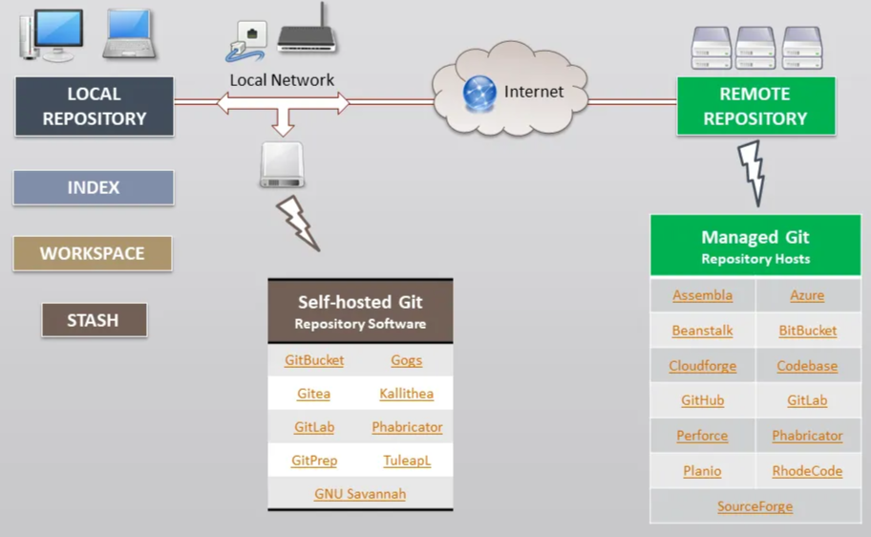
GIT
Version Control with Git
Repositories

Slide 8
GIT
Types of Repositories
Remote Repository:
Stored on a server, which is accessible over the internet.
Allows collaboration with other developers.
Use case: Sharing your project with team members, continuous integration, and deployment.
Repositories

Slide 9
GIT
Types of Repositories
Local Repository:
Stored on your local machine.
Allows you to work on your project without needing an internet connection.
Use case: Making and testing changes privately before sharing with others.
Repositories

Slide 10
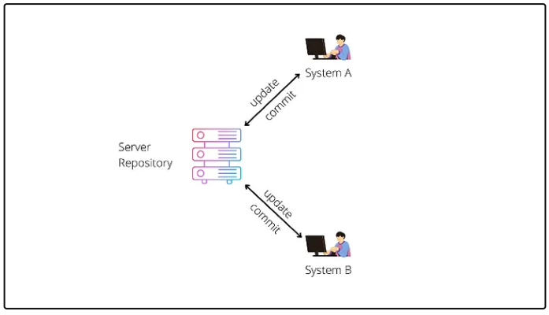
GIT
Centralized Version Control System
Repositories

Slide 11
GIT
Centralized Version Control System
Server and Client Model:
Server is the master repository containing all versions of the code.
Clients can access, pull, and push files to/from the server.
Basic Workflow:
Get the latest code from the central repository.
Make changes locally.
Commit or merge changes back into the main repository.
Advantages:
Enables easy collaboration with multiple developers.
Centralized location for all code versions.
Disadvantages:
Single point of failure: versioning and collaboration halt.
Repositories

Slide 12
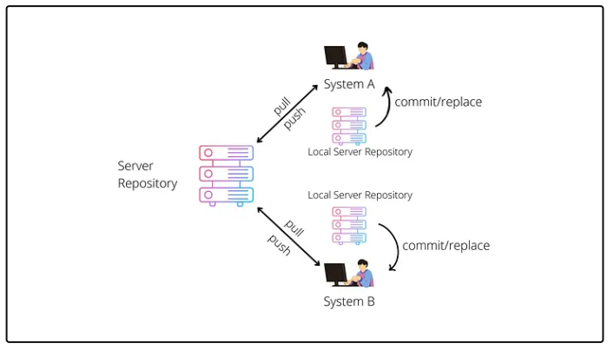
GIT
Distributed Version Control System
Repositories

Slide 13
GIT
Distributed Version Control System
Server-Client Model:
Each developer has their own local repository.
Full repository history and branches are mirrored locally.
Basic Workflow:
Developers clone the entire repository.
Work locally, commit changes to local repository.
Push changes to share with others, pull to update local repo.
Advantages:
Each local repo serves as a backup.
Easier branching, merging, and parallel development.
Disadvantages:
Managing distributed repos can be more complex.
Potential for conflicts when syncing changes.
Repositories

Slide 14
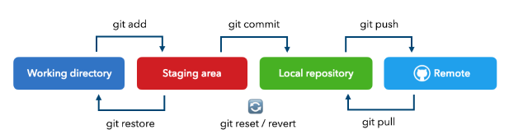
GIT
Version Control lifecycle
Repositories

Slide 15
GIT
The Working Directory
Definition:
Is the folder on your local machine where you work on files.
It contains the Local Repository
Purpose:
Allows you to make changes, edit, add, or remove files before staging and committing them.
Commands:
git status: Shows the status of the working directory.
git diff : Shows the state of the working directory and staging area.
git checkout -- <file>: revert to last committed state).
git clean -f: Remove untracked files from the working directory.
Repositories

Slide 16
GIT
Staging Area
Definition:
A temporary area where changes are prepared before committing.
Acts as an intermediate between the working directory and the local repository.
Purpose:
Allows selective inclusion of changes.
Facilitates better commit management.
Commands:
git status: Shows the state of staging area.
git add <file>: Adds changes to the staging area.
git reset <file>: Unstages the changes for a specific file.
Repositories

Slide 17
GIT
Staging Area
Definition:
A repository on your local machine.
Stores the complete history of commits.
Purpose:
Allows offline access to the project's history.
Facilitates local branching and merging.
Commands:
git commit -m "message": Records changes to the local repository.
git log: Shows the commit history.
git reset --soft <commit>: Resets to a specific commit but keeps changes in the staging area.
git reset --hard <commit>: Resets to a specific commit and discards all changes.
Repositories

Slide 18
GIT
The Origin (Remote Repository)
Definition:
A remote repository typically hosted on a server.
Centralized repository for collaboration.
Purpose:
Facilitates sharing and collaboration.
Acts as the primary source of truth for the project.
Commands:
git remote add origin <url>: Adds a remote repository.
git push origin <branch>: Pushes local changes to the remote repository.
git pull origin <branch>: Fetches and merges changes from the remote repository.
Repositories

Slide 19
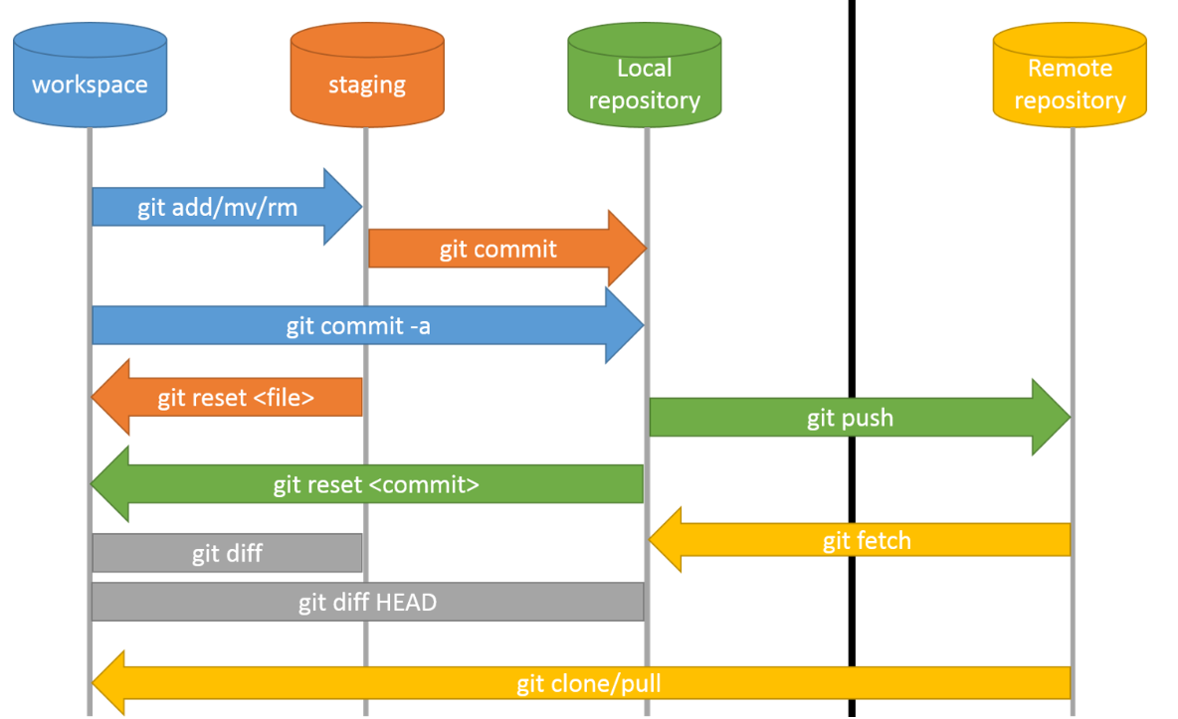
GIT
Actions
Repositories

Slide 20
GIT
Create New Repository
Create New local repository.
Add relevant files & folders to the local repository.
Commit the changes with a message.
Link the local repository to a remote repository.
Push the commit of your changes to master/main Branch on the remote repository.
Repositories

Slide 21
GIT
Maintain Existing Repository
Clone the remote repository.
Navigate to the Cloned Repository.
Do the relevant changes .
Commit the changes to stage.
Push the commit to master on the remote repository.
Repositories

Slide 22
GIT
Update Existing Local Repository from Remote Repository
Fetch Changes from Remote Repository.
Merge Changes into Local Branch.
Pull Changes from Remote Repository.
Repositories

Slide 23
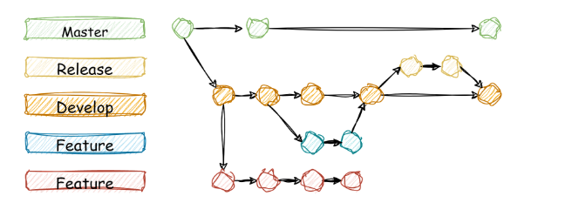
GIT
Branches
Branches

Slide 24
GIT
What is a Branch?
A branch is a parallel version of a repository.
Branch can exist in both local and remote repositories.
Branch allows you to work on different features or fixes independently.
The master / main branch is the default branch.
Branches

Slide 25
GIT
Why are we use Branch?
Allows multiple work on different features simultaneously.
Each branch represents an isolated environment.
Branches enable a structured workflow, such as feature branching or bug fixing.
Preserves a clear history of changes and developments.
Branches

Slide 26
GIT
Types of branches in Git
Master Branch:
Default branch in a Git repository.
Represents the main line of development and stable version of the code.
Feature Branches:
Created for developing new features or improvements.
Separate from the main branch.
Merged back into the main branch when the feature is complete.
Bugfix Branches:
Created for fixing specific bugs in the code.
Separate from the main branch.
Merged back into the main branch when the bug is fixed.
Branches

Slide 27
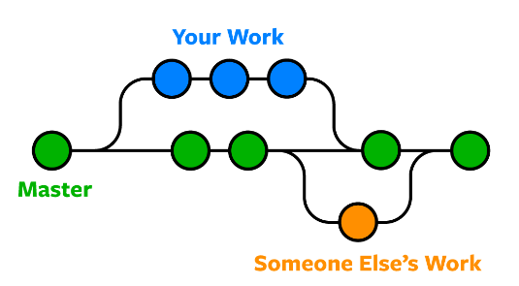
GIT
Create a new branch: git branch branch_name
Switch to existing branch: git checkout branch_name
Create a new branch and switch to it : git checkout -b branch_name
List local branches : git branch
Delete the specified branch : git branch -d branch_name
Delete in force the specified branch : git branch -D branch_name
Rename the branch name : git branch -m new_name
Merge the specified branch into the current branch:
git merge specified_name
Rebases the current branch onto the specified branch:
git rebase specified_name
Pulls changes from the remote repository for the specified branch : git pull origin main
Branches

Slide 28
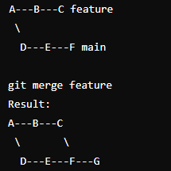
GIT
What is Git Merge?
Definition:
Combining multiple branches into one.
How it Works:
Creates a new commit that includes changes from both branches.
Keeps the history of both branches intact.
Visual Example:
Branches

Slide 29
GIT
Why Use Git Merge?
Preserve History: Retains the complete history of changes.
Collaboration: Allows multiple team members to work on different features simultaneously.
Stability: Useful for integrating changes without rewriting history.
Branches

Slide 30
GIT
Why Use Git Merge?
Merge branch
Switch to the Main Branch git checkout main
Pull the Latest Changes git pull origin main
Merge the Feature Branch git merge feature-branch
Resolve any conflicts git add <resolved-file>
Commit the Merge git commit
Branches

Slide 31
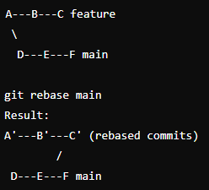
GIT
What is Git Rebase?
Definition:
Reapplying commits on top of another base commit.
How it Works:
Moves or combines a sequence of commits to a new base commit.
Changes the commit history.
Visual Example:
Branches

Slide 32
GIT
Why Use Git Rebase?
Cleaner History: Produces a linear and cleaner commit history.
Simpler Log: Easier to follow the project history.
Avoid Merge Commits: Useful for avoiding unnecessary merge commits in the history.
Branches

Slide 33
GIT
How to Git Rebase?
Rebase branch
rebasing allows you to integrate changes from one branch into another by applying the commits individually.
Ensure you are on the branch to be rebased
git checkout feature-branch
Fetch the latest changes from the remote repository
git fetch origin
Rebase the branch onto the target branch
git rebase main
Resolve any conflicts
git rebase –continue
Branches

Slide 34
GIT
Merge VS. Rebase?
Git Merge:
Retains the complete history, shows true branch structure.
Can result in complex commit history with many merge commits.
Git Rebase:
Cleaner, linear commit history.
Rewrites history, can be dangerous if not used carefully (especially with shared branches).
Branches

Slide 35
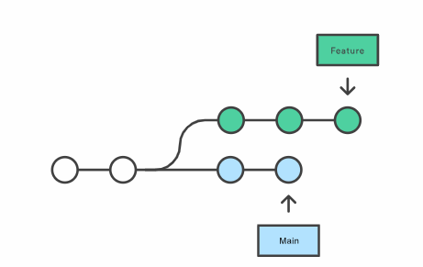
GIT
Merge VS. Rebase?
Branches

Slide 36
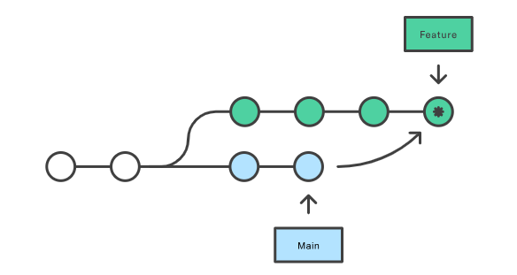
GIT
Merge
git checkout feature
git merge main
Branches
OR
git merge feature main

Slide 37
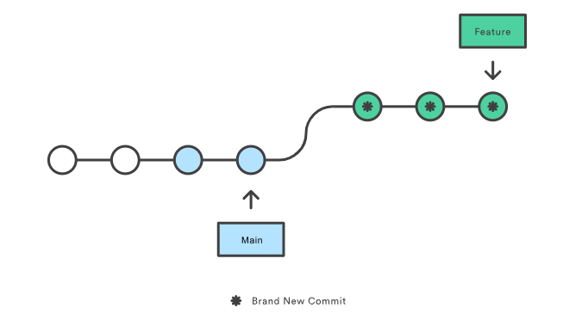
GIT
Rebase
git checkout feature
git rebase main
Branches

Slide 38
GIT
What is Conflict ?
Definition: A conflict occurs when Git is unable to automatically merge changes in a file.
Common Scenarios:
Concurrent modifications of the same file.
Changes in the same lines of a file.
Conflicts

Slide 39
GIT
When Do Conflicts Occur?
Merging Branches: Conflicts occur when merging branches with changes to the same lines of code.
Rebasing: Conflicts can arise during rebasing if the base branch has conflicting changes.
Cherry-Picking: Conflicts may happen when cherry-picking commits that introduce overlapping changes.
Conflicts

Slide 40
GIT
Identifying Conflicts
Visual Indicators:
Conflicted files are marked with conflict markers
<<<<<<<, =======, >>>>>>>.
Commands to Detect Conflicts:
git status: Shows conflicted files.
git diff: Shows the differences between branches.
Conflicts

Slide 41
GIT
Example of a Conflict
Scenario:
Two branches, feature-a and feature-b, both modify file.txt.
Conflict Markers:
<<<<<<< HEAD
Changes from the current branch
=======
Changes from the other branch
>>>>>>> feature-b
Conflicts

Slide 42
GIT
Resolving Conflict
Steps:
Open the conflicted file and locate conflict markers.
Edit the file to combine the changes or choose one side.
Remove conflict markers and save the file.
Add the resolved file: git add <file>.
Continue the merge: git commit.
Conflicts

Slide 43
GIT
Ignore
.gitignore files are used to specify which files and directories to ignore in a project
. gitignore preventing certain files from being tracked and included in version control.
. gitignore generally useful for preventing certain build artifacts, temporary files, and sensitive information.
The file . Gitignore is created under the root dir of the repository
Git Ignore

Slide 44
GIT
Ignore
.Ignore all files with a specific extension *.log , *.tmp
Ignore a specific file like secret.txt
Ignore a directory like /node_modules /dist
Git Ignore

Slide 45
GIT
Ignore
.Ignore all files with a specific extension *.log , *.tmp
Ignore a specific file like secret.txt
Ignore a directory like /node_modules /dist
Git Ignore

Slide 46
GIT
Stash
Git stash is a powerful feature that allows you to save your uncommitted changes temporarily without committing them.
Git stash Keeps your working directory clean.
Git stash Allows for context switching without losing work.
Git stash Helps in managing work in progress.
Git Stash

Slide 47
GIT
Stash
Workflow :
Stash Changes: Run git stash to stash your current changes.
Switch Branch: Checkout to a different branch
Apply Stash: After completing work on the other branch, return to the original branch and run git stash apply to restore the stashed changes.
Git Stash

Slide 48
GIT
Stash Commands
git stash: Stashes the changes in a dirty working directory.
git stash list: Lists all stashed changes.
git stash apply: Applies the most recent stash.
git stash apply stash@{n}: Applies a specific stash.
git stash drop: Deletes a specific stash.
git stash pop: Applies the most recent stash and removes it from the stash list.
Git Stash

Slide 49
GIT
What are Issues?
Issues are a way to track
tasks
enhancements
bugs
feature requests
Issue is used to
Categorize and prioritize tasks.
Clear documentation of bugs and features.
Monitor the status of tasks and assignments.
Allow team members to discuss and refine tasks.
Issue

Slide 50
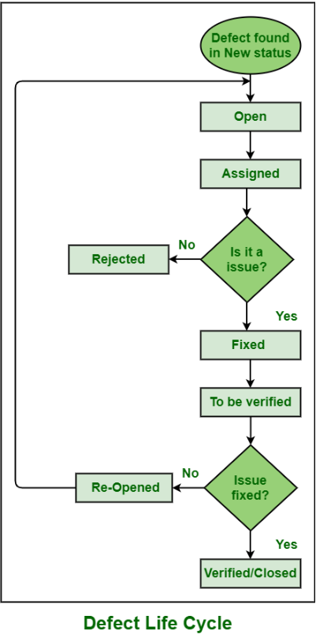
GIT
Issues Life cycle
Issue

Slide 51
GIT
What are Pull Requests (PR)?
A Pull Request is a way to propose changes to a repository.
Coming to Submit :
New features
Bug fixes
Documentation changes.
PRs are used to:
Enforce code reviews and discussions before merging.
Facilitate team collaboration and feedback.
Provide a history of changes and decisions.
Ensure changes are tested and do not introduce new issues.
Issues

Slide 52
GIT
Pull Requests workflow
Create a branch
Commit changes
Open a Pull Request
Code review and discussion
Merge into the main branch
Issues

Slide 53
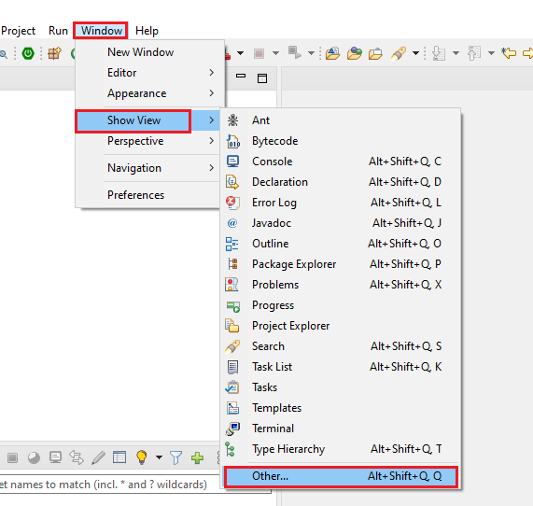
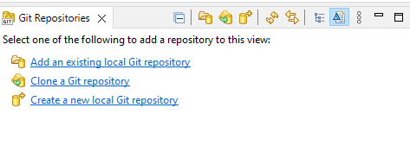
GIT
Eclipse Integration
Issues

Slide 54
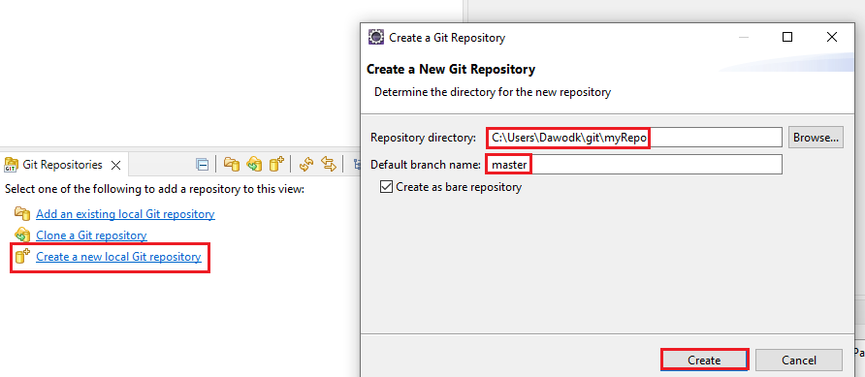
GIT
Eclipse Integration
Issues

Slide 55
GIT
GIT
Thank You !!

