Slide 1


Application Development

Slide 2
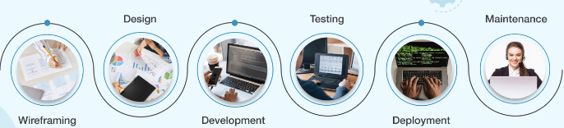
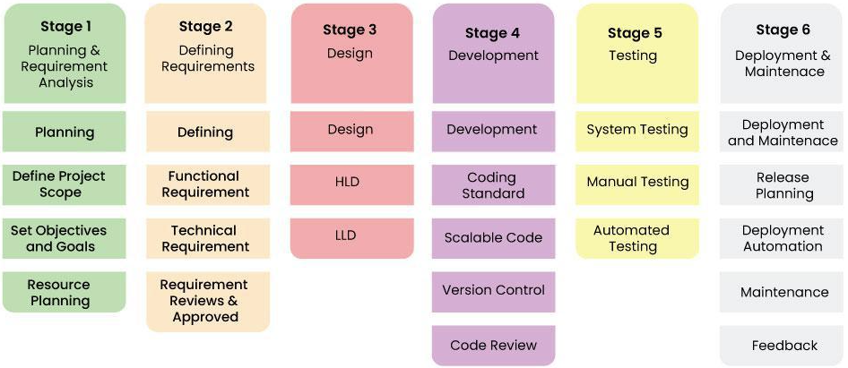
Application Development
SDLC

Slide 3
Application Development
Application Tiers
Client
Server
DB
HTTP
IIOP
RMI
Architecture
Web
Client
Web
Container
Logic.
Container
DB
HTTP
IIOP
RMI
Client
Application Server

Slide 4
Application Development
MVC Model 2
Client
show data
Controller
get data
Model
DB
Architecture
dispatch
view 1
view 2
view 3
Application Server

Slide 5
Application Development
MVC Model 2
Client
request
controller
model
DB
get data
Architecture
view
data
Application Server

Slide 6
Application Development
Server
Web
Container
Logic.
Container
Application Server
Application Server
An application server is a modern form of platform middleware.
A server that hosts applications, providing an environment where applications can run.
Manages and executes web-based applications, handling business logic, data storage, and user interactions.

Slide 7
Application Development
Server
Application Hosting: Running business applications.
Load Balancing: Distributing client requests across multiple servers.
Transaction Management: Ensuring data integrity during operations.
Security Management: Protecting data and applications.
Application Server

Slide 8
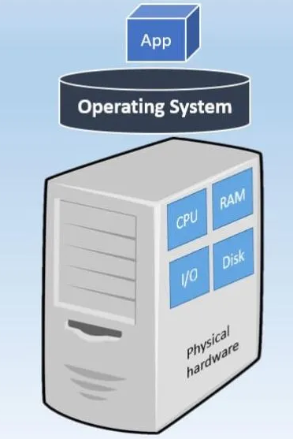
Application Development
Server
Web Servers: Handle HTTP requests (e.g., Apache HTTP Server).
Java EE Servers: Support Java Enterprise Edition applications (e.g., Apache Tomcat, JBoss).
.NET Servers: Support .NET applications (e.g., IIS - Internet Information Services).
Application Server

Slide 9
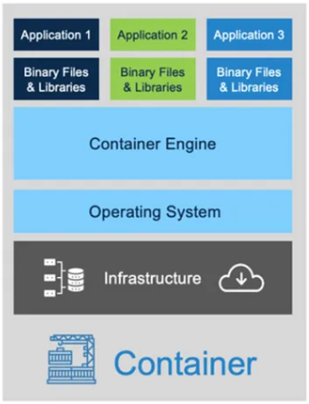
Application Development
Container
Lightweight: Minimal overhead compared to VMs.
Portable: Consistent environments from development to production.
Isolated: Separate processes, file systems, and network interfaces.
Scalable: Efficient resource usage, easy to replicate and scale
Application Server

Slide 10
Application Development
Logic Container
Logic container is a component of an application server that manages the execution of enterprise beans for Java EE applications.
Lifecycle Management: Manages the lifecycle of logic components from creation to destruction.
Transaction Management: Handles transaction boundaries, ensuring ACID (Atomicity, Consistency, Isolation, Durability) properties.
Security: Enforces security policies, handles authentication, and authorization.
Concurrency Control: Manages concurrent access to logic, ensuring thread safety and resource allocation.
Dependency Injection: Injects dependencies and resources into logic , simplifying resource management.
Messaging: Supports asynchronous coammunication through Java Message Service (JMS).
Application Server

Slide 11
Application Development
Web Container
A web container(servlet container) is a component of an application server that manages the execution of web applications, including servlets, JSPs and other web components.
Application Server
Lifecycle Management: Initializes, manages, and destroys servlets and JSPs.
Request Handling: Receives HTTP requests from clients and dispatches them to the appropriate web components.
Session Management: Manages user sessions, ensuring stateful interactions.
Security: Enforces security constraints, handles authentication and authorization.
Concurrency Control: Manages multiple simultaneous requests, ensuring thread safety and resource allocation.

Slide 12
Application Development
Technologies
Application Server
No Java /Java
HTTP
Web + java
Java
DB
Application Server
Java
RMI

Slide 13
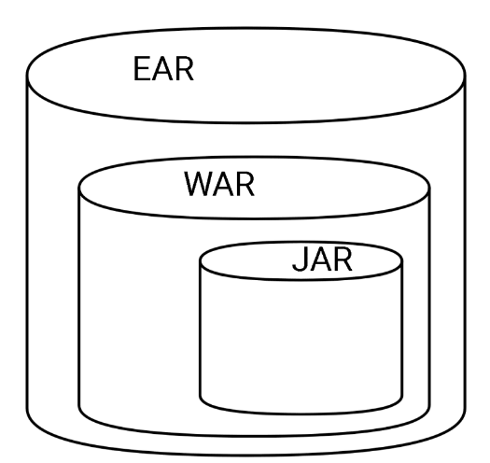
Microservices Architecture
Deployment
Config Files
Application Server
Web Files config Files
javaFiles.class prop Files config Files

Slide 14
Application Development
Deployment
No Java /Java App
.War
.Jar
DB
Application Server
.ear
Java App

Slide 15
Application Development
What is RPC?
Client
Server
RPC
Network
RPC is a form of client-server interaction implemented via a request-response or message-passing system.
RPC abstracts the procedure or method call, allowing a program to invoke a function on another address space or machine as if it were a local call.

Slide 16
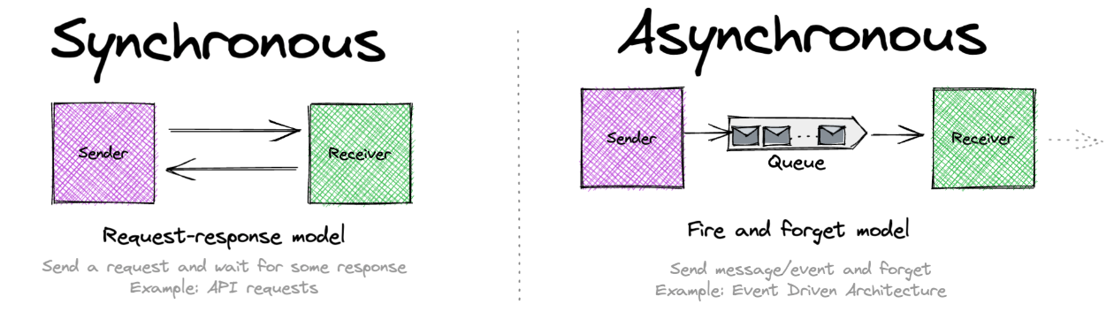
Application Development
Synchronous VS. Asynchronous

Slide 17
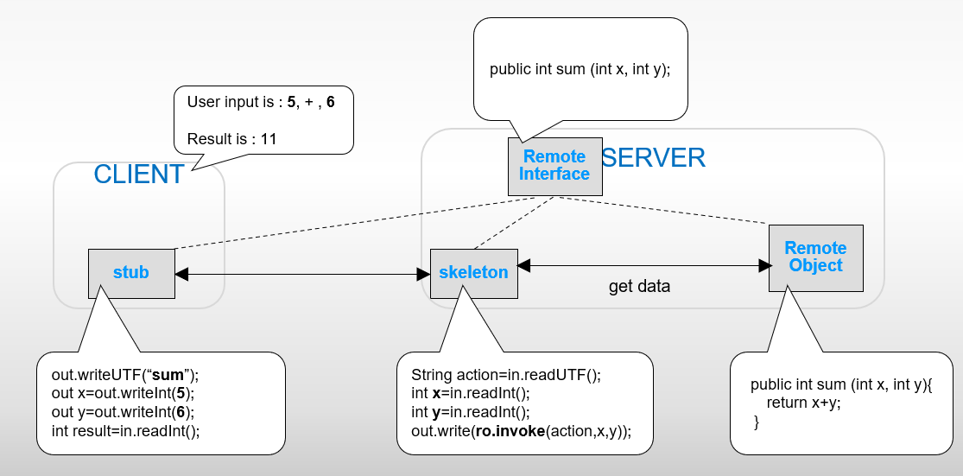
Application Development
Example
RPC

Slide 18
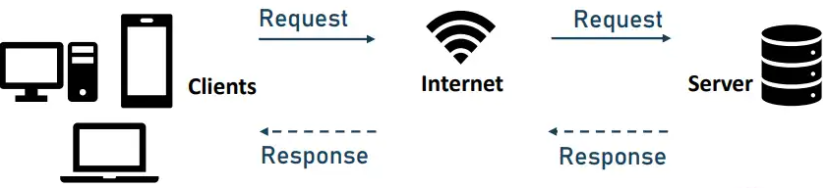
Application Development
Webservices
RPC

Slide 19
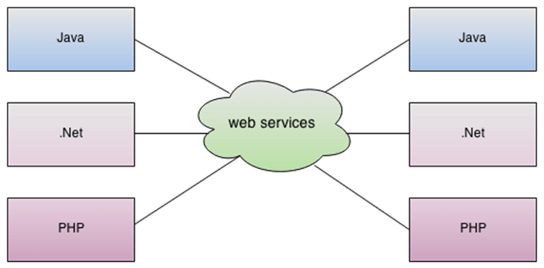
Application Development
Webservices
RPC

Slide 20
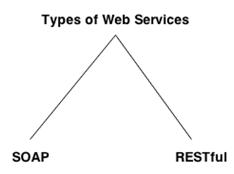
Application Development
webservices
SOAP is an acronym for Simple Object Access Protocol.
SOAP is a XML-based protocol for accessing web services.
SOAP is a W3C recommendation for communication between applications.
Web Service
REST is an HTTP ‘enrichment’ that provides advanced RPC
REST passing data in any format including XML, JSON and binary data
REST can be counted as part of HTTP unlike SOAP which is a separate protocol

Slide 21
Application Development
Thank You !!

