Slide 1

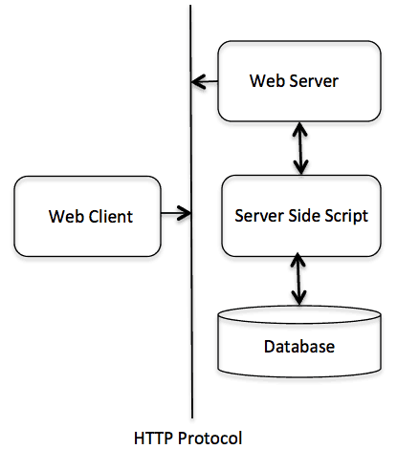
HTTP
Content
What is HTTP
HTTP URL
HTTP Parameters
HTTP Methods
HTTP Status Code
HTTP Request and Response
HTTP Header
HTTPS

Slide 2
HTTP
Hypertext Transfer Protocol (HTTP)
HTTP is an application-layer protocol used for transmitting hypermedia documents, such as HTML.
HTTP is used for transferring hypertext (text with links) over the Internet.
HTTP follows a client-server model, where the client (web browser) requests resources, and the server provides those resources.
HTTP is a stateless protocol , each request-response pair is self-contained.
An HTTP transaction involves a request sent by the client to the server, followed by a response sent by the server to the client.

Slide 3
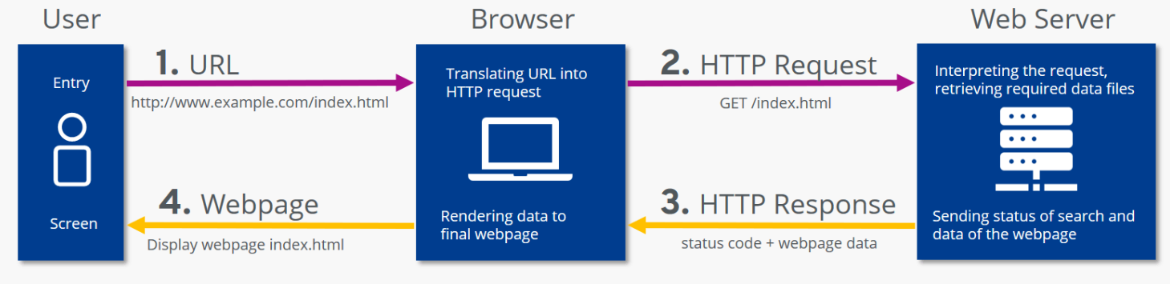
HTTP
HTTP Communication process

Slide 4
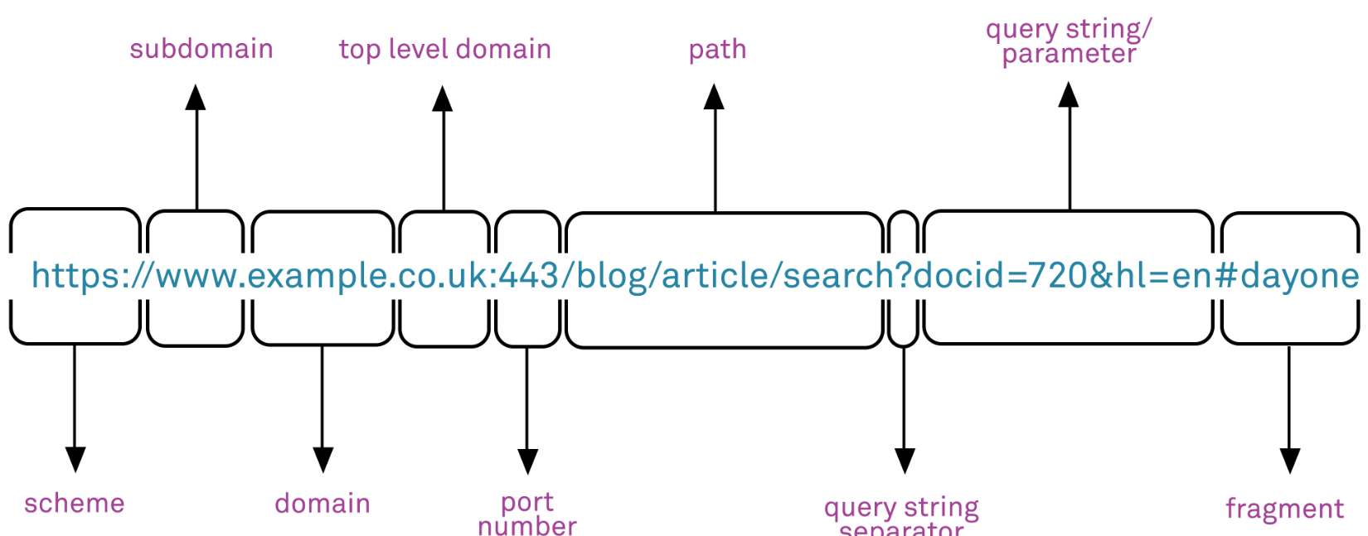
HTTP
HTTP URL
HTTP
HTTP URL (Uniform Resource Locator) is a specific type of URL that specifies the location of a resource on the web and the protocol to be used for retrieving it.
HTTP URLs are used for identifying and accessing resources on the World Wide Web.

Slide 5
HTTP
HTTP Parameters
http://www.example.com/path/resource? param1=value1&param2=value2
http://www.example.com/path/resource is the base URL.
? indicates the start of the query string.
param1=value1 and param2=value2 are the parameters, each consisting of a parameter name and its corresponding value.
HTTP
https://www.example.com/products/electronics/smartphones/iphone
The forward slash (/) is a path separator and is used to structure the hierarchy of resources in the URL.

Slide 6
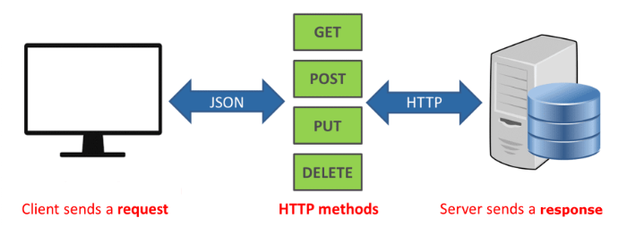
HTTP
HTTP Methods
HTTP
HTTP defines a set of methods that indicate the desired action to be performed on a resource identified by a URL.
Each HTTP request typically includes a method, allowing the client to communicate its intention to the server.

Slide 7
HTTP
HTTP Methods
GET:
The GET method is used to request data from a specified resource.
It is a safe and idempotent method, meaning it should not have side effects on the server, and multiple identical requests should produce the same result.
Example: Retrieving information from a web page.
POST:
The POST method is used to submit data to be processed to a specified resource.
It is not idempotent, and the request can have side effects on the server.
Example: Submitting a form, uploading a file.
HTTP

Slide 8
HTTP
HTTP Methods
PUT:
The PUT method is used to update a resource or create a new resource if it does not exist.
It is idempotent, meaning that making the same request multiple times should have the same effect as making it once.
Example: Updating the contents of a file.
DELETE:
The DELETE method is used to request the removal of a resource.
It is idempotent, meaning that making the same request multiple times should have the same effect as making it once.
Example: Deleting a record from a database.
HTTP

Slide 9
HTTP
HTTP Methods
PATCH:
The PATCH method is used to apply partial modifications to a resource.
It is typically used when only a part of the resource needs to be updated.
Example: Partially updating the content of a document.
HEAD:
The HEAD method is similar to GET but does not return the actual data; it is used to obtain metadata about the resource.
It is often used to check for the existence of a resource or to retrieve information about the resource without transferring the entire content.
Example: Checking the availability or freshness of a resource.
HTTP

Slide 10
HTTP
HTTP Methods
TRACE:
The TRACE method is used for diagnostic purposes and echoes the received request back to the client.
It is rarely used in practice and is often disabled for security reasons.
CONNECT:
The CONNECT method is used to establish a network connection to a resource, typically for tunneling purposes.
It is used when the client needs to establish a secure communication channel through a proxy server.
HTTP

Slide 11
HTTP
HTTP Status Code
HTTP status codes are three-digit numbers that are returned by a server in response to a client's request made to the server.
These codes are included in the HTTP header of the response and provide information about the status of the request.
Each status code indicates a specific type of response and conveys whether the request was successful, encountered an error, or requires further action.
HTTP

Slide 12
HTTP
Status Codes
1xx - Informational:
These status codes indicate that the request was received, continuing process, or a preliminary response is expected.
Example:
100 Continue: The initial part of the request has been received and the client should continue with the request.
HTTP

Slide 13
HTTP
Status Codes
2xx - Success:
These status codes indicate that the request was successfully received, understood, and accepted.
Examples:
200 OK: The request was successful, and the server has returned the requested data.
201 Created: The request has been fulfilled, resulting in the creation of a new resource.
HTTP

Slide 14
HTTP
Status Codes
3xx - Redirection:
These status codes indicate that further action needs to be taken to complete the request.
Examples:
301 Moved Permanently: The requested resource has been permanently moved to a new location.
302 Found: The requested resource has been temporarily moved to a different location.
HTTP

Slide 15
HTTP
Status Codes
4xx - Client Error:
These status codes indicate that the client seems to have made an error or the request cannot be fulfilled.
Examples:
400 Bad Request: The server cannot understand the request due to malformed syntax.
401 Unauthorized: The request requires user authentication.
403 Forbidden: The server understood the request but refuses to authorize it.
408 Request Timeout: The server timed out waiting for the request.
HTTP

Slide 16
HTTP
Status Codes
5xx - Server Error:
These status codes indicate that the server seems to have made an error or the request cannot be fulfilled.
Examples:
500—Internal Server Error
501 – Not Implemented
502 – Bad Gateway
503 – Service Unavailable
504 – Gateway Timeout
509 –Bandwidth Limit Exceeded
511 – Network Authentication Required
HTTP

Slide 17
HTTP
HTTP Request
An HTTP client sends an HTTP Request to a server in the form of a request message which includes following format
HTTP
A Request-line.
Zero or more header (General|Request|Entity) fields followed by CRLF.
An empty line (i.e., a line with nothing preceding the CRLF) indicating the end of the header fields.
Optionally a message-body.

Slide 18
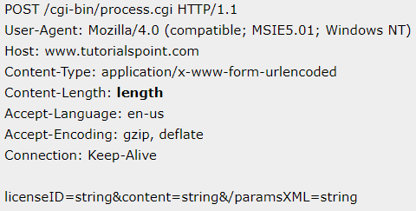
HTTP
HTTP Request
HTTP

Slide 19
HTTP
HTTP Response
After receiving and interpreting a request message, a server responds with an HTTP response message:
A Status-line
Zero or more header (General|Response|Entity) fields followed by CRLF.
An empty line (i.e., a line with nothing preceding the CRLF) indicating the end of the header fields.
Optionally a message-body.
HTTP

Slide 20
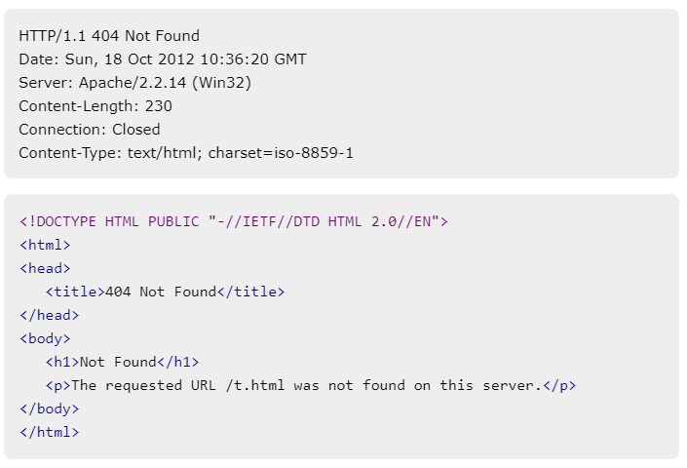
HTTP
HTTP Response
HTTP

Slide 21
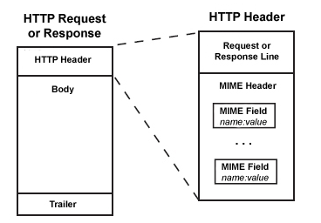
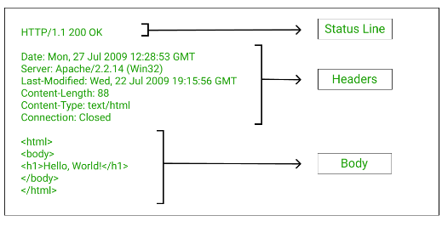
HTTP
HTTP Header
HTTP

Slide 22
HTTP
JSON
{
“people”: [
{ “name": “David“, “age": “20“},
{ “name": “Dana“, “age": “25“},
{ “name": “Eve“, age": “30“},
]
}
HTTP

Slide 23

HTTP
HTTPS
Definition: HTTPS stands for Hypertext Transfer Protocol Secure.
Purpose: It is the secure version of HTTP, used to transfer data securely over the internet.
Encryption: Uses SSL/TLS to encrypt the data between the client's browser and the web server, protecting it from eavesdropping, tampering, and message forgery.
Visual Indicator: HTTPS is typically indicated by a padlock icon in the browser's address bar and a URL that starts with "https://".
HTTP

Slide 24
HTTP
Why Use HTTPS?
Security: Encrypts data to protect sensitive information like login credentials, credit card numbers, and personal data from cyber threats.
Trust: Builds trust with users by ensuring their interactions with your website are secure. Modern.
Compliance: Helps meet security standards and regulations, such as GDPR for data protection.
Data Integrity: Prevents data from being corrupted during transfer, ensuring that the information sent from the user’s browser to the server is not tampered with.
HTTP

Slide 25
HTTP
HTTP
Thank YOU

