Slide 1


JSON
Content
What is JSON
HTTP URL
HTTP Parameters
HTTP Methods
HTTP Status Code
HTTP Request and Response
HTTP Header
HTTPS

Slide 2
JSON
What is JSON
{
“people”: [
{ “name": “David“, “age": “20“},
{ “name": “Dana“, “age": “25“},
{ “name": “Eve“, age": “30“},
]
}
JSON stands for JavaScript Object Notation.
A lightweight data interchange format.
Easy for humans to read and write.
Easy for machines to parse and generate.

Slide 3
JSON
JSON Syntax
Data is in name/value pairs.
Data is separated by commas.
Curly braces hold objects.
Square brackets hold arrays.

Slide 4
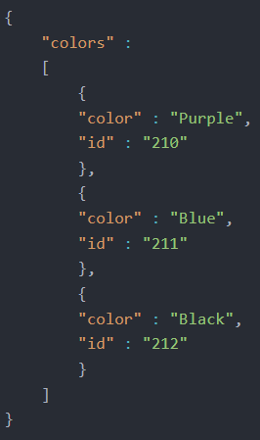
JSON
JSON Data Types
Numbers
Strings
Objects
Arrays
Booleans
Null

Slide 5
JSON
JSON Objects
Collections of key/value pairs.
Keys are strings, values can be any JSON data type.
Represented with curly braces {}.

Slide 6
JSON
JSON Arrays
Ordered list of values.
Values can be any JSON data type.
Represented with square brackets [].

Slide 7
JSON
JSON vs. XML
Simplicity: JSON is simpler and more compact.
Data Types: JSON supports more data types.
Readability: JSON is easier to read and write.
Usage: Widely used in web APIs.

Slide 8
JSON
JSON
Thank YOU

