Slide 1

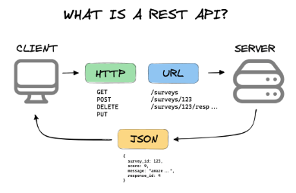
Restful API
Content
What is API?
What is REST?
HTTP URL
HTTP Parameters
HTTP Methods
HTTP Status Code
HTTP Request and Response
HTTP Header
HTTPS

Slide 2
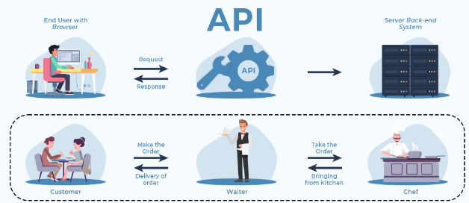
Restful API
What is API ?
Application Programming Interface is a layer that:
Enables communication between different software applications.
Hides the complexity of the system.
Enables integration of third-party services.

Slide 3
Restful API
What is API ?
Application Programming Interface Components
Endpoints: URLs through which APIs interact with applications.
Methods: Specific operations (e.g., GET, POST, PUT, DELETE).
Data Formats: Commonly JSON or XML for data exchange.

Slide 4
Restful API
What is API ?
Application Programming Interface Types
REST (Representational State Transfer)
SOAP (Simple Object Access Protocol)
GraphQL

Slide 5
Restful API
What is API ?
Application Programming Interface Examples
Google Maps API: Embeds maps and provides location services.
Twitter API: Allows access to tweets and other Twitter functionalities.
Payment APIs: Stripe, PayPal for processing online payments.

Slide 6
Restful API
What is Rest ?
REpresentational State Transfer is an HTTP ‘enrichment’ that provides advanced RPC
Stateless: Each request contains all necessary information.
Client-Server: Separation of client and server concerns.
Cacheable: Responses can be cached to improve performance.
Layered System: Architecture can be composed of hierarchical layers

Slide 7
Restful API
What is Rest ?
REpresentational State Transfer Frameworks
Java REST Frameworks:
Jersey , Spring Boot
Python REST Frameworks:
Flask-RESTful , Django REST Framework (DRF)
JavaScript REST Frameworks:
Express.js , NestJS

Slide 8
Restful API
Rest Methods
REpresentational State Transfer Methods
GET: Retrieve resources
POST: Create new resources
PUT: Update existing resources
DELETE: Remove resources
PATCH: Partial updates
OPTIONS: Describe communication options

Slide 9
Restful API
Rest Status Codes
REpresentational State Transfer Status Code
1xx: Informational
2xx: Success
3xx: Redirection
4xx: Client Error
5xx: Server Error

Slide 10
Restful API
Rest Endpoint
REpresentational State Transfer Endpoint
Base URL: https://api.example.com
Resource: /users, /products
Example Endpoint: https://api.example.com/users

Slide 11
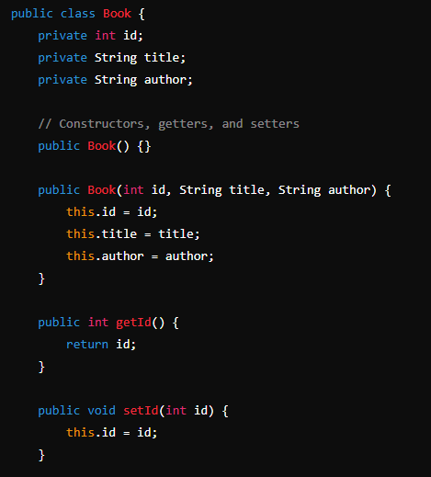
Restful API
Rest Example
The Model

Slide 12
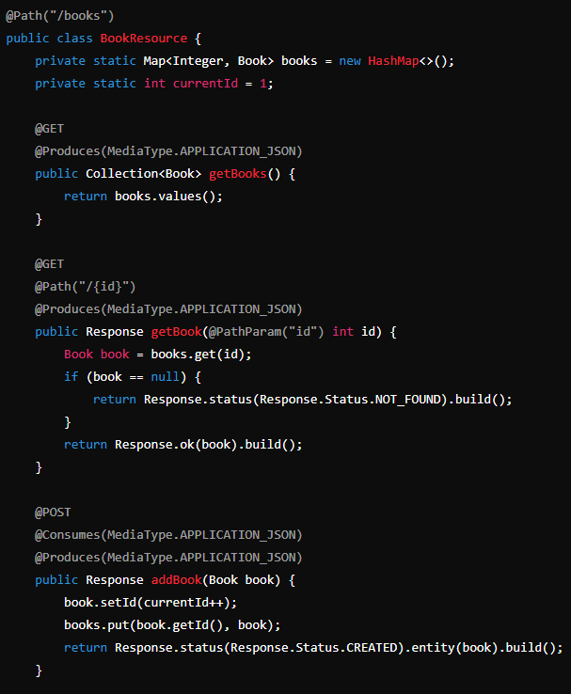
Restful API
Rest Example
The Resource

Slide 13
Restful API
Rest Example
GET All Books:
URL: http://localhost:8080/api/books
Method: GET
GET a Book by ID:
URL: http://localhost:8080/api/books/{id}
Method: GET
POST a New Book:
URL: http://localhost:8080/api/books
Method: POST
Body:
{
"title": “Microservices",
"author": “Daoud Kabha"
}

Slide 14
Restful API
Rest Example
PUT to Update a Book:
URL: http://localhost:8080/api/books/{id}
Method: PUT
Body:
{
"title": " Java Microservices",
"author": " Daoud Kabha "
}
DELETE a Book:
URL: http://localhost:8080/api/books/{id}
Method: DELETE

Slide 15
Restful API
Thank YOU

