Slide 1

OOP
Content
Class & Object
Encapsulation
Inheritance
Polymorphism
Abstraction
Interfaces

Slide 2
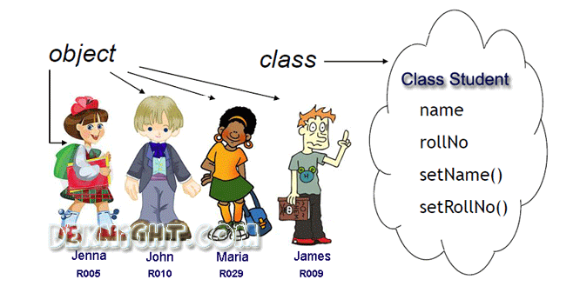
OOP
From Class to Object
Class & Object

Slide 3
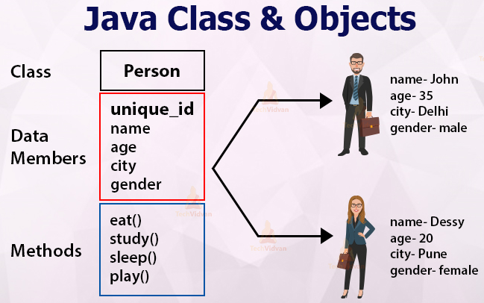
OOP
From Class to Object
Class & Object

Slide 4
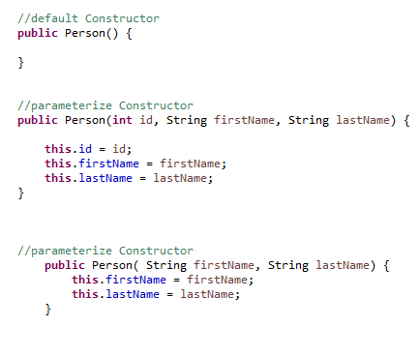
OOP
From Class to Object
Constructor

Slide 5
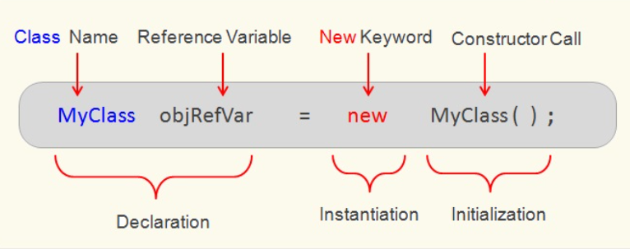
OOP
From Class to Object
Class & Object

Slide 6
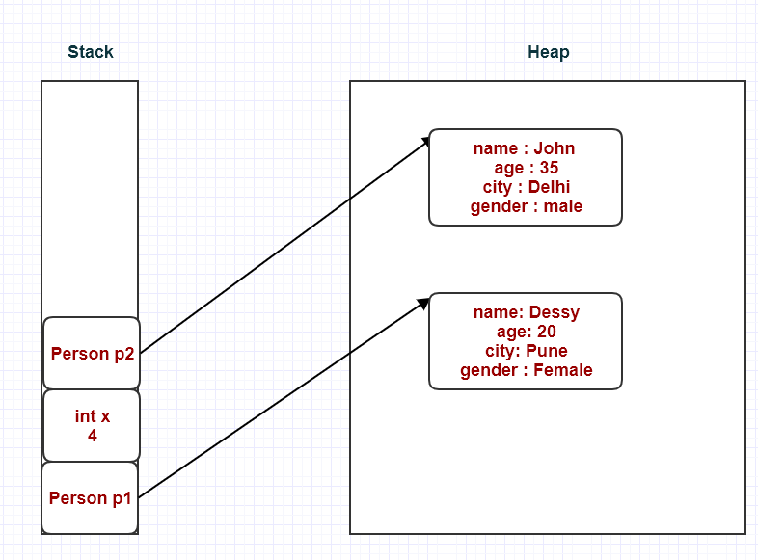
OOP
From Class to Object
Class & Object

Slide 7
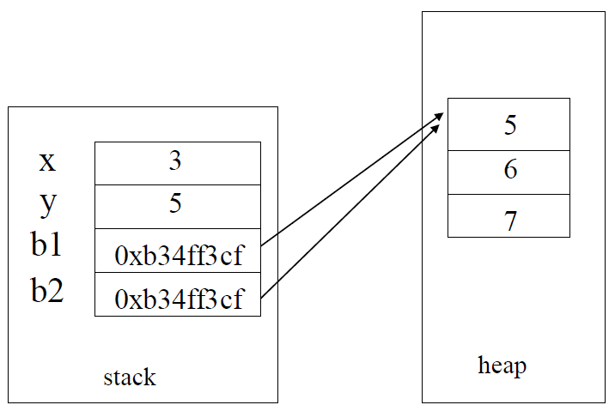
OOP
Initiates and values assignments
Class & Object
int x = 3, y = 5;
Box b1 = new Box(5, 6, 7);
Box b2 = b1;

Slide 8
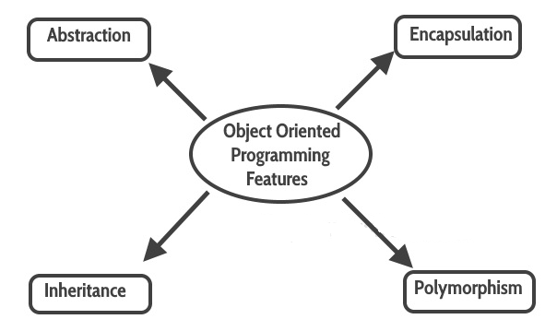
OOP
OOP
OOP Principles

Slide 9
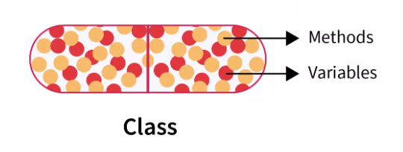
OOP
Encapsulation
Encapsulation

Slide 10
OOP
What is an encapsulation ?
Encapsulation is the concept of bundling the data (variables) and the methods (functions) that operate on the data into a single unit, called an object.
Internal object details are hidden from the outside world. Only specific, exposed methods can access and modify the object’s data.
Public, private, and protected keywords are used to control the visibility of class members.
Encapsulation

Slide 11
OOP
Example of encapsulation
public class Account {
private double balance; // Private variable
// Public method to get the balance
public double getBalance() {
return balance;
}
// Public method to deposit money
public void deposit(double amount) { if (amount > 0) {
balance += amount;
}
}
// Public method to withdraw money
public void withdraw(double amount) { if (amount > 0 && amount <= balance) {
balance -= amount;
}
}
}
Encapsulation

Slide 12
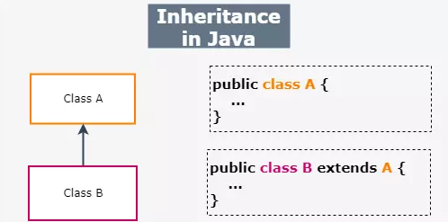
OOP
What is an Inheritance ?
Inheritance

Slide 13
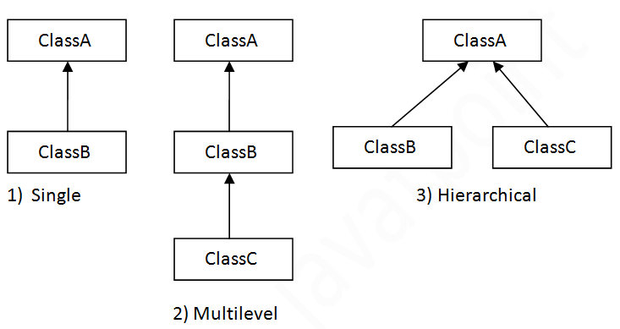
OOP
Allowed Inheritance
Inheritance

Slide 14
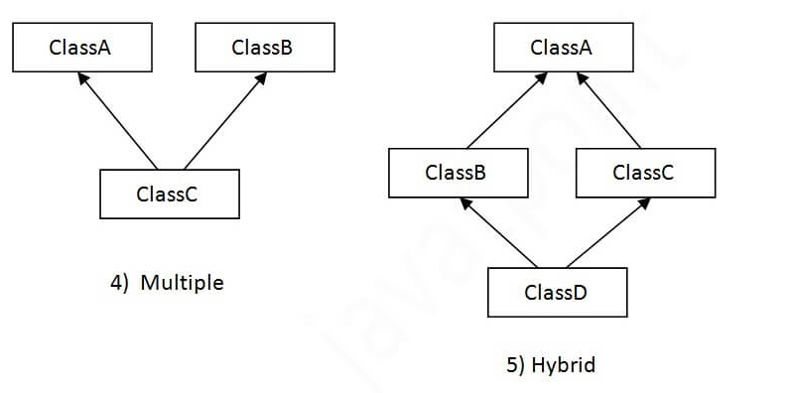
OOP
Not- Allowed Inheritance
Inheritance

Slide 15
OOP
What is not inherited?
Constructors
Private attributes & operations (inherited but not reachable)
Static attributes & operations
Inheritance

Slide 16
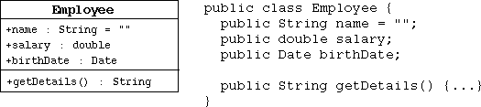
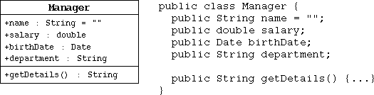
OOP
Example of Inheritance
Inheritance

Slide 17
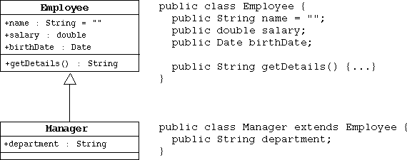
OOP
Example of Inheritance
Inheritance

Slide 18
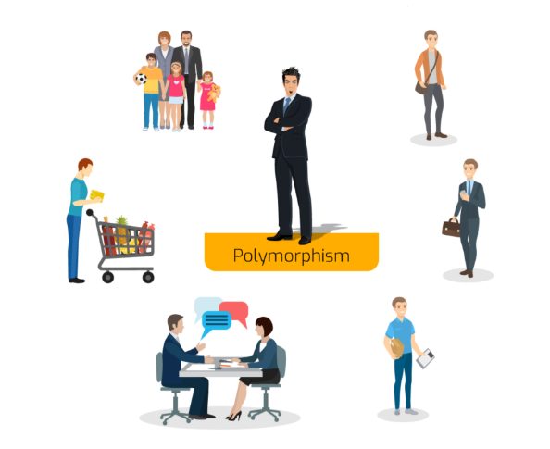
OOP
What is a Polymorphism ?
Polymorphism
Polymorphism is the ability of an entity to take several forms.
In object-oriented programming, it refers to the ability of an object to take different forms of objects.

Slide 19
OOP
Polymorphism Types
Method polymorphism
Object Polymorphism
Polymorphism

Slide 20
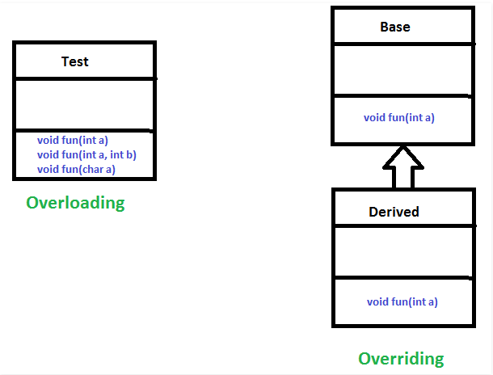
OOP
Method Polymorphism
Overriding:
The Method fun is defined in the parent class base.
In the class Derived we are overriding the behavior of the method fun.
Overloading:
In same class we are overloading fun (make some other copies)
Polymorphism

Slide 21
OOP
Object Class
Remember that the Object class is the root of all classes in Java
A class declaration with no extends clause, implicitly uses "extends Object"
Object’s methods that are usually overridden are
toString
equals
hashCode
Polymorphism

Slide 22
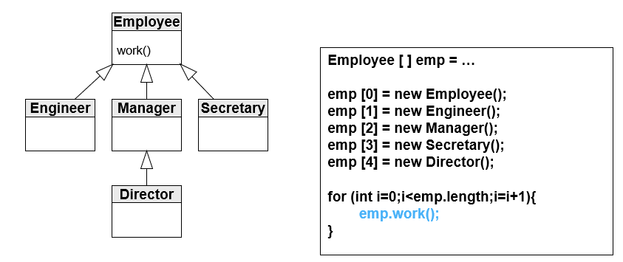
OOP
Objects Polymorphism
Subclass has all Functionality of Superclass.
Subclass instance can be used in same place where super class instance is used.
polymorphism we can make multi forms by creating deferent objects from deferent forms(classes) and refer them to the same reference variable
Polymorphism

Slide 23
OOP
Objects Polymorphism
Collections of objects with the same class type are called homogenous collections
Collections of objects with different class types are called heterogeneous collections
Polymorphism
Object[] objects = new Object[5];
objects[0] = new Box(3, 2, 5);
objects[1] = "AAA";
objects[2] = new Date();

Slide 24
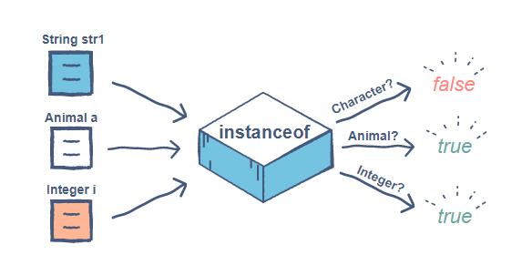
OOP
Instance Of
instance of is an operator is used to check the type of
Return true when :
instance referenced to the specific type of the Class
instance referenced to the specific type of the superClass (inheritance)
Polymorphism

Slide 25
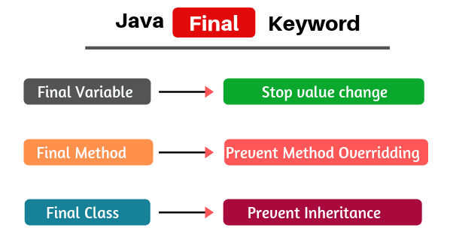
OOP
Final & polymorphism
Polymorphism
Final class – cannot be inherited
Usually required for system classes
Some basic behaviors that mustn’t be extended or changed
Final method cannot be overridden
Forces sub-classes to use a specific implementation
Final variable can have only one assignment [constant]
Defines a constant values
Local variables can also be defined as final

Slide 26
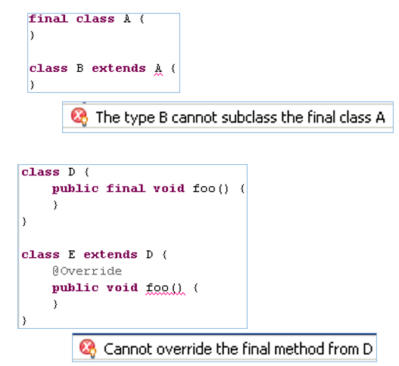
OOP
Final & polymorphism
Polymorphism

Slide 27
OOP
Abstract class
A class that represents an abstract object and therefore can not be instantiated .
Abstract classes may(but not mandatory) have abstract methods.
A method that represents an abstract operation and therefore has no body (implementation).
These method must be overridden in non-abstract subclasses to provide an implementation.
A class /method cannot be both final and abstract at the same time
Abstraction

Slide 28
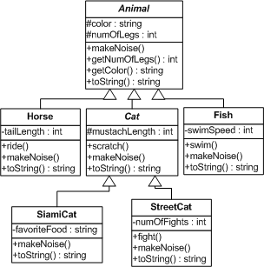
OOP
Abstract Example
Abstraction

Slide 29
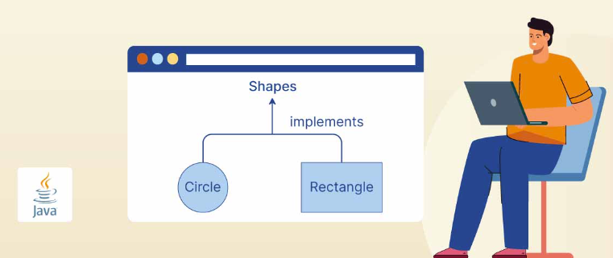
OOP
What are interfaces ?
Interfaces

Slide 30
OOP
What are interfaces ?
A "public interface" is a contract between client code and the class that implements that interface.
A Java interface is a formal declaration of such contract in which all methods contain no implementation.
Many, unrelated classes can implement the same interface .
A class can implement many, unrelated interfaces
Interfaces

Slide 31
OOP
What are interfaces ?
Interfaces can contain:
final variables (constants)
abstract methods
static methods
default methods (will be discussed later)
A non-abstract class implements an interface if and only if:
it declares that it implements the interface (using the implements keyword)
it implements all of the abstract methods of the interface
Interfaces

Slide 32
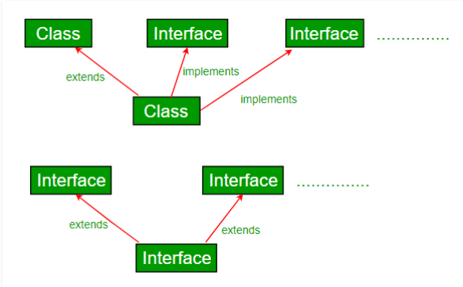
OOP
What are interfaces ?
Interfaces

Slide 33
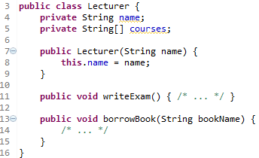
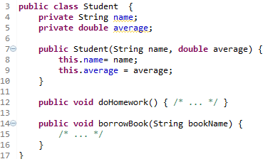
OOP
What are interfaces ?
לשתי המחלקות יש במקרה פעולה זהה, אבל מסיבה כלשהי איננו רוצים שיהיה אבא משותף
Interfaces

Slide 34
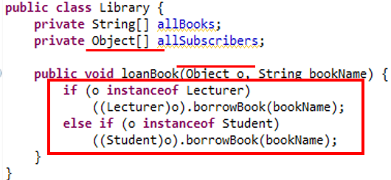
OOP
What are interfaces ?
Interfaces
מאחר ואובייקטים מסוגים שונים, ללא אבא משותף, יכולים להיות פרמטרים למתודה או חלק ממערך המחלקה, היא חייבת לקבל Object

Slide 35
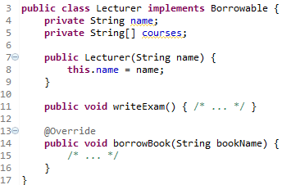
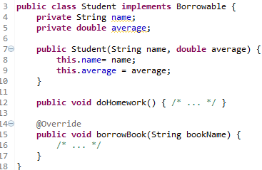
OOP
What are interfaces ?
Interfaces

Slide 36

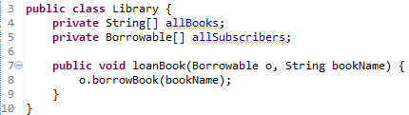
OOP
What are interfaces ?
Interfaces
במקרה זה לא מעניין אותנו מי הישות המועברת, אלא רק שיש לה את יכולת השאלת ספר מהספרייה

Slide 37
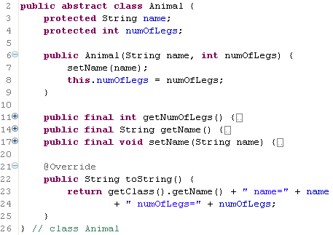
OOP
What are interfaces ?
Interfaces
שיטות אלו הן final מאחר ואין סיבה לדרוס אותן

Slide 38
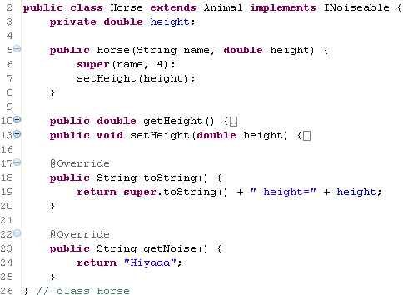
OOP
What are interfaces ?
Interfaces

Slide 39
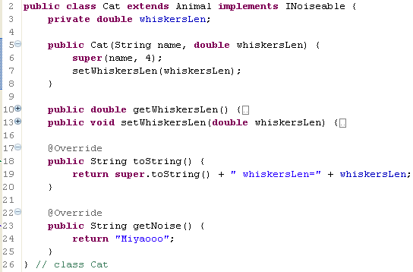
OOP
What are interfaces ?
Interfaces

Slide 40
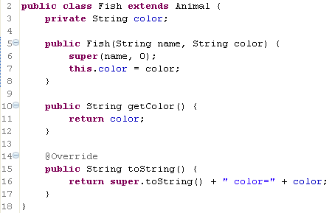
OOP
What are interfaces ?
Interfaces

Slide 41
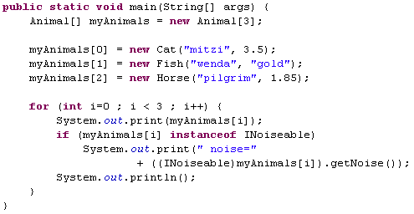

OOP
What are interfaces ?
Interfaces
במקום לבדוק האם החיה היא חתול או סוס (וטיפוסים שונים בהמשך), נבדוק האם האובייקט מממש את ההתנהגות המבוקשת

Slide 42
OOP
Comparable
An interface used to define the natural ordering of objects.
Includes only method signature compareTo(Object o).
Implemented by a class whose objects need to be ordered.
Interfaces
public class Student implements Comparable<Student> {
private int id;
private String name;
public int compareTo(Student other) {
return this.id - other.id; // Natural ordering by ID
} }

Slide 43
OOP
Comparator
An interface used to define the custom ordering of objects.
Includes only method signature compare(Object o1, Object o2)
Implemented by a separate class or through lambda expressions to provide multiple ways to compare objects.
Interfaces
public class Student implements Comparator<Student> {
public int compare(Student s1, Student s2) {
return s1.getName().compareTo(s2.getName());
// Custom ordering by name
}
}

Slide 44
OOP
Thank You !!
OOP

