Slide 1

DP
Content
Introduction
O-O aspects
Selected Patterns

Slide 2
DP
What is the DP?
Design patterns are recurring solutions to design problems you see over and over.
Design patterns constitute a set of rules describing how to accomplish certain tasks in the realm of software development.
Introduction

Slide 3
DP
What is the DP?
DP is coming for :
How to write a new program feature?
Have all possible avenues considered?
A more methodologically way to do the job
Develop the best solution to the problem.
Introduction

Slide 4
DP
Patterns Types
Creational
Structural
Behavioral
Introduction

Slide 5
DP
Creational Types
Factory Method
Abstract Factory
Builder
Prototype
Singleton
Introduction

Slide 6
DP
Structural Types
Adapter
Bridge
Composite
Decorator
Façade
Flyweight
Proxy
Introduction

Slide 7
DP
Behavioral Types
Interpreter
Template Method
Chain of Responsibility
Command
Iterator
Mediator
Memento
Observer
State
Strategy
Visitor
Introduction

Slide 8
DP
Patterns Classification
what a pattern does ?
Creational patterns - concern the process of object creation
Structural patterns - deal with the composition of classes or objects
Behavioral patterns - characterize the ways classes or objects interact
Introduction

Slide 9
DP
Patterns Classification
2. how the pattern is applied
Class patterns - ‘is A’ relationships, static
Object patterns - ‘has A’ relationships
Compound patterns - deal with recursive object structures
Introduction

Slide 10
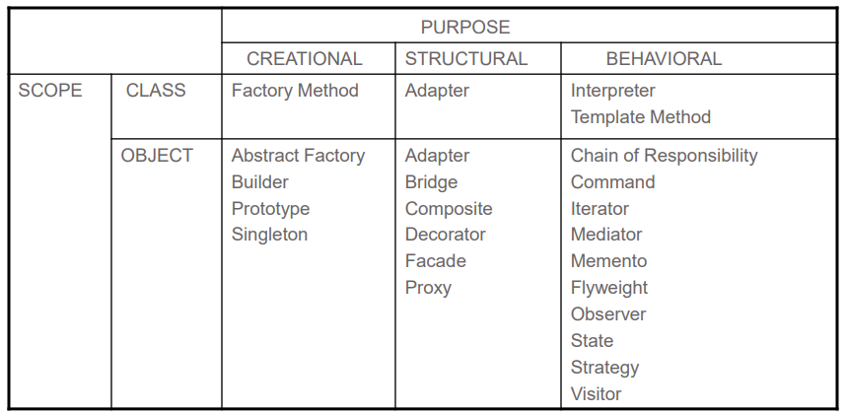
DP
Patterns Scopes and Purpose
Introduction

Slide 11
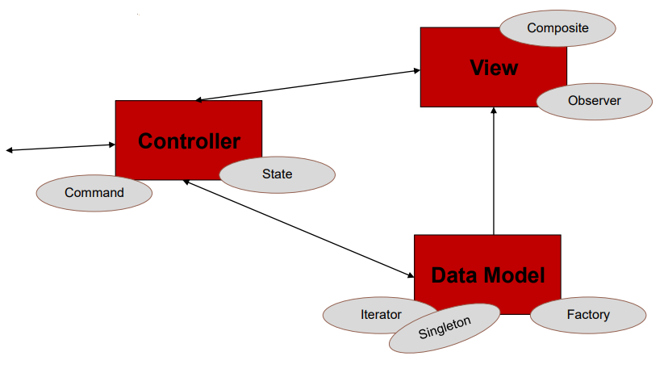
DP
Architecture VS. Design Patterns
Introduction

Slide 12
DP
agenda
Object Oriented approach
Object composition
Problems of redundancy
Defining Object roles
Inheritance vs. Composition
O-O aspects

Slide 13
DP
Object Oriented approach
Keeping classes separated
Avoid “reinventing the wheel”
There are several strategies that OO use to achieve separation, among them encapsulation and inheritance.
O-O aspects

Slide 14
DP
Object Composition
object composition- “The construction of objects that contain others, encapsulation of several objects inside another one.”
Inheritance is not the solution of every problem
O-O aspects

Slide 15
DP
Problems of Redundancy
Problem: Many elements in a system will share similar structures and/or functionality
Common solutions:
Subroutines and modules
Inheritance
Define new structure and/or functionality then define a static relationship with “parents” to use theirs
Implementation (operations and attributes)
Interface (sub-type)
Composition
Combine common “parts” then define new structure and/or functionality as necessary
O-O aspects

Slide 16
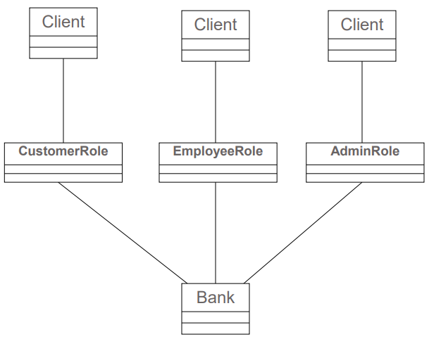
DP
Modules
Here, every new client type – forces a whole new module creation
O-O aspects

Slide 17
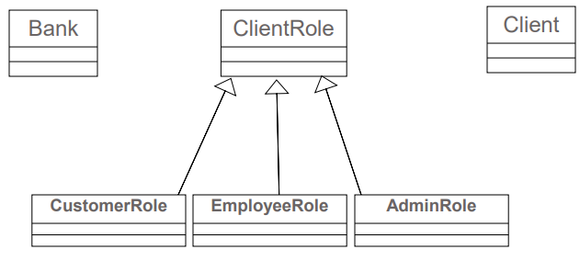
DP
Inheritance
Here, every new client type is a new subtype of ClientRole
O-O aspects

Slide 18
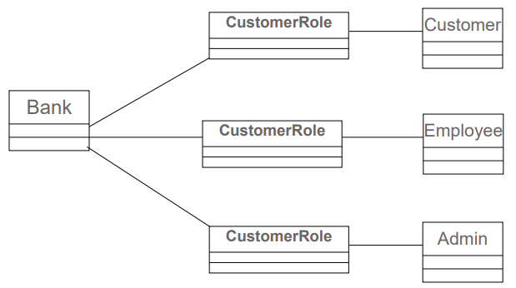
DP
Inheritance
Here, client types are visitors of a consistent CustomerRole class used by the Bank
O-O aspects

Slide 19
DP
Creational Patterns
Singleton Pattern
Prototype pattern
The Abstract Factory Pattern
The Factory Method pattern
Builder pattern
Selected Patterns

Slide 20
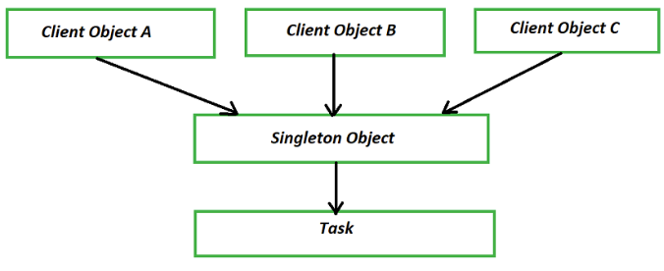
DP
The Singleton Pattern
Singleton
One instantiation that is globally shared
The class itself responsible for the creation and lifetime

Slide 21
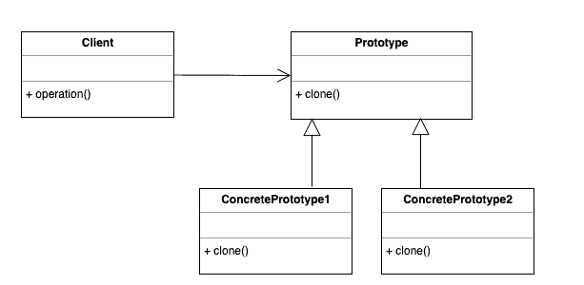
DP
The Protype Pattern
Protype
Create copies of Objects in runtime without knowing their actual nature in advance
Constructing new Object from a given Object – Clone

Slide 22
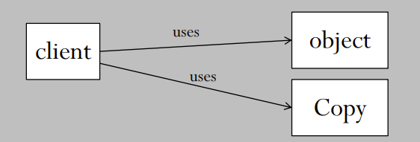
DP
The Problem
Prototype
You don’t know the actual nature / type of Object when you process it for cloning
You need to create similar objects (or identical, e.g. clone) from a given object

Slide 23
DP
The Problem
Prototype
Client is forced to :
check the origin object type (class)
call the origin class constructor to instantiate a copy instance
verify everything is well copies and populated in that copy
To much time, performance and tightly coupling design…

Slide 24
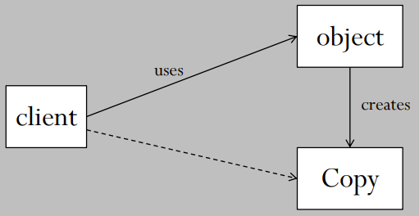
DP
The Solution
Prototype
Client uses the origin object in order to construct a copy
Object becomes a Factory of its own replications

Slide 25
DP
The Abstract Factory Patterns
Abstracts the object creation.
Let's extensibility.
Provides an interface for creating families of related or dependent objects.
Abstract Factory

Slide 26
DP
The Abstract Factory Patterns
The Problem
An office needs to process different types of reports before entering them into a database.
Each report has unique fields and requires different processing steps.
Additionally, a third type of report is in planning, and more types may be added in the future.
The goal is to design a flexible and scalable system that can handle these reports efficiently.
Abstract Factory

Slide 27
DP
The Abstract Factory Patterns
The Solution:
Abstract Factory Design Pattern
The Abstract Factory pattern provides an interface for creating families of related or dependent objects without specifying their concrete classes.
This makes it easier to add new report types and processing steps without altering the existing system.
Abstract Factory

Slide 28
DP
The Abstract Factory Patterns
The Solution:
Define Abstract Product Interfaces- Define an interface for each type of report and its processing steps.
Abstract Factory
// Report interface
public interface Report {
void generateReport();
void saveToDatabase();
}

Slide 29
DP
The Abstract Factory Patterns
The Solution:
2. Concrete Product Implementations – implement the report interface for each specific report type
Abstract Factory
// Report Type A
public class ReportTypeA implements Report {
@Override
public void generateReport() {
System.out.println("Generating Report Type A..."); }
@Override
public void saveToDatabase() {
System.out.println("Saving Report Type A to database..."); } }

Slide 30
DP
The Abstract Factory Patterns
The Solution:
3. Abstract Factory Interface - Define an abstract factory interface for creating reports.
Abstract Factory
public interface ReportFactory {
Report createReport();
}

Slide 31
DP
The Abstract Factory Patterns
The Solution:
4. Concrete Factory Implementations- implement the ReportFactory interface for each specific report type.
Abstract Factory
// Factory for Report Type A
public class ReportTypeAFactory implements ReportFactory {
@Override public Report createReport() {
return new ReportTypeA(); }
}
// Factory for Report Type B
public class ReportTypeBFactory implements ReportFactory { @Override public Report createReport() {
return new ReportTypeB(); }
}

Slide 32
DP
The Abstract Factory Patterns
The Solution:
5. Client Code - Use the abstract factory to create and process reports without depending on the specific report types.
Abstract Factory
public class ReportProcessor {
private ReportFactory reportFactory;
public ReportProcessor(ReportFactory reportFactory) {
this.reportFactory = reportFactory;}
public void processReport() {
Report report = reportFactory.createReport();
report.generateReport();
report.saveToDatabase();}
}

Slide 33
DP
The Abstract Factory Patterns
The Solution:
5. Main App- demonstrate the use of the abstract factory pattern.
public class Main {
public static void main(String[] args) {
ReportFactory reportTypeAFactory =
new ReportTypeAFactory();
ReportProcessor processorA =
new ReportProcessor(reportTypeAFactory);
processorA.processReport();
ReportFactory reportTypeBFactory =
new ReportTypeBFactory();
ReportProcessor processorB =
new ReportProcessor(reportTypeBFactory);
processorB.processReport(); }}
Abstract Factory

Slide 34
DP
The Abstract Factory Patterns
Benefits:
Modularity: Each report type is encapsulated in its own class, making the codebase more modular and easier to maintain.
Scalability: Adding a new report type involves creating a new concrete product class and a corresponding factory class, with no changes to the existing code.
Flexibility: The client code works with factories and reports through their abstract interfaces, making it easy to extend the system with new report types.
Abstract Factory

Slide 35
DP
The Abstract Factory Patterns
Extending the System:
To add a new report type (e.g., ReportTypeC):
Create a new concrete report class that implements the Report interface.
Create a new factory class that implements the ReportFactory interface and returns an instance of the new report class.
Update the client code to use the new factory class when needed.
Abstract Factory

Slide 36
DP
The Factory Method Patterns
The Factory Method pattern is a creational design pattern
It’s providing an interface for creating objects in a superclass.
It’s allowing subclasses to alter the type of objects that will be created.
It’s done by defining a method for creating objects, which subclasses can override to instantiate the appropriate class.
Factory Method

Slide 37
DP
Structural Patterns
Adapter pattern
Facade Pattern
The Bridge Pattern
Composite Pattern
Proxy Pattern
Decorator pattern
Selected Patterns

Slide 38
DP
The Adapter Patterns
Wrap up existing classes inside a new target interface.
Helps in the reuse of existing class with a different interface.
Achieving it by converting an existing interface to a new interface.
Adapter

Slide 39
DP
The Facade Patterns
Facade defines a higher-level interface that makes the subsystem easier to use.
Provides a simplified interface and minimizes the dependency between subsystem.
Facade

Slide 40
DP
The Composite Patterns
Compose objects into tree structures
Let's clients treat individual and compositions of object uniformly
Complex object out of elementary objects
Explains the context and forces when a pattern can be applied
Composite

Slide 41
DP
The Proxy Patterns
Proxy Provide a surrogate or placeholder for another object to control access to it.
A proxy controls access to another object.
Can also defer the full cost of creation.
Types:
Cache Proxy
Count Proxy
Protection Proxy
Remote Proxy
Virtual Proxy
Proxy

Slide 42
DP
Behavioral Patterns
Iterator Pattern
Strategy Pattern
State Pattern
Command Pattern
Mediator Pattern
Observer Pattern
Visitor Pattern
Chain of responsibility
Selected Patterns

Slide 43
DP
The Iterator Patterns
Iterator is browsing a collection of entities without dealing with its implementation.
Accesses the elements of an object collection sequentially.
Done without exposing its underlying representation.
Iterator

Slide 44
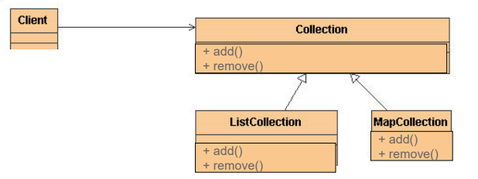
DP
The Problem
Clients needs to be familiar with code and logic
Iterator

Slide 45
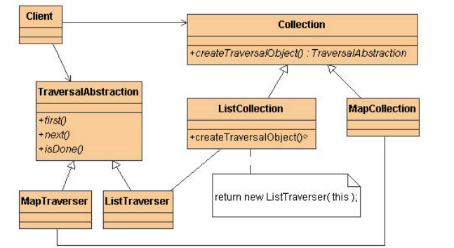
DP
The Solution
Iterator

Slide 46
DP
The State Patterns
Allow an object to alter its behavior when its internal state changes , The object which appear to change its class.
“Implementing discrete object states using explicit classes“
An object’s behavior depends on its state, and it must change its behavior at run-time depending on that state.
Operations have large, multipart conditional statements that depend on the object’s state
State

Slide 47
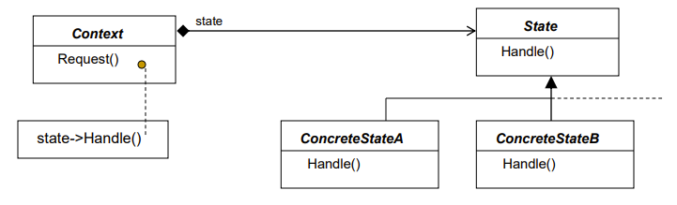
DP
The State Patterns
State

Slide 48
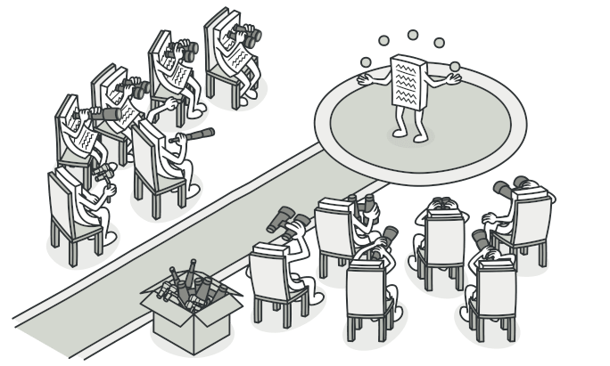
DP
The Observer Patterns
observer

Slide 49
DP
The Observer Patterns
Creates a publish-subscribe relationship.
Observers can register to receive events from the subject.
Define a one-to-many dependency between objects
When one object changes state, all its dependents are notified and updated automatically
observer

Slide 50
DP
Thank You !!

