Slide 1
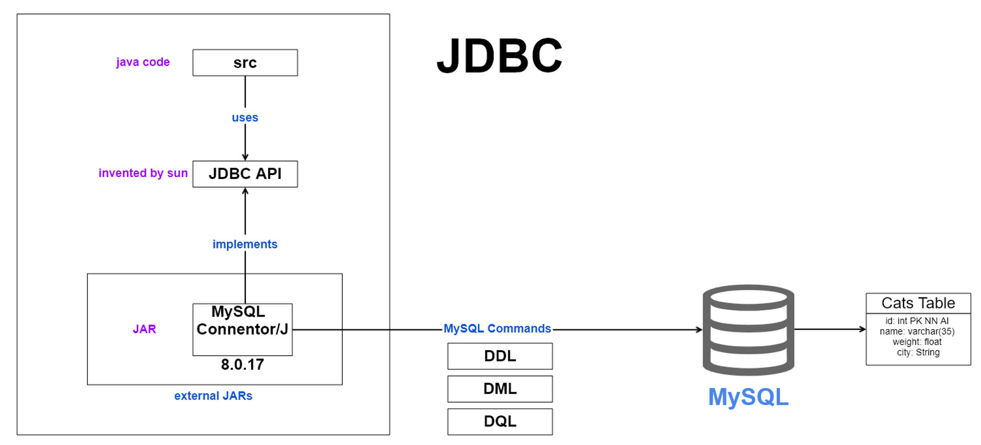
JDBC
What is JDBC?
JDBC
Definition: JDBC (Java Database Connectivity)-is a standard Java API that allows Java programs to connect and interact with databases.
Purpose: Enables Java applications to execute SQL statements, retrieve data, and manage database transactions.

Slide 2
JDBC
JDBC Architecture?
Components:
Driver Manager: Manages a list of database drivers.
Driver: Handles communication with the database.
Connection: Represents a connection to the database.
Statement: Used to execute SQL queries.
ResultSet: Represents the result set of a query.
JDBC

Slide 3
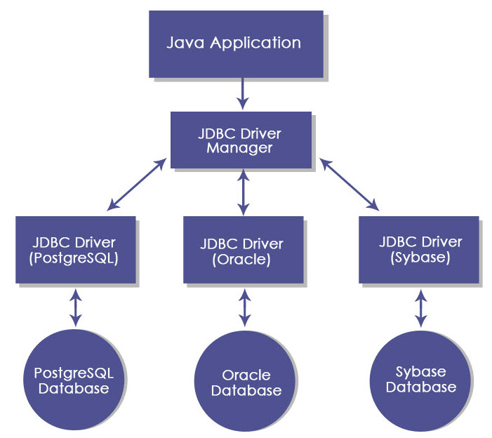
JDBC
JDBC Architecture?
JDBC

Slide 4
JDBC
Types of JDBC Drivers
JDBC-ODBC Bridge Driver.
Native-API Driver (Partially Java Driver).
Network Protocol Driver (Middleware Driver).
Thin Driver (Pure Java Driver).
JDBC

Slide 5
JDBC
Establishing a Connection
Load the JDBC driver.
Establish a connection using DriverManager.getConnection().
Example code snippet.
JDBC

Slide 6
JDBC
Executing SQL Queries
Statement: For simple SQL statements.
PreparedStatement: For parameterized queries.
CallableStatement: For calling stored procedures.
JDBC

Slide 7
JDBC
Result Set and Data Retrieval
ResultSet Methods: next(), getString(), getInt(), etc.
Code Example: Demonstrate how to iterate through a ResultSet to retrieve data
JDBC

Slide 8
JDBC
Managing Transactions
Transactions:
Commit: Save changes.
Rollback: Undo changes.
Auto-Commit: Explain auto-commit mode and how to disable it.
JDBC

Slide 9
JDBC
Thank YOU !!

