Slide 1

Linked in

Slide 2
Content
Introduction
Why Linked in
Networking
Networking Tips
LinkedIn Guide
Profile Reviews (Live Linked-In feedback)

Slide 3
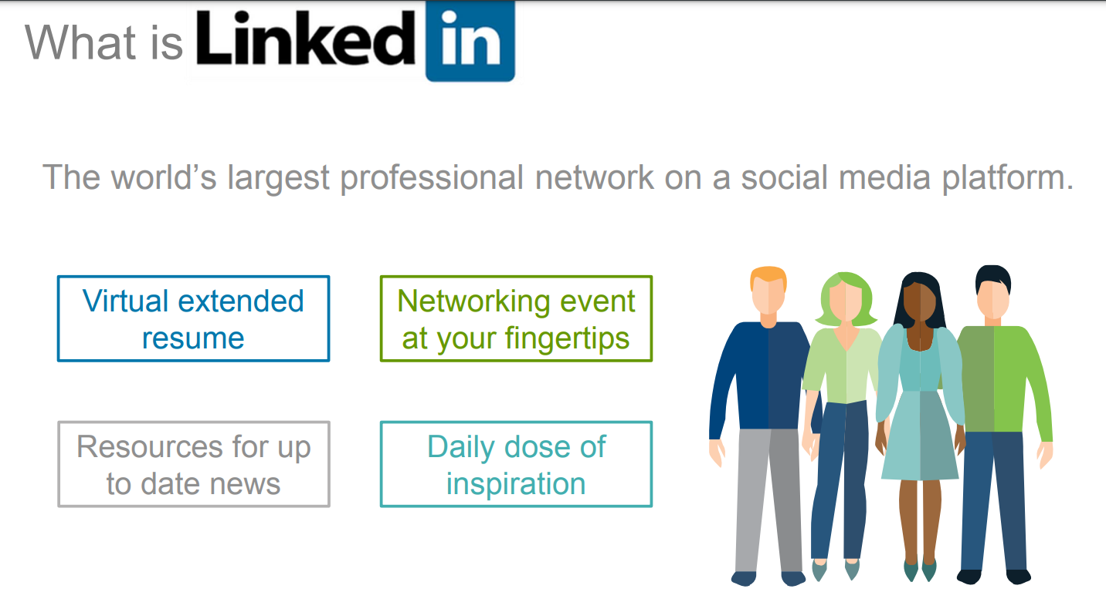

What is LinkedIn?
Introduction

Slide 4
What is LinkedIn?
Professional Networking Platform
Connect with colleagues, industry peers, and professionals
Job Search & Recruitment
Explore job postings, apply for roles, and connect with recruiters
Profile & Resume
Showcase work experience, skills, education, and certifications
Industry Discussions & Groups
Join groups, share content, and engage in professional conversations
Company Pages
Follow companies, get updates, and learn about opportunities
LinkedIn Learning
Access courses for skill development and continuous learning
Introduction

Slide 5
What is LinkedIn?
Personal and Business Profiles
Connections
Personal Messages
Various groups
Industry-Specific Groups
Career and job search
Alumni group
Entrepreneurship & Startups
Company Groups (internal to the company)
Mentorship & Coaching
Introduction

Slide 6

Useful Links
MST Company
Daoud’s Linked In
My Linked In
Introduction

Slide 7

Why LinkedIn?
Connect with people
peers from the industry
Academic people
School principals
New opportunities
participation in trainings
Getting professional support
Pedagogical cooperation and more
Why Linked in

Slide 8

Career Advancement
Great tool to advance your career
Show your experience
Highlight your skills
Boast about your accomplishments
Find new Jobs
Find advancement opportunities
Why Linked in

Slide 9

Knowledge Sharing
Share Knowledge
Share experience and ideas with peers
Discussion groups
Publications of professional articles
Why Linked in

Slide 10

Stay Up To Date
LinkedIn is an excellent source of current information in the education and the technology fields
Relevant groups and people can be followed
Get Updates related to upcoming events
Get exposed to new researches
Why Linked in

Slide 11

Strengthening personal brand
Invest on your profile
Publish professional content
Participate actively in groups and discussions
Attend relevant events
Join relevant groups
Follow industry leaders, influencers and learning instructors
Why Linked in

Slide 12

What is Networking?
Central business tool
Recruiting employees
Building a set of professional connections
Employer’s Purpose
Find, attract and hire suitable people
Employees’ purpose
Connect with like-minded professionals
Connect with talent acquisition people
Find exciting job opportunities
Methods used
Active / Inactive search
Using social networks such as Linked-in, facebook, etc..
Networking events
Social events, meetups and make personal connections
Webinars and virtual events
Networking

Slide 13
What is Networking?
Building Relationships
Connect with professionals to exchange information and support each other’s careers.
Expanding Contacts
Grow your professional network by meeting people in your industry and related fields.
Gaining Insights
Learn from others’ experiences and expertise to enhance your own knowledge.
Networking

Slide 14
What is Networking?
Creating Opportunities
Discover new job opportunities, collaborations, and partnerships through your network.
Networking Settings
Engage in networking at conferences, industry events, online platforms (e.g., LinkedIn), and informal gatherings.
Mutual Benefits
Establish connections that offer advice, opportunities, and support for career growth.
Networking

Slide 15
What is Networking?
Central business tool
Recruiting employees
Building a set of professional connections
Employer’s Purpose
Find, attract and hire suitable people
Employees’ purpose
Connect with like-minded professionals
Connect with talent acquisition people
Find exciting job opportunities
Methods used
Active / Inactive search
Using social networks such as Linked-in, facebook, etc..
Networking events
Social events, meetups and make personal connections
Webinars and virtual events
Networking

Slide 16
What is Networking?
Building Relationships
Connect with professionals to exchange information and support each other’s careers.
Expanding Contacts
Grow your professional network by meeting people in your industry and related fields.
Gaining Insights
Learn from others’ experiences and expertise to enhance your own knowledge.
Networking

Slide 17
Networking via LinkedIn
Professional network
Detailed profiles
Advanced search
Skills network
Networking

Slide 18

Successful profile design
Make sure your LinkedIn profile contains
Updated information
A professional description
A professional photo
Networking Tips

Slide 19
Building a professional network
Focus on making connections with:
people in the same fields
organizations related to the field
Networking Tips

Slide 20
Participation in events and conferences
Participate in events and Meetups related to you
Research the event before attending
Follow up after
Don’t be invisible
Mingle & Small-Talk
Share your experience
Connect on linked-in
Networking Tips

Slide 21
TODO – Reached here!!

Slide 22
Listening for information
Follow professional updates and activities of people in your professional network and participate in them. This will help you build strong relationships and be aware of opportunities.
Networking Tips

Slide 23
professional groups
Join professional LinkedIn groups related to your networking interest. Participate in discussions, reflect your expertise and make connections with people in the field.
Networking Tips

Slide 24
Content sharing
Share professional and interesting content on LinkedIn, such as articles, tips and updates. This can help you appear as an expert and attract attention from other users.
Networking Tips

Slide 25
personal messages
Use private messages to start conversations with people you want to connect with.A personal and helpful message may result in a response and interest in further conversation
Networking Tips

Slide 26
Locating suitable candidates
Use LinkedIn's advanced search tools to find suitable candidates for the open positions in your organization
Networking Tips

Slide 27
Building relationships
Build professional relationships with people in your professional network. Take an interest in their activities and information, offer help and show support
Networking Tips

Slide 28
performance measures
Use LinkedIn metrics to track the performance of your profile and connections. You can see the number of views, visits and comments you received.
Networking Tips

Slide 29
Premium program
There is a free month - why not take advantage of it... when?
Networking Tips

Slide 30
Premium program
Increased visibility in search results
Access to full information such as "Who Viewed My Profile“
Advanced search and filtering results - for recruiters!
Professional learning - LinkedIn Learning
Comparability: Your performance can be compared to the professional field and the competition
Advanced profile management capability: you can add additional features to your profile such as premium videos for a business presentation, graphic displays
Networking Tips

Slide 31


LinkedIn profile overview
Banner Photo
Intro
Profile
Customize URL
Content
Ask for recommendation
Set Your “Open to” (finding a new job)
LinkedIn Guide

Slide 32
Search in linkedIn
People
Jobs
Posts
Groups
Events
Companies
Schools
Courses
Services
Products
LinkedIn Guide

Slide 33
Connect with recruiters
Add to your network
Go over their posts
Try to communicate
LinkedIn Guide

Slide 34
I am Hiring!
Search for names with I am Hiring!
Talk to them
Checkout posts
LinkedIn Guide

Slide 35
Job Alert
Create a job alert for your search!
Follow alerts even if you are not really searching
LinkedIn Guide

Slide 36
Job Application
Apply in the company website
Search for friends working in the company
Add your C.V to LinkedIn profile
User easy apply
Apply on linkedIn
LinkedIn Guide

Slide 37
Open for opportunities
Use the option: open for opportunities
Not for a long time
LinkedIn Guide

Slide 38
Profile Optimization
Complete your profile 100%. This boosts your search ranking and increases your chances of being seen by recruiters and potential employers. Include relevant keywords and accomplishments.
Use an attractive professional headshot. First impressions matter
Write a compelling headline and summary. Summarize your skills and experience in a way that grabs attention.
Request recommendations and endorsements. These add social proof and credibility to your profile.
LinkedIn Guide

Slide 39
Networking & Engagement
Connect with colleagues, classmates, and people in your industry. Aim for quality connections over quantity.
Join relevant groups and communities. Participate in discussions and share your expertise.
Follow influential people and companies in your field. Stay updated on industry trends and network with decision-makers.
Share valuable content regularly. Articles, insights, and updates showcase your knowledge and attract the right people.
Engage with other people's content. Like, comment, and share to build relationships.
LinkedIn Guide

Slide 40
Request recommendations
How to do that? Follow along
LinkedIn Guide

Slide 41
Using Chat GPT
To create about section
Don’t copy as-is
LinkedIn Guide

Slide 42
Short LI URL
Go to My Profile
Edit and updated your URL
LinkedIn Guide

Slide 43
Update your skills
Add relevant skills
Ask people for endorsement
Endorse back ☺
Sort by most important first (how?)
LinkedIn Guide

Slide 44
Add Banner to your profile
Use Canva for example for free
Choose LinkedIn banner
Add your information
Download the picture and update your profile with it
LinkedIn Guide

Slide 45
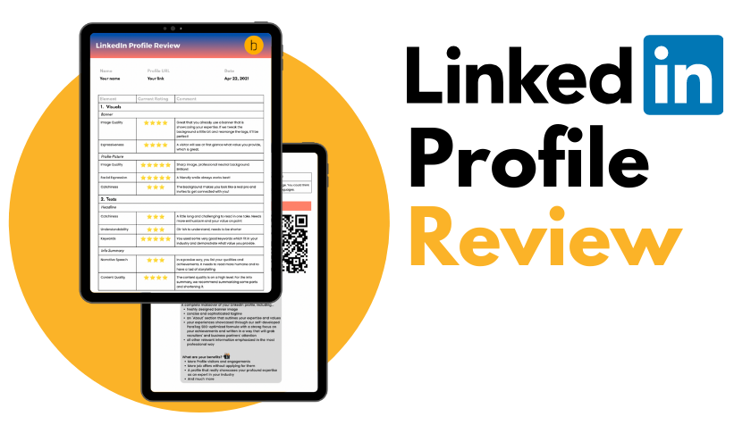
We need volunteers
Let’s do some profile reviews
Profile Reviews

Slide 46
Thank You !!

