Slide 1
Front End Engineering- Project
Name- Abhinav Kumar
Roll no- 2110990051
Faculty Coordinator: Mr. lavish Arora
:
Chitkara University Institute of Engineering and Technology,
Chitkara University, Punjab

Slide 2
Table of Contents
Introduction
Problem Statement
Technical Details
Key Tags Used
Key Features
Project Highlights
Bonus Feature(optional)
Conclusion
References/Links used

Slide 3
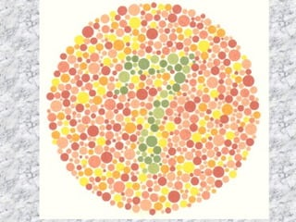
Introduction
JavaScript Quiz Game
Ishihara- Colour Blindness Test
Ishihara is a website made by the student of G5 after the name Ishihara color blindness test. Based on scientific research, Ishihara has developed color vision enhancement lenses to correct color vision deficiency and color blindness. By providing each patient with an individual color vision diagnostic exam, we can determine the type(red-green)and severity of each patient’s color deficiency.
In an Ishihara test, a person looks at a series of circles (known as Ishihara plates) with dots of different colors and sizes. A person who has trouble seeing red and green will find the shapes and numbers hard to see, or may not see them at all
By:
Abhinav Kumar(2110990051)

Slide 4
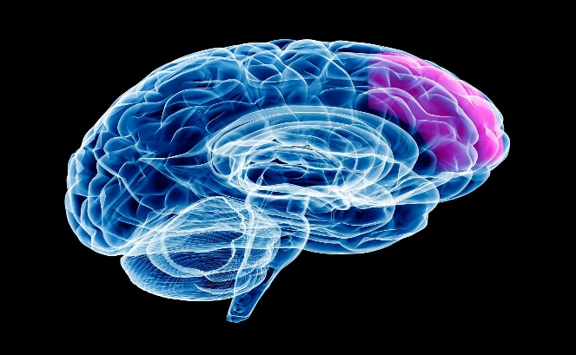
Problem Statement
1 in 12 men and 1 in 200 women are affected by color blindness. Are you one of them?
What is colour blindness?
If you have color blindness, it means you see colors differently than most people. Most of the time, color blindness makes it hard to tell the difference between certain colors. Most people who are colour blind are able to adjust and don’t have problems with everyday activities.
What are the symptoms of color blindness?
The main symptom of colour blindness is not seeing colours the way most people do. If you’re colour blind, you may have trouble seeing:
The difference between colors
How bright colors are
Different shades of colors
And since we get used to the way we see colours, many people with colour blindness don’t know they have it.

Slide 5
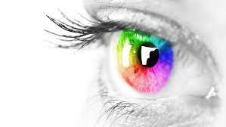
Contd.
To make people realise the increasing effect of colour blindness on today’s generation and the peak need of our is to know whether are we the prey of this disorder named as colour blindness, we are here with the Ishihara which in the form of quiz make people realise their problem.

Slide 6
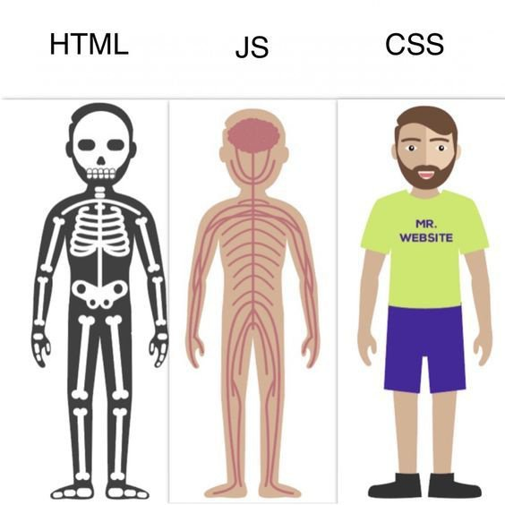
Technical Details
HTML, CSS, and JavaScript are often called the building blocks of the Web. These three tools dominate web development. Every library or tool seems to be centered around HTML, CSS, and JS.
A web document or website is a set of HTML (Hypertext Markup Language) tags saved in a plain text editor and run in a web browser.
CSS is a design language that you use to make your web page look nice and presentable.
JavaScript is the programming language. You can program actions, conditions, calculations, network requests, concurrent tasks and many other kinds of instructions.

Slide 7
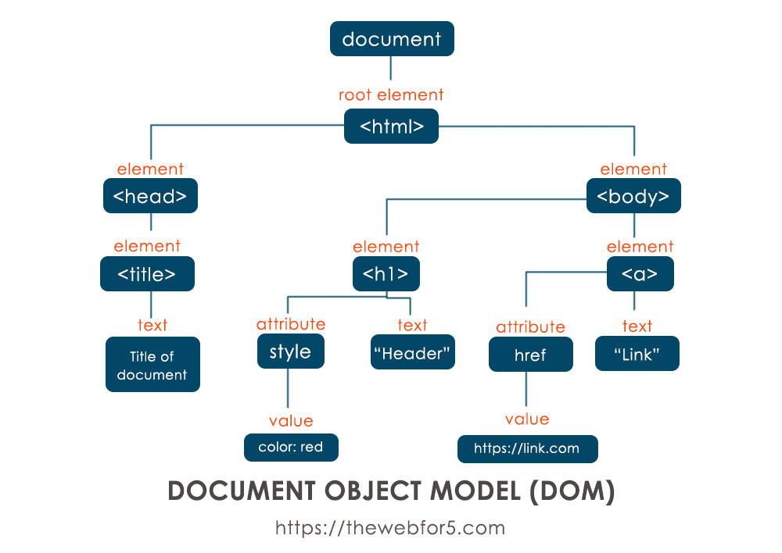
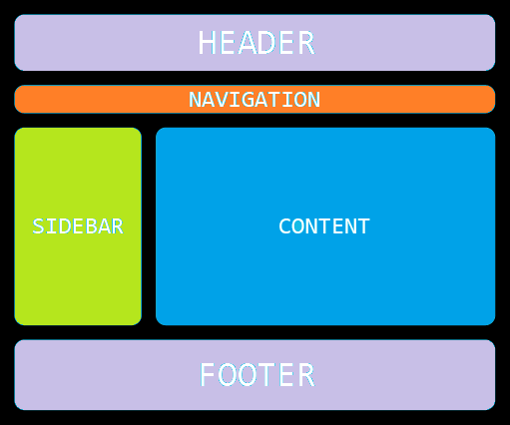
Contd.
Basic Structure Of Website

Slide 8
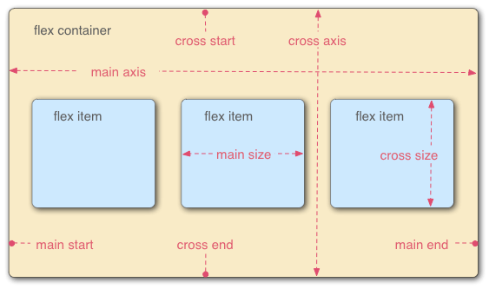
Key Tags used
Flex Box
The Flexible Box Layout Model (flexbox) is a layout model designed for one-dimensional content. It excels at taking a bunch of items which have different sizes, and returning the best layout for those items.
This is the ideal layout model for this sidebar pattern. Flexbox not only helps lay the sidebar and content out inline, but where there's not enough space remaining, the sidebar will break onto a new line. Instead of setting rigid dimensions for the browser to follow, with flexbox, you can instead provide flexible boundaries to hint how the content could display.

Slide 9
Resources Used
Visual Studio Code: Visual Studio Code combines the simplicity of a source code editor with powerful developer tooling, like IntelliSense code completion and debugging. First and foremost, it is an editor that gets out of your way. The delightfully frictionless edit-build-debug cycle means less time fiddling with your environment, and more time executing on your ideas.
Netlify: Netlify is the platform developers love for building highly-performant and dynamic websites, e-commerce stores and web applications. By uniting an extensive ecosystem of technologies, services and APIs into one workflow, Netlify unlocks new levels of team productivity, while saving time and money. www.netlify.com

Slide 10
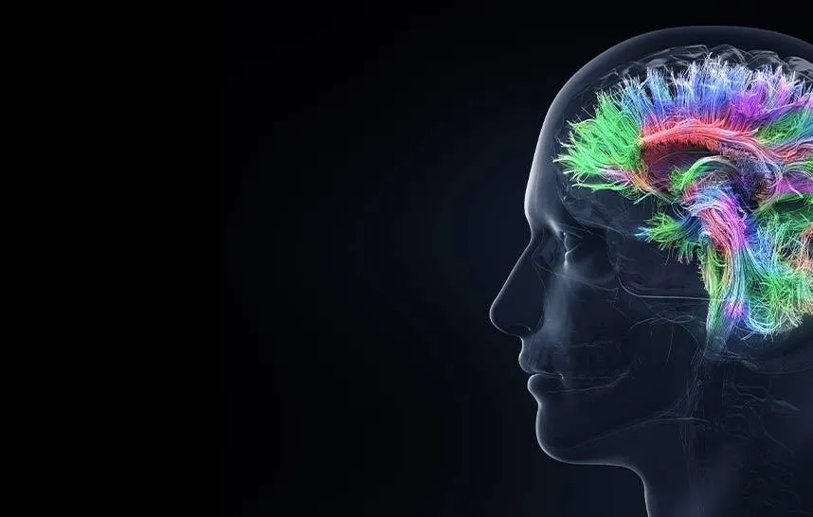
Key Features
“It’s not just about seeing color, it’s about seeing the world.”
Our Mission: To make a meaningful contribution to the human experience through boundary-breaking colour vision science and technologies
Ishihara’s revolutionary color vision solutions combine the latest in colour perception neuroscience and lens innovation to bring colorful possibilities to all.
Ishihara provides an easy pre-doctor consultation at just one click to detect whether the person is becoming the prey of colour blindness.
After detection of colour blindness(red-green), Ishihara also suggests you the colour blindness special glasses and lenses to improve your vision.

Slide 11
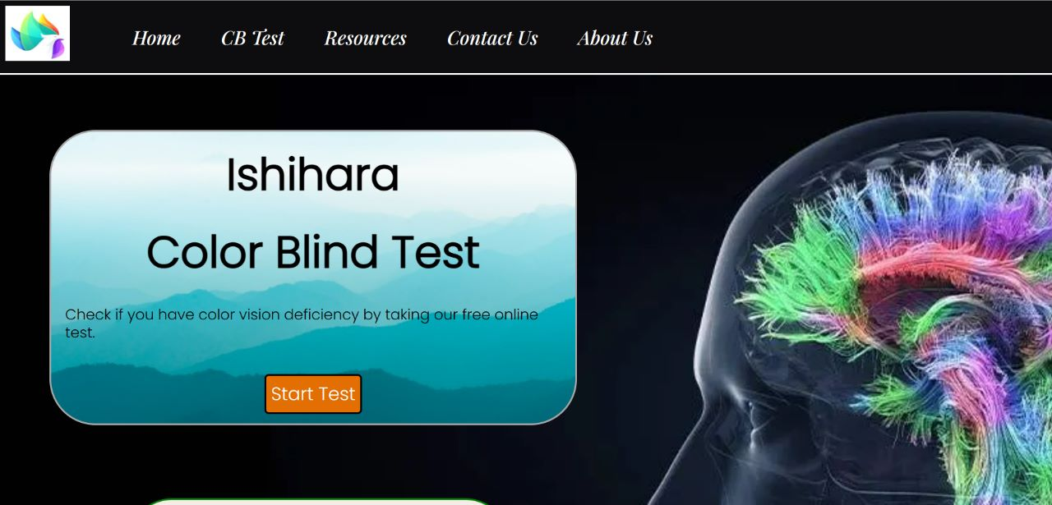
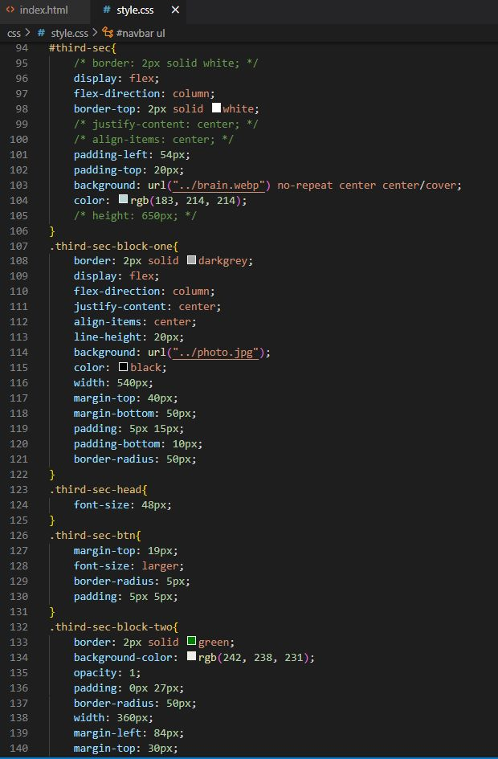
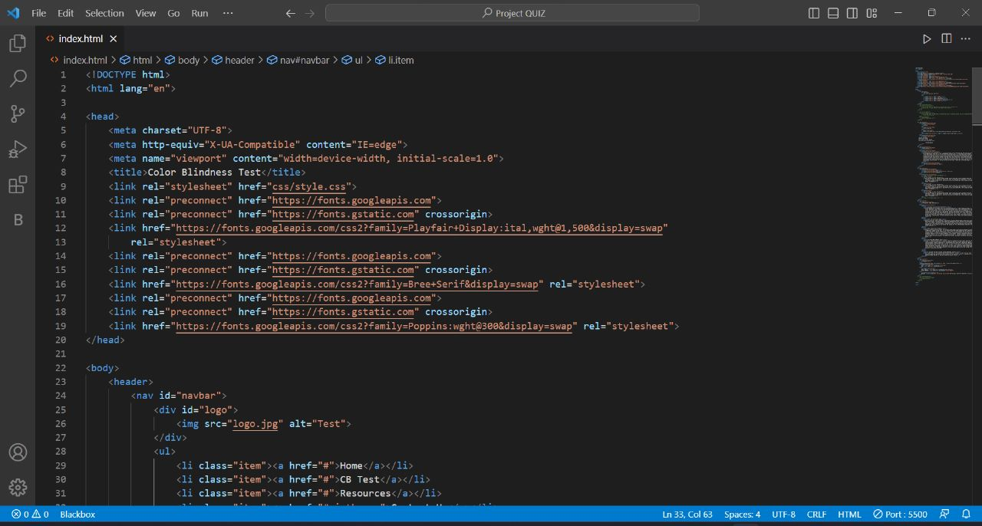
Project Highlights- Home Page
Html Code
& CSS Code

Slide 12
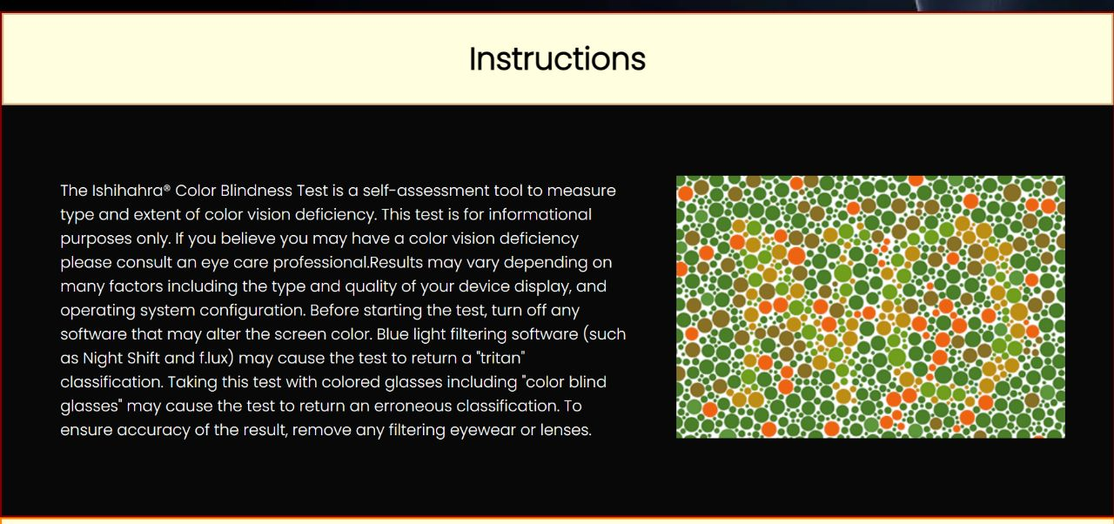
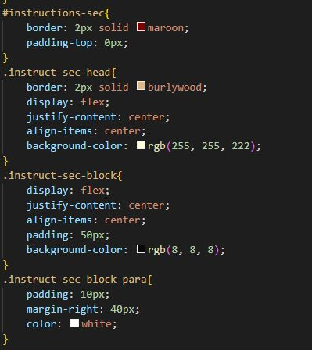
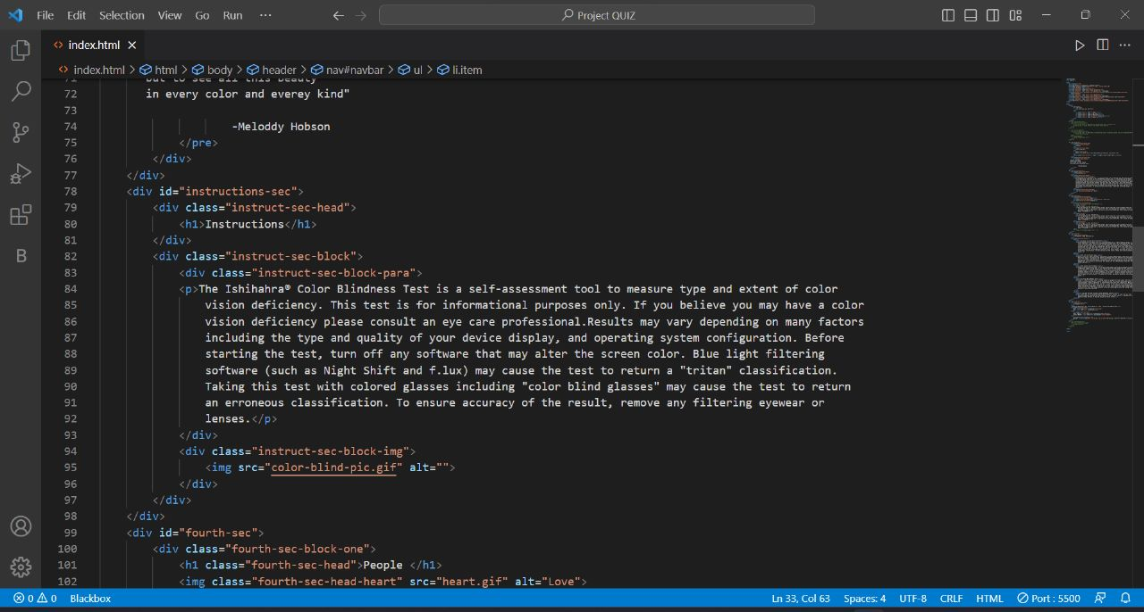
Instructions
Guidelines to use the website content are involved in this. What are the steps to be followed and what carefulness is required.

Slide 13
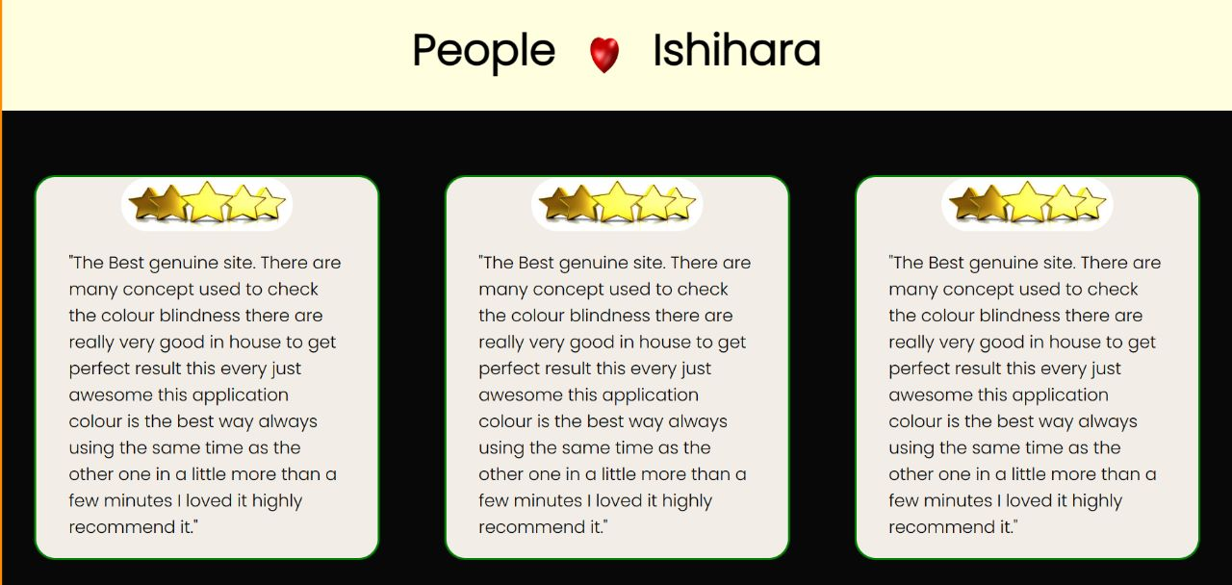
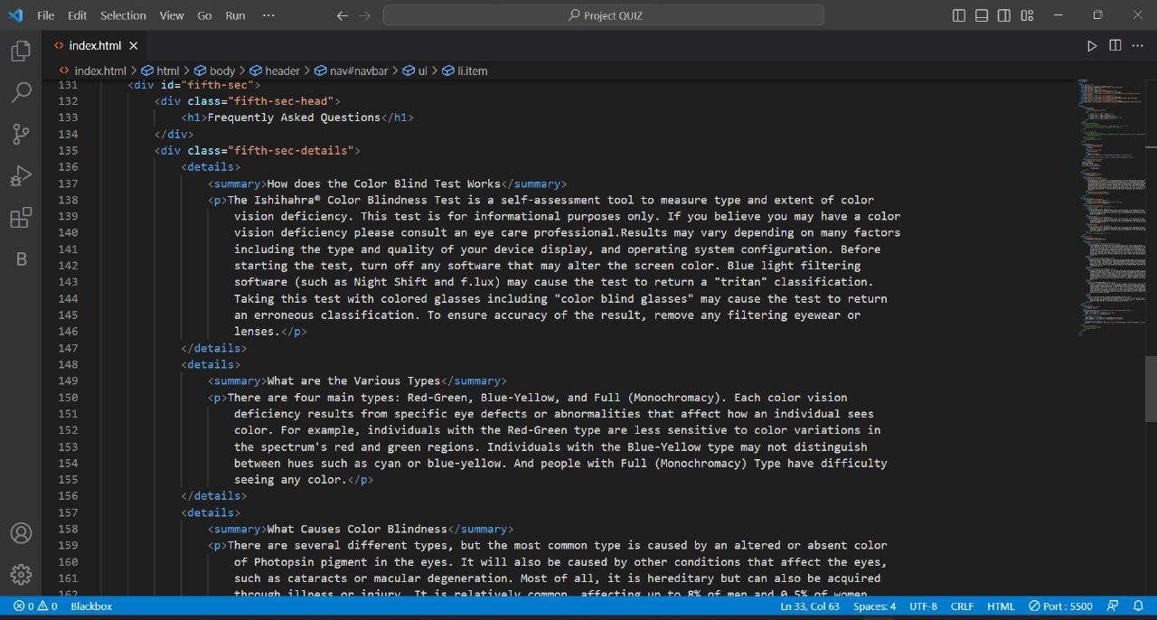
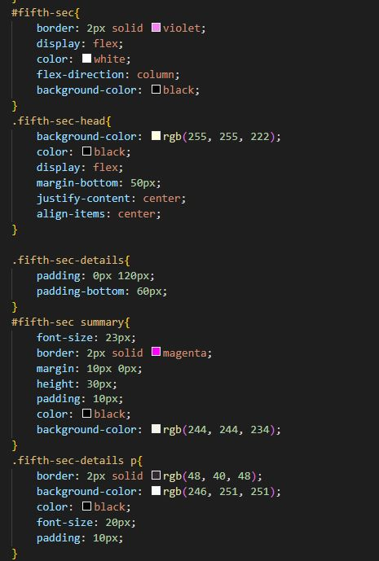
Reviews
Customer reviews will add social proof to your website. Your potential clients will know that you're a trusted brand.

Slide 14
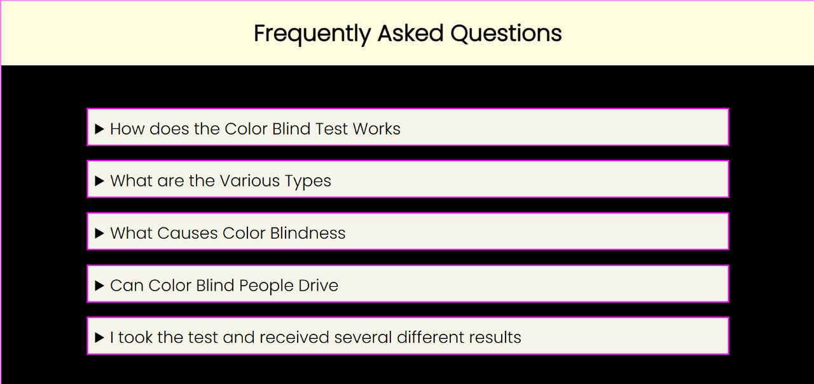
FAQs
FAQs include the frequently asked questions by the customers so that they don’t have to wait for our reply on contacting us.

Slide 15
Bonus Feature(optional)
The graduation of colour vision tests to the digital space offers several advantages, but is not trivial. Even if the digital tests mimic a traditional test, the digital version must be requalified or validated and every screen it is viewed on must be well-calibrated. However, when well controlled, digital tests offer several significant advantages over their analog counterparts:
They randomize solutions, which eliminates memorization.
The test can adapt in real time to the subject's performance.
They don't suffer from color fading like the pigments/dyes in analog tests.
The variance in test administration is minimized
The tests are immune to mistakes in interpreting the results
Test parameters can be dynamic and vary with time
This Colour Blindness site can be collaborated with wide variety of doctors and lens making companies and a highly collaborative business can be raised.
Ishihara solves the problem of millions of people in just one click. Out of their busy schedules, people can easily check if they are colour blind or not. After that they can have their preferred Doctors and respective lenses

Slide 16
Conclusion
Websites are made of a set of code or programming languages. The most common languages used to build websites are:
Hypertext markup language (HTML) helps browsers display webpage elements such as text, links and media.
Cascading style sheets (CSS) define webpage styles such as colors, layouts and fonts.
Hypertext Preprocessor (PHP) is the programming language used to create dynamic and interactive websites. PHP is responsible for retrieving content from databases and displaying them on your website. With PHP, you can create login pages, forms and galleries.
JavaScript allows you to implement complex features to your website. Anytime your website does more than display static information, JavaScript is probably involved.
In the form of JavaScript quiz game, Ishihara solves the problem of millions of people in just one click. Out of their busy schedules, people can easily check if they are colour blind or not. After that they can have their preferred Doctors and respective lenses.

Slide 17
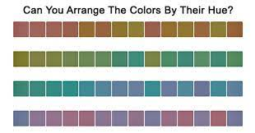
Future Scope
This Colour Blindness site can be collaborated with wide variety of doctors and lens making companies and a highly collaborative business can be raised.
Other than Red-Green Colour blindness Test, other tests can also be introduced to detect the other types of colour blindness.

Slide 18
References/Links used
https://en.wikipedia.org/wiki/Color_vision_test
https://enchroma.com/
https://colormax.org/color-blind-test/

Slide 19


