Slide 1

Machine Learning Project
House Prices (Kaggle)
Team: Boost 5
DongHyun, Hua, James, Kevin, Zhe

Slide 2
EDA
Exploring Data Analysis
And
Baseline Model Performance

Slide 3
Pre-processing
Data Import and Clean
Data Imputation
Missing Values
Imported all data without filtering NA and transfer ‘fake’ NA into something else
Train/Test dataset Conversion
Combined test.csv with train.csv and used data documentation to extract the data type and the factor levels
then converted object into nominal & ordinal categorical data.
Chose top 7 ordinal features with high correlation with sale price, then converted them into numeric data.
KNN & Excel
used the KNN to impute the numeric data and for the categorical data.
Dummification
After imputation, we used ‘get dummy’ function to transfer categorical variable into dummy variables.

Slide 4
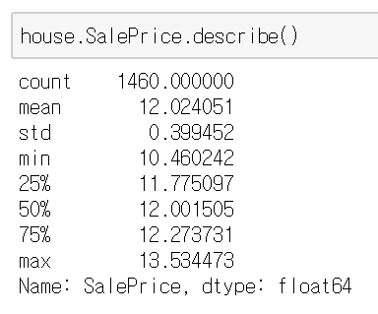

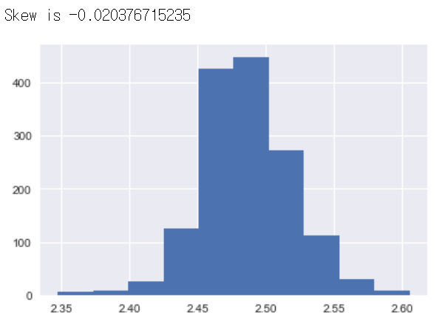
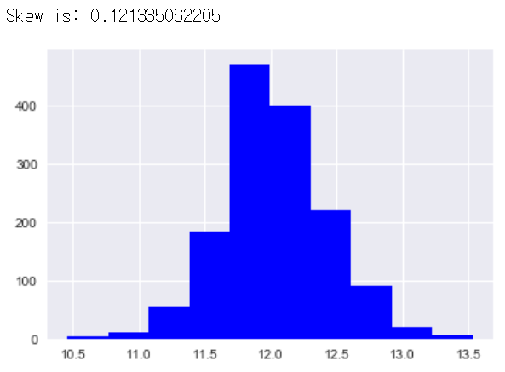
Sale Price Summary & Skewness
Improved!

Slide 5
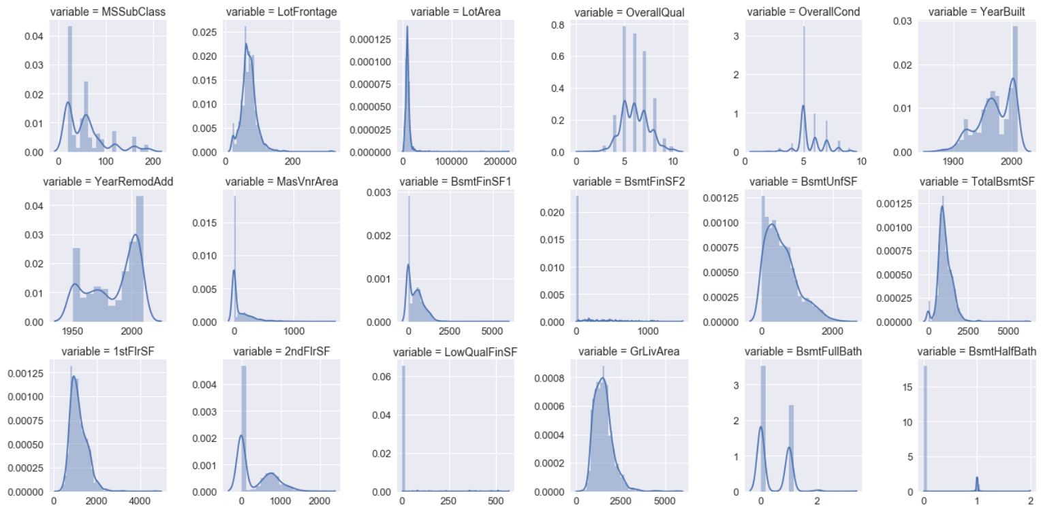
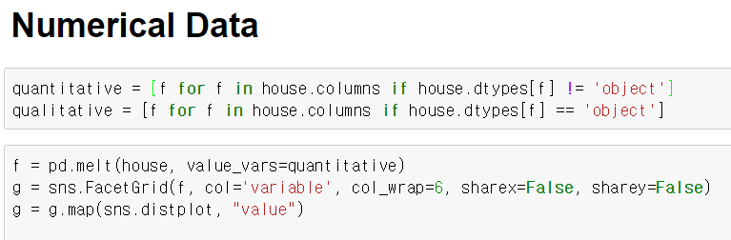
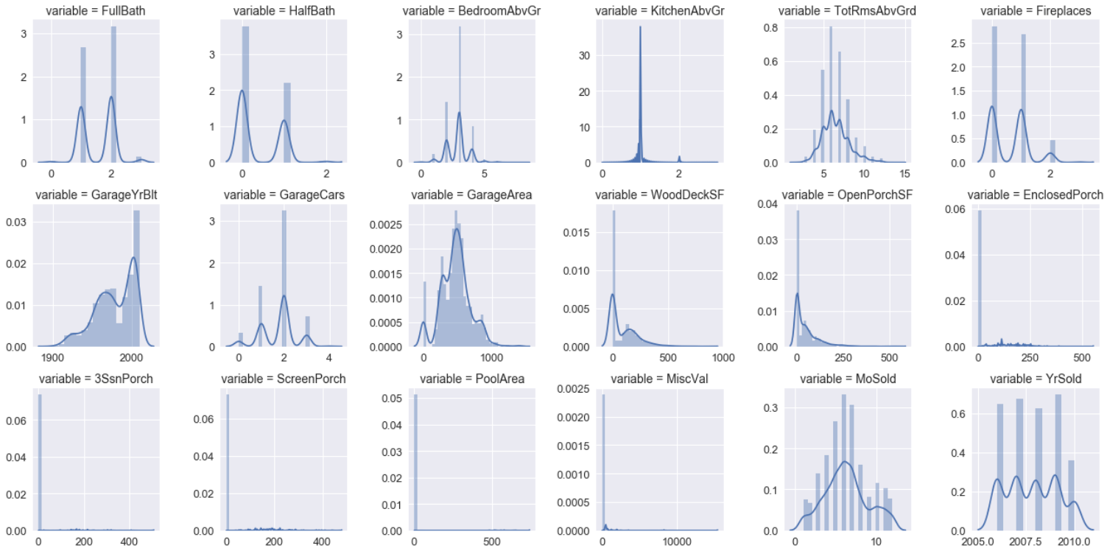
Numerical Data Exploration
Some great features for log transformation:,,,
Total Basement
OverallQual
YearBuilt
BsmtUniSF
GrLivArea
Garage Year Built
LotFrontage
LotArea
TotalBsmtSF
1st Floor
GarageArea
KitchenAbvGr

Slide 6
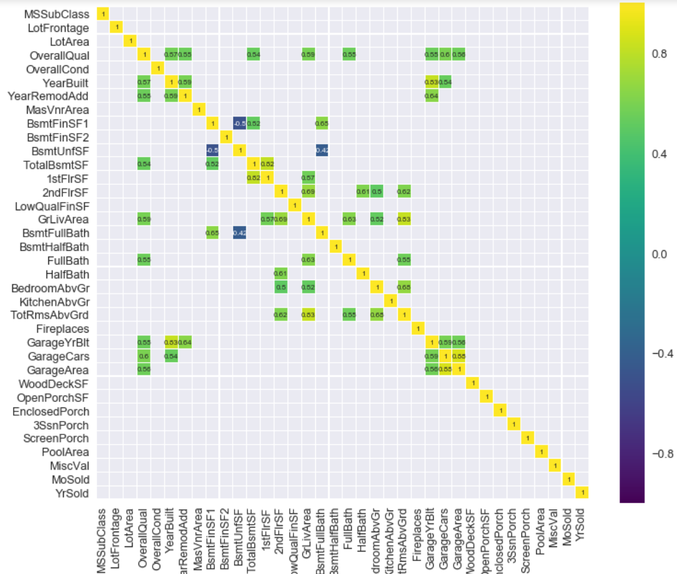
Numerical Data Correlations (Heatmap)
corr >= 0.5
1st Floor & Total Basement
Total Rooms Grd & Gr Liv Area
Garage Year Built & Year Built
Garage Area & Garage Cars
corr <= -0.4
Basement Full Bath
Basement Unif

Slide 7
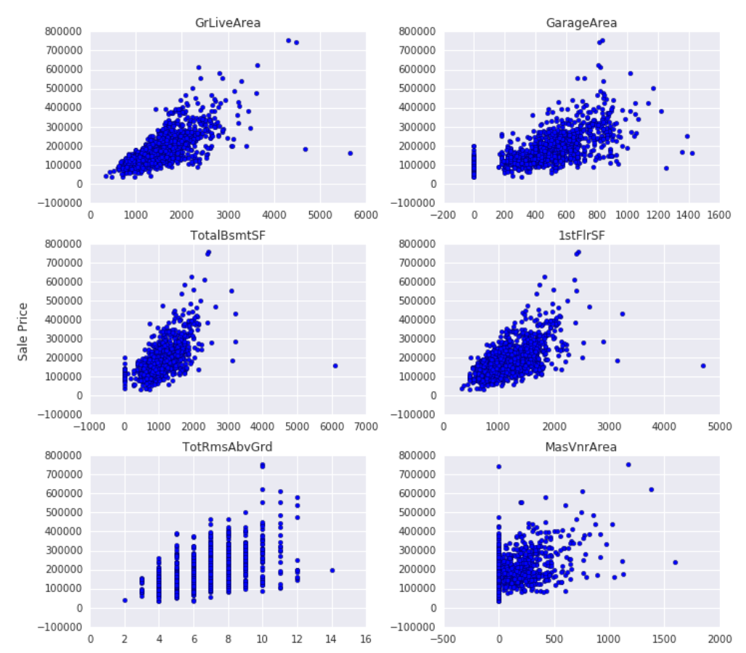
Numerical Data on Sale Price
Top 6 Numerical Features by their correlation with Sale Price on scatterplot
GrLivArea
GarageArea
TotalBsmtSF
1stFlrSF
TotRmsAbvGrd
MasVnrArea

Slide 8
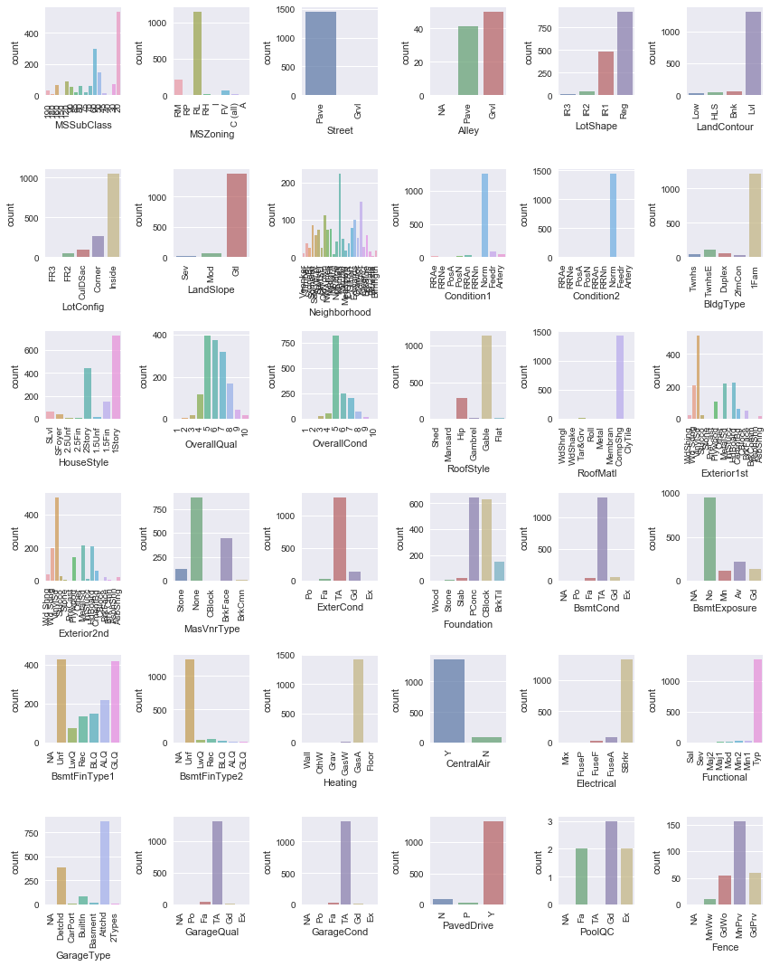
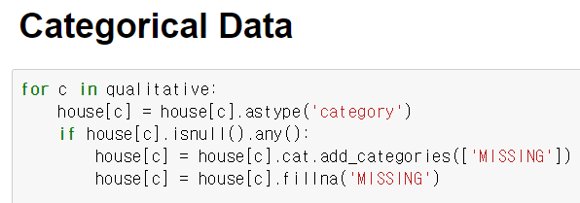
Categorical Data
36 Categorical Features

Slide 9
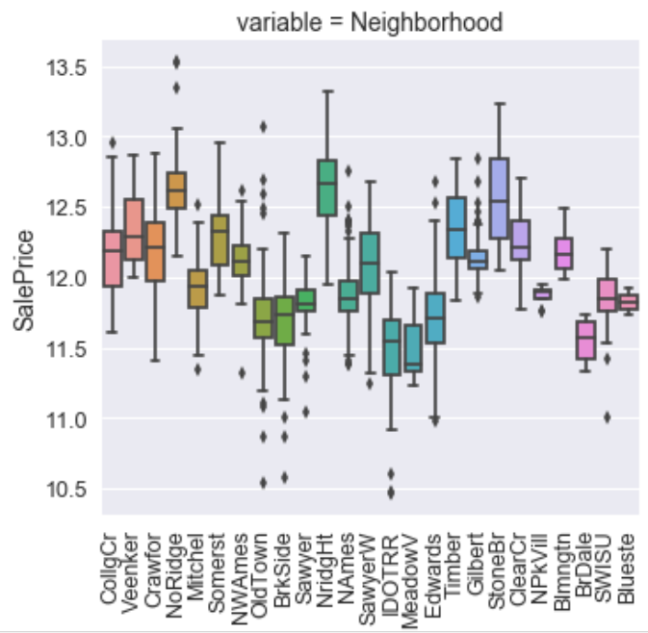
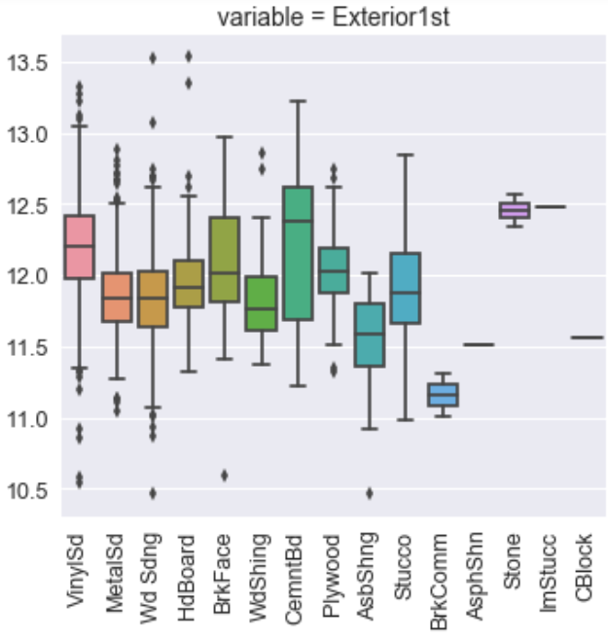
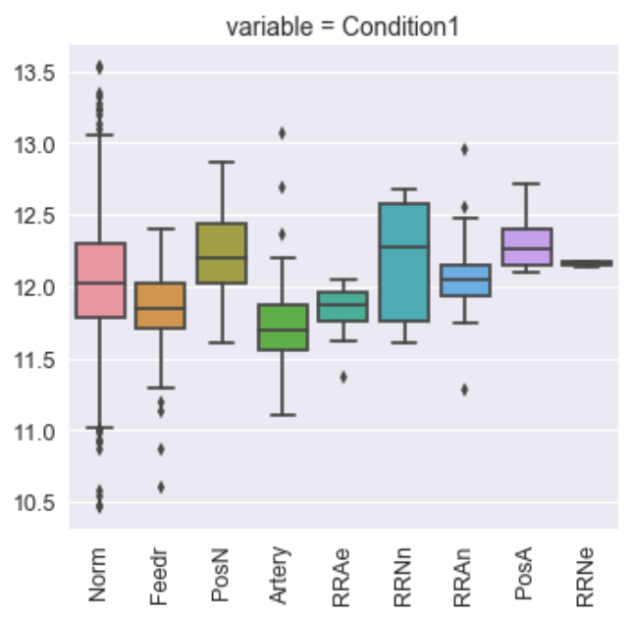
Categorical Data Correlations
'Neighborhood' feature has the leargest impact on SalesPrice having many different obs in a wide range of Sales price.
Exterior and Condition seem to have some strong impact as well

Slide 10
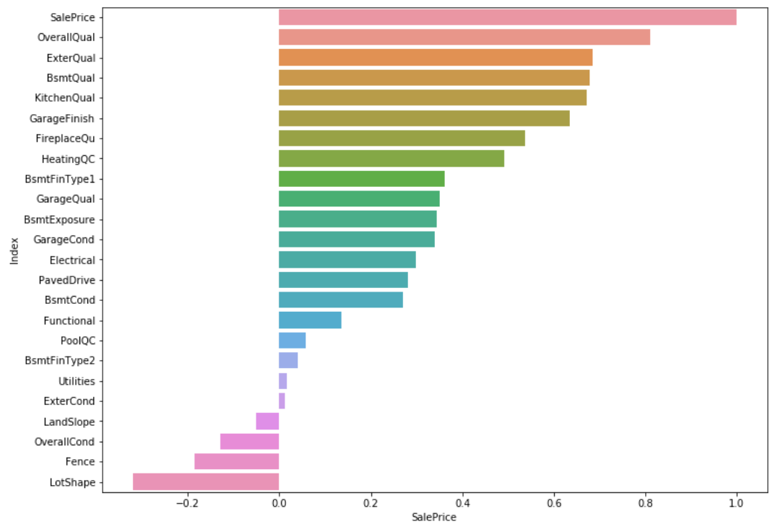
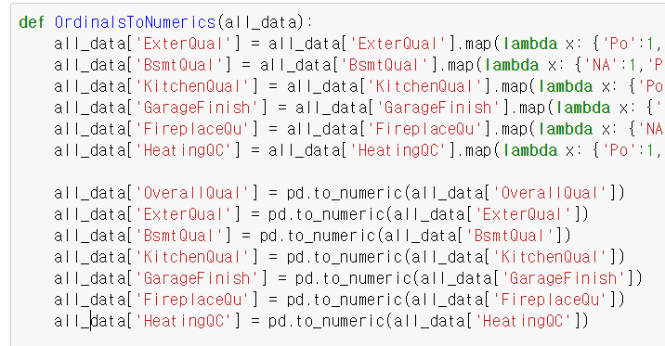
Ordinal Features
Converted categorical data with non-numerical features with rank into ordinal categories
Seems there are at least 5 house conditions from ordinal features having impact on SalePrice
Overall Quality
Exterior Quality
Basement Quality
Kitchen Quality
Garage Finish
And the least correlated…
LotShape, Fence, OverallCond, etc

Slide 11
Data Engineering
Baseline Model

Slide 12
Baseline Model
Baseline Model - Algorithms
Multi Linear Models
Lasso, Ridge and Elastic Net to train the linear model.
Tree based Models
GBM, Random Forest and XGboost to fit the tree-model. Then we put random noise in data frame in order to use Random Forest to find the feature importance of each feature.

Slide 13
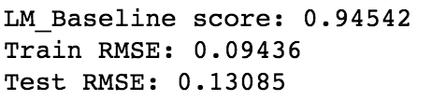
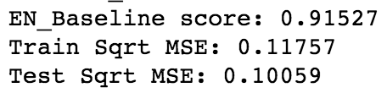
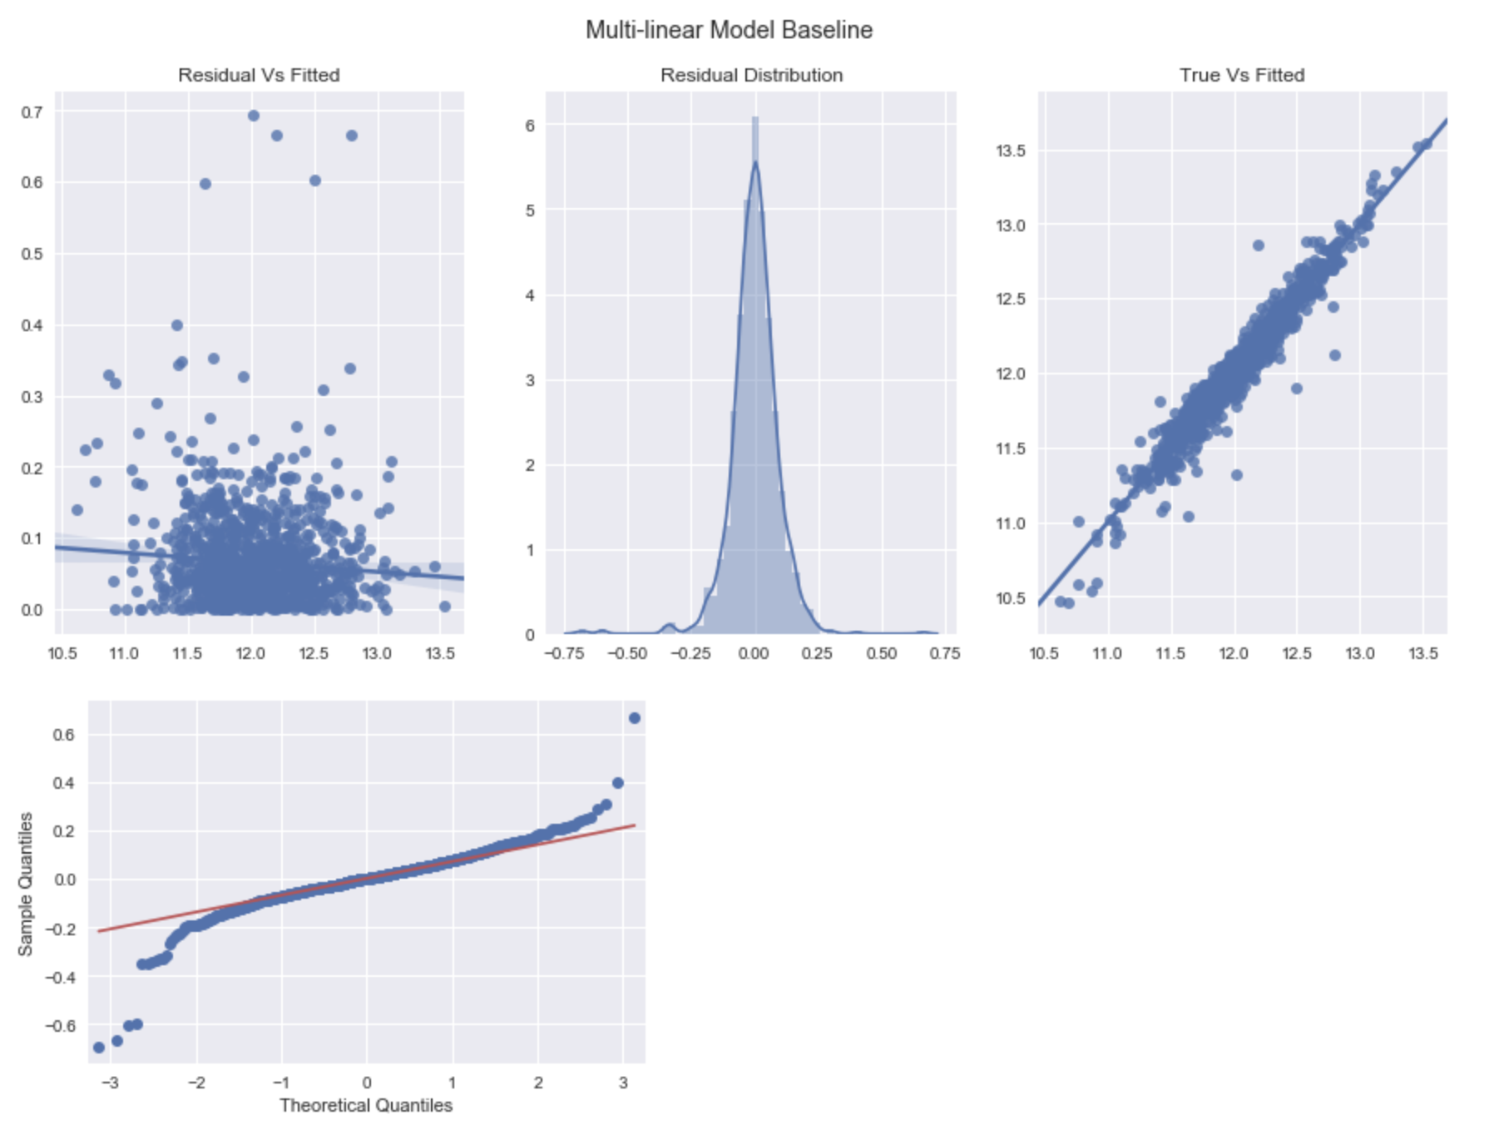
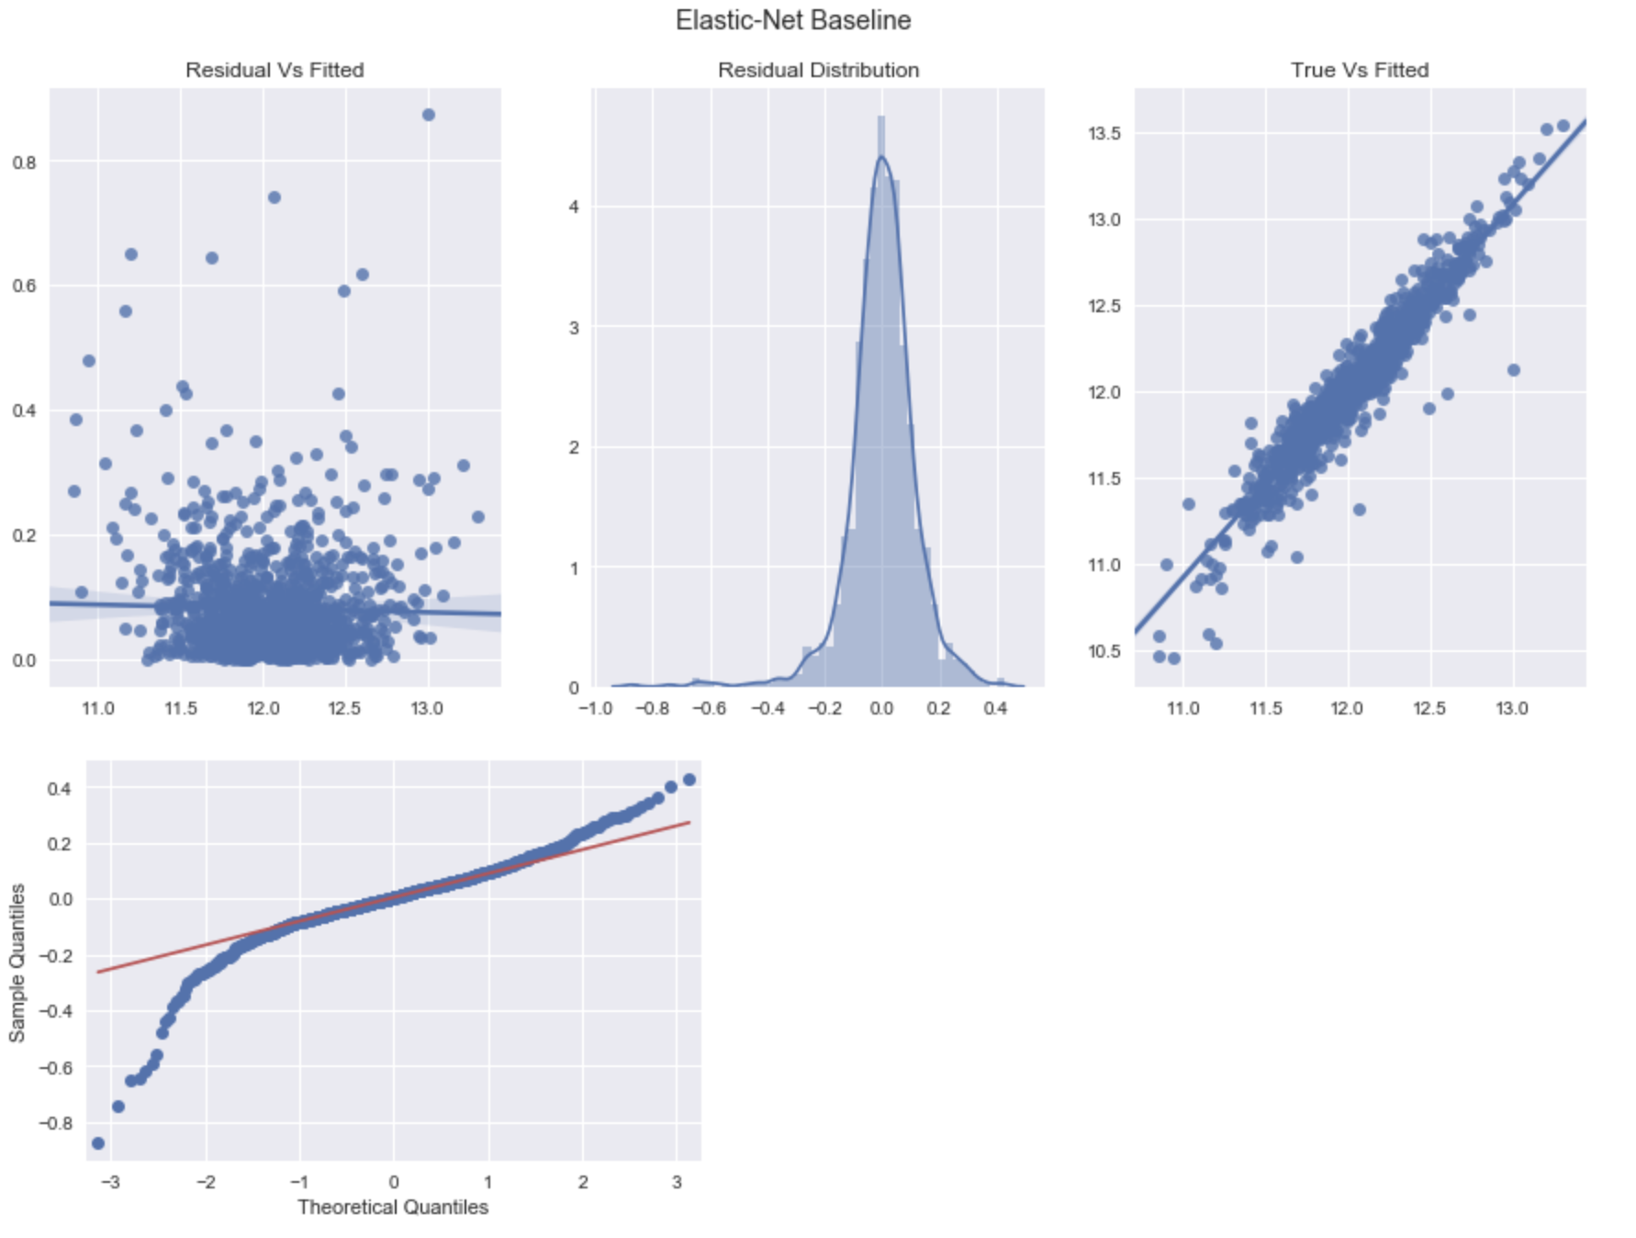
Baseline Model Performance
OLS
Elastic Net
Residual Plot
Residual Plot
The fitted values don’t have constant variance.

Slide 14
Data Engineering
Data Engineering

Slide 15
Feature Engineering
1. Added total sqfootage feature
4. LotFrontage
Since the area of each street connected to the house property most likely have a similar
2. Garage
Replacing missing data with 0 on GarageYrBlt, GarageArea and GarageCars (Since No garage = no cars in such garage.)
5. Neighborhood
Area to other houses in its neighborhood , we can fill in missing values by the median LotFrontage of the neighborhood.
3. Basement
Missing values are likely zero for having no basement; BsmtFinSF1, BsmtFinSF2, BsmtUnfSF, TotalBsmtSF, BsmtFullBath and BsmtHalfBath

Slide 16
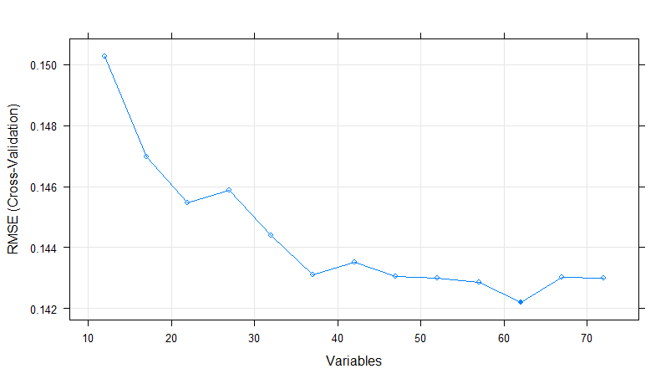
Feature Selection
Methods: Backward selection using Random Forest and Cross Validation
R package Caret: Recursive Feature Elimination (RFE)
- R’s Random Forest package can handle categorical variables as-is if #levels < 33
Backward selected w/ cross validation (CV)
- remove 5 variables at a time from full set of 72 variables, and check CV RMSE, to find the best result.
RFE backward selection result
62 (out of 72) variables yields min RMSE
10 variables removed from RMSE
Alley ExterCond BsmtFinSF2
Heating Electrical BsmtHalfBath
PavedDrive Fence MiscFeature
MoSold

Slide 17
Feature Selection
Feature importance analysis (with noise variables)
Added one [0,1] uniform and one standard normal noise variable as “new features”
Ran Random Forest (w/ best tuned hyperparameters) and checked feature importance ranking compared w/ two noise variables
The relative ranking of the two noise variables could vary a lot, so it’s better to add two differently distributed noise variables for the check
Select the variables w/ feature importance ranking lower than the noise variables as additional feature removal candidates
9 more variables to remove:BsmtFinType2
LandContour Enclosed
SaleType Functional
LotConfig ScreenPorch
YrSold LandSlope
Porch

Slide 18
Feature Selection
R based feature analysis, results used in Python modeling to drop features
Tested (1) drop 10 variables identified from backward selection (2) drop additional 9 variables that has less feature importance than noise variables.
Both dropping will improve linear regression model performance (i.e. lower RMSE), e.g. base linear regression, Ridge, Lasso, ElasticNet.
Overall stacked final model w/ best ElasticNet + best GBM + best RF performance is improved a little.
GBM
Better result
(after re-tuning)
Stacked
= ElasticNet
+ GBM
+ RF
Conclusion
dropping selected lowest importance features helps the overall modeling performance.
Random Forest
Degraded
(after re-tuning)

Slide 19
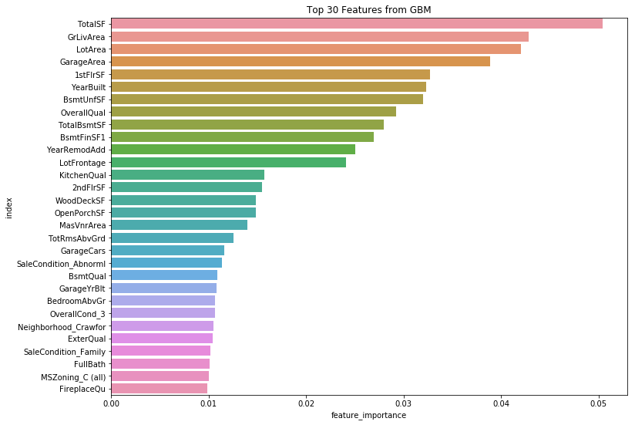
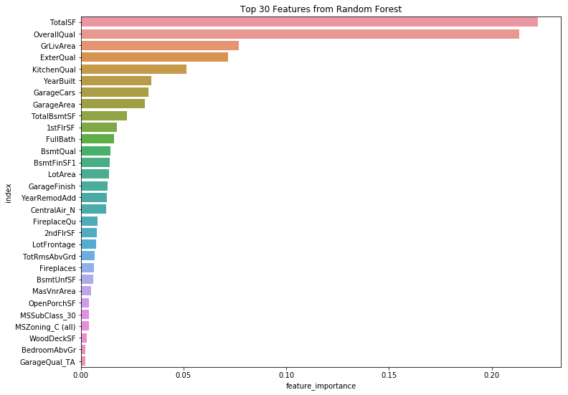
Feature importance analysis (with noise variables)
Top 30 important features from GBM and RF

Slide 20
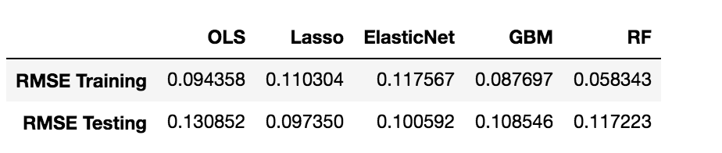
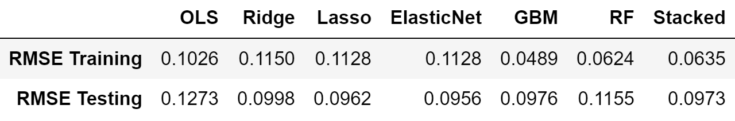
Model Selectin & Stacking
Best single model selection
Compared basic linear regression, best tunned Ridge, Lasso, ElasticNet, GBM, and RF, the best performance is achieved by ElasticNet.
With best tunned ElasticNet model, only about 32% features are finally used (i.e. w/ non-zero model coeffiicents) from all the totally 280 feature variables (all categorical variables been converted into dummy variables).
Baseline Model Performance
Model Performance

Slide 21
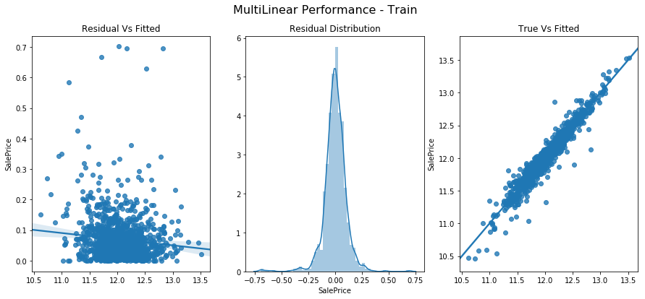
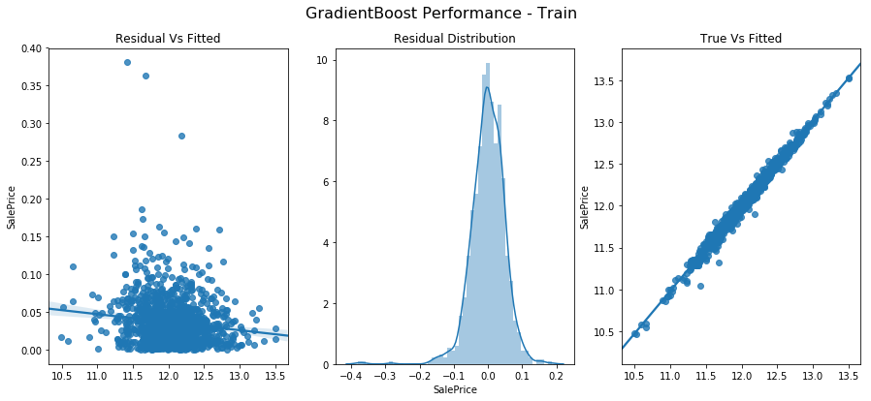
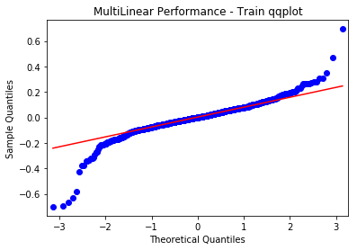
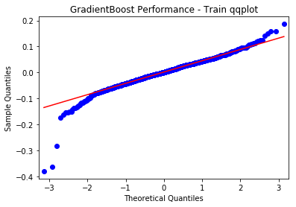
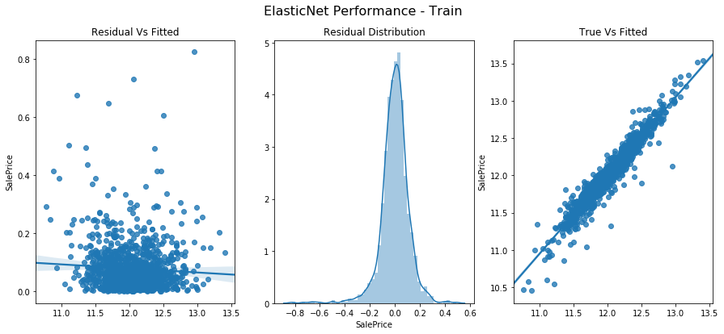
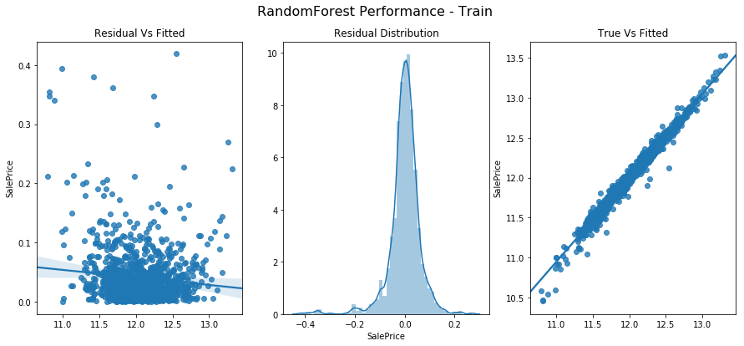
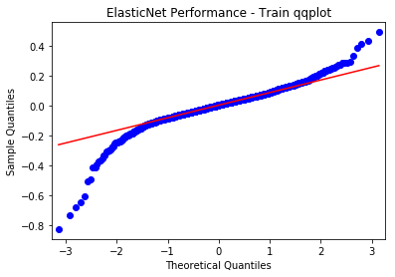
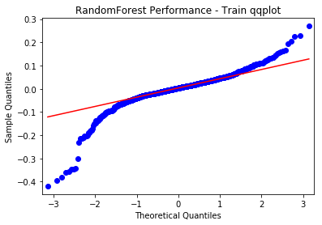
Model Selection
Multilinear Performance - Train
GradientBoost Performance - Train
ElasticNet Performance - Train
Random Forest Performance - Train

Slide 22
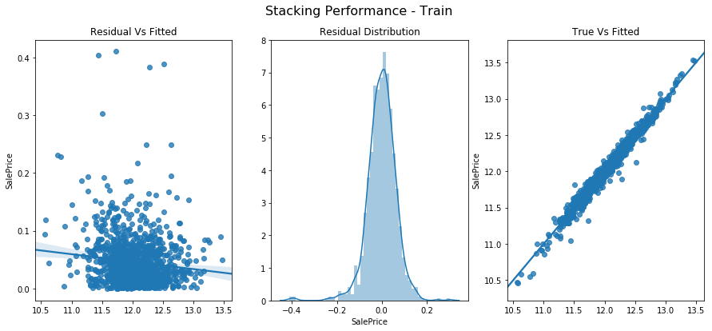
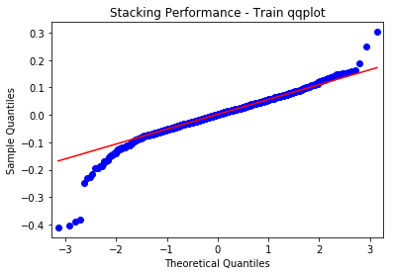
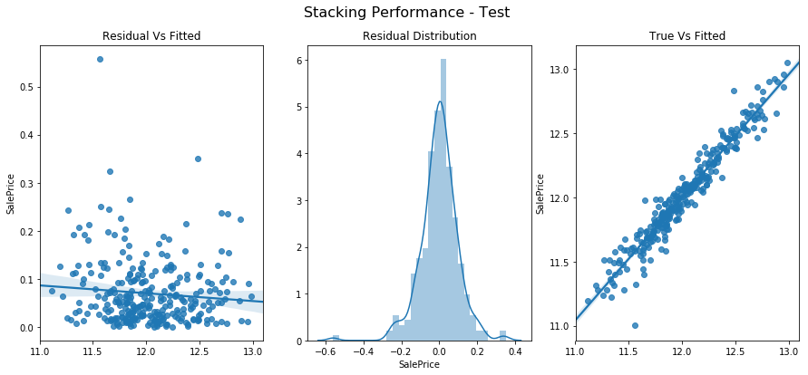
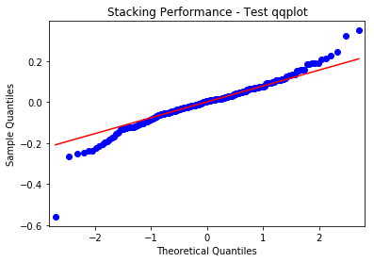
Stacked Model Performance (ElasticNet, GBM, and RF)
Train
Test

Slide 23
Multi Model Stacking
Best multi-model stacking
Stacked best ElasticNet, GBM, and RF models together
Performance is a little bit lower than best ElasticNet model alone.
Still deemed more robust than ElasticNet alone, and firstly submitted to Kaggle: score: 0.12906 (top 29%).
Confirmed by submitting best ElasticNet model alone to Kaggle: score: 0.13252 (worse) and best GBM model alone: score: 0.13113 (worse)

Slide 24
Future Work
Try other advance models XGBoost, SVR, etc. and tune w/ Bayes Optimizer
No converting categorical vars to dummy for tree-based models (H2O RF, etc.)
Different feature selection for different models i.e. only drop features for linear models, but not tree-based non-linear models
More preprocessing choices BoxCox transformation, PCA, etc.
Outlier check and removal
Clustering analysis generate new useful categorical features
Feature selection try other advanced algorithms e.g. Genetic algo, and simulated annealing, from R Caret package.

