Slide 1

System‑Wide Live Captioning with Multilingual Transcription, Emotion Detection, and NLP Assistants for All System Audio AIE-A-Batch-17
ROLL NUMBER | NAME
AV.EN.U4AIE22010 | Dokala Sai Parthava Naidu
AV.EN.U4AIE22015 | R Kabin Dev
AV.EN.U4AIE22043 | Vishnu Vardhan Kollipara
MENTOR
Dr. K S L PRASANA

Slide 2
INTRODUCTION
This project presents a real-time live captioning system designed to capture and transcribe all audio output from a computer, including video calls, streaming media, and system sounds.
Leveraging advanced speech recognition and natural language processing technologies, the system supports multilingual transcription, speaker identification, and emotion detection.
Additional features include automated summarization, translation, and real-time visual overlays to enhance user experience.
The solution aims to improve accessibility and inclusivity by enabling individuals with hearing impairments to actively engage in conversations and comprehend multimedia content, thereby bridging communication gaps in diverse, global environments.

Slide 3
Motivation
In an increasingly virtual and globalized world, real-time live captioning systems are essential tools for making communication accessible, inclusive, and effective.This project aims to empower users across diverse abilities and languages by providing seamless, accurate, and intelligent transcription and translation of all system audio from video calls to streaming media.
Most importantly, it enables persons with hearing impairments or hearing defects to actively communicate and engage in conversations during calls, breaking down communication barriers and fostering true inclusion.

Slide 4
Problem statement:
Currently, there is a lack of an integrated system capable of capturing and accurately transcribing all system audio in real time across multiple languages, while simultaneously providing advanced functionalities such as speaker identification, emotion recognition, and content summarization. This gap significantly restricts effective communication and accessibility, particularly for individuals with hearing impairments.

Slide 5
LITERATURE SURVEY
Title | Authors | Methodology | Published Year | Limitation
[1] Optimizing Vosk Models for Transcribing Educational Lectures in Real Time | Emma O, Mark W | The study focuses on optimizing the Vosk speech recognition toolkit for real-time transcription of educational lectures by leveraging custom language models. | 2025 | The default models provided by Vosk may not always meet the specific needs of educational contexts, necessitating the development of custom models.
[2] Improving Speech Recognition Accuracy Using Custom Language Models with the Vosk Toolkit | Aniket Abhishek Soni | The work explores how to increase speech-to-text accuracy by incorporating custom language models with the open-source Vosk Toolkit. | 2025 | Many existing tools show a significant drop in accuracy when applied to real-world audio with background noise, regional accents, or specialized vocabulary.
[3] Flexi-Transducer: Optimizing Latency, Accuracy and Compute for Multi-Domain On-Device Scenarios | Jay Mahadeokar et al. | The paper proposes a Flexible Transducer (FlexiT) for on-device ASR that uses a single compact model to handle multiple use-cases with different accuracy and latency requirements. | 2021 | On-device ASR models operate with significant hardware constraints such as memory, disk space, and battery consumption.

Slide 6
[4] Performance Evaluation of Offline Speech Recognition on Edge Devices | Santosh Gondi, Vineel Pratap | The paper evaluates the performance and efficiency of transformer-based speech recognition systems on edge devices like Raspberry Pi and Nvidia Jetson Nano. | 2021 | The word error rate on the edge is still higher than on a server, and transformer models are not directly suitable for streaming applications.
[5] MeetDot: Videoconferencing with Live Translation Captions | Arkady Arkhangorodsky et al. | The system combines automatic speech recognition (ASR) and machine translation (MT) in a cascade to provide live captions for video calls. | 2021 | The re-translation strategy used to translate streamed speech can cause "caption flicker."
[6] Automatic captions on video calls: a must for the older adults | Eduardo Nacimiento-García et al. | The authors developed an automatic captioning tool using Coqui STT that is independent of the video call platform and allows for customizable text size, color, and background. | 2024 | Not all video calling tools offer automatic captioning, and some only support it in certain languages.
[7] Streaming End-to-End Multilingual Speech Recognition with Joint Language Identification | C. Zhang et al. | The paper proposes modifying a cascaded-encoder-based recurrent neural network transducer (RNN-T) model by integrating a per-frame language identifier (LID) predictor. | 2022 | Many previous works on LID predictions are in non-streaming systems, which is not suitable for a streaming ASR setup with production constraints.

Slide 7
[8] TRANSCRIBE-TO-DIARIZE: NEURAL SPEAKER DIARIZATION FOR UNLIMITED NUMBER OF SPEAKERS USING END-TO-END SPEAKER-ATTRIBUTED ASR | Naoyuki Kanda et al. | This paper presents a new speaker diarization approach that uses an end-to-end (E2E) speaker-attributed automatic speech recognition (SA-ASR) model as its core. | 2022 | Previous methods that combined ASR and speaker diarization were separately trained and did not fully use the inherent link between the two tasks.
[9] Integrating Emotion Recognition with Speech Recognition and Speaker Diarisation for Conversations | Wen Wu et al. | The paper proposes a single, jointly-trained system that integrates automatic emotion recognition (AER) with automatic speech recognition (ASR) and speaker diarisation | 2023 | Most current AER studies use manually segmented utterances, which are not usually available in real-world use cases.
[10] WhisperX: Time-Accurate Speech Transcription of Long-Form Audio | Max Bain et al. | The paper presents a system that uses voice activity detection (VAD) and forced phoneme alignment to achieve time-accurate transcription of long-form audio. | 2023 | The predicted timestamps from large-scale speech recognition models like Whisper are often inaccurate, and word-level timestamps are not available out-of-the-box.

Slide 8
Dataset Desription
Vosk's Core Pretrained Components
Each Vosk "model" package is built from these specialized parts:
1. Acoustic Model (AM): Learns to map audio sounds to phonemes. (The "ear".)
2. Language Model (LM): Learns word sequences and grammar. (The "brain".)
3. Phonetic Dictionary: Maps words to their phonetic pronunciations. (The "translator".)
Training Datasets
1.LibriSpeech: Large, read English corpus; core for general English Acoustic and Language Models.
2.Common Voice: Crowdsourced, multi-language; enables diverse accents & languages for AMs and LMs.
3.Custom Recordings: Your own data for domain-specific accuracy, fine-tuning AMs & LMs, and enriching the Phonetic Dictionary

Slide 9
Real-time Multilingual Speech Recognition & Speaker Diarization System based on Whisper Segmentation Ke-Ming Lyu, Ren-yuan Lyu, Hsien-Tsung Chang
How the System Works:
The system uses the Whisper model to automatically segment live audio into smaller chunks, with each chunk typically containing speech from a single speaker.
A unique voice profile is created for each speaker in the segmented audio.
An incremental clustering technique is used to match new audio segments to the correct speaker profile in real time.
The system delivers a continuous stream of text with speaker labels, showing what was said and by whom.

Slide 10
Dataset Description
Whisper for Multilingual Transcription:
Whisper is OpenAI’s large-scale ASR model; whisper is a real-time version
Dataset Used: 680,000 hours of supervised data
Sources: Internet videos with subtitles (e.g., YouTube)
Languages: 96+ (top coverage includes English, Spanish, Hindi, Chinese, Arabic, etc.)
Label Type: Weak — no speaker ID or perfect timestamps, but diverse and scalable

Slide 11
Results
By using Whisper's segmentation, the system avoids complex steps found in older methods, making it faster.
Achieved a Word Diarization Error Rate (WDER) of 2.68% for two-speaker conversations and 11.65% for three-speaker conversations, with an overall WDER of 6.96%.
Two-Person vs. Three-Person Scenarios:
In two-person conversations, the model performed exceptionally well, achieving a WDER of 2.68%, which was significantly better than the baseline and exceeded expectations.
In three-person conversations, the WDER increased to 11.65%, indicating a decrease in accuracy, though this did not significantly impact the overall performance.

Slide 12
Research Gaps
Existing ASR tools perform poorly in noisy environments, with accents, and domain-specific terms.
Key features like speaker diarization, LID, AER, and accurate timestamping are fragmented or missing in current systems.
No fully integrated system exists for real-time, multilingual audio transcription with speaker ID, emotion recognition, and summarization.

Slide 13
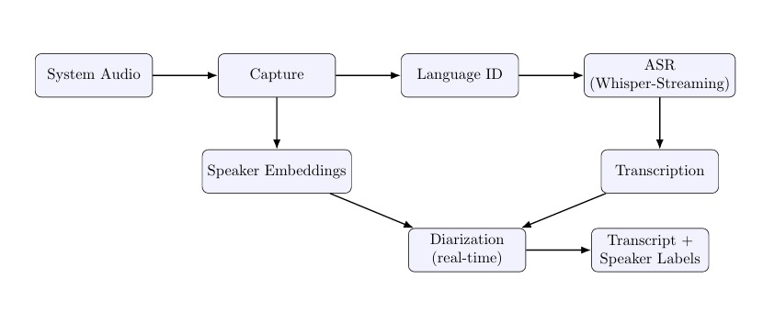
Expected Work flow
Fig1: WORKFLOW

Slide 14
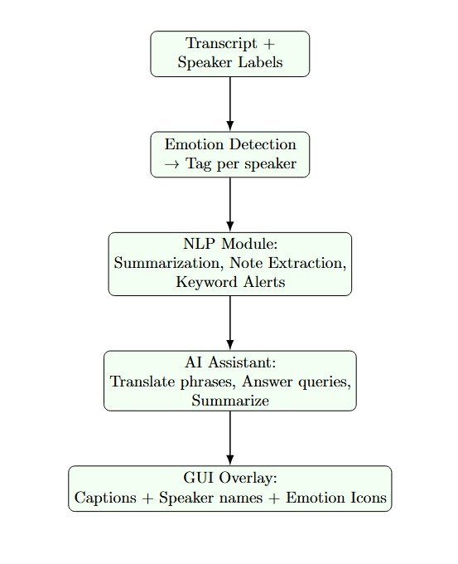
Fig2: ADDITIONAL FEATURES

Slide 15

WORK FLOW
Audio Capture & Preprocessing :
The paper involves capturing all system audio, such as from video calls and streaming media, in real time. The captured audio is then normalized and resampled to a consistent format, like 16kHz and mono, in preparation for analysis. The tools used for this are WASAPI Loopback to ensure direct access to the audio stream and Librosa, a library for tasks like resampling and normalization
We are using sounddevice library to capture audio from a specified input device, which can be configured for a system audio source like "Stereo Mix" to replicate the functionality of WASAPI Loopback. The normalize_audio function within the EnhancedContinuousTranscriptionEngine class performs audio normalization, which is a key processing step
Advantage
Our model's advantage lies in its comprehensive approach to audio capture and preprocessing. It is designed to capture all system audio, including from video calls and streaming media. This contrasts with models that might be optimized for a more limited scope, such as the paper focus on educational lectures. By leveraging tools like WASAPI Loopback and Librosa, our system ensures it can directly access and prepare a wide range of audio sources for analysis.

Slide 16
WORK FLOW
Multilingual Transcription:
Language Identification: Dynamically detects the spoken language.
TOOLS: Uses a real-time model (like Whisper-Streaming) to convert the audio into a live text transcript.
The paper is to use a real-time model, specifically Whisper-Streaming, for multilingual transcription. The Whisper model is an OpenAI ASR (Automatic Speech Recognition) model trained on 680,000 hours of data from internet videos, enabling transcription in over 96 languages
We use the Google Speech Recognition API (accessed via speech recognition library) to Convert audio to a text transcript. While this achieves the core function of transcription, it is an alternative to the planned Whisper-Streaming model
Advantage
Google's Speech Recognition API generally offers better seamless integration and scalability for businesses. It's a cloud-based service that requires less setup and infrastructure management, making it an easier "plug-and-play" option for developers. It also provides advanced features like real-time, low-latency performance and enterprise-grade reliability.

Slide 17
WORK FLOW
Real-Time Speaker Diarization:
Extracts unique voice characteristics (speaker embeddings) from the audio.
Combines text and embeddings to assign speaker labels, answering "who said what.“
TOOLS: pyannote-audio:State-of-the-art diarization tool from Hugging Face. Real-time supported.

Slide 18
pyannote-audio for Speaker Diarization:
Build using pytroch + Hugging face
Dataset Used: VoxCeleb + AMI Corpus
VoxCeleb (1 & 2):
Size: 1,200+ hours of celebrity interviews from YouTube
AMI Corpus:
Full name: Augmented Multi-party Interaction
Size: ~100 hours of recorded meeting speech
Speakers: Multiple participants per session
Format: Audio, video, transcripts, speaker annotations

Slide 19
WORK FLOW
Emotion & Content Analysis:
Emotion Detection: Analyzes audio and text to tag each utterance with the speaker's emotion.
TOOLS: SpeechBrain - Supports emotional speech recognition using deep learning and pre-trained models.
NLP Layer:Summarize key points of the conversation and extract important terms and create alerts.
TOOLS: spaCy
We are using an EventDetectionEngine that uses TensorFlow and YAMNet to detect non-speech events instead of emotions. While it is a related feature, it does not implement the emotion detection or advanced NLP.
Advantage
TensorFlow and YAMNet has the advantage of detecting a broad range of non-speech events, such as clapping and laughter, which is a different function from the emotion recognition and linguistic analysis capabilities of SpeechBrain and spaCy

Slide 20
Dataset Description
SpeechBrain for Emotion Detection:
An open-source toolkit built on PyTorch for Emotion Detection tasks.
Dataset Used: IEMOCAP
Full name: Interactive Emotional Dyadic Motion Capture Database
Size: ~12 hours of audio-video data
Speakers: 10 actors (5 male, 5 female)
Speech Type: Scripted + improvised dialogues
Emotions Covered: Angry, happy, sad, neutral, frustrated, excited

Slide 21
WORK FLOW
AI Assistant and Real-Time Display Layer:
TOOLS: LLaMA-3 model
Conversational Support: It can answer user questions and translate phrases from the conversation as they occur.
Context-Aware Summaries: The assistant offers context-aware summaries of the ongoing dialogue in real-time
Enriched Display: The final output presented to the user is an enriched stream of information that includes not just the live transcription, but also speaker labels and emotional tags for each utterance, creating a comprehensive and smart communication tool.
The EnhancedTranscriptionGUI class uses the Tkinter library to create a graphical interface that displays the live transcription with speaker labels and detected events. The code successfully implements the GUI overlay, but the AI Assistant layer is not included. It focuses on the core transcription and diarization display rather than the conversational features of an AI assistant

Slide 22
Evaluation Metrics
Automatic Speech Recognition (ASR)
Word Error Rate (WER): Measures transcription errors (substitutions, insertions, deletions). Lower is better.
Real-Time Factor (RTF): Measures system speed (Processing Time / Audio Duration). RTF < 1 means real-time.
Speaker Diarization
Diarization Error Rate (DER): A single metric that combines missed speech, false alarms, and speaker confusion.

Slide 23
Partial demonstration:
STEP 1: Audio Capturing:
Device Selection: The program identifies all available audio devices, including microphones and system audio sources ("Stereo Mix," WASAPI devices), enabling the user to choose their input via a dropdown menu.
Stream Initialization: Clicking "Start Capture" opens a continuous audio stream set to 16,000 Hz sample rate and a single (mono) channel for a balance of quality and processing speed.
Chunking: The audio stream is broken down into small, 250-millisecond chunks, a key technique for maintaining low latency and real-time performance.
Callback Function: An audio_callback() function runs for every new audio chunk, performing immediate tasks like stereo-to-mono conversion and measuring loudness (RMS energy).
Queueing: Each processed audio chunk is placed into a queue, acting as a buffer to hold the data for more intensive tasks like transcription and diarization without interrupting the live audio capture.

Slide 24
Partial demonstration:
STEP 2: Audio Preprocessing:
Convert Stereo to Mono
Chunking
Normalization
Voice Activity Detection (VAD): The system uses an energy threshold to differentiate between silence and actual speech.

Slide 25
Partial demonstration:
STEP 3: Transcription (Speech-to-Text):
The audio chunk with speech is sent to Google Speech Recognition.
Input Audio: The system receives small, pre-processed chunks of speech.
Example: The user says, "How are you today?“
Feature Extraction: The raw audio is converted into spectrograms, which are visual representations of sound frequencies over time. Example: The system creates a "heatmap" showing the distinct frequency patterns for the sounds of "H," "ow," "are," "you," "to," "day.“

Slide 26
STEP 3: Transcription (Speech-to-Text):
Acoustic Model: The acoustic model analyzes the spectrogram and matches the sound patterns to phonemes or letters. Example: The model recognizes the sound "h-ow" and associates it with the word "how.“ Language Model: The language model applies grammatical rules to ensure the output makes sense in a natural language. Example: The acoustic model might initially detect "are" and "you" as "r" and "u," but the language model corrects this to the grammatically correct phrase "are you." Final Transcript: The outputs from both models are combined to generate the most probable and accurate text transcript. Example: The final output is the full, correct sentence: "How are you today?"

Slide 27
Partial demonstration:
STEP 4: Speaker Diarization:
Speaker diarization is the process of identifying and labeling different speakers in an audio recording. It answers the question, "Who is speaking?”
Voice Fingerprints: The system creates unique voice profiles by analyzing each person's specific pitch, tone, and speed.
Audio Segmentation: The conversation is automatically split into small, manageable audio chunks of a few seconds each.
Clustering: Audio chunks with similar voice patterns are grouped together to identify distinct speakers.
Speaker Labeling: The program assigns labels like "Speaker 1" and "Speaker 2" and links the transcribed text to the correct speaker.

Slide 28
Partial demonstration:
STEP 5: Event Detection:
The system identifies and labels significant non-speech sounds, such as laughter, music, or alarms.
The audio is processed by YAMNet, a Google machine learning model specifically trained to recognize a vast range of everyday sounds.
The model compares the incoming audio to its database of known sounds and provides a confidence score for potential matches.
Sounds with a sufficiently high confidence score are identified and marked as detected events.
Each detected event is assigned an emoji and a descriptive label, which is then added to the final transcript.

Slide 29
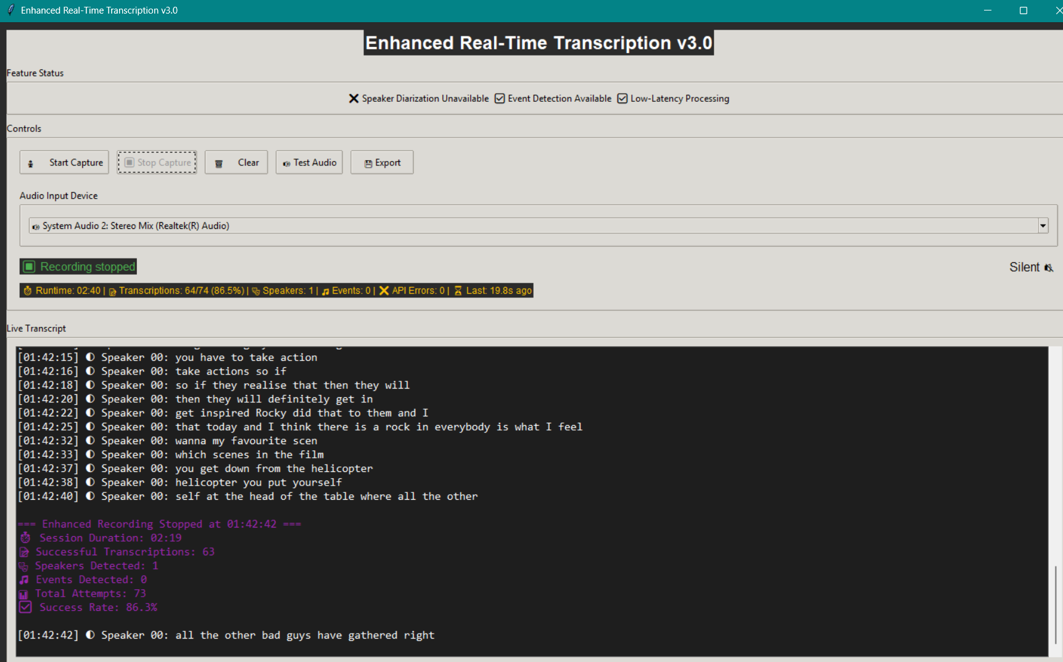
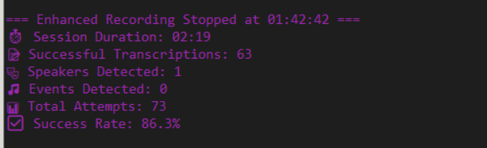
Partial demonstration:

Slide 30
Conclusion
This project is a real-time system that listens to all sounds from a computer, like video calls or media, and turns them into live captions. It can understand different languages, tell who is speaking, detect emotions in voices, and give summaries using AI. The goal is to help people, especially those with hearing difficulties, better understand and follow conversations. By combining tools like Whisper, pyannote-audio, and SpeechBrain, the system makes communication more clear, inclusive, and smart. In the future, it can be expanded to work with mobile apps, AR/VR, and more advanced AI assistants.

Slide 31
Reference
[1] Optimizing Vosk Models for Transcribing Educational Lectures in Real Time- Emma O, Mark W. Optimizing Vosk Models for Transcribing Educational Lectures in Real Time.
[2] Improving Speech Recognition Accuracy Using Custom Language Models with the Vosk Toolkit- Soni AA. Improving Speech Recognition Accuracy Using Custom Language Models with the Vosk Toolkit. arXiv preprint arXiv:2503.21025. 2025 Mar 26.
[3] Flexi-Transducer: Optimizing Latency, Accuracy and Compute for Multi-Domain On-Device Scenarios- Mahadeokar, Jay, et al. "Flexi-Transducer: Optimizing Latency, Accuracy and Compute for Multi-Domain On-Device Scenarios." Interspeech. 2021.
[4] Performance Evaluation of Offline Speech Recognition on Edge Devices- Gondi, Santosh, and Vineel Pratap. "Performance evaluation of offline speech recognition on edge devices." Electronics 10.21 (2021): 2697.
[5] MeetDot: Videoconferencing with Live Translation Captions- Arkhangorodsky, Arkady, et al. "MeetDot: Videoconferencing with live translation captions." arXiv preprint arXiv:2109.09577 (2021).

Slide 32
Reference
[6] Automatic captions on video calls: a must for the older adults-Nacimiento-García, Eduardo, Carina S. González-González, and Francisco L. Gutiérrez-Vela. "Automatic captions on video calls: a must for the older adults." Universal Access in the Information Society 23.1 (2024): 75-98.
[7] Streaming End-to-End Multilingual Speech Recognition with Joint Language Identification-Zhang, Chao, et al. "Streaming end-to-end multilingual speech recognition with joint language identification." arXiv preprint arXiv:2209.06058 (2022).
[8] Transcribe-to-diarize: Neural speaker diarization for unlimited number of speakers using end-to-end speaker-attributed ASR-Kanda, Naoyuki, et al. "Transcribe-to-diarize: Neural speaker diarization for unlimited number of speakers using end-to-end speaker-attributed ASR." ICASSP 2022-2022 IEEE International Conference on Acoustics, Speech and Signal Processing (ICASSP). IEEE, 2022.
[9] Integrating Emotion Recognition with Speech Recognition and Speaker Diarisation for Conversations-Wu, W., Zhang, C., & Woodland, P. C. (2023). Integrating emotion recognition with speech recognition and speaker diarisation for conversations. arXiv preprint arXiv:2308.07145.
[10] WhisperX: Time-Accurate Speech Transcription of Long-Form Audio-Bain, Max, et al. "Whisperx: Time-accurate speech transcription of long-form audio." arXiv preprint arXiv:2303.00747 (2023).

Slide 33
THANK YOU

