Slide 1

E-COMMERCE WEBSITE (FabBASKET)
Supervised By:
Mr. Sharad Kumar Sir
Asst. Professor
Department of Computer Engineering & Applications

Slide 2
Submitted by: Kabir Kararia (Univ. Roll No.-171500150) Aditya Vikram Singh (Univ. Roll No.-171500021) Anukriti Pathak (Univ. Roll No.-171500056) Gitansh Sehgal (Univ. Roll No.-171500110) DEPARTMENT OF COMPUTER ENGINEERING APPLICATIONS Institute Of Engineering and Technology GLA University Mathura-281406,INDIA 2020
SUBMITTED BY

Slide 3

OUTLINE
Why E-Commerce??
Introduction
Objectives
Challenges Faced
Technologies Used
>Front end
>Database
>Back end
Screenshots
Future Scope
References

Slide 4
Why E-Commerce Website ?
WHY??
Global Market
Open All Hours
Higher Conversion Rate
Personalisation
Marketing Through Social Media & Search Engines
Less Overheads

Slide 5
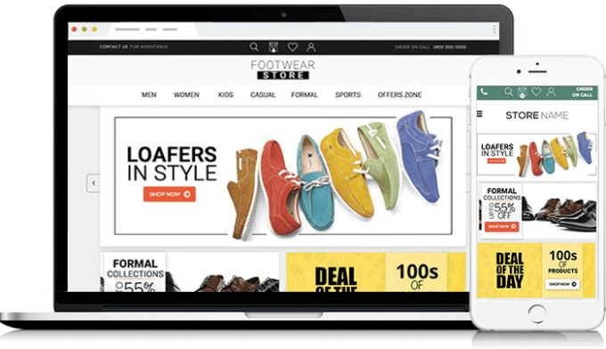

Slide 6
INTRODUCTION
INTRODUCTION
E-Commerce websites are online portals that facilitate online transactions of goods and services through means of the transfer of information and funds over the Internet.
Selling products through an online shop is the best way to make a bit of extra money, one can easily introduce your products to a large number of customers at once.
An E-commerce platform will play an important role to push Indian economy.

Slide 7
OBJECTIVES
OBJECTIVES
From the website we will be able to order multiple items in one go.
The interface will be easy to use & website will quickly scale with increasing traffic load.
The customer will be able choose products from long list and order them easily.
For authentication we will have password-based service.
After an order is placed, the customer will get an email receipt confirming the placement of his/her order.
Every email receipt has unique ID to track each order.

Slide 8
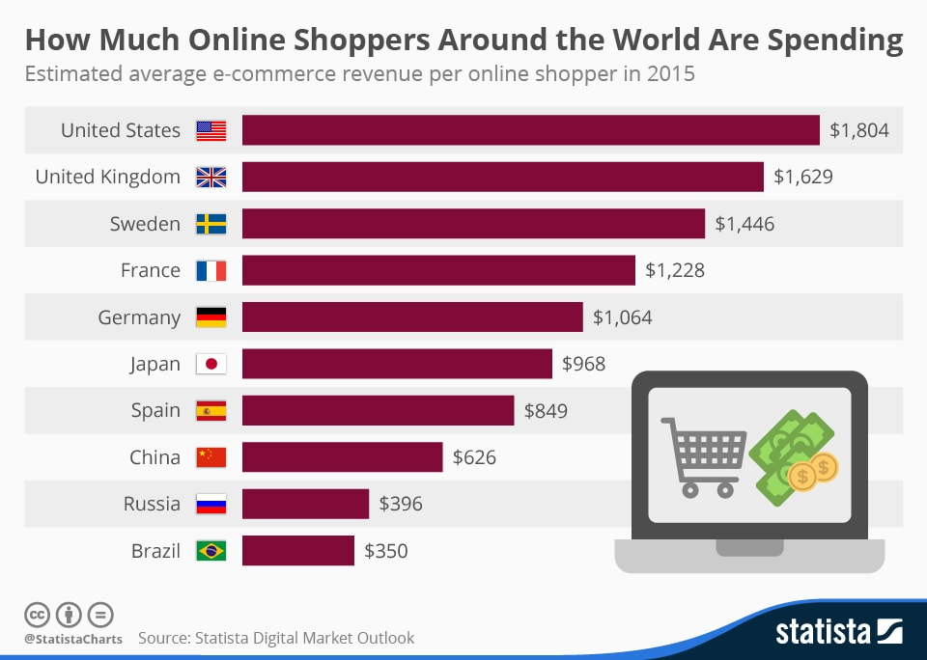

Slide 9
CHALLENGES FACED
CHALLENGES FACED
Suspicious Reviews
Neglecting SEO
Slow Online Store Website Speed
Digital Payment Failures
Unfriendly Returns Policy
Images not done right

Slide 10
TECHNOLOGIES USED
TECHNOLOGIES USED
FRONT END
We have made use of HTML , CSS and Javascript and Bootstrap templates for designing the user interface of the website.
HTML-is the standard markup language for documents designed to be displayed in a web browser.
CSS-is a style sheet language used for describing the presentation of a document written in HTML.
JAVASCRIPT-JavaScript is the programming language of HTML and the Web.
BOOTSTRAP-Bootstrap is a free and open-source CSS framework directed at responsive, mobile-first front-end web development.

Slide 11
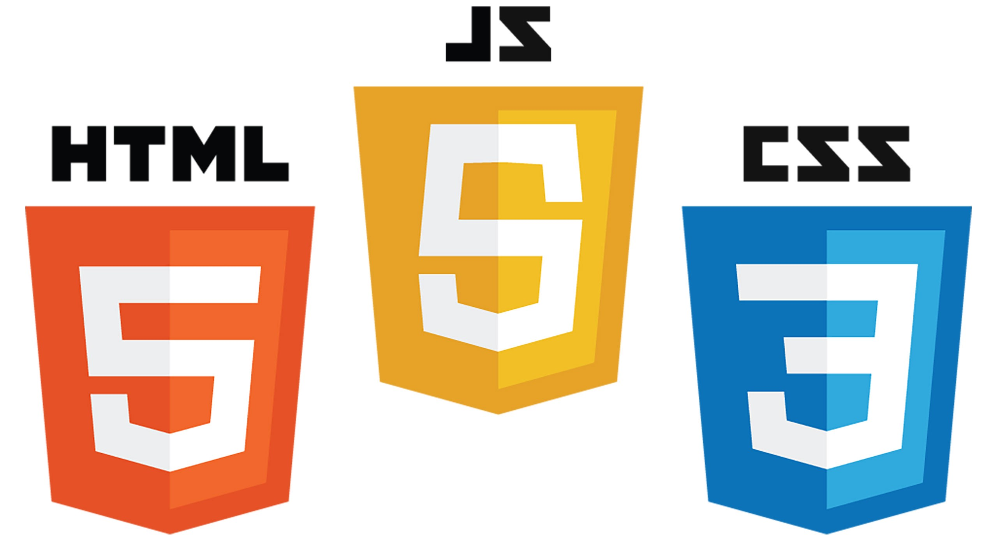

Slide 12
DATABASE
Firebase is used for database.
The Firebase Realtime Database lets you build rich, collaborative applications by allowing secure access to the database directly from client-side code.
Data is persisted locally, and even while offline, realtime events continue to fire, giving the end user a responsive experience.
The Realtime Database is a NoSQL database.

Slide 13


Slide 14
BACK END
We have used Nodejs and Express for back end.
Node.js is an open-source, cross-platform, JavaScript runtime environment that executes JavaScript code outside of a web browser.
Express is a minimal and flexible Node.js web application framework that provides a robust set of features for web and mobile applications.

Slide 15


Slide 16

SCREENSHOTS

Slide 17
HOME PAGE

Slide 18
HOME PAGE

Slide 19
PRODUCT PAGE

Slide 20
LOGIN PAGE

Slide 21
CART PAGE

Slide 22
ABOUT US

Slide 23
CONTACT US

Slide 24
ORDER PLACED

Slide 25
FUTURE SCOPE
FUTURE SCOPE
Drone Delivery
App only Approach
Google's Buy Now Button
Artificial Intelligence
Ecommerce personalization will be a standard

Slide 26
REFERENCES
https://firebase.google.com/
https://inurture.co.in/blogs/rise-e-commerce-industry-india/
https://semantic-ui.com/
https://www.wikipedia.org/

Slide 27
THANK YOU

