Slide 1


Project - 2
Tic Tac Toe Game with Minimax and Alpha-Beta Pruning Algorithm
Course title: Artificial Intelligence Lab
course code: cse 404
Submitted By:
Md. Meherub Hossain Yemon(20201037)
Md. Raihan Kabir (20201048)
Md.Sohel Rahman (20201054)
Nooruddin Ahammed(19201011)
Section :A2
Submitted To:
Dr. Nasima Begum
Assistant Professor, CSE Department
University of Asia Pacific

Slide 2

CONTENTS
GOAL OF PROJECT
PROBLEM STATEMENT
ADVERSARIAL SEARCH
MINIMAX ALGORITHM
ALPHA-BETA PRUNING
ILLUSTRATION OF TIC TAC TOE
GAME MODES
FUNCTIONS
INPUT
OUTPUT
PROJECT REPORT’S LINK
SOURCE CODE’S LINK
CONCLUSION

Slide 3

GOAL OF PROJECT
Goals for Implementing Tic Tac Toe Game with Minimax and Alpha-Beta Pruning:
Create a functional Tic Tac Toe game.
Implement the Minimax algorithm for optimal AI decision-making.
Integrate Alpha-Beta pruning to enhance algorithm efficiency.
Allow human and AI interaction within the game.
Check and declare win or draw conditions.

Slide 4

PROBLEM STATEMENT
Implement Tic Tac Toe Game with Minimax and Alpha-Beta Pruning Algorithm.
In this assignment, we need to implement the classic game of Tic Tac Toe as an adversarial search problem and develop an AI player using the minimax algorithm with alpha-beta pruning.
We have to create a program that allows human vs. computer and computer vs. computer gameplay and should print the game board on the console after every move.

Slide 5

ADVERSARIAL SEARCH
Adversarial search refers to a search algorithm applied in games where multiple participants take turns, aiming to maximize their own benefits while minimizing their opponents' gains. When developing a Tic Tac Toe game employing adversarial search, it's commonly employed to craft a smart computer player (AI) capable of making strategic and nearly perfect moves in reaction.

Slide 6
MINIMAX ALGORITHM
The Minimax algorithm is a specialized form of adversarial search technique designed to reduce the potential losses for the player executing a move. It chooses the move that results in the most favorable outcome while taking into account the opponent's optimal counteractions.
Minimax is implemented in Tic Tac Toe to develop a smart computer opponent capable of making the best possible decisions. This is achieved through an assessment of all potential game scenarios while also considering the opponent's likely actions.

Slide 7
ALPHA-BETA PRUNING
Alpha-Beta pruning is a technique used in the Minimax algorithm to reduce the number of nodes evaluated in the game tree. It eliminates branches that cannot possibly influence the final decision, making the search more efficient.
In Tic Tac Toe, which has a relatively small game tree, Alpha-Beta pruning is still valuable for optimizing the AI's decision-making process, ensuring it reaches the best move more quickly by reducing unnecessary evaluations of unfruitful game states.

Slide 8
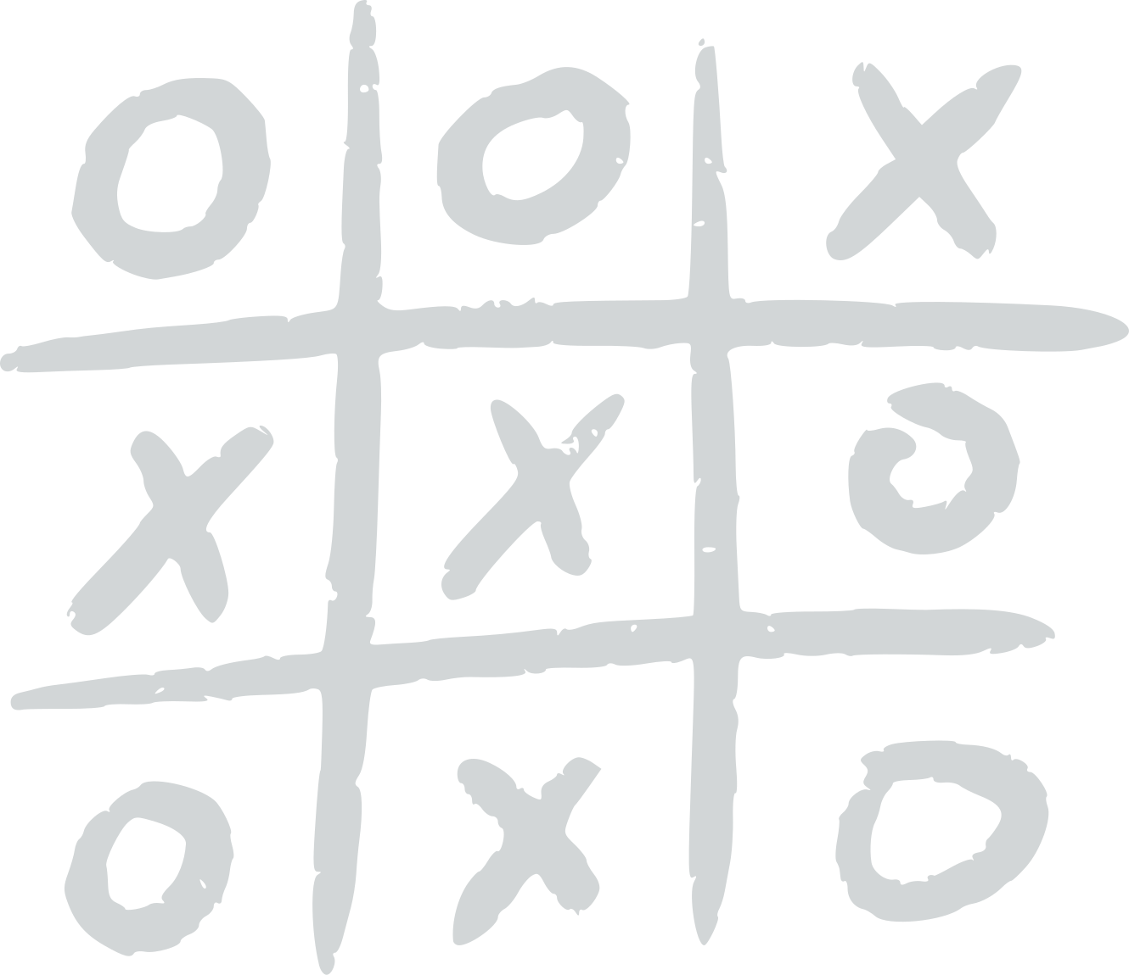


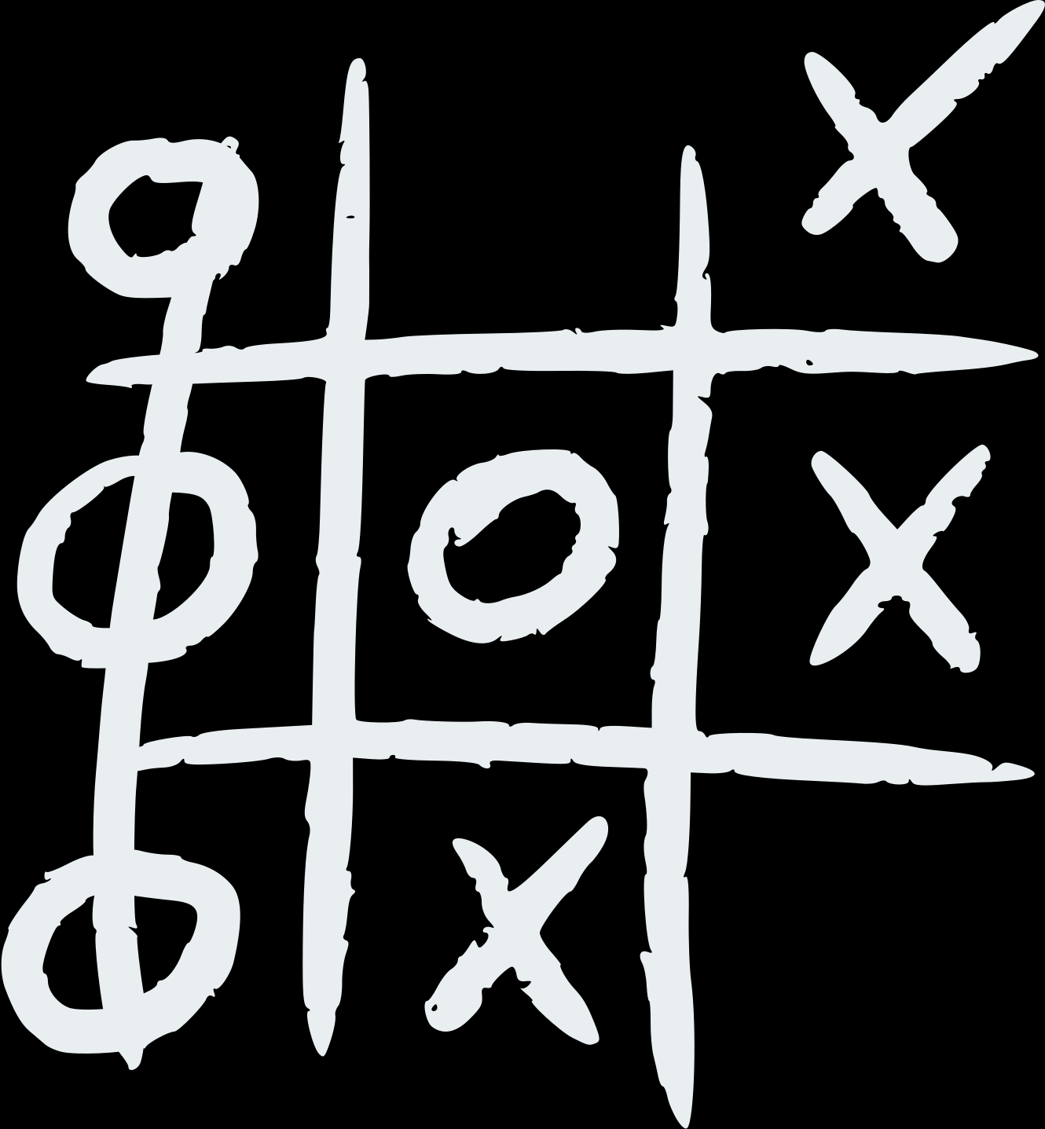
ILLUSTRATION OF TIC TAC TOE
Diagonally
VERTICALLY
DRAW
Horizontally

Slide 9
GAME MODES
THERE ARE TWO TYPES OF GAME MODES:
HUMAN VS COMPUTER: A GAME MODE WHERE A HUMAN PLAYS AGAINST A COMPUTER OPPONENT.
COMPUTER VS COMPUTER: A GAME MODE WHERE TWO COMPUTER PROGRAMS OR AI AGENTS PLAY AGAINST EACH OTHER.

Slide 10

FUNCTIONS
def print_board(board)
# Function to print the game board
def is_game_over(board):
# Function to check if the game is over
def is_winner(board, player):
# Function to check if a player has won
def evaluate_board(board, player):
# Function to evaluate the board for the AI player
def minimax(board, depth, alpha, beta, maximizing_player, player):
# Minimax algorithm with Alpha-Beta Pruning
def get_opponent(player):
# Function to get the opponent's symbol
def make_ai_move(board, player, depth, ai):
# Function to make the AI's move in Human vs AI and AI vs. AI move

Slide 11
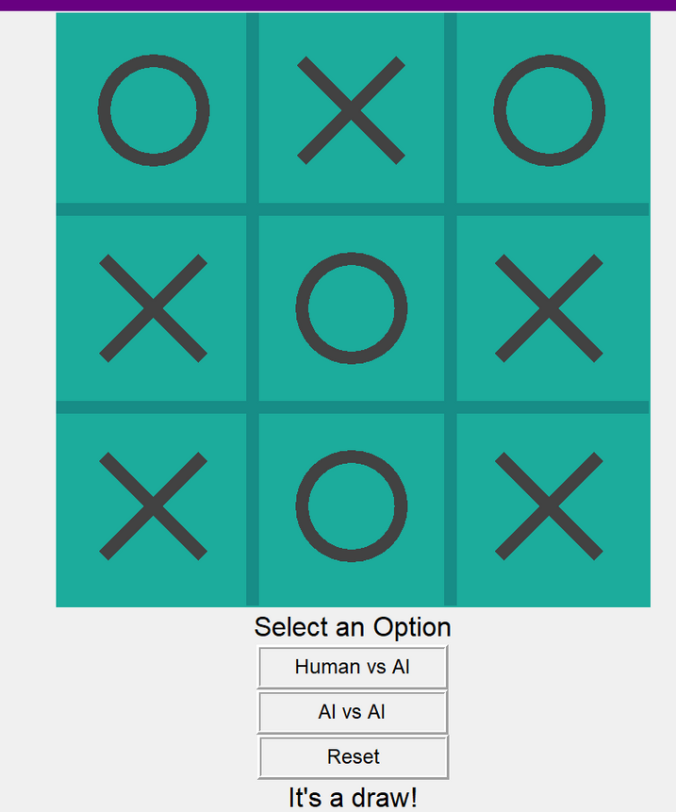
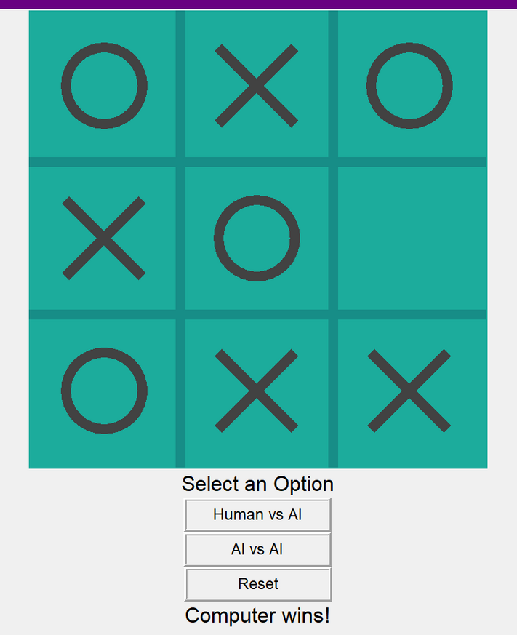
INPUT OUTPUT FOR HUMAN VS AI

Slide 12
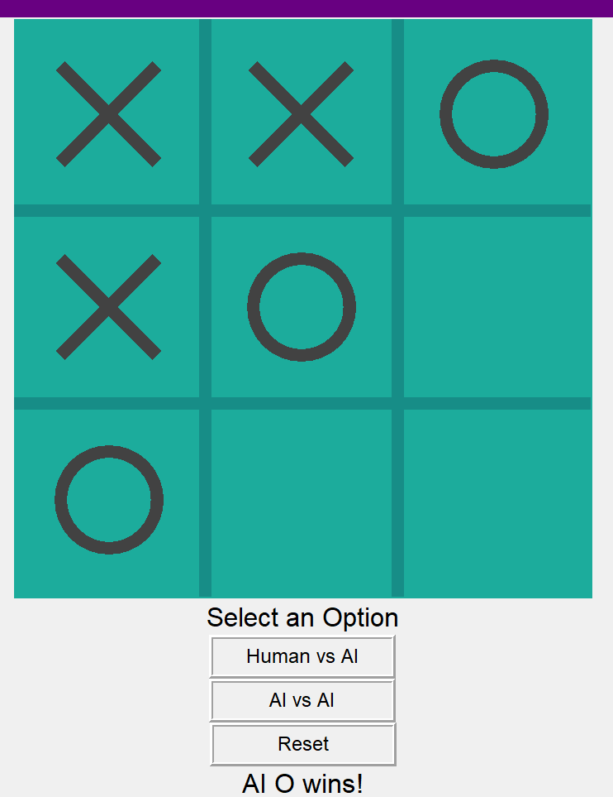
INPUT OUTPUT FOR AI VS AI

Slide 13
TECHNICAL REPORT
REPORT LINK: CLICK HERE

Slide 14
SOURCE CODE
SOURSE CODE LINK : CLICK HERE

Slide 15
CONCLUSION
TIC TAC TOE, WITH THE MINIMAX ALGORITHM AND ALPHA-BETA PRUNING, HIGHLIGHTS HOW ARTIFICIAL INTELLIGENCE AND STRATEGIC DECISION-MAKING WORK TOGETHER.
THIS ENHANCES OUR UNDERSTANDING OF ADVERSARIAL SEARCH AND EFFICIENT ALGORITHMS, WHICH, IN TURN, HELPS US BECOME BETTER AT PROBLEM-SOLVING AND CODING.
IT ALSO PREPARES FOR MORE COMPLEX AI APPLICATIONS.

Slide 16


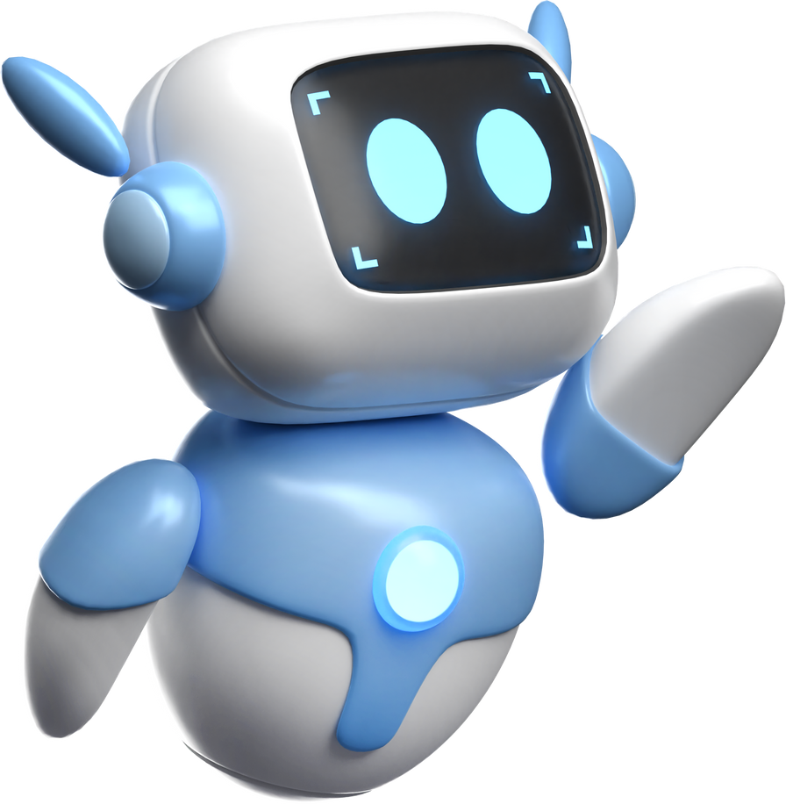
Thank you

