Slide 1

Introduction to Programming
Programming is the process of creating instructions for a computer to perform specific tasks. It is the foundation for developing software, websites, and applications that we use in our daily lives. This introduction will provide a broad overview of the key programming concepts.

Slide 2
Fundamentals of C Programming
Operators and Expressions
Syntax and Structure
Explore the various operators available in C and how to create expressions to perform computations.
Learn the basic syntax, keywords, and structure of the C programming language.
1
2
3
Variables and Data Types
Understand how to declare and use different data types to store and manipulate information.

Slide 3
Data Types and Variables in C
Primitive Data Types
Variable Declaration
Arithmetic Operations
C has several built-in data types such as int, float, double, and char that can be used to store different kinds of data.
Variables are used to store data, and they must be declared with a specific data type before they can be used.
Perform basic arithmetic operations like addition, subtraction, multiplication, and division on variables and values.

Slide 4
Control Structures in C
1
Conditional Statements
2
Loops
3
Switch Statement
Implement different loop structures like for, while, and do-while to repeat a block of code.
Provide a more concise way to handle multiple conditions using the switch statement.
Use if-else statements to make decisions based on certain conditions.

Slide 5
Functions and Arrays in C
Functions
Arrays
Learn how to define, call, and pass arguments to reusable blocks of code called functions.
Store and manipulate collections of data using one-dimensional and multi-dimensional arrays.
Pointers
String Manipulation
Understand how to use pointers to access and modify memory locations, which is a powerful feature in C.
Work with strings, including reading, writing, and performing operations on character arrays.

Slide 6




Introduction to C++
Object-Oriented
Standard Library
Performance
Compatibility
C++ is an object-oriented programming language that allows you to create and work with objects.
C++ has a large and powerful standard library that provides a wide range of functionality.
C++ is known for its speed and efficiency, making it a popular choice for systems programming.
C++ is compatible with C, allowing you to use both languages together in your projects.

Slide 7
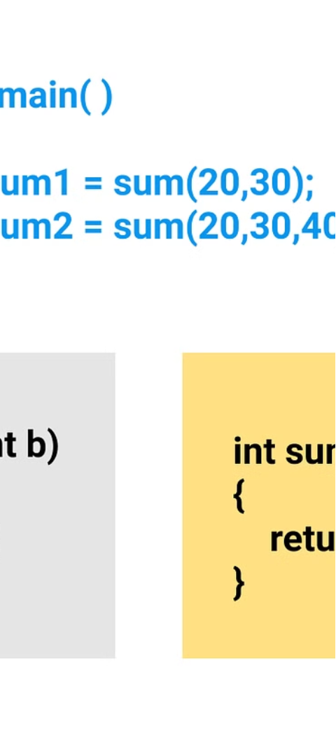



Object-Oriented Programming in C++
Classes
Learn how to define and use classes to create custom data types in C++.
Inheritance
Understand the concept of inheritance, which allows you to create new classes based on existing ones.
Polymorphism
Explore how polymorphism enables objects of different classes to be treated as the same type.

Slide 8

Conclusion and Resources
1
Recap
2
Next Steps
We've covered the fundamentals of C and C++, from data types and control structures to object-oriented programming.
Continue your learning journey by practicing coding exercises, exploring online tutorials, and building personal projects.
3
Resources
Check out recommended books, websites, and online courses to further enhance your programming skills.

