Slide 1
Testing vertical influences on greenhouse gas fluxes (CO₂, CH₄ and N₂O) along tropical tree stems
Kabi Raj Khatiwada¹, Ivan A. Janssens², Andreas Richter³, Benjamin Runkle⁴, Clément Stahl⁵, Laëtitia M. Bréchet⁵
¹Environmental Dynamics Program, University of Arkansas, Fayetteville, AR 72701, USA
²Center of Excellence Global Change Ecology, Department of Biology University of Antwerp, Universiteitsplein 1, B-2610 Wilrijk, Belgium
³University of Vienna, Centre for Microbiology and Environmental Systems Science, Djerassiplatz 1, 1030 Wien, Austria
⁴Biological and Agricultural Engineering, University of Arkansas, Fayetteville, AR 72701, USA
⁵INRAE, UMR EcoFoG, CNRS, CIRAD, AgroParisTech, Université des Antilles, Université de Guyane, 97310 Kourou, France
Monday, 04 May, 17:40 CEST / 10:40 CT

Slide 2
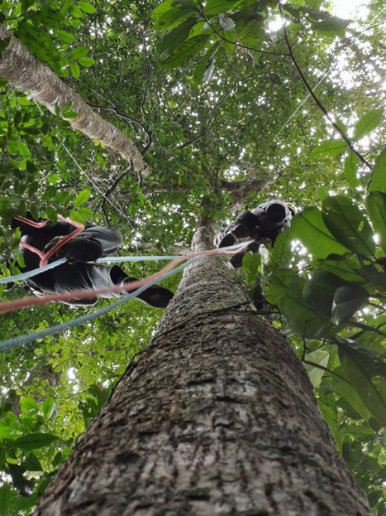
Many thanks
Jocelyn Cazal for installing the tree-climbing system
Jean-Yves Goret and Warren Daniel for their help in constructing the chambers and conducting gas measurements
Landscape Flux Group at the University of Arkansas, Fayetteville, AR
FLUXNET Secondment program awarded to K. Khatiwada and L. Bréchet
IMBALANCE-P European Research Council Synergy grant
RainForest-GHG Marie Skodowska-Curie Individual Fellowship
Research Fund of the University of Antwerp
Gordon and Betty Moore Foundation and Stanford University
National Research Institute for Agriculture, Food and Environment (INRAE)
Investissement d’Avenir grant, LabEx CEBA

Slide 3

Background
Methods
Results
Take home message
Let’s imagine this as a tree from a tropical forest

Slide 4
Background
Tropical forests are now widely recognized as pathways for the flux of GHGs such as carbon dioxide (CO₂), methane (CH₄), and nitrous oxide (N₂O) through tree stems (Covey et al., 2012; Pangala et al., 2017).
  Higher CO₂ fluxes in the upper canopy (Cavaleri et al., 2006) or at the stem base (Kunert, 2018).
  Stem CH₄ fluxes generally decreased with height along the tree stem (Pangala et al., 2013).
  Stem N₂O fluxes generally remain low, with no distinct vertical variation in tropical, temperate, or other forest biomes.
Studies have shown high temporal variation in stem GHG fluxes that were closely linked with sap flow (Barba et al., 2024), humidity and pH (Moisan et al., 2025), soil moisture (Covey et al., 2012), internal decay and microbial processes (Covey & Megonigal, 2019; Kirschke et al., 2013).

Slide 5
Background
Most studies on vertical variation in GHG fluxes have focused predominantly on:
  lower stem sections,
  only on one of the GHGs.
We still lack clear picture of how major GHGs change,
  from the forest floor to the canopy height.
Creating uncertainties in contributions from trees?
Study | GHG measured | Measurements heights (m)
Epron et al. (2025) | CH₄ | up to 12 m above ground
Klaus et al. (2024) | CO₂, CH₄, N₂O | 0.35, 0.75, 1.55
Jeffrey et al. (2023) | CH₄ | 0.3,0.55,0.9, 1.2
van Haren et al. (2021) | CO₂, CH₄ | 0.07 to 4.91 m
Katayama et al. (2019) | CO₂ | 1, 22, 32
Barba et al. (2019) | CO₂, CH₄, N₂O | 0.75, 1.5
…………

Slide 6
Questions we are trying to answer
In tropical forests on upland soils,
how does stem CO₂, CH₄ and N₂O fluxes change with an increase with height?
Is there a consistent pattern of GHG fluxes along the tree height continuum?
  Emissions decrease from the stem base to the canopy ?
  A fixed height from where a tree shifts from net source to net sink or vice versa?
Can we expect tree traits to explain the variability in the vertical net GHG fluxes?

Slide 7
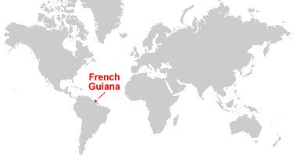
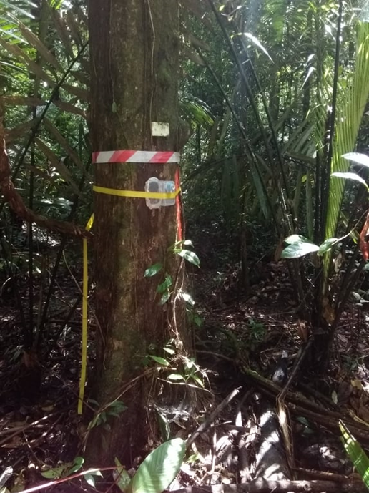
Methods
Paracou research station (5°50’N, 52°55’W),
located in the coastal region of French Guiana, South America.
(March 2020)
Eight measurements were taken along the tree stems
from the base to the canopy,
at 0.5 m, 1.3 m, 2 m, 5 m, 10 m, 20 m, 28 m, and 29 m
(For one tree canopy height measurements were at 20 m, 21 m).
Three trees were measured as individual entities,
trees Tr1 and Tr2 (Fabaceae) and tree Tr3 (Lecythidaceae),
both of which belong to dominant families at the study site.

Slide 8
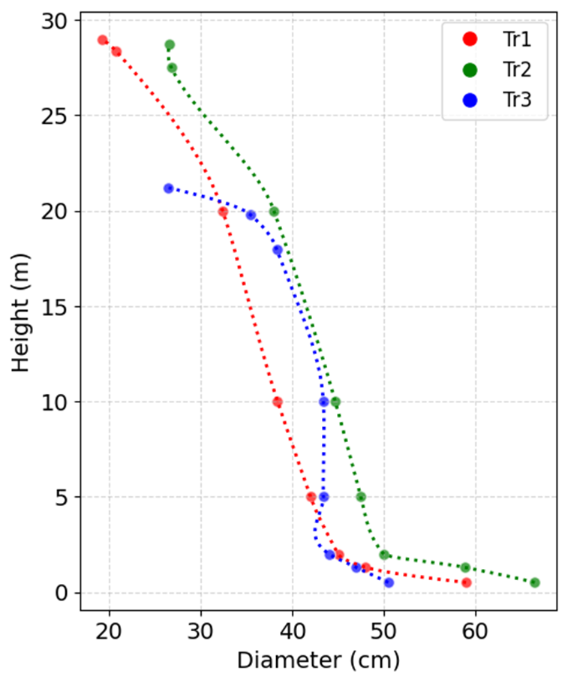
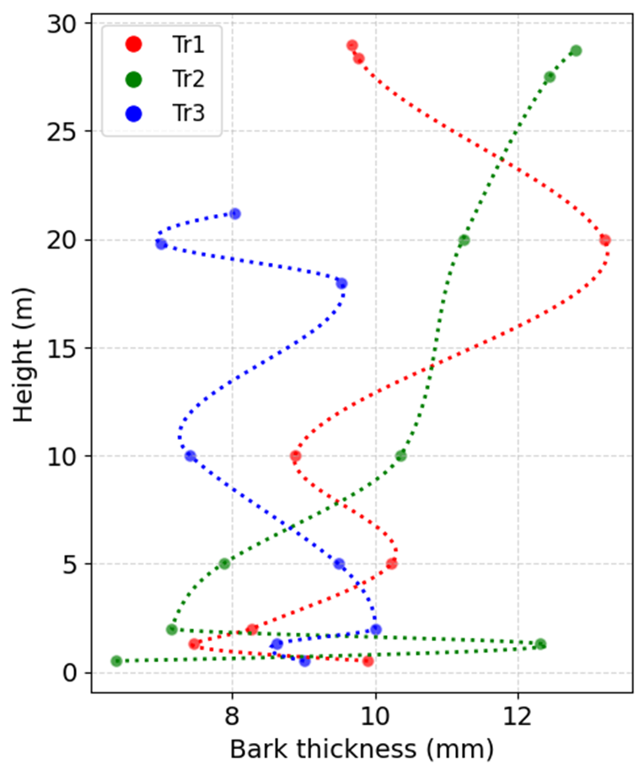
Results

Slide 9
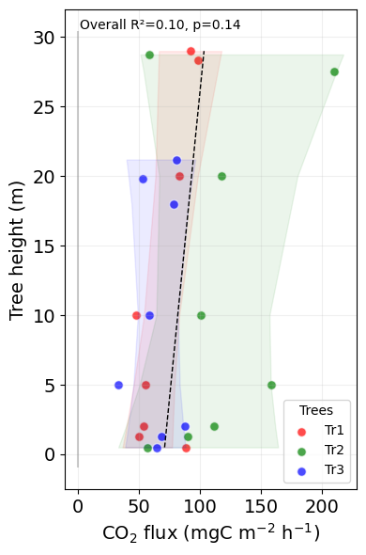

How does stem CO₂, CH₄ and N₂O fluxes change with an increase with height ?
All three trees had similar CO₂ fluxes (50 -100 mg C m⁻² s⁻¹) up to ~3 m along the tree stem, and beyond that, each tree showed distinct patterns up to a canopy height.
The mean fluxes of Tr1 and Tr3 were comparable, i.e., 90 (± 50) mg C m⁻² s⁻¹, however, the mean of Tr2 was much higher 130 (± 60) mg C m⁻² s⁻¹.

Slide 10
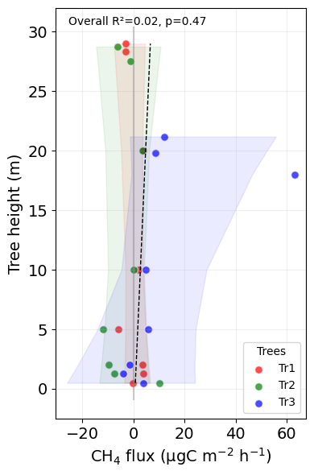
How does stem CO₂, CH₄ and N₂O fluxes change with an increase with height ?
There were no clear vertical patterns of CH₄ flux along the tree stems:
  At 1.3 m, only Tr1 emitted CH₄, while
  at the heights of 5 m, only Tr3 emitted.
No clear pivotal point for the change in the flux behavior

Slide 11
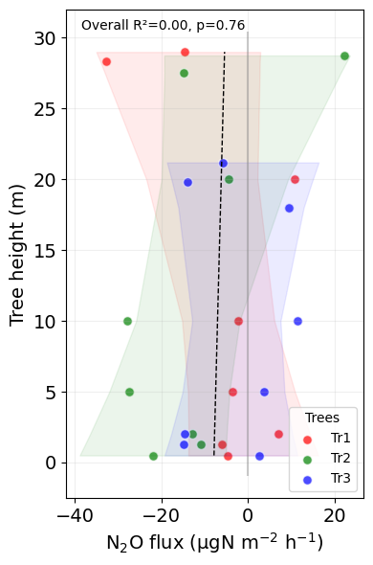
How does stem CO₂, CH₄ and N₂O fluxes change with an increase with height ?
Stem N₂O fluxes were either emissions or uptake depending on the height and the tree.
It is difficult to generalize and mean of fluxes of the trees were near to zero.

Slide 12
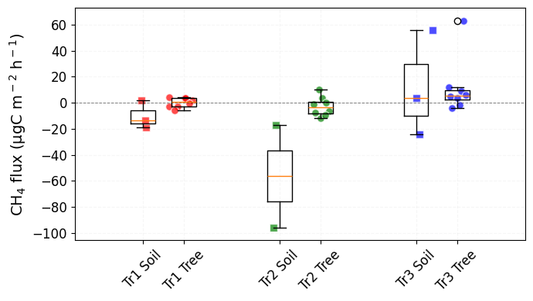
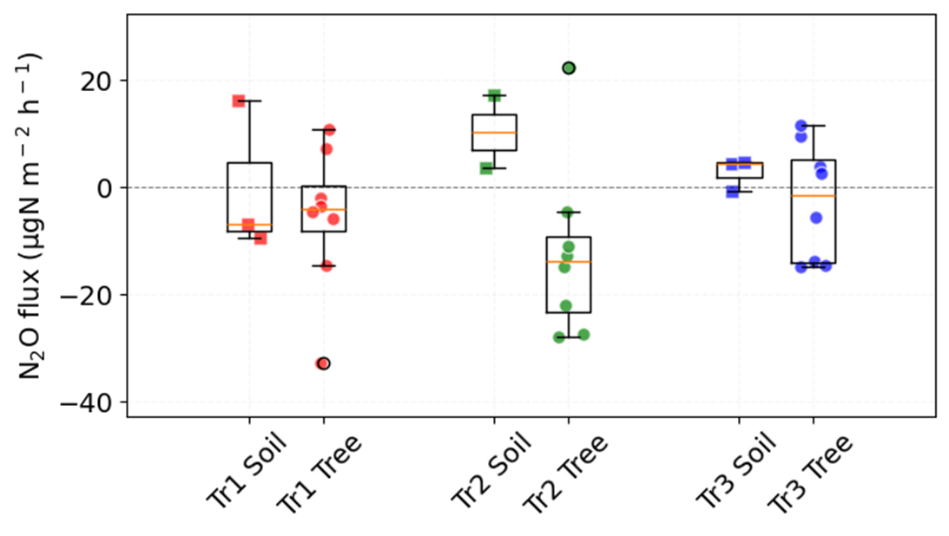
Soil as source of forest fluxes ?
For CH₄ flux:
Forest floor around the trees showed both uptake (~100 µg C m⁻² s⁻¹) and emission (~60 µg C m⁻² s⁻¹).
For N₂O flux:
Forest floor showed variability of 10 (± 10) µg N m⁻² s⁻¹ for Tr2, and 3 (± 3) µg N m⁻² s⁻¹ for Tr3.

Slide 13
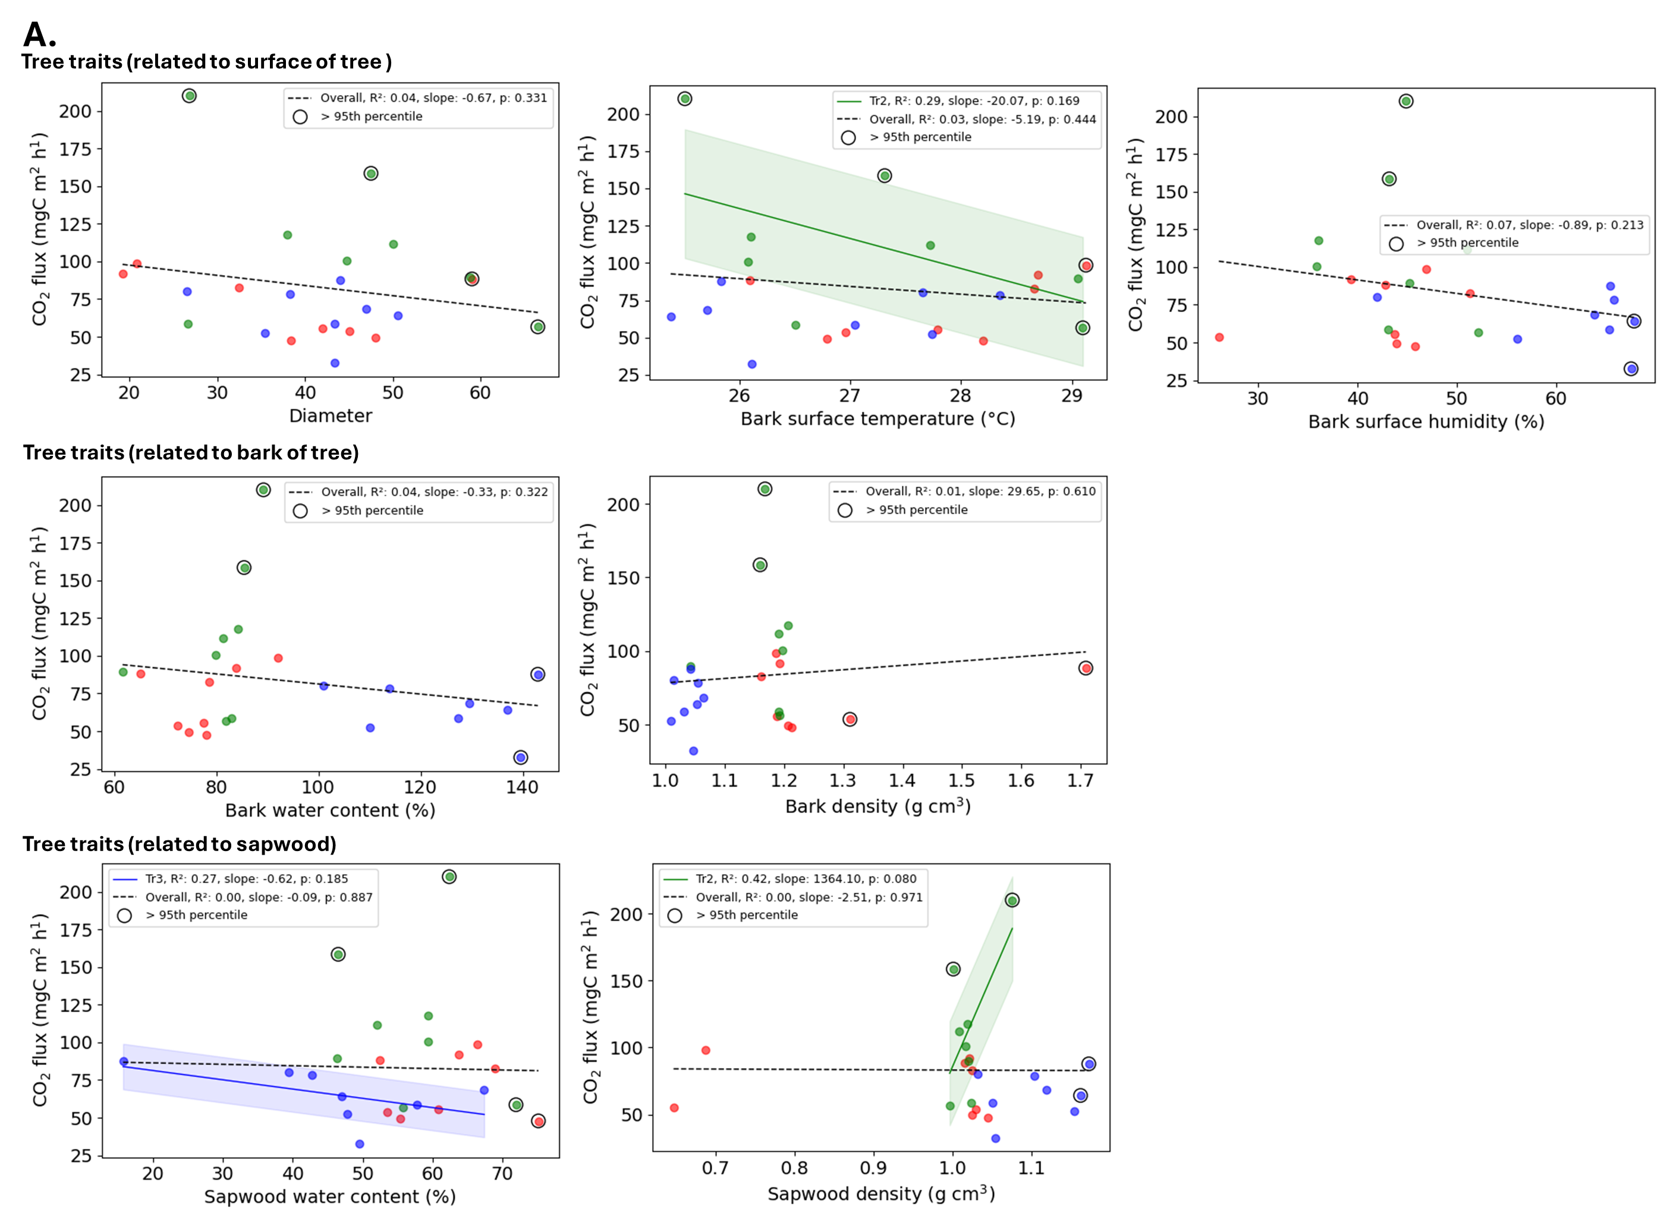
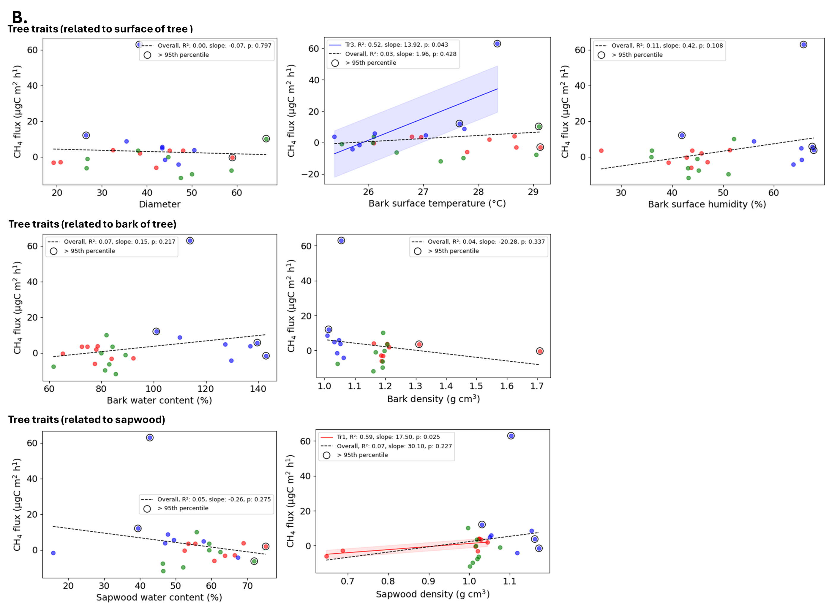
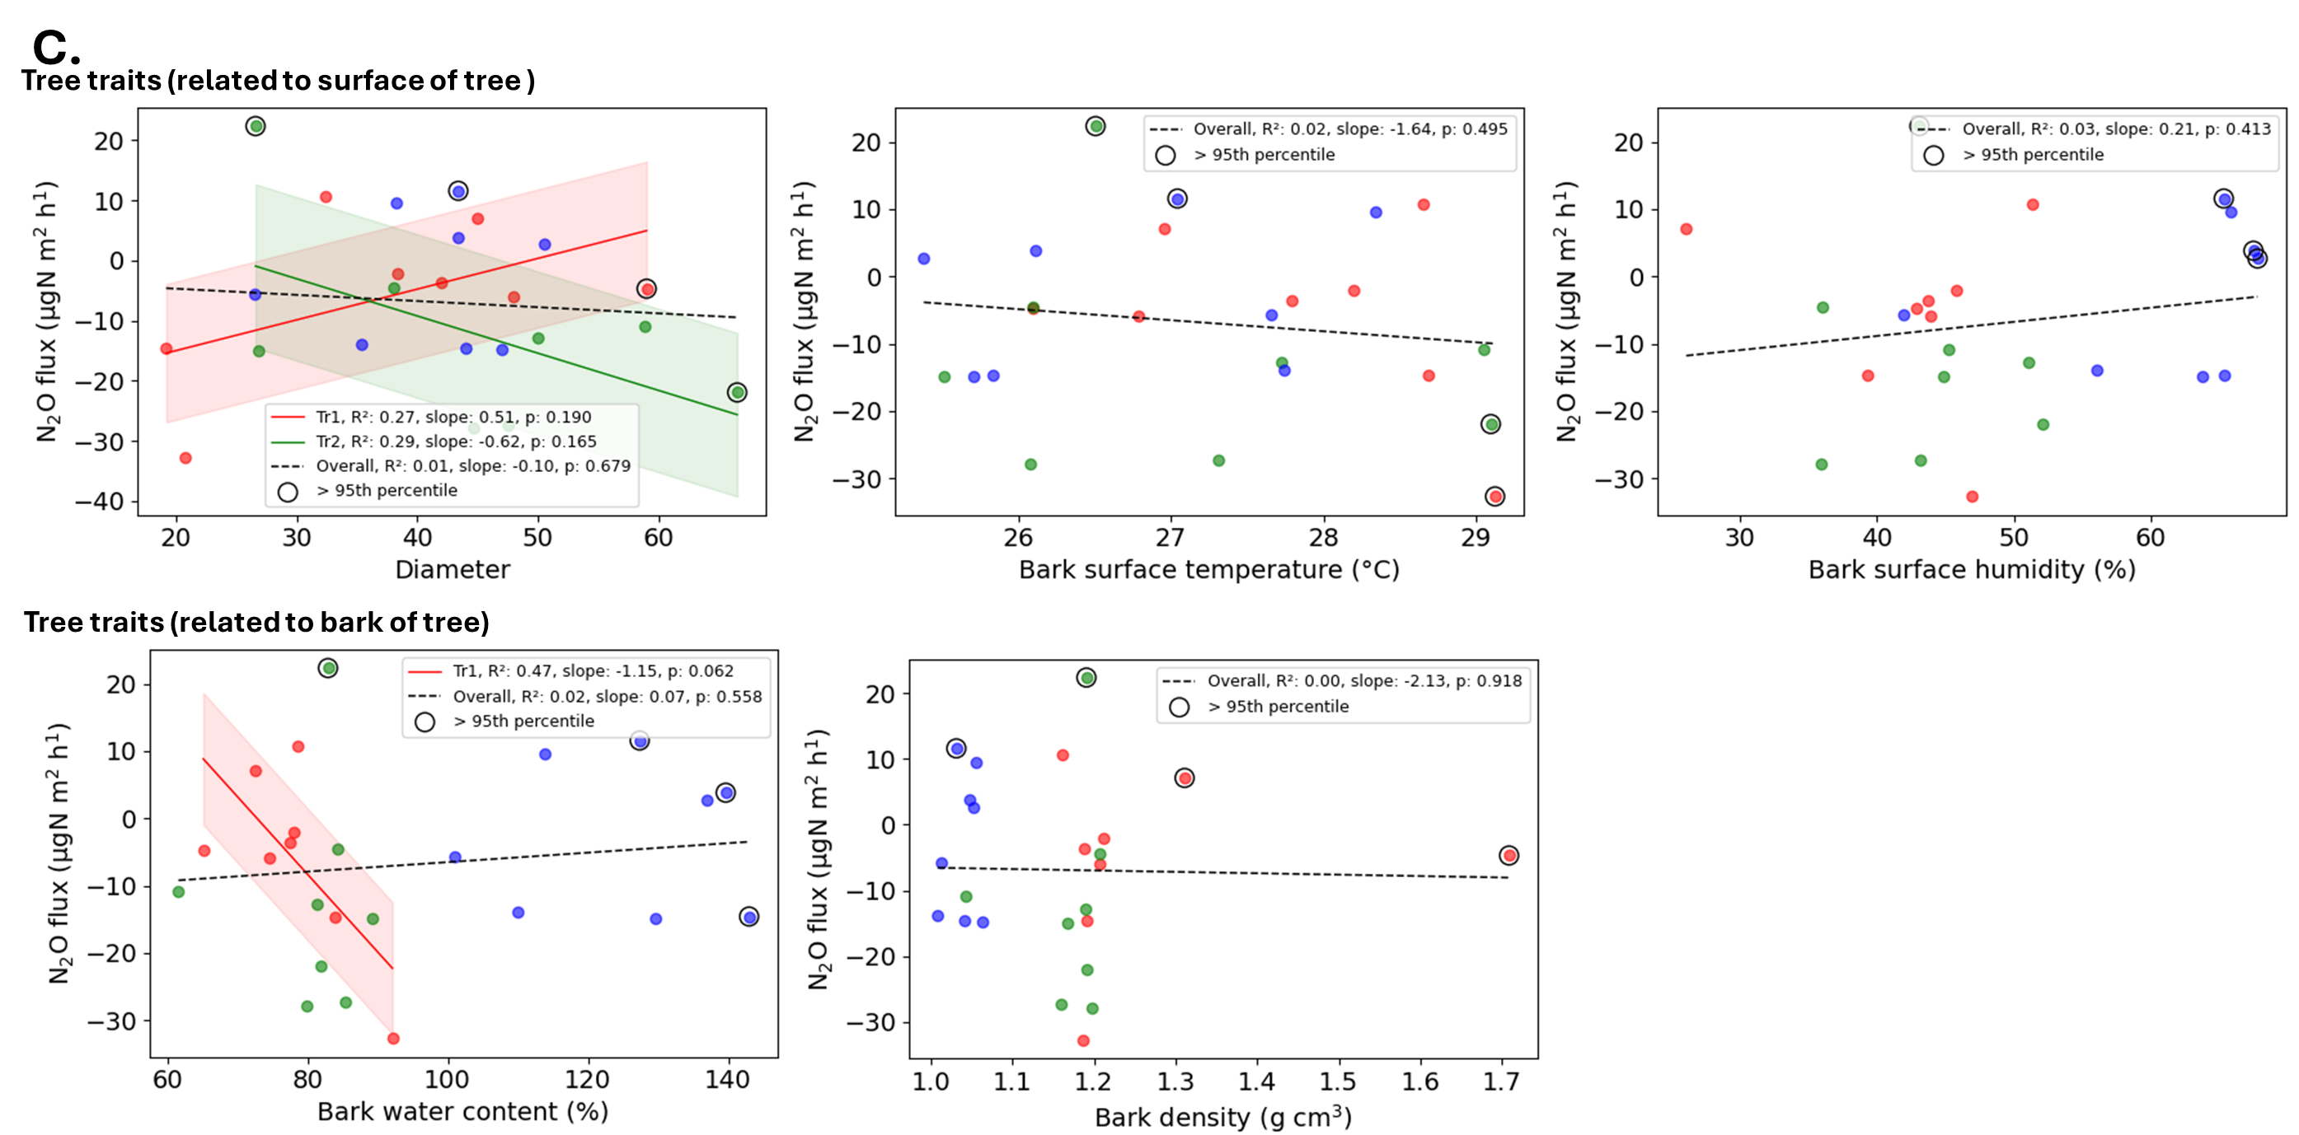
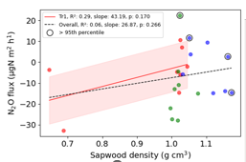
Stem traits as determinants of stem GHG fluxes ?

Slide 14
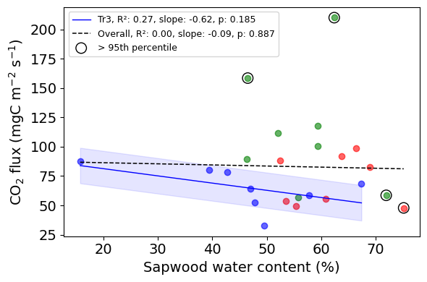
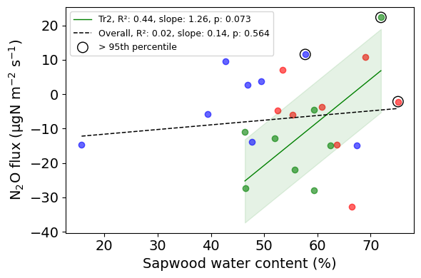
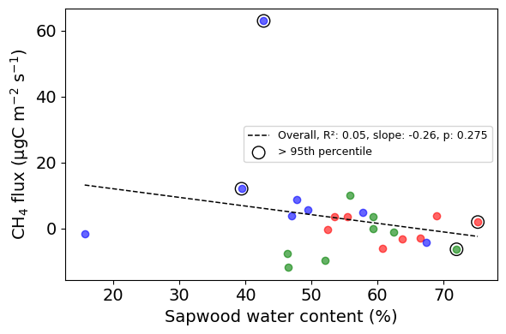
Stem traits as determinants of stem GHG fluxes ?
Some tree traits seem linear to the fluxes (R² > 0.25),
they failed to reach statistical significance of 5%.
Figure: Linear relationships between flux and tree traits.
Each tree is represented by a unique circular color: Tree 1 in red, Tree 2 in green, and Tree 3 in blue.
Data points exceeding the 95th percentile in overall flux or tree traits value are circled in black.
The overall linear fit considering all data (black dashed line) is shown for all the plots, while individual tree regression lines and shading of ±1 residual standard deviation are shown only when R2 > 0.25 or p-value < 0.05.

Slide 15
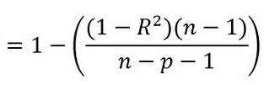
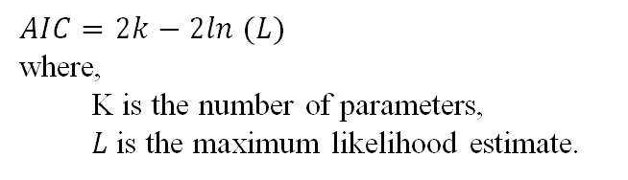
Multiple linear regression models
Two model selection criteria:
Akaike information criterion (AIC)
Adjusted R²
$$AIC=2k−2ln (L)$$
where,
  K is the number of parameters,
  $L$ is the maximum likelihood estimate.
Why these criteria?
Penalizes model with more parameters or sample size
Balance goodness-of-fit, avoid overfitting by discouraging unnecessary complexity
adj_R²
where,
  R² is the regular R-squared,
  n is the number of observations,
  p is the number of predictors in the model.
Selected three best models from each selection criteria

Slide 16
Stem traits as determinants of stem GHG fluxes ?
Output flux | Tree traits | AIC | adj_R2 | p-value | Both criteria
CO₂ flux (mg C m⁻2 h⁻¹) | Bark surface humidity | 244.90 | 0.03 | 0.21 | False
 | Bark thickness | 244.00 | 0.06 | 0.12 | False
 | Bark surface humidity, Bark thickness | 244.83 | 0.07 | 0.19 | False
 | Diameter, Bark surface temperature, Bark water content, Sapwood water content | 245.49 | 0.10 | 0.20 | False
 | Diameter, Bark surface temperature, Bark surface humidity, Bark water content, Sapwood water content | 246.19 | 0.10 | 0.23 | False
 | Diameter, Bark surface temperature, Bark water content, Bark thickness, Sapwood water content | 246.94 | 0.07 | 0.28 | False
CH₄ flux (µg C m⁻² h⁻¹) | Bark surface humidity | 195.46 | 0.07 | 0.11 | False
 | Bark surface temperature, Bark surface humidity | 196.06 | 0.08 | 0.15 | False
 | Bark surface temperature, Bark surface humidity, Sapwood density | 196.20 | 0.11 | 0.16 | False
 | Bark surface temperature, Bark water content, Sapwood density | 196.03 | 0.12 | 0.15 | True
 | Bark surface temperature, Bark water content, Bark density, Sapwood density | 197.37 | 0.09 | 0.22 | False
N₂O flux (µg N m⁻² h⁻¹) | Bark thickness | 195.07 | 0.03 | 0.22 | False
 | Sapwood density | 195.36 | 0.01 | 0.27 | False
 | Bark surface humidity, Bark thickness | 195.68 | 0.04 | 0.26 | False
 | Bark thickness, Sapwood density | 195.17 | 0.06 | 0.21 | True
 | Bark thickness, Sapwood density, Sapwood water content | 196.39 | 0.04 | 0.29 | False
Dominant traits: bark surface humidity, sapwood density, bark surface temperature, bark water content……

Slide 17
Take home message
There was no significant pattern in CO₂, CH₄ and N₂O fluxes with height for three tropical trees.
If you rely on flux assumptions,
recognize their limits before drawing broad conclusions.
There was no clear pivotal point at a given height for the change in the flux behavior.
If someone claims flux shifts from 2 or 3 or X m,
accept it with interest but not as general proof.
Multiple tree traits, related to the surface of the tree, bark and sapwood, co-define the magnitude of the fluxes.
If total tree flux is extrapolated from base height measurements,
encourage reconsideration of linear flux assumptions.

Slide 18

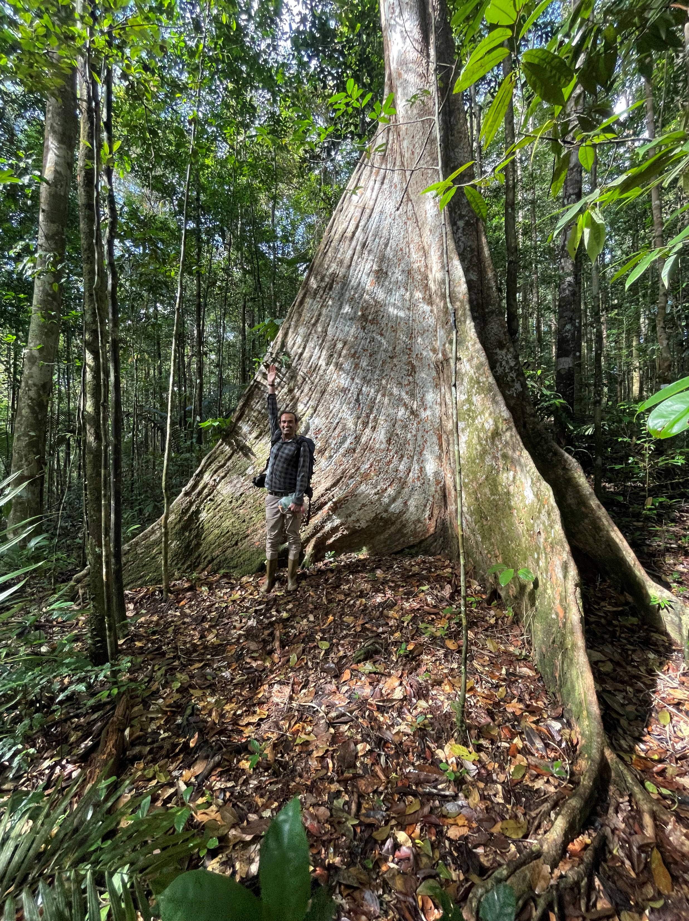




Thank you ☺
Laetitia
Kabi

Slide 19
https://meetingorganizer.copernicus.org/EGU26/EGU26-6055.html
Abstract:
Our knowledge of how greenhouse gas (GHG) fluxes vary from the soil to the tree canopy is limited, particularly in upland tropical rainforests. In this case study, we show changes in the fluxes of the primary GHGs (carbon dioxide (CO₂), methane (CH₄), and nitrous oxide (N₂O)) along the soil - stem continuum, and their relationships with corresponding stem traits at different heights. To do this, we used static chambers to measure the GHG fluxes from three stems, both on the surrounding forest floor and at eight heights ranging from 0.5 m to 30 m, while also assessing tree traits at these heights. We selected representative emergent trees from a tropical forest in French Guiana, South America. We found no clear pattern in the GHG fluxes along the stems, with highly variable CO₂ emissions and alternating CH₄ and N₂O emissions and uptake.
Regression analysis showed that stem traits related to the tree’s surface area, bark, and sapwood partly explain the measured fluxes along the stem height.
For CO₂ fluxes, the best explanatory variables are identified as bark surface temperature, bark water content, and sapwood density; for CH₄ fluxes, the key drivers are tree diameter, bark water content, and bark surface temperature; and for N₂O fluxes, the more influential variables are sapwood density, and sapwood water content. We concluded that the variability in GHG fluxes along the stems was not only specific to tree traits, but also to individual trees. These findings pose a challenge for scaling efforts - it will not be trivial to create bottom-up estimates of tree-impacted fluxes, and a convergence of approaches will be needed to generate a complete GHG balance for these ecosystems.

Slide 20
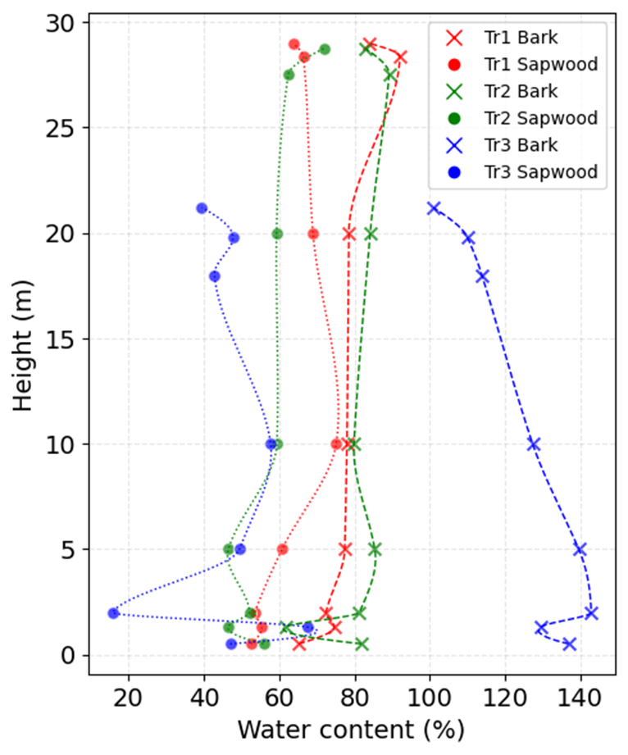
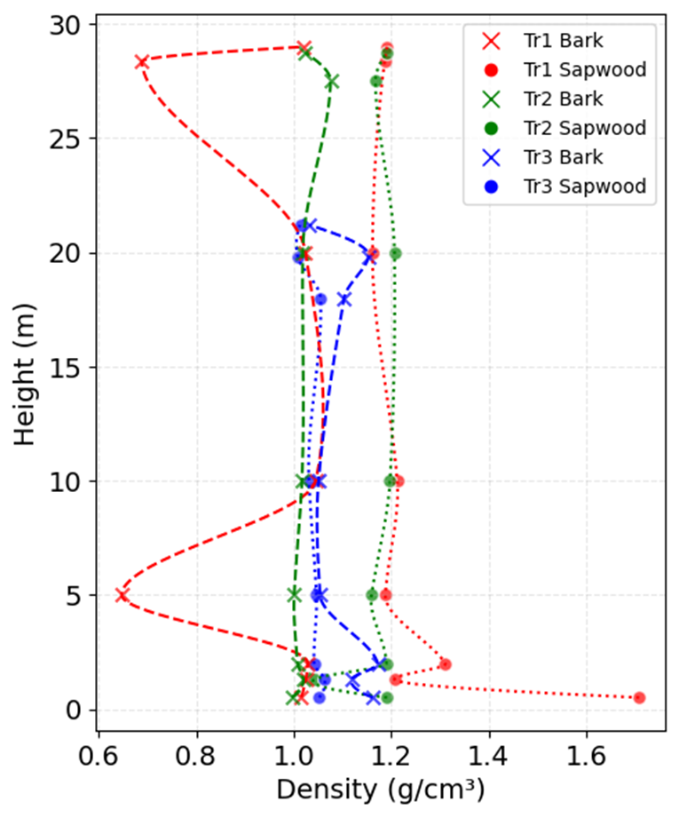
Results

