Slide 1
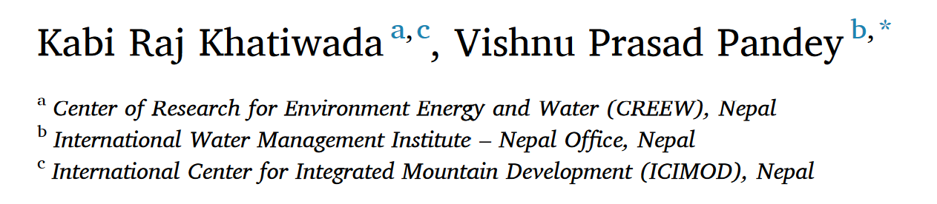
Characterization of hydro-meteorological drought in Nepal Himalaya:
A case of Karnali River Basin
a.
Senior Graduate Assistant, University of Arkansas, Arkansas, US
b.
Professor (Water Resources), Department of Civil Engineering, Pulchowk Campus
Deputy Director, Center for Water Resources Studies (CWRS)
12-14 December, 2022
International Conference on Sudurpaschim Studies

Slide 2
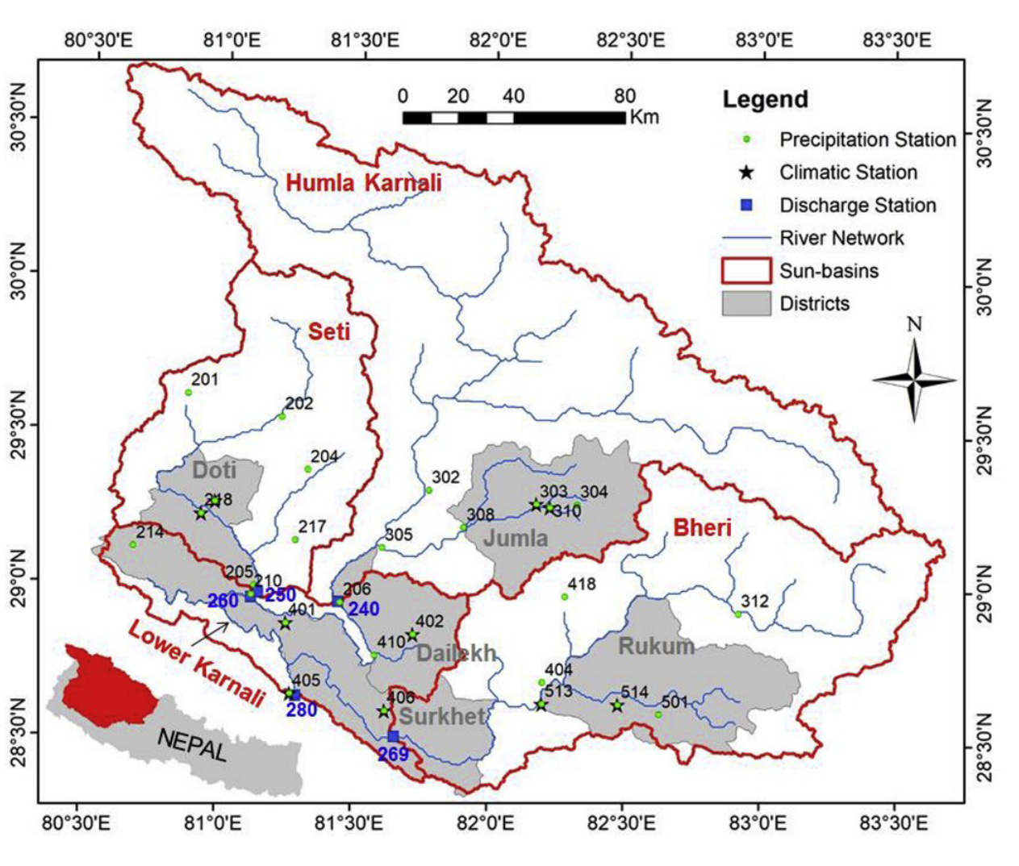
Karnali River Basin
  Area of more than 46,100 km²
  The elevation in the basin varies from 100 to 7 721 m above sea level (masl)
  Major three sub-basins
Location of Karnali River Basin in Nepal and hydro-meteorological stations used in this study.

Slide 3
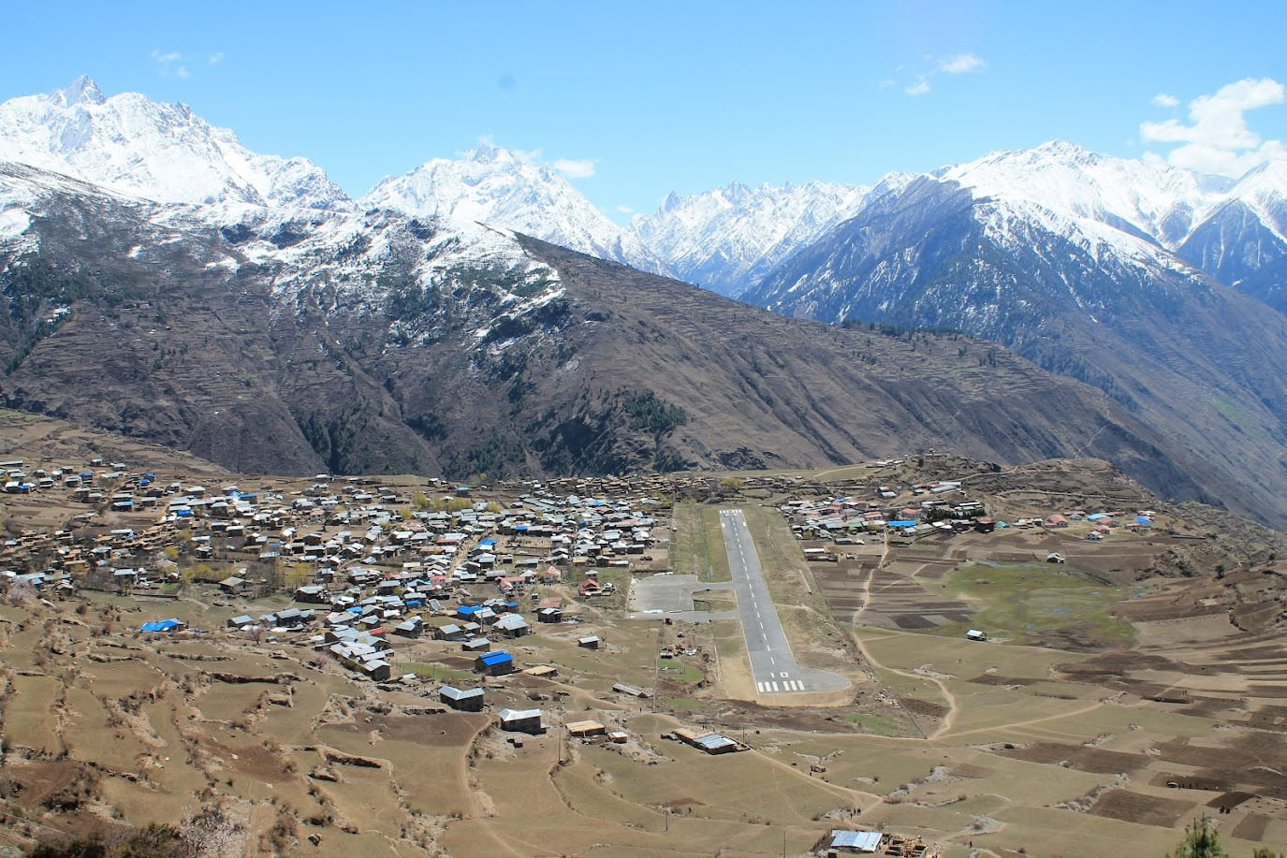
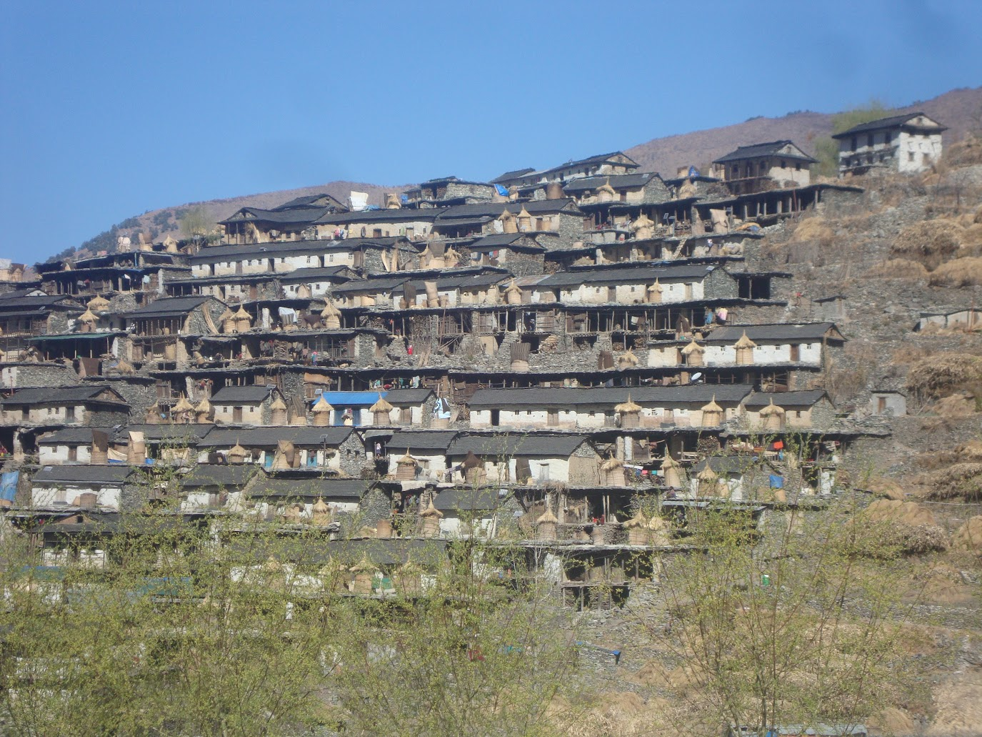
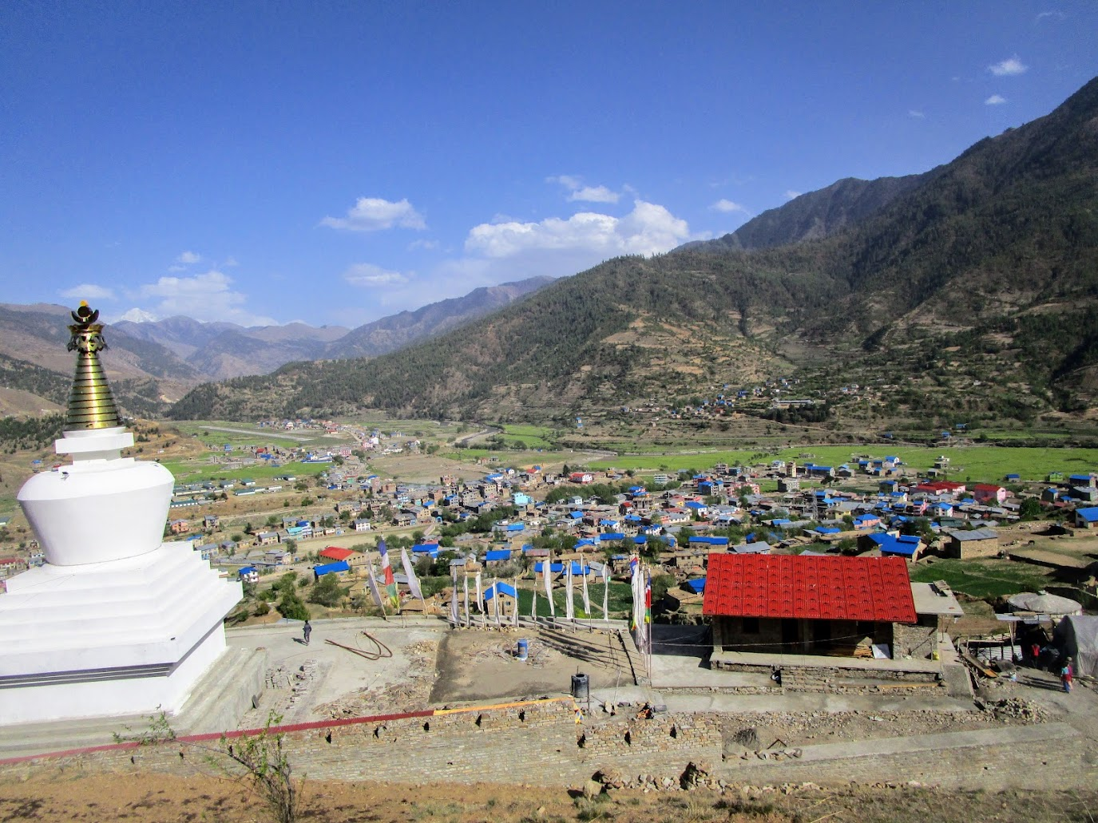
Humla, near to Simkot
Jumla, near to Chandannath municipality
Rukum, near to Taksera

Slide 4
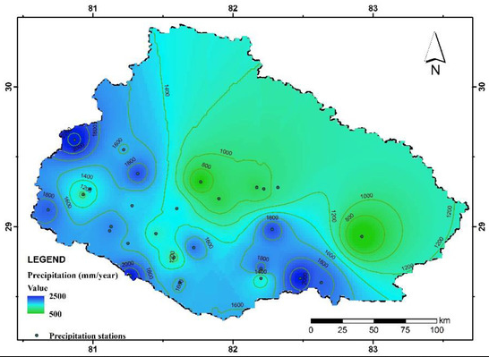
The average annual precipitation in the basin is 1479 mm and
  77% of this rainfall occurs during the summer monsoon season (June to September),
  whereas only 7% occurs in winter (December to February).
  Pre-monsoon (March to May) precipitation accounts for 12% of the annual
  while post-monsoon (October to November) is only 4%
  (Khatiwada et al., 2016)
The summer monsoon, which originates from the Indian Ocean, is the main cause of monsoon precipitation, while westerly influence mostly the winter.

Slide 5
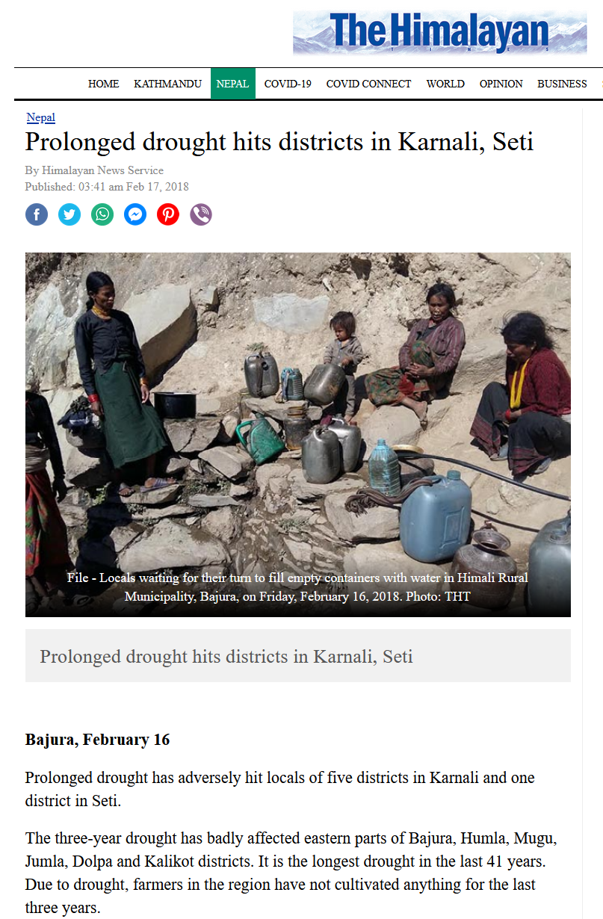
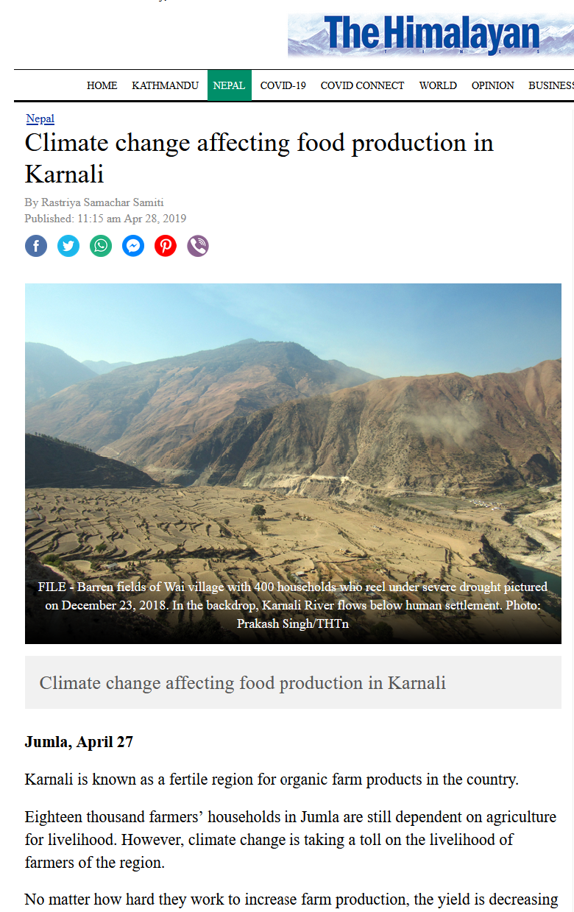
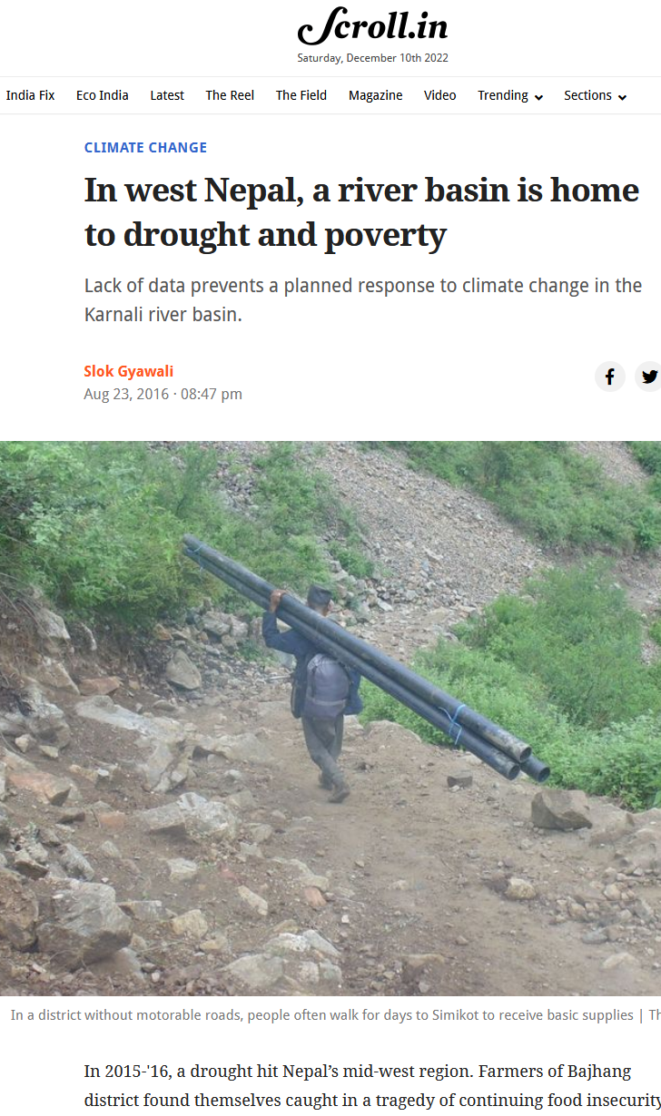

Slide 6
There are more than 100 drought indices discussed in literatures and applied across the globe; around 30 amongst them are used as measures of monitoring spatial and temporal variability of water shortage (Halwatura et al., 2016).
Different approaches for drought assessment include:
perception/observation-based approach,
remote-sensing data-based approach,
model-based approach, and
in-situ (hydro-meteorological/climatic) data-based approach.

Slide 7
The two specific objectives are –
  i) to compare different drought indices and select suitable one to represent drought scenario in the region; and
  ii) to quantify major drought events in the KRB based on available data.

Slide 8
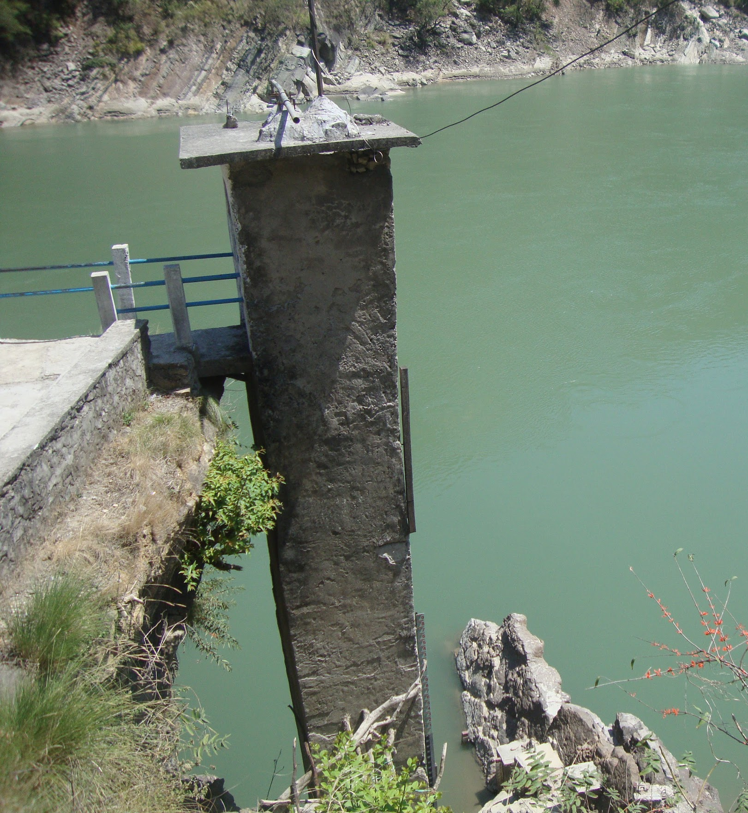
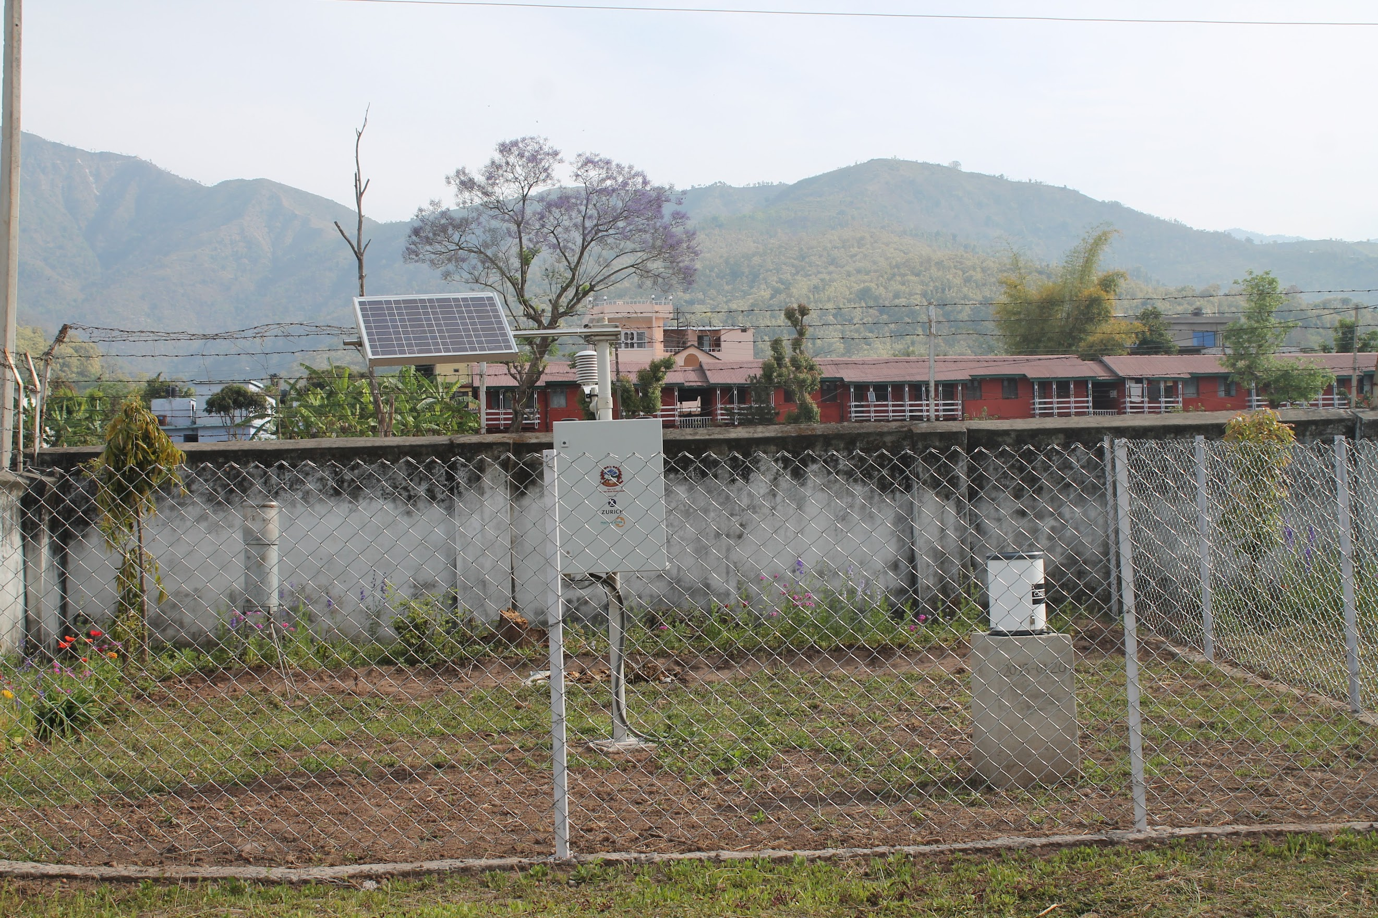
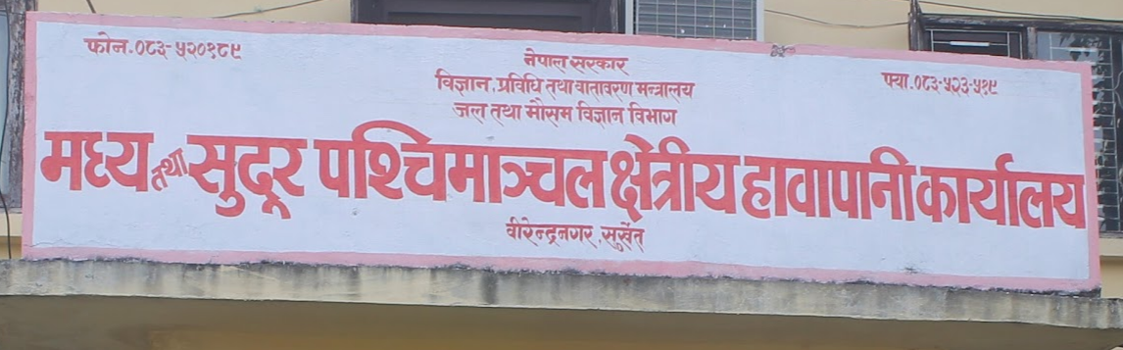
Observed daily time-series of precipitation, temperature and discharge from Department of Hydrology and Meteorology (DHM) for 1981–2014 were used.
Temperature data from 10 stations distributed across KRB were selected.
Likewise, precipitation at 27 stations with longer-term data availability and less than 10% missing data were selected.
Calculation of the drought indices:
(used in this presentation)
Standardized Precipitation Index (SPI)
Standardized Precipitation Evapotranspiration Index (SPEI)
Reconnaissance Drought Index (RDI)
Self-Calibrated Palmer Drought Severity Index (sc-PDSI)
Hydrological station at Chisapani

Slide 9
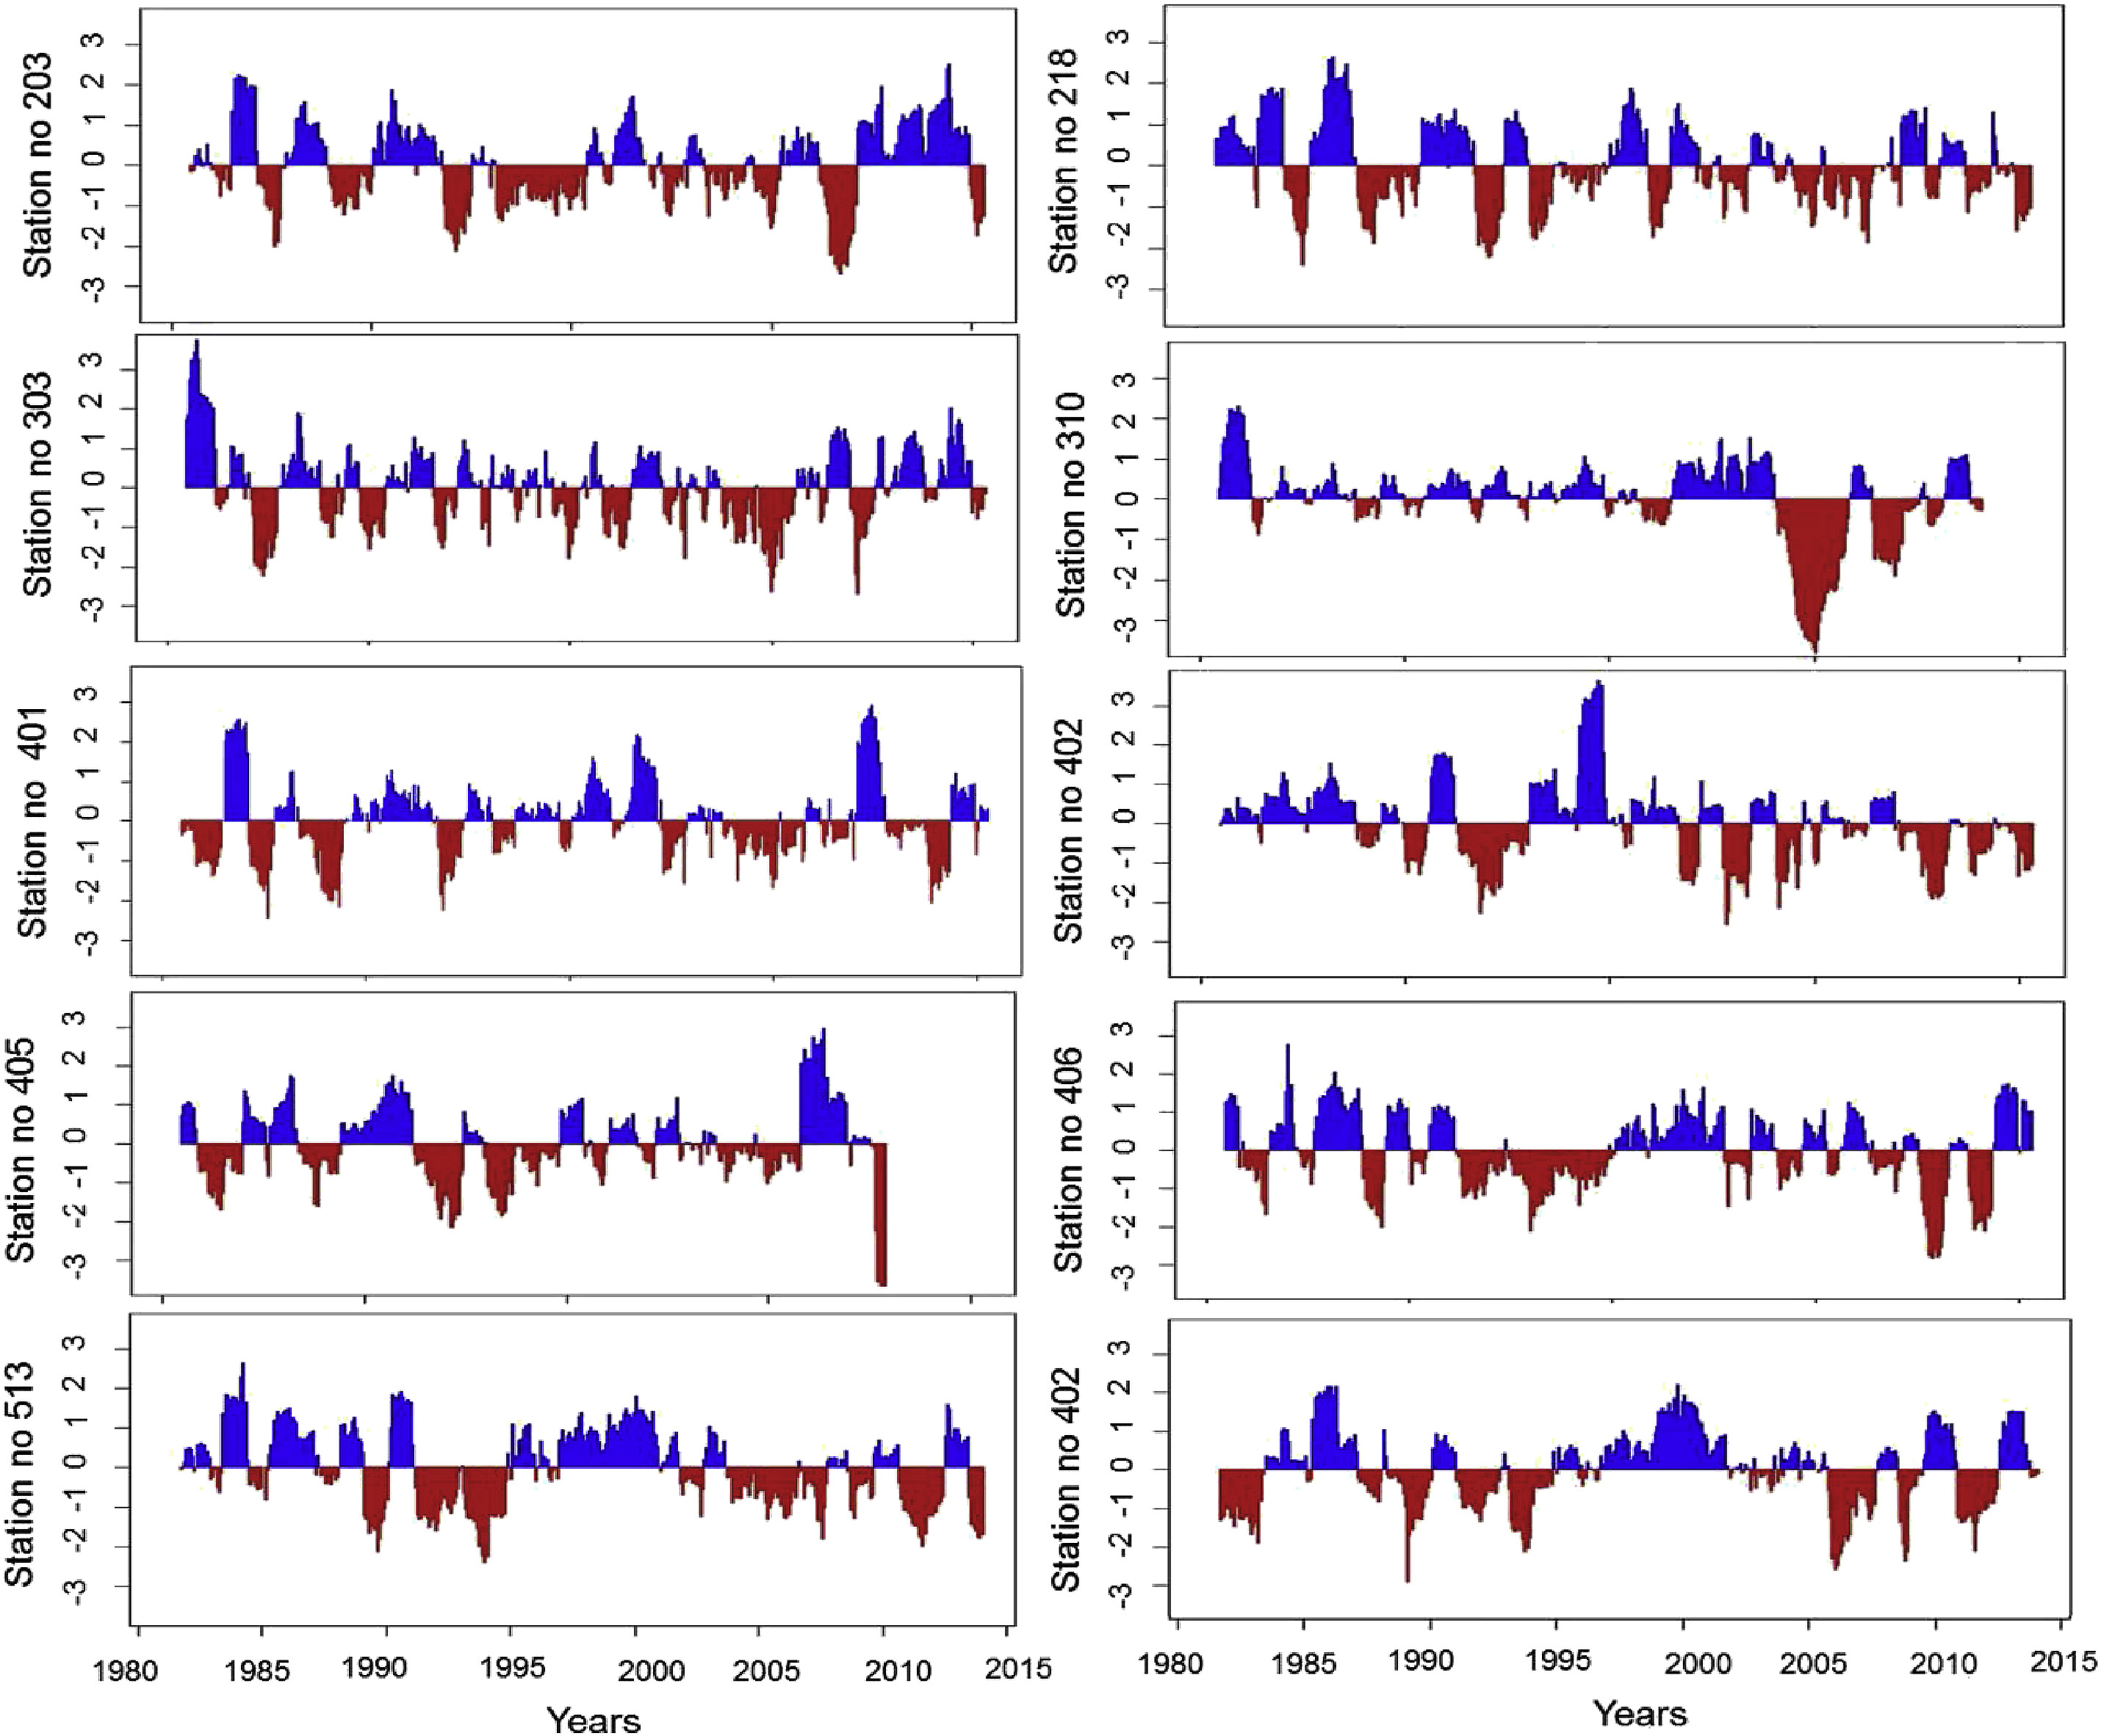
Based on the long-term time series of precipitation (McKee et al., 1993).
This study uses SPI_SL_6. exe tool available at National Drought Mitigation Centre maintained by University of Nebraska.
Spatio-temporal distribution of SPI in Karnali basin.

Slide 10
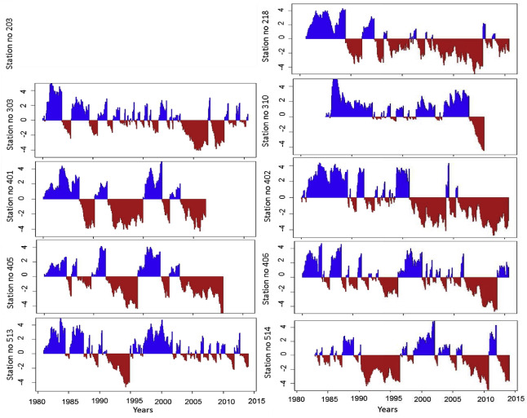
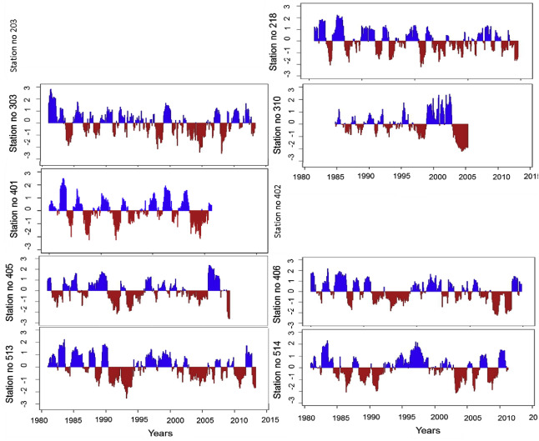

Spatio-temporal distribution of sc-PDSI in Karnali basin.
Spatio-temporal distribution of SPEI in Karnali basin
Palmer Drought Severity Index (PDSI) was calculated to measure the duration and intensity of long-term drought (Palmer, 1965; Guttman et al., 1992) with monthly temperature and precipitation as inputs.
For this analysis the software from greenleaf project was used
The SPEI (Vicente-Serrano et al., 2010) is the monthly difference between precipitation and potential evapotranspiration (PET) (i.e., SPEI = P−PET

Slide 11
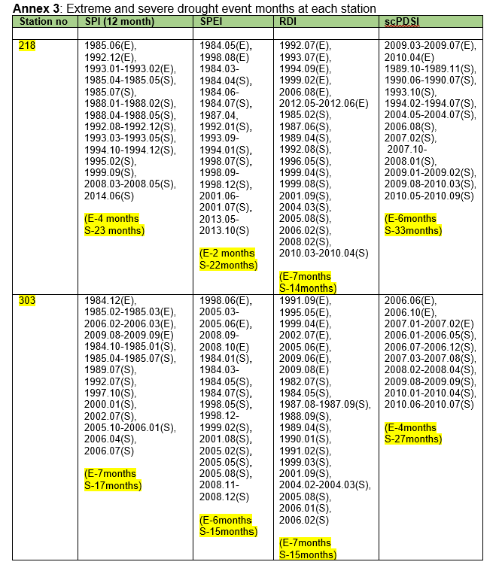
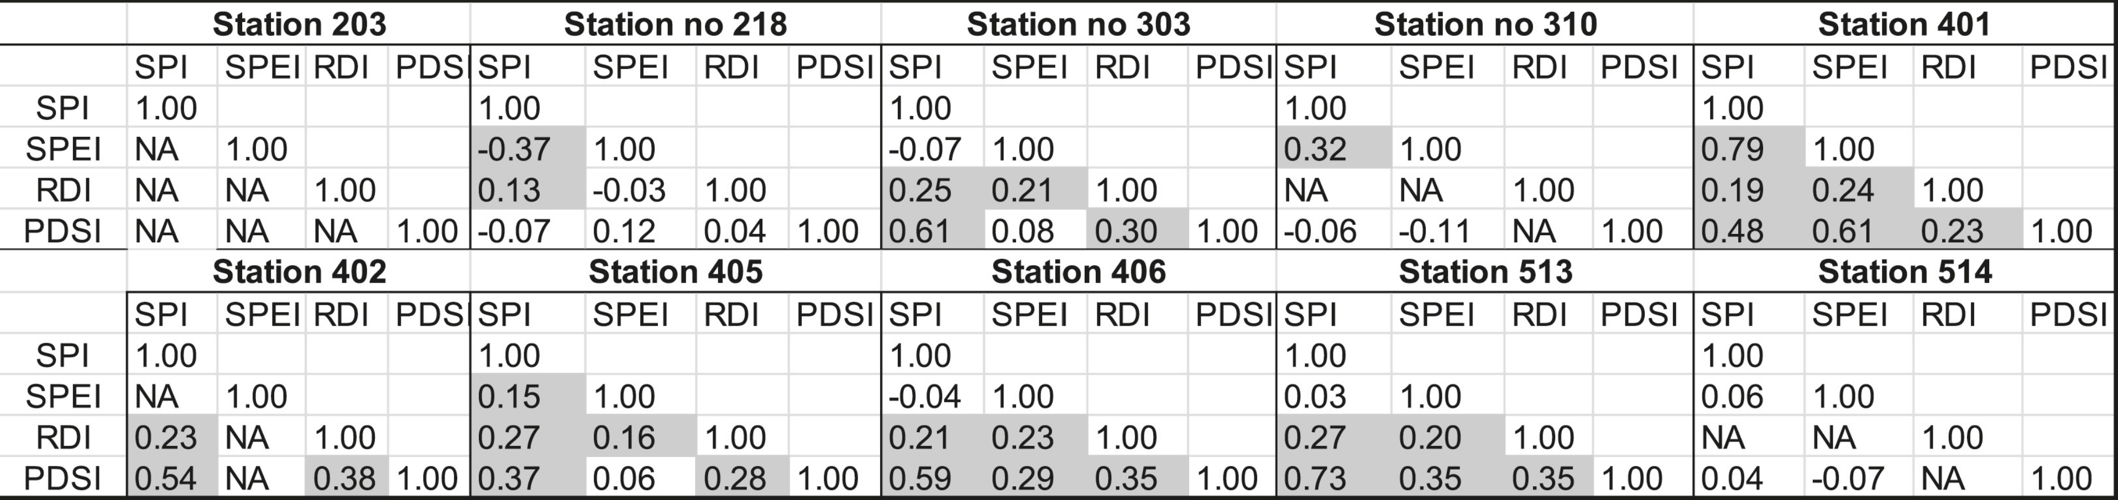
Correlation among the different indices. Highlighted values are statistically significance at 95% confidence.

Slide 12
Influence of filling of data: Yes
In station 218, the year 1981 and 2011 had been filled and it seems that the PDSI is influenced by these filled values.
For the station no 401, the data of the years 2011 and 2012 were filled and the extreme values were reflected in the SPI indices.
Influence of filling of data: No
The temperature data of station 514 was filled mostly during the year 1981 and 1982, while the extreme dry is seen in the year 2010 in PDSI and 2004 in SPEI, therefore filling the data might have a little influence.
The station 513, the year 2010 was filled but it was not reflected as dry or wet extreme.
Influence of filling of data: Partial
In station 402, the temperature data was filled during the year 1996 and the precipitation was during the year 2013 and extreme from PDSI was reflected in both the years, however the extreme was not reflected in other indices.
Missing rainfall data accounts for
<1% for 8 stations,
2–5% for 14 stations, and
7–10% for 5 stations located in high-altitudes.
Missing data was filled using krigging and then monthly time-series was generated before analysing.
The missing temperature data, for up to three days, were filled from average of that week. For longer missing data, they were filled based on monthly regression equations established from the previous and preceding years.

Slide 13
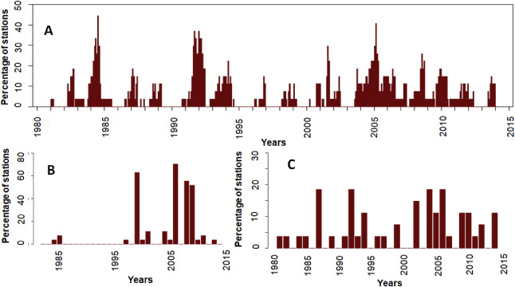
Percentage of stations showing drought events in time-series of: a) monthly; b) winter; and c) monsoon.

Slide 14
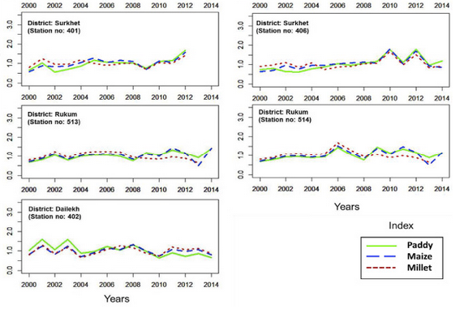
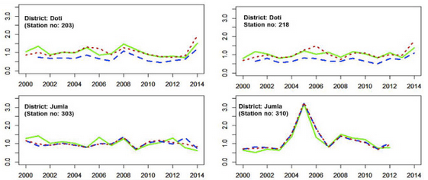
In case of crop productivity, yield of major crops (i.e., paddy, maize, and millet) are influenced by precipitation pattern and anomaly in the KRB-districts, revealing drought impacts on crop production.
Sensitivity of crop production to precipitation change.

Slide 15
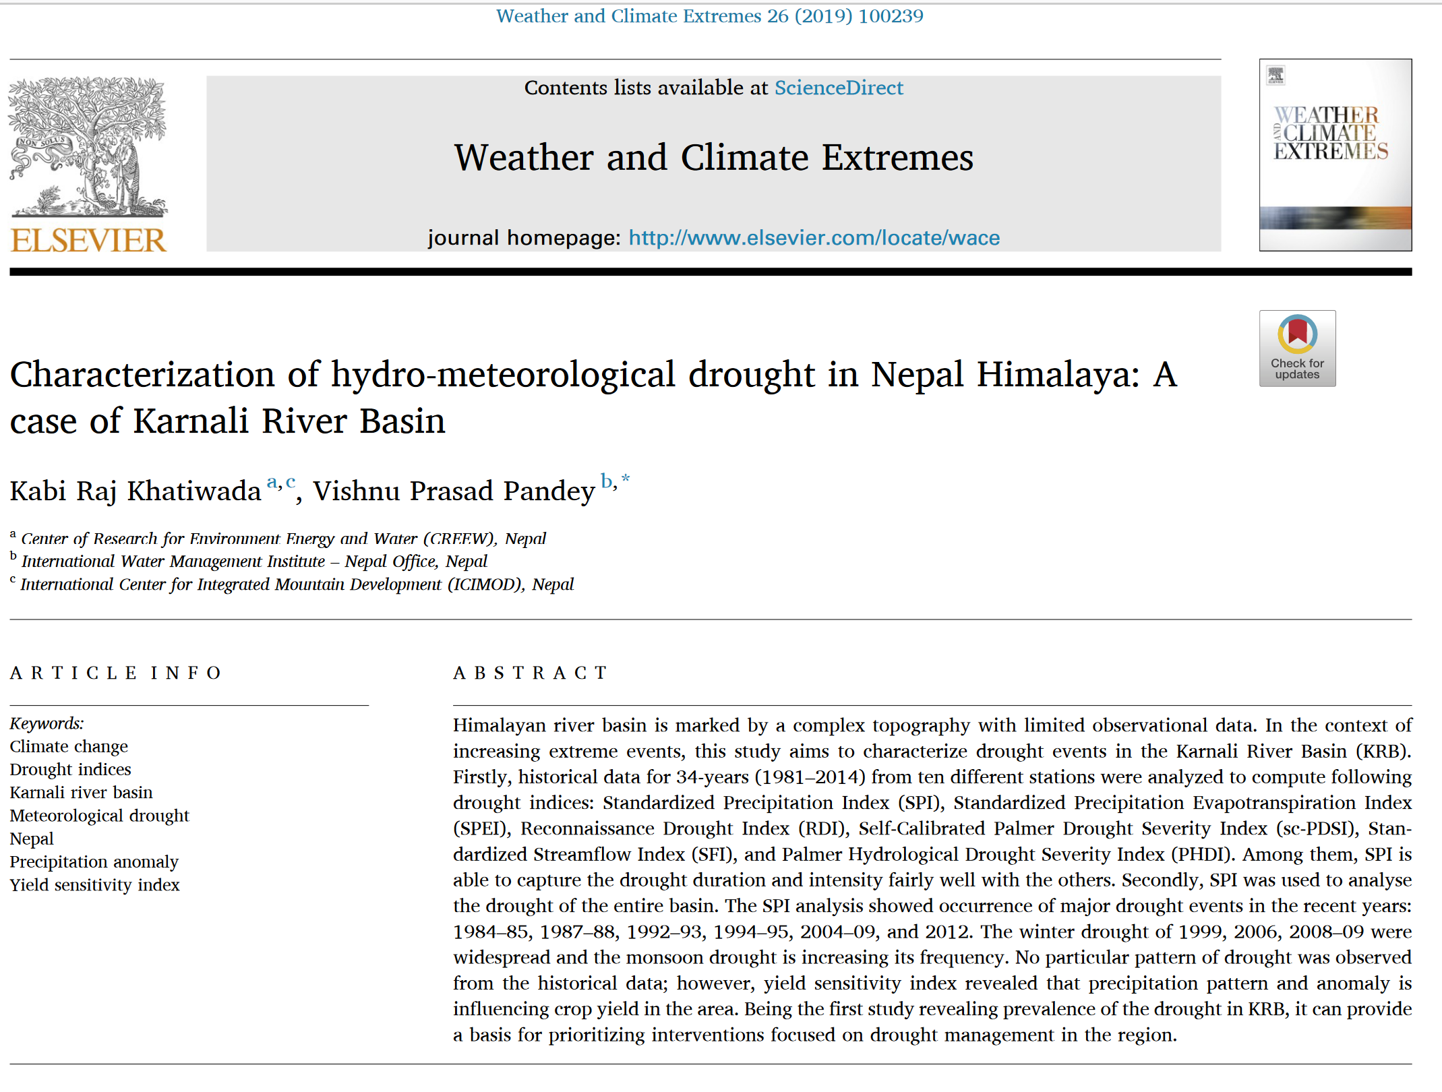
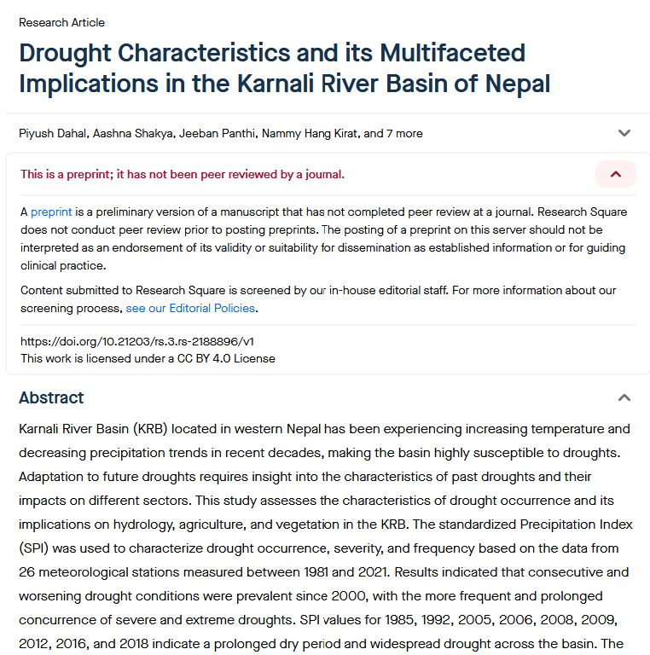
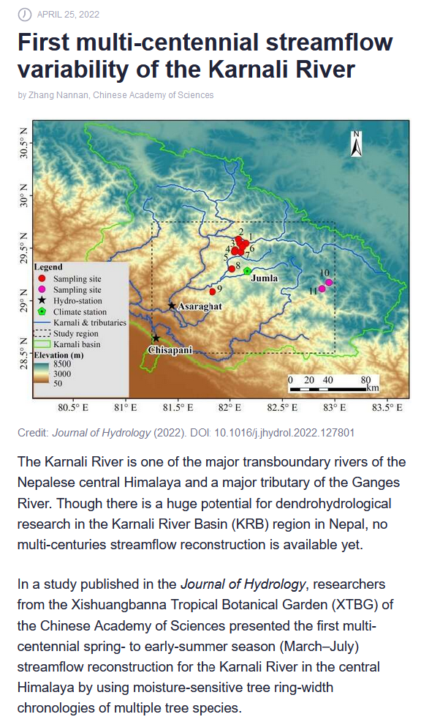
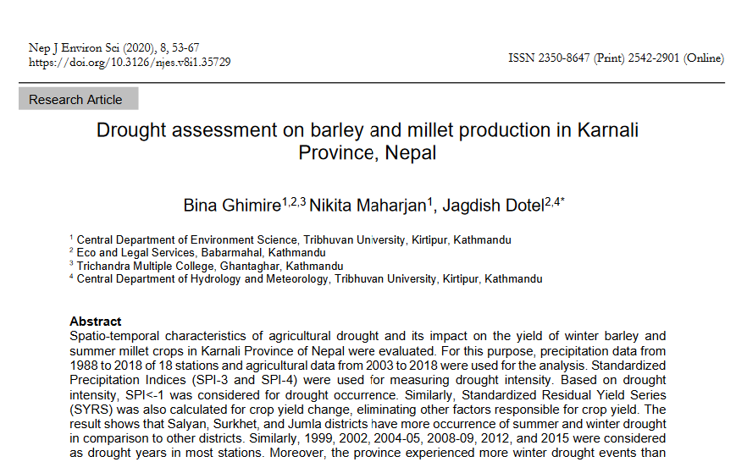

Slide 16
Take home message
An evaluation of different indices revealed that SPI is well correlated with other drought indices, and therefore is capable to represent drought dynamics fairly well in data-spare regions.

Slide 17
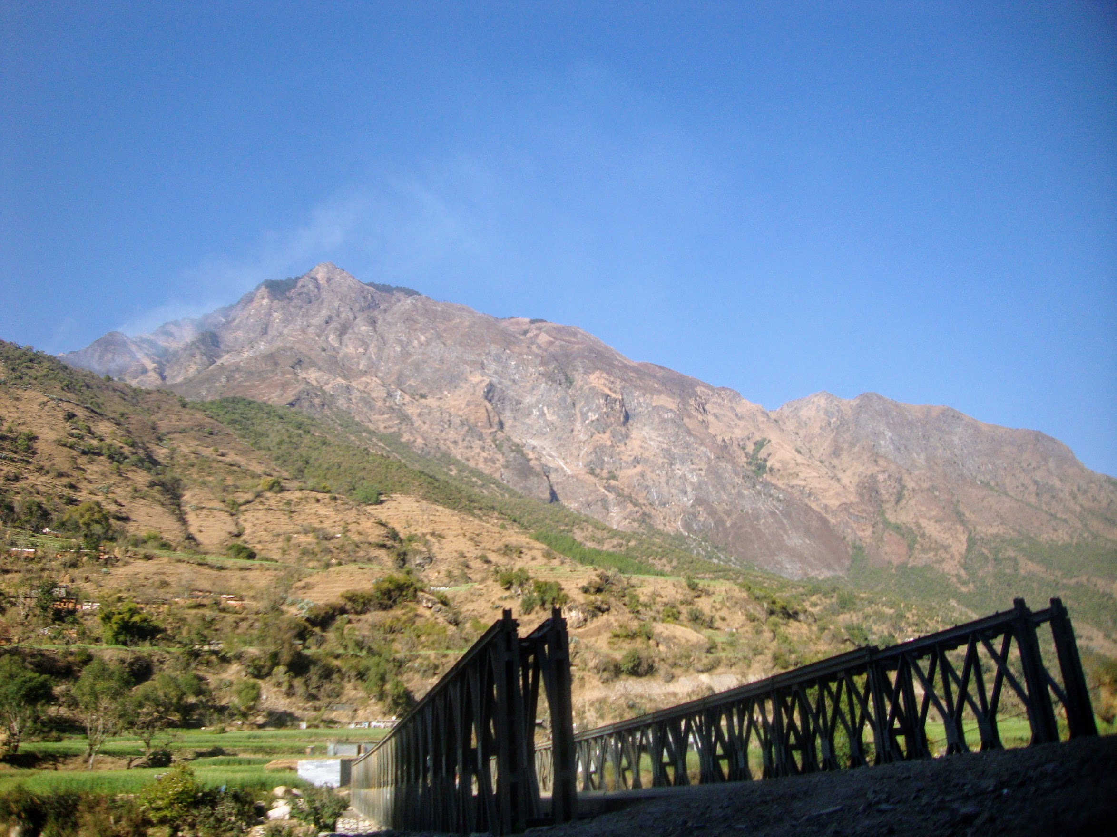
Thank you ☺
© kabiraj

Slide 18
Method used for sensitivity of crop production
The precipitation anomaly was calculated by dividing long-term average rainfall in the growing season (April and September) by the amount of rainfall in the same period for a given year.
Similarly, harvest anomaly index was calculated as a measure of deviation of the harvest production from the normal.
Finally, the harvest anomaly index for each crop was divided by the rainfall anomaly index, returning a high number for years when only small deviations from normal rainfall levels were matched with large deviations in harvest (Fraser et al., 2008).

