Slide 1
SupplyChain360 Data Platform
End-to-End Data Platform for Supply Chain Optimization
Presented for Management
Kabir Olawale Mohammed

Slide 2
Business Background
Fast-growing retail distribution company
Managing hundreds of stores across the U.S.
Facing operational inefficiencies in supply chain

Slide 3
Key Challenges
Frequent stockouts of popular products
Overstock of slow-moving items
Delivery delays
Lack of real-time insights

Slide 4
Critical Business Questions
Which products cause stockouts?
Which warehouses are inefficient?
Which suppliers deliver late?
Why decisions are delayed

Slide 5
Root Cause
Data fragmentation across systems:
- Warehouse systems
- Logistics records
- Supplier logs
- Store sales
Manual reporting → outdated insights

Slide 6
Solution
Unified Supply Chain Data Platform
Centralized data for real-time analytics
Improves decision-making and efficiency

Slide 7
Business Impact
Reduced stockouts
Optimized inventory
Improved supplier performance
Better delivery efficiency
Potential cost savings (millions annually)

Slide 8
Project Overview
Modern ELT pipeline:
- Data ingestion
- AWS S3 Object Storage
- Snowflake Warehouse
- dbt transformations
- Airflow orchestration
Production-grade design

Slide 9
Objectives
Build reliable ELT pipeline
Automate workflows
Enable analytics:
- Stockout trends
- Supplier performance
- Warehouse efficiency
- Demand forecasting

Slide 10
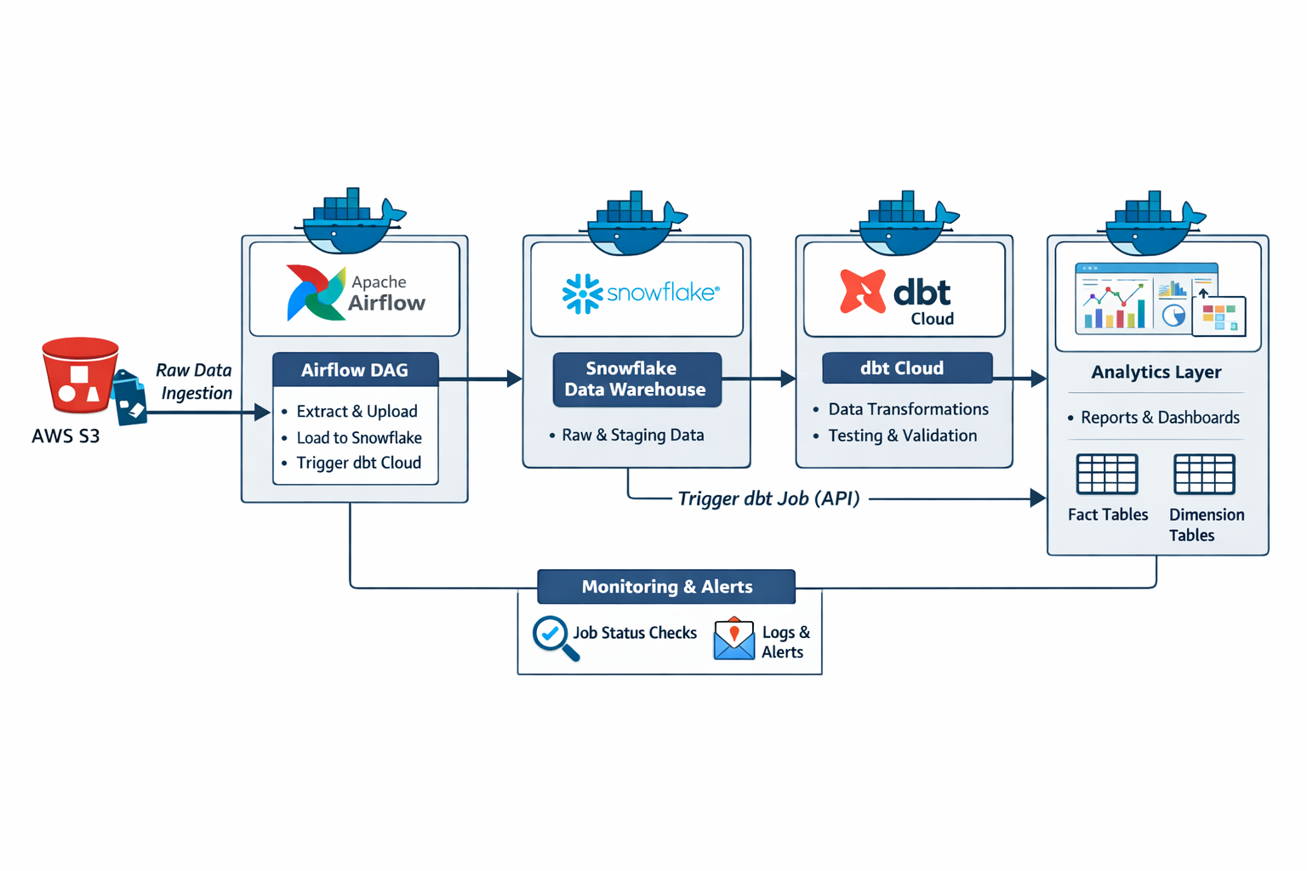
Architecture (High Level)

Slide 11
Tech Stack
Airflow (Orchestration)
Snowflake (Data Warehouse)
dbt Cloud (Transformation)
Python (Logic)
AWS S3 (Storage)
Docker (Containerization)

Slide 12
Setup Overview
Clone repository
Install dependencies
Run Airflow with Docker
Automated daily pipeline execution

