Slide 1
NYC Fire Cases

Slide 2
Introduction to problem
With a tremendous increase in NYC food joints fire reports have also increases.
It is necessary to have a full report of places with high chances of fire.
This will help fire department to be prepare in case of a mishappening.
This will also keep the citizen and tourists safe.

Slide 3
Data acquisition
The following dataset were used:
Fire Department Dataset (To analyse past fire incidents) https://data.cityofnewyork.us/Public-Safety/Incidents-Responded-to-by-Fire-Companies/tm6d-hbzd
Location Database (to extract Coordinates) https://data.cityofnewyork.us/widgets/i8iw-xf4u
FOURSQUARE api (to determine food joints in the proximity of fire effected place)

Slide 4
Data cleaning
From fire department dataset we only require
ZIP_CODE (Zip code of the place)
TOTAL_INCIDENT_DURATION (Time period for which the fire was not extinguished)
INCIDENT_TYPE_DESC (Type of incident)
HIGHEST_LEVEL_DESC
ACTION_TAKEN1_DESC (Action taken by the authority)
Extracting fire department dataset
Extracting relevant data and applying feature scaling
Group by the dataset on Zip Code
Clustering the data
Extracting coordinate data and merging (plotting)
Calculating number of food joints using coordinates
Classifying data and preparing final data

Slide 5
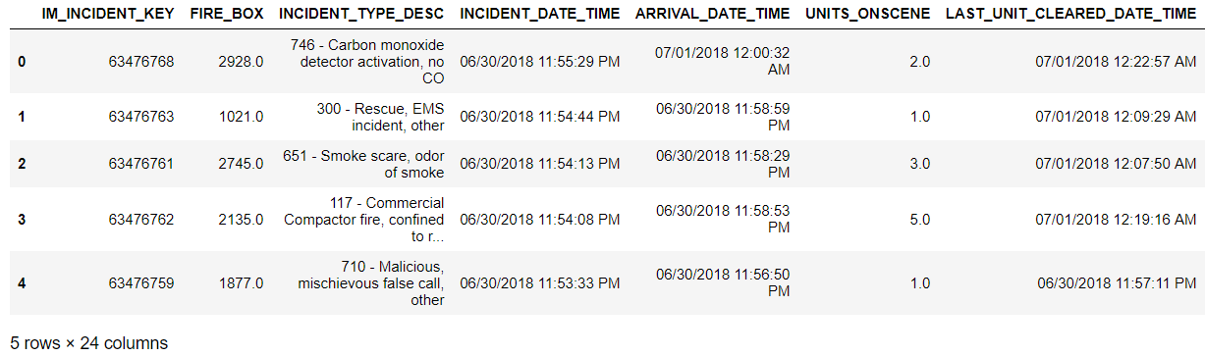
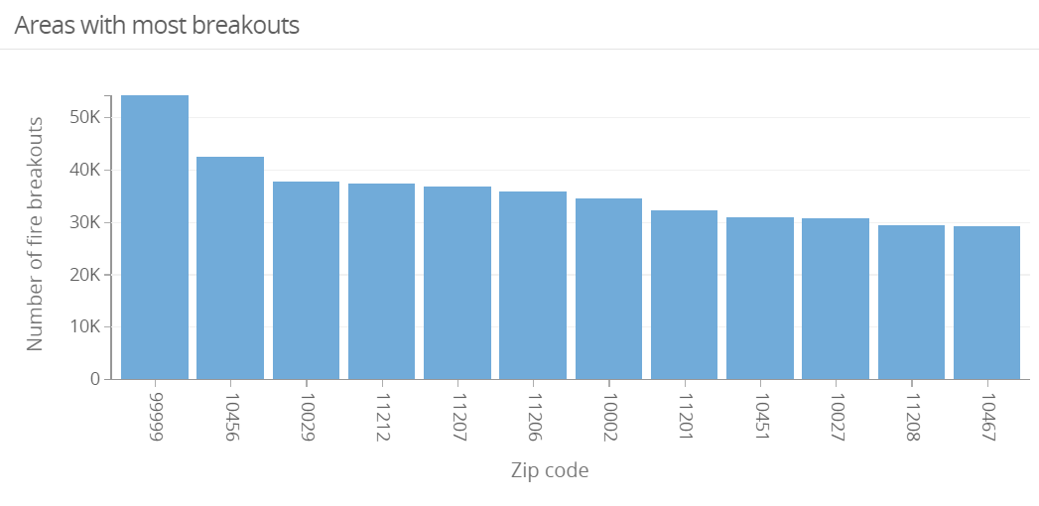
Data analysis
Fire department dataset has a lot of incident between 2016 and 2018.
Here is the plot of all the major breakouts with their Zip code.

Slide 6
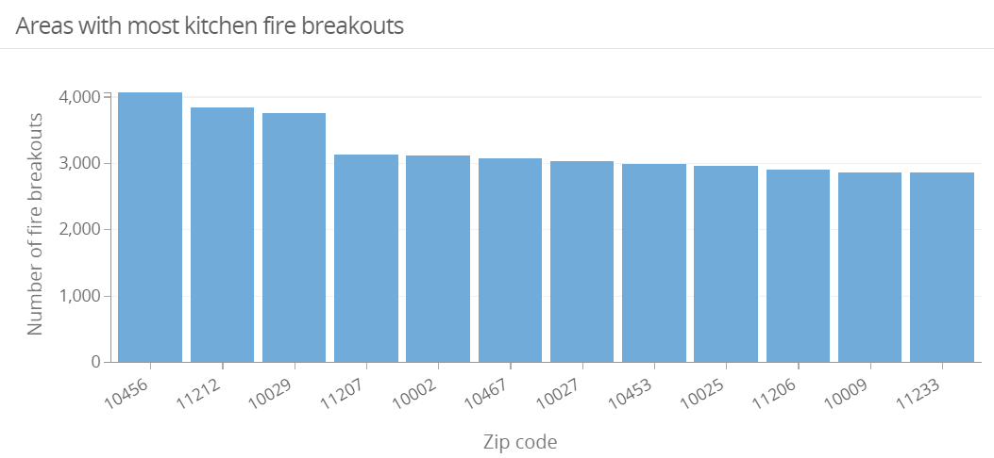
number of kitchen fire-breakout with zip-code

Slide 7
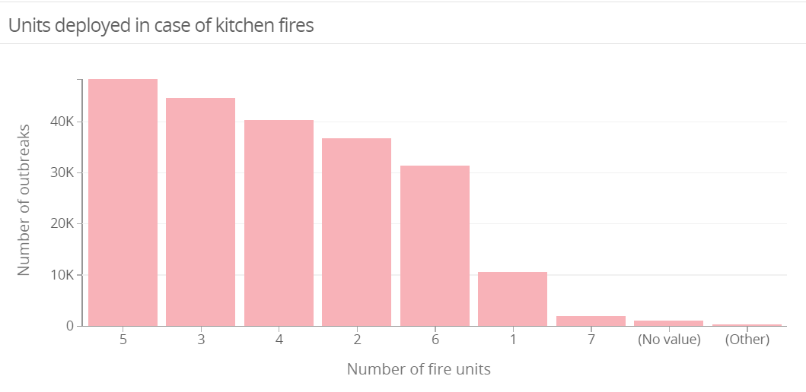
Fire units deployed
The fire outbreak is large if the time duration and fire units deployed to extinguished fire of the incident was large.

Slide 8
Machine Learning Modelling
For separating the zip-codes on the bases of fire-breakouts K-Means algorithms was used.
K-means depends on two things
A metric used to compute the distance between two points
the value of "k" the number of neighbours to consider.
Cluster 0: Zip-code with most chances of fire breakouts
Cluster 1: Zip-code with moderate chances of fire breakouts
Cluster 2: Zip-code with least chances of fire breakouts

Slide 9
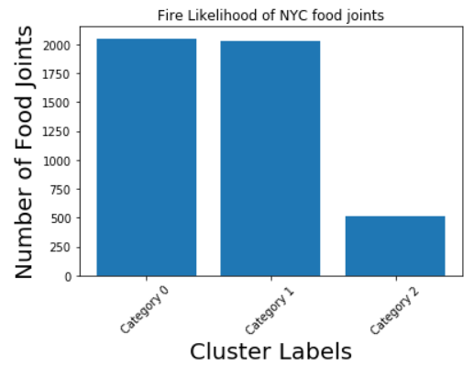
Results
As from the dataset most fire breakouts were in the region with high number of food joints. Fire breakouts were less in the regions with less food joints.

Slide 10
Discussion
We conclude that
Most fire breakouts in NYC are due to food joints.
This include kitchen fires or others due to high density of customers.
Hence fire department must express its concern for the issue and work for safety of people in the region.
People must be aware about first aids
Emergency equipment must be present in the food joint premises.

Slide 11
Conclusion
Hence, we have concluded that most fire breakouts in NYC are due to food joints.
This include kitchen fires or others due to high density of customers.
Hence fire department must express its concern for the issue and work for safety of people in the region.
This will help tourist and residents for a better lifestyle.

