Slide 1

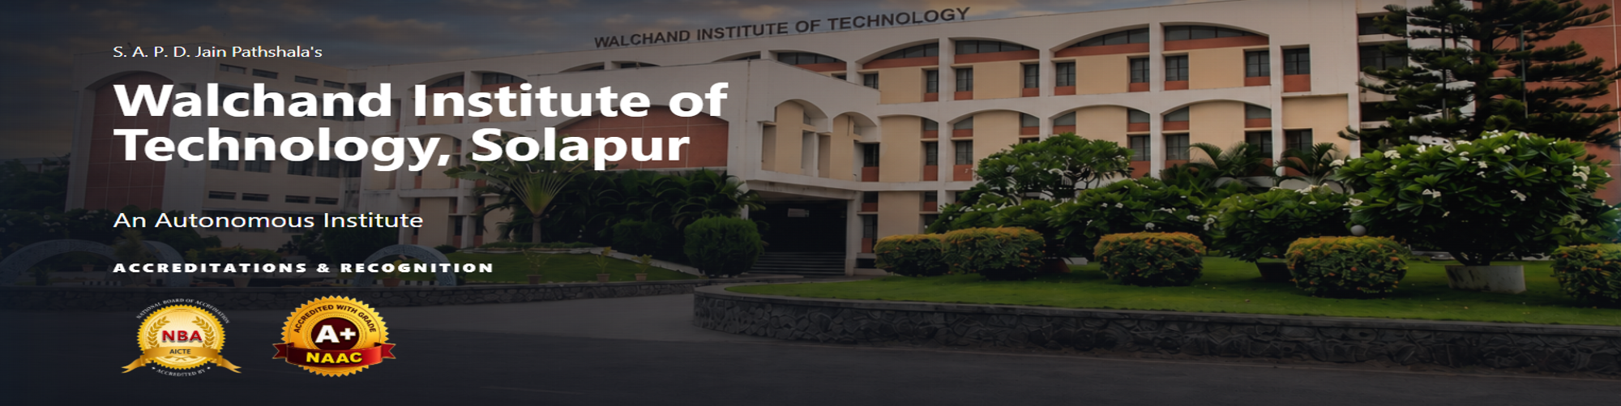
Department of Information Technology
WIT, Solapur
PROJECT DESIGN PRESENTATION
"Design and Evaluation of an Educator-Led Experiential Pedagogical Model and Personalized Digital Platform for Holistic Student Growth"
GROUP NO: | B-07
GUIDE : Dr. Ms. D. D. Awasekar

Slide 2
TEAM DETAILS
Department of Information Technology
WIT, Solapur
"Design and Evaluation of an Educator-Led Experiential Pedagogical Model and Personalized Digital Platform for Holistic Student Growth"
TEAM DETAILS
Sr.
Name of Student
Roll No.
1.
Kabir Shitalkumar Patil
B-26
2.
Alok Shriniwas Perla
B-34
3.
Vidhi Jatinbhai Patel
B-23
4.
Rudraksh Rahul Vaidya
B-61
9/12/2026
EDUCATOR-LED EXPERIENTIAL LEARNING PLATFORM
2

Slide 3
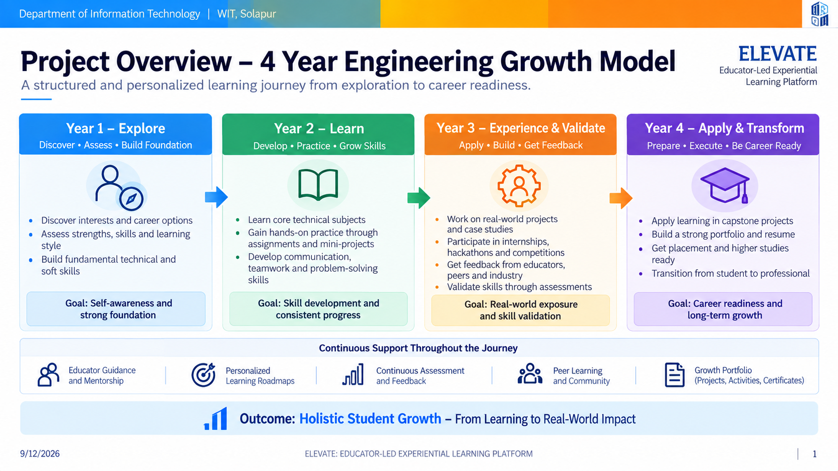
1. Project Overview
9/12/2026
ELEVATE: EDUCATOR-LED EXPERIENTIAL LEARNING PLATFORM
3

Slide 4
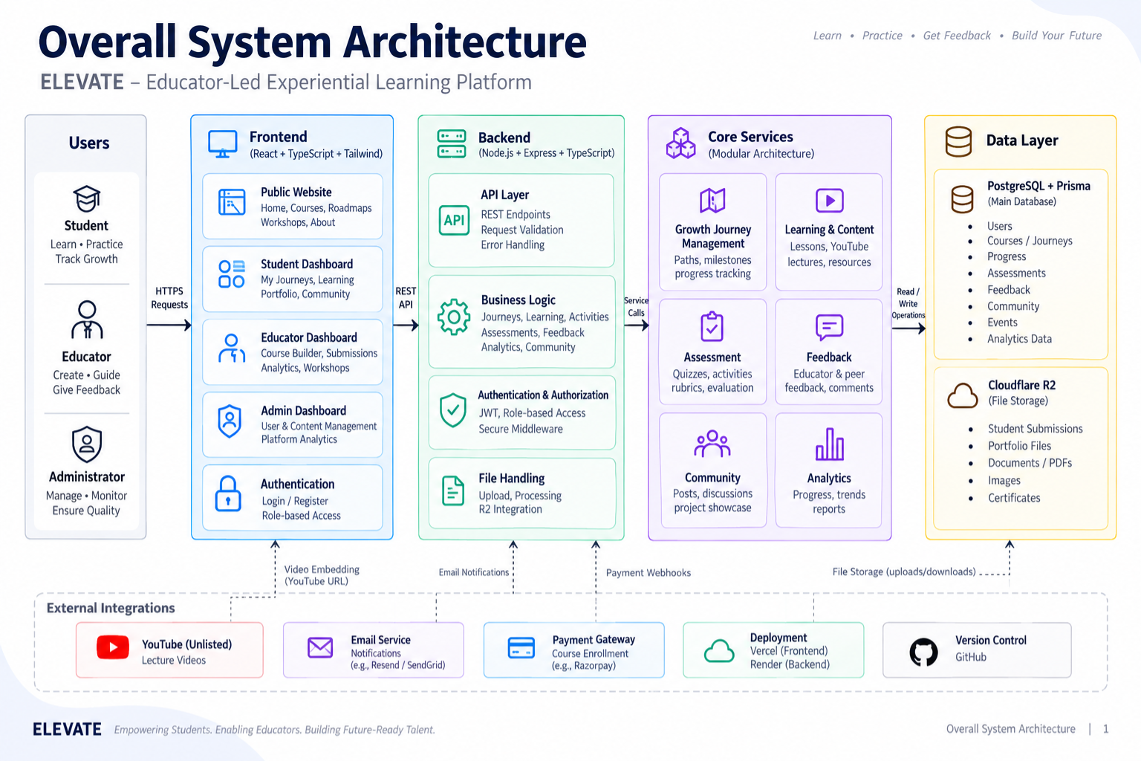
2. Overall System Architecture
9/12/2026
ELEVATE: EDUCATOR-LED EXPERIENTIAL LEARNING PLATFORM
4

Slide 5
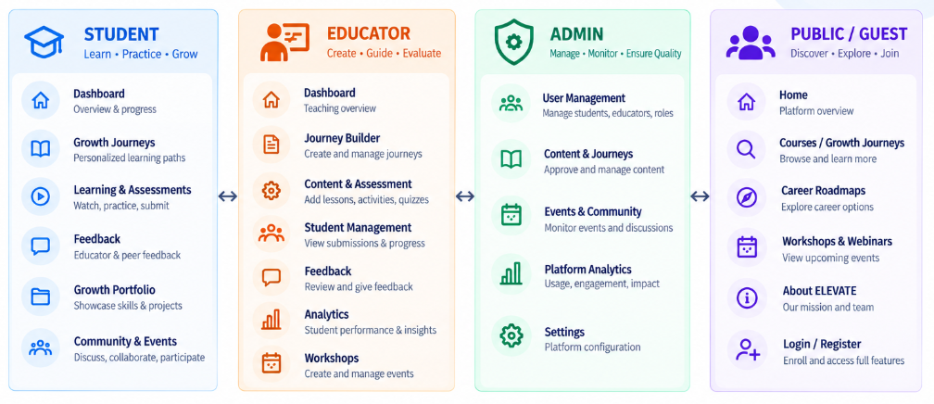
3. Module Design
9/12/2026
EDUCATOR-LED EXPERIENTIAL LEARNING PLATFORM
5

Slide 6
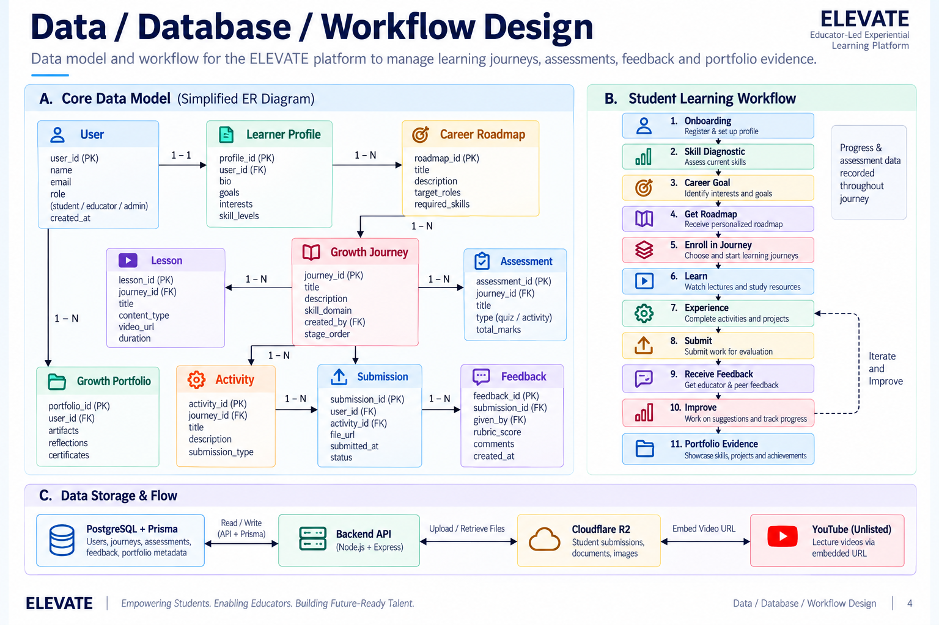
4. Data / Database / Workflow Design
9/12/2026
EDUCATOR-LED EXPERIENTIAL LEARNING PLATFORM
6

Slide 7
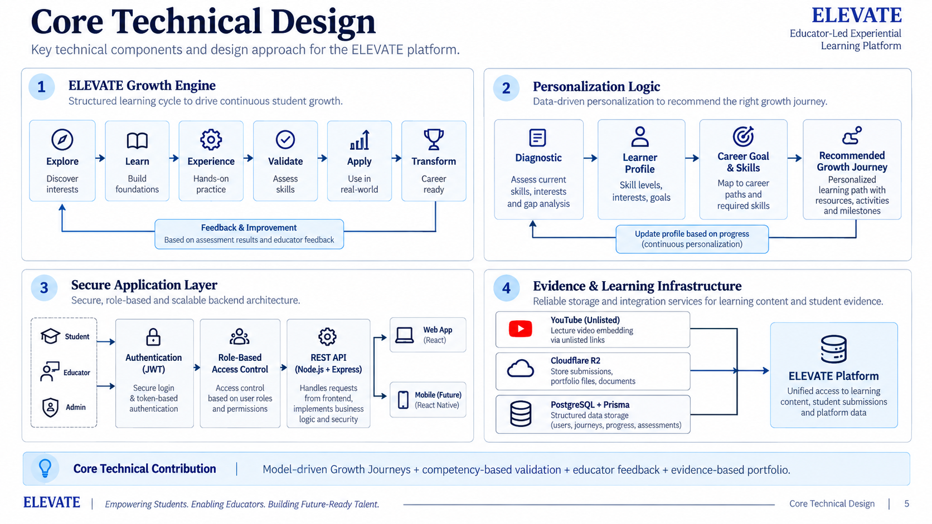
5. Core Technical Design
9/12/2026
EDUCATOR-LED EXPERIENTIAL LEARNING PLATFORM
7

Slide 8

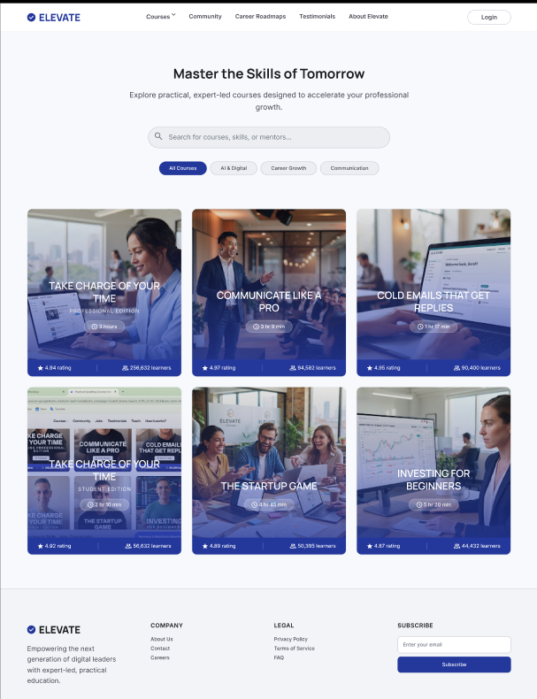
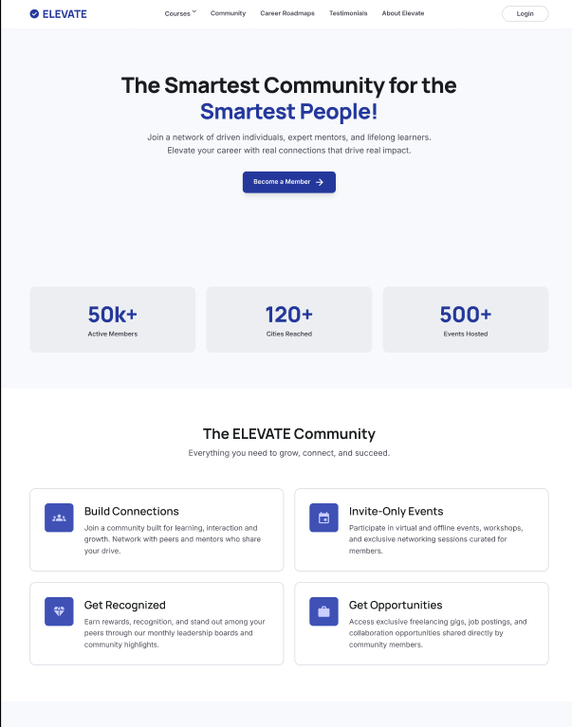
6. UI / Prototype / Wideframe
9/12/2026
EDUCATOR-LED EXPERIENTIAL LEARNING PLATFORM
8

Slide 9
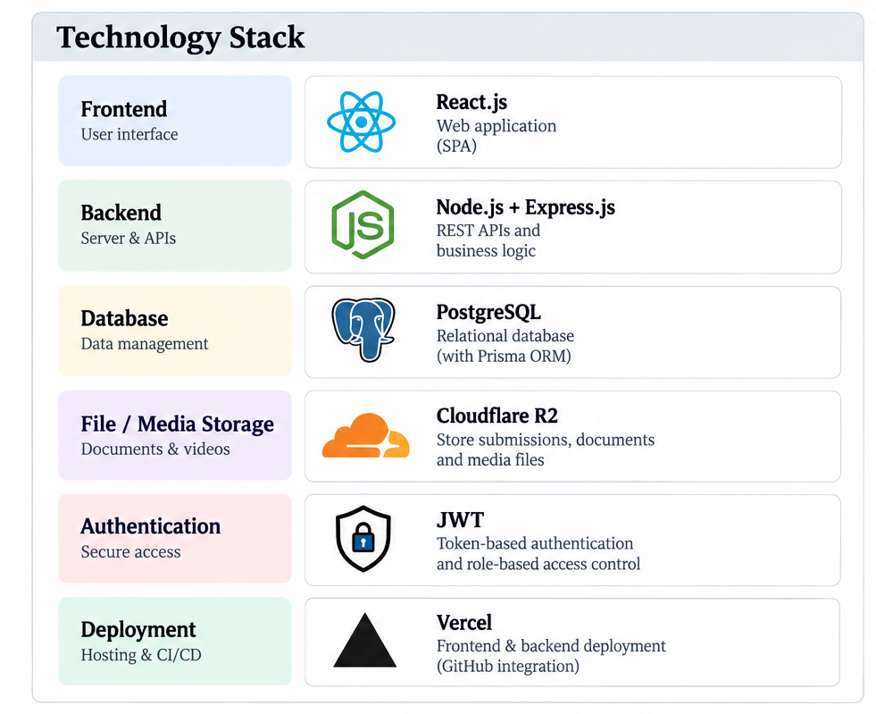
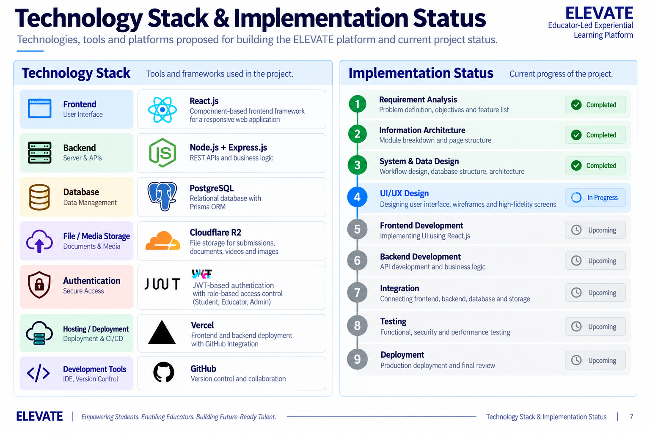
7. Technology Stack & Implement
9/12/2026
EDUCATOR-LED EXPERIENTIAL LEARNING PLATFORM
9

Slide 10
QUESTIONS
9/12/2026
EDUCATOR-LED EXPERIENTIAL LEARNING PLATFORM
10

Slide 11
THANK YOU !
9/12/2026
EDUCATOR-LED EXPERIENTIAL LEARNING PLATFORM
11

